Slide 1
Data-Driven Decisions: Supporting Social Emotional and Mental Health in Schools
Federal Grants Spring Conference
May 13, 2024

Slide 2
DESE’s Educational Vision
All students in Massachusetts, particularly students from historically underserved groups and communities, will have equitable opportunities to excel in all content areas across all grades.
Culturally and linguistically sustaining classroom and school practices will support students to thrive by creating affirming environments where students have a sense of belonging, engage in deeper learning, and are held to high expectations with targeted support.
All students are known and valued
Learning experiences are relevant, real-world, and interactive
Individual supports enable students to excel at grade-level (or beyond)
Educational Vision - Office of the Commissioner of Elementary and Secondary Education (mass.edu)

Slide 3
District Presentations
Abby Kelley Foster Charter
Advanced Math and Science Academy Charter
Cambridge Public School

Slide 4
Abby Kelley Foster Charter

Slide 5
After Pandemic Goals
Meet the social emotional needs of all members of our district
Enhancing MTSS system in Elementary and Middle schools to support students in all areas
Hiring District Level clinician
roles has changed over time

Slide 6
After Pandemic Goals
Parent Engagement Opportunities in Social Emotional Learning
Parent Workshops with Executive Functioning Coach - Jim Dunn
Role has also changed over time
Focusing on SEL support in the classroom
Working toward small changes in the classroom that promote SEL skills (calm corner, morning meetings, greetings at the door) Providing professional development as well for teachers.

Slide 7
Resources:
Jim Dunn, Executive Functioning Coach
https://www.addchieve.com/
Robert Brooks
https://www.drrobertbrooks.com/

Slide 8
Advanced Math and Science Academy Charter

Slide 9
Needs Assessment
SHAPE System
Signs of Suicide Data
Climate Data – Challenge Success Survey
Safe and Supportive Schools Self Assessment
MTSS Mapping

Slide 10
Grounded in MTSS
How do we address our findings in all tiers? What needs attention and where?
Tier 3- Intensive Support
Tier 2- Targeted Support
Tier 1- Universal Support
The MTSS Pyramid representing distribution of supports for students

Slide 11
SOS Data - > Action Planning
Tier 1 | Universal Mental Health Screening SEL Screening Advisory Curriculum Health Curriculum
Tier 2 | TRAILS Cognitive Behavioral Therapy Groups Revised SST Protocol
Tier 3 | Professional Development focused on Evidence-Based Counseling Interventions Clinical Supervision Care Solace Referral System bryt Model Program- Bridge

Slide 12
Plan – Do – Study – Act (PDSA Cycle)
TRAILS to Wellness
Plan
Train Counselors
Identify Students through SOS, updated Universal Screeners
Do
Pre/Post Screener
10 weeks
Study
Individual and Group Data
Counselor Reflections
Act
Prioritize TRAILS in annual planning

Slide 13
Resources:
bryt
Challenge Success
Panorama Education
TRAILS to Wellness
Kate Driver, Director of School Counseling
Advanced Math and Science Academy
kdriver@amsacs.org

Slide 14
Kim Huffer, LICSW: Director of Social Emotional Learning
18 Schools
6,915 Students
35.5% Low Income
22.8% Students with Disabilities
11% English Language Learners

Slide 15
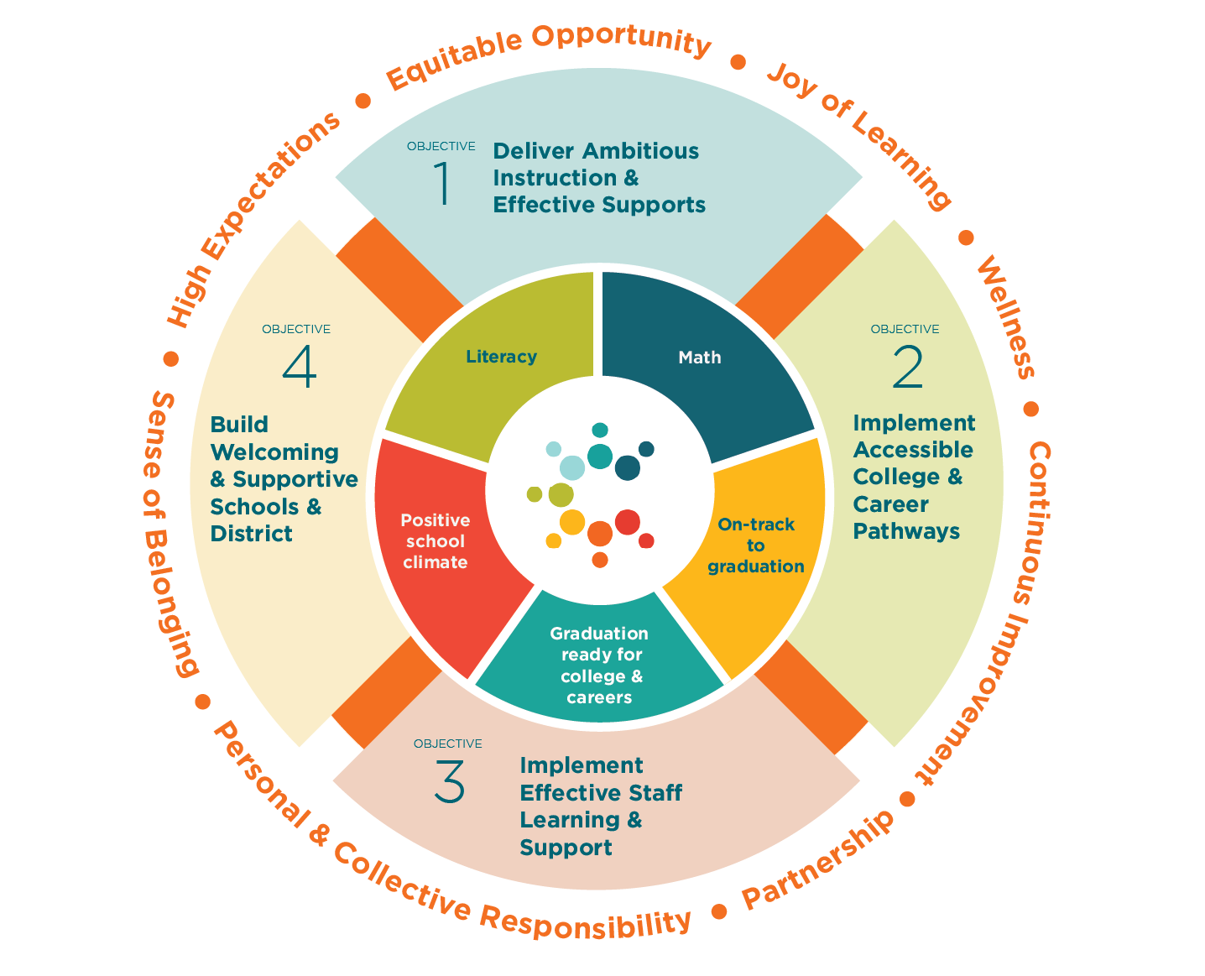
District Strategic Initiative:
Establish robust multi-tiered systems of support to support students’ academic, social, emotional, and behavioral needs.

Slide 16
GOAL: Develop a Comprehensive School Mental Health System (CSMHS) that provides a continuum of evidence-based mental health services to support students, families, and school communities.
Tier 3: Intensive Supports
Expand Mental Health Partnerships (Cartwheel, bryt Consultation/Partnership)
Tier 2: Targeted Interventions
Build Clinical Knowledge & Skills In School-Based Mental Health Staff (SPACE Treatment Training, Boston College Courses, Suicide Risk Assessment)
Tier 1: Universal Supports
Strengthen Foundational Knowledge & Tier 1 SEL Instruction (Wayfinder SEL Pilot, SEL Look Fors Tool & Professional Learning)

Slide 17
Needs Assessment: Data Collection
SEL Screener Data: Devereaux Student Strengths Assessment (DESSA)
Students rated “In Need of Instruction”
K-5th (Educator Rating): 9%
6th- 8th: 14%
9th & 10th: 27%
Youth Risk Behavior Survey (YRBS)
Symptoms of Anxiety:
48% (HS), 34% (MS)
Symptoms of Depression:
37% (HS), 22% (MS)
Suicidal Ideation
20% (HS), 14% (MS)
Mental Health Referral Data
67 Referrals to teletherapy services during 4 month pilot.
Feedback Surveys/Focus Groups from School Mental Health Staff
Broad range of understanding & use of evidence based practices
Inconsistent practices related to crisis response and assessment

Slide 18
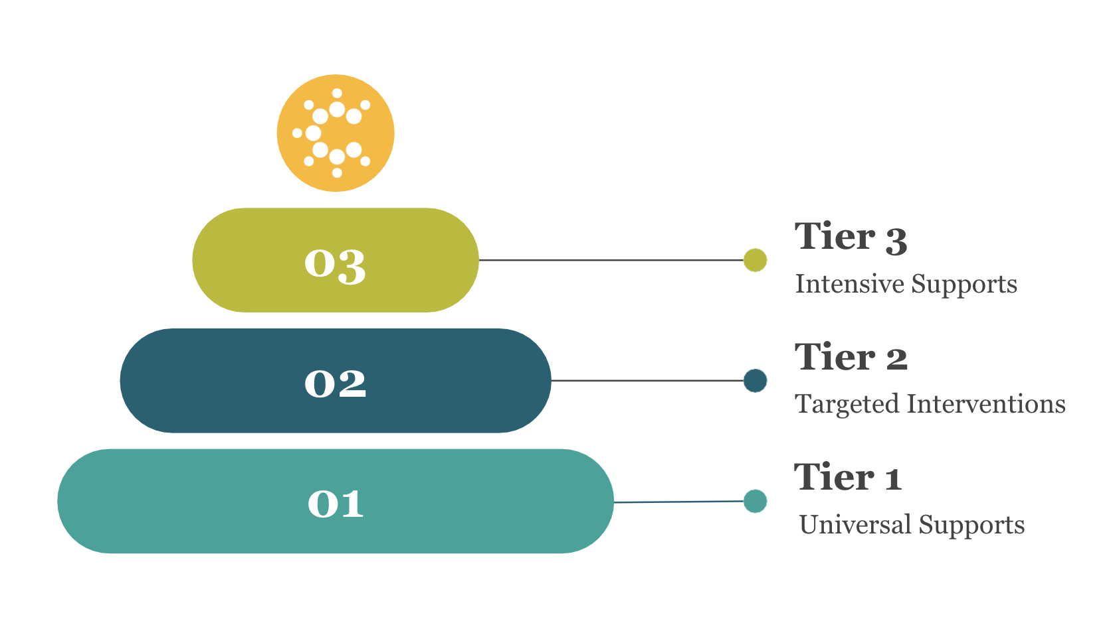
Implementation Data: Progress Monitoring
bryt Programming
Implementation Rubric
Feedback Surveys w/ caregivers & students
Cartwheel
Referral & Service Usage Trend Data
Student & Caregiver Satisfaction Surveys & Feedback
Professional Development for Clinicians (SPACE treatment training, BC Courses, Suicide Assessment)
Evidence of integration of content/skills into practice
“Train-the-Trainer” opportunities at staff meetings
Tier 1 SEL Instruction
SEL Look Fors Tool data to identify area(s) of strength/growth in each school and targeted coaching/ and professional learning needs
Wayfinder utilization data & feedback from students

Slide 19
Evaluation & Desired Outcomes: Next Steps
Tier 1 SEL Instruction Data
Increase in usage data of Wayfinder SEL Curriculum
Increase in ratings on SEL Look Fors
DESSA SEL Screener/Assessment Data
Increase in Students rated in Typical/Strength categories on DESSA mini and student self reports.
Youth Risk Behavior Survey Data
Decrease in percentage of students indicating suicidal ideation.
Increase in percentage of students indicating connection to adult
School Climate Survey Data
Increase in Student, Staff, and Caregiver perception of positive school climate & sense of belonging
Mental Health Referral Data
Increase in number of students and families accessing mental health services
Decrease in time getting connected to services.

Slide 20
Advancing Comprehensive School Mental Health Systems
School Health Assessment and Performance Evaluation System (SHAPE)
CASEL Indicators of SchoolWide SEL Walkthrough Tool
Resources
Kim Huffer, LICSW
Director of Social Emotional Learning
khuffer@cpsd.us
Notes:
Nicole

Slide 21
Thank you

