Slide 1
The ESSER III Homestretch
May 13, 2024 (updated August 21, 2024)

Slide 2
DESE's Educational Vision
What outcomes do we envision as a result of our work?
Our vision is that as a result of their public education in Massachusetts, students will attain academic knowledge and skills, understand and value self and others, and engage with the world.
This will enable students to be curious and creative, shape their path, feel connected, and be empowered.
2

Slide 3
DESE's Strategic Objectives
DESE partners with districts, schools, and programs to:
Strategic Objective 2 - "Deeper Learning"
Strategic Objective 3 - "Diverse and Effective Workforce"
Develop and sustain a workforce that is diverse, culturally responsive, well-prepared, and committed to continuous improvement, so that all students have equitable access to effective educators.
Promote deeper learning so that all students engage in grade-level work that is real-world, relevant, and interactive.
Cultivate systems to support the whole student and foster joyful, healthy, and supportive learning environments so that all students feel valued, connected, nourished, and ready to learn.
Strategic Objective 1 - "Whole Student"
3
Notes:
The Department’s new educational vision sets an ambitious and long-term expectation of the learning experiences for students across the Commonwealth. The Department is deeply committed to providing aligned supports to districts, schools, and programs so that this vision may become a reality. As such, DESE has identified three key strategic objectives that it will focus on strengthening over the next four years.

Slide 4

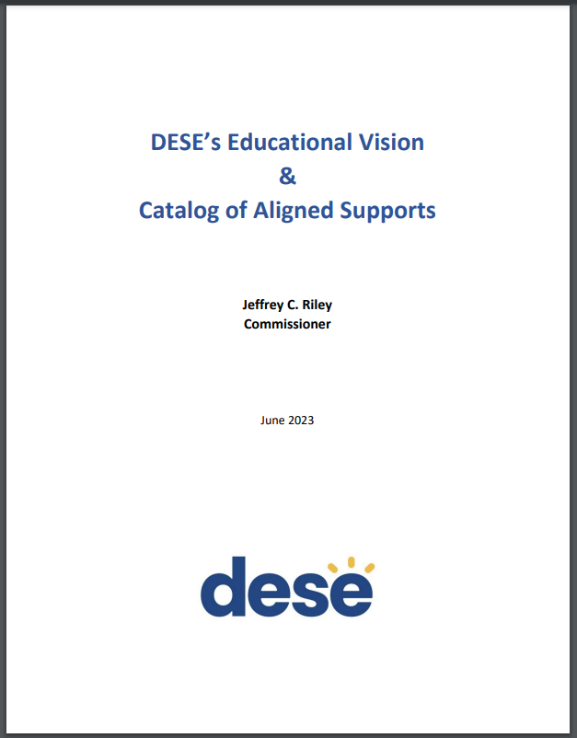
DESE's Educational Vision - Helpful Resources
Educational Vision
Catalog of Aligned Supports (coming next month)
www.doe.mass.edu/commissioner/
4

Slide 5
ESSER Reminders

Slide 6
Federal COVID Relief Funding – Sequencing of ~$3 billion over ~3 years
Today
Federal Coronavirus Relief Fund
$181.8 million
(CARES Act) Federal ESSER-I Fund
$194.4 million
(CRRSA Act) Federal ESSER-II Fund
$739 million
(American Rescue Plan) Federal ESSER-III Fund
$1.66 billion
(American Rescue Plan) Federal “ARP IDEA” (supplemental to the regular IDEA grants)
$63.2 million
FY21
6/30/21
Begin FY22
12/31/21
9/30/22
9/30/23
9/30/24
6
Notes:
Also over $48 million to private schools, and $260 million to approved private special education schools.

Slide 7
ESSERs I, II, and III: Claimed vs. Unclaimed through August 9, 2024
99.99%
.01%
21%
7

Slide 8
Claims/Draw Down Status
You can see claims status reports for your district via our monthly Federal Grant Programs newsletter
  Not on the list? Email FederalGrantPrograms@mass.gov!
8

Slide 9
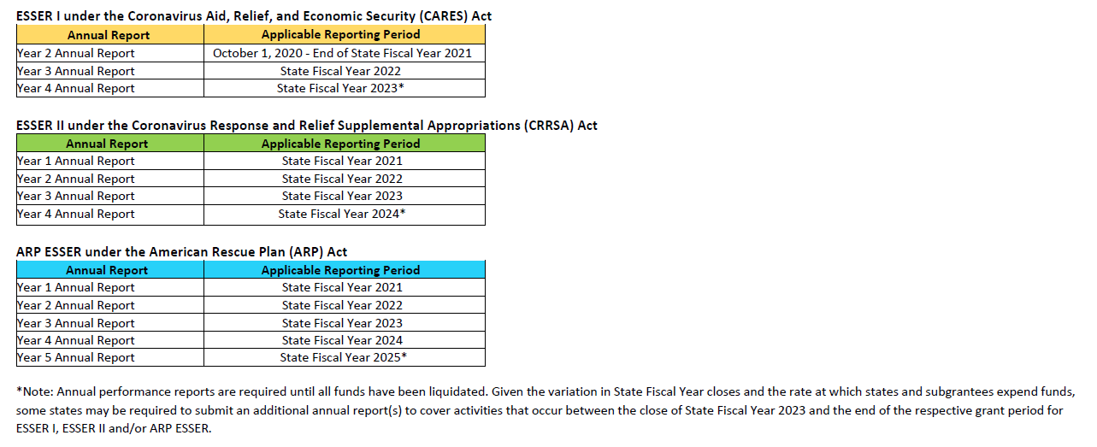
ESSER Reminders – Data Collection

Slide 10
ESSER Reminders – Data Collection
FY23 ESSER Data Collection window closed last Friday 5/10.
If you failed to submit, please contact me ASAP, as I’m submitting this year’s data to the feds this Friday
10

Slide 11
ESSER III Reminders – the 20% rule
Districts must use at least 20% of funds to combat loss of instructional time/learning loss by using evidence-based practices
  US Dept of Ed. data collection asks for a separate accounting of this 20% reserve
  Similarly, in your grant applications, you budgeted for the 20% reserve separately
Please be sure that this requirement is met, and that records are kept so that accurate and compliant data can be reported to the feds
11

Slide 12
ESSER III Reminders – Maintenance of Equity
ESSER-III requires all districts to Maintain Equity for their highest poverty schools (highest quartile) this fiscal year.
  There is no disproportionate reduction in combined State and local per pupil funding compared to all schools served by the LEA in that fiscal year
  There is no disproportionate reduction in the number of FTE staff per pupil compared to all schools served by the LEA in that fiscal year
DESE will be collecting 2023-24 waivers (if necessary) for districts not in compliance during the data collection period
12

Slide 13
ESSER III Reminders – Changing Your Plans
Many districts are making changes to their ESSER-III plans
  If a district is making substantial changes to its approved ESSER III plan, USED has set an expectation that stakeholder outreach should be done.
  If the changes are insignificant, stakeholder outreach would not be necessary.
Plans must stay on your website until October 1, 2024, regardless of whether you’ve closed out the grant
13

Slide 14
ESSER III Reminders – Capital Projects
Prior to seeking reimbursement for ESSER construction projects, districts must submit to liaison:
  Request for Final Approval Form
  Final bid/quote/purchase order
  Plans demonstrating all required approvals, certifications, signoffs
  Building permits
For ESSER minor remodel, repair, or maintenance projects, districts must submit to liaison:
  Request for Final Approval Form
  Final bid/quote/purchase order
Visit our ESSER page for more info: https://www.doe.mass.edu/federalgrants/esser
14

Slide 15
ESSER III Reminders – Davis-Bacon Prevailing Wages
Applies to all facilities contracts more than $2,000 paid in whole or in part with federal grant dollars (except IVAQ FC 209)
Paying prevailing wages under Massachusetts law is not sufficient.
Where a project receives both federal and state/local funding, the project may be subject to both Davis-Bacon prevailing wage requirements and state or local laws that similarly require payment of prevailing wage rates set by the state or locality.
Where both federal and state/local prevailing wage requirements apply, contractors must pay whichever rate is higher for each job classification and meet whichever requirements are more protective of workers.
Davis-Bacon prevailing wage rates are set by county and can be found on https://sam.gov (see guidance on how to find applicable federal wage rates here).
Davis-Bacon requires that districts receive certified payroll records weekly and other monitoring of contractors/subcontractors to ensure accurate weekly payment of required wage rates and retention of those records, among other responsibilities.
15

Slide 16
ESSER Updates – What’s New?

Slide 17
New Requirement – Federal Interest in a Property
USED has issued new guidance this Spring with details on how and when federal grant recipients must record a federal interest in property that was improved with federal ESSER funds “in the official real property records for the jurisdiction in which the improved or purchased property is located” (typically the Registry of Deeds)
17

Slide 18
New Requirement – Federal Interest in a Property
Recording
Generally, recording applies only to real property improvements using $1 million or more in ESSER funds.
Those required to record a federal interest must do so by January 28, 2025.
While the USED guidance does not provide a form, it does list the elements that notices of federal interest must contain.
18

Slide 19
New Requirement – Federal Interest in a Property
Reporting
Annual reports are required for any real property that was improved or purchased using federal grant funds.
There is no dollar threshold for reporting.
Reports are required for at least the first 15 years after the project is funded.
Moveable equipment, such as “HVAC equipment, mobile classrooms, building furniture” is exempt from reporting.
The report must be made on form SF-429-A Real Property Status Report.
Procedures for submitting these forms to DESE will be forthcoming this summer.
19

Slide 20
ESSER III Late Liquidation

Slide 21
Late Liquidation for ESSER III
Clarity around terminology:
  Obligation (a formal commitment to spend funds, but this can vary depending on the kind of commitment)
  Service delivery
  Liquidation (claim/draw down from DESE)
21

Slide 22
Obligations depend upon what you’re spending $ on
If you’re spending federal $ on this… | The obligation is considered made…
Employees | When service is performed
Public utility services | When service is performed
Travel | When travel is taken
Rentals/Leases | When rental/lease is used
Acquisition of real or personal property | When you make a binding written agreement (contract or work/purchase order)
Services by a contractor (not an employee) | When you make a binding written agreement (contract or work/purchase order)
22

Slide 23
“Standard” Obligation, Performance, and Liquidation Deadlines

Slide 24
ESSER-II and ESSER III Late Liquidation
Fortunately, unlike with obligation deadlines, USED does not need authority from Congress to waive/extend liquidation deadlines, which would also effectively extend the performance period.
24

Slide 25
Important ESSER-III Deadlines
When the US Congress appropriates money for a grant program, it usually contains an obligation deadline.
  ARP ESSER-III Obligation Deadline: 9/30/2024
Performance can happen (services can be delivered) for a short period of time (60 days) after the obligation deadline.
  ARP ESSER-III Service Delivery Deadline: 11/29/2024
Funds can be liquidated/claimed (through EdGrants) for 30 days after the service delivery deadline.
  ARP ESSER-III Liquidation Deadline: 12/29/2024
25

Slide 26
ESSER-III Obligation Deadline Remains 9/30/2024
The US Department of Ed (USED) has no authority to extend an obligation date, unless they are explicitly granted waiver authority by Congress.
We have seen no indication that Congress will consider granting such waiver authority to USED.
Therefore:
All ESSER-III properly obligated expenditures must be made by Saturday, September 30, 2024;
26

Slide 27
Obligations depend upon what you’re spending $ on
If you’re spending federal $ on this… | The obligation is considered made…
Employees | When service is performed
Public utility services | When service is performed
Travel | When travel is taken
Rentals/Leases | When rental/lease is used
Acquisition of real or personal property | When you make a binding written agreement (contract or work/purchase order)
Services by a contractor (not an employee) | When you make a binding written agreement (contract or work/purchase order)
27

Slide 28
ESSER-III Late Liquidation
The federal government announced up to an additional 14 months to liquidate funds, but only in select cases on an expense-by-expense basis. It is NOT a blanket provision that can be used for all situations.
ESSER II Late Liquidation is closed. ESSER III Late Liquidation will follow an almost identical process.
Districts who need this must:
  Obligate ESSER-III funds by 9/30/2024;
  Provide evidence (upload docs) that funds were obligated on time;
  Provide a compelling rationale for why late liquidation is needed, beyond simply needing additional time, how much time is needed, and why; and
  Provide assurance that the district has the capacity to liquidate funds within the extended period.
Districts can submit late liquidation requests starting today through September 30, 2024, in the GEM$ Application Supplements section (ESSER III Late Liquidation Request).
28
Notes:
for each late liquidation request to ensure that expenditures have been obligated in a timely manner, that there is a justification for the request beyond simply needing additional time to spend down funds, and an assurance that districts have been assessed for risk and have sufficient “capacity for liquidating funds within the extended period.”

Slide 29
29

Slide 30
Approval or Denial - Caveats
Both DESE and USED must approve requests
  DESE receives your requests, and if deemed approvable, must submit to USED for final approval
  DESE will review requests on a rolling basis, and will contact you ASAP with a determination
Please note that submission of a request does not guarantee approval for a liquidation extension. Therefore, districts should plan for an alternative source of funds for any contractual performance extending beyond the standard performance period (November 29, 2024) should an extension request be denied.
Further, if a late liquidation request is approved by DESE and USED, no changes can be made to the specific project or contract. If the executed contract cannot be fulfilled, the funds subject to late liquidation must be forfeited.
30
Notes:
for each late liquidation request to ensure that expenditures have been obligated in a timely manner, that there is a justification for the request beyond simply needing additional time to spend down funds, and an assurance that districts have been assessed for risk and have sufficient “capacity for liquidating funds within the extended period.”

Slide 31
Approval or Denial – Caveats
Note: Last year, 6 MA districts applied for late liquidation, and all were approved by both DESE and US Department of Education.
DESE will submit completed and approvable ESSER III late liquidation requests to the US Department of Education as close to October 1, 2024 as possible. Then, as soon as USED notifies DESE of its decisions, DESE will pass that information on to all districts that applied.
31
Notes:
for each late liquidation request to ensure that expenditures have been obligated in a timely manner, that there is a justification for the request beyond simply needing additional time to spend down funds, and an assurance that districts have been assessed for risk and have sufficient “capacity for liquidating funds within the extended period.”

Slide 32
Helpful Resources
In addition to this PowerPoint, which will be posted, we have three helpful quick reference guides
  Obligation, Performance, and Liquidation of Federal Grants Quick Reference Guide (https://www.doe.mass.edu/federalgrants/resources/obligation-performance-liquidation.docx)
  ESSER III Late Liquidation Quick Reference Guide (https://www.doe.mass.edu/federalgrants/esser/esser3-late-liquidation-qrg.docx)
  Instructions for Completing an ESSER II Late Liquidation Request in GEM$ (https://www.doe.mass.edu/federalgrants/esser/late-liquidation-instructions.docx)
32
Notes:
for each late liquidation request to ensure that expenditures have been obligated in a timely manner, that there is a justification for the request beyond simply needing additional time to spend down funds, and an assurance that districts have been assessed for risk and have sufficient “capacity for liquidating funds within the extended period.”

Slide 33
Questions thus far…?

Slide 34
News from Washington

Slide 35
“Debt Ceiling Deal” – Impact on FY25
Fiscal Responsibility Act of 2023 signed into law on June 3rd
No ESSER funds were rescinded
Agreements made that FY25 federal spending will be capped at FY24 levels
Congress passed education-related appropriations (ESSA, IDEA, Perkins, et al) earlier in the Spring that were consistent with the 2023 agreement.
35

Slide 36
GEM$ Updates

Slide 37
GEM$ - On to Year 2 of Implementation
We’re all still on the GEM$ learning curve
Goal is to have all new FY25 DESE grants on GEM$. EdGrants needs a few years to fully phase out, due to multiyear grants.
Certain aspects of the grant application process did not go as we had expected
Even though this grantmaking system has wide use nationally, we will need to tweak and refine it to Massachusetts’ needs
  GEM$ Ambassador’s Group has been incredibly helpful
37

Slide 38
Other Grant-Related Odds and Ends

Slide 39
Thank You!

