Slide 1
Family Engagement Panel:
Fulfilling ESSA requirements and leveraging resources
May 13, 2024

Slide 2
Agenda
Agenda
Welcome and Introductions (5 mins)
ESSA Family Engagement Requirements (5 mins)
Massachusetts Family Institute for Student Success (FISS) (5 mins)
Lowell (10 mins)
Falmouth (10 mins)
Greater Fall River Vocational Tech School (10 mins)
Questions (15 mins)

Slide 3
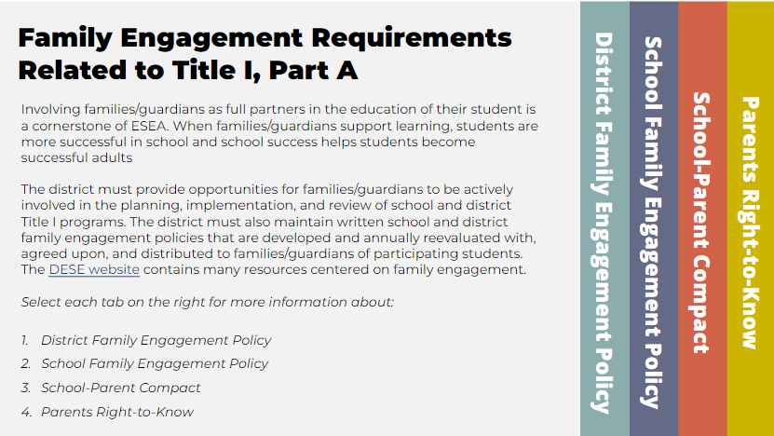
Family Engagement Requirements

Slide 4
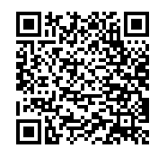
Review new ESSA Family Engagement
e-learning tool
and provide feedback in comments.
https://tinyurl.com/ESSAFamily
*note the e-learning tool is meant for desktop use

Slide 5
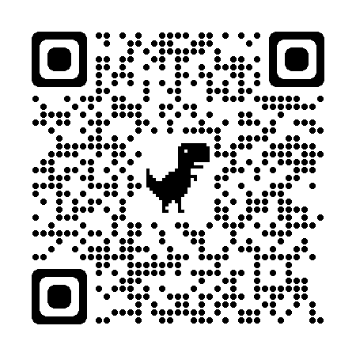
“Students and families have a sense of belonging: they are known, respected, and valued for who they are and what they bring to the school community, including their unique identities, strengths, interests, needs, languages, exceptionalities, and backgrounds.”

Slide 6
Massachusetts Family Institute for Student Success (FISS)
The Family Institute for Student Success (FISS) is a capacity building institute that offers a portfolio of workshops to parents, caregivers, school staff and community-based providers to facilitate common knowledge, shared mindsets and collective intentional action by all stakeholders influencing the growth of children and youth
FISS is an evidenced-based family engagement institute anchored under the Dual Capacity Building Framework for Family and School Partnerships (Mapp, K. & Kuttner, P; U.S. Department of Education, 2013, and Mapp, K. L. & Bergman, E. 2019, version 2). FISS goals and theory of action are informed and aligned with DESE’s foundational family engagement framework as represented in the “Strengthening Partnerships: A Framework for Prenatal through Young Adulthood Family Engagement in Massachusetts,” and the revised 2.0 version of the Massachusetts Family, School and Community Partnership Fundamentals.

Slide 7
FISS Theory of Action
The following hypotheses support
FISS’ Theory of Action
As a capacity building program, FISS is anchored in the promotion of all-around Self-Efficacy, given the strong correlation that exists between Self-Efficacy and long-term success, well documented in research
Parents / families increases in Self-efficacy around supporting the education of their children
School staff increases in Self-efficacy around their ability to work with families effectively.
The collective capacity building of Self-efficacy around high impact areas
The improvements in student outcomes are the result of the Responsive Action that consistently occurs when families, school staff and community-based providers

Slide 8
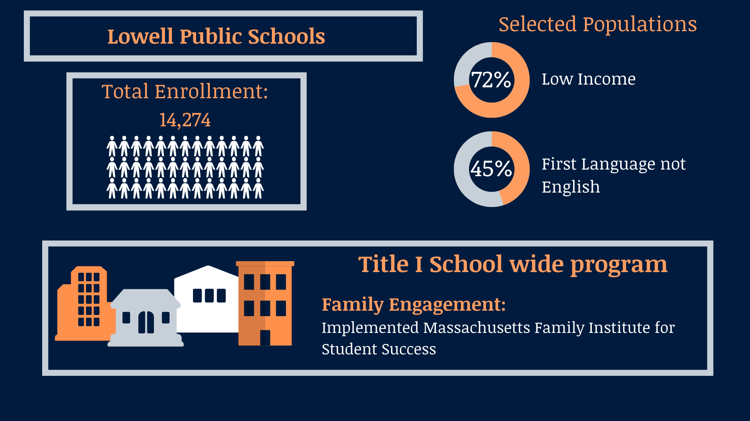
Lowell Public Schools

Slide 9
LOWELL PUBLIC SCHOOLS FAMILY ENGAGEMENT
ABOVE and BEYOND COMPLIANCE

Slide 10
TITLE I COMPLIANCE
ANNUAL MEETING
PARENT ENGAGEMENT PROCEDURES
SCHOOL/ FAMILY COMPACTS
PARENTS’ RIGHT TO KNOW
DISTRICT and SCHOOL PARENT LIAISONS
PARENT SURVEYS

Slide 11
STRATEGIC GOAL
INCREASE LPS COMMUNITY ENGAGEMENT and EMPOWER FAMILIES AS PARTNERS
ACROSS ALL DEPARTMENTS AND SCHOOLS
PROVIDING VARIOUS OPPORTUNITIES for FAMILY ENGAGEMENT
PROVIDING ACCESS TO INFORMATION IN MULTIPLE LANGUAGES
PROVIDING MULTI-LINGUAL STAFF

Slide 12
SCHOOL/ FAMILY ENGAGEMENT
RESPONSIBILITY OF ALL STAFF
ADMINISTRATORS
TEACHERS
SUPPORT STAFF
SCHOOL SITE COUNCIL
PARENT ORGANIZATIONS
COMMUNITY ORGANIZATION

Slide 13
ABOVE AND BEYOND: DISTRICT FAMILY ENGAGEMENT
RESPONSIBILITY OF ALL DEPARTMENTS
EQUITY and ENGAGEMENT OFFICE
FAMILY RESOURCE CENTER
COMMUNITYOUTREACH
CURRICULUM OFFICE
DATA OFFICE
FINANCE OFFICE

Slide 14
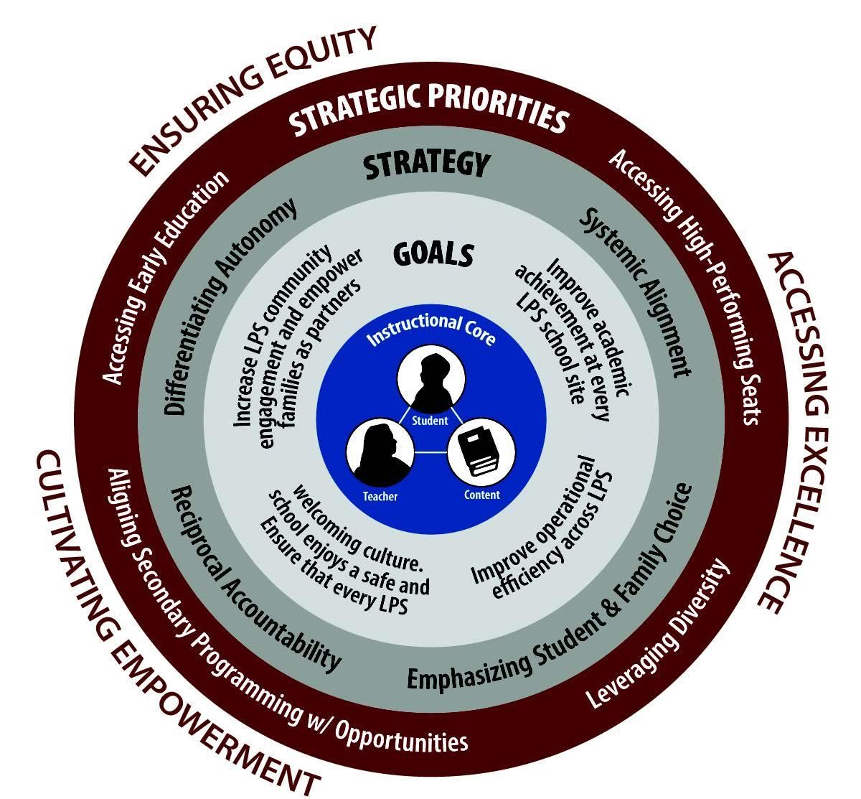
Ensuring Equity

Slide 15
LOWELL PUBLIC SCHOOLS QUESTIONS and NEXT STEPS
What can we do next to improve our service to families?
How can we continue to empower and enrich lives of the students we serve?
Looking ahead to always incorporate Equity and Empowerment of Families as they are paramount to the success of our students in LPS. We believe in the fabric of engaging families and keeping them at the forefront of their children's education.

Slide 16
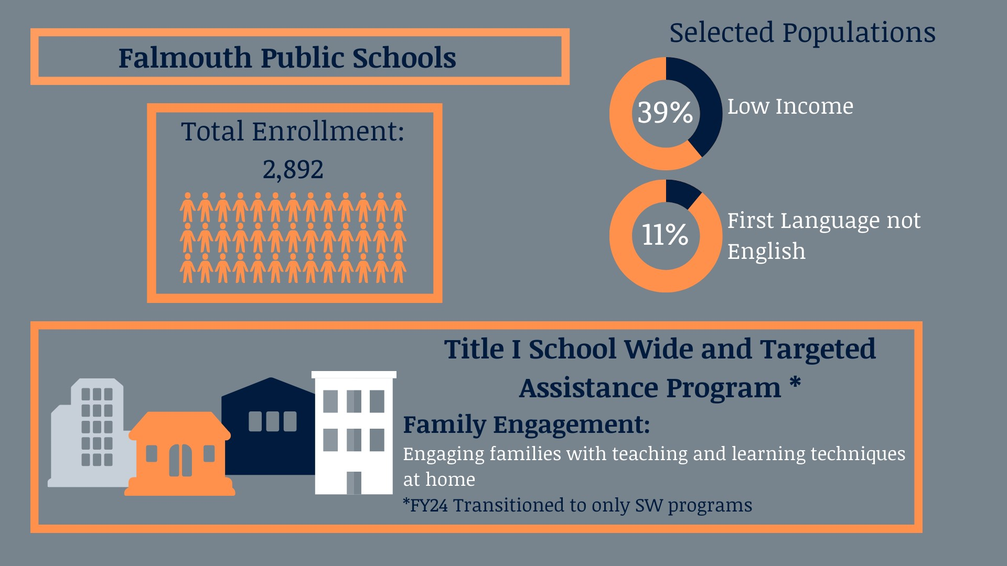
Falmouth Public Schools

Slide 17
Greater Fall River

Slide 18
Diman RVTHS Family Engagement
May 2024

Slide 19
Diman RVTHS
Parent(family) liaison
Family groups (PAC and PTO)
Parent outreach (cold calling, emailing, attending events, etc.)
Supports parent communication
Website
Bi-monthly meetings with administration
Monthly reports
End-of-year report for district and school committee

Slide 20
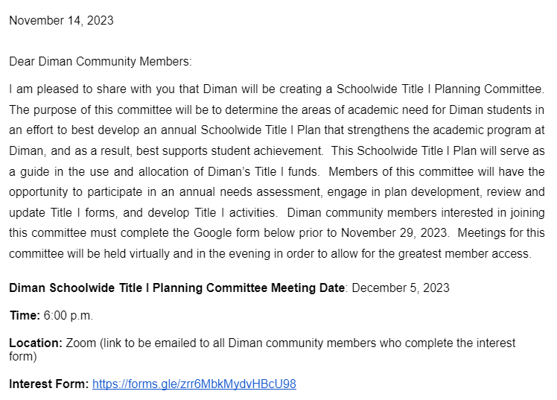
Schoolwide Title I Committee

Slide 21
Schoolwide Title I Committee
Met seven times (including presentation to district administration)
Three goals:
Increase family involvement
Address state focus related to accelerated coursework
Improve math fluency
Research-based
Stakeholder run presentation

Slide 22
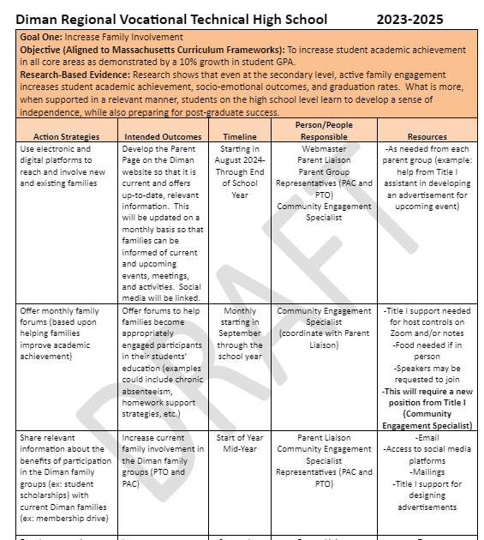
Schoolwide Title I Committee

Slide 23
Moving Forward
Increase parent forums (ex: supporting high school student with homework assignments, addressing chronic absenteeism, etc.)
Expand outreach (inclusive) with community engagement specialist (facilitate forums for community at large, support with recruitment planning for family groups (PAC, PTO, etc.), support with digital platforms to expand outreach to existing families
Increase educator/family communication via regular outreach strategies (see SIP)

Slide 24
Questions

