Slide 1
Federal Grants Conference: Fiscal Topics
May 13, 2024
Linda Brandon and Melissa Williams
Grants Management

Slide 2
Amendments are Required when:
There is a significant change in program objectives; or
There is an increase or decrease in the total award amount of the grant; or
An increase in a line of the budget that exceeds $100 or 10% of the line (whichever is greater), or exceeds $10,000
Amendment validations are built into the reimbursement request form in GEM$.
Notes:
Validations – bullet 2 and 3. decrease – reimb request will not allow you to draw more than the new amount;

Slide 3
Amendments Cont…
Amendments are due 30 days prior to grant end date (check your GAN!). This is very important with grants housed in GEM$!!
Reimbursement requests will prevent reporting expenditures over the allowable amendment thresholds based on the last approved budget on file.
Reimbursement request deadlines are imposed on DESE by the state fiscal year timelines; if on 8/25 (final day for reimbursement requests) you realize you need to file an amendment to accurately report expenditures, we will not be able to process this grant payment in time; you will be forfeiting the remaining balance.

Slide 4
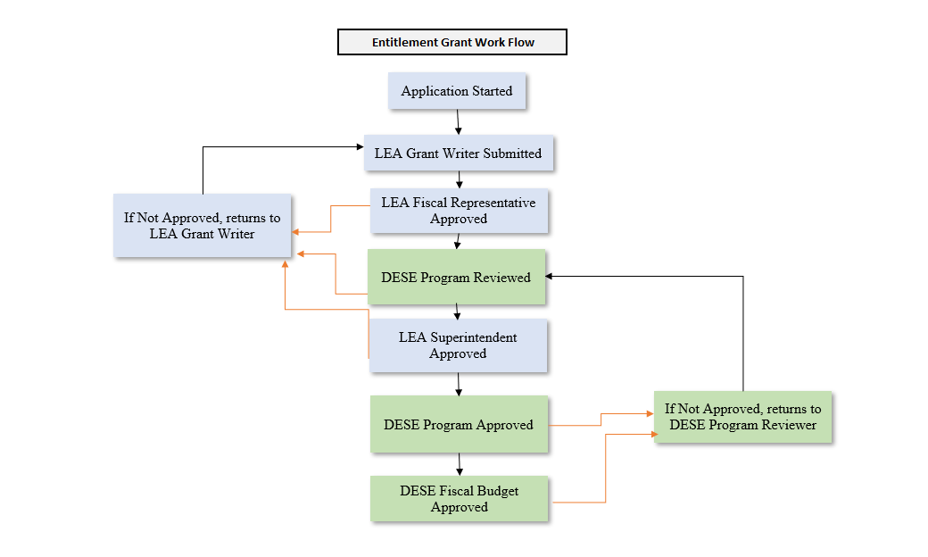
Worfklow
Notes:
DESE fiscal budget approved step is when it will reflect on the Reimbursement request.

Slide 5
Multi-year Grants
Grants that show 9/30/2024 (or later) on the GAN as the end date (project duration)
Grant GANs that show 6/30/2024 as the end date are not multi-year grants
Unclaimed balances on multi-year grants will be assessed after June 30th by DESE
Unclaimed balances will roll into FY25 (once funding structures are established by DESE)

Slide 6
Multi-year Grants (cont.)
Payments that are processed as of July 1st will hit FY25/Year 2 of the grant
No changes to project duration (start or end date) regardless of when the payments are made
If funds are required by the LEA by June 30^{th:} LEA should reconcile and plan to submit final reimbursement request by the second week of June (June 15th at the latest). Submit final amendments NOW for these grants so that you are not caught needing a revision when you need to be requesting the final drawdown by 6/15. (Only applies to some districts)
Notes:
Bullet 3 is for cities/towns that require school districts to have all funds in hand by June 30^{th.}

Slide 7
Final Requests for Payments/Reimbursement (all grants – not multi-year)
FY2024 multi year grants are not impacted by this final FY2024 reimbursement request process as any unclaimed balances will roll into FY25. (CHECK THE GAN).
FY2024 grants housed in GEM$ with a 6/30/2024 end date must be fully drawn/all requests made by the end of July.
If needed, you can request reimbursement through 8/25 (either by filing reimbursement request or FER/closeout form). Any funding request filed after 8/25 will be at risk of forfeiting grant balance as we cannot guarantee the payment will clear.
If you need grant funds to clear LEA/district on or before June 30th, you will need to have expended all grant funds and made the final reimbursement request by June 15th.
Notes:
Multi-year grants will always have more time – they will need to pay attention to deadlines once in Year 3; Bullet 4 is for all cities/towns who require school district to have all grant funds in hand by June 30th. (regardless of it multi-year or not)

Slide 8
Grant Closeout Process: EdGrants
Grants housed in EdGrants will close out in EdGrants
DO NOW: Determine which FR-1s are delinquent and submit asap
Lots of FY23 FR-1s missing
Many Prior FY FR-1s missing (FY22, FY21)
Log in to EdGrants, Front Office, select grant, in Submissions identify whether a date/time stamp is next to the Final Financial Report
If yes, the FR-1 is filed/complete; no action needed
If no, the FR-1 is delinquent and must be submitted ASAP
Reach out to grants management if the FR-1 is not allowing entry; many of these have expired and we will need to re-open them for you to submit. EdGrants@mass.gov
Notes:
Take inventory of which FR-1s need filing; contact GM if the FR-1 is not allowing entry – these steps expire.

Slide 9
Grant Closeout Process: GEM$
GEM$ closeout process will require filing a Financial Expenditure Report (FER)
FER replaces the FR-1
Financial Expenditure Report (FER) will allow for one final reimbursement if filed by 8/25. (most grants)
Financial Expenditure Report (FER) will allow for one final reimbursement if filed by 12/31 (multi-year/carryover ONLY)
If there is an application revision started the system will not allow you to file the FER
Notes:
FER will allow the Year 3 multi-year folks to use that FER to claim final reimbursements if filed by 12/31.

Slide 10
Reminders about Post-approval
Once grant status changes to “DESE Fiscal Budget Approved” funds can be drawn/reimbursement requests can be submitted
The Grant Award Notification (GAN) will appear on the Sections page of your grant
GAN will display the grant project duration; GAN also displays important draw down deadlines
Please request grant funding! USED was asking MA why there were such high balances unclaimed around March.
Reminder: No request windows in GEM$
The LEA Fiscal Representative role has authority to seek reimbursements in GEM$.
Once your funding application has reached DESE Fiscal Budget Approved, the workflow is complete
Only Select “Application Revision Started” when you want to amend your grant
If you accidentally select Application Revision Started, you can leave it at that status until you need a revision (amendment)
Notes:
kathy

Slide 11
Grant Award Notice (GAN)
Notes:
Section 5 has all the important info! Dates! Amount! Increases/decreases will show here as well.

Slide 12
Obligation and Liquidation for Federal Grants
Best Practice = Obligate and Liquidate before the grant deadline.
Deadline for obligation depends on type of expense:
If the obligation is for: | The obligation is made:
Acquisition of real or personal property | On the date on which the State or subgrantee makes a binding written commitment to acquire the property.
Personal services by an employee of the State or subgrantee | When the services are performed.
Personal services by a contractor who is not an employee of the State or subgrantee | On the date on which the State or subgrantee makes a binding written commitment to obtain the services.
Performance of work other than personal services | On the date on which the State or subgrantee makes a binding written commitment to obtain the work.
Public utility services | When the State or subgrantee receives the services.
Travel | When the travel is taken.
Rental of real or personal property | When the State or subgrantee uses the property.
A pre-agreement cost that was properly approved by the Secretary [of Education] | On the first day of the grant or subgrant performance.

Slide 13
Questions

