Slide 1
Thinking About Induction & Mentoring
DESE Federal Grants Conference 2024
Notes:
Session Description: Are you looking for new ways to support and retain staff? Do you want to hear some fresh ideas for your induction and mentoring program? Come and collaborate with other districts to add to your repertoire of strategies!

Slide 2
MPSD 2012
Two days for induction
Everyone attended everything together
Writing Across Curriculum Training plus “Toolkit” information
Notecard to self
Sit down luncheon/celebration
Gift of instructional strategies book

Slide 3
MPSD 2012
New hires met one another
Time to visit building
Team sit-down luncheon
Mostly teachers participated
Funding for luncheon from grant; less time in buildings
Did we meet the needs of all new hires?

Slide 4
Pause for Shared Reflection
At your table, discuss:
Positive components of your district’s program
Missing components or areas you may want to improve

Slide 5
MPSD Through the Years
number of induction days
increased building time
offered additional mentor training
Marshfield Mystery Ride
evaluation model component
technology component
hosted Studying Skillful Teacher courses
decreased luncheon time
eliminated Writing Across Curriculum training

Slide 6
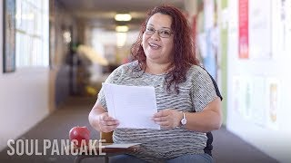
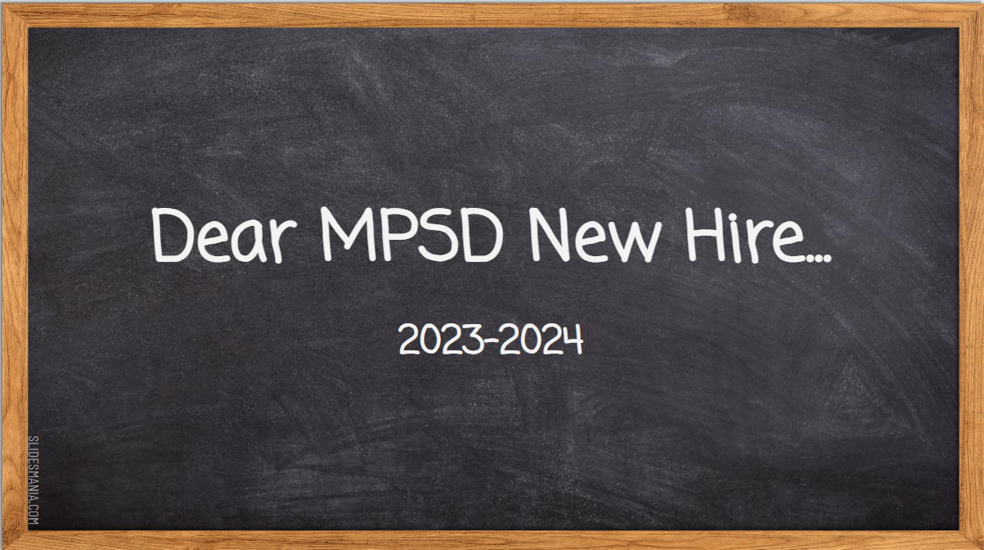
MPSD Through the Years cont.
Note to Self
Advice for New Hires

Slide 7
MPSD Now
2023-2024
Build upon a historically strong high quality educator orientation in the MPSD.
Create a welcoming first experience for new members of our community.
Meet the diverse needs of our new educators.
Provide important information, equipping new educators with information & resources to succeed as MPSD employees.

Slide 8
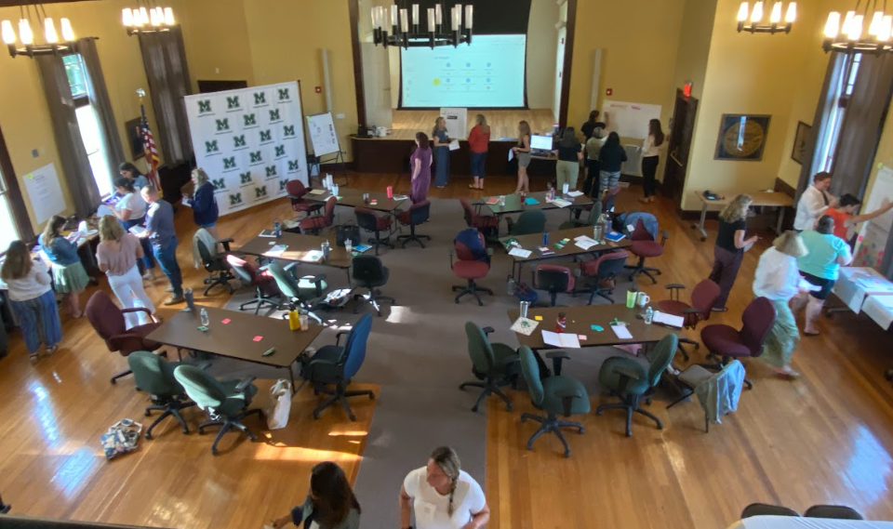
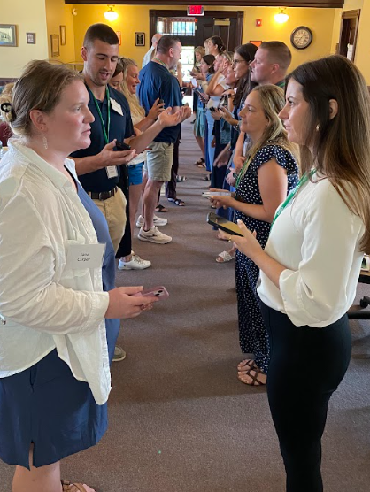
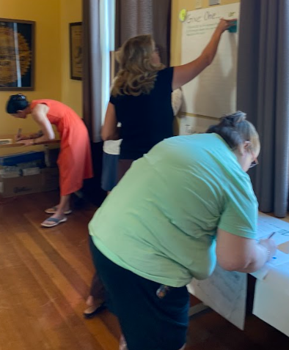
Community Building

Slide 9
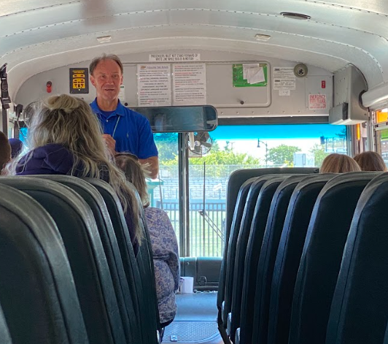
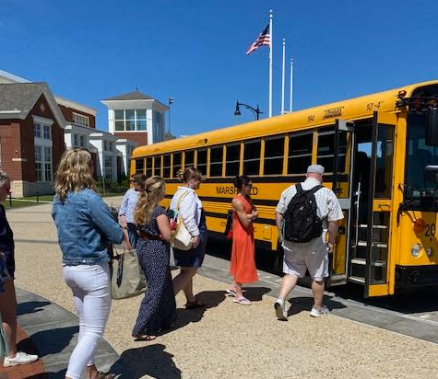
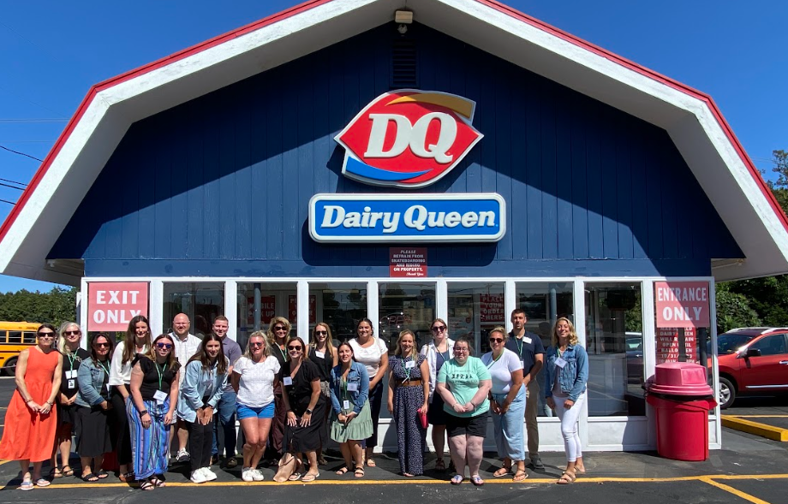
Community Building cont.

Slide 10
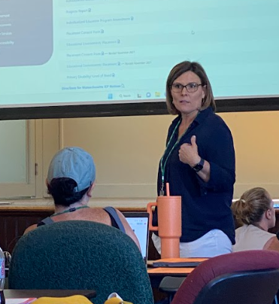
Increased Information & Learning
Welcome to MPSD
Getting to Know MPSD
SEL Session

Slide 11
Differentiated Sessions
Role:
Elementary
Middle
High School
Special Educators
Nurses
Topic:
Curriculum w/ Coaches
Procedures
Program Resources
Technology Choice Boards

Slide 12
Beginning Teacher Institute (BTI)
Reimagined Structure:
Secondary 2:30-3:00 PM Micro-session
Full Group 3:00-3:45 PM Micro-session
Elementary 3:45-4:15 PM Micro-session

Slide 13
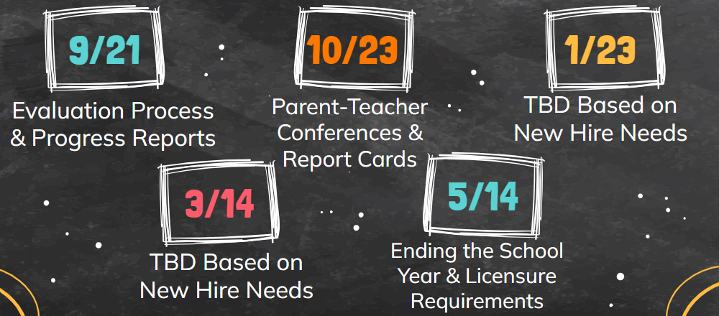
Beginning Teacher Institute
Built-in Flexibility to Meet Educator Needs

Slide 14
MPSD Looking Ahead
2024-2025
facilitate observations protege → mentor mentor → protege
Increase mentor involvement in facilitating BTIs
update Mentor Handbook
develop Mentor training

Slide 15
Pause for Reflection
At your table, discuss:
New ideas you heard
At least one takeaway you will investigate or try

Slide 16
Share your takeaway!

Slide 17
Thank You!

