Slide 1
ESSA Grant Program Private School Outreach and Participation
Federal Grant Programs Spring Conference – May 13, 2024
Alex Lilley – DESE
Kristopher Theriault – Chicopee Public Schools

Slide 2
Outreach - obligation
Who do you need to reach out to?
For Title I: Any private school that resident students are attending (even beyond your district) who would have attended a Title I school in district
Eligible students can participate in Title I if funds are generated (at least one is considered low-income) and there’s academic need for supplemental assistance.
For Titles IIA, IIIA, and IVA: Every private school located in your district (all students and staff are eligible to participate)

Slide 3
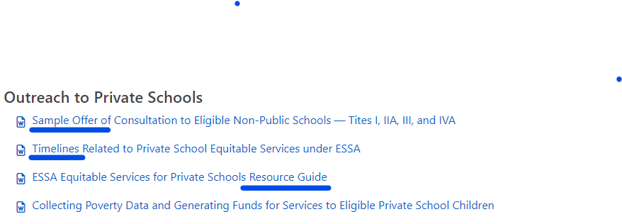
Outreach - resources
District Level Equitable Services for Private Schools - Federal Grant Programs (mass.edu)

Slide 4
ESSA Application – list eligible schools not participating

Slide 5
ESSA Application Title I – list participating schools…low-income count generates allocation

Slide 6
Title IIA – list participating schools…enrollment generates allocation (# of El’s for Title III)

Slide 7
Track and Document Outreach!
Send letters by return receipt (either snail mail or email)
Keep record of responses and receipts (if no response)
For those that choose to participate:
Arrange for timely consultation (initial, then ongoing)
Collect signed Affirmation of Consultation with Participating Schools
Keep on file and upload with grant application
Use to document agreed upon services

Slide 8
Consultation and Participation Resources District Level Equitable Services for Private Schools - Federal Grant Programs (mass.edu)

Slide 9
Important Rules
Consultation must be “timely” and “meaningful”
Complete before you finalize plans and consider/meet their needs
Never pay the private school
You must maintain control of public funds – no reimbursing…you hire, you own, you inventory…you take back at end
Supplement, Not Supplant applies
For Title I, it will always be a Targeted Assistance program for the eligible/participating students only
All services and materials must be additional to what the school would provide without participating

Slide 10
Important Rules (a couple more)
Services and materials provided must be “secular, neutral, and non-ideological”
Can hire non-secular group to provide secular services, though
Costs must be “allowable, necessary, and reasonable”
You must adhere to regulations, seriously consider views of private school, and you have final say (and responsibility).

Slide 11
A few details
District Title I allocation exceeds $500,000?
Must reserve 1% of private school allocation for family engagement
Title IIA cannot be used for class-size reduction in private schools.
Teachers hired by the district must meet state licensure requirements (teachers hired by third-party providers do not).

Slide 12
Some Tips
Send outreach by return receipt…document, document, document
Provide reasonable deadlines and clear consequences for non or late responses…yet allow some leeway
Document agreed upon plans in Affirmation of Consultation with Participating Private Schools form
Communicate, check-in on plans and spend-down…consultation is ongoing

Slide 13
Guidance and Resources
Equitable Services Webpage: www.doe.mass.edu/federalgrants/resources/equitableservices-essa/
USED guidance – question and answer
DESE resource guide – step-by-step guide
Sample offer of consultation to private schools
Suggested timelines related to equitable services
ESSA Ombudsman
Alex Lilley
ESEAequitableservices@mass.gov
ESSA statute
Title I, Sec. 1117(a)(3)(B) and Title VIII, Sec. 8501(a)(3)(B)…for all other Title programs

Slide 14
How do you do this?
In context…
Kris will share his equitable services journey – it can be done and it can turn out well!

Slide 15
By: Kris Theriault
Shareable
Equitable
Share
Information

Slide 16
Get to know your private school leadership
1
Building trust and rapport: By getting to know them on a personal level, public schools can foster a sense of collaboration and mutual respect that can lead to positive outcomes for all students involved.
2
Professional Collaboration: By getting to know the parochial school, public schools can work together with them more effectively to address common challenges and support student learning. Understanding their unique goals and approaches can help develop joint initiatives and programs that benefit all students.
3
Effective coordination of services: Public schools and private schools can work together to coordinate services and programs funded by Title I to maximize impact.
Aaron Loeb
Alfredo Torres
Juliana Silva
Daniel Gallego
Olivia Wilson
Principal
Business Manager
Head Master
Vice Principal
IT Expert

Slide 17
District Level Equitable Services for Private Schools - Federal Grant Programs (mass.edu)
Private School Equitable Services under ESSA
Everything you need to know and should know about equitable service under ESSA is here:
Know the Answers or Know Where to Find the Answers
02
The more you know about this process the
smoother it will all work for everyone involved.
What is most helpful for me
The timeline
A step-by-step process: From the identification of private schools to the consultation process
Sample forms: offer of consultation, agreement to participate, meeting template

Slide 18
3
March 1 thru April 30
1
Title II, III, IV – Eligible District Private
Title I – Where City Residents Attend
Identifying your receiving private schools
2
I work with our attendance liaison to identify all of our receiving private schools, both inside and outside of our city.
Prepare my typed letter and emailed letter for the Offer of Consultation
4
Identify the current principal and send out both the email and USPS letter

Slide 19
Set-Up Your Systems and Processes
1
Use the timeline Provided by DESE
Prepare your forms to be used during the year
Offer for Consultation
Affirmation of Consultation
Blank Signature Sheet
2
3
List of Chicopee Students at Each Private School
Shared Google Doc: Once the consult is accepted and the meeting takes place
Identified Eligbile Title I Student low-income count through Direct Certification
4
Materials ordering forms
Used with every purchase
No randos
5
Budget Page
We Share a blank Google ledger sheet
We compare at our meetings

Slide 20
Building A Relationship Now Helps During Difficult Moments Later
“What stood out for me was that you were very knowledgeable about proportionate share with the private schools, and you shared your knowledge with me”.
1
“I appreciated your patience with me as we navigated the process to choose a path forward that was most beneficial to our student.”
2
3
“I appreciated your consideration in reaching out to update me about our school's textbook order. I felt your professional courtesy was exemplary.”
“Your willingness to answer any of my questions, as well as to research some unusual questions I put forth to you during our meeting, helped me to make sound decisions.”
4

Slide 21
Work with your federal grants liaison
When you’re in doubt about something or when things are beginning to fall apart..
1
Connect with Alex Lilley, the Ombudsman, at DESE early
2

Slide 22
Thank you! Please reach out as needed!
Your liaison: http://www.doe.mass.edu/federalgrants/liaisons.xlsx
General email address: federalgrantprograms@mass.gov
Website: www.doe.mass.edu/federalgrants

