Slide 1
Playful Learning: An Instructional Strategy for PK-3rd Grade
Federal Grants Convening
May 13, 2024
11:15 – 12:15

Slide 2
AGENDA
Welcome and context setting
What are playful learning/indicators
School team panel to talk about the Playful Learning Institute, PK-3, pilot
Discussion/Q&A
Sharing of resources/Wrap Up

Slide 3
Background Context on the Playful Learning Institute, PK-3 (PLI)

Slide 4

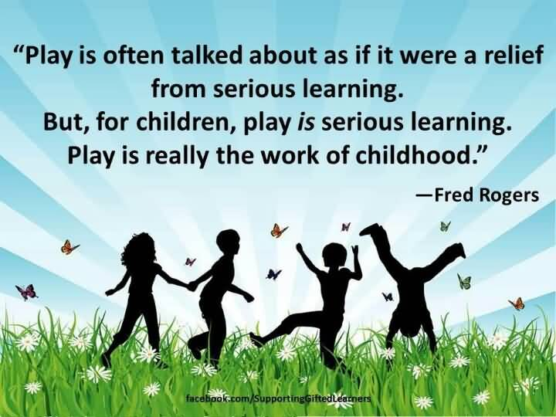
Quotes on Playful Learning

Slide 5
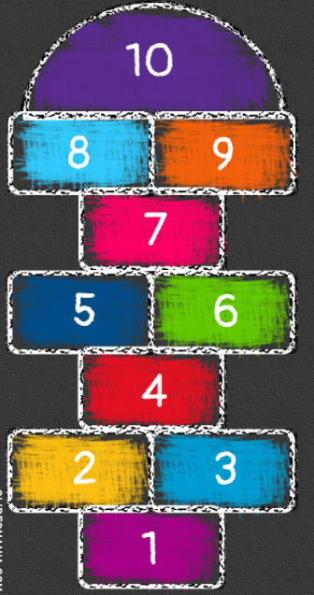
Joint Position Statement on Intentional and Playful Learning
https://www.doe.mass.edu/sfs/earlylearning/resources/play-statement.docx
Co-Endorsed by the Department of Elementary and Secondary Education and the Massachusetts School Administrators Association
Developed in collaboration with MSAA Elementary Principals Subcommittee and practitioners in the field (teachers, district administrators, school principals)
Preschool to 3rd Grade Focus
Resources

Slide 6
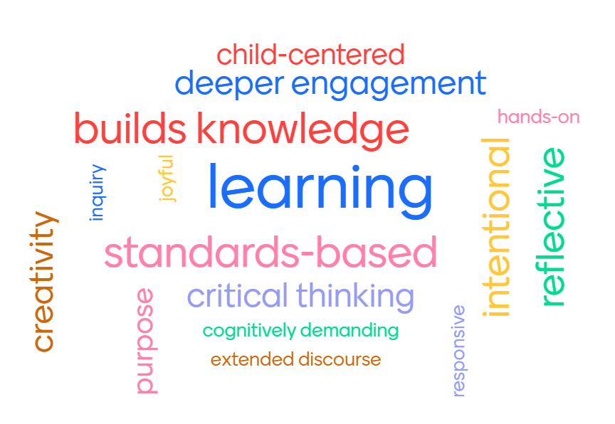
Characteristics of Playful Learning

Slide 7

What is the Playful Learning Institute, PK-3?

Slide 8
Purpose of the Playful Learning Institute
Designed for: district and school administrators, pre-kindergarten through grade 3 classroom educators, and community-based early childhood and out-of-school time program staff and administrators
Goal: to provide participants with the tools and strategies needed to embed playful learning that supports:
  deep dives into content;
  creates equitable access to learning; and
  creates varied opportunities for assessment across content areas.
  More information can be found on our early learning website.

Slide 9
Components of the Playful Learning Institute
Team
The participating team must include:
  two (2) inclusive classroom educators from each grade level, Preschool through 3rd grade along (PK-3);
  a district administrator (preferably one who has responsibility and oversight for curriculum decisions); and
  the school administrator of the building where the educators teach.
  If possible, the preference is for the educators to be from the same school but in cases where grade level configurations for schools don’t include all grades, two schools may be paired together to make up the team; in these cases, the building principal from both schools must be active participants.

Slide 10
Components of the Playful Learning Institute (continued)
Professional development (PD)
For school teams that includes the district and school administrators as well as two (2) educators each in PK-3.
  Includes both asynchronous/virtual pre-work and 10 hours of in-person PD
  PD resulted in coordinated grade level action plans for each team to implement in the 2023-24 school year.
  The grade-level action plans focused on implementation strategies at each grade level of at least one of the following:
    Boston Public Schools’ Focus Curriculum; and/or
    Implementation of two or more of the playful learning instructional strategies (Read Alouds, Center/Studios, Writing, Storytelling/Story Acting, and Thinking and Feedback) that are utilized in this integrated curriculum; and/or
    Other playful learning strategies learned through the professional development.

Slide 11
Components of the Playful Learning Institute - continued
Coaching
Monthly coaching for administrators and educators from October through May of the 2023-24 school year
  Educators – 3-5 hours per month
  District and school administrators – 1-2 hours per month

Slide 12
Playful Learning Indicators

Slide 13
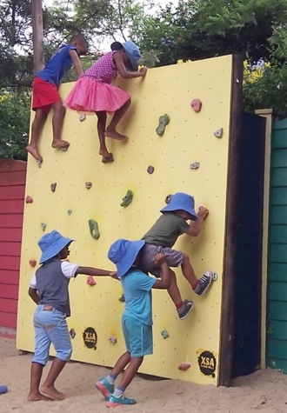

Pedagogy of Play
Project Zero
Harvard Graduate School of Education

Slide 14

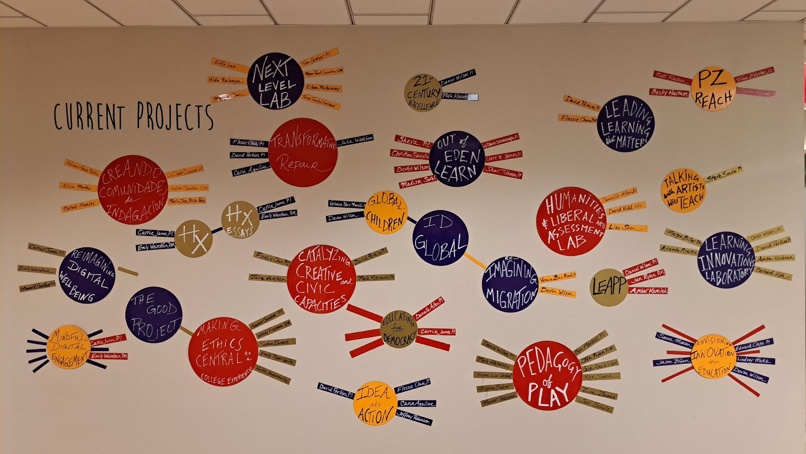
Project Zero

Slide 15
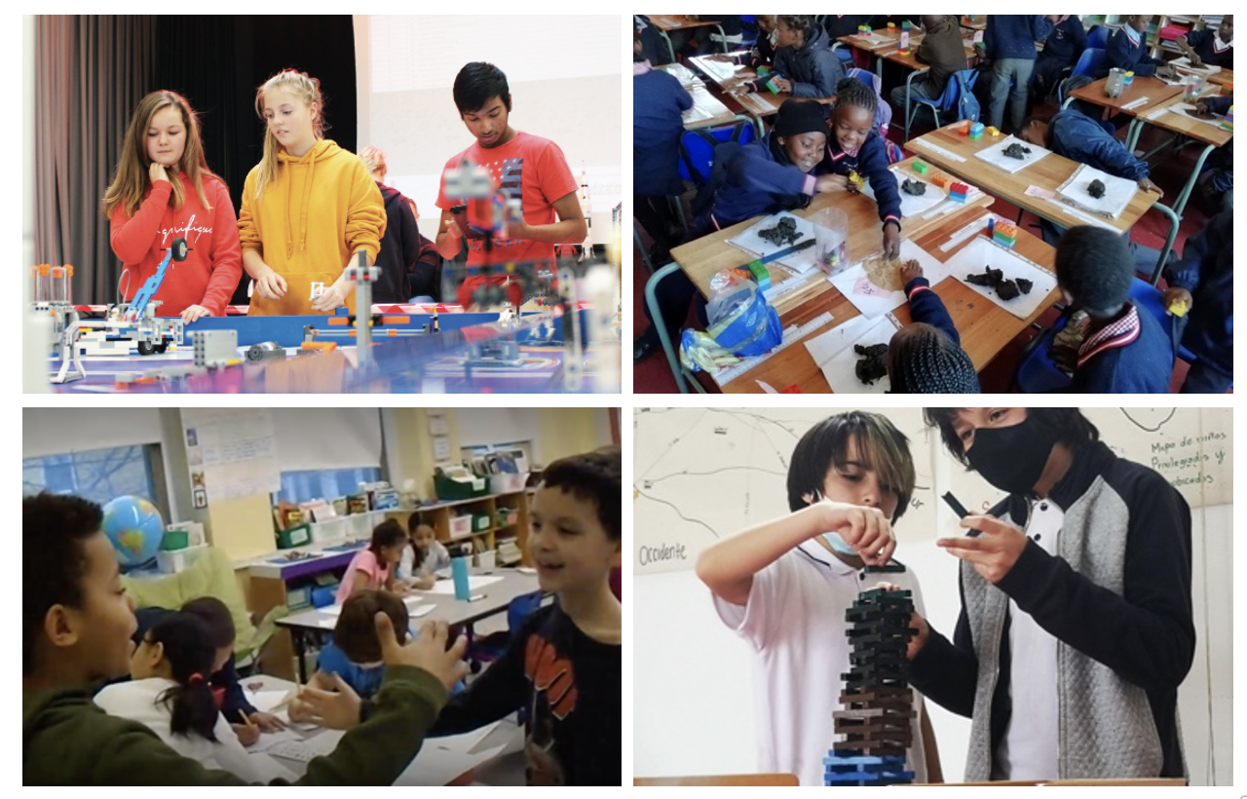
Images of Playful Learning from Project Zero

Slide 16
What does playful learning look and feel like in different cultural contexts?

Slide 17
Free Association
When I say cat, you think: rat, or purr, or sneeze ...
Summer
Picnic
Coffee
Playful Learning

Slide 18
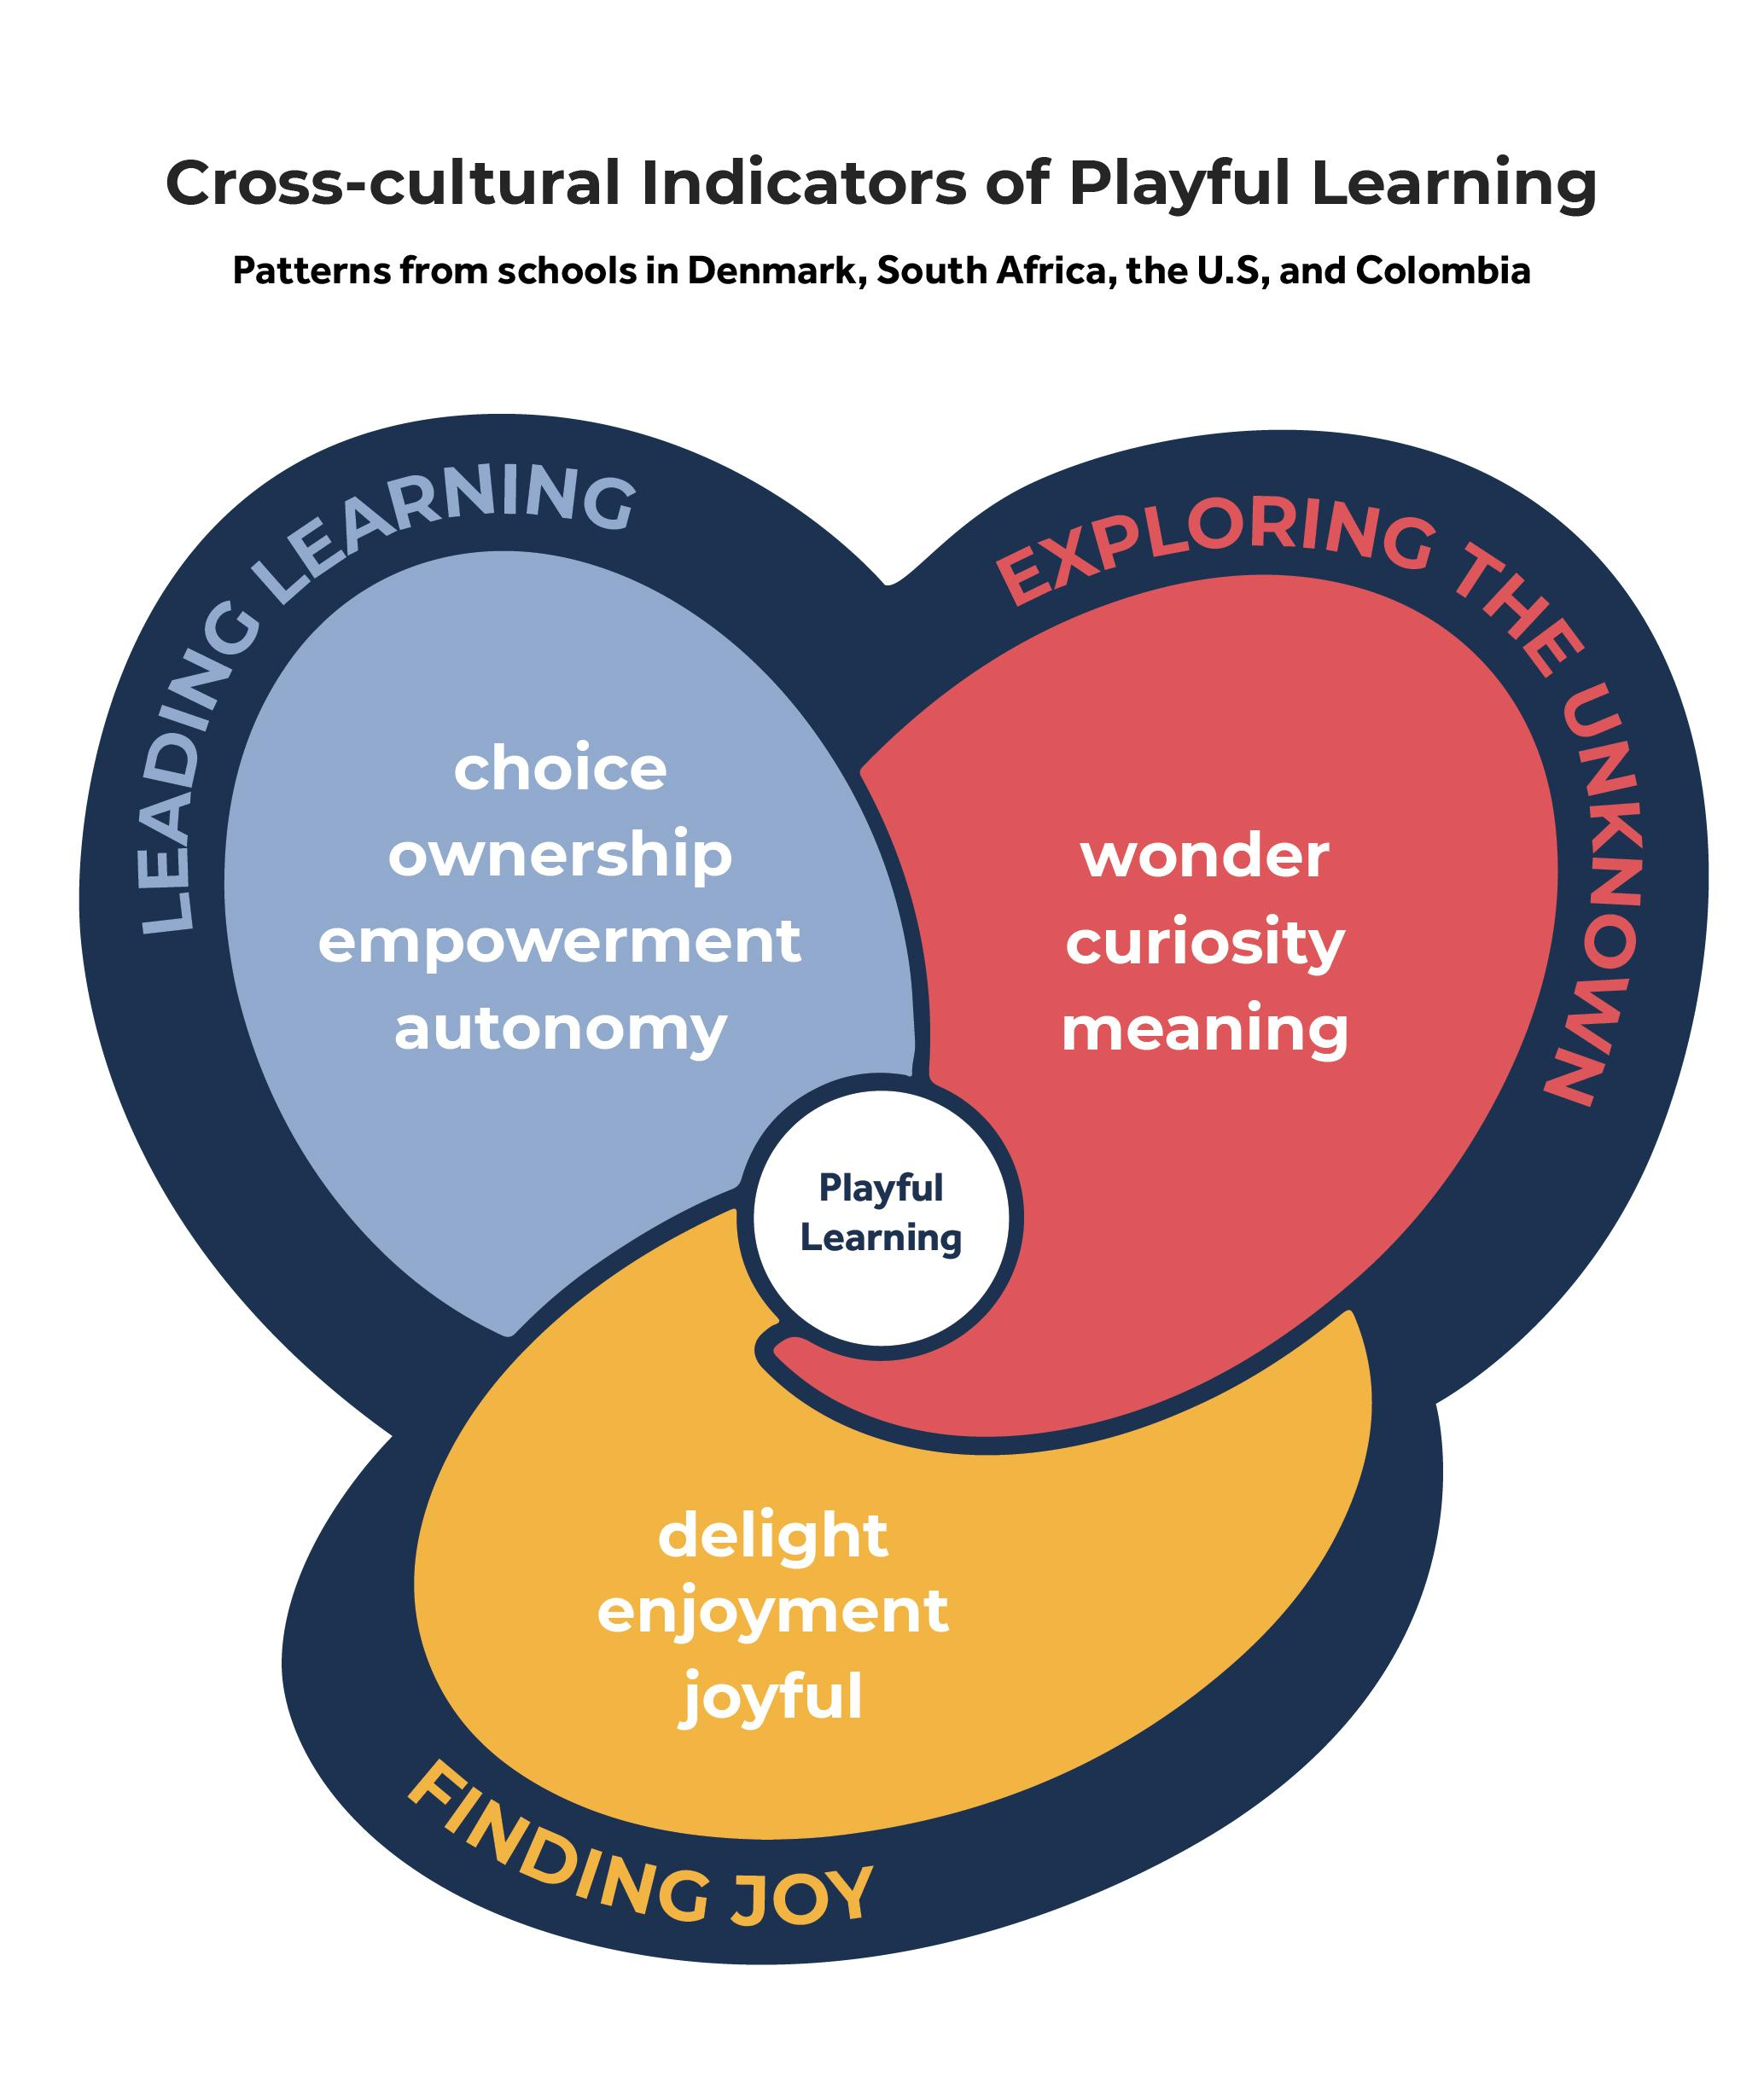
Cross-Cultural Indicators of Playful Learning

Slide 19
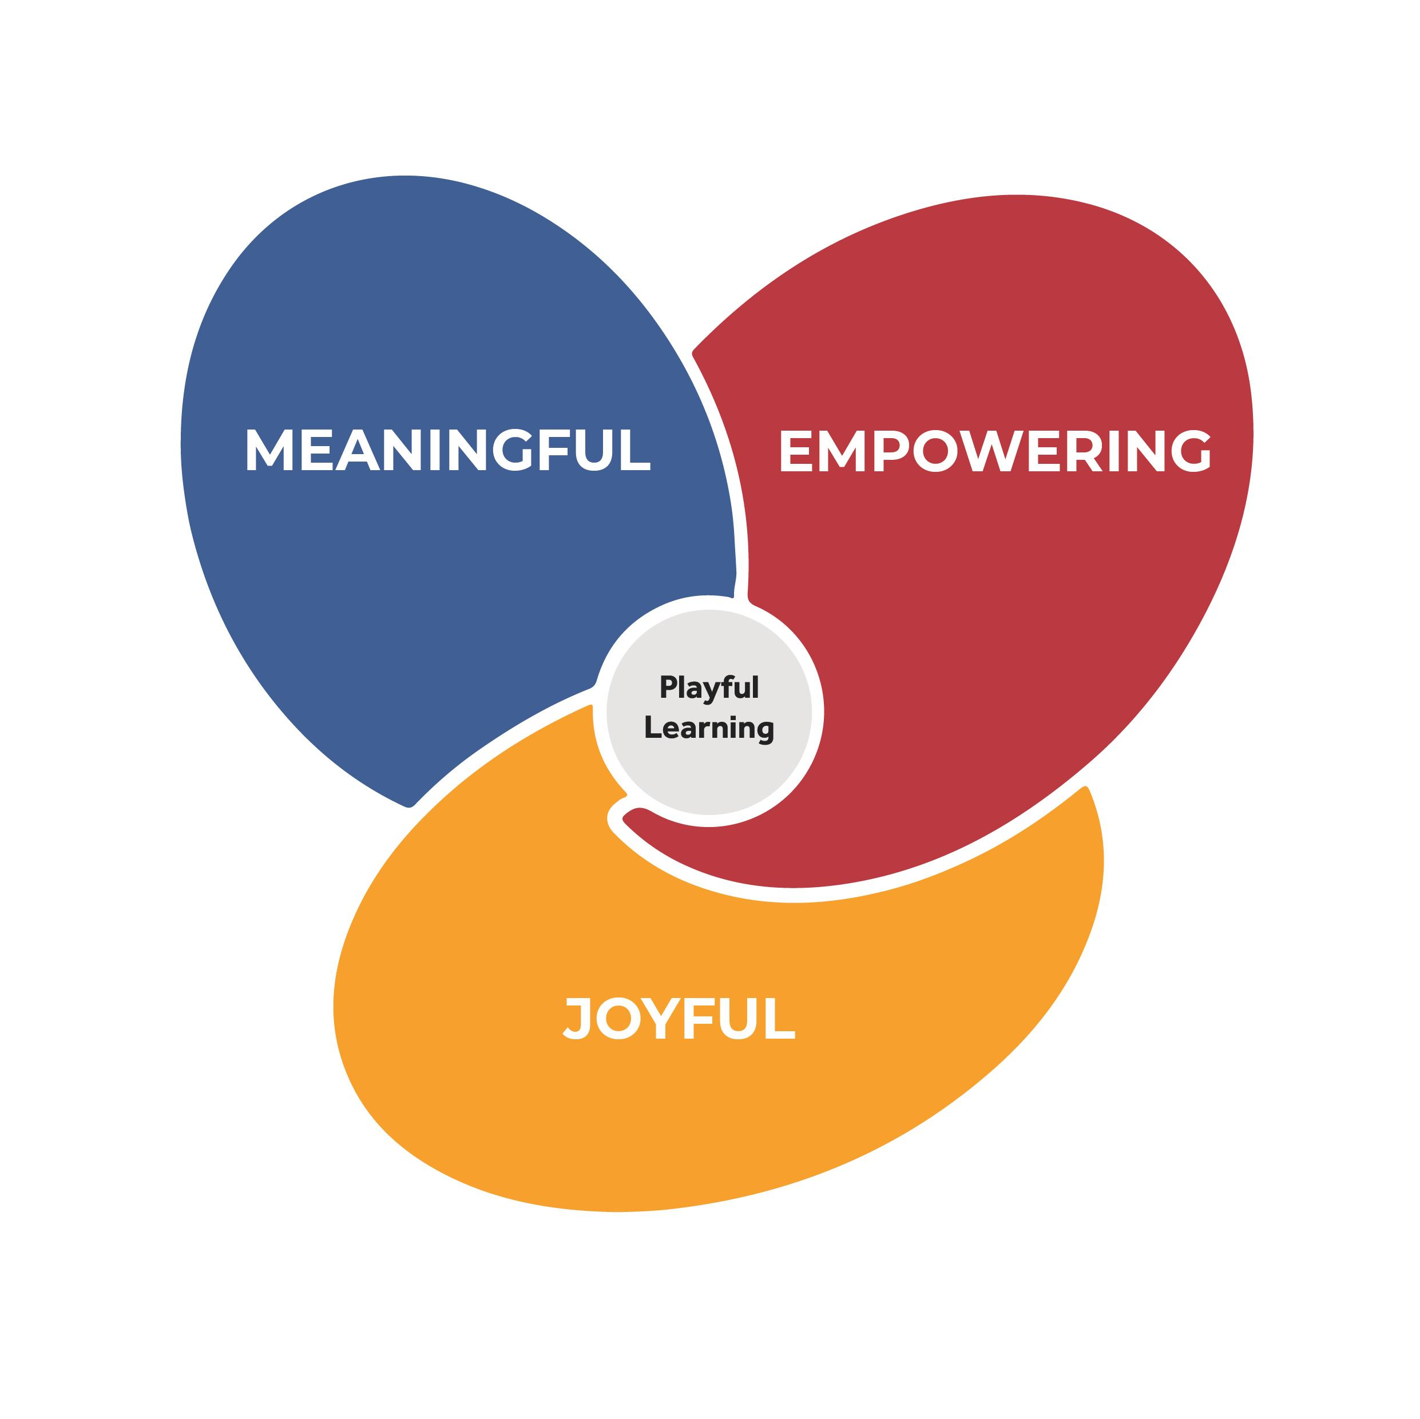
Indicators of Playful Learning from 6 U.S. Schools

Slide 20
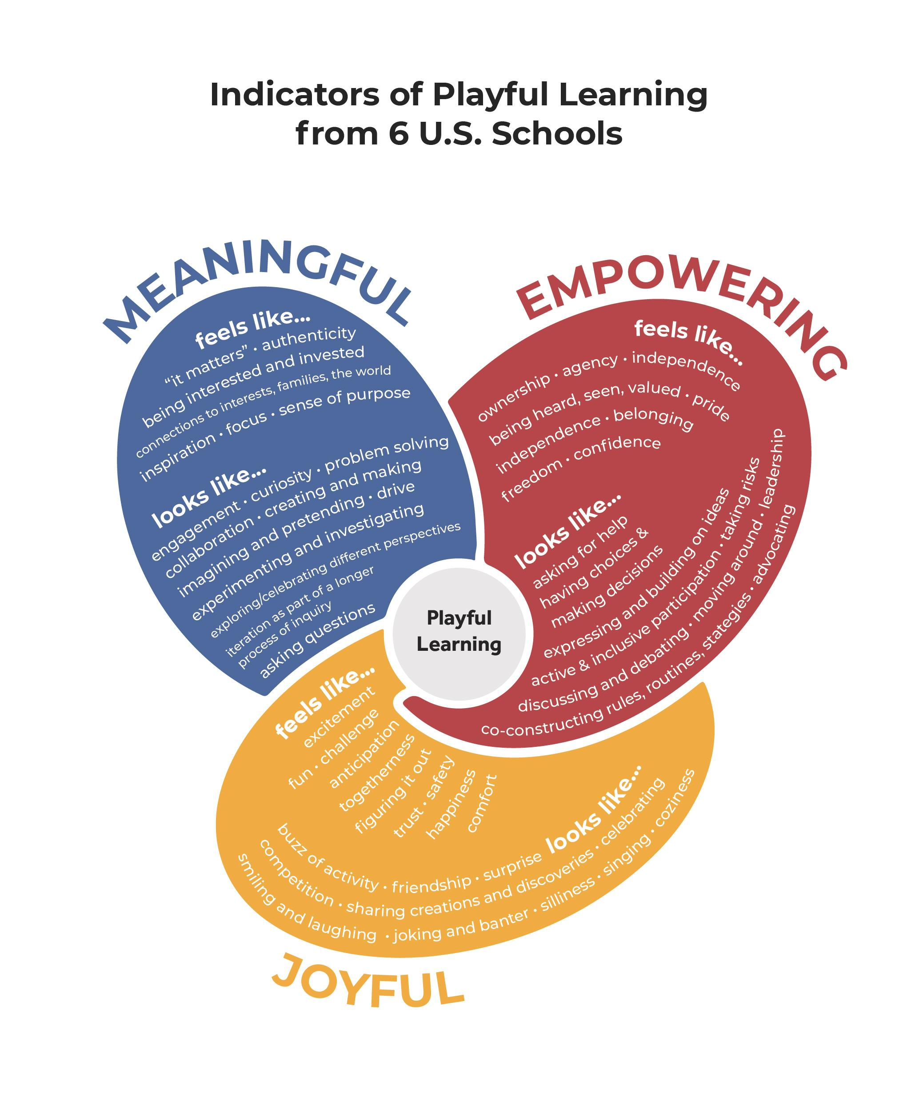
Indicators of Playful Learning from 6 U.S. Schools

Slide 21

Playful Learning Indicator Categories
Empowering
feels like...
Ownership
Agency
Being heard, seen, and valued
Independence
Belonging
Pride
Freedom
Confidence
looks like...
Having choices and making decisions
Leadership
Taking risks
Co-constructing rules, routines,
strategies
Active and inclusive participation
Expressing and building on ideas
Asking for help
Discussing and debating
Advocating
Moving around
Meaningful
feels like...
“It matters”
Being interested and invested
Connections to interests, families, the world
Authenticity
Inspiration
Focus
Sense of purpose
looks like...
Engagement
Curiosity
Collaboration
Drive
Creating and making
Imagining and pretending
Experimenting and investigating
Problem solving
Asking questions
Exploring and celebrating different perspectives
Iteration as part of a longer
process of inquiry
Joyful
feels like...
Excitement
Challenge
Anticipation
Togetherness
Figuring it out
Trust
Safety
Comfort
Happiness
Fun
looks like...
Buzz of activity
Friendship
Surprise
Coziness
Competition
Sharing creations and discoveries
Singing
Celebrating
Smiling and laughing
Joking and banter
Silliness

Slide 22
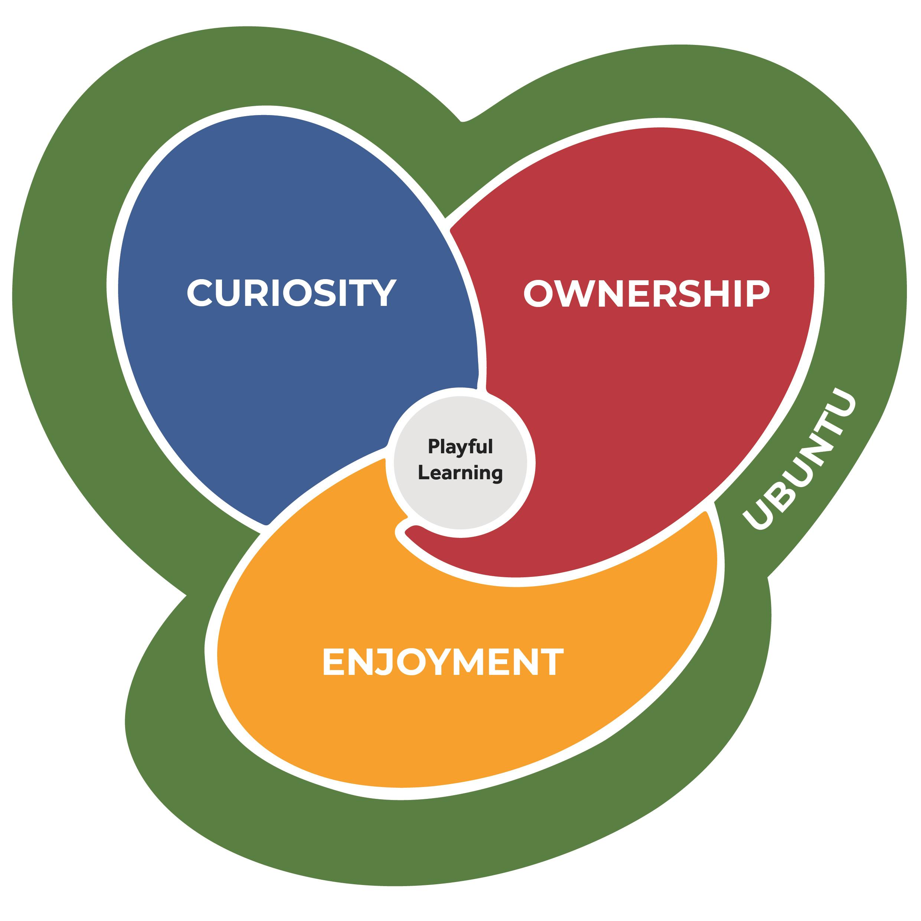
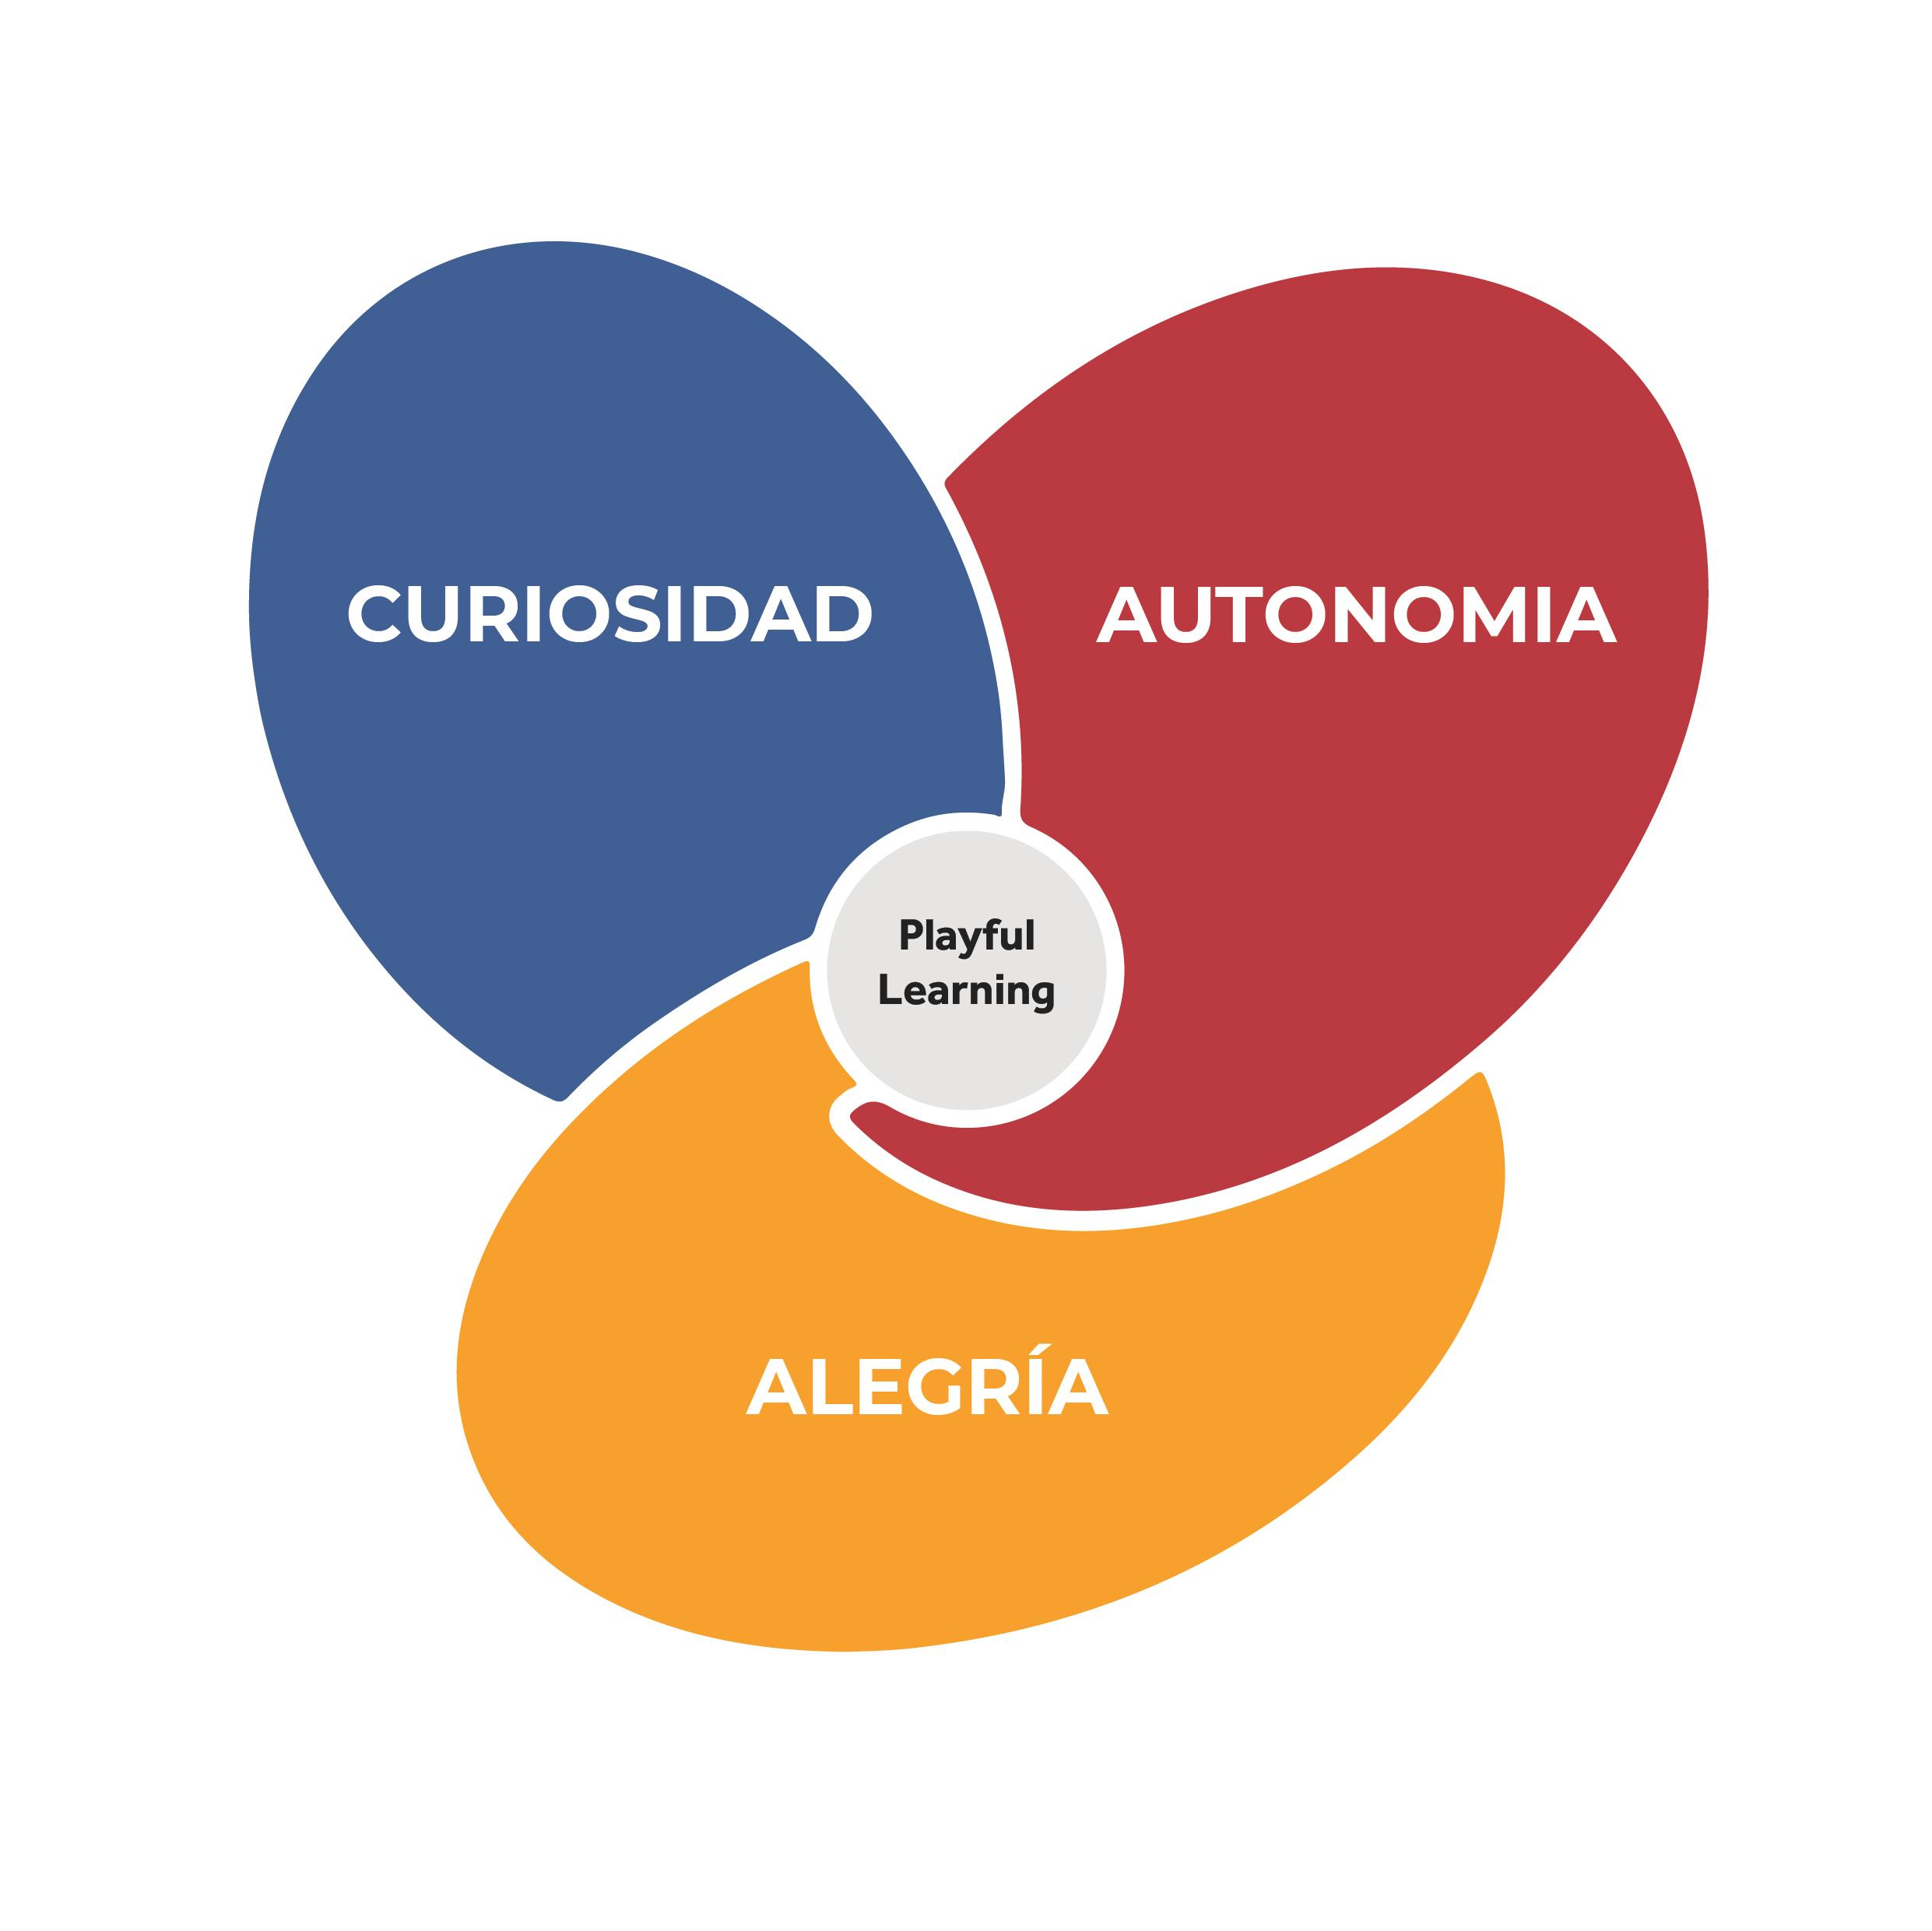
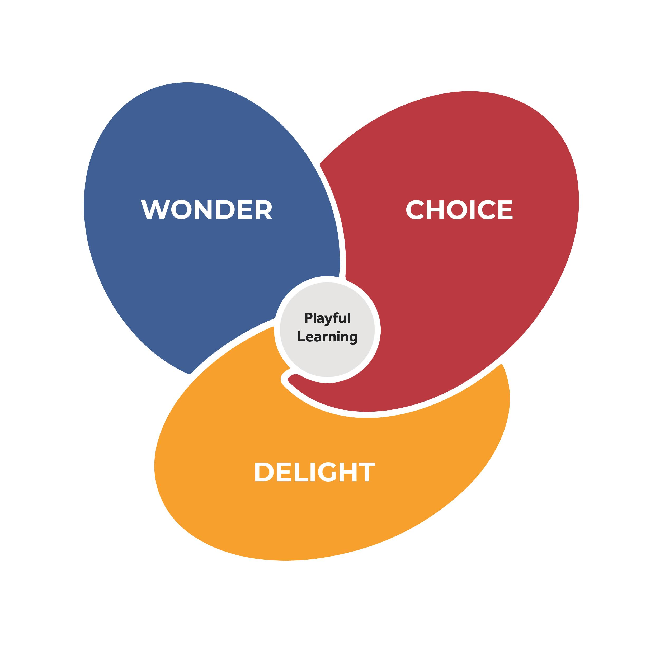
Indicators of Playful Learning
International School of Billund, Denmark
3 South African Schools
5 Colombian Schools

Slide 23

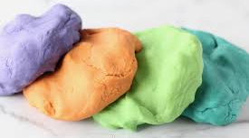
Indicators of Playful Learning
This is ongoing work – we will revisit across the year
“What does playful learning mean for our community?”
Developing our own Indicators of Playful Learning

Slide 24
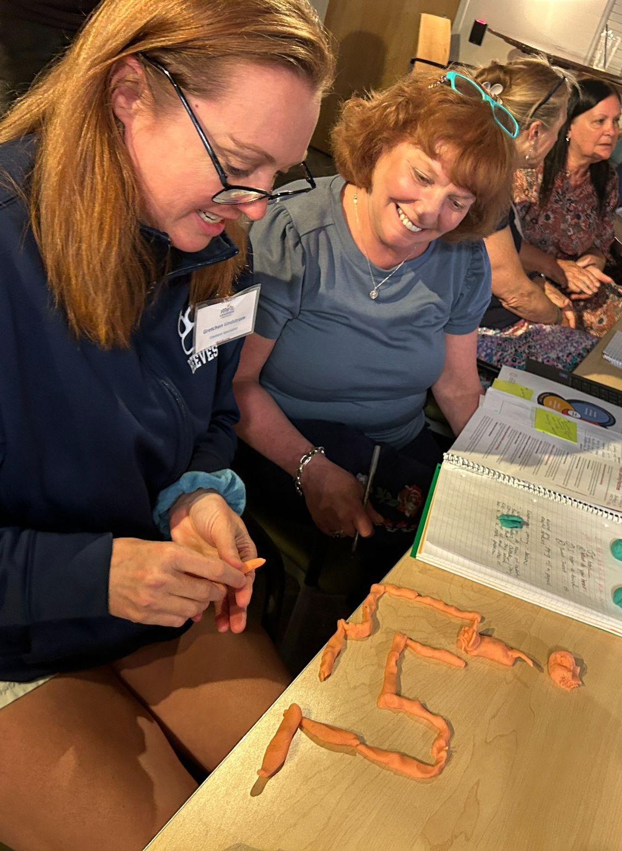
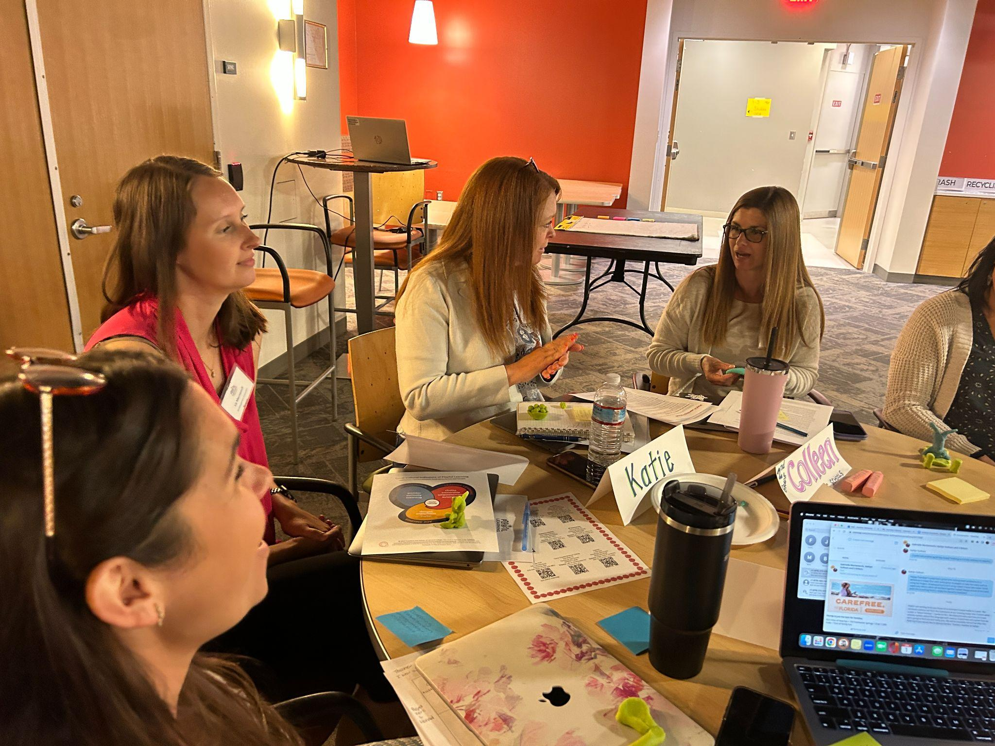
Images from PLI

Slide 25
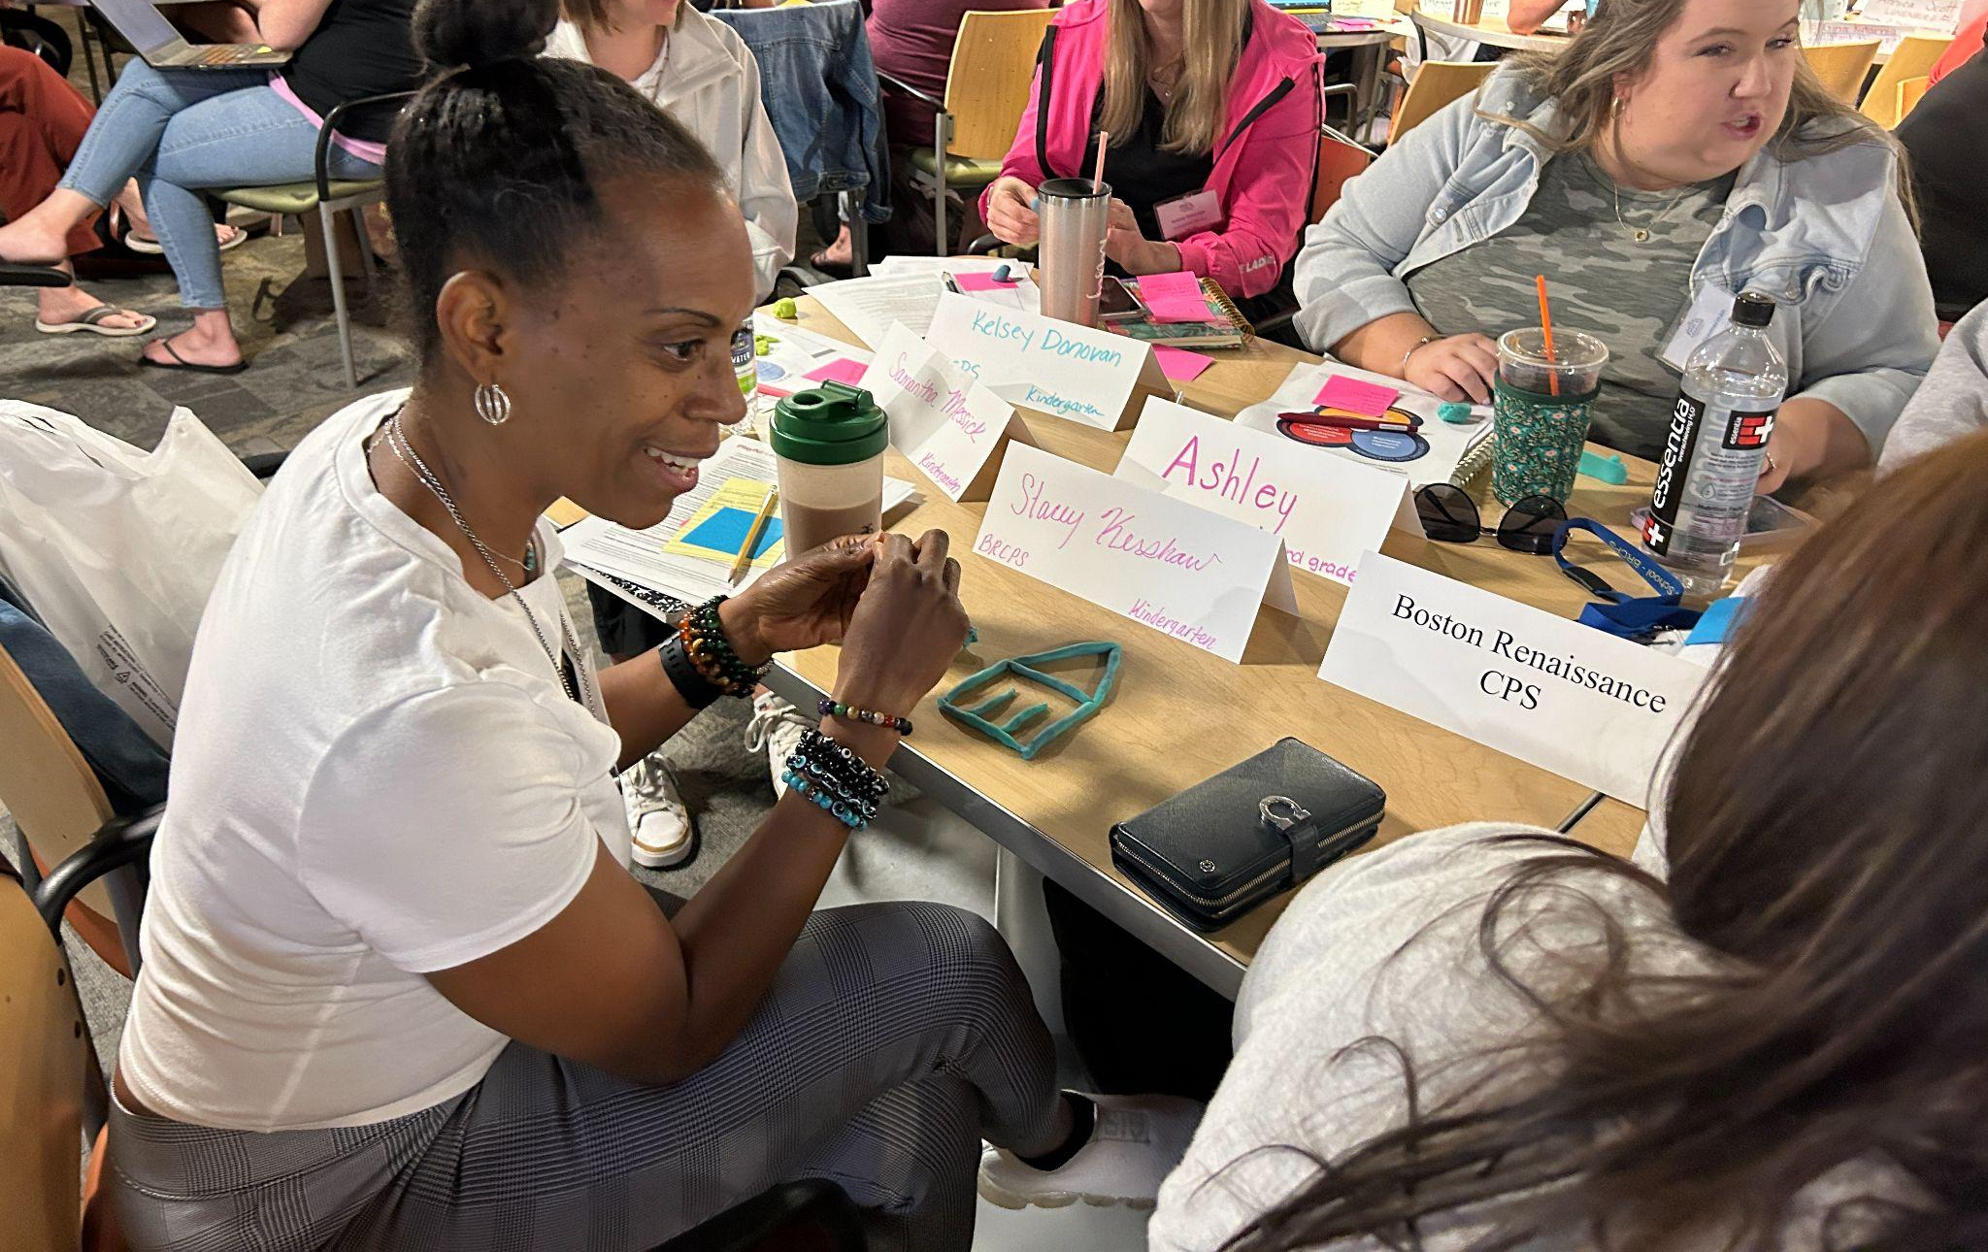
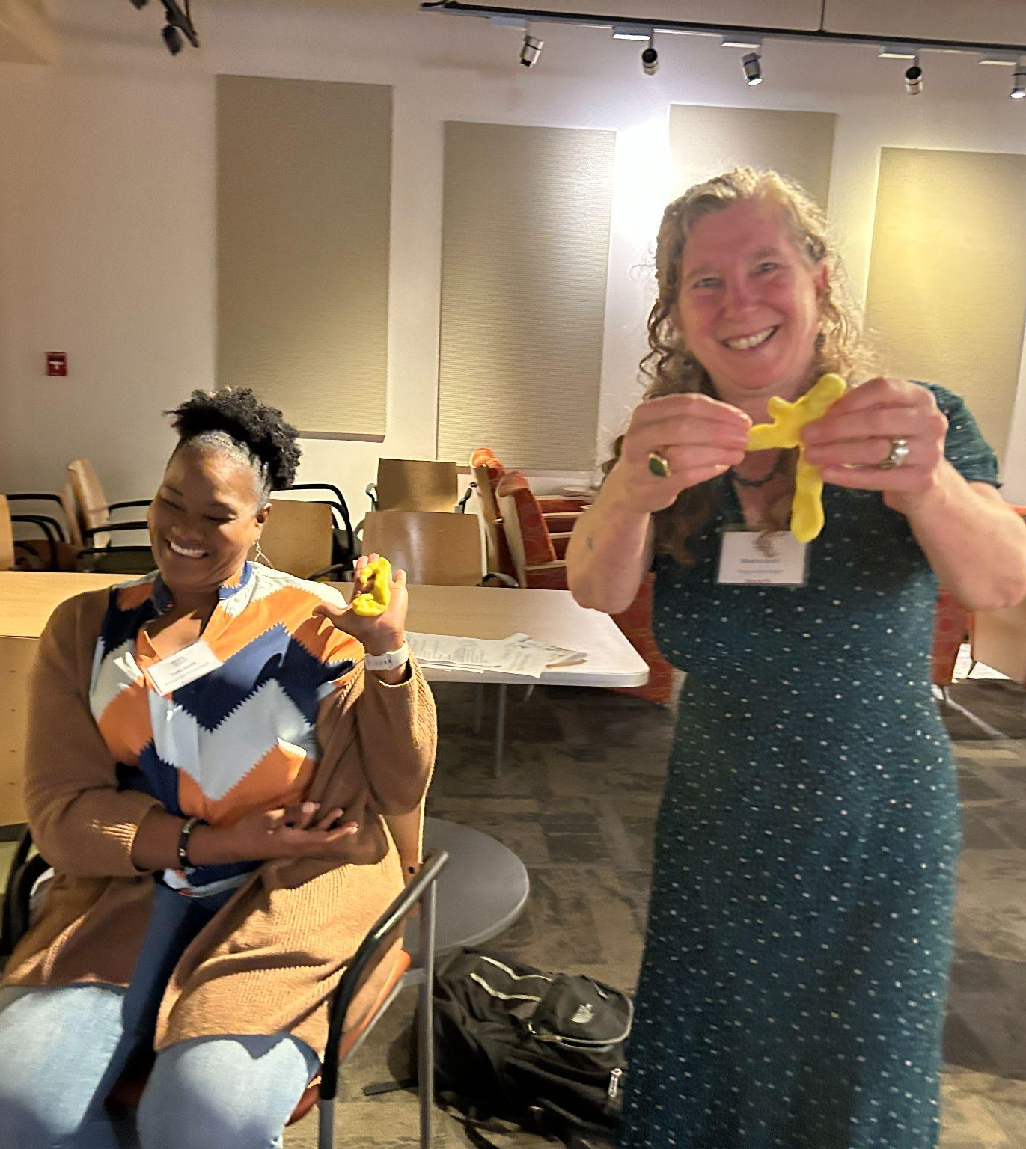
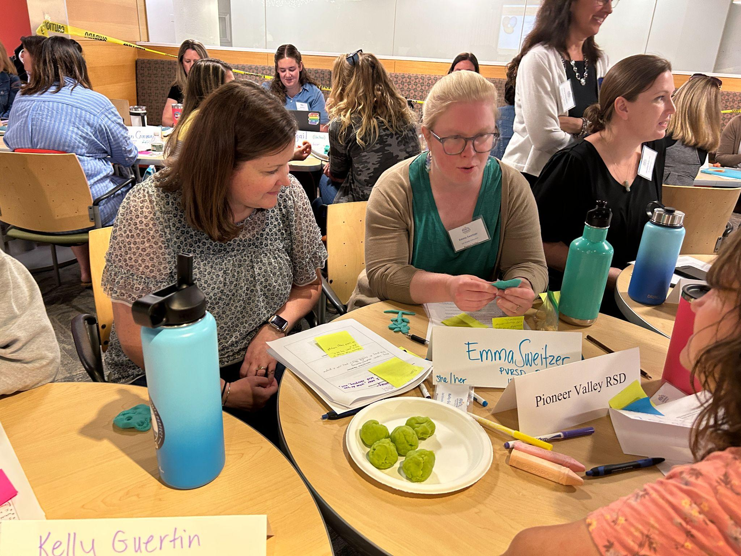
Images from PLI continued….

Slide 26
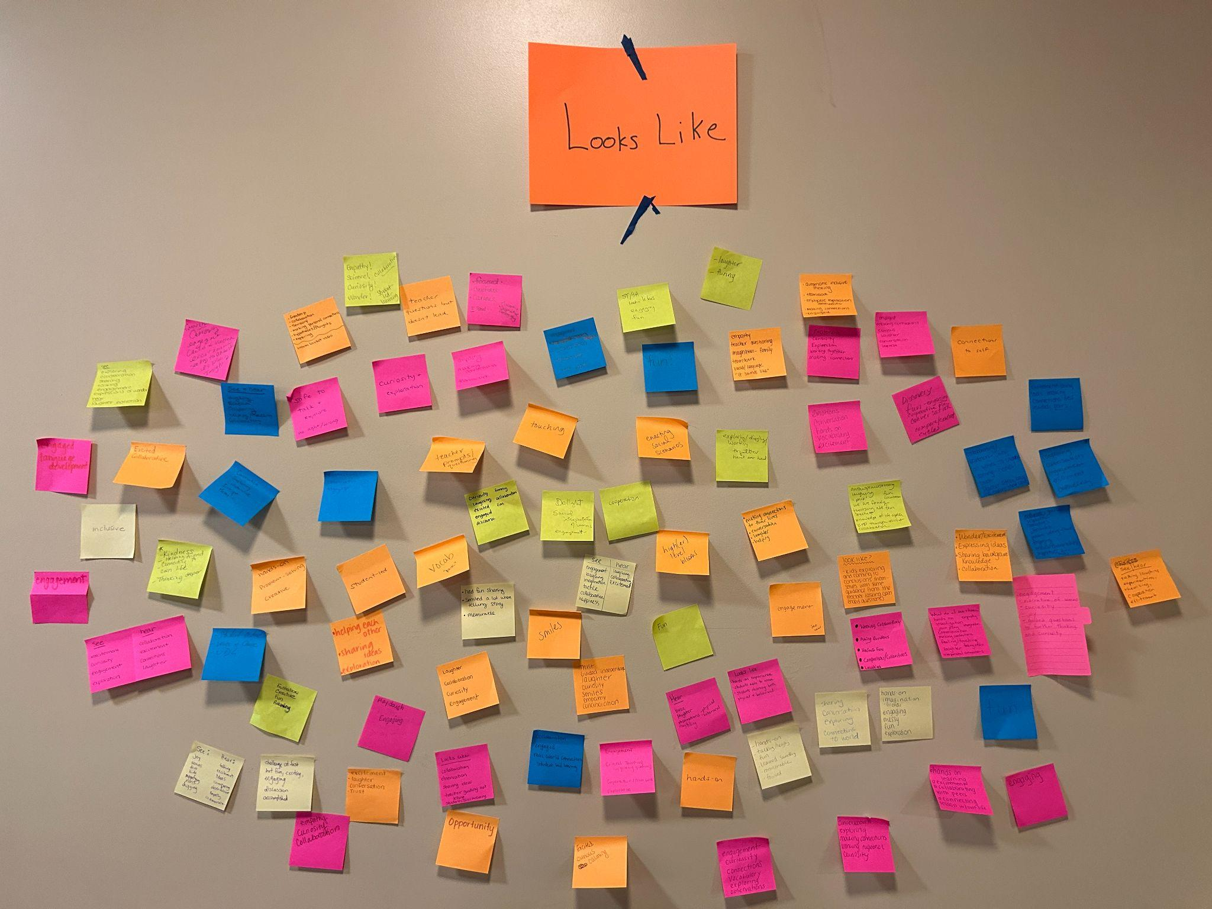
What does Playful Learning Look Like?

Slide 27
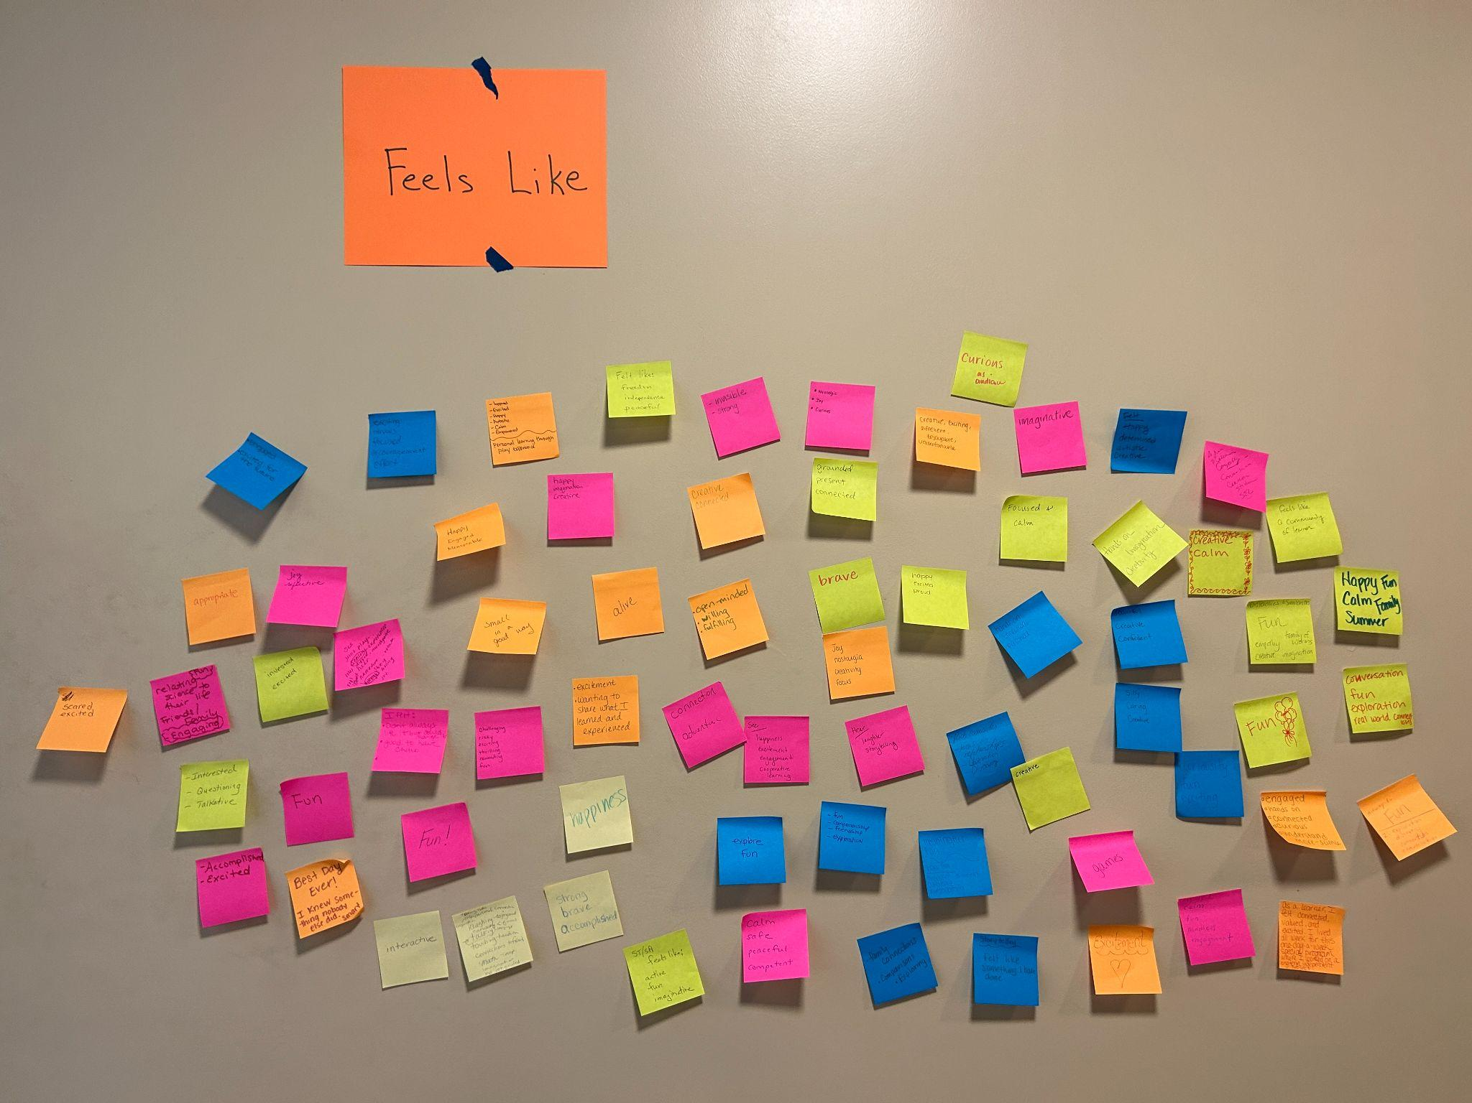
What does Playful Learning Feel Like?

Slide 28
PLI Playful Learning Indicators
Curiosity |  | Engagement |  | Enjoyment |  | Connection
Looks like | Feels like | Looks like | Feels like | Looks like | Feels like | Looks like | Feels like
conversation/ discussion | creativity | expressing ideas | empowerment | laughing/laughter | fun | cooperation/ collaboration | being supported
making hypotheses | discovery | collaboration | having voice | positive talk | memorable | empathy | being respected
exploration | intrigue | problem solving | having choice | enthusiasm | excitement | teamwork | inclusive
asking questions | insight | self-guided | independence | smiling | happiness | peers supporting peers | connection
touching materials | wonder | teacher sitting back | autonomy | storytelling | friendship | community focused | safety
imagining | challenge | child-directed | investment | calm | accomplishment | helping each other | trust
interest | frustration | talking | opportunity | buzz of activity | culturally sustaining | sharing materials/ideas | being valued
using all senses | interest | comparing | smart | focused attention | relaxing | kindness | connected
expressing wonder | meaningful | hands-on | inspired | silliness | delight | sharing background knowledge | being present
narration | adventure | moving around | brave | caring | fulfillment | inclusivity | compassion
messy |  | interactions | freedom | desire to share ideas | peaceful | making real life connections
critical thinking |  | taking risks | confidence |  | feeling alive
reflection |  |  | strong/powerful
 |  |  | pride
Circle anything that feels really important.
Write in anything that is missing.
Cross out anything that doesn’t work.
Move anything that belongs in a different category.

Slide 29
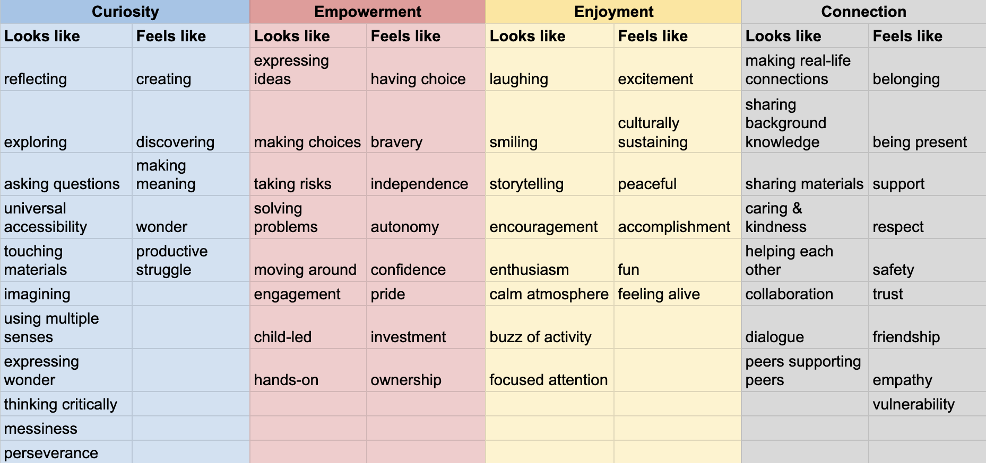
Current Version of our MA Playful Learning Indicators – April ‘24

Slide 30
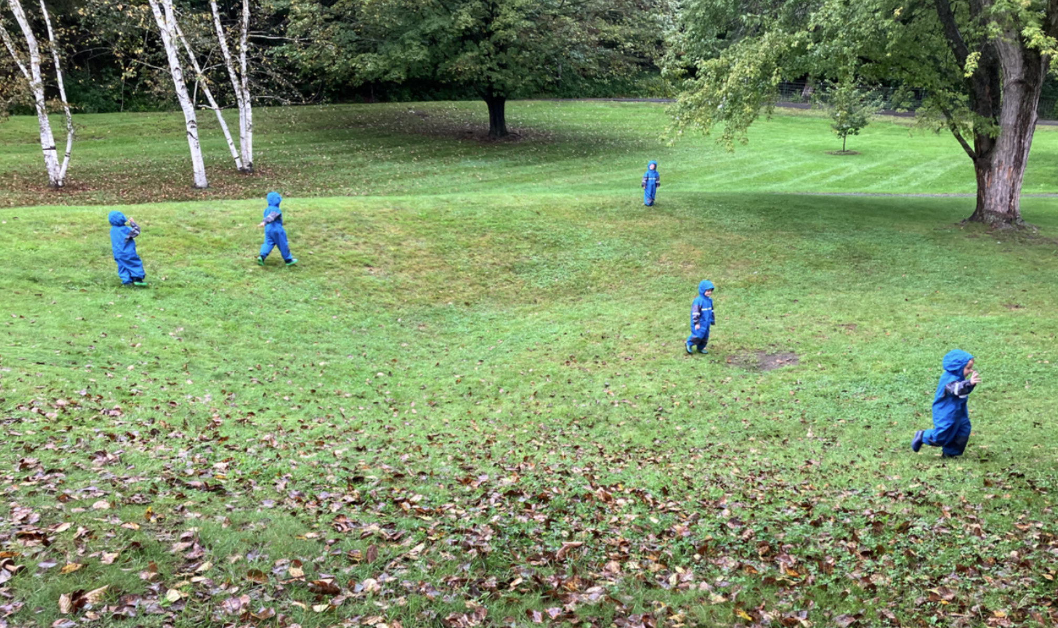
Pioneer Valley
Regional School District
Bernardston Elementary School &
Northfield Elementary School
Grades: prek-6

Slide 31
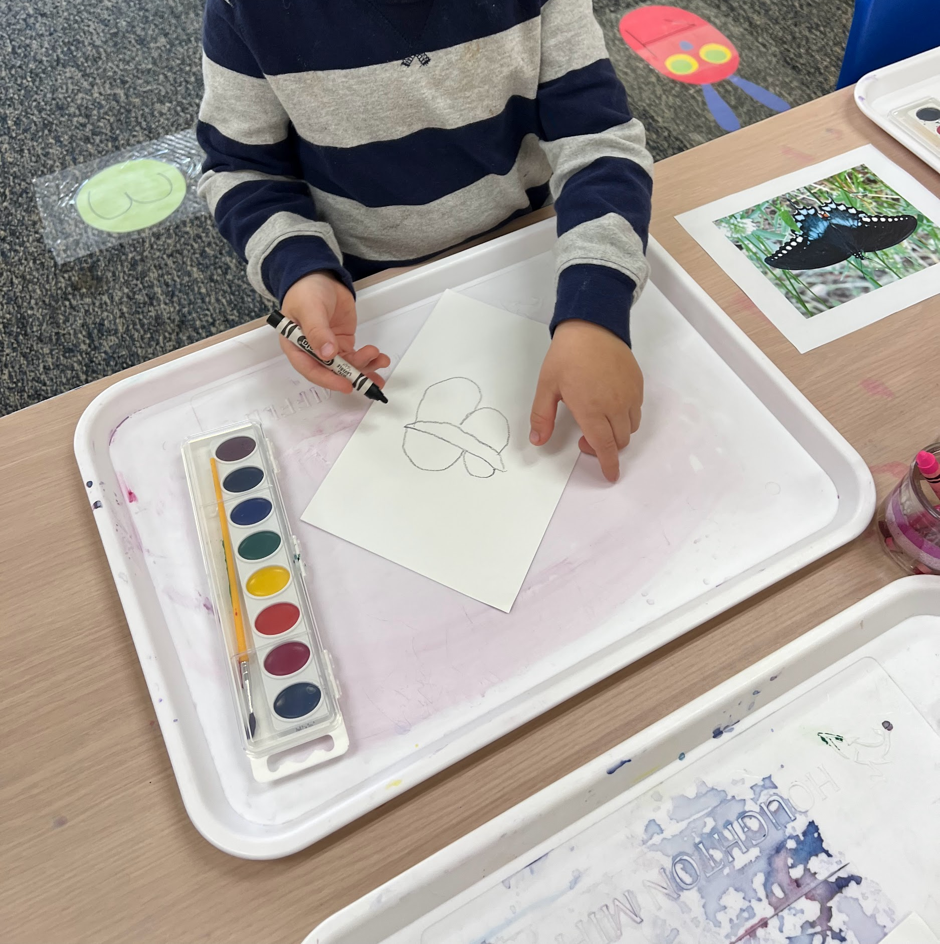
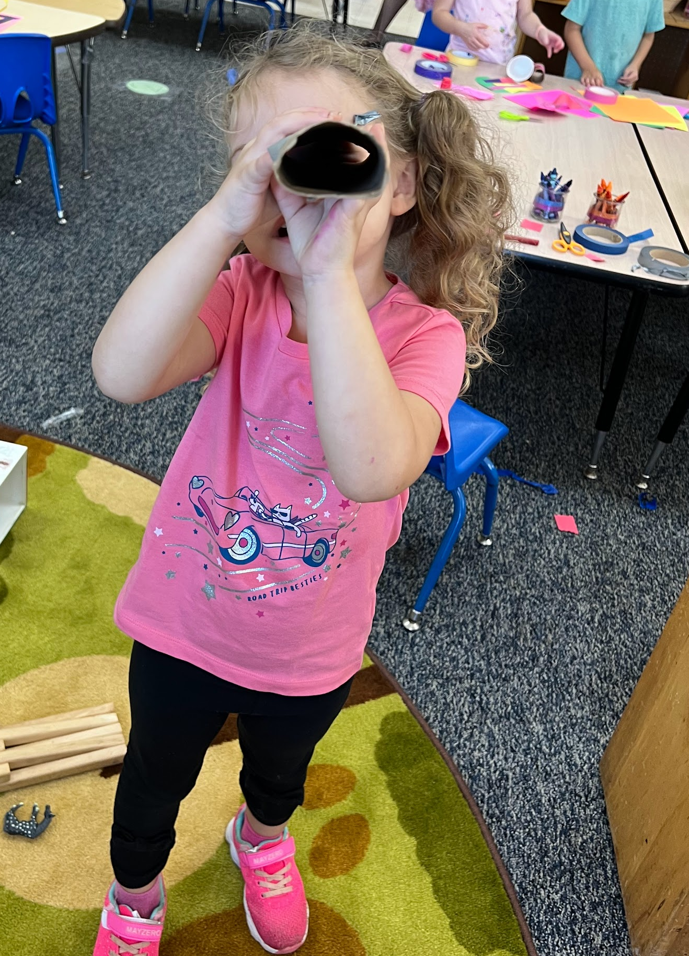
Instructional Strategies
Studios
Story Telling & Story Acting
Thinking and Feedback

Slide 32
Opportunities and Challenges
Opportunities & Successes
DESE support
Resources
Individual coaching
Teacher buy-in
Student learning outcomes
Alignment with ELA curriculum
Obstacles & Challenges
Foundational knowledge
Time and coordination
Competing district initiatives
Admin turnover

Slide 33
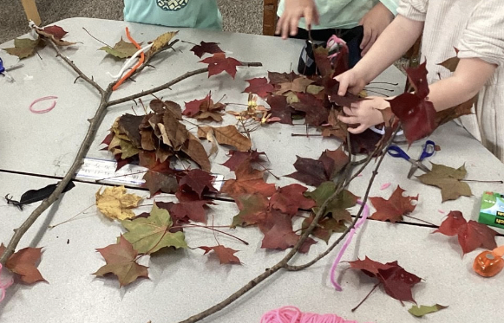
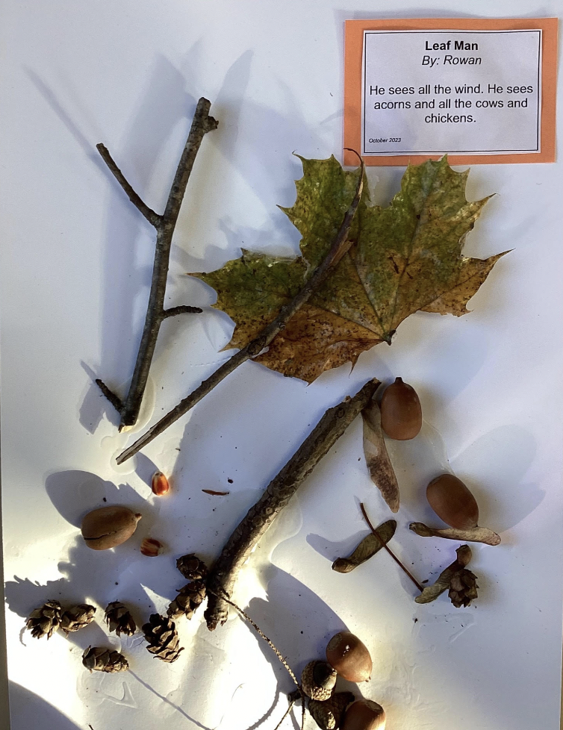
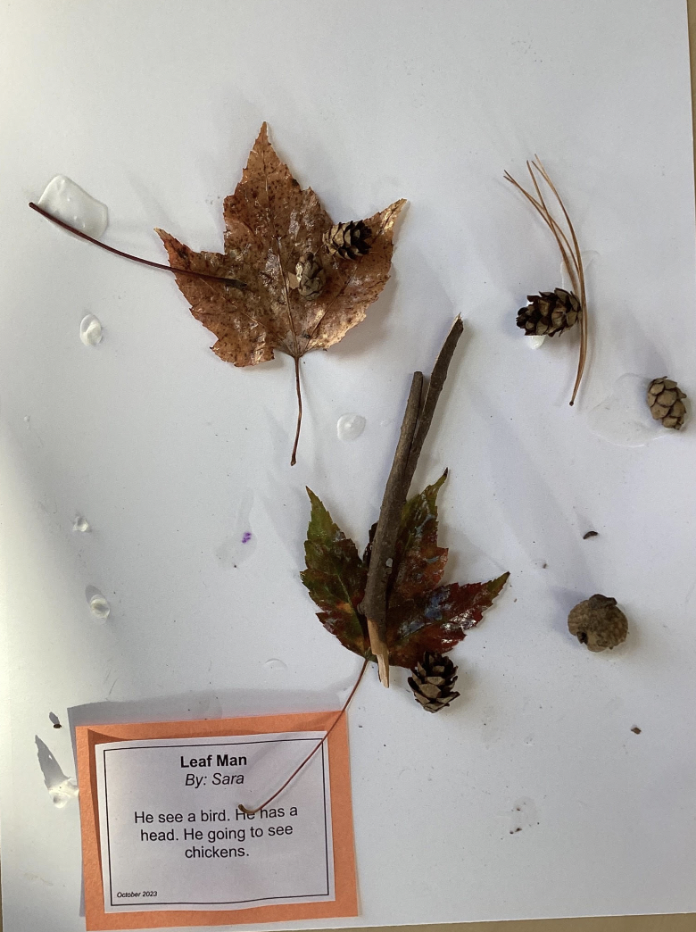
Next Steps:
With continued coaching, teachers will develop a stronger understanding of guided play, ultimately becoming more confident in their ability to embed instructional strategies and purposeful play throughout the curriculum.
Greenfield Open Studios Day update

Slide 34
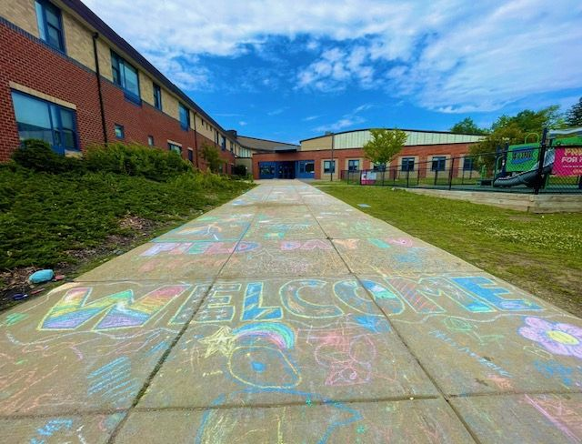
Woburn Public Schools PLI Partnership
Reeves Elementary School

Slide 35
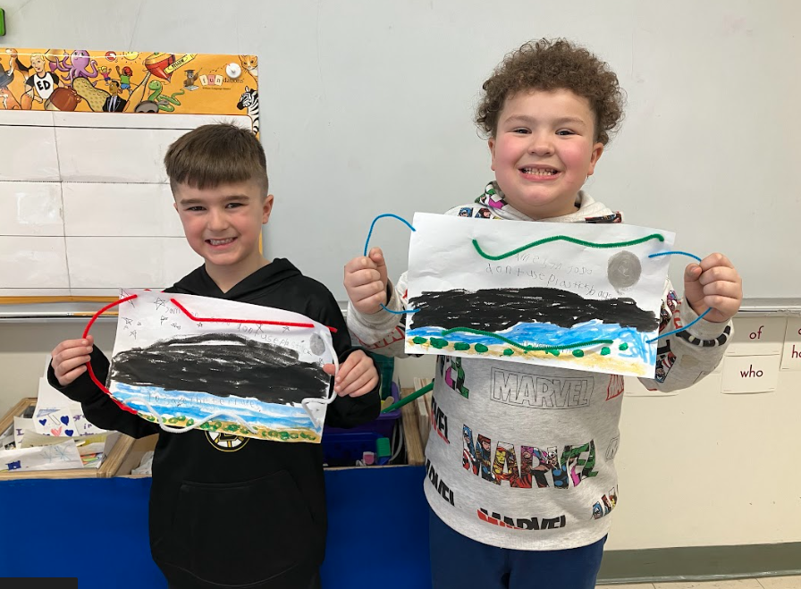
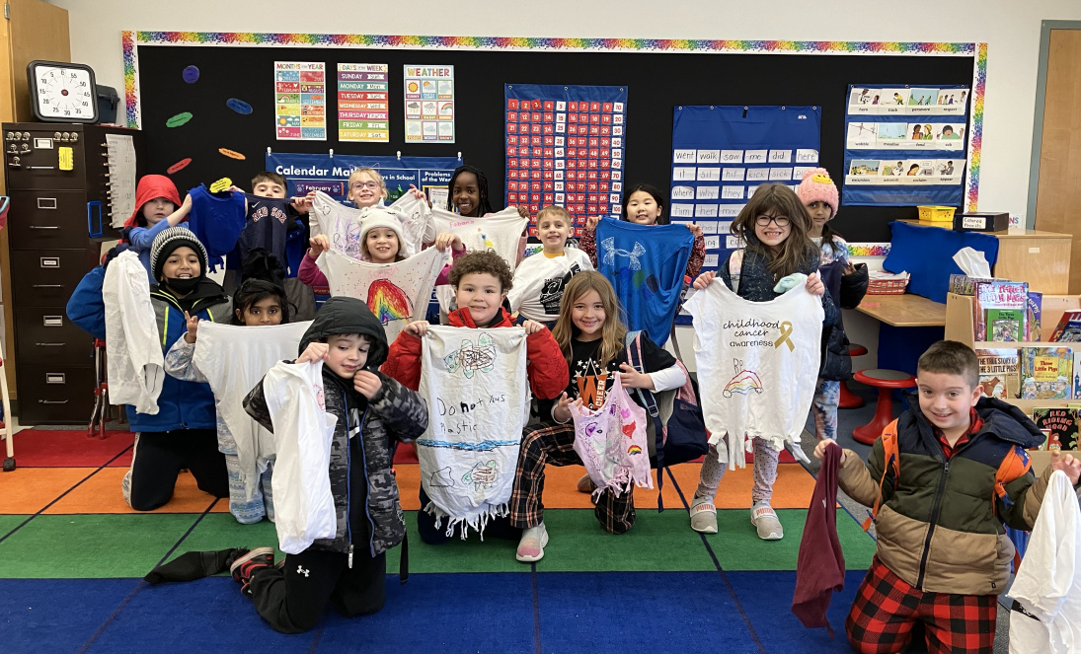
PreK-3 Participants Involvement
During 2023-2024
Grade Level | Objective and application of PLI during 2023-2024 School Year
Preschool | Implement complete Focus Curriculum units using PLI practices as outlined by BPS.
Kindergarten, 1st Grade, and 2nd Grade | Implement 2 Focus Curriculum units using PLI practices as outlined by BPS. Embed studios, storytelling and story acting, thinking and feedback and Community Meeting into lessons throughout the year.
3rd Grade | Implement PLI instructional practices into 3rd grade curriculum. Practices include storytelling and story acting, thinking and feedback, Community Meeting, and activities using PLI indicators.

Slide 36
Successes and Challenges
All answers below are statements and feedback from staff
Successes | Challenges
Brings classrooms together through motivation and excitement Community Meeting builds confidence and collaboration Students want to do Thinking and Feedback all the time Kindergarten science has been the best year ever Preschool vocabulary and cooperation has increased. Learning cooperative play has been very beneficial Using PLI indicators has children engaged in their learning and happy | Following Focus curriculum is difficult and especially on website, wanting to use studios with Woburn’s curriculum Would like designated time in the schedule for studios Pacing was difficult and unable to cover enough topics

Slide 37
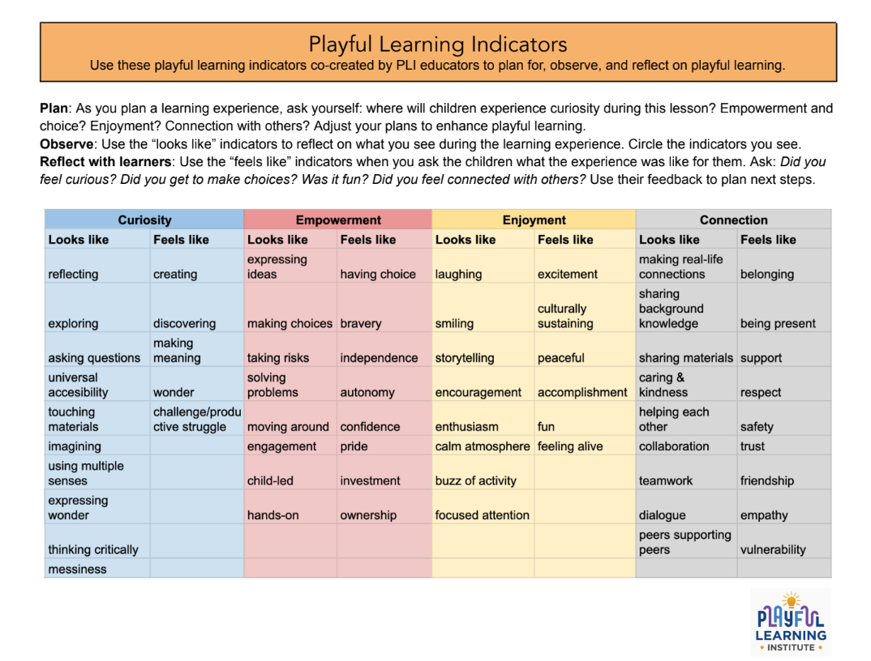
Ideal Next Steps

Slide 38
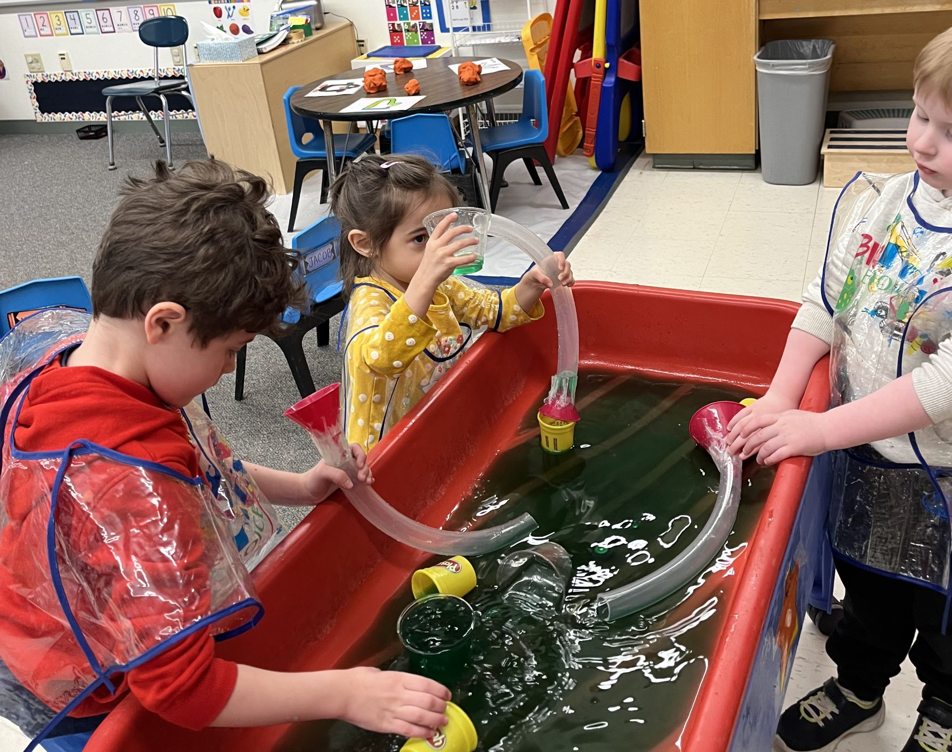
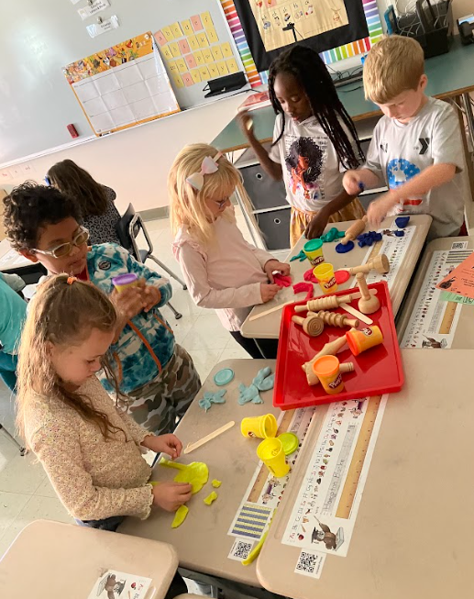
All PLI participants at The Reeves met and reflected on their experiences from this year and what they would like as a next step. The team agreed that the positives from this year’s experience warranted continuation for next school year. As described on the previous slide, following the Focus Curriculum had its challenges in all subject areas except for Science.
The Reeves is excited to implement the PLI indicators and practices into Woburn’s existing curriculum for next school year. Some grade levels wish to continue the science curriculum as well. We are hoping for a continuation grant and to continue to work in collaboration with DESE and our current coach Megina as we enter the 2024-2025 school year!

Slide 39
Discussion/Questions and Answers

Slide 40
Resources

Slide 41
Playful Learning Resources
DESE’s Educational Vision
Playful Learning Institute, Preschool through 3rd Grade – Student and Family Support (SFS) (mass.edu)
Boston Public School's Playful Learning Practices Overview:
Curriculum Overview
Read Alouds and Text Talks
Center and Studios
Thinking and Feedback
Writing
Storytelling and Story Acting
Community Meeting
Additional Resources¹:
Research brief on playful learning
A Pedagogy of Play: Supporting Playful Learning in Classrooms and Schools

Slide 42
Contact Information
Kelly Meehan-Rooney, Early Learning Specialist
  Kelly.Meehan-Rooney@mass.gov; 781-338-6334
Donna Traynham, Early Learning Team Lead
  Donna.j.Traynham@mass.gov; 781-338-6372
Megina Baker, Boston Public Schools
  mbaker3@bostonpublicschools.org
Matt Comenitz, Woburn Public Schools
  mcomenitz@woburnps.com
Maren Law
  lawm@pvrsdk12.org

Slide 43

Thank you!

