Slide 1
Rising Numbers, Unmet Needs:
Immigrant Newcomers in
Massachusetts High Schools
A research partnership between DESE and the
Annenberg Institute at Brown University
May 13, 2024

Slide 2
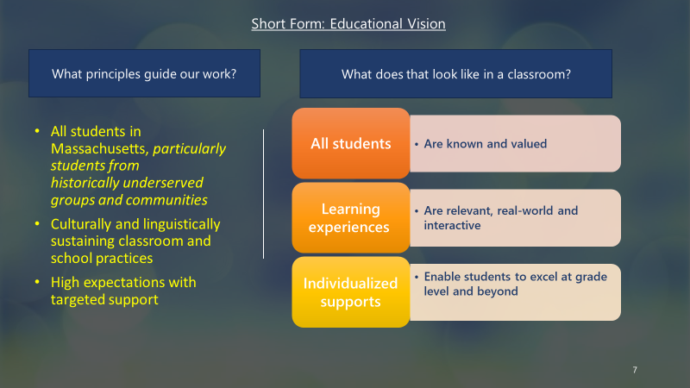
Short Form: Educational Vision

Slide 3
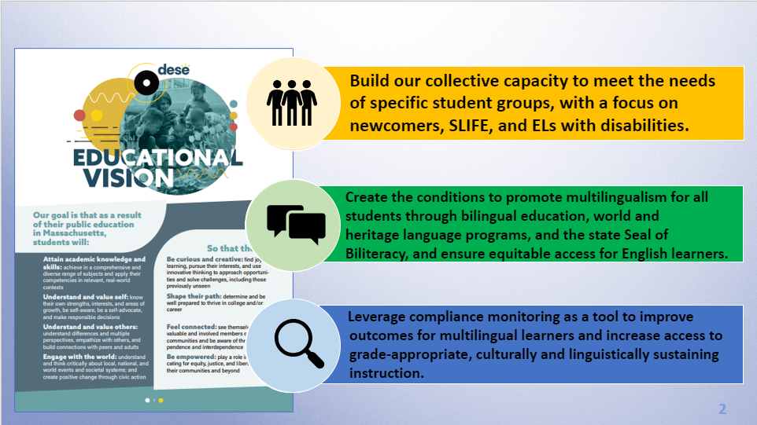
OLA partners with districts, schools, & programs to…

Slide 4

Enlace

Slide 5
Why this research? Why now?

Slide 6
English Learner Enrollment
SY22-23 saw a significant increase in EL enrollment, despite a decrease in overall enrollment. There are 110,554 ELs, which is 12.1% of total enrollment.
12.1%
2023

Slide 7
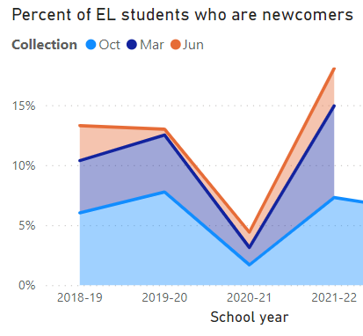
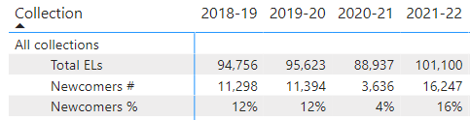






Increasing numbers of newcomers enrolling
A large drop in newcomers in 2021 was followed by a surge in 2022.
While most newcomers still enroll in Urban Gateway Cities and Boston, we are seeing increasing numbers arriving in smaller, non-urban districts.

Slide 8
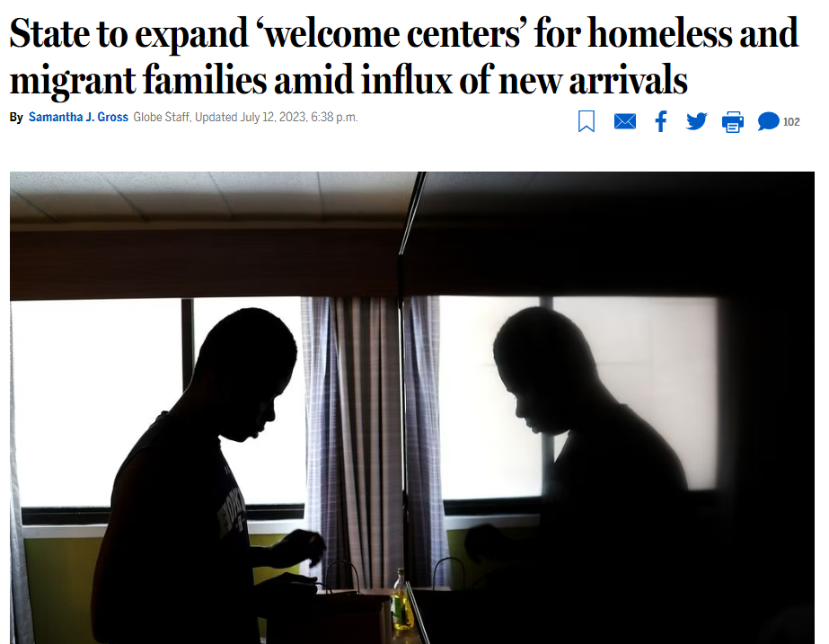
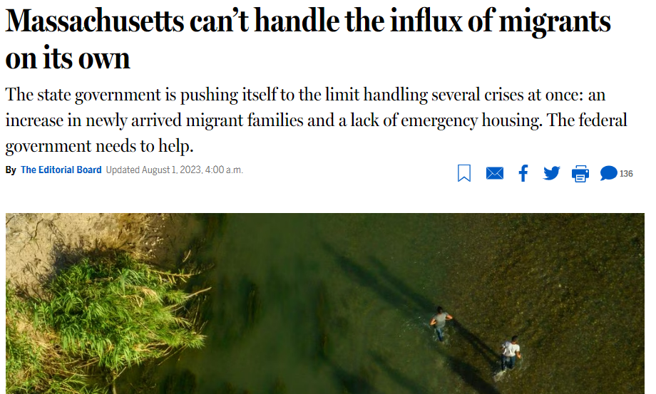
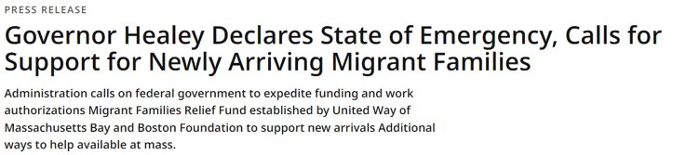
Summer 2023 headlines
August 8, 2023

Slide 9
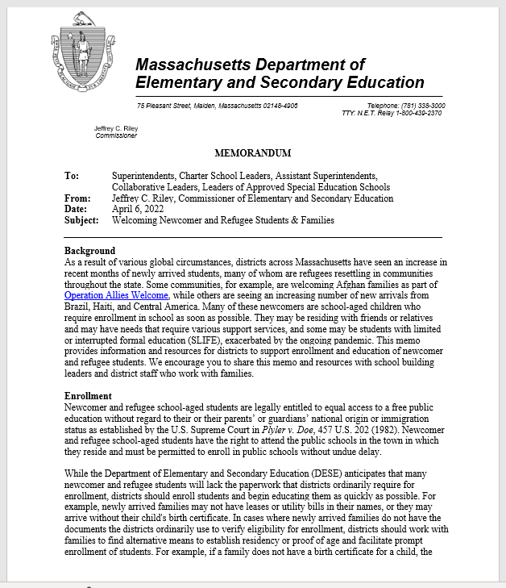
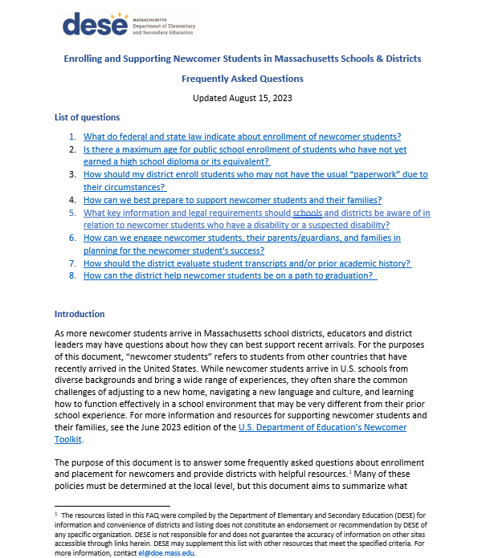
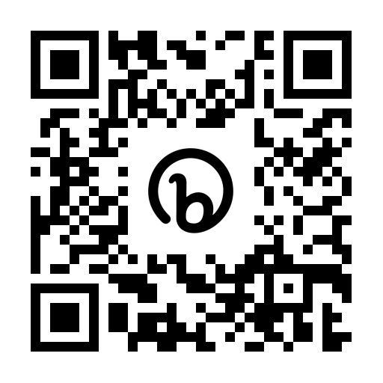
Newcomer Guidance
https://www.doe.mass.edu/ele/resources/immigrant-refugee.html
“A Memo from the Commissioner: Welcoming Newcomer and Refugee Students and Families” (4/6/22)
“Enrolling and Supporting Newcomer Students in Massachusetts Schools & Districts FAQ” (8/15/23)
Find both on DESE OLA’s page called “Resources for Supporting Immigrant & Refugee Students”

Slide 10
DESE Supports
Technical Assistance & Targeted Supports for EA Shelter Districts
SLIFE Community of Practice
Newcomer Webinar Series, Guidance, & Resources

Slide 11
Defining Newcomers
  English learners (ELs) in their first 12 months of schooling in the U.S. who entered a Massachusetts public school in the 2007-08 school year (hereafter, 2008) or later
  This report:
    Newcomers entering grades 9-12
    Newcomers 18 years of age or younger on September 1 of their entry year
The research reported here was supported by the Institute of Education Sciences, U.S. Department of Education, through Grant R305H190035 to Brown University. The opinions expressed are those of the authors and do not represent views of the Institute or the U.S. Department of Education.

Slide 12
…
  “One of the questions we ask them on the Needs Assessment Form is ‘Why do you want to go to school?’ Most of them say, ‘I want to learn English. I want to participate in sports. I want to go to college. I have never been able to go to school. I am really excited.’ They believe they are going to school to learn English.”
  “[Our staff] want to make them feel welcome, because they usually come very afraid, and scared, and lost, and confused. The first thing is ‘You’re welcome here, you’re not alone.’ We want to explain how school works here. It’s very different from other countries. The calendar is different, uniform, lunches, transportation -- everything is different. For them it’s like a whole new world.”
  Ivette Martinez
  Welcome Center Director
  Lynn Public Schools Im

Slide 13
We Highlight Six Key Findings
Over the past 15 years, the number of newcomers has nearly tripled and the population has changed dramatically.
More districts are serving newcomers, but newcomers are concentrated in relatively few schools.
The profiles of newcomers differ dramatically across districts.
Most newcomers are not meeting growth targets for English language proficiency.
The Commonwealth’s competency determination (CD) policy disproportionately affects newcomers.
High-school completion and college enrollment rates for newcomers are relatively low.

Slide 14
Newcomer Demographics

Slide 15
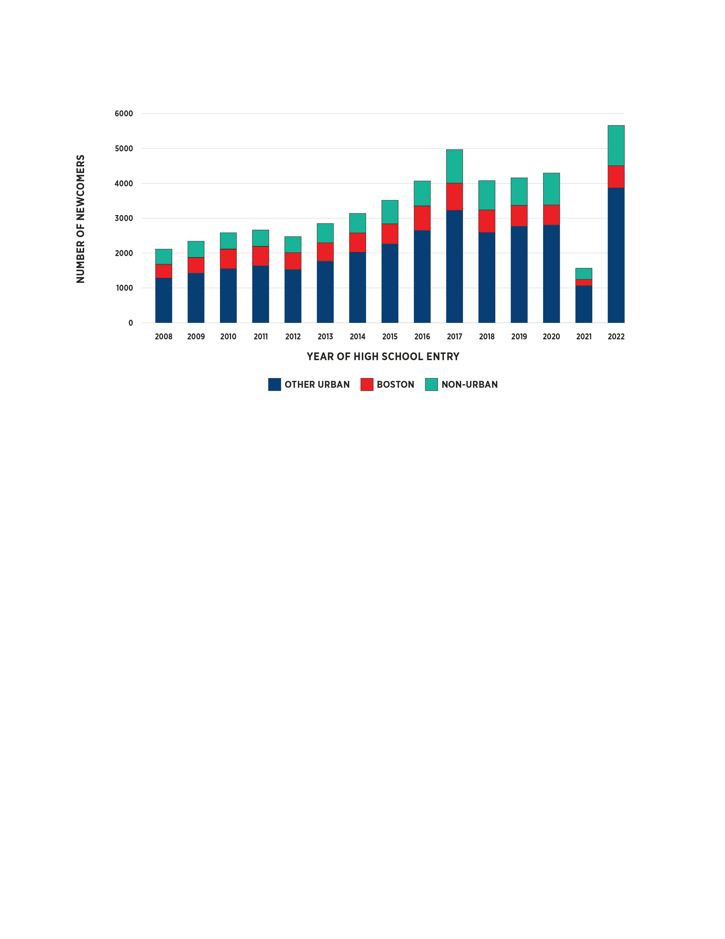
Over the past 15 years, the number of newcomers has nearly tripled.
Just over 13% were enrolled in the Boston Public Schools in 2023, compared to 20% in 2008.
Given the rise in migrant families entering the Commonwealth during the summer of 2023, patterns of newcomer enrollment are likely to remain dynamic for some time.
Total Number of Newcomers, Overall and by District Type of First High School Enrollment, 2008 to 2022

Slide 16
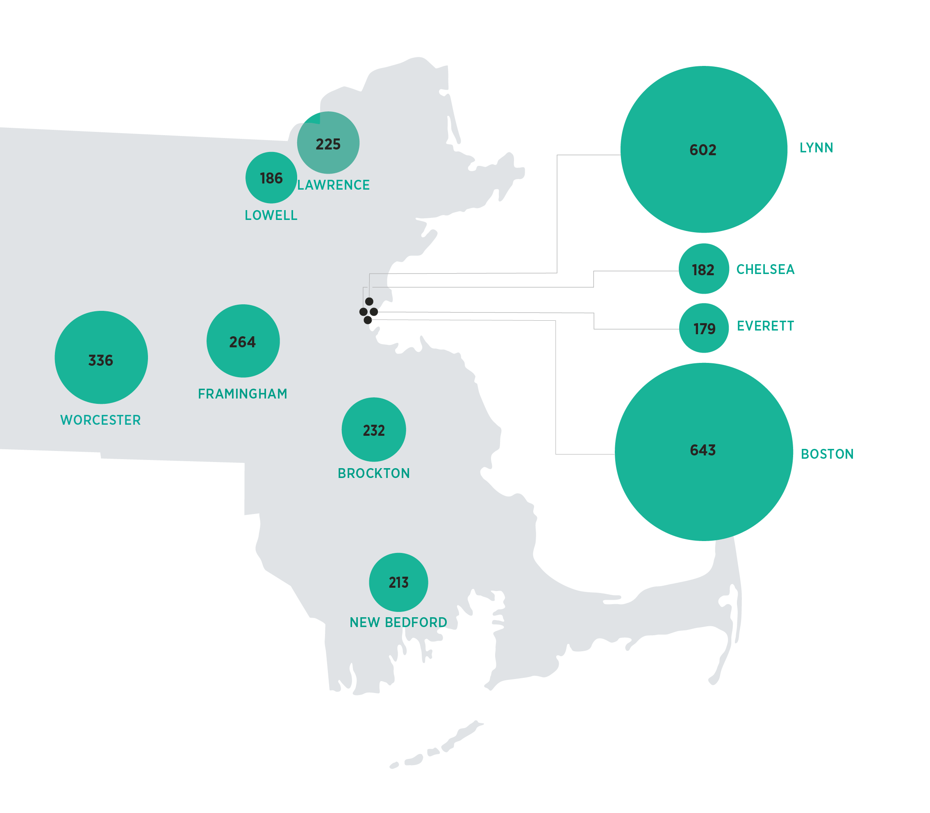
Newcomers are clustered in many large urban districts, but more districts are serving newcomers than ever before.
Most urban districts have seen very large increases since 2008 in the number of newcomers arriving each year.
Half of 2023 newcomers attended one of 16 high schools.
103 districts served at least 5 newcomers in 2023, compared to 59 in 2008.
Map of Select Urban Districts in Massachusetts with the Most Newcomers Entering in 2022.

Slide 17
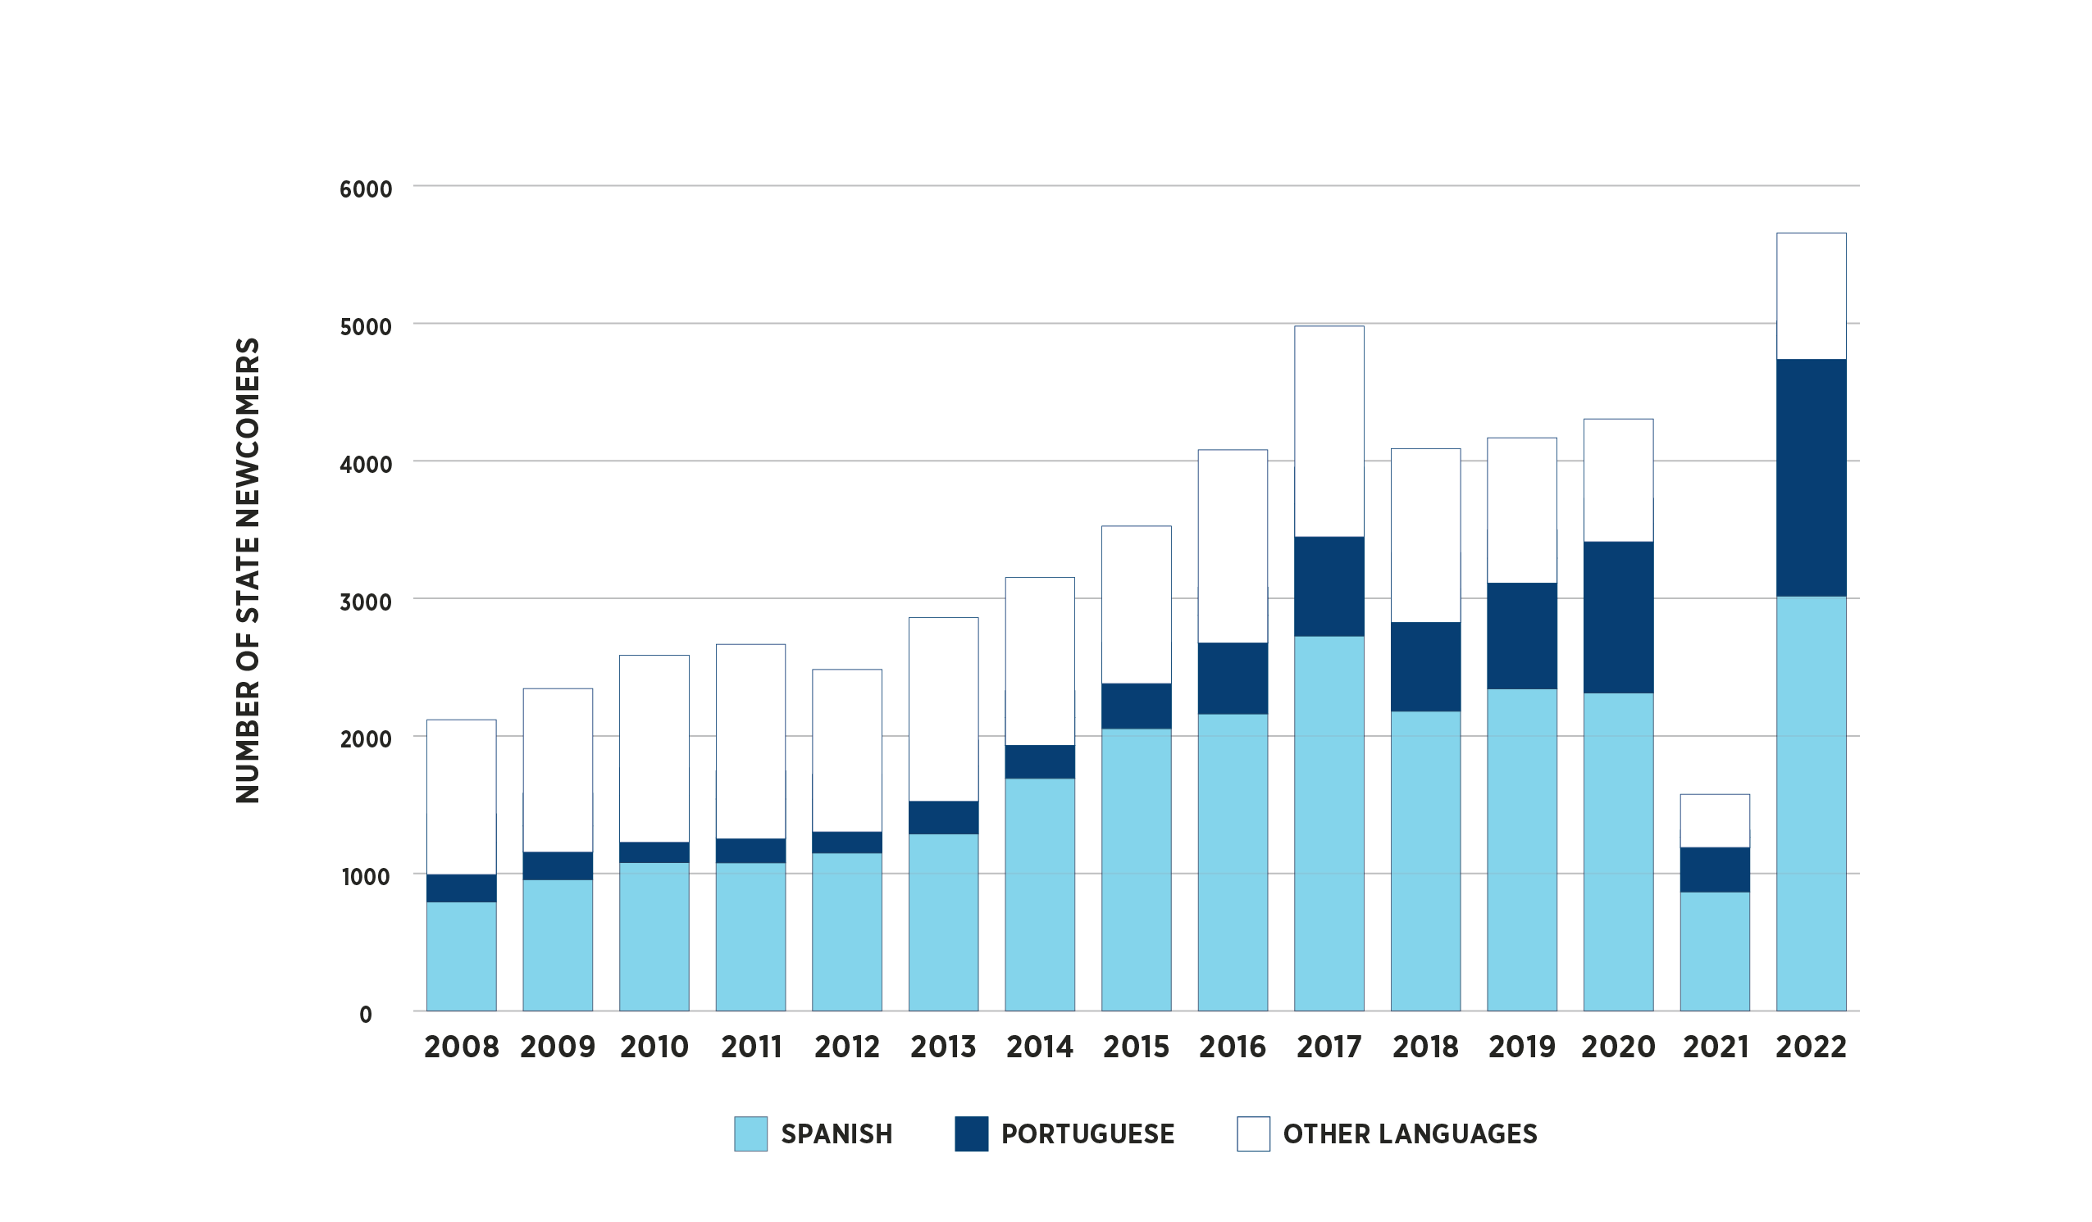
First language and initial English proficiency of newcomers have changed dramatically.
84% of newcomers in 2022 spoke Spanish or Portuguese, compared to 42% in 2008.
First Languages of Newcomers Over Time, 2008 to 2022

Slide 18
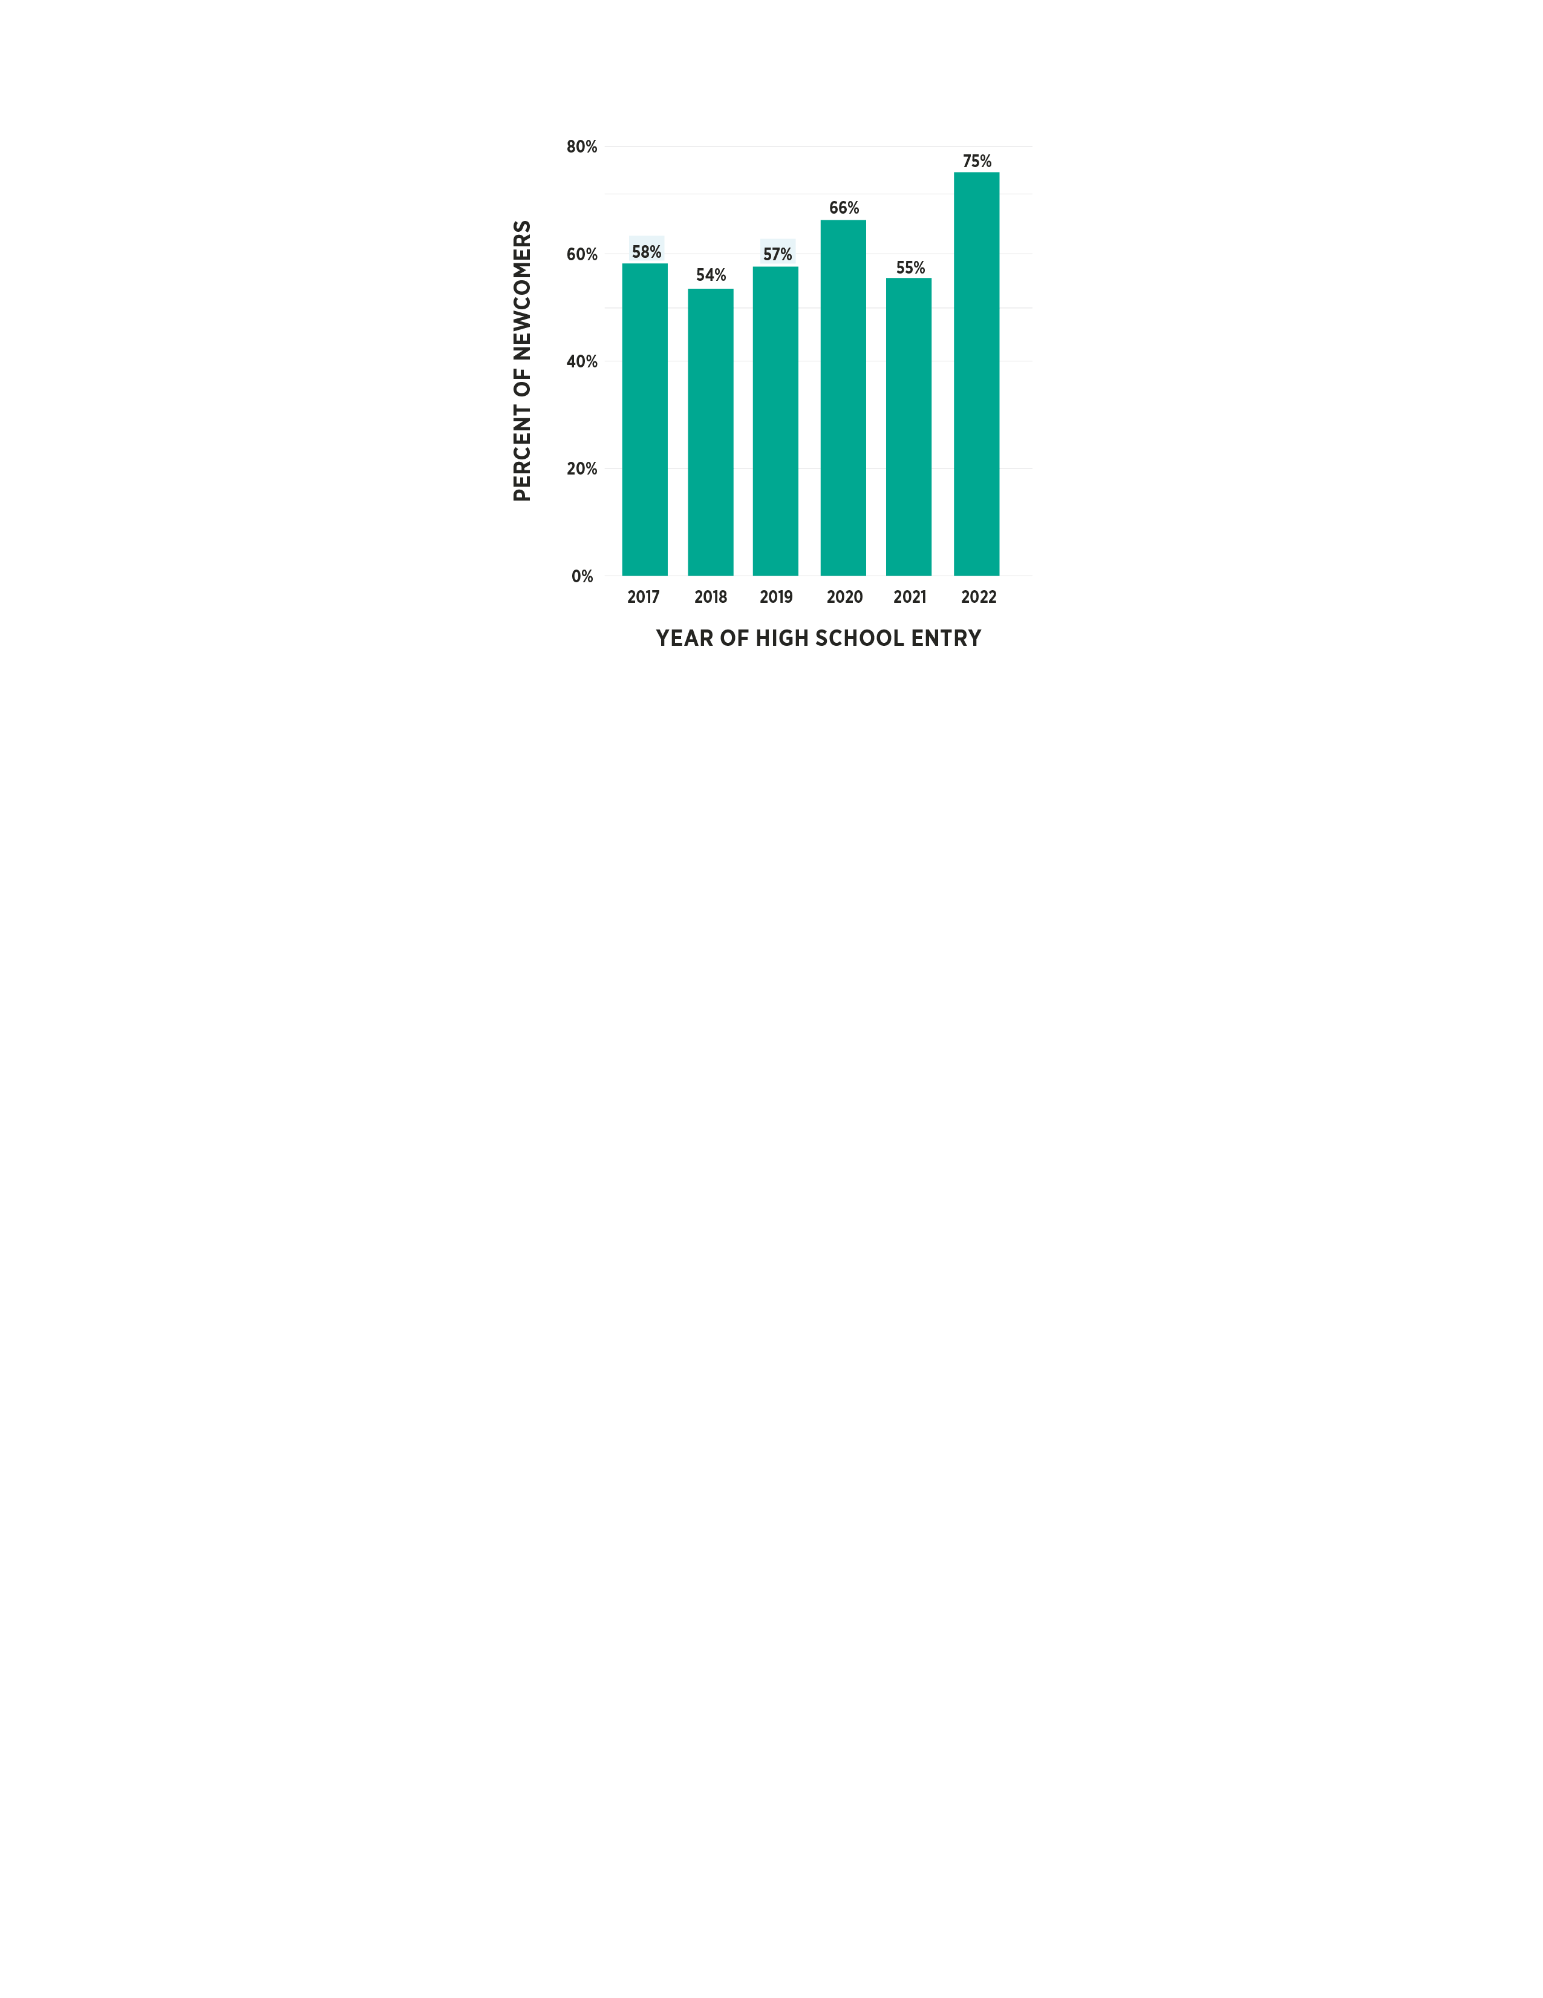
First language and initial English proficiency of newcomers have changed dramatically
Two-thirds arrived with very low levels of English proficiency in 2023, compared to 58% in 2017.
Percent of Newcomers Initially Scoring within Foundational Range
NOTE Figure includes newcomers who took ACCESS 2.0 in year of high school entry.

Slide 19
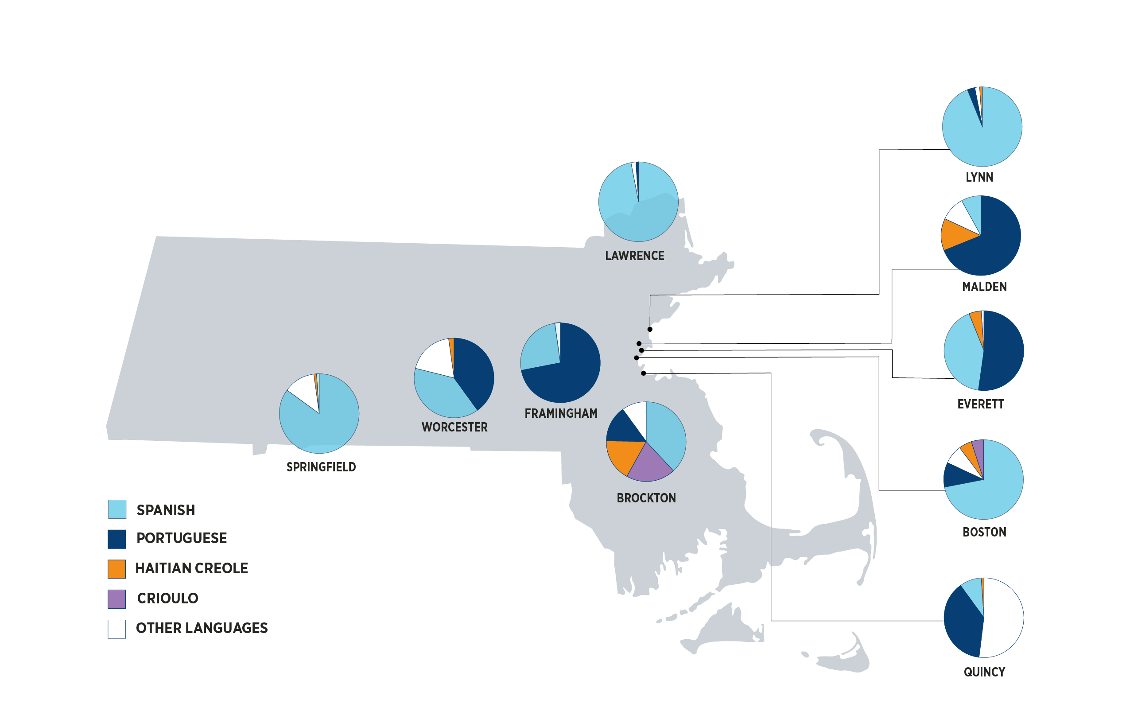
Newcomer profiles are very different across districts.
Three district categories:
Most newcomers speak Spanish
At least half of newcomers speak Portuguese
Newcomers speak many different languages
Map of First Languages Spoken Within Selected Districts
(of Newcomers Entering High School in 2022)

Slide 20
Newcomer Outcomes

Slide 21
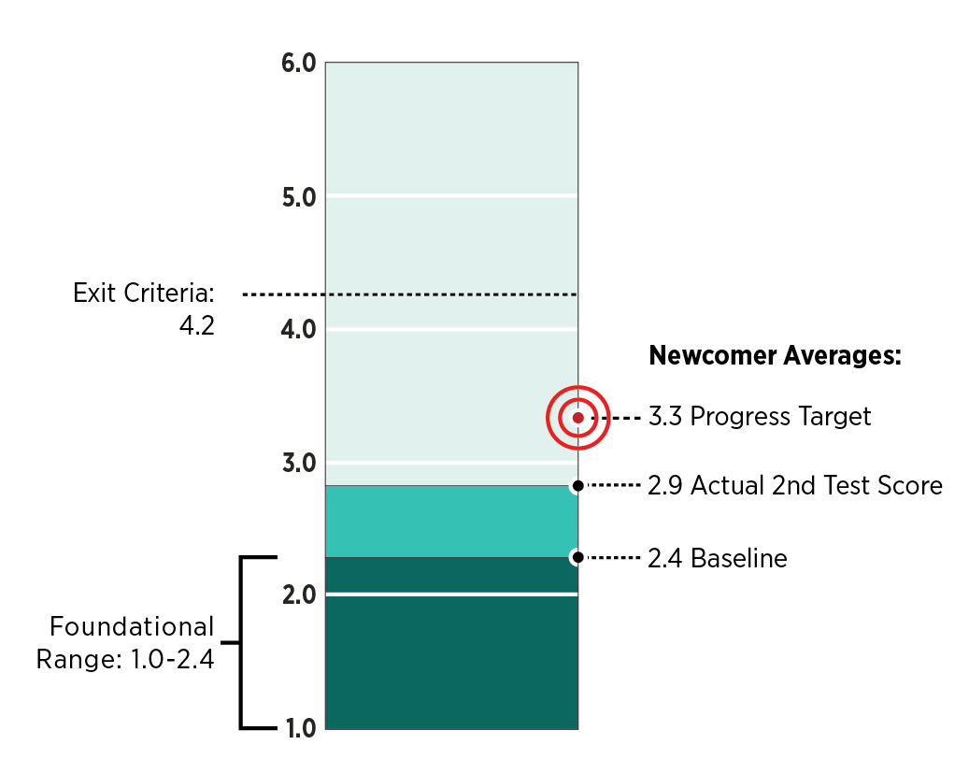
Most newcomers are not meeting growth targets for English language proficiency.
28% of 2019 newcomers who took the ACCESS test twice met their growth targets
25% of newcomers showed no improvement in their overall levels in their first full year of school
79% of newcomers never met the exit criteria
Average ACCESS Levels and Target for 2019 Newcomers Who Tested at Least Twice (N=1,852)

Slide 22
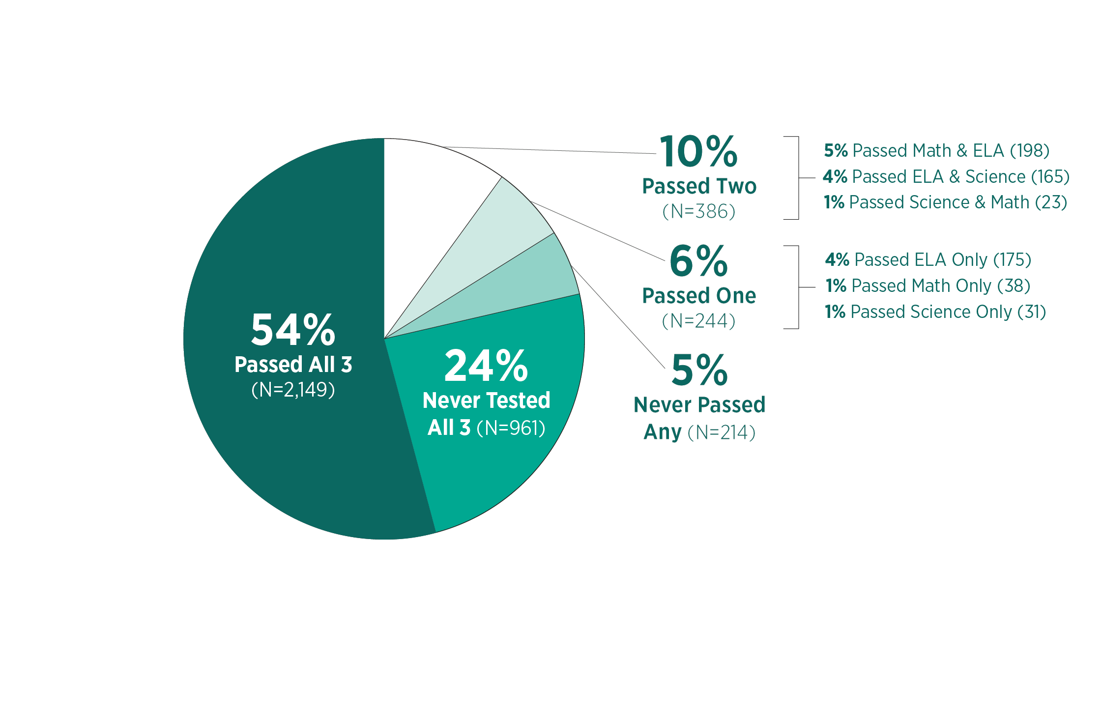
Only half of newcomers eventually exceed the minimum required score on all three high-school MCAS tests.
Before the pandemic, newcomers made up 4% of high-school students attempting all three MCAS tests, but 32% of those who never passed at least one.
Number and Percent of Newcomers Entering in 2016 Who Passed Each MCAS Test (N=3,954)

Slide 23
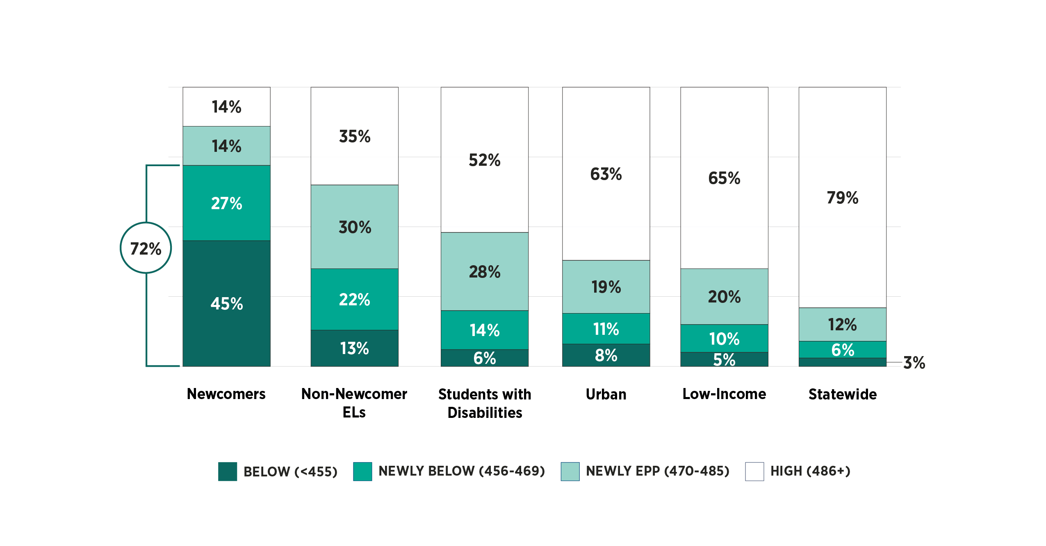
The Commonwealth’s CD policy disproportionately affects newcomers.
72% of newcomers who took the 2022 ELA test scored below the new minimum score of 470:
45% scored below the “old” threshold of 455
27% scored above the old but below the new threshold
2022 MCAS ELA Score Distributions for Newcomers and Other Key Student Groups

Slide 24
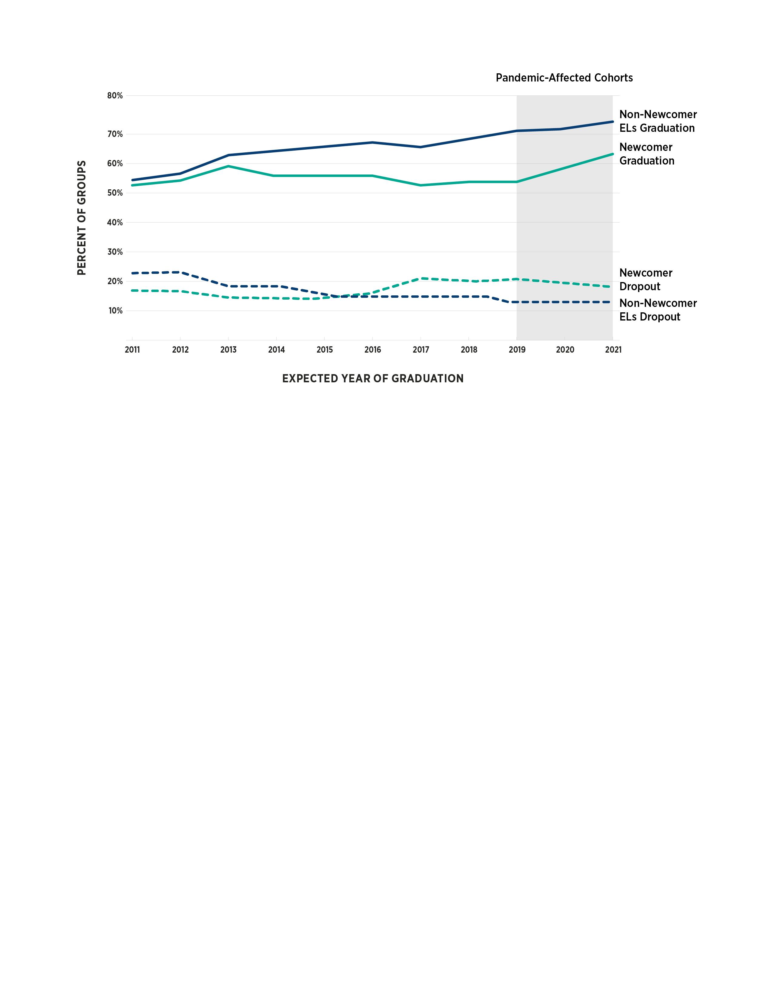
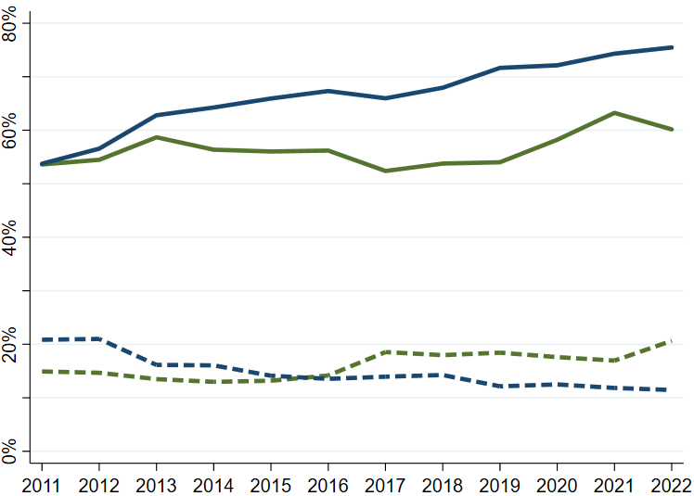
Newcomers’ high-school graduation rate remained under 60% until MCAS requirements were waived during the pandemic.
Newcomers in the 2018 cohort:
  54% graduated
  18% dropped out
  18% transferred
  7% earned a Certificate of Attainment (COA)
  3% still enrolled
Trends in High-School Outcomes of English Learners One Year After Their Expected Graduation, 2011-2022
NOTE Newcomers expected to graduate in 2019 were only impacted by the pandemic if they remained enrolled through the spring of 2020, therefore becoming eligible for the waiver of the testing requirement.

Slide 25
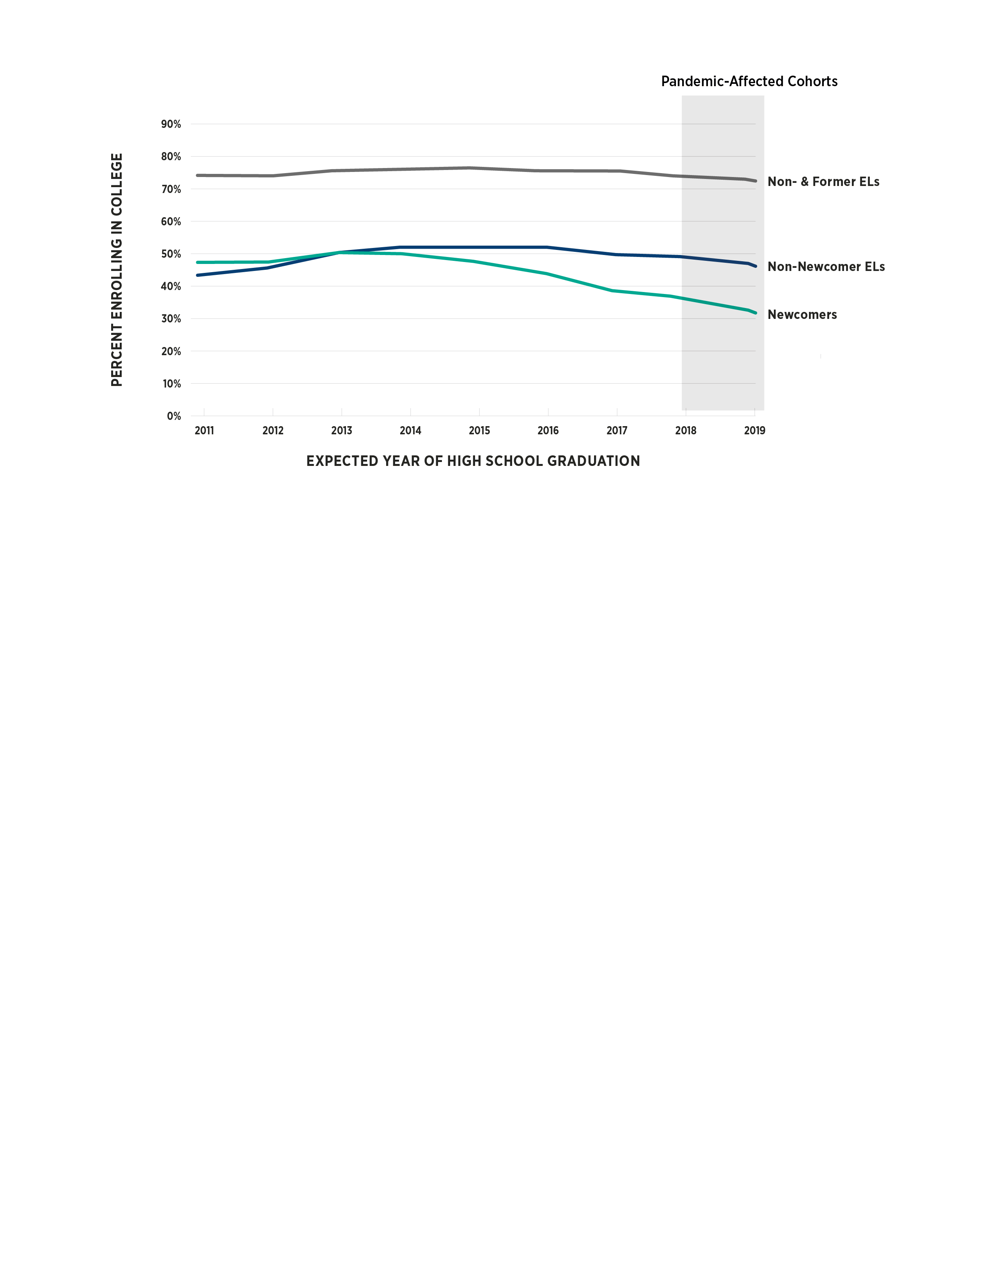
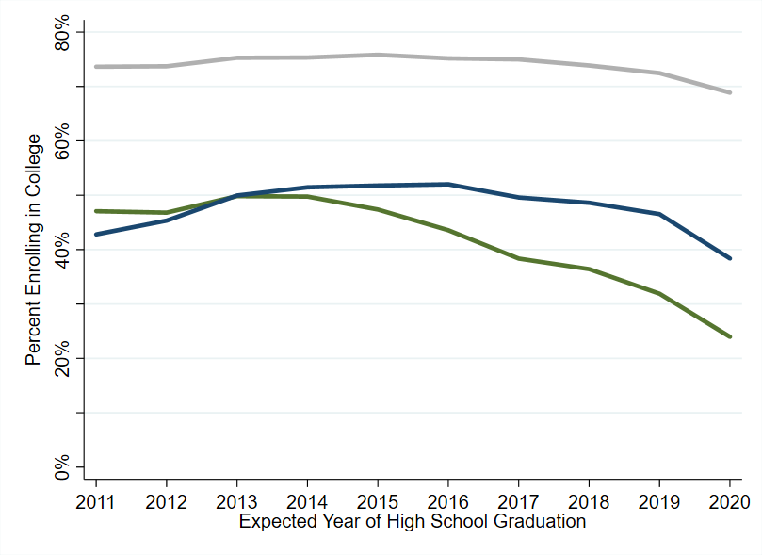
College enrollments of newcomers have declined steeply, both before and during the pandemic.
Trends in College Enrollment of High-School Students Within 3 Years After Expected Graduation, 2011-2020

Slide 26
Newcomer Variation

Slide 27
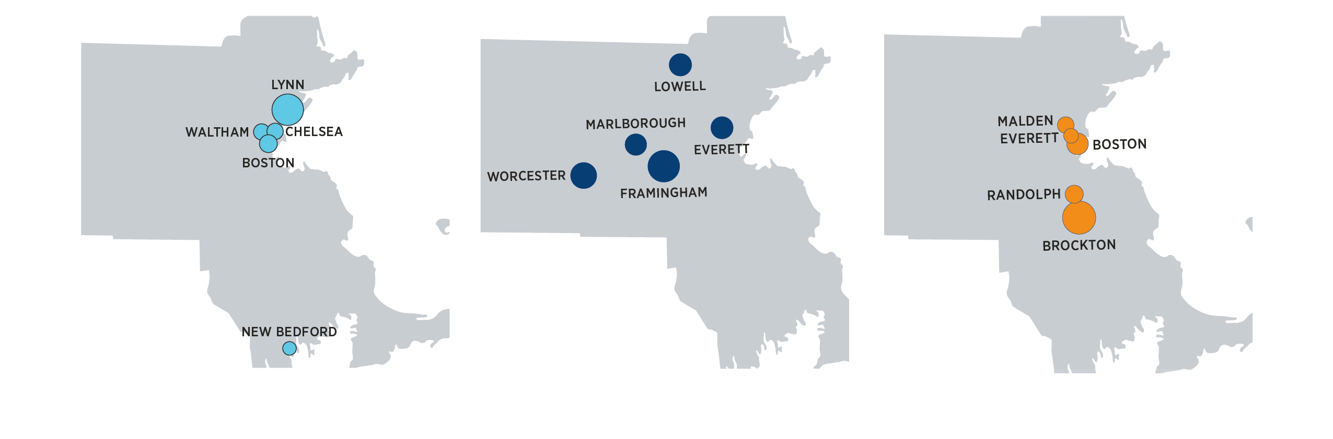
The profiles of newcomers differ dramatically across districts.
Spanish/Northern Triangle
(10% in 2008, 24% in 2023)
Portuguese/Brazil
(6% in 2008, 15% in 2023)
Creole/Haiti
(9% in 2008, 4% in 2023)
Maps of Primary District Enrollments for Three Language/Country Groups

Slide 28
Large differences by language/country group underline the need for customized supports and interventions.
Spanish/ Northern Triangle | Creole/ Haiti
92% at lowest level of English proficiency | 43% at lowest level of English proficiency
26% retained in 9th grade | 11% retained in 9th grade
39% dropped out | 6% dropped out
37% graduated | 78% graduated
22% of grads to college | 82% of grads to college

Slide 29
  Key takeaways
  Patterns in where newcomers come from and where they enroll are very dynamic, even within a short window of time.
  Newcomers continue to be concentrated in urban districts, but more districts are enrolling newcomers than ever before.
  The profiles of newcomers differ dramatically across districts, underlining the need for customized supports and interventions.
  The Commonwealth’s CD policy disproportionately affects newcomers.
  High-school completion and college enrollment rates of newcomers are relatively low.

Slide 30
Thoughts from EL administrators
“Teachers do not know how to teach this group of students. Maybe your ESL teachers do, but your regular biology teacher – we need to invest more in supporting teachers in teaching this population. One SEI course is absolutely not enough.”
Brittany Baggett
Fmr. Director of English Learners
Everett Public Schools
“Not providing the opportunity for multilingual learners – newcomers -- at the earliest proficiency levels to get their diploma has real long-term political, economic, and social implications.”
Kellie Jones
Director of Bilingual Educ.
Brockton Public Schools

Slide 31
Potential areas of focus
  Newcomers could benefit from more flexible, alternative high-school programs:
    Accommodate work obligations by granting extended time and supports to earn course credits
  Newcomers need to quickly learn English:
    Diversify EL program offerings beyond SEI and focus on teacher recruitment and professional development at the high-school level
  Newcomers are disproportionately affected by the CD policy:
    Assess the CD policy and its implications for newcomers
  Newcomers’ declining college enrollment is cause for concern:
    Work to inform families of new eligibility for in-state tuition and provide supports with college and financial aid application processes
  Districts differ dramatically in their newcomer populations and in how they are serving them:
    Share best practices among districts with large numbers of newcomers and among those with just a few

Slide 32
Implications for Our Work

Slide 33
More districts need different types of support.
Traditionally low-enrollment districts are seeing their EL and newcomer numbers grow rapidly and need support building the basic infrastructure of English learner education programming and culturally & linguistically sustaining practices.
We can provided more targeted supports to the high schools receiving the most newcomers.
All districts would benefit from clearer guidance on supporting newcomers & SLIFE.

Slide 34

DESE Targeted Assistance
Most intensive support
Further support options
All districts
Extended Consultation & Support (may be prioritized based on interest)
In-person visit with DESE team to diagnose and prioritize needs and identify relevant resources/supports, including sustained collaboration with partner(s)
Virtual Technical Assistance (districts who request)
Consultation with DESE staff via Zoom to diagnose and prioritize needs and identify relevant resources / supports
Virtual Kick-off (all districts with EA shelters)
Introduction of needs assessment & how to access available resources / supports

Slide 35



DESE-funded Supports for EA Districts
Translation/Interpretation
Sign up to use DESE's contract for Document Translation, Phone and Virtual Interpretation
No cost to districts
ESL Licensure/ SEI Endorsement
DESE contracted with providers to offer virtual SEI Endorsement Courses to educators
No-cost professional learning and technical assistance opportunities
Professional Development
Free ESL MTEL Prep Course Modules available to educators
ESL certification grant
Focus on family engagement, creating a welcoming environment and the infrastructure for culturally and linguistically sustaining systems and instruction
Notes:
For Translation/Interpretation
DESE will award a contract to vendors and will partner the vendors with districts based on vendor expertise/availability and district need

Slide 36

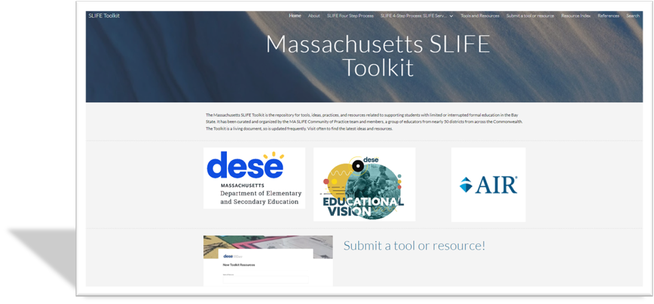



DESE SLIFE Community of Practice and Forthcoming Resources
Research
Community of Practice
Guidance & Tools
Data & Screening

Slide 37
What else can we do?
Identify flexible models and pathways that are asset-based and designed around newcomers’ needs
Elevate exemplars and best practices (in MA and outside)
  Programming
  Curriculum and instruction
Reflect on policy implications

