Slide 1
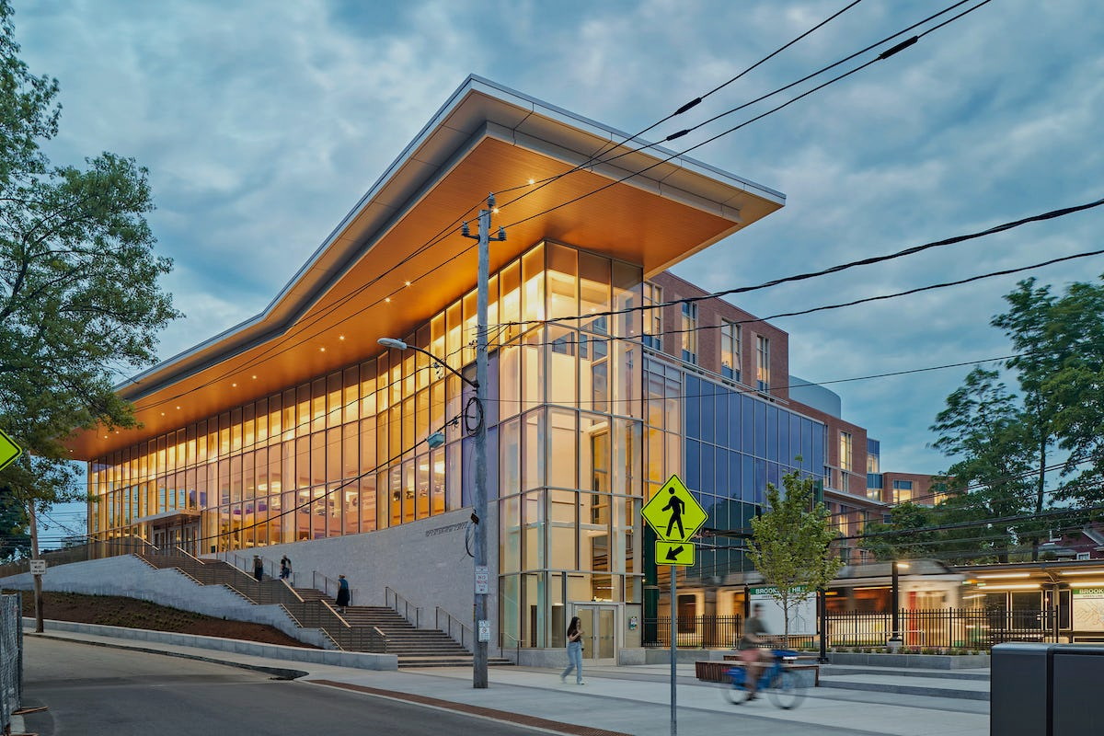


Brookline High School Title I
Federal Grants Conference
May, 13th, 2024

Slide 2
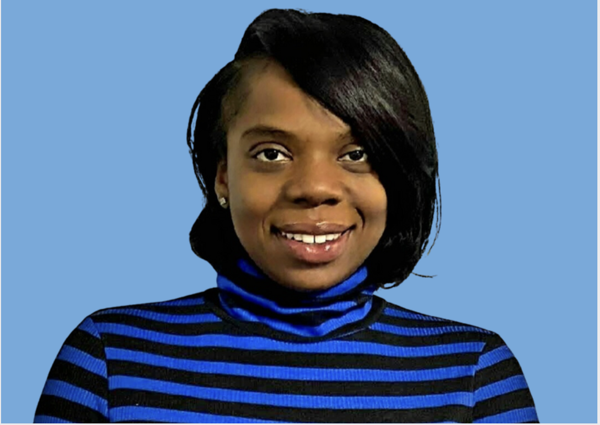
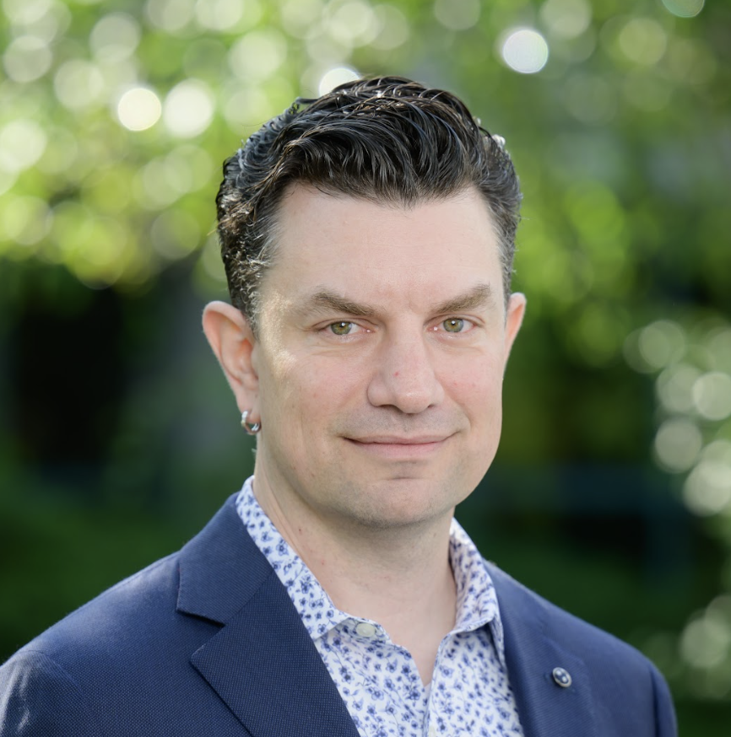
Speakers
SOPHYA WILLIAMS-LOUIS
District Director of Steps to Success
GABRIEL McCORMICK
Senior Director of Teaching & Learning

Slide 3
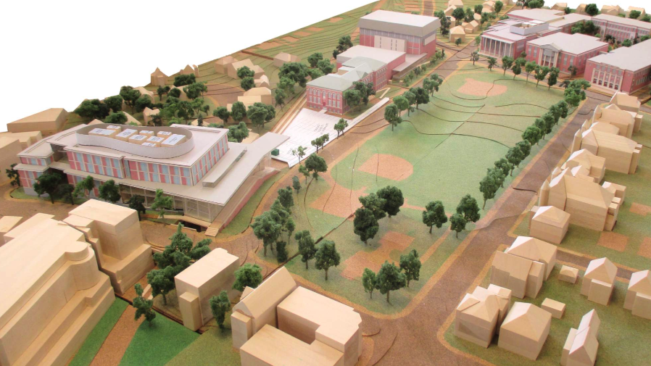
Overview
In this session, school districts will learn how to leverage Title I funds to create culturally relevant programs that address the social-emotional needs of vulnerable students. In partnership with passionate educators, students continue to develop self-awareness, resilience, self-advocacy, academic support, and goal setting. Consequently, students can envision themselves as successful confident young adults post high school.

Slide 4

What is Steps to Success?
It is…
An Independent Non-Profit
A School Program
A Civic Partnership
… serving Brookline-residing students from low-income families

Slide 5
PARTNERSHIP POWER
Public Schools of Brookline
Brookline Housing Authority
Steps Inc
PARTNERSHIP POWER
  Our Vision: We envision a community where all students can attain their educational, economic and life goals into adulthood.
  Our Mission: We partner to leverage resources from each organization to provide comprehensive, integrated services and supports to achieve educational equity for families and students who are low-income in the Public Schools of Brookline.
Notes:
Sophya

Slide 6

Wrap-around support
Partnership Focus
Out of School
Wrap-around Support
Home and Family
In School
College and Career Readiness
Academic Support
Social and Emotional Learning
Student and Family
Enrichment
PSB
BHA
Partnership Management • Sustainability • Accountability • Enrichment
STS

Slide 7
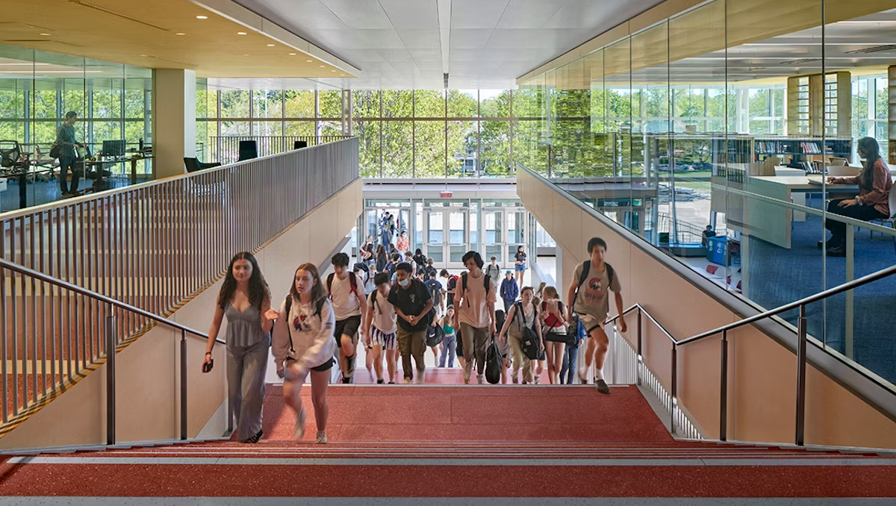
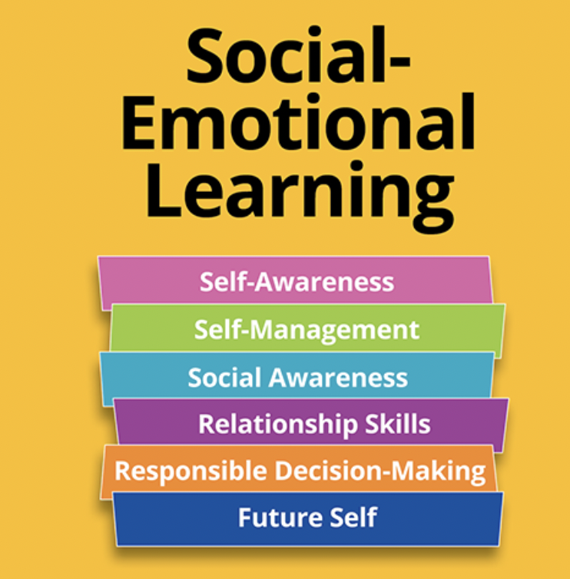
Big Picture Goal:
Social-Emotional Learning & Vulnerable Populations
Increase sense of belonging and attendance to improve academic success.
Students from historically disadvantaged backgrounds
Eligible for free or reduced lunch
At risk of not earning credits towards graduation
At risk of not earning enough credits to be
promoted to the next grade level
Notes:
Anthony

Slide 8
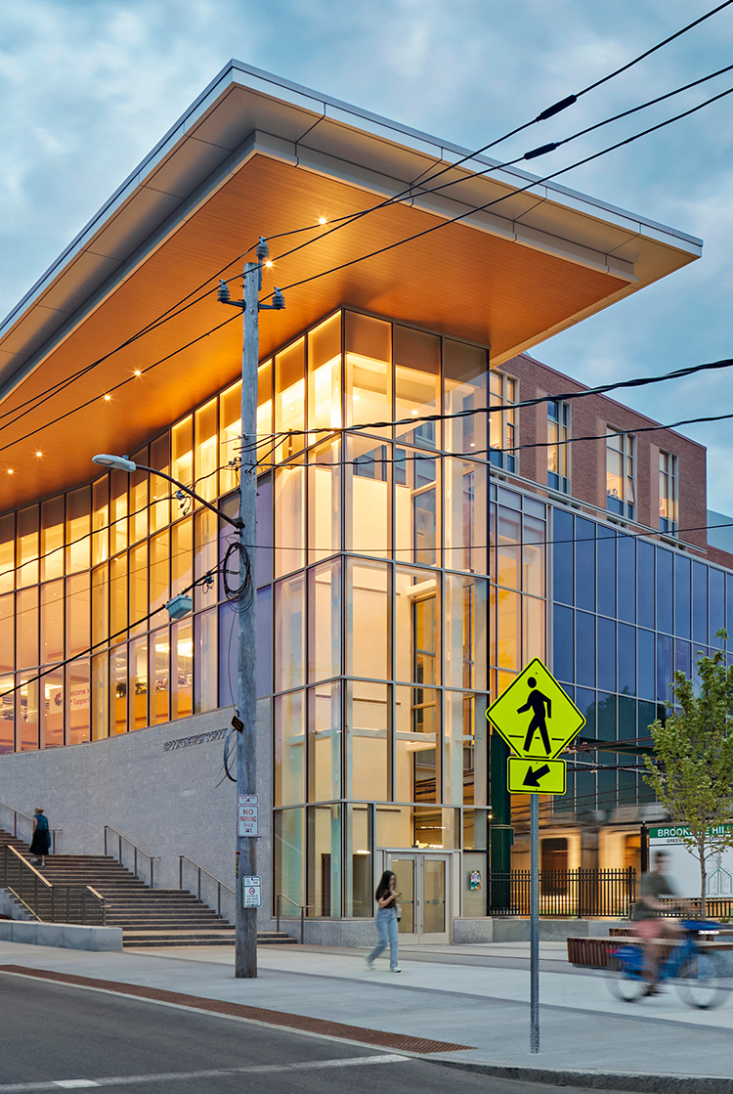
Academic Achievement Center
ACADEMIC ACHIEVEMENT CENTER
The Academic Achievement Center (AAC) focuses on supporting Brookline High School students who have demonstrated academic needs. The Center supports students as a wraparound service beyond the school day including after school, on weekends, and during extended school breaks.
The Center provides high dosage academic support to students who are in danger of failing one or more classes. While the Center focuses on academic support, the Center takes a holistic approach that includes family engagement, trauma informed practices, and social & emotional support.
Restorative Opening Circles
Academic Coaches for English, Math, & Science
4: 1 Ratio

Slide 9
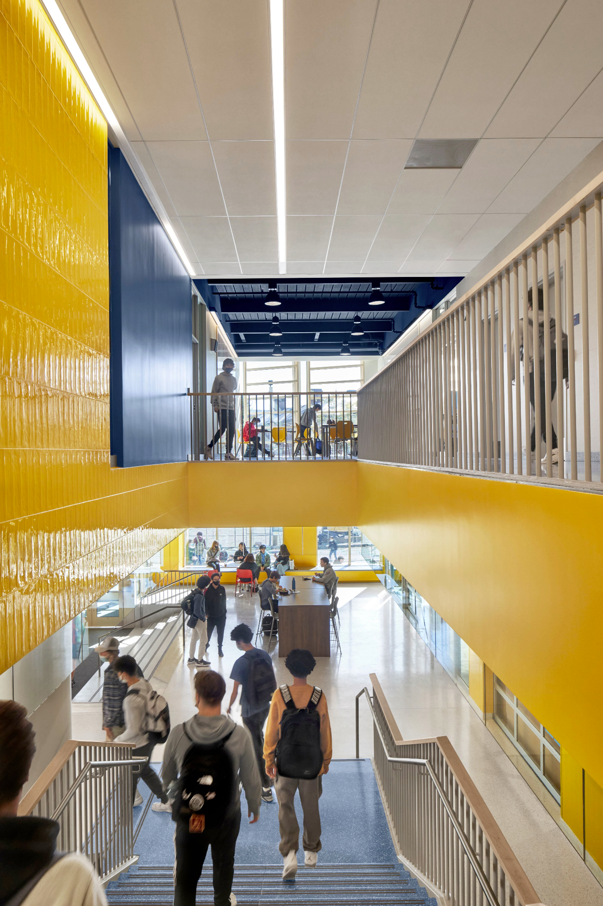
Affinity Groups
AFFINITY GROUPS
Culturally and socially responsive.
Supporting Cultural Identity Program 2.0: grounded in the cultural identity framework, the SCIP 2.0 uses by meeting students, who identify as girls of color or are influenced by feminine culture, starting from 9th grade through 12th grade to cultivate a deeper understanding of their cultural identity.
Youth Enrichment Services (YES): grounded in restorative practices,YES supports students who identify a young men or are influenced by masculine culture to increase self-awareness and develop leadership skills.
Notes:
Gabe and Anthony

Slide 10
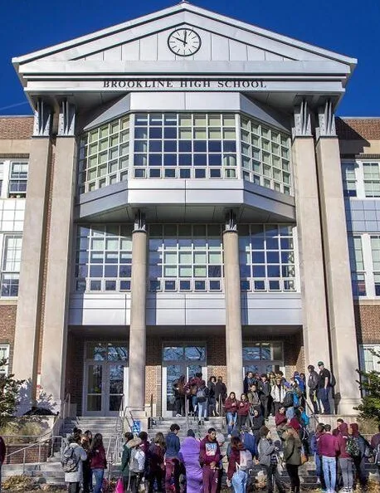
Tutorial
TUTORIAL
General education Tier 2 intervention.
Supports executive function and school skills.

Slide 11
Tutorial Course Description
Brookline High School Tutorial is a one-credit class providing content area support and academic monitoring within a supportive learning community. Tutorial goals are reviewing course content for increased comprehension and strengthening underdeveloped study skills. In collaboration with their Tutorial teachers, students identify specific focus areas for improving academic achievement such as test preparation, reading comprehension, composition development, and organization skills. Class time is divided between individual consultation with a Tutorial teacher and independent practice where the student implements recommended prescriptive strategies.
Notes:
Gabe and Anthony

Slide 12
Administrator Position: Tutorial Coordinator
Program evaluation
Increased professional development
Reimagining the program for increased STEM support
Cross-departmental collaboration
Notes:
Gabe and Anthony

Slide 13
Discussion

Slide 14

WPS mentoring program
Presenters:
Stefan Czaporowski, Superintendent of Schools
Susan Dargie, Director of Curriculum and Instruction
Bruce Hastings, Westfield Technical Academy Principal
Charles Jendrysik, Westfield High School Principal

Slide 15
WHS Mentoring Program
5
42
1-2
At WHS we have assembled a team of highly motivated, empathetic, and effective mentors. This team is diverse in their ages, backgrounds, professional experiences, academic backgrounds, and approach to students. At the beginning of the school year, we sought recommendations from teachers and staff for students who they felt could benefit from having a mentor in the building. These staff members could quickly recommend students using the WHS Mentoring Referral Form.
Number of mentors
Number of students with a mentor
Times per week students meet with mentors
Self-confidence
Better relationships
Self-advocacy
Emotional regulation
Increased attendance
Academic performance
Graduation rate
Academic
Social-emotional
Organization
Student challenges
Positive outcomes
School outcomes

Slide 16
WTA Mentoring Program
9
125
1-2
At WTA our mentoring program serves 125 students in grades 9-12. Students in the program gain the skills and confidence to overcome challenges not only in their current lives, but skills that will benefit them far beyond their high school career. Students receive support and mentorship from caring adults, helping to guide them on their career pathway journey at WTA. At the beginning of the school year, we identify students who would benefit from the program through recommendations from teachers and staff, part of our Student Teacher Assistance Program (STAT).
Number of mentors
Number of students with a mentor
Times per week students meet with mentors
Self-esteem & motivation
Organizational skills
Interpersonal relationships
Improve academic and technical performance
Increased graduation rates
Academic
Social-emotional
Organizational
Student challenges
Positive outcomes
School outcomes

Slide 17
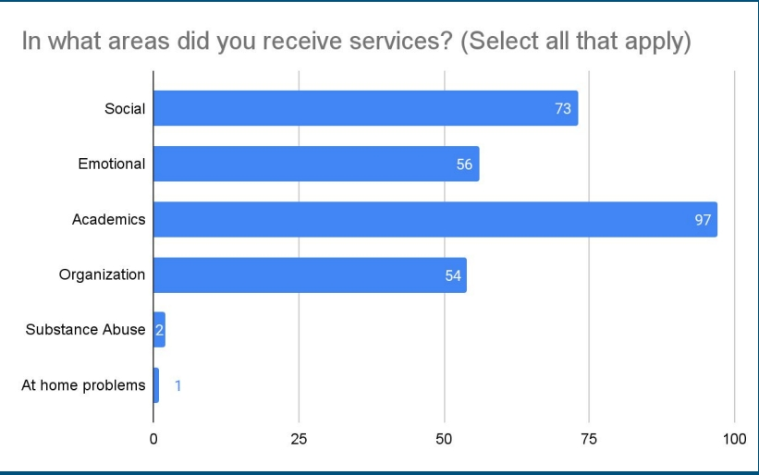
Services data

Slide 18
District survey results
Made a difference in my overall success
The survey was administered to students at WMS, WTA, and WHS
118 students took the survey
Goals Met
84.7%
74.5%
Created Clear Goals
93.2%

Slide 19
Dropout reduction
WHS
As a result of the mentoring program, I feel I am less likely to drop out of school
88.2%
WTA
82.7%
WPS
66.0%

Slide 20
Survey comments from students
She always finds time in her day even when she is busy to make sure I am ok if I send her am email saying I need her, I have only been talking to her for a few weeks and our connection.
Being able to talk about school and what is going on in my daily life.
Not feeling alone.
I like that it’s just 1 on 1 and we’re working on things that are helpful.
It helped with my grades a lot more than I thought it would.
Being able to discuss ways to improve my grades.
Getting to talk to someone and not have them judge me no matter what.
She gives me confidence.
They help me get my stuff done and my mentor really helps me.
Talking, eating, or playing games.
Getting non-teacher insight into teacher lessons.

Slide 21

Mentoring program: student outcomes
Significant improvement in district dropout rate and 4-year graduation rate.
1
Improved academic performance and student attendance rates.
2
Positive relationship building between mentor/mentee as well as in school
3

Slide 22



Thank You

