Slide 1
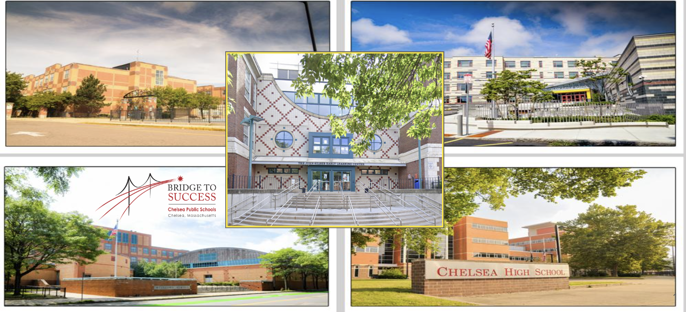
Family Engagement: A Strategy to Improve Student Outcomes (Connecting Family Engagement to Student Learning)
Dr. Tamara Blake-Canty, Johnny Giraldo, Yolanda Valles and Jay Velez
November 13, 2024

Slide 2
Objectives
We will explore…
What we now know from current research about the impact of family engagement on both student achievement and school improvement.
The purpose and goals of the Dual Capacity Framework (Version 2) for Family-School Partnerships.
Through the Dual Capacity Framework, what we now know about how to effectively engage families.

Slide 3
Agenda
Meet the Team (Organization Chart)
District Priorities
Challenges to Family Engagement
Data Results from MA DESE Family-School Partnership Initiative (FSPI) Audit
What is Family Engagement?
Family involvement vs. Family Engagement
Connecting Family Engagement to Student Learning

Slide 4
Our Mantra

Slide 5
Presenters
Dr. Almi Abeyta
Superintendent
Dr. Tamara Blake-Canty
Assistant Superintendent
Yolanda Valles
Lead Family Liaison
Jay Velez
Lead Family Liaison

Slide 6
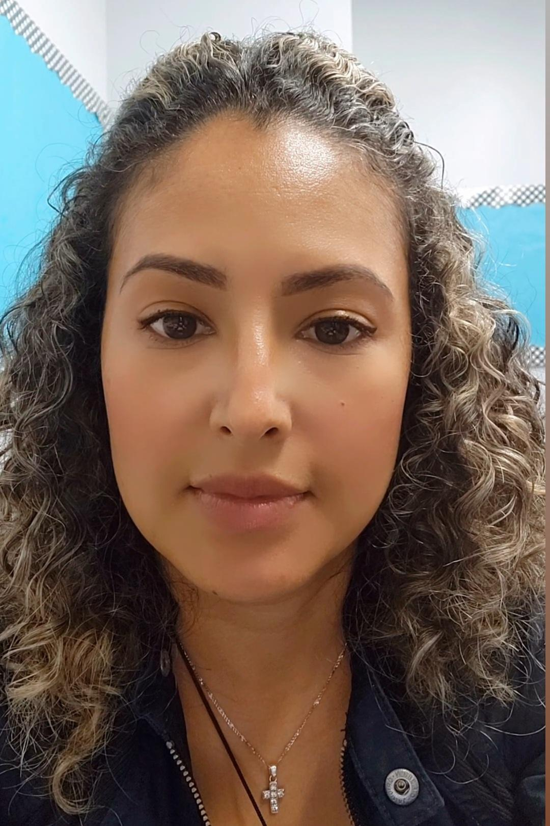
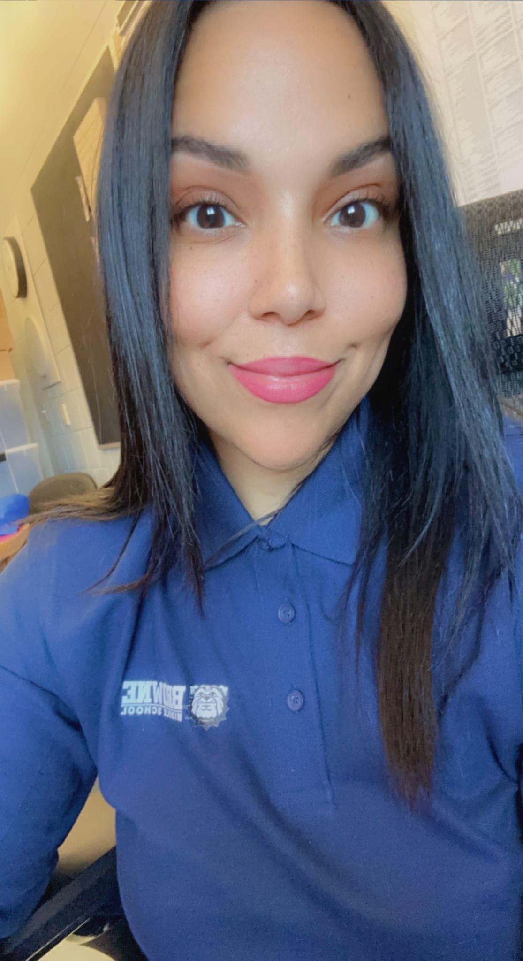
CPS FAMILY LIAISONS
Delmy Perez Mejia
Krishell Orellana
Johnn Giraldo
Vivian Quiles
Ivonne Cano
Marlene Garcia
Zuleima Perez
Angie Garcia
Yrlen Ysasis
Olga Escalante

Slide 7
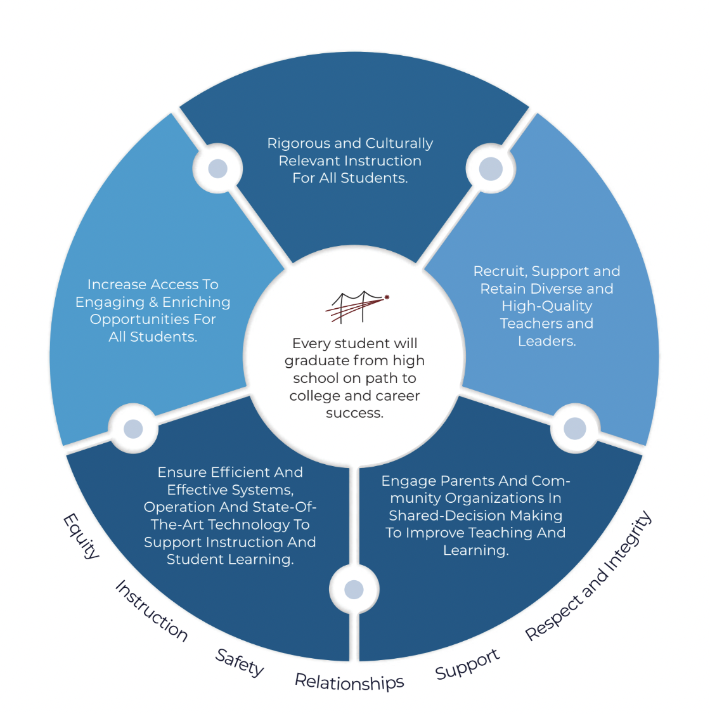
District Priorities

Slide 8
Family Engagement is a Strategy:
Investment in Family Liaisons
and
Children’s Cabinet
Integral parts of the ecosystem

Slide 9
Engage Parents and Community as Partners
District and Schools: Family Liaisons
Greatest strength listening, stakeholders voices matters
2 way communication, open and honest it builds trust and creates more engagement
Welcoming and safe space at all School sites a positive experience
Empowering families to be actively engaged in their child’s education
Creating a long lasting partnership
Genuine love and respect
Collaborating with Community Based Organizations
Providing workshops of interest
Family Liaison Newsletter
Outreach activities throughout the school year
Volunteer opportunities
Special events dedicated just for parents and guardians
Strong commitment to build community
Providing support and information of school programs
Supportive advocate
School-home relationships aligned with

Slide 10
Engage Parents and Community as Partners
District and City
Children’s Cabinet mission is to support the well-being of children and youth in our community (network of care)
Children’s Cabinet: 3 areas of focus to allow the district to expand our capacity to better meet the needs of students.
Mental Health: Start earlier with mental health support and resources
Extended Learning: Increase opportunities both within and outside of school for Chelsea youth, need for more systemic communications and connection to opportunities
College and Career: increase exposure and opportunity for varied college and career pathways

Slide 11
Challenges of Family Engagement
Data Results: MA DESE Family-School Partnership Initiative (FSPI) Audit
Students (elementary-high school)
Move discussions beyond behavior and problems to more about progress and strengths
Want more school wide events
Address more around SEL issues as root cause vs. implementing consequences–need more sensitivity. Teachers often go to a negative consequence first.
Majority of students said not enough homework
Mutual respect–we are respectful of roles and stress on teachers, but there is a lack of respect from teachers to students

Slide 12
Challenges of Family Engagement
Data Results:MA DESE Family-School Partnership Initiative (FSPI) Audit
Families:
Communication, Communication, Communication!
Importance/”essentialness” of School Site Councils
Need more Parent-to-Parent Peer opportunities *
Equity and Access to Ensure Language and Cultural Inclusion–especially Spanish language supports and offerings
Need for more after school activities
Family Voice–questionnaires plus to help get information on my child, share insights, connect with me as a partner

Slide 13
Challenges of Family Engagement
Data Results:MA DESE Family-School Partnership Initiative (FSPI) Audit
Staff:
Not enough time to do the work of parent and family engagement
Teachers feel awkward not being able to have a real and authentic conversation about their child due to language and cultural barriers
Need more support from administration–we value the work, but don’t have enough time

Slide 14
What is Family Engagement:
Family Engagement is a
full, equal, and equitable partnership
among families, educators and community partners
to promote children’s learning and development from birth
through college and career.

Slide 15
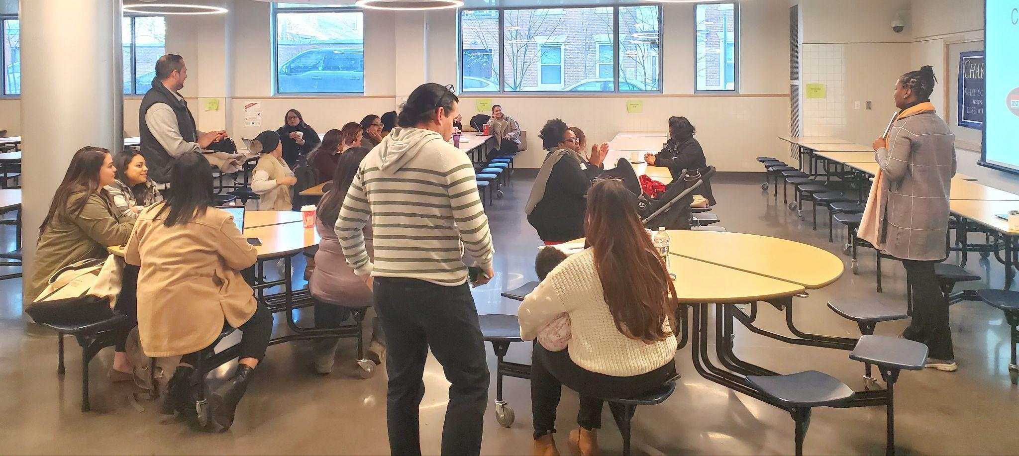
Involvement Vs. Engagement
Focuses on collective
responsibility and partnership
Communication with families
is two-way
Focuses on collaborative
practice
Relationship is transformative
Focuses on individual responsibility
Communication to families
is one-way
Focuses on programming
Relationship is transactional

Slide 16
Why is Family Engagement so Important?

Slide 17
Wins for Students

Slide 18
Wins for Eductors

Slide 19
Wins for Families

Slide 20
Wins for Schools

Slide 21
Wins for Districts and Communities

Slide 22
Five Essential Supports

Slide 23
Sticky Note:
List at least five events/activities that schools currently have for families (think across the entire school year)

Slide 24
Events
Back 2 School Celebration
Open House
Multicultural Events
Donuts for Dads and Muffins for Moms
Coffee Hours
SSC
Game Nights
Literacy and Math Nights
Fall Festival
P/T Conferences
Summer Learning Workshop
Moving on Ceremonies

Slide 25
Linked to Learning

Slide 26
Dual Language Capacity-Building Framework for Family-School Partnerships
Relational…build on mutual trust
Asset or strengths based
Culturally responsive (we add linguistically)
Collaborative and interactive
Connected to learning and development

Slide 27
Three Shifts last year…
Family engagement committee at each school
Family engagement activities connected to student learning
Title 1 parent involvement funds to be used to:
Stipend teachers to co-teach with family liaisons during academic nights
Purchase materials/resources to support learning at home
Dinner

Slide 28
Connecting Family Engagement to Student Learning (Title 1)
Family engagement committee along with family liaisons plan and implement:
Academic Nights with a focus on higher order thinking and student talk
Math: Tutorial Video Series
Literacy
Science
Curriculum Nights
Early College Orientation for Families
Pop Up in the Park (summer learning)
Family Enrichment Cafe
Aspen training for access to student’s academic progress.
Connect families to all CHS programs including TRIO, AVID, REACH, Bunker Hill, etc.

Slide 29
Extended Learning Opportunities (Title IV)
For Kids Only (elementary and middle)
Arts: Chorus, Apolinair Dance and Theatre
Middle School Athletic programs
Acceleration Academy
STEM Programs
Soccer without Borders
Reach
Notes:
These learning opportunities came about from feedback from families (Annual Parent Involvement Meeting and Superintendent data entry plan) and Panorama Data

Slide 30
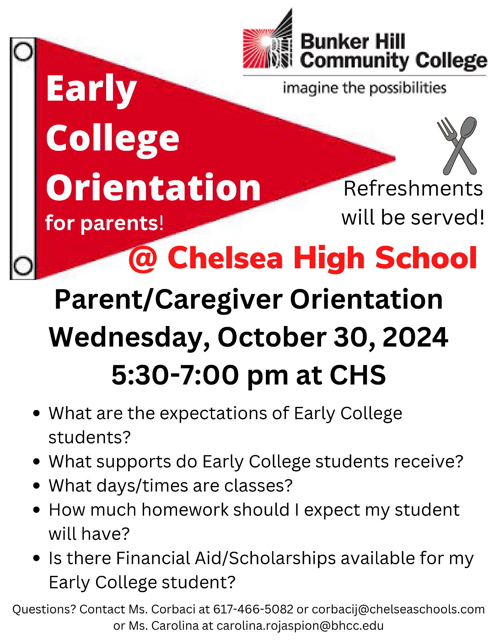
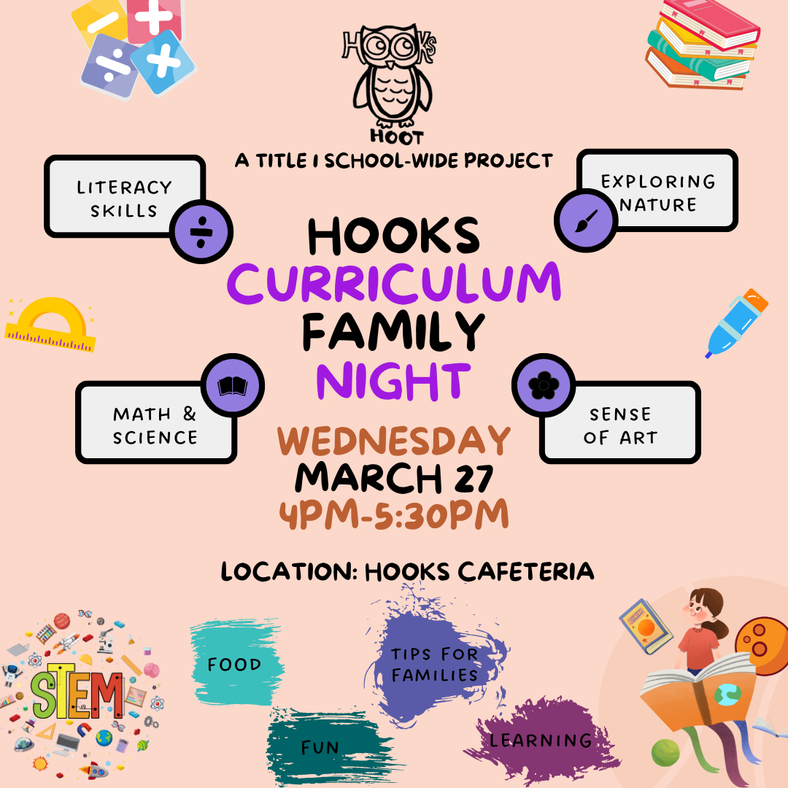
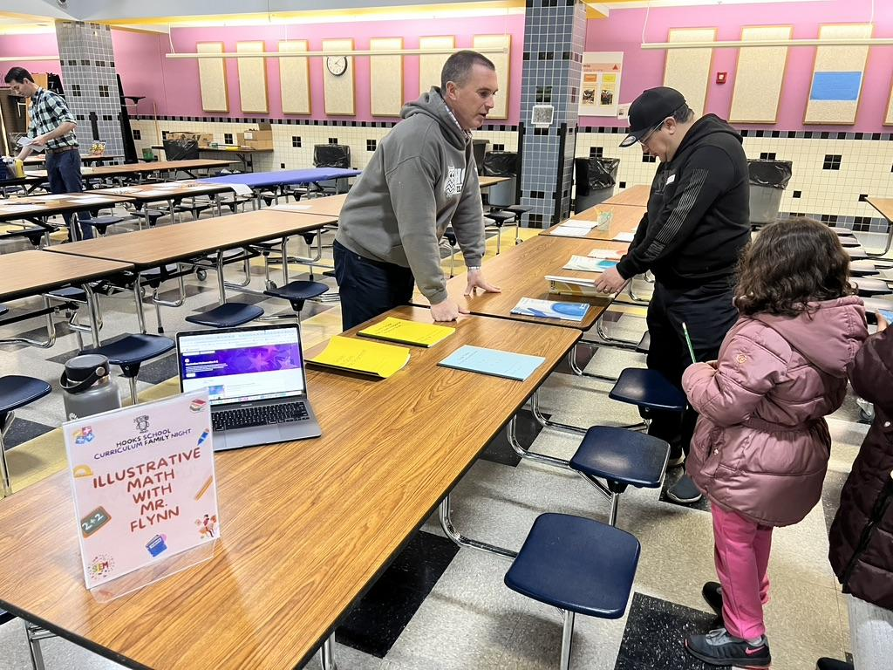
Connecting Family Engagement to Student Learning

Slide 31
Q&A
Dr. Tamara Blake-Canty - blakecantyt@chelseaschools.com
Johnny Giraldo - giraldoj@chelseaschools.com
Yolanda Valles - vallesy@chelseaschools.com
Jay Velez - velezja@chelseaschools.com

