Slide 1
Fostering a Successful Partnership in a Title IIIA Consortium: Insights from the CREST Collaborative
Federal Grant Programs
November 2024
Notes:
Helen Deranian, Coordinator
Professional Development and Grant Projects
Brent Conway, Ed.D., Assistant Superintendent of Schools, Pentucket Regional School District
bconway@prsd.org
Chrissa Pissios, M.Ed., ESL Coordinator, Newburyport Public Schools
cpissios@newburyport.k12.ma.us
Dessi Kirova, Federal Grants Specialist at DESE

Slide 2
Housekeeping Items
Before we begin:
  These slides are posted, with all other slides from this virtual conference, on our website.
  To preserve bandwidth, your video and microphone are turned off.
  Use the Q and A feature at the bottom of the screen to ask questions (not Chat).

Slide 3
Session Poll
Is your LEA new to an FY25 Title IIIA Consortium?
Yes, we are a fiscal lead to newly formed FY25 Title III Consortium
Yes, we are a member district to newly formed FY25 Title III Consortium
No, we have been a fiscal lead to a Title III Consortium before
No, we have been a member district to a Title III Consortium before

Slide 4
Contents
01
FY25 Title IIIA Consortia
CONTENTS
02
CREST Collaborative & Members
03
Questions and Reactions

Slide 5
FY25 Title IIIA Consortia
01
FY25 Title IIIA Consortia

Slide 6
FY25 Title IIIA Consortia
FY25 Title IIIA Consortia by the Numbers
15 fiscal leads (including 3 Collaboratives)
52 member districts being provided with Title IIIA services
A total of 2,716 EL students and their families currently being served as part of the 15 Title IIIA Consortia
Increase in the number of Title IIIA Consortia from FY24 to FY25 (12 to 15)
Decrease in the average number of member districts per Title IIIA Consortium (6.5 to 3.5)

Slide 7
CREST Collaborative and Members
02
CREST Collaborative & Members

Slide 8
Fostering a Successful Partnership in a Title III Consortium: Insights from the CREST Collaborative
November 12, 2024

Slide 9
CREST Consortium Includes:
CREST’s Title IIIA Consortium Includes:
Newburyport Public Schools and
Pentucket Regional School District
Keys to Success: Strong collaborative, shared commitments to newcomers, their families and their teachers, at any grade level.

Slide 10
Our Title IIIA Consortium Promotes:
⇨Shared Goals
⇨Shared Resources
⇨Consistent Leadership

Slide 11
Our Title IIIA Consortium Offers:
…an annual cohesive budget, and flexibility, when planning for new learning opportunities for EL students attending multiple low-incidence districts

Slide 12
Introduction of Consortium Partner:
Newburyport Public Schools
Current English Learners: 62
Home Country: Brazil, Afghanistan, Dominican Republic, India, Nepal, US
Home Languages: Portuguese, Dari, Spanish, French, Bengali, Gujarati, Swahili
Proficiency Levels:
Entering: 17
Emerging: 15
Developing: 21
Expanding: 7
Notes:
Chrissa Pissios, Director of EL Learning in the Newburyport Public Schools will offer local district comments.

Slide 13
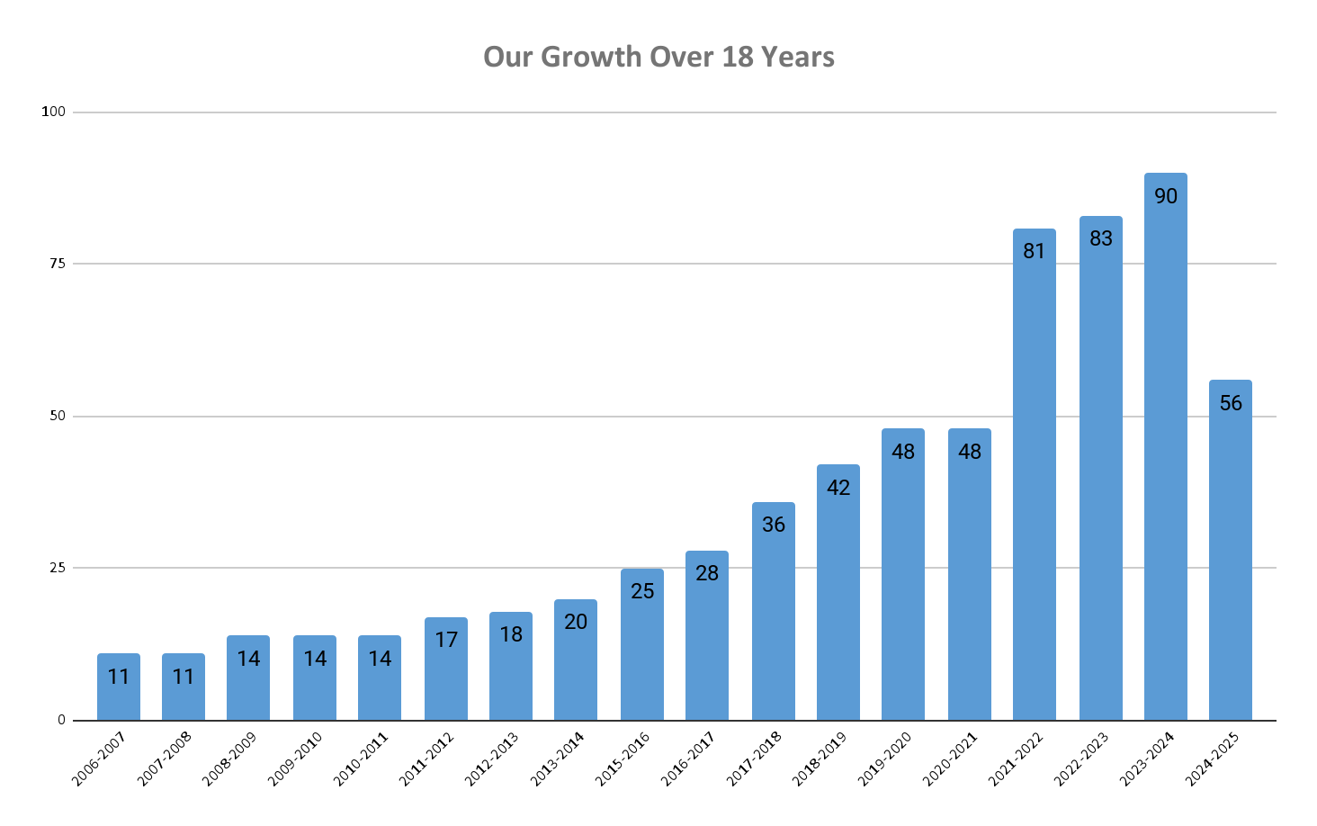
Over the Years In Newburyport

Slide 14
Introduction of Consortium Partner:
Pentucket Regional School District
Serving the Communities of Groveland, Merrimac and West Newbury
As a low incidence district some of our challenges are keeping and marinating professional knowledge for staff so that it remains relevant and applicable.
We are now 100% SEI endorsed for all required teachers K-12, expect those who are on waivers
We continue to focus our PD on evidence based literacy for all, but set aside time for staff to use the "WIDA Can Do" to outline informed expectations for their EL students
Notes:
Brent Conway, Assistant Superintendent of Pentucket RSD will offer local district comments.

Slide 15
Pentucket Regional School District, Continued
As a low-incidence district, having one of our EL teachers serve as a parent liaison has helped both staff and families feel there is always a person available with insights and understanding.
We have also shifted language used in our SST process and in Data Meetings to focus on MLL through an asset based lens rather than deficit focused.
Notes:
Brent Conway, Continued, Assistant Superintendent of Schools

Slide 16
Consortium Goal/Activities: Direct Instruction
Across Newburyport and Pentucket RSD
Vacation Camps (February, April, June)
HS Senior Seminars, Literacy, Mathematics, STEM
Notes:
Resources: Vetted Classroom Resources Reflecting EL Students and Their Families

Slide 17
Consortium Goal/Activities: Family Engagement
Across Newburyport and Pentucket RSD
Family/Parent Liaison Support
Engaging Families in Schools Beyond Entry

Slide 18
Consortium Goal/Activities: Professional Learning
Across Newburyport and Pentucket RSD
“Effectively Teaching English Learners in Your Class”
Spring 2025 Title IIIA Grant Course
Two credits graduate options, 15 or 24 PDPs
Gordon College ($150.00)
See sample credit registration process by navigating to: https://www.gordon.edu/professionallearning/register

Slide 19
Consortium Highlights
Planning Instructional Opportunities for EL Students, Together
New Families Provided Liaisons Low-Incidence Districts
Consistent, Annual Staff Professional Development
Purchasing high quality, instructional materials that support ongoing EL goals at all levels

Slide 20
How? $15,739
Federal Budget Identified and Communicated to Consortium Districts; Assistant Superintendents, EL Directors, and Teachers
Grant Needs Identified at Local District Level
CREST Submits Grant on Behalf of Local Districts
CREST manages budget with flexible timelines for each district to develop and design new opportunities for EL learning
Business Office Procurement: Purchases, Invoicing, and
Payments

Slide 21
Questions and Reactions
03
Questions and Reactions

Slide 22
Resources and Guidance on DESE Website
Title IIIA Consortia Resources
Sample Title IIIA Consortium Memorandum of Understanding
English Learners Guidance to Consortia Formed for Title IIIA Subgrant Purposes — School Year 2024-2025
Title III Consortia Quick Reference Guide

Slide 23




THANK YOU
781-338-6230
federalgrantprograms@mass.gov
www.doe.mass.edu/federalgrants
135 Santilli Highway, Everett, MA 02149

