Slide 1
Closing out ESSER
Nov 12, 2024

Slide 2
DESE's Educational Vision
What outcomes do we envision as a result of our work?
Our vision is that as a result of their public education in Massachusetts, students will attain academic knowledge and skills, understand and value self and others, and engage with the world.
This will enable students to be curious and creative, shape their path, feel connected, and be empowered.
2

Slide 3
DESE's Strategic Objectives
DESE partners with districts, schools, and programs to:
Strategic Objective 2 - "Deeper Learning"
Strategic Objective 3 - "Diverse and Effective Workforce"
Develop and sustain a workforce that is diverse, culturally responsive, well-prepared, and committed to continuous improvement, so that all students have equitable access to effective educators.
Promote deeper learning so that all students engage in grade-level work that is real-world, relevant, and interactive.
Cultivate systems to support the whole student and foster joyful, healthy, and supportive learning environments so that all students feel valued, connected, nourished, and ready to learn.
Strategic Objective 1 - "Whole Student"
3
Notes:
The Department’s new educational vision sets an ambitious and long-term expectation of the learning experiences for students across the Commonwealth. The Department is deeply committed to providing aligned supports to districts, schools, and programs so that this vision may become a reality. As such, DESE has identified three key strategic objectives that it will focus on strengthening over the next four years.

Slide 4
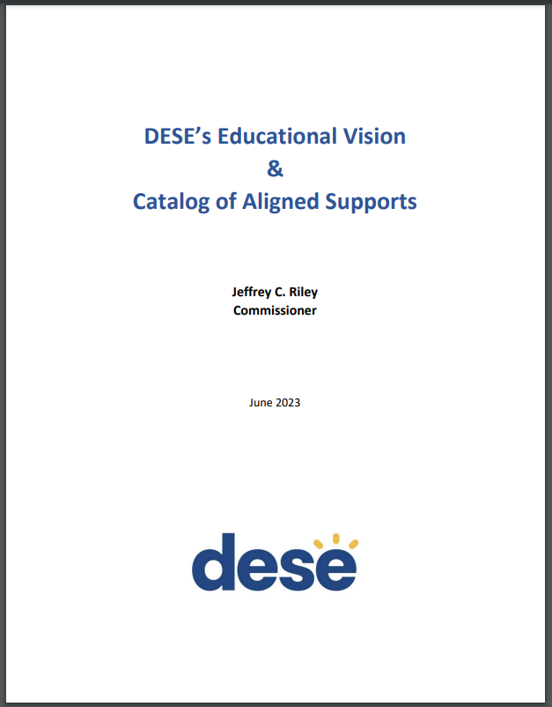
DESE's Educational Vision - Helpful Resources
Educational Vision
Catalog of Aligned Supports
www.doe.mass.edu/commissioner/
4

Slide 5
Closing out ESSER

Slide 6
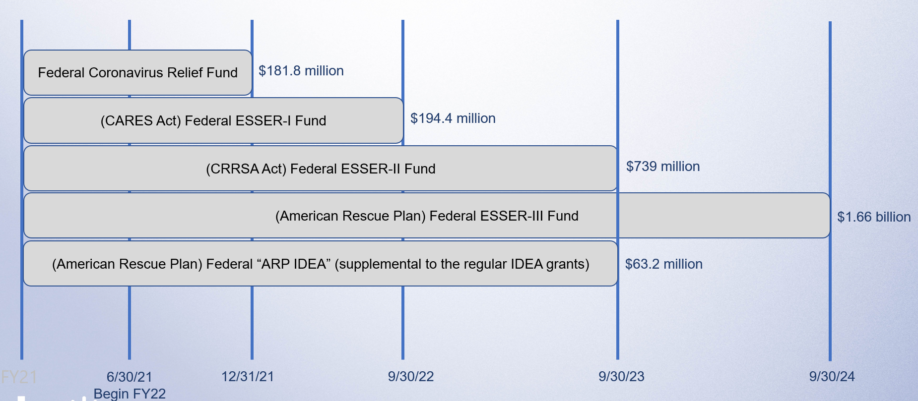
Federal COVID Relief Funding – Sequencing of ~$3 billion over ~3 years
6

Slide 7
ESSERs I, II, and III: Claimed vs. Unclaimed through October 11, 2024
99.99%
.01%
9%
7

Slide 8
Claims/Draw Down Status
You can see claims status reports for your district via our monthly Federal Grant Programs newsletter
Not on the list? Email FederalGrantPrograms@mass.gov!
8

Slide 9
EdGrants Claim Windows for ESSER III
Last standard liquidation claim window for ESSER III will be from November 20th to December 15th. 32 districts still have balances but did not apply for late liquidation, so this claim window will be your last.
Please file your FR-1 ASAP after final draw-down
For the 38 districts that received late liquidation approval, DESE will create draw-down windows in EdGrants starting in late January 2025
9

Slide 10
ESSER III Late Liquidation Update
38 out of 38 districts received late liquidation approval from the federal government in October 2024 for a combined $158.2 mil
All 38 received approval until February of 2026
DESE will create draw-down/liquidation windows in EdGrants starting in late January 2025 through February of 2026
Submit FR-1s ASAP after final draw-down. Note that all ESSER-III grants must be closed and FR-1s submitted by February 28, 2026.
10

Slide 11
ESSER III Late Liquidation Update (cont.)
When the standard liquidation period ends on December 15, if you are approved for late liquidation and need to revise down the amount needed for late liquidation please reach out to Matt Deninger by December 31st.
For example, let’s say you were approved for late liquidation for $100,000, and you had $20,000 in expenses in November. You therefore drew down $20,000 during the final standard liquidation window to cover those expenses, leaving you with $80,000 yet to be liquidated during the late liquidation period. Contact Matt to revise $100,000 down to $80,000.
If you did not apply for late liquidation, and you’re realizing that you should have, please reach out to Matt Deninger by December 31st.
DESE will submit a final updated late liquidation request to the feds in January.
11

Slide 12
Cash Management reminders – for all grants
As a general rule:
Districts are to draw/liquidate funds from DESE on a reimbursement basis
If you’ve drawn down money in advance:
Federal grant dollars (for most grant recipients) must be deposited into interest-bearing accounts. If the accounts in which you keep the federal funds earn interest in excess of $500 per year combined across all federal funds, you must remit any earned interest over $500 directly to the federal government. You may use up to $500 in earned interest for the upkeep of the bank accounts.
Keep a close eye on the interest you earn on those funds
DESE will ask your business official to attest that the district will only use the funds for the approved, budgeted purposes
12

Slide 13
ESSER III – Capital Projects
Prior to seeking reimbursement (standard liquidation or late liquidation) for ESSER construction projects, districts must submit to your federal grants liaison:
Request for Final Approval Form
Final bid/quote/purchase order signed/accepted by your district
Plans demonstrating all required approvals, certifications, signoffs
Building permits
For ESSER minor remodel, repair, or maintenance projects, districts must submit to your federal grants liaison:
Request for Final Approval Form
Final bid/quote/purchase order
Visit our ESSER page for more info: https://www.doe.mass.edu/federalgrants/esser
13

Slide 14
Overall ESSER Closeout Activity Timeline
Notes:
Also over $48 million to private schools, and $260 million to approved private special education schools.

Slide 15
ESSER Updates – What’s New?

Slide 16
New Requirement – Federal Interest in a Property
USED has issued new guidance this Spring with details on how and when federal grant recipients must record a federal interest in property that was improved with federal ESSER funds “in the official real property records for the jurisdiction in which the improved or purchased property is located” (typically the Registry of Deeds)
16

Slide 17
New Requirement – Federal Interest in a Property (cont.)
Recording
Generally, recording applies only to real property improvements using $1 million or more in ESSER funds.
Those required to record a federal interest must do so by January 28, 2025. NEW as of fall 2024: US Department of Education will be issuing further guidance around this requirement, and therefore January 28th deadline may be pushed back. Stay tuned.
While the USED guidance does not provide a form, it does list the elements that notices of federal interest must contain.
17

Slide 18
New Requirement - Federal Interest in a Property
Reporting
Annual reports are required for any real property that was improved or purchased using federal grant funds.
There is no dollar threshold for reporting.
Reports are required for at least the first 15 years after the project is funded.
Moveable equipment, such as “HVAC equipment, mobile classrooms, building furniture” is exempt from reporting.
The report must be made on form SF-429-A Real Property Status Report.
Procedures for submitting these forms to DESE will be forthcoming in 2025.
18

Slide 19
Update to federal Uniform Grant Guidance
Entities that spend $1,000,000 as of October 1, 2024 or more in federal funds in a fiscal year must have their federal programs audited by an independent auditor. (2 CFR § 200.501(b))
Former standard used to be $750,000
In a single audit, among other things auditors will:
Determine whether the financial statements and schedule of expenditures of federal awards prepared by auditees are presented fairly,
Test the auditee’s internal controls, and
Determine whether the auditee complied with key federal requirements for its major programs. (2 CFR § 200.514)
19

Slide 20
Disposal (disposition) of equipment and supplies
Because you may have purchased a lot of “stuff” with federal funds, it’s important to note that the federal government has an interest, and that there’s a process for getting rid of equipment and supplies. (CFR 200.313&314)
Equipment
If you intend to sell or dispose of any equipment with a per-unit fair market value over $10,000, the federal government is entitled to the proceeds, based on the percentage of federal funds used in the original purchase.
Think buses, large career/tech equipment, etc.
Supplies
If you intend to sell or dispose of any unused supplies with a per-unit fair market value under $10,000, but $10,000 or more in aggregate value, the federal government is entitled to the proceeds, based on the percentage of federal funds used in the original purchase.
Think Chromebooks, COVID PPE, etc.
This regulation does not apply to used supplies.
20

Slide 21
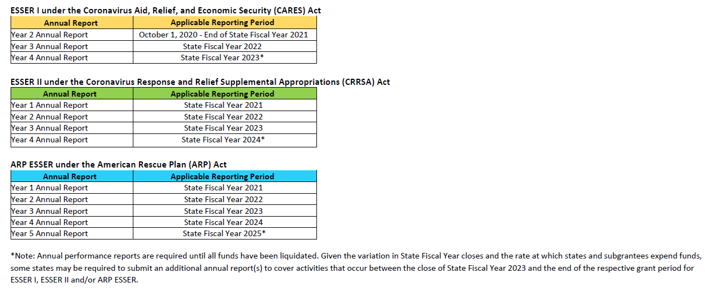
ESSER Reminders – Data Collection

Slide 22
ESSER Reminders – Data Collection (cont.)
FY24 ESSER II and III Data Collection window is tentatively scheduled for April 7 – May 9, 2025.
22

Slide 23
News from Washington

Slide 24
FY26 Federal Funding Outlook
Congress passed a Continuing Resolution to fund the federal government through 12/20/2024
FY26 ESSA funds have not been finalized
President Biden and the Senate have proposed increases
House has proposed 20% decrease in Title I, and elimination of Title IIA and Title III
We’ll know more about FY26 funding levels in the coming weeks. Stay tuned.
24

Slide 25
Questions?

Slide 26
Thank You!

