Slide 1
ESSA Family Engagement Foundations Panel November 12, 2024

Slide 2
What are the ESSA requirements?
Policies
Notifications
Meetings
Capacity Building
Notes:
Thank you for joining us as a part of our November Federal Grants Conference. This webinar distills the foundations of ESSA requirements to four activities. Four activities, we believe all districts are completing to a certain degree. The goal of this meeting is to help participants learn from our panelist of their practical strategies for compliance and implementation.

Slide 3
Agenda
11:00am Welcome
Policies – Medford Public Schools
Meetings – Weston Public Schools
Notifications - Blue Hills Regional Technical School
Capacity Building – Westport Public Schools
11:40am Questions and Conversation
11:55am Resources
11:05am ESSA Family Engagement requirements
Notes:
Our panelist, Medford, Weston, Blue Hills and Westport represent the diversity of districts we have in Massachusetts and will speak to their district successes and challenges with fulfilling ESSA Family Engagement requirements. Thank you to our panelist for sharing your work within each of your districts. Feel free to add questions in the Q&A and we can use the questions to start the conversation

Slide 4
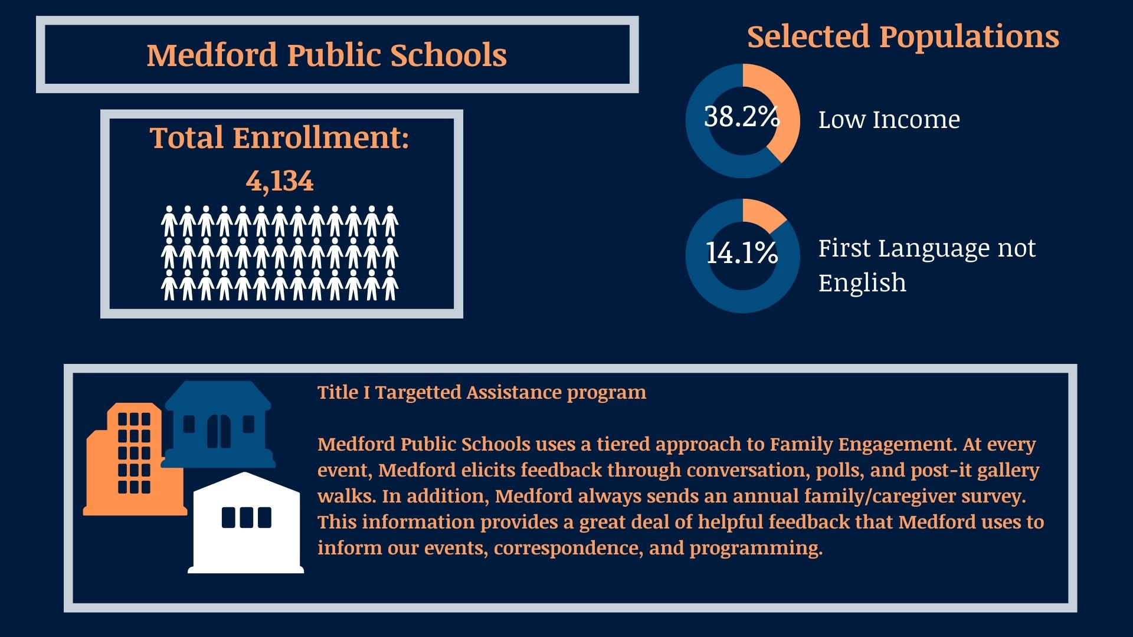
Medford Public Schools
Notes:
Suzanne B. Galusi Assistant Superintendent for Academics & Instruction at Medford Public Schools. Medford Public Schools serves two schools in a Targetted assistance program with TI funds.

Slide 5
Family/ Guardian Policies
Describe specific rights of families/guardians
Provide information and opportunities for meaningful activities developed with families/guardians so the entire community is prepared to participate in student educational growth.
Describe how families/guardians are involved in an annual evaluation of the effectiveness of the family/guardian engagement in improving academic achievement

Slide 6
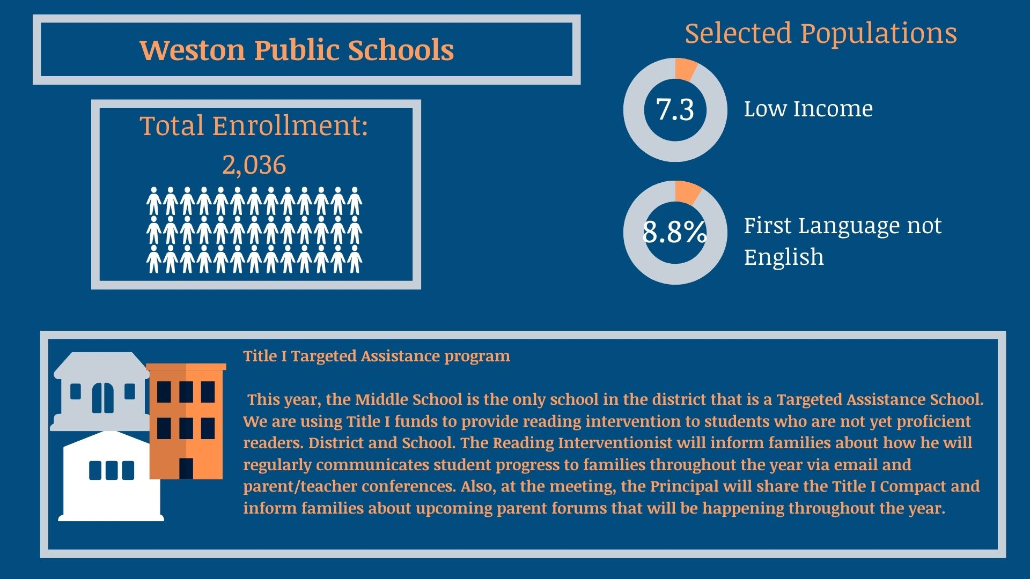
Weston Public Schools
%
Notes:
Kimo Carter, Asst. Superintendent for Teaching and Learning at Weston Public schools. Weston Public Schools is only serving their middle school with TI funds.

Slide 7
Annual TI Meeting
Schedule to inform participating families/guardians of students about Title I programs
Meeting Agenda Topics include:
a. | The state’s academic content standards and state student academic achievement standards
b. | State and local academic assessments, including alternative assessments
c. | The family/guardian engagement requirements (Engagement Policies and Compacts (distribute, evaluate and update), Families’ Right to Know, Report Cards and notifications)
d. | Sharing best practices and resources with families/guardians on how to monitor and improve student academic progress and achievement
e. | Additionally, districts and schools provide accessible tools to assist all families in understanding and collectively supporting student improvement and achievement.
File and save documentation of meeting, agenda topics and family participation and attendance

Slide 8
Blue Hills Regional Technical
Notes:
Paul Bavuso, Academic Director, Blue Hills Regional Technical School will speak to Notifications and communicating with Families. Blue Hills is a technical high school and a single school district.

Slide 9
Annual Family/Guardian Notifications
Distribute to families/guardians written family/guardian engagemet policies and school-family/guardian compacts
Publish and distribute annual report cards for district and all district schools
Notify family/guardian of school and district accountability status as well as right to request teacher qualification information
Notify (if applicable) families/guardian that student has been taught for four or more consecutive weeks by a teacher who does not meet licensure requirements

Slide 10
Notifying Families
Overview
Strategic communication across multiple regions through both district-wide and local community channels
Full language accessibility built into every stage of communication, ensuring equal access for all families
Diverse outreach methods tailored to families' preferred communication styles and available technology
Carefully planned timeline that includes translation services and multiple family engagement opportunities before the presentation
Identification
Identification of the most common languages in your school community
Utilization of district translation services already in place
Use of bilingual staff members when available
Consideration of using QR codes linking to translated digital versions
Creation of materials in all identified primary languages
Use of universal symbols and icons when possible
Provision of translation services’ contact information on all materials

Slide 11
Outreach Considerations
Digital Outreach
Supporting Multiple Means of Engagement through…
School website announcements (multi-language toggle options)
Weekly email newsletters to all families
School's social media platforms (Facebook, Instagram)
School messaging system (texts/automated calls)
Local community Facebook groups for all nine towns
QR codes on printed materials linking to RSVP form
Traditional Media
Printed flyers sent home with students
Local newspaper announcements in all nine towns
Community bulletin boards:
Libraries
Community centers
Religious institutions
Local grocery stores
Laundromats
Coffee shops
Multi-Language Materials​
Creation of materials in all identified primary languages​
Use of universal symbols and icons when possible​
Provision of translation services’ contact information on all materials​
​
Personal Outreach​
Engage current parent volunteers to spread the word​
Use existing parent networks such as your Boosters Club or Parent-Teacher Association​
Leverage parent-teacher conferences, open houses, and back-to-school nights for face-to-face promotion​
​ ​

Slide 12
Westport Public Schools
Notes:
Lisa Kaminski, Director of Curriculum, Instruction & PD at Westport Public Schools. Westport Public Schools serves all schools with TI funds.

Slide 13
Capacity Building
Opportunities for meaningful activities developed with families/guardians so the entire community is prepared to participate in student educational growth.

Slide 14
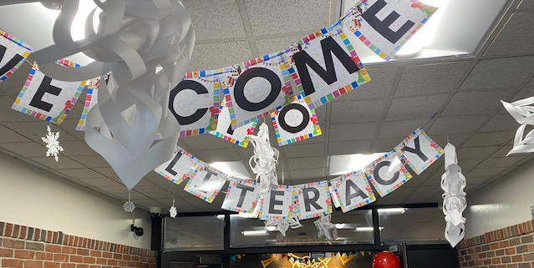
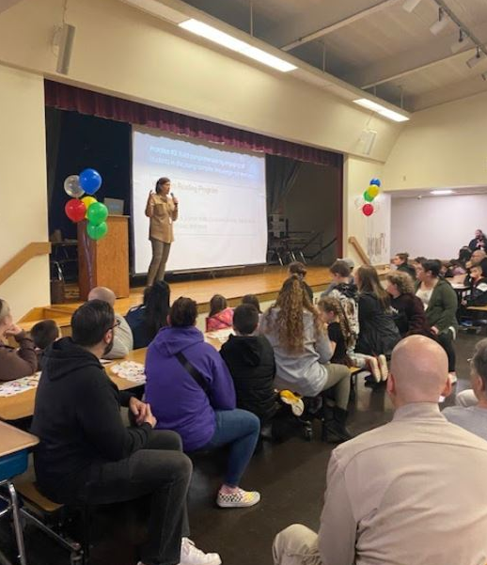
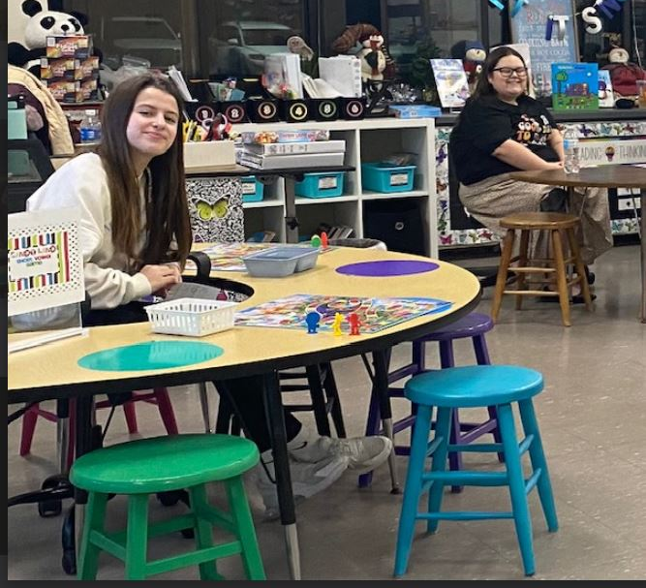
Westport Public Schools Capacity Building
Last year, staff came together with student interns and families, through the PTO, to create an amazing evening of literacy fun and exploration. We started the night with a quick mini-lesson on where we are as a district with literacy.
81378451
This year, we are building on this with more evening events, including events at our middle-high school.

Slide 15
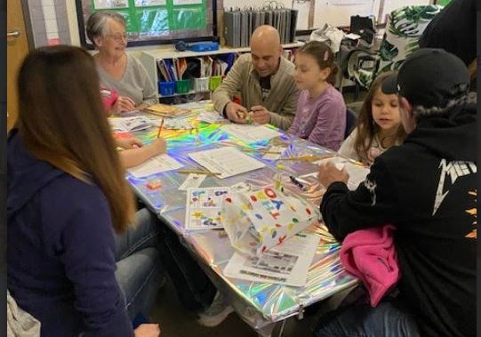
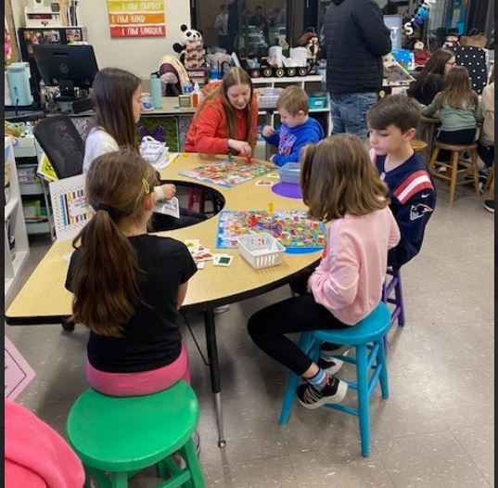
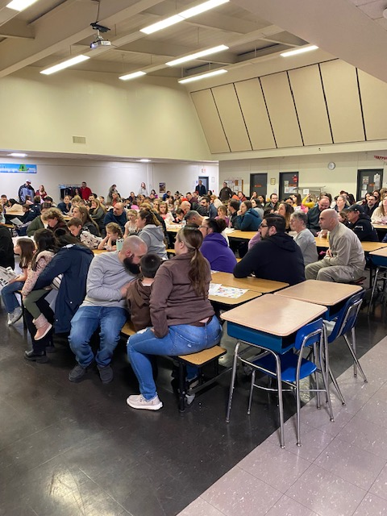
Ah-Ha Moments
When we create opportunities that families see as relevant and valuable, and that celebrate their children's learning, they show up!
Notes:
In addition to the policies, meetings and notifications, opportunities for community and capacity building are the next step to Family and Guardian engagement. This should also be explcitly indicated in the Family Engagement policies. What are some opportunities and activities does your district provide?

Slide 16
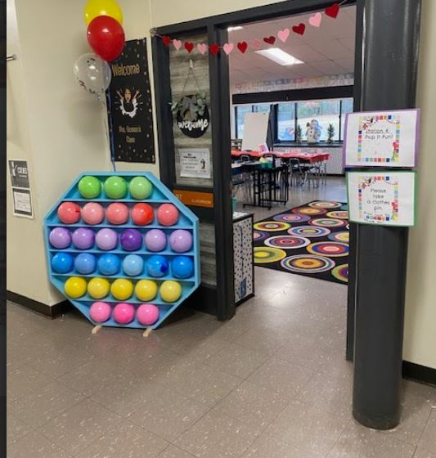
Capacity Building Resources
Helpful Links
Amazing Picture Books
Book Marks PDF
Literacy Game Night Ideas
Literacy Game Night Passport
Take Home Pamphlet
Notes:
In addition to the policies, meetings and notifications, opportunities for community and capacity building are the next step to Family and Guardian engagement. This should also be explcitly indicated in the Family Engagement policies. What are some opportunities and activities does your district provide?

Slide 17
Questions and Conversation on fulfilling ESSA Requirements
Notes:
Before we open up to questions from participants I want to thank our panelist for sharing.

Slide 18
Resources:
District and School Family Engagement & Required Policies (DESE Guidance)
School- family/guardian compact Report Card Cover Letter and Right-to-Request (English)
Right-To-Know: Teacher Not Meeting State Licensure Requirements ESSA Family Engagement Overview – Coming Soon!
Notes:
Cycle to the resources on our website

