Slide 1
Grant Fiscal Year Timeline
Federal Grants Fall Conference – November 14, 2024

Slide 2
Presenters
Jenn Ahern, Director, Grants Management
Melissa Williams, Grants Management

Slide 3
State Fiscal Year
The state fiscal year runs from 7/1 through 6/30.
FY2025 began 7/1/2024 and ends 6/30/2025.
Federal entitlement grants run for 27-months (multi-year grants).

Slide 4
State Fiscal Year
FY2025 entitlements (Titles, IDEA) run from 7/1/2024- 9/30/2026 because they are multi-year grants in the grants system.
Covers 3 fiscal years
  Year 1: 7/1/2024 – 6/30/2025 (FY25)
  Year 2: 7/1/2025 – 6/30/2026 (FY26)
  Year 3: 7/1/2026 – 9/30/2026 (FY27 - 3 months)

Slide 5
State Fiscal Year
Multi-year entitlements have a process where DESE rolls unclaimed balances from Year 1 (7/1/2024 – 6/30/2025) into Year 2 (7/1/2025 – 6/30/2026); and again into Year 3 (7/1/2026 – 9/30/2026)
Year 3 = 3 months long (July – Sept)
RFP posting and Grant Award Notice (GAN) will tell you if the grant is a true multi-year grant in the system.
Other grant types that have 6/30 as their end date are not multi-year grants in the system, even if the RFP has a continuation year. Continuation year grants require a re-application process for the new fiscal year.

Slide 6
State Fiscal Year
RFP posting displays grant end date.
GAN displays grant end date.
Final Reimbursement requests will be due 58-60-days (varies due to Accounts Payable) post grant end.
FERs due 90-days post grant end. Federal entitlements (Titles, IDEA) can use FER to claim final balances (not Perkins).

Slide 7
Federal Entitlement Activities (May / June)
FY Close Activities | FY Open Activities
Spend down current FY entitlements | Apply for new FY entitlement grants
Reconcile and submit any needed revisions | Submit grant through LEA Fiscal Representative Approved on or before desired start date
Final Revisions are due 30-days prior to grant end (if 6/30 is the intended end date all final revisions should be submitted by 5/30. | Respond to RASP team with any requested edits in a timely manner
Request Reimbursement for expenditures (unapproved revisions will impact the ability to draw funds)

Slide 8
Grant Activities for 6/30 ends (May / June)
FY Close Activities | FY Open Activities
Review Grant Award Notice to confirm end date and end of year/close deadlines. | Apply for new FY grants as RFPs are available.
Prepare for Accounts Payable for all grants that end 6/30. | Start date for non-comps is the date the LEA Fiscal Representative Approved in GEM$.
All revisions submitted by 5/30. | Apply for Summer only grants prior to 7/1 to obtain 7/1 start date.
Finalize all obligations.
Perkins falls into the 6/30 end category.

Slide 9
Federal Entitlement Activities (July / August)
FY Close Activities | FY Open Activities
Review Grant Award Notice (GAN) for important deadlines. | July 1 marks start of new Fiscal Year.
Submit revisions to utilize the oldest award first for multi-year entitlements (if continuing into year 2 or 3). | Apply for new FY entitlement grants. Deadline is typically October.
Submit all final reimbursement requests for Perkins (FC 0400 / 0401) funding by the August accounts payable deadline as issued by Grants Management (varies, but on or around 8/26). | Submit grant through LEA Fiscal Representative Approved on or before desired start date.
Perkins is a one –year entitlement award so must adhere to 6/30 end deadlines. | Respond to RASP team with any requested edits in a timely manner
File Perkins FER(s) by 9/30 to close grant. FERs can be used to close and request final reimbursement if filed by August 15th.
Submit final revisions for any 9/30 end grants by 8/31.

Slide 10
Accounts Payable (AP) 7/1 – 8/31
FY2025 AP will be 7/1/2025 – 8/31/2025.
AP is the timeframe where DESE must complete processing and paying all prior fiscal year grants (that have a 6/30 end date). (PERKINS)
Grants with extended end dates/multi-year options have additional time to draw funds.
  For example, Titles with the multi-year feature balances will roll and seamless requests for reimbursement until November 2026.*
  FY24 FC 0274 ended 9/30/2024 and can be drawn through November 2024.
Grants Management will continue to use GEM$ messaging feature to blast important deadline information.

Slide 11
Federal Entitlement Grants
The grant start date for entitlements is based on when the grant is submitted through LEA Fiscal Representative Approved step in GEM$.
  Only grants submitted through this step on or before 7/1 will get 7/1 as a start date.
Spend down current FY entitlements - utilize oldest funds first! (First In, First Out)

Slide 12
Grant Activities for 6/30 ends (July / August)
FY Close Activities | FY Open Activities
Reconcile and submit all final reimbursement requests | July 1 marks start of new Fiscal Year.
Deadline for reimbursements will be late August (varies each year – review Grants Management communication for deadline; typically on or around 8/26). (58-ish days post grant end) | Apply for new FY grants as RFPs outline.
Perkins is a federal entitlement but is a one-year 6/30 end grant! | Submit grant through LEA Fiscal Representative Approved on or before desired start date.
FERs can be used to claim final expenditures if they are submitted by August 15th. | Respond to DESE program team with any requested edits in a timely manner.
All FERs due 9/30. (90-days post grant end) | Alert the DESE program manager if you intend to forfeit grant funds.

Slide 13
Federal Entitlement Activities (Sept - Dec)
Prior Closed FY Activities | New/Current FY Activities
Submit final reimbursement requests for 9/30 end grants by 11/30. | Submit reimbursement requests as needed.
Use old money first! | Reconcile frequently and submit revisions 30-days prior to need, as needed.
Review GAN for deadlines! | Review GANs for start dates & deadlines.
File FER by 12/31. FER can be used to claim final expenditures. | Alert the RASP / Federal grants group if you intend to forfeit the grant funds.
If the end date is off state FY cycle, FER can be used to claim final balances. (i.e., FY2024 Title/IDEA grants)

Slide 14
Grant Activities for 6/30 ends (Sept - Dec)
Prior Closed FY Activities | New/Current FY Activities
File FER by 9/30. Cannot use FER to claim final balance as this point. | Submit reimbursement requests as needed.
FERs filed after 8/15 that include final balance requests will be sent back for grantee to remove unclaimed expenditures from the FER. (PERKINS!) | Reconcile frequently and submit revisions 30-days prior to need, as needed.
 | Review GANs for start dates & deadlines.
 | Alert the DESE program unit if you intend to forfeit all or some of the grant funds.
8/31 or 9/30 summer only ends: | Summer only grants: if grantee anticipates not spending entire award, contact DESE program person to adjust allocations down and trigger a revision (decrease).
 | Summer only grants: Final reimbursement requests due by October or November (check GAN) FERs due November or December.

Slide 15
Summer only / off-cycle end dates
Summer only and off-cycle end date grants have shortened timeframe for obligation, liquidation and closeout.
  For example, 8/31 ends have through October to file reimbursement request
  FERs due 11/30
Summer only (non-comp) grants should be submitted through LEA fiscal Representative Approved on or before 7/1 to get a 7/1 start date.

Slide 16
Ongoing / As needed (Dec – May)
LEAs should be reconciling approved budgets quarterly to assess if a revision (amendment) is needed.
Revisions should be submitted 30 days prior to need
Final Revisions are due 30 days prior to grant end date.
Click Application Revision Started in Sections to initiate a revision

Slide 17
Federal Entitlement Activities (March – April)
  Federal entitlement grants have a reallocation process where additional funds are added to existing allocation amounts.
    New award amounts trigger a revision to be initiated in GEM$
    Grantees need to account for the new award on the budgets
    Incomplete revisions will impact the ability to draw down the new award amount and can cause issues with final reimbursement requests and FER filing.
    Submit revisions by deadline issued by RASP
    Alert RASP / Federal grants group if forfeiting increase

Slide 18
Grant Activities for 6/30 ends (March - April)
  LEAs should assess whether they intend to expend grant funds in full.
    If it is known that all funds will not be obligated and spent, contact DESE grant program person to revise allocation amount which will trigger a revision (decrease).
    DESE would expect all changes to allocation/award amounts to be submitted in March/April so they can be processed by DESE by mid-May. (workflow)
  Summer only grants are typically available in Spring (May or June) for the upcoming Fiscal Year.
    For example, a state funded grant with PAC language would be made available in May or June of FY25 for FY26 (7/1/2025) summer only award.
    State funded PAC grants MUST BE decreased in the Spring of the prior fiscal year to have funds available in the summer of the next fiscal year.

Slide 19
Grant Award Notice (GAN)
The Grant Award Notice (GAN) end date determines the timing of deadlines
  Final Revisions (amendments): 30-days prior to grant end date
  Final Reimbursement Requests: 60-days post grant end date
  Final Expenditure Report: 90-days post grant end date
Grants that end 6/30 (most) have slightly less than 60 days to request final reimbursement depending on what day Accounts Payable ends. (PERKINS!)
Grants that end beyond 6/30 (Titles, IDEA) of the current fiscal year the FER can be used to both close the grant as well as grab final grant balances.
If a GAN is showing dates that look incorrect, please let us know!

Slide 20
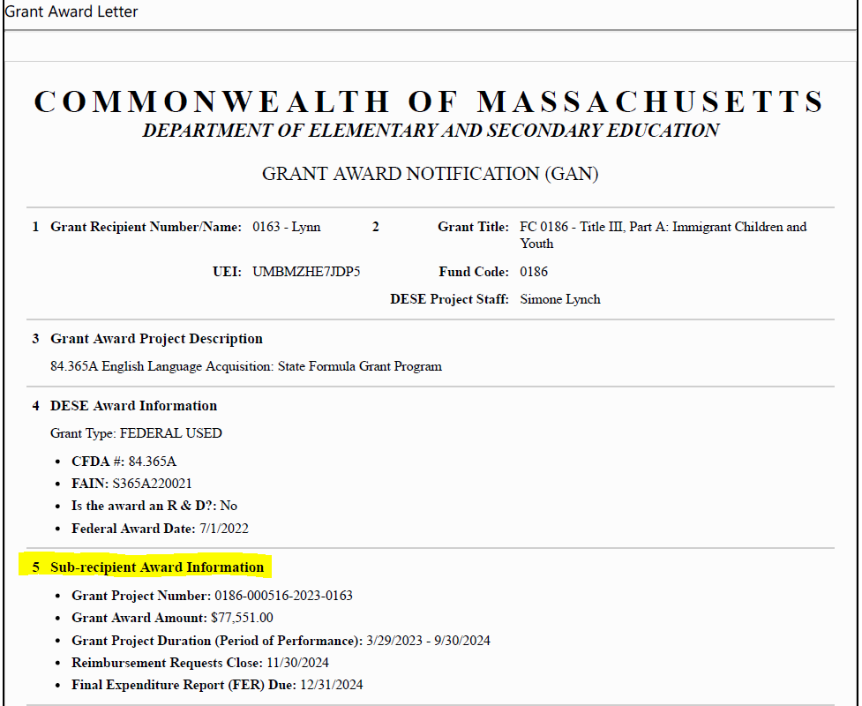
Grant Award Notice (GAN)
Notes:
Section 5 has all the important info! Dates! Amount! Increases will show here as well.

Slide 21
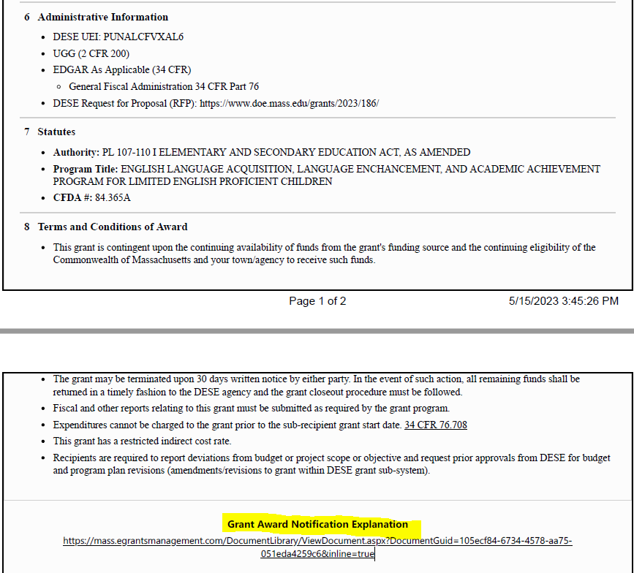
GAN Cont.
Notes:
GAN explained link

Slide 22
Reminder Slides

Slide 23
Links
Grants Management Website (RFP postings and more)
Grants for Education Management System (GEM$)
How to file Final Expenditure Report (FER) – GEM$

Slide 24
Revisions / Amendments are Required when:
there is any significant change in program objectives; or
there is any increase or decrease in the total amount of the grant; or
an increase in a line of the budget exceeds $100 or 10% of the line (whichever is greater), or exceeds $10,000
amendment validations will be built into the reimbursement request form
Notes:
Validations – bullet 2 and 3. decrease – reimb request will not allow you to draw more than the new amount;

Slide 25
Obligation and Liquidation for Federal Grants
Best Practice = Obligate and Liquidate before the grant deadline.
Deadline for obligation depends on type of expense:
If the obligation is for: | The obligation is made:
Acquisition of real or personal property | On the date on which the State or subgrantee makes a binding written commitment to acquire the property.
Personal services by an employee of the State or subgrantee | When the services are performed.
Personal services by a contractor who is not an employee of the State or subgrantee | On the date on which the State or subgrantee makes a binding written commitment to obtain the services.
Performance of work other than personal services | On the date on which the State or subgrantee makes a binding written commitment to obtain the work.
Public utility services | When the State or subgrantee receives the services.
Travel | When the travel is taken.
Rental of real or personal property | When the State or subgrantee uses the property.
A pre-agreement cost that was properly approved by the Secretary [of Education] | On the first day of the grant or subgrant performance.

Slide 26
Obligation and Liquidation for Federal Entitlement Grants
For contracts for services/goods, if necessary, grant recipients may take up to 90 days past the grant deadline for performance of the contract.
If you are not sure of deadlines, check your GAN!
Quick Reference Guide for Obligation/Liquidation: https://www.doe.mass.edu/federalgrants/resources/obligation-performance-liquidation.docx

