Slide 1
Program Evaluation
Webinar #2
November 13th, 2024

Slide 2

Introductions
Leif Jacobsen
DESE, Federal Programs Team
Kendra Winner
DESE, Research and Evaluation Coordinator

Slide 3
Objectives
By the end of today’s convening, participants will...
Understand how a theory of action:
  Supports achieving your outcomes
  Establishes your evaluation framework
  Pinpoints your measures/metrics
Understand how to develop a theory of action
Know how to draft a plan for data collection including:
  Select data that measures what you intend to measure
  Prepare for the logistics of data collection
  Create a timeline for data collection

Slide 4
Why is this important?
Federal law mandates that as a condition of accepting Title grant funding, a district must annually evaluate its Title grant programs.

Slide 5
Your Feedback and Upcoming DESE Support
Upcoming Webinars
As a result, we are planning five webinars in the upcoming year: Today: Theory of Action & Data Collection January: Metrics and Collecting and Analyzing Data March: Preparing Your Analysis May: Communication Plan

Slide 6
What We Covered in Webinar #1
We covered:
Federal Title Grant Requirements
What DESE requires you submit for review during monitoring
Common Evaluation Challenges
Defining Your Title grant program goals
Identifying/Creating a team
Creating a data collection plan
*Recording available to view on DESE Federal Programs website.*

Slide 7
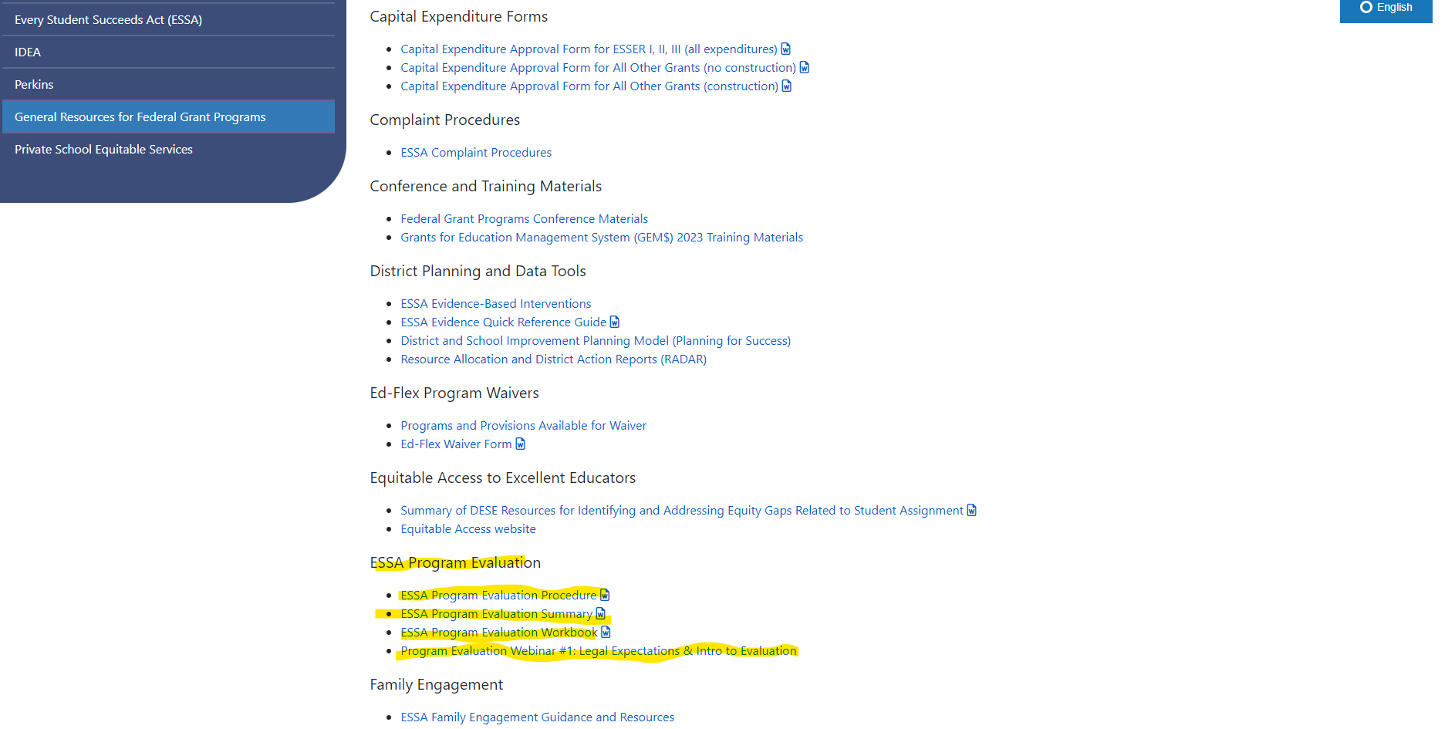
Where to Find Evaluation Resources
1. On DESE Website, go to
Federal Grant Programs
->
General Resources for Federal Grant Programs ->
ESSA Program Evaluation

Slide 8
Title Grants Program Evaluation Workbook
An outline and checklist of five steps to take
The key questions each step is meant to answer
Tools to support completing the steps

Slide 9
Evaluation Checklist
Step | Question | Checklist
1: Define program goal and evaluation questions | What did we design our program to do? What do we want to find out? How would we know? What is measurable and attainable?
2: Identify members of the team | What skill(s) do we need on our team and who has those skills?
3: Create a data collection plan | How and when do we collect and analyze the data?
4. Analyze data and summarize findings | How do we analyze our findings?
5. Report, discuss, and apply evaluation findings | How do we report our findings and what do we do as a result of our findings?

Slide 10
Key Takeaways
Start with where you want to go
Get it in writing, but use a pencil
Plan way in advance

Slide 11
TOA: Step 1 of the Evaluation Checklist
Step 1
Program Goal(s):
  What did we design our program to do?
  What are we doing to achieve our program goal?

Slide 12
Theory of Action Definition
A theory of action is a connected set of propositions, a logical chain of reasoning that … “connects the dots” explaining in a commonsense way which features are expected to produce results that lead to the final desired outcome (Haertel, National Academy of Science, 2009).

Slide 13
How is TOA related to program evaluation?
Establishes your evaluation framework – a map of your key outcomes and how you will measure progress (indicators)
Clarifies and specifies the shorter and longer-term outcomes that you want to measure.
Focuses monitoring and evaluation efforts on those changes you really want and need to track.
A TOA should make evaluation more effective, relevant, and easier.

Slide 14
Typical Theory of Action: If … Then … So That
If…. | Then… | So that…
DESE improves program evaluation guidance for and provides additional targeted assistance on program evaluation to districts. | Districts will have the resources and support necessary to complete quality evaluations of their Title Grant Programs. | Districts conduct program evaluations that are valuable to them to guide their work and meet federal program evaluation requirements.
Challenges
Starts with what we plan to do and works its way toward where we hope to get.
No explicit information about what we’re going to do.
Missing information about how and why we think we’ll get where we want to go.

Slide 15
TAKE AWAY 1: START WITH WHERE YOU WANT TO GO

Slide 16
#1 Start With Where You Want to Go
If…. | Then… | So that…
DESE improves program evaluation guidance for and provides additional targeted assistance on program evaluation to districts | Districts will have the resources and support necessary to complete quality evaluations of their Title Grant Programs | Districts conduct program evaluations that are valuable to them to guide their work and meet federal program evaluation requirements
Reverse the order to backwards plan:
Long Term Goal (So That) | Short Term Goal (Then) | Key Actions (If)
Districts conduct program evaluations that are valuable to them to guide their work and meet federal program evaluation requirements | Districts will have the resources and support necessary to complete quality evaluations of their Title Grant Programs | DESE improves support to districts to conduct program evaluations and provides additional targeted assistance on program evaluation to districts.

Slide 17
#2 Make your best thinking explicit
Explicit Key Actions
We create evaluation support: a workbook that explains a step-by-step approach to conduct an evaluation and recorded webinars; AND We get feedback from districts to improve the workbook and the webinars; AND We work with volunteer districts to provide them with targeted support and get their feedback on the workbook and webinars; AND We revise the workbook to address feedback;
Original “General” Key Actions
DESE improves support to districts to conduct program evaluations and provides additional targeted assistance on program evaluation to districts.

Slide 18
#3 Spell Out How and Why
Step 1
Develop an evaluation workbook with planning steps, a checklist, and tools to provide information about and supports to conduct federally funded required Title Funding Evaluations.
What changes? Why do we think this will help get to the long-term outcome?
What changes? | Districts have access to written resources that provide a step-by-step how to conduct a federal grants evaluation that’s aligned to federal requirements.
Why does it lead to the outcome? | These new resources fill a gap in the supports that have been available to districts. These new resources provide more detailed information and instructions than were previously available.

Slide 19
How are we going to know? Measures and Data Collection
We’re going to ask you!
  Can you find and access the resources?
  Do the resources include the right stuff?
  Do the resources help you?

Slide 20
Measures and Data Collection Plan

Slide 21
Data Collection: Timeline
Fall 2024 | Winter 2024 | Spring 2024
Identify metric(s) aligned with your short- and long-term goals Determine whether data already exists (if so, where it is housed) or whether it must be collected If data already exists or is to be collected (e.g., literacy benchmark assessments), identify who collects and stores the data and identify right tools for analysis (e.g., excel) and how to upload/transfer data into your data analysis tool. | If data must be collected, identify data collection tools (e.g. survey program) and make sure it has a report function Collect data Aggregate and clean data and prepare it for analysis Conduct any BOY and MOY comparisons/analysis if your data lends itself to that. | Data analysis, write up, and dissemination

Slide 22
Data Collection: Types of Data
The data that you need to collect will depend on what you are evaluating. Some common metrics are:
Student achievement/growth: MCAS, DIBELS, Access, ANET, other internal Assessments
Attendance: Attendance rate, tardy rate
Extracurricular engagement: participation rate
Parent Engagement: Parent attendance at parent-teaching meetings, PTA, etc.

Slide 23
Data Collection: Validity
“How do I ensure that the data I am collecting measures what I want it to measure?”
Make sure that there is alignment between what you are evaluating and your metric.
For example, using MCAS data to measure family engagement wouldn’t make sense.

Slide 24
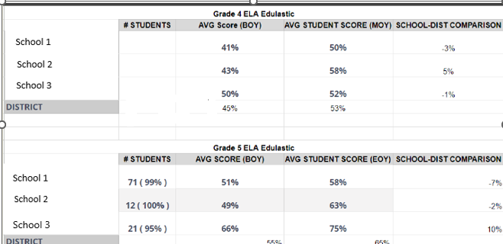
Data Collection: Cleaning Raw Data
1) Clean the Data
Check for Errors: Identify and correct inaccuracies, such as duplicates, missing values or outliers.
Standardize Formats: Ensure consistency in data formats (e.g. categorial variables).
2) Organize the Data
Structure the data in a way that aligns with your analysis needs.

Slide 25
Data Collection: Think-Aloud
Given these program goals, how might the evaluation coordinator think about data collection?
Evaluation Goal #1 | Evaluation Goal #2 | Evaluation Goal #3
To evaluate whether the literacy skills of elementary students were improved through targeted literacy interventions. | To evaluate whether holding regular parent workshops increased parent and family engagement. | To evaluate whether Title-I funded SEL programs improved students’ social and emotional skills.

Slide 26
More Evaluation Support Coming!
Webinars
January: Metrics and Data Collection
March: Preparing Your Analysis
May: Communication Plan
Workbook Additions
We are continuing to update the workbook tool that you can use to guide your evaluation work.

Slide 27
District Feedback Questions
How difficult is it for you to find the federal title evaluation supports? What’s the biggest challenge to finding these? How could DESE improve your ability to access these?
Do the federal title evaluation supports cover the information you need? What could be improved? What is missing? Are the supports easy to understand? Easy to use? What/how could they be improved?
Do the federal title evaluation supports improve your understanding of the evaluation process? Help you to carry out the evaluation process? What needs to be improved? What is missing? What challenges do you have that are not addressed?

Slide 28
Survey
Please complete the survey that is emailed to you (also dropped here in the chat) so that we can incorporate your feedback.
Other questions: please email leif.jacobsen@mass.gov.

