Slide 1
Establishing a Title III Consortium from the Ground Up
Federal Grant Programs
November 2024

Slide 2
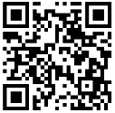
AGENDA
FY25 TITLE IIIA CONSORTIA
A COLLABORATIVE APPROACH (Tantasqua)
QUESTIONS & REACTIONS
WELCOME
https://padlet.com/judithrmagloire/establish-a-title-iii-consortium-bxgm6g5rttrp2tf6

Slide 3
FY25 Title IIIA Consortia by the Numbers
15 fiscal leads (including 3 Collaboratives)
52 member districts being provided with Title IIIA services
A total of 2,716 EL students and their families currently being served as part of the 15 Title IIIA Consortia
Increase in the number of Title IIIA Consortia from FY24 to FY25 (12 to 15)
Decrease in the average number of member districts per Title IIIA Consortium (6.5 to 3.5)

Slide 4
Title IIIA Consortia Resources
Sample Title IIIA Consortium Memorandum of Understanding
English Learners Guidance to Consortia Formed for Title IIIA Subgrant Purposes — School Year 2024-2025
Title III Consortia Quick Reference Guide
www.doe.mass.edu/federalgrants
Federalgrantprograms@mass.gov

Slide 5
Title III Consortium:
A Collaborative Approach to
Supporting English Learners
Tantasqua/Union 61 Schools
North Brookfield Public Schools
Palmer Public Schools
Notes:
Presentation Notes
Description Slide 1: Scrabble letters spell out English Learners

Slide 6
Consortium Members
(*Panelists)
Tantasqua/Union 61 (Fiscal Lead)
*Coleen DeBari, Compliance and Equity Coordinator
*Dam Nguyen, EL Coordinator/Teacher
*Stephanie West, EL Coordinator/Teacher
Darci Andrade, EL Teacher
*John Vargas, EL Teacher
North Brookfield
*Kailyn LaChapelle, EL Teacher
Palmer
Kelly Simpkiss, EL Teacher
Karyn Perry, EL Teacher
Lisa Newton, EL Teacher

Slide 7
Birth of a Title III Consortium
Building a Consortium
Needs Analysis
Program Alignment and Requirements
Shared Responsibility and Resources
Year One Accomplishments
Strategic Shifts for Year Two
Q & A/ Discussion
Notes:
Pictured: Each School District Symbol/Emblem: TU61, North Brookfield Public Schools, Palmer Public School District: Birth of a Title III Consortium

Slide 8
01.
BUILDING A CONSORTIUM
Notes:
Pictured: Hand of all shades coming together

Slide 9
Initial Steps
➣ Partner Outreach
➣ Intent to Participate
➣ MOU (GEM$)
➣ Narrative/Plan
➣ Budget
➣ Act!
Notes:
Pictured: Student legs walking up steps

Slide 10
Building a Consortium: Challenges and Successes
Successes
Challenges
Building Stronger Inter-District Relationships
Shared Learning and Best Practices
Enhanced Pooling of Resources and Expertise
Family Connection Across Districts
Securing Buy-In
Establishing Clear Communication Channels
Varying Needs Across Districts
(Allocation of Funds)
Unexpected Influx
Notes:
Pictured: Cream colored puzzle pieces with on missing part of the puzzle off to the side: Challenges and Successes

Slide 11
02.
NEEDS ANALYSIS
Notes:
Pictured: Fingers pointing to data on a chart: Needs Analysis

Slide 12
Identification of Needs
Identification
of
Needs
Notes:
Pictured: Screenshots from EL Data Dashboard for all towns within the consortium

Slide 13
Funding Support
ACCESS Scores, School Assessments, and Surveys: Through a careful analysis of these data points, Title III funds could enable the consortium to monitor ELs' progress in language proficiency and academic content. This data-driven approach helped tailor instructional strategies and allocate resources where they are most needed.
Rapid Resource Allocation: With funding, the consortium would be able to respond promptly to areas experiencing a sudden increase in EL enrollment, which was the case in Palmer and Sturbridge. This included funding for additional staffing to provide tutoring supporting, providing translation and purchasing materials to aid in that instruction.
Family Orientation Resources: Title III funds could provide materials and orientation sessions to help newcomer families understand the school system, available resources, and their role in supporting their children’s learning. These funds made it possible to hire staff to lead these initiatives.
Language Support for Families: Title III funds could offer ESL classes for parents and guardians, empowering them to engage more fully with the school community and support their children’s education. This also builds stronger school-family connections.
After-School and Individualized Tutoring: Title III funds would be able to support additional tutoring services specifically for ELs, including after-school programs and one-on-one sessions, addressing individual learning needs and promoting language acquisition.
Summer Language Programs: Title III funds could be allocated to support summer programs that focus on language development and content reinforcement, helping ELs retain skills and reduce summer learning loss. Programs can include language-rich activities and educational outings designed for language immersion.
Summer Slide Prevention: Title III funds could support programs that prevent the regression of language skills and academic knowledge during summer, including language camps and supplemental reading materials.
Supplemental Materials: Title III funds could be used to purchase bilingual/tiered resources, visual aids, and culturally relevant materials that enrich instruction for ELs, making learning more accessible and effective.

Slide 14
03.
PROGRAM ALIGNMENT
Notes:
Pictured: Star alignments- Program Alignmnet

Slide 15
Consortium Programming: Alignment and Requirements
Language Support for ELs/MLLs
EL Academic Support Services
EL Expeditions
Family Engagement/Fostering Partnerships for Student Success
EL Information Night and Parent Workshops
ESL Parent Classes
Heritage Homecoming
Professional Development for Educators
Confianza PLC
MATSOL

Slide 16
04.
SHARED RESPONSIBILITY AND RESOURCES
Notes:
Pictured: Rosy the Riveter “We Can Do It” poster: Shared Responsibility and Resources

Slide 17
Shared Responsibility and Resources
Lead Fiscal Agent
Directors/Coordinators
EL Staff
Notes:
Pictured: Hands showing “all in”

Slide 18
05.
YEAR ONE ACCOMPLISHMENTS
Notes:
Pictured: Person leaping from one mountain to another: Year One Accomplishments

Slide 19
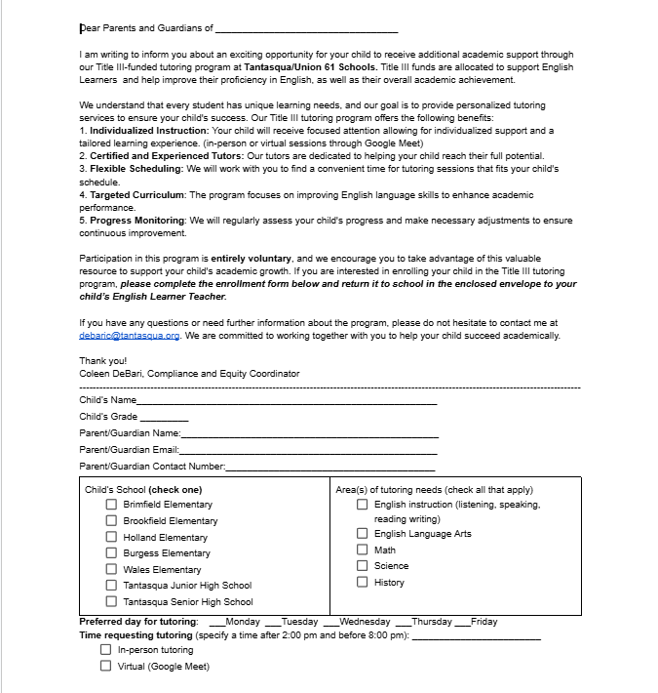
Language Support for ELs/MLLs
EL Academic Support Services
(in-person or virtual/ one to one or small group)
Qualified consortium EL tutors/teachers offered English language services both individually or in small-groups with EL students, tailoring the sessions to their unique language needs. These sessions focused on building language skills in line with curriculum objectives, engaged students in collaborative language activities. Participants practiced effective language learning strategies, study skills, and techniques for improving language proficiency both inside and outside the classroom. (Services provided as requested Oct 2023-May 2024, excluding holidays and vacation weeks.)
Notes:
Pictured: Outreach letter template to families of Tutoring Sessions offered by Consortium

Slide 20
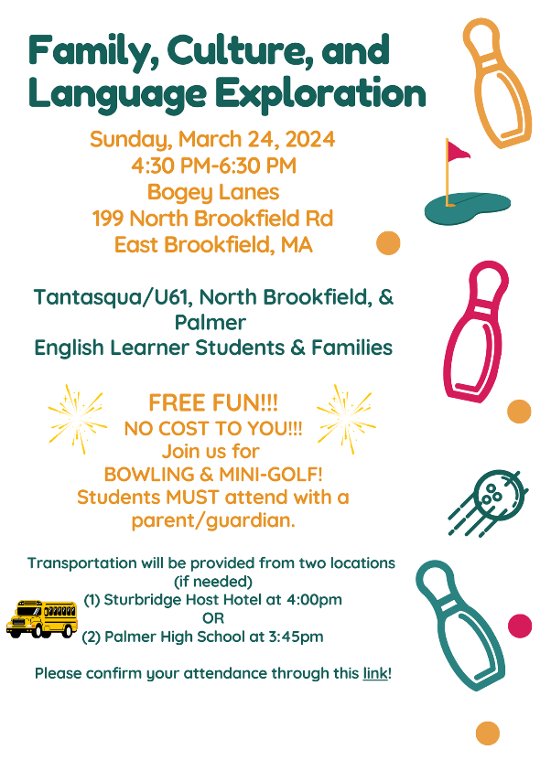
Family Engagement
Our consortium recognizes the significant impact that parent and family engagement has on the academic success of English Learners (ELs). We are committed to establishing strong partnerships with parents and families to create a supportive and inclusive learning environment that maximizes the language development and educational outcomes of ELs. By prioritizing parent engagement, our consortium aims to create a holistic approach to EL education that involves parents as active partners in their child's language acquisition journey, ultimately leading to improved academic outcomes and a more connected school community.
Notes:
(Pictured: Event flyer, people bowling with the lights dimmed, Title III staff group picture in bowling lane)

Slide 21
Family Engagement cont.
ESL Parent Classes
The consortium offered a class focusing on language instruction that equips parents with the vocabulary and strategies to support their child's language and literacy growth. This included reading techniques, vocabulary-building exercises, and storytelling practices. Based on interest and accessibility, we worked with families to determine the mode of delivery for in-person or virtual instruction.
Notes:
(Pictured: Free English class flyer.)

Slide 22
Professional Development for Educators
Confianza envisions an educational landscape where all leaders and educators are prepared to provide access and opportunity for culturally and linguistically diverse learners across the entire system. They aim to increase student outcomes in schools and organizations by improving cultural understanding, communication, and collaboration. Through a PLC, educators throughout the consortium will participate in a book study using The Language Lens for Content Classrooms: A Guidebook for Teachers, Coaches & Leaders (2nd ed.) is the starting point for any educator, including coaches and leaders, of Academic Language Learners (ALLs) and Multilingual Learners (MLLs) in today’s diverse schools.
Through this study educators will explore ideas to invest in all students' identities; learn strategies to boost the learning of all students through speaking, listening, reading, and writing skills across the curriculum; gather tips to support student ownership in their academic success and, ultimately, their career, college, workplace, and life readiness! (Will be offered as a 15 SEI PDP course)
Notes:
(Pictured: Language Lens Book Study Flyer.)

Slide 23
Family Engagement cont
EL Family Workshops and Information Sessions
The consortium organized (2) family workshops/information sessions throughout the year (November/March) on topics including but not limited to family literacy, navigating the educational system, and connecting to community resources. These sessions were conducted with translators present to accommodate the linguistic diversity of our EL families.
Notes:
(PIctured: Fostering Partners for Student Success flyer and one consortium member speaking with two fathers; one consortium member presenting slides)

Slide 24
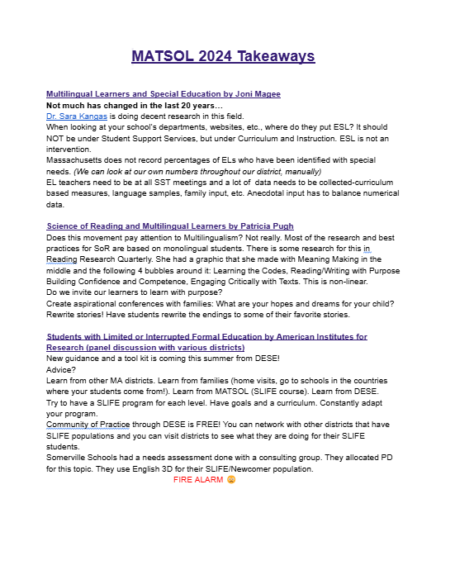
Professional Development for Educators
MATSOL’s mission is to promote equity and excellence in the education of multilingual learners. Their core values include
Professionalism: We believe in sound, research-based educational practices and policies for educators and English language learners alike. We believe that educators of English language learners deserve the recognition, respect and compensation due as professionals and experts.
Educational Quality: We believe that all students have a right to high quality education that empowers them to achieve their life goals.
Multilingualism and Multiculturalism: We believe that proficiency and literacy in more than one language is an asset that should be encouraged and supported. We value the multicultural perspectives and knowledge that both educators and students bring to our schools and society.
Collaboration: We believe in collaborating with other stakeholders to achieve common goals.
Diversity: We believe that diverse identities, backgrounds, and perspectives strengthen and inform our work.
Notes:
(Pictured: Staff photos at MATSOL conference sessions.)

Slide 25
Family Engagement cont.
Heritage Homecoming
The consortium organized a Spring Community Cultural Exchange event where families can share their cultural traditions, stories, and experiences with the school community. This helped foster a sense of belonging and understanding among all stakeholders.
Notes:
(Pictured: Heritage Homecoming flyer, display table for Mexico, display table for Jamaica.)

Slide 26
Language Support for ELs/MLLs
EL Expeditions
The consortium organized (4) local field trip experiences for ELs throughout the year. These adventures occured during summer vacations. Transportation was provided. These expeditions provided opportunities for increased background knowledge and an opportunity to promote and encourage social language skills.
Notes:
(Pictured: Trampoline bounce pad, shark exhibit.)

Slide 27
Language Support for ELs/MLLs
EL Expeditions
Small groups led by trained EL staff interacted with concepts and ideas in science, technology, and history. In addition, students engaged in listening, reading, writing, and speaking activities authentically as they learned from presenters and cherished wonderful experiences with new friends.
Notes:
(Pictured: kids playing mini-golf, kids doing artwork at table.)

Slide 28
06.
STRATEGIC SHIFTS FOR STRENGTHENING YEAR TWO
Notes:
Pictured: World Map: Strategic Shifts for Strengthening Year Two

Slide 29
FINAL REFLECTIONS
“It is worth all of the hard work!” -Coleen
I love being able to connect with other EL teachers. Great ideas come when we work together!-Stephanie
“It has been great to be apart of a team of EL teachers who support and value each other”-Kailyn
“It’s all about working together as a team and making a difference in our community”- Johnny
“I would do it all over again!” -Dam
Notes:
Pictured: Final Reflection Quotes from Consortium Members

Slide 30
Quote
“
None of us, including me, ever do great things. But we can all do small things, with great love, and together we can do something wonderful.
“
— Mother Teresa
Notes:
Pictured: Quote from Mother Teresa

Slide 31
CONTACT US
Tantasqua/Union 61 (Fiscal Lead)
*Coleen DeBari: debaric@tantasqua.org
*Dam Nguyen: nguyend@tantasqua.org
*Stephanie West: westst@tantasqua.org
*Darci Andrade: andraded@tantasqua.org
*John Vargas: vargasj@tantasqua.org
North Brookfield
*Kailyn LaChapelle: klachapelle@nbschools.org
Notes:
Pictured: Contact information for Consortium members

Slide 32
Thank you
Notes:
Pictured: Thank You message in many languages

Slide 33
CONNECTING THE DOTS
https://padlet.com/judithrmagloire/establish-a-title-iii-consortium-bxgm6g5rttrp2tf6

