Slide 1
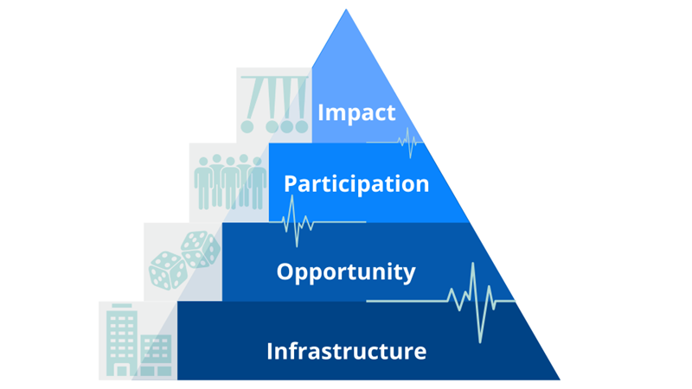
Arts & Cultural Vitality Index
June 10, 2025
12:50-1:50 PM

Slide 2
Agenda
Overview of the Arts & Cultural Vitality Program
12:50-1:10- Dawn
District Case Study A- Worcester
1:10-1:20- Lisa
District Case Study B- North Reading
1:20-1:40- Andrew, Carla
Questions about the ACV Index and Program
1:40-1:50- All
Today's Presenters:
Dawn Benski
Arts Content Support Lead
DESE
Lisa Leach
District Performing Arts Curriculum Specialist
Worcester Public Schools
Andrew Dexter
Visual Arts Department Co-Curriculum Chair
North Reading Public Schools
Carla Lister
Performing Arts K-12 Curriculum Chair
North Reading Public Schools
Patrick Daly, Ed. D.
Superintendent
North Reading Public Schools

Slide 3
Purpose of Today’s Session
★ Offer an overview of the Arts & Cultural Vitality (ACV) Index resource
★ Provide details about the ACV review cycle and program of delivery
★ Explain how to use grant funding to support the ACV program
★ Share case studies from districts who have participated in the ACV program
★ Participants will leave the session having an increased awareness of DESE’s Arts & Cultural Vitality Index and funding options to use the tool

Slide 4
The Resource
Arts & Cultural Vitality (ACV) Index

Slide 5
About the ACV Index Resource:
PURPOSE: To support the development and sustaining of access, equity, and culturally sustaining practices for the arts in MA schools
EQUITY
“Vitality" refers to the "healthiness" of a school's arts and culture
A voluntary, self-evaluative resource to support arts programming that is comprehensive, yet not overwhelming

Slide 6
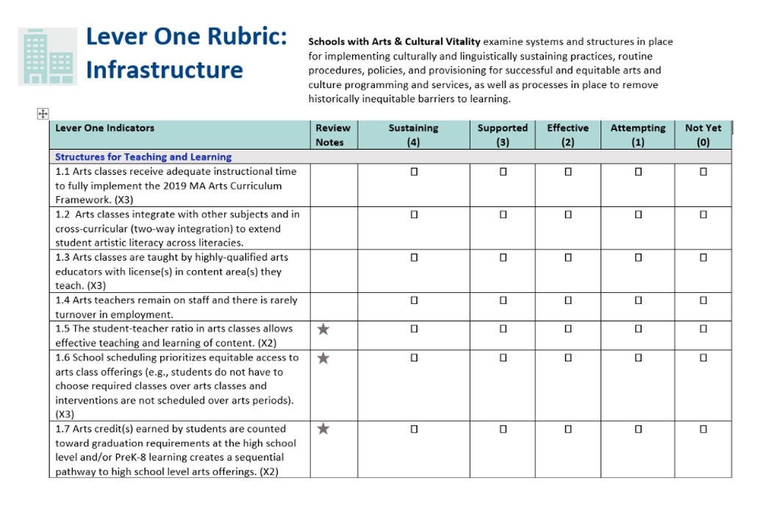
ACV Index Organization
Four Dynamic Levers​
Each lever represents a separate metric that is unique to, and changing within, a school community​
Four Rubrics of Indicators
Each lever has a rubric of indicators with a rating system to help pinpoint areas of strength or needed support​ within the arts & culture of the school

Slide 7
Levers within the ACV Index
Lever One: Infrastructure
Examine systems and structures in place for implementing culturally and linguistically sustaining practices, routine procedures, policies, and provisioning for successful and equitable arts and culture programming and services, as well as processes in place to remove historically inequitable barriers to learning.
Lever Two: Opportunity
Offer students, families, and staff rich opportunities to learn and engage in arts and culture. They ensure that all school members have access and equity in arts and culture programming and services both in and out of school.
Lever Three: Participation
Have a high level of engagement, and active and equitable participation in arts and culture programming and services by all members of the school community.
Lever Four: Impact
Evaluates arts and culture programming and services by the effect they have on the community, particularly on student learning, educator effectiveness, and school climate outcomes, and have evidence of significant, positive, and equitable impact.

Slide 8
Benefit to You
Why should you use the ACV Index in your district?
Formative Benefits:
Enriching conversations about learning in the arts
Shared visioning across stakeholder groups
Summative Benefits:
A "roadmap" to the exact areas that need support
Data-informed decision-making in the arts
Equity is centered to support students
TESTIMONIAL
Our review with the Arts & Cultural Vitality Index gave us a direction for the conversation we’ve been trying to have for many years around equity. A great crossroad between frameworks and equity around the district for conversations that are difficult to have.

Slide 9
The Arts & Cultural Vitality Program
The Review Cycle and Funding Options

Slide 10
Arts & Cultural Vitality Program Features
A Review Cycle that makes the process clear and easy to follow
Professional Learning Community (PLC)
Ongoing DESE support
State Competitive Grant (FY23-FY25, FY26 PENDING APPROPRIATION)
Three tracks
Summer Rollover option (July 1-August 31)
Federal Title IVA funding

Slide 11
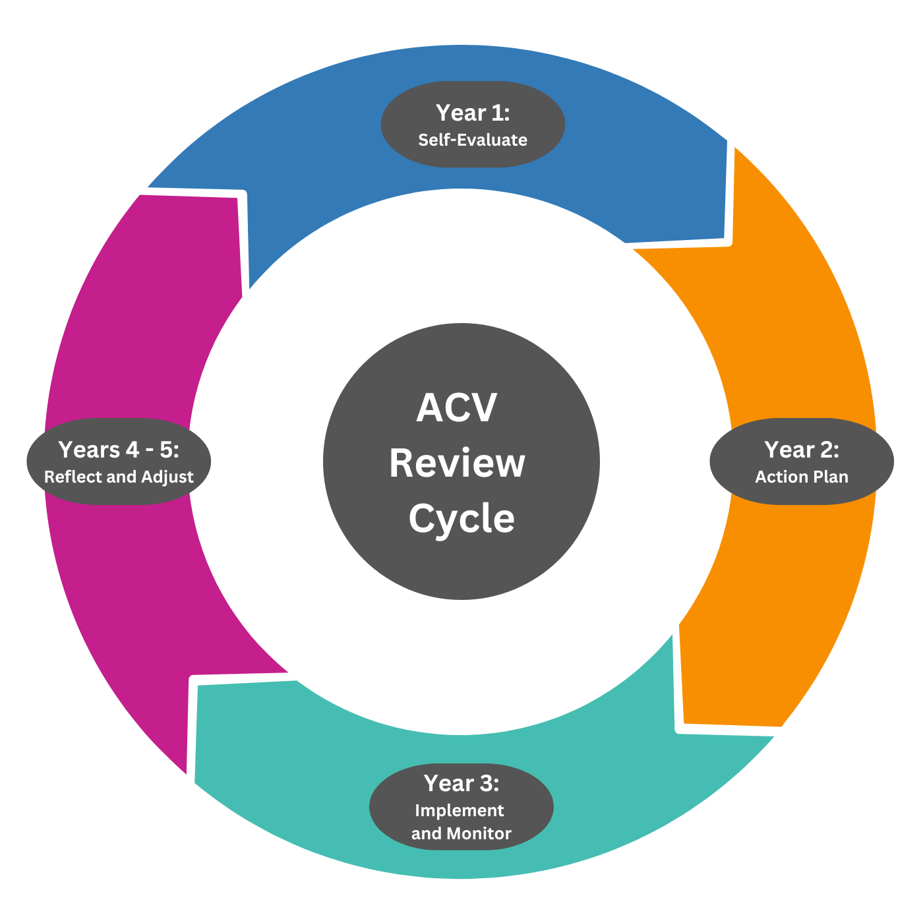
The ACV Review Cycle
Year 1: Self-Evaluate
School or District uses the ACV Index to conduct a review of arts programming through an equity lens.
Year 2: Action Plan
School or District uses the findings from the ACV review to prioritize goals and create an action plan for strengthening equity in the arts.
Year 3: Implement and Monitor
School or District uses the action plan to implement changes in arts programming that will benefit all students and formatively assesses the success of the implementation.
Year 4-5: Reflect and Adjust
School or District assesses the effectiveness of changes in the preceding school year and makes adjustments to and expand on them in Year 4. School or District takes stock of what work still needs to be done, and if appropriate uses Year 5 to refine implementation.

Slide 12
About the State Funded Competitive Grant Program
For the past three years...
Purpose: To provide funding for stipends of school staff members participating as review team members of the Arts & Cultural Vitality Index
Three Tracks:
New grant recipients:
use the Arts & Cultural Vitality Index to conduct a review of their arts programming. (Track 1)
Returning grant recipients:
use their ACV review findings to action plan for improvements to arts programming. (Track 2)
implement steps of the ACV action plan and monitor impact through ongoing analysis of data collection. (Track 3)

Slide 13
Alignment to Title IVA Priorities
Fund Code 0309: Creating Safe, Healthy and Supportive, High-Quality Educational Learning Environments for All
Provide all students with access to a well-rounded education;
Do all students have opportunities to learn outside of core curriculum?
Improve school conditions for learning to ensure safe and healthy students; an
Do all students feel safe at school and are they healthy (mentally and physically)?
Improve the use of technology to improve academic achievement
How can our educators effectively use technology to engage all students?

Slide 14
Targeting Title IVA funds
Districts are required to prioritize funds to schools based on one or more of the following criteria:
they are among the schools with the greatest need (as determined by the district);
they have the highest percentages of low-income students;
they are identified for comprehensive support and improvement;
they have consistently underperforming subgroups; and
they are identified as a persistently dangerous public elementary school or secondary school under section 8532 of the Elementary and Secondary Education Act (ESEA).

Slide 15
Burncoat High School, Worcester, MA
District Case Study A
Track 1

Slide 16
ARTS AND CULTURAL VITALITY INDEX -TRACK 1
www.worcesterschools.org
Date: June 10, 2025
Presenter: Lisa Leach, Curriculum Specialist

Slide 17
WHY DID WE APPLY?
The Levers
Infrastructure
Opportunity
Participation
Impact
Our Questions
How does an arts magnet program impact our larger high school and community?
How can we extend the reach of the arts magnet program to other areas or students?
How can we increase participation and opportunity through the new school build?

Slide 18
IT’S OUR TURN TO DREAM
Worcester Tech
North High School
South High
Doherty Memorial
2006
2011
2021
2024

Slide 19
OUR TEAM
Administration
Arts and Non Arts Teachers
Parents and Students

Slide 20
PLANNING SUPPORT
Thank you, ACV PLC Meetings
Thank you, Waltham
Thank you, WPS Grants

Slide 21
WHAT WE’VE LEARNED SO FAR
Participation
Opportunity
Impact
More students participate in arts classes at BHS than any other HS in Worcester
Infrastructure
Media Art and Dance options
Multiple ensembles/clubs
Alumni and community investment in programs and students.
Programs have grown significantly in the last 6 years creating a need for space.

Slide 22
OUR PLAN MOVING FORWARD
Complete artifact collection
Analyze findings
Summer 2025
June 2025
Present to school and community
Track 2?
Pending support
August 2025

Slide 23
CONTACT US
Phone
+774-242-6735
Email
leachl@worcesterschools.net
Website
www.worcesterschools.org
Location
Durkin Administration Building
20 Irving Street
Worcester, MA 01609

Slide 24
North Reading Public Schools
District Case Study B
Track 3

Slide 25
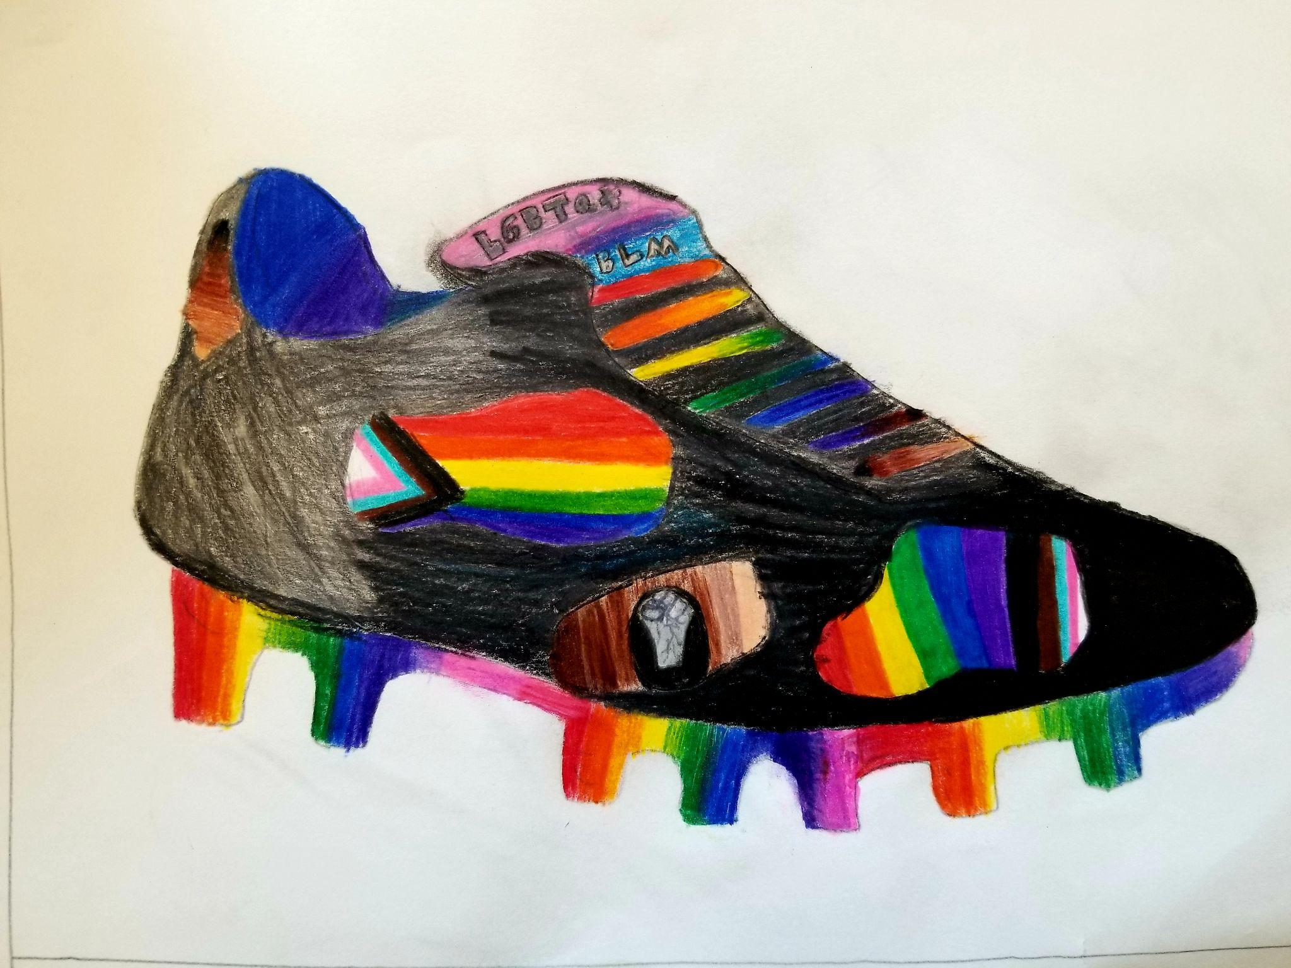
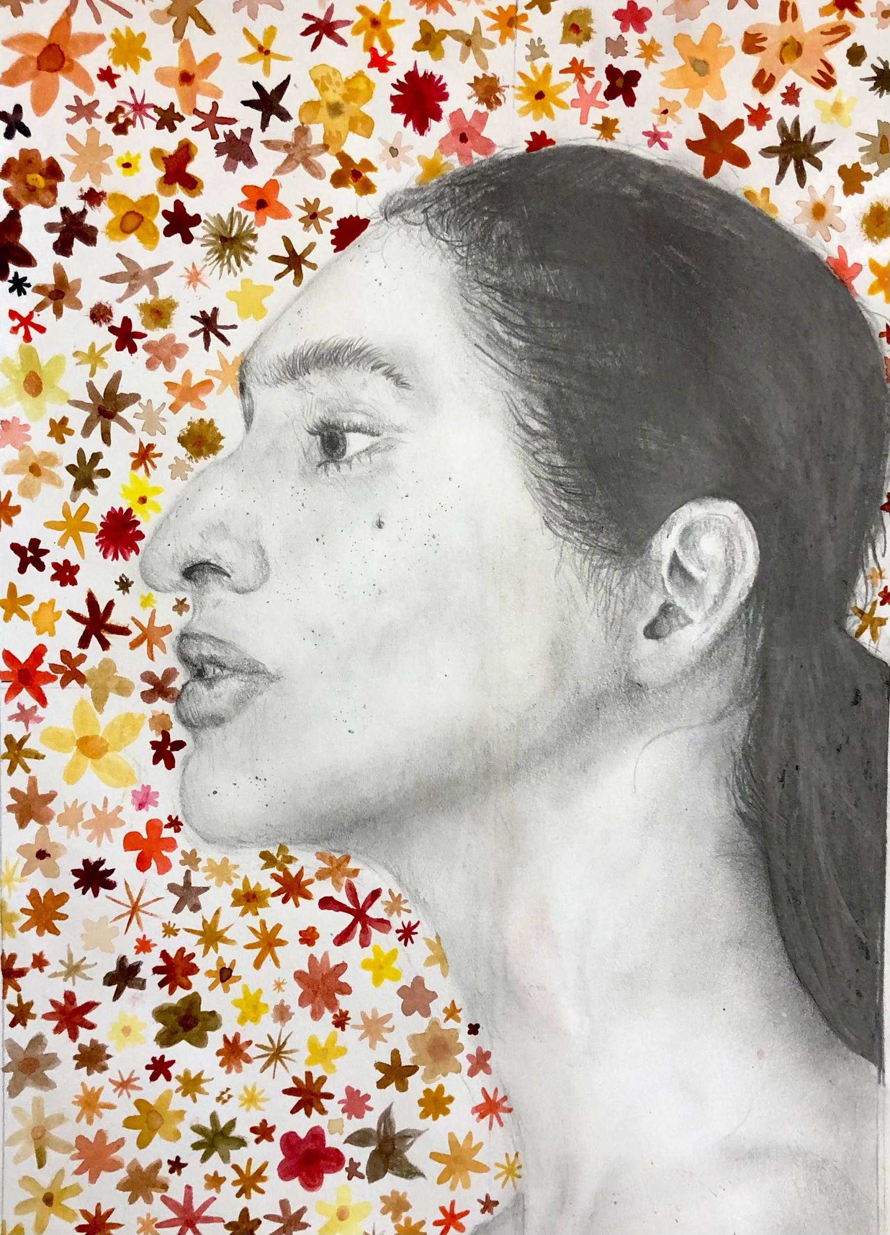
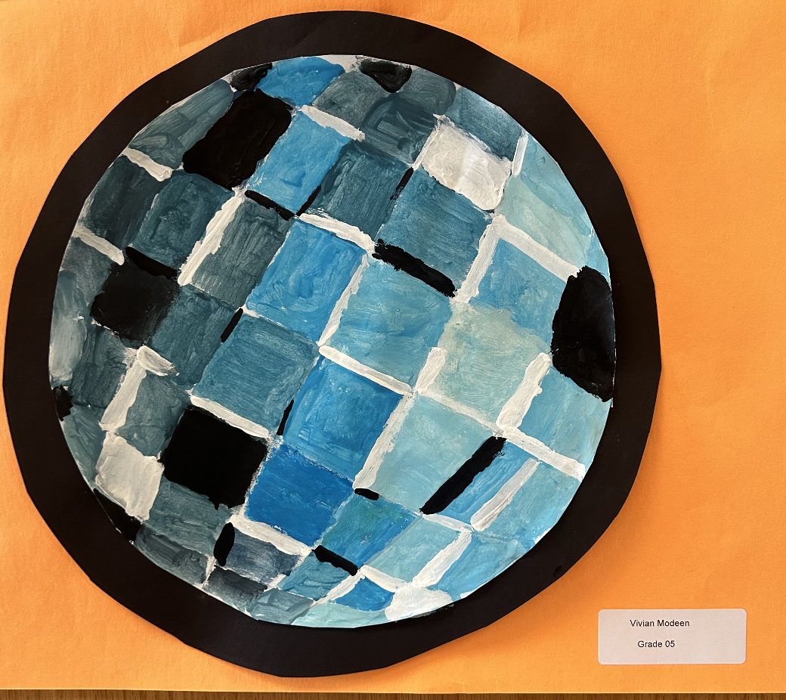
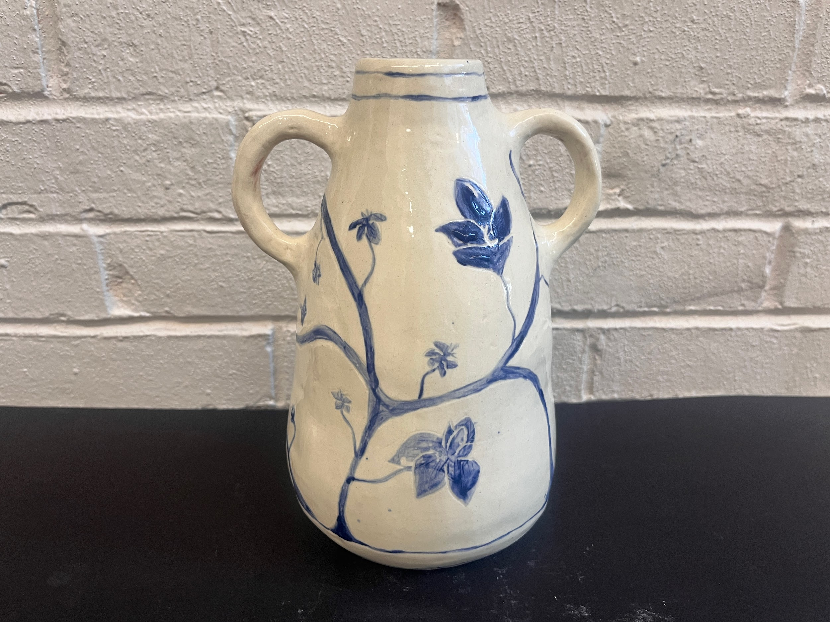
North Reading Visual and Performing Arts
Arts and Cultural Vitality
Findings, Action Planning and Implementation

Slide 26
North Reading - At a Glance
Town Population ~ 16,379
Schools:
L.D. Batchelder Elem: 462
J. Turner Hood Elem: 416
E. Ethel Little Elem: 303
North Reading Middle: 494
North Reading High: 652
MIDDLE SCHOOL:
General Arts Offerings:
General Music, Art, Video Production, Robotics, PE, Health, Digital Learning, Band, Chorus
Four, 50 minute classes/PE required
ELEMENTARY:
Visual Art: 45 minutes/once a week
Music: 30 minutes/twice a week
4th & 5th Grade Chorus:
45 minutes/once a week
4th & 5th Grade Band:
30 minutes small group lessons/once a week
45 minute ensemble/once a week
HIGH SCHOOL:
Block Scheduling:
78 minutes/ 2 day rotation
Visual Arts Electives:
Eleven classes: 1 AP, 2 Honors, 8 Academic
Performing Arts:
Thirteen classes: 1 Ap, 2 Honors, 11 Academic
Band:
45 minutes every day during powerblock

Slide 27
The Team
Resources
District and School Administrators
Guidance Department
Data Leaders
Student, Teacher and Parent Feedback
Carla Lister, Performing Arts Curriculum Chair,
Andrew Dexter, Visual Arts Co-Curriculum Chair
Ashley Doke, Visual Arts Co-Curriculum Chair
Jessie O’Brien, Middle School Visual Arts Teacher
Tara Atsalis, High School Visual Arts Teacher
Allison Kane, High School Performing Arts Teacher
Ben Owens, High School Performing Arts Teacher
Dana Lewis, Middle School Media Arts Teacher
Jana Comeau, Elementary Performing Arts Teacher
Isaac Gliklich, Elementary Performing Arts Teacher
Chris Tatro, Elementary Performing Arts Teacher
Stakeholders
Students
Administrators
Guidance Counselors
Special Education Staff
Teachers
Parents
Community
Alumni

Slide 28
Track 1 - Findings
Based on teacher and student input survey issued 2023, ACV team determined three major topics that warranted further investigation
Scheduling
Accessibility to courses
Even time across content areas (k-8)
Course weighting (HS)
Full vs. half year courses (HS)
Conflicts (Services that pull students from classes (MS/HS)
Time on learning (equitable arts focus K-12)
Student choices - Multi Level/tiered Classes
Facilities and Equipment
Use of Facilities - A study of accessibility
Learning Spaces - Do the spaces available meet teaching requirements?
Equipment - Does the instructional equipment meet the needs of the curriculum?
Perception of Fine/Performing Arts in Practical Applications: Building Community
Student/Family/Community/Staff involvement during school hours and after school hours
Integration into other disciplines

Slide 29
Questions:
Scheduling
What is limiting student access to participating in arts classes?
What electives are students taking entering HS, and why?
How do we identify areas in the scheduling that typify equity & access to arts classes?
How are services that students are receiving for their IEP limiting their access to arts classes?
Facilities and Equipment
Does each school have sufficient space and instructional equipment to meet the needs of students as well as the curriculum?
Does the shared space model at the MS/HS limit student access to curriculum as well as after school activities?
Does the student experience differ between schools depending on?
Perception of Fine/Performing Arts in Practical Applications: Building Community
How do we increase family/community/staff involvement and use of the arts in everyday opportunities?
How do we change the perception of the arts in our community from a nonviable career option in priority of scheduling, and reality fairs?

Slide 30
Track 2 - Action Planning: How do we find the answers to our questions?
SCHEDULING:
Surveys for 5th & 8th grade students focusing on elective classes and retention issues
Survey for 12th grade students focused on overall experience and engagement in the arts
Research student enrollment
High school student enrollment by grade focusing on elective classes
Middle school scheduling of general arts and student services for IEPs
Elementary scheduling flexibility issues
FACILITIES & EQUIPMENT:
Compile scheduling data for all shared spaces (PAC/Vans/Shared Classrooms), and limitations it has put on curriculum.
Compile a list of equipment that needs updating or repairing
BUILDING COMMUNITY:
Student Involvement
Family, Community & Staff Involvement
Perception as a Financially Practical Career Option

Slide 31
Track 3 - Implementation
Scheduling
Changed prerequisites in HS classes to increase access to classes.
Worked with administration to balance elective course numbers &/or reduce number of sections for particular electives.
Promoted arts classes through the use of videos, student mentorship & combined performances
Adjust curriculum at MS to promote HS classes
AP classes added to Visual and Performing Arts
Perception of Fine/Performing Arts in Practical Applications: Building Community
Invitations to community members/parents/teachers/students to visit class.
District Art Show in person and digital
Performances (Concerts, Musicals) scheduled well in advance and shared with community.
Increase use of NORCAM to video concerts which are then televised on community channel.
Facilities and Equipment
Create a 5 year budgetary plan for the upkeep and repair of equipment with the assistance of Administration
HS/MS class scheduled hard wired to ensure equitable use of class space. This might have adverse effects on students ability to take classes at the HS level.

Slide 32
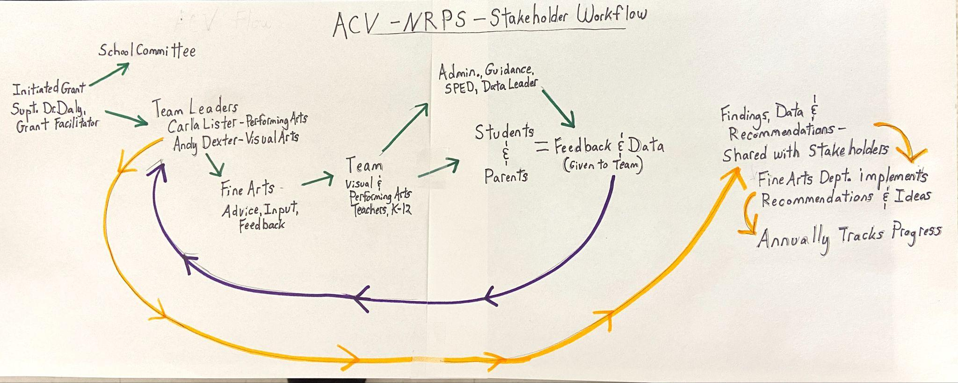
NRPS Workflow Strategy

Slide 33
The Equity Outcomes for Reflection

Slide 34
Questions about the ACV Index and Program?
Ask any of our presenters today!
Dawn Benski, DESE
Lisa Leach, Worcester
Andrew Dexter, North Reading
Carla Lister, North Reading
Patrick Daly, North Reading

Slide 35
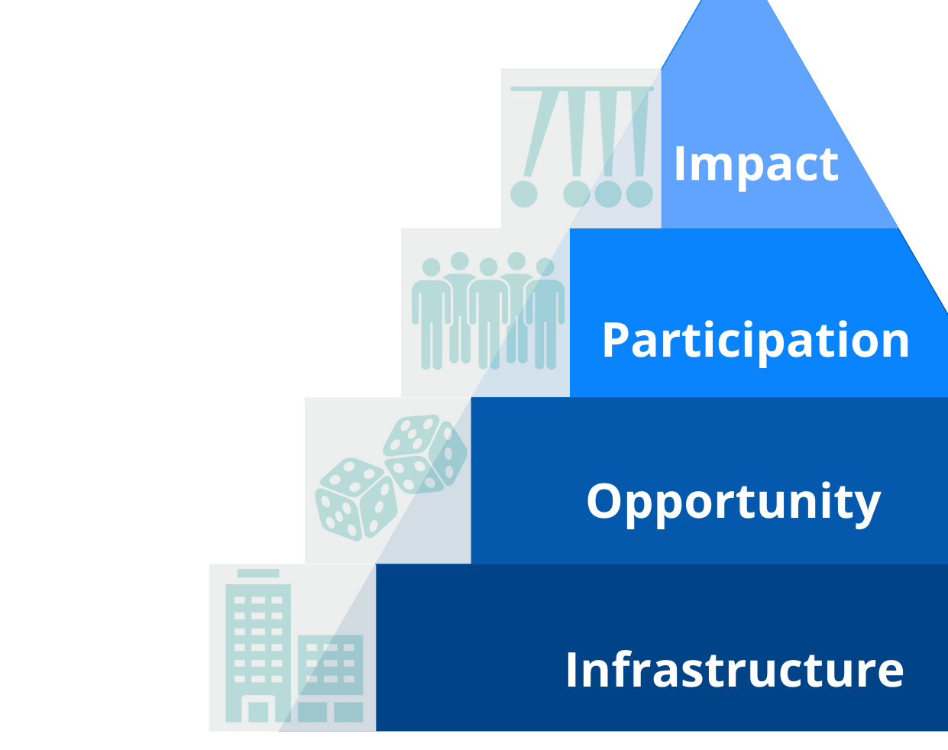
THANK YOU!
Dawn Benski,
Arts Content Support Lead, DESE
dawn.m.benski@mass.gov
Office of Literacy and Humanities
Center for Instructional Support

