Slide 1
Lawrence Family Development Charter School
Located in Lawrence, MA
PK-8th Grade
897 Total Students
86% Low Income
37% ELL
10% Sp. Education
99% Hispanic

Slide 2
Storyline - Grant beginning Devel.
Good morning, everyone! I’m Stacey O’Brien and I serve as the Grants Administrator at Lawrence Family Development Charter School. It’s a pleasure to join so many passionate educators and leaders who understand that what happens after the bell rings is just as critical as what happens during the school day.
At LFDCS, our after-school programs are designed to support the whole child—improving attendance, deepening academic growth, and fostering a sense of belonging.
I’m proud to introduce two key members of our homegrown Program Evaluation Team:
Sandy Calandrella, our Extended Day Program Director, whose leadership ensures our clubs and supports are intentional and responsive.
And Sarah Hecht, our Paraprofessional Coach, who empowers our staff with tools to elevate student engagement and outcomes.
Together, we work to align every after-school effort with our mission—and your insights today will help us keep growing.
Before we explore strategies and solutions, let’s take a moment to connect—because the best ideas often begin with meaningful conversation.

Slide 3
Presentation Overview
Quick show of hands for an icebreaker:
Who has an extended day, out of school or afterschool program in their district?
Does your OST/extended day after school program have components that address academic needs?
Address student interest
Homework support
Provide enrichment activities
For those schools that have afterschool programming, have you ever considered or conducted a program evaluation?
Topics Reviewed Today
Grant Development & Narrative | Intro, Grant details
Overarching Program Information | History, Enrollment Data, Longevity of Program, Program Format
Data Collection | An assortment of graphics related to survey responses
Post Program Enhancements | List of program changes made based upon program evaluation
Continuation of Change | Future goals

Slide 4
Program Evaluation & Design for LFDCS Extended Day
How the Evaluation Began
Joined LFDCS as a Grants Writer and immediately began reviewing grants and reporting needs.
Collaborated with leadership to gain a clear understanding of program structure, oversight responsibilities, and strategic priorities.
Connected with Sandy, Extended Day Program Director, to dive deeper into program goals and daily operations.
Early conversations revealed a clear opportunity: build a consistent, data-driven evaluation process to measure impact and guide improvement
Program Evaluation in Action
Team Launched: Engaged program leads, faculty, and leadership to drive the process.
Deep Dive Review: Assessed current programming, enrollment, and staffing landscape.
Strengths & Growth Areas: Identified what’s working and where support is needed.
Stakeholder Voice: Facilitated “wish list” reflections to surface key priorities.
Action Steps Taken:
Engaged Sarah Hecht, Paraprofessional Coach, to lead and support program goals.
Expanded tech access—securing iPads and Chromebooks for all after school students.
Looking Ahead: Using insights to shape stronger, data-driven programming for Fall 2025.

Slide 5
Grant Narrative
Data Collection & Review
Student Success
Improve academic & attendance outcomes
Systematic evaluation of existing evidence-based supports to inform strategic initiatives
Resources
Enhanced After-School Programming
Strategic Program Growth
Expand targeted, high-impact student supports
Align future programming with evolving student needs & NPSS standards

Slide 6
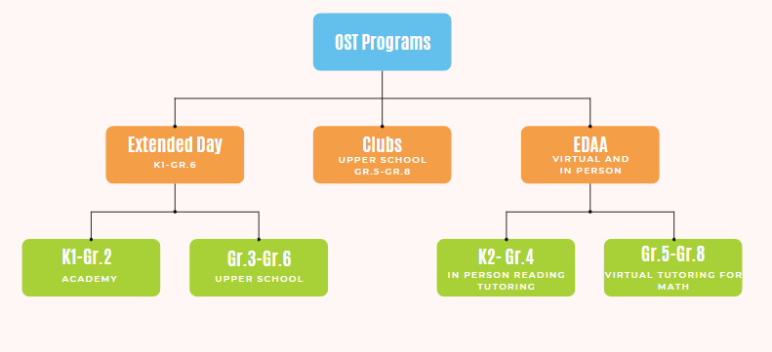
Out of School Time Programs at LFDCS

Slide 7
Extended Day Program Overview
Location: Upper School and Academy for Early Academic Preparation
Length of Operation: 15 Years
Current Enrollment: 95 students in grades K1 through 6th Grade
Number of Staff: 15 including one Site Director
Program Components: Snack, Homework Time, Enrichment/Gym/Outdoors
Program Outcomes: Happy families, students have better attendance overall, and students get exposure to enrichment activities different from what they might experience from their home life.

Slide 8
Clubs Program Overview
Location: Upper School
Length of Operation: 15 Years
Current Enrollment: 108 students in grades 5th through 8th
Number of Staff: 27 staff members including teachers and paraeducators
Program Components: Snack, enrichment activities that are centered around club objectives
Program Outcomes: Academic and social-emotional skill development,
community engagement, 8th grade application enhancement

Slide 9
Clubs We Offer
STEM Clubs
Sports Clubs
Civic & Enrichment
Robotics
Coding
Basketball
Volleyball
Running
Changemakers
Art
Cooking
Creative Writing
Step Team Dance
Choir
Model UN
EmpowerHER
Chess

Slide 10
EDAA Program Overview
Location: Upper School, Lower School and Academy for Academic Preparation
Length of Operation: 3 Years
Enrollment Criteria: Eligibility is based on students who score 20% or below on their MAP test. MAP testing is done in the fall, winter and spring.
Program Staffing Format: Comprised of in person and virtual academic tutoring
Program Components: Reading and math tutoring program offered on Tuesdays & Thursdays for the fall and winter.
Program Outcomes: Increased MAP testing scores in math and reading

Slide 11
Attendance Rate Data
Clubs and Extended Day attendance rates ensure students come to school and stay at school. This data was over a 6 Month Period and, as you can see, it’s almost a full percentage higher for clubs.
School Wide Attendance Rate
96.97% * assessing 897 enrolled students
Clubs Attendance Rate
97.73 %* assessing 108 enrolled students
Extended Day Attendance Rate
97.14%* assessing 95 enrolled students

Slide 12
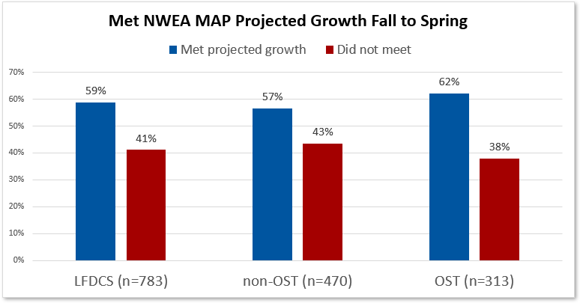
Positive Impacts of OST Programs
Students in our OST programs (EDAA, Clubs and Extended Day) have higher MAP score growth.

Slide 13
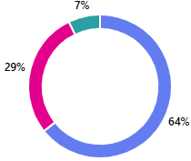
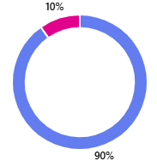
Student Feedback for Extended Day Offerings
K1-Grade 2
Grade 3-6
Clubs Gr. 5-8
84% Response Rate of Students Enrolled in Afterschool
90% Response Rate of Students Enrolled in Afterschool
76% Response Rate of Students Enrolled in Clubs

Slide 14
Parent Feedback
75% Response Rate from Parents who have their children enrolled in Extended Day

Slide 15
Parent Testimonials
“I’ve had both my children in the extended day program and I think it’s the best thing keeps them busy after school most importantly they get a head start on their homework.”
“I really enjoy the extended day program, the staff is amazing. Any comments or concerns that I bring up are always valued and respected. It feels great to know that my children are in a safe environment with their classmates and adult peers.”
“The after-school program has been amazing for my daughter! She’s been able to make some wonderful friendships there.”
“My daughter loves afterschool. It has become an important role in her life. She likes that she can interact with older kids. Her sharing and friendship skills have been developed more because of afterschool.”
“Feliz y agradecida por el programa.”
“Estoy muy contenta con la gran ayuda que nos dan a nosotros que trabajamos, la seguridad que les dan es una tranquilidad.”

Slide 16
Post Program Enhancements
GoGuardian implemented for students doing work on chromebooks and iPads for online safety
Collaboration with Special Ed Department for students enrolled in afterschool programs to provide wrap around support in alignment with IEP goals
Exit Interview Surveys implemented for staff members leaving programs for program enhancement/updates
Revision to Handbook/ Policies
Creation of a Staff Handbook
After School Appreciation Week / Spring Break (Nationally Recognized)
Registration Management System
Provisions of iPads to the Academy/Collaboration of existing resources
Provision of Chromebooks to the Upper School
Staff Adjustment and Changes for Extended Day/Employing and attaining high quality staff
Four Professional Development dates throughout the year for ongoing training and support

Slide 17
Continuation of Change
Creation of a Counselor in Training program for 7th/8th graders to be a role model and assist in Extended Day
Parent open house to kick off the year and continued alignment with our schools family engagement goals
Develop new positions such as Enrichment Coordinator
Use targeted outreach for staffing using our BambooHR
Enhance Extended Day by adding a career competency through program design and the use of online self discovery curriculum for all grade levels
Increase the use of ongoing data collection
Notes:
These are things we hope to continue to explore as we make improvements to OST programs and after school extended day.

Slide 18
Thanks!
Do you have any questions?
SCalandrella@lfdcs.org
SObrien@lfdcs.org
SHecht@lfdcs.org
LFDCS.org

Slide 19
Greater Lowell Technical High School
Timothy Fallon, Chronic Absenteeism/Drop out Prevention Coordinator
Cheryl Ann Bomal, Title I Facilitator

Slide 20
Chronic Absenteeism/Drop out Prevention Coordinator
Goal:
The Chronic Absenteeism/Drop out Prevention Coordinator builds relationships with families to limit student absences and prevent students from dropping out of school to improve GLTHS drop out/retention rate and monthly attendance rates.
Action Plan:
The main office notifies Tim of students missing school.
He visits families during normal school hours, evenings and weekends.
The Coordinators speaks with families, drops off handouts from guidance on topics related to absences and encourages students to come to school.
He brings the family liaison with him if interpretation is needed.

Slide 21
2023-2024 School Year
GLTHS
95.1 Attendance Rate
97% Graduation Rate
.2% Drop Out Rate
11% Chronic Absenteeism Rate (down 1.4% from last year)
which is below the state average of 19.6 %

Slide 22
GLTHS Attendance Rates 2024-2025

Slide 23
Methuen Public Schools
Using ESSA Funds to Reduce Chronic Absenteeism
Spring Federal Grants Conference
Marlborough, MA
June 10, 2025

Slide 24
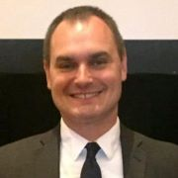
Lisa Golobski Twomey
Assistant Superintendent of Teaching and Learning
lagolobski@methuen.k12.ma.us
(978) 722-6007
John Crocker
Director of School Mental Health and Behavioral Services
jncrocker@methuen.k12.ma.us
(978) 722-6000

Slide 25
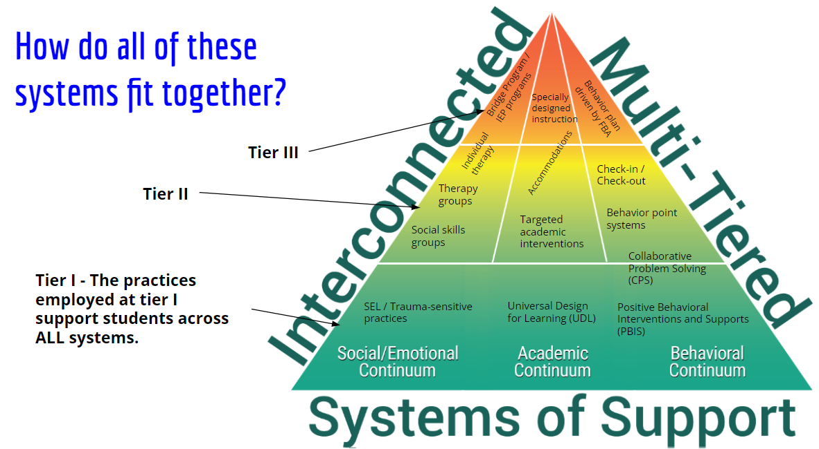
How do all of these systems fit together

Slide 26
Major Features of Methuen’s CSMHS
Comprehensive staffing model
All staff are responsible for providing care and support across all domains of need and tiers of support
Specialization is honored and leveraged through project assignments
Comprehensive Student Support Team (CSST)
Universal screening in grades K-12
Evidence-based therapeutic care across all tiers of support
Tier I - Cognitive theory based SEL curriculum; mental health literacy activities; PBIS; Collaborative Problem Solving; trauma-informed classroom practices
Tier II - CBT groups; short term individual therapy; skills based groups
Tier III - SPED programmatic services; bryt Program; long term individual therapy; wraparound services with community based partners
Community partners
Beth Israel Lahey Health Behavioral Services (Local CBHC); Cartwheel; Care Solace; Nan Project; NAMI

Slide 27
Director of School Mental Health and Behavioral Services
Title IIA (flex into Title IV)- Salary for the Director of School Mental Health and Behavior Services
The Director of School Mental Health and Behavioral Services provides quality professional development to staff in all schools regarding social and emotional well-being and trauma-sensitive classrooms, supervises all guidance staff in the district to service focused on mental health needs and drives data decision-making around student discipline and behavior.
The position has been funded through this budget for the past five years.

Slide 28
The Value of Clinical Leadership
Support in designing a comprehensive school mental health system
Development of policy and guidelines that drive the vision of the CSMHS
Staffing models that effectively position and leverage SMH staff
Clinical supervision, feedback, and evaluation
Professional development and job-embedded coaching
Partnership development with community based behavioral health and social services agencies
Selection and implementation of evidence-based practices
Expert content knowledge to inform critical incident management
Hiring and onboarding support
69.1% of districts surveyed do not have an administrator with counseling experience to oversee mental health/SEL initiatives and provide clinical supervision to school mental health staff
Notes:
John

Slide 29
District Behavioral Support Specialist
Title IIA- 35% of Salary for the District Behavioral Support Specialist
The District Behavioral Support Specialist provides professional development for building administrators around student behavior and discipline.
Title IV- 65% of Salary for the District Behavioral Support Specialist
The District Behavioral Support Specialists reviews Office Discipline and non-Office Discipline referral data and conducts bullying investigations.

Slide 30
Care Solace
Title IV- Contracted Services: Care Solace
resource to support matching students (as well as staff and families) to community based mental health services
draws on a national database of mental health providers and manages coordination of service matching through intake
accessed confidentially
support available in multiple languages for all forms of insurance
students under 18 need consent of caregivers to begin accessing services

Slide 31
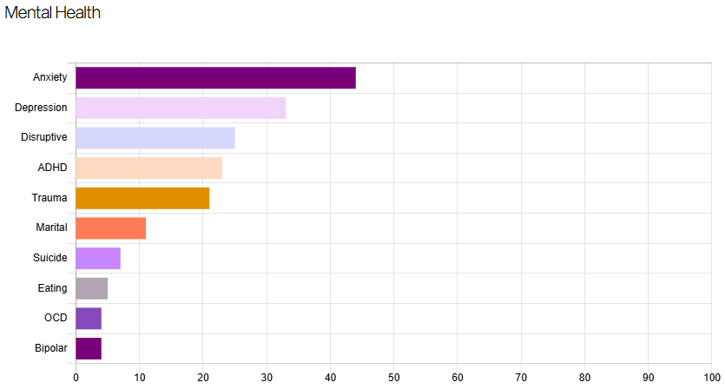
“Warm handoff” takes seconds to complete.
All communication is logged to provide complete transparency regarding care matching.
Data dashboard informs programmatic planning and oversight.

Slide 32
MHS Bridge Program (designed using the bryt Program framework)
Title IV- Salary for Bridge Program Staff
The role of this Bridge program staff person is to help students transition back to school following an extended leave of absence.
MHS Bridge is a tier III, general education, programmatic intervention.
Responds to the needs of students who have had an academic disruption in relation to a mental health concern.
Designed to provide wraparound care and outstrip typical approaches to reentry following hospitalization.
Includes clinical and academic supports and coordination with a larger team of individuals, including the family.
Supported through a partnership with Brookline Center for Community Mental Health’s bryt Program.

Slide 33
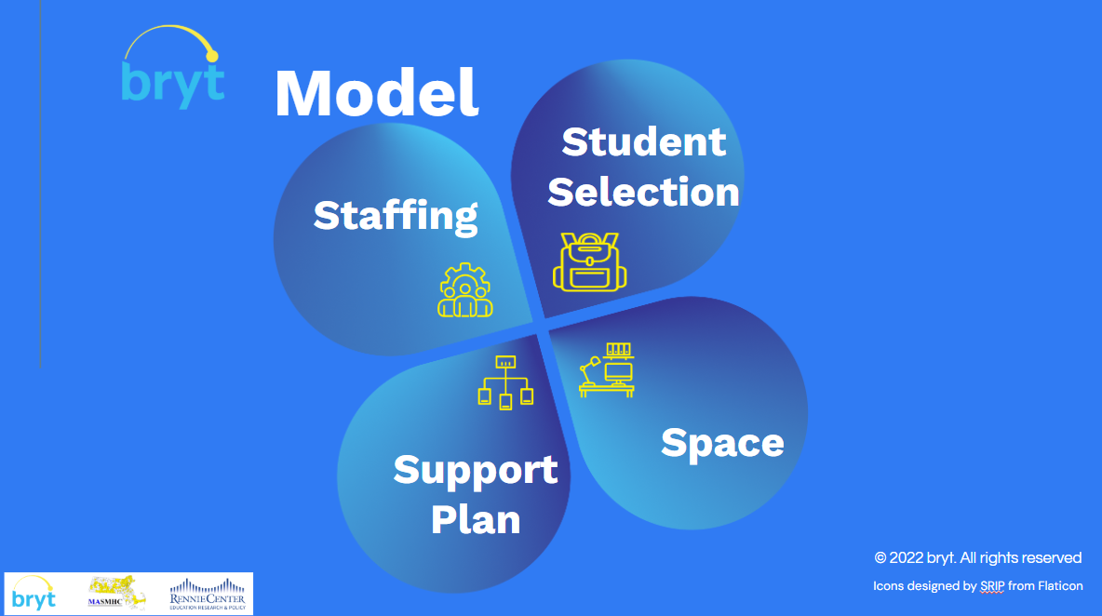
The bryt Model: Key Intervention Components
A home base space that provides physical and emotional safety
Dedicated staffing
A customized support plan integrating:
Clinically-informed, proactive emotional/therapeutic/coping supports
Academic coordination/teacher collaboration
Family communication and support
Care coordination (among school and wider community stakeholders)
Alignment with schoolwide systems allowing for effective transition to other supports when the student is ready

Slide 34
Home/Hospital Tutoring
Cost Savings
Student | Weeks in Bridge | $ District Saved w/o Home Hospital Tutoring
Student 1 | 5 | $2,800.0
Student 2 | 1 | $560.0
Student 3 | 10 | $5,660.0
Student 4 | 21 | $11,760.0
Student 5 | 17 | $9,520.0
Student 6 | 8 | $4,480.0
Student 7 | 23 | $3,120.0
Student 8 | 21 | $12,880.0
Student 9 | 4 | $2,240.0
Student 10 | 3 | $1,680.0
Student 11 | 9 | $5,040.0
Student 12 | 10 | $5,600.0
Student 13 | 1 | $560.0
Student 14 | 5 | $2,800.0
Student 15 | 4 | $2,240.0
Student 16 | 5 | $2,800.0
Total: |  | $82,380.0

Slide 35
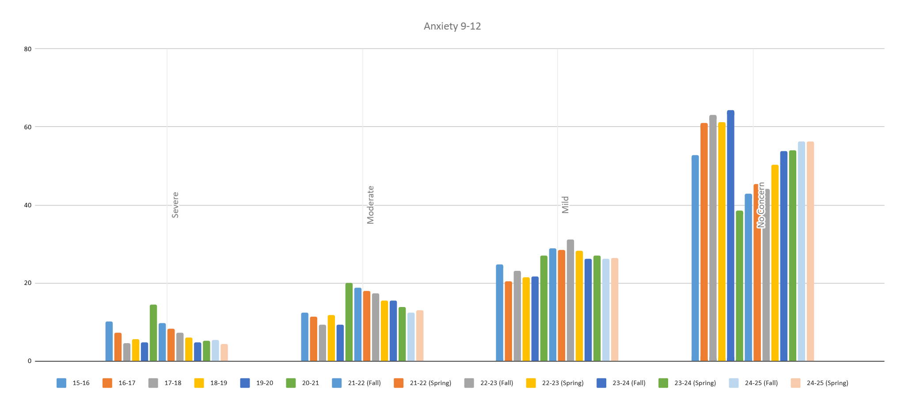
Student Levels of Anxiety (Grades 9-12)
Severe anxiety is now lower than pre-pandemic levels
Maintenance and minor growth for other score ranges

Slide 36
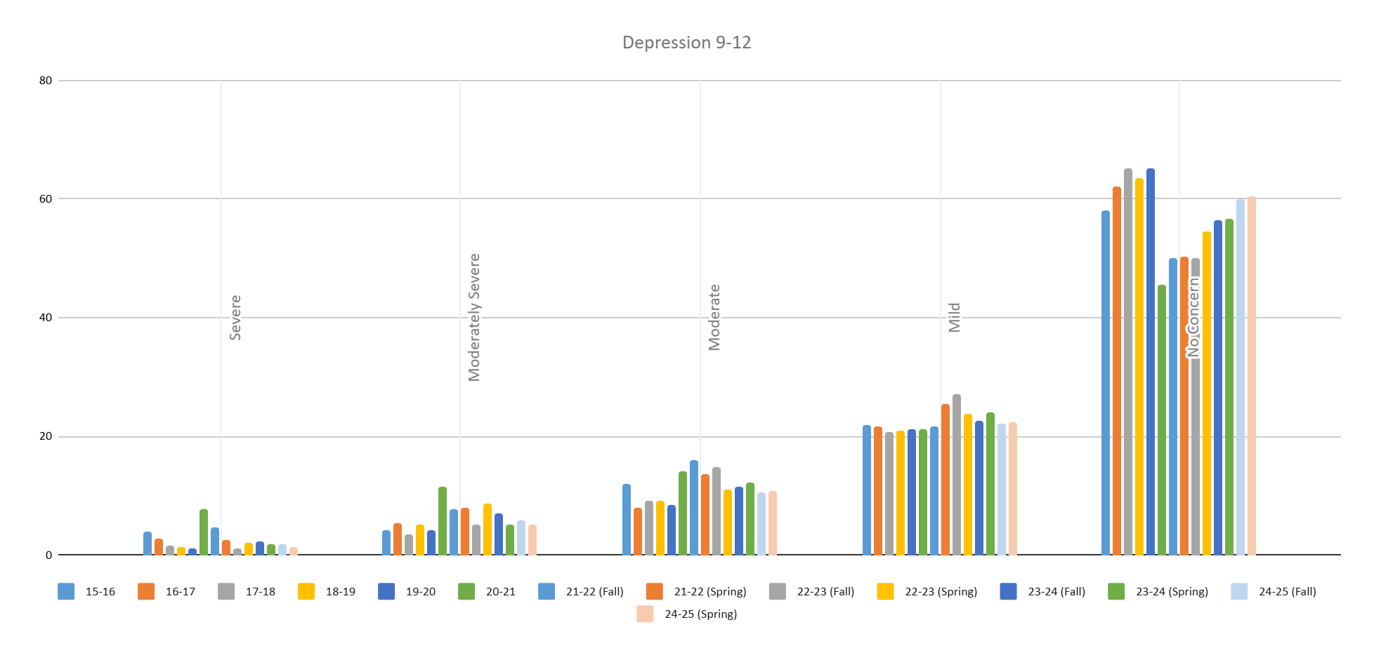
Student Levels of Depression (Grades 9-12)
Continued decrease in “Severe” and “Moderately Severe” score ranges
Slight improvement in reports of “No Concern” scores for depression

Slide 37
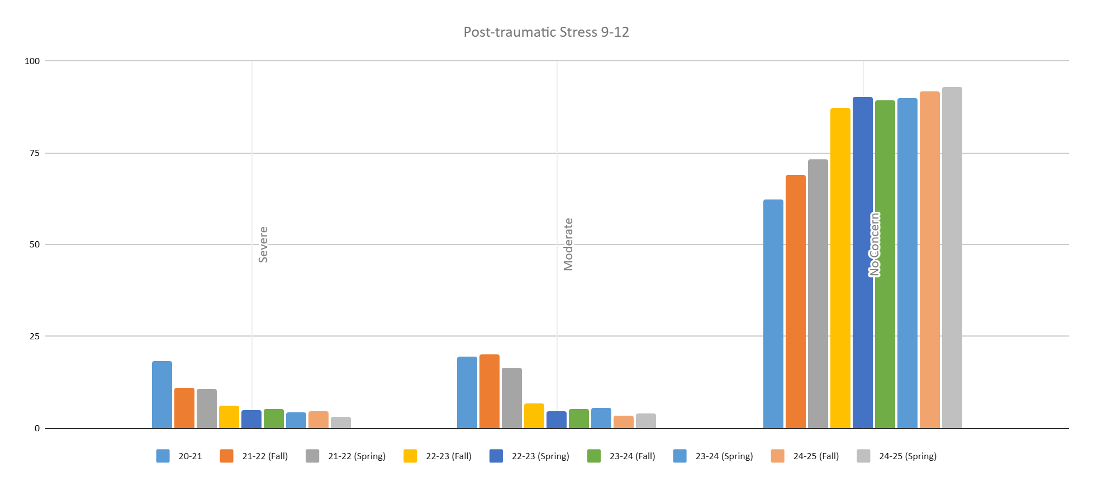
Student Levels of Post-traumatic Stress (Grades 9-12)
Reduction in severe symptoms of post-traumatic stress
Increase in reports of “No Concern” for post-traumatic stress

Slide 38
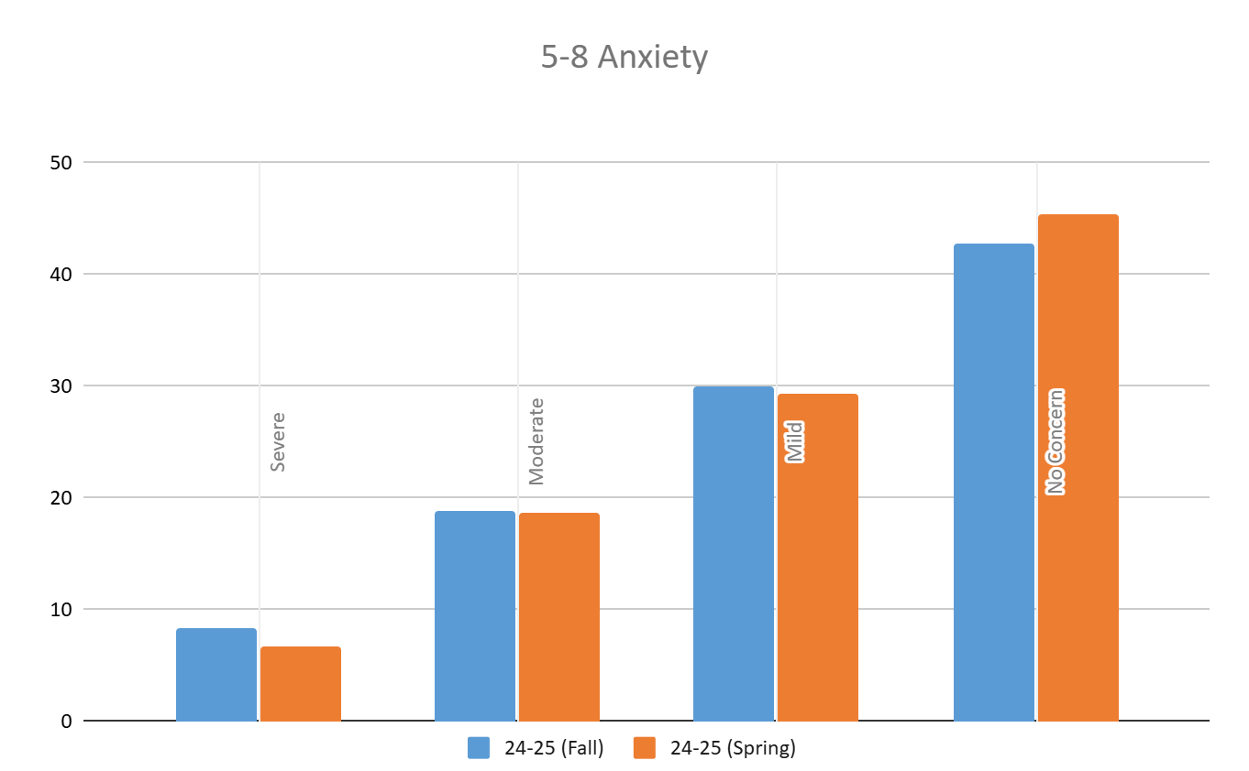
Student Levels of Anxiety (Grades 5-8)
First report of trend since adoption of new measures for anxiety & depression in 5-8
Strong growth across all scores ranges

Slide 39
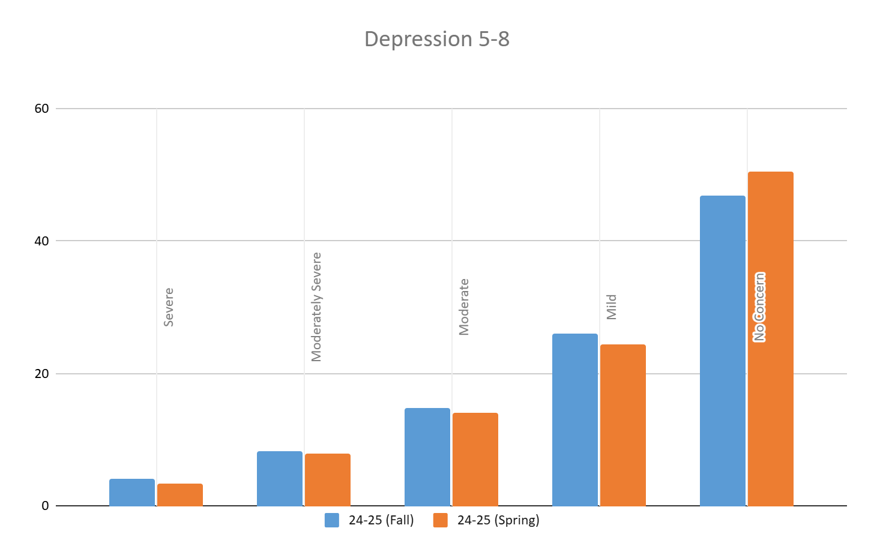
Student Levels of Depression (Grades 5-8)
First report of trend since adoption of new measures for anxiety & depression in 5-8
Strong growth across all scores ranges

Slide 40
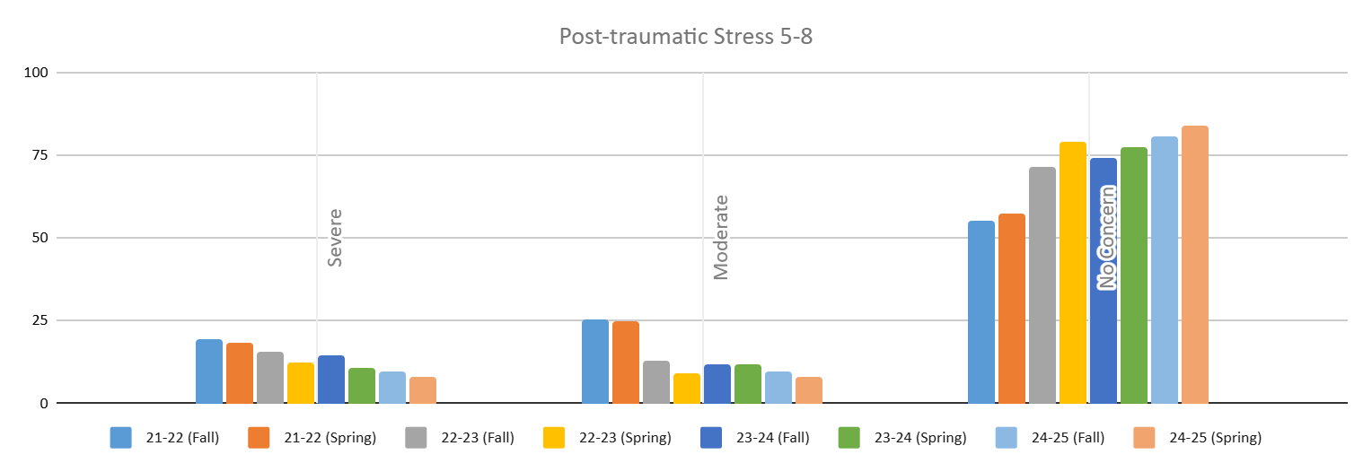
Student Levels of Post-traumatic Stress (Grades 5-8)
Strong growth across all scores ranges
Data is trending in a positive direction consistently over the past 2 years

Slide 41
Caseload Monitoring and Partner Services
SY24-25 Q3 Report
1197 tier II/III services were offered in quarter 3 across all schools
91.5% of tier II/III services resulted in social emotional/mental health progress
71.5% of tier II/III services resulted in academic progress
71% of tier II/III services resulted in attendance progress
76.2% of tier II/III services resulted in behavioral progress
All Counseling Department staff collect progress monitoring data that matches with the specific goal of the service they are providing for social/emotional services on a routine (typically biweekly) basis to monitor student growth and to inform their practice.
Attendance, behavior, and attendance data are also regularly reviewed by counseling staff to ensure services are impacting those outcomes and to inform adjustments to services if necessary.
342 referrals have been made to Care Solace (248) and Cartwheel (94) to augment the available mental health services offered to students

Slide 42
Fund Uses in Titles IIA and IV
Title IIA (flex into Title IV)- Salary for the Director of School Mental Health and Behavior Services
Title IIA- 35% of Salary for the District Behavioral Support Specialist (professional development)
Title IV- 65% of Salary for the District Behavioral Support Specialist (reviewing disciplinary data and completing bullying investigations)
Title IV- Salary for Bridge Program Staff
Title IV- Care Solace Mental Health Supports

