Slide 1
Our Programmatic Cupcake A Collaborative Effort
Dessi Kirova
Federal Grants Specialist
Judith R. Magloire
ELE Programing Manager

Slide 2
AGENDA
Program Overviews
A Shared Goal
A Closer Look at ELE Programming
Let’s Talk Cherries: Field Practices
Reflections
Introductions & Objectives

Slide 3
Making Connections
1. How do you know that your EL program is both research-based and responsive to student need (targeted)? 2. How many required components of ELE programming can you name?
3. Which Title IIIA-funded strategies have had the most impact in your district?
Notes:
Judith Introduces Dessi Dessi Introduces Judith

Slide 4
ELE Programming
Aims to support English Learners to learn English, access challenging state academic content and meet academic achievement standards.
Notes:
Judith

Slide 5
Title III
Provides funding for English learners and immigrant students succeed in schools by assisting them in becoming fluent in English and meeting challenging state academic content and academic achievement standards.
Notes:
Dessi

Slide 6
Collaboration
Working Together
for a common
GOAL
Notes:
Both – quick overview of the why of the work and what we have done.

Slide 7
Short Form: Educational Vision
Notes:
Judith

Slide 8
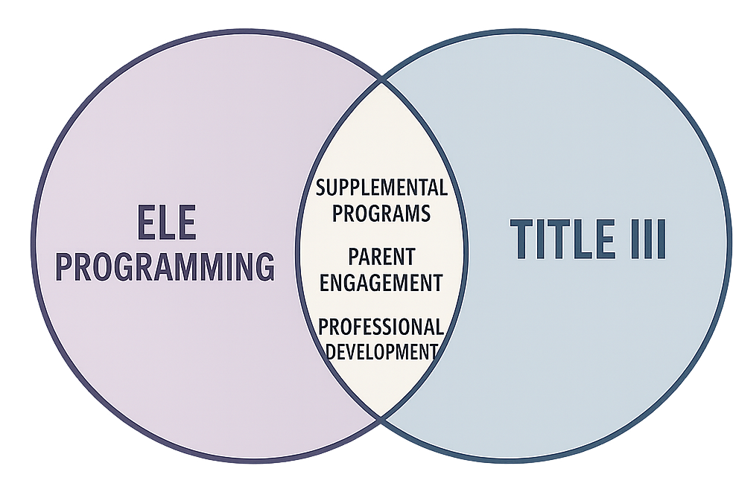
ELE Programming and Title III
Notes:
Dessi

Slide 9
Our
Programmatic Cupcake
Notes:
Dessi

Slide 10
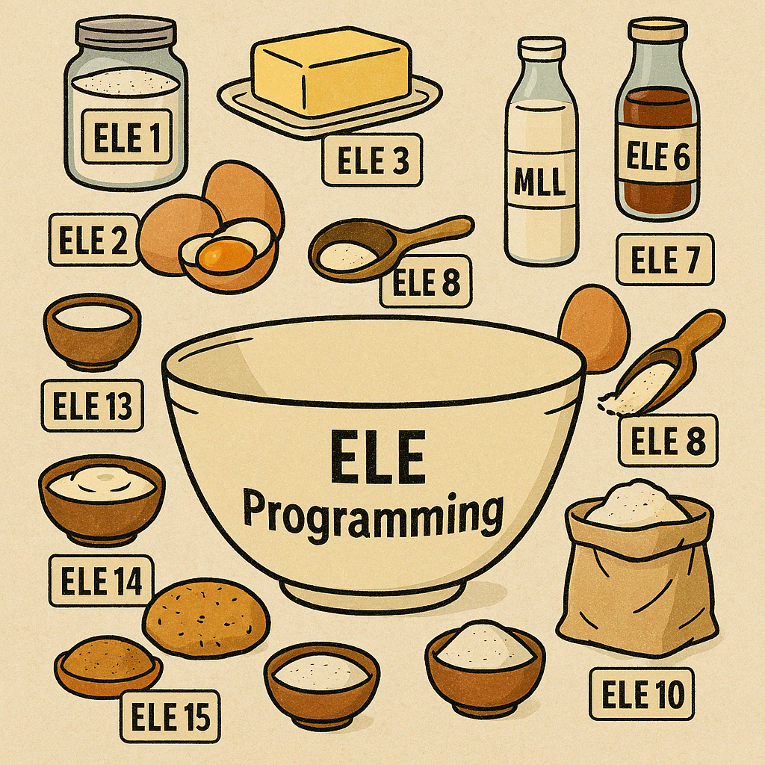
REQUIRED Ingredients
ELE 5
Notes:
10-18 Judith

Slide 11
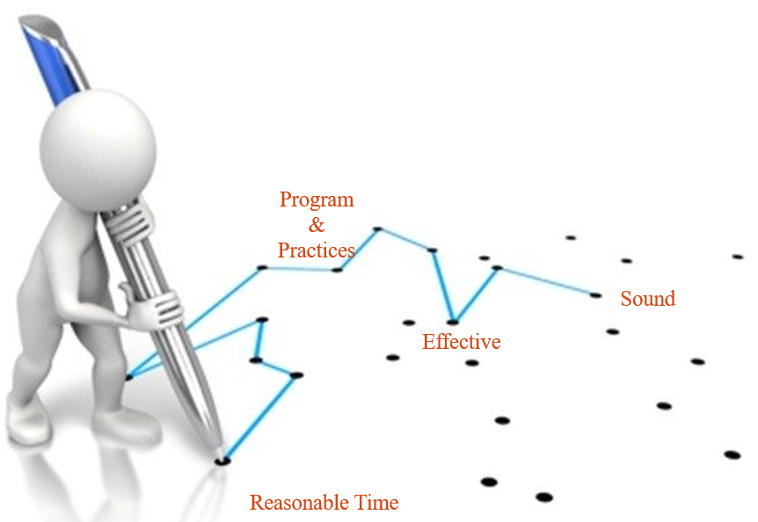
ELE PROGRAMMING
First, is the EL program informed by sound educational theory?
Second, are the “practices, resources, and personnel” reasonably calculated to implement the EL program “effectively”?
Third, do program results show language barriers “actually being overcome”?
Notes:
10-18 Judith

Slide 12
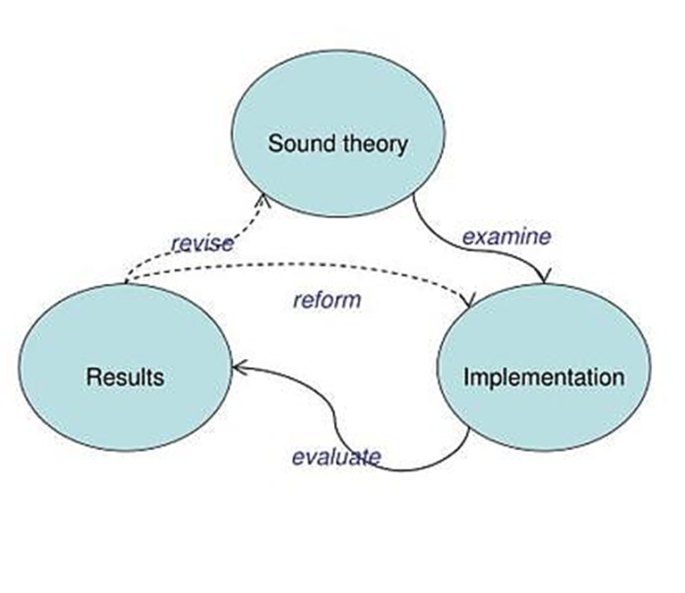
PROGRAMMING
Resources: ESL Curriculum
TFM Self-Assessment
Parent Engagement: ELPAC
EL Data Dashboard
Notes:
10-18 Judith

Slide 13
Advocacy & Empowerment
INTERPRETATION
TRANSLATION
Notes:
10-18 Judith

Slide 14
ENGLISH LEARNER EDUCATION (ELE) programMING in MASSACHUSETTS
"Programs shall be research-based and include subject-matter content and an English language acquisition component." (M.G.L. c. 71a)
ELE
PROGRAMMING
Taught by content area licensed & SEI or Bilingual Education endorsed teachers
Access to grade level content & development of discipline specific academic language.
Occurs throughout the day and is designed for optimum EL engagement
Taught by and ESL licensed teacher
"systematic, explicit, and sustained" development of English as a Second Language (ESL)
Occurs for a specific amount of time each day or week according to student need.
Content
ESL
SEI
DLE
TBE
Other
Pull-out
Push-in
Co-taught
Self-contained
Embedded
Notes:
10-18 Judith

Slide 15
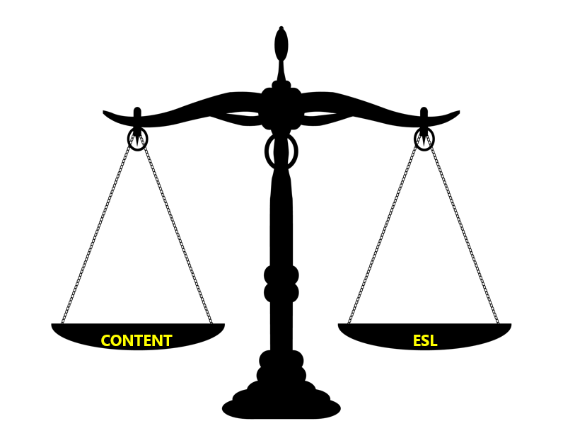
Important Reminder
Notes:
10-18 Judith

Slide 16
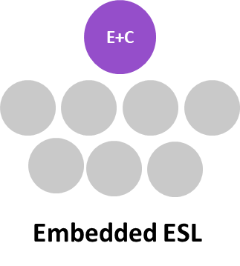
ESL INSTRUCTIONAL DELIVERY APPROACHES
 | ESL INSTRUCTIONAL DELIVERY APPROACHES | STRUCTURE
Co – Teaching |  | The co-teachers jointly plan for, deliver, and assess dedicated, systematic, explicit, and sustained standards-based and language-focused ESL instruction that connects to content area topics and analytical practices. Co-teaching ESL is part of English learners and co-teachers’ regular schedule. It is taught in grade level/content area classrooms.
Embedded ESL |  | Taught by a dually licensed teacher within grade level/content area classrooms. In these cases, the teacher is licensed in both the grade level/content area and ESL, so ESL is built within the school’s master schedule and individual English learners’ schedules.
Pull-Out ESL |  | Taught by a licensed ESL teacher in a separate classroom during designated times in a students’ schedule. It is most appropriate for situations where there are small numbers of English learners spread across grade levels.
Push-In ESL |  | Taught by a licensed ESL teacher within grade level or content area classrooms during designated times in a students’ schedule. Push-in ESL may be most appropriate for elementary levels, given instructional and logistical characteristics of secondary settings.
Self-Contained ESL |  | Taught by a licensed ESL teacher in a separate classroom. It is built within a school’s master schedule as a component of English learners’ regular schedule.. It can be effective with different groups of students identified as English learners (ELs), especially ELs who need considerable time and support for language development such as newcomers, students with limited and interrupted formal education (SLIFE), and ELs at early English language proficiency levels. Common at secondary school levels, where it is scheduled as a specific, credit-bearing course.
Notes:
To provide dedicated, systematic, explicit, and sustained standards-based and language-focused instruction connecting to content area topics and analytical practices. 10-18 Judith

Slide 17
FAMILY/PARENT ENGAGEMENT
Each school district serving 100 or more ELs or in which ELs comprise at least five percent of the student population, whichever is less, shall establish an English learner parent advisory council.
Each school designated as underperforming or chronically underperforming and operating a program for English learners shall establish an English learner parent advisory council.
Districts must provide language assistance (translation/interpretation) to all limited English proficient parents whose primary language is not English, even if their child is proficient in English.
Schools must provide translation or interpretation from appropriate and competent individuals and may not rely on or ask students, siblings, friends, or untrained school staff to translate or interpret for parents.
Notes:
10-18 Judith

Slide 18
PROFESSIONAL DEVELOPMENT
Districts must develop a professional development plan and provide training for teachers in second language acquisition techniques for the re-certification of teachers and administrators (15 PDPS)
Notes:
10-18 Judith

Slide 19
Making Connections
1. What does your district’s ELE “cupcake” currently include and what key ingredients may be missing? 2. How have you utilized EL Data/ EL Data Dashboard to inform your grant planning?
3. How does your district empower EL families beyond translation services?
Notes:
Judith Introduces Dessi Dessi Introduces Judith

Slide 20
TITLE III REQUIREMENTS
Title III Part A of the federal Elementary and Secondary Education Act provides funds to help English learners, including immigrant children and youth, succeed in school by assisting them in becoming fluent in English and meeting challenging state academic content and student academic achievement standards.
The priorities of Title III are to:
1) Provide Effective language instruction educational programs
2) Provide Effective professional development
3) Provide and implement other effective activities and strategies that enhance or supplement language instruction educational programs for ELs which shall include parent, family, and community engagement activities
Notes:
20 – 25 (Dessi)

Slide 21
PROFESSIONAL DEVELOPMENT
Districts awarded Title III funds must provide effective professional development to classroom teachers, school administrators, and other school or community-based organizational personnel that is
(B) designed to enhance the ability of such teachers, principals, and other school leaders to understand and implement curricula, assessment practices and measures, and instructional strategies for ELs;
(C) effective in increasing children's English proficiency or substantially increasing the subject matter knowledge, teaching knowledge, and teaching skills of such teachers; and
(D) of sufficient intensity and duration (which shall not include activities such as one-day or short-term workshops and conferences) to have a positive and lasting impact on the teachers' performance
(A) designed to improve the instruction and assessment of ELs;
Notes:
20 – 25 (Dessi)

Slide 22
Compliance in Practice
Sample of FY24 Title IIIA Supplemental Language Instruction
Extended School Day Programming
Before and afterschool tutoring
College and career counseling for ELs
Social-emotional support for ELs
Field trips and experiential learning
EL program coordinator
Extended School Year Programming
Summer programming
Weekend and Spring break academies
Program assistants’/tutors' stipends
Transportation
Classroom Support
Classroom aid(s), providing supplemental support for ELs
Notes:
Dessi

Slide 23
Compliance in Practice
Sample of FY24 Title IIIA Professional Development Activities
Supplemental In-District HQPD
PD/PLC coordinator or facilitator
Embedded instructional coaching
Stipends to educators to lead/facilitate PD
Book study
Classroom substitute teachers
Supplemental Out-of-District HQPD
Conference registration, including travel
PD course registration
Classroom substitute teachers
PD consultants
Stipends for educators to attend PD sessions
Online Journal Subscriptions & Online PD
Professional organizations membership
Online PD supplies and tools, licenses for online PD platforms
Print and digital books
Virtual conferences, summits, and professional networking
Online PD courses
Notes:
Dessi

Slide 24
Compliance in Practice
Sample of FY24 Title IIIA Parent and Family Engagement Activities
Family Engagement Events
Stipends for staff to coordinate and facilitate family engagement events
Contracts for external speakers
Crafts, games, and children literacy
Cultural events, e.g., International night
Educating parents of EL students about U.S. educational system, social-emotional wellbeing, and civics
Childcare for siblings of ELs
Title IIIA Family Engagement Liaison
Administrative responsibilities – coordination with vendors, community partners, parent groups, etc.
Data collection and analysis
Engaging with families of EL students
Home visits and establishing a relationship with ELs’ families
Serving as a bridge between parents, students, and school staff and increasing parental involvement
Adult Literacy Courses and Workshops for Parents of ELs
Evening and afterschool sessions
Online adult literacy subscriptions, e.g., Rosetta Stone
Stipends for staff to coordinate and lead adult education classes
Supplies and materials, including books
Contracts with vendors to provide ESL classes to parents
Notes:
Dessi

Slide 25
ELE 5 ELE 7 ELE 15
Our
Programmatic Cupcake
Notes:
20 – 25 (Dessi)

Slide 26
Who Is at Your Planning Table? Who Is Missing?
Notes:
Judith

Slide 27
REFLECTIONS
Goals Data Barriers Collaboration
Implementation
Monitoring
Impact & Outcomes
Notes:
Judith Introduces Dessi Dessi Introduces Judith

