Slide 1
"Why Was My Grant Returned?" Common mistakes to avoid when trying to get your ESSA application approved
Spring 2025 Federal Grants Conference

Slide 2
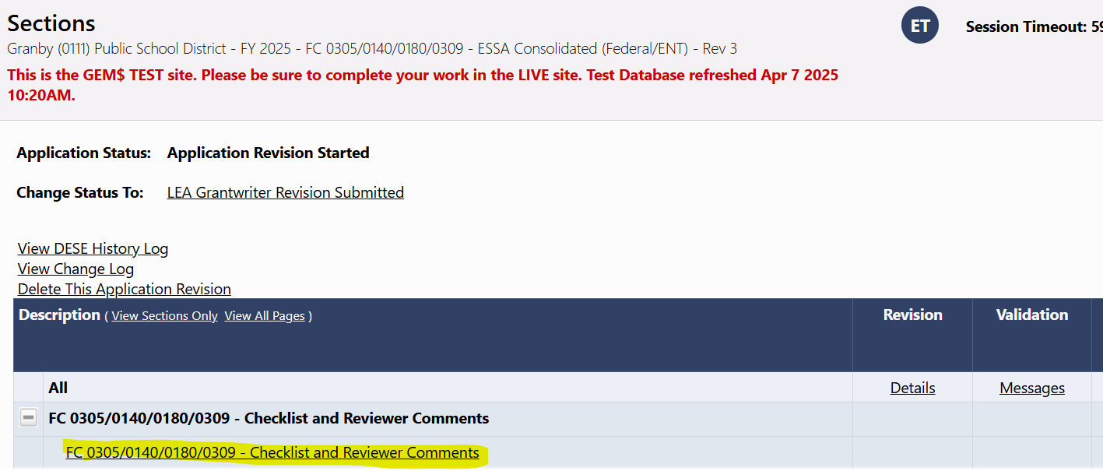
Checklist is your guide
Always refer to the checklist when your application is returned from DESE for edits
Reviewers provide specific comments and edits of what needs to be addressed.
For all ESSA, IDEA, and Perkins grants, the checklist is at the top of the Sections page.
Notes:
We will use the checklist order to guide this presentation.
To be clear-we are not covering every aspect of the ESSA application in this presentation. We are highlighting the most common errors that our reviewers have found over the last few years of using GEM$. as always, we strongly suggest you connect with your districts' federal grant liaison if you have specific questions regarding your ESSA application.

Slide 3
Grant Assurances
FY26 Grant Assurances are posted here: https://www.doe.mass.edu/federalgrants/resources/grant-assurances.docx
They should be signed by the district superintendent or executive director.
They must be dated.
Review the document in its entirety.
Please check all appropriate boxes.
Notes:
Sample on the next slide

Slide 4
Grant Assurances example
Notes:
In this version of the grant assurances document, the district did not receive Title III. Therefore, Section G does not need to be checked. All Title III districts should check Section G.
All districts must have at least one box checked in Section C and Section J.5.

Slide 5
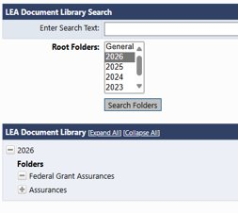
Grant Assurances upload
Upload the FY26 grant assurances to the LEA Document Library.
More information on how to upload items to the LEA Document Library here
Only need to upload the completed signature page.
Notes:
While only the signature page is required to be uploaded, you should keep the entire document on file at the district. This will be important to have at hand in case there is an audit or other situation that requires it in the future.

Slide 6
Title I: Improving Basic Programs Operated by Local School Districts (Fund Code 0350)

Slide 7
Title I Reservations
Notes:
Required reservations have not been made
Every district must reserve a “reasonable amount” for homeless student services, even districts that currently have no students experiencing homelessness
Districts receiving more than $500,000 in Title I funds must reserve 1% of their Title I budget for family engagement activities

Slide 8
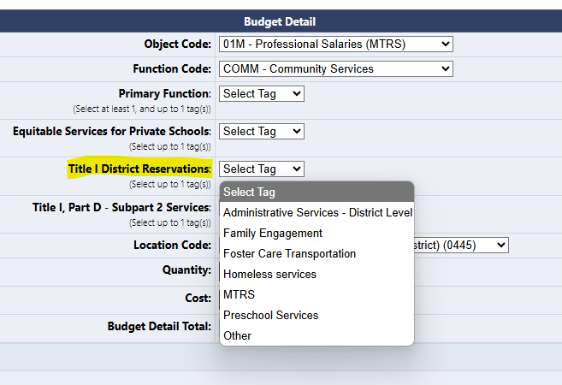
Tagging Title I Reservations in the Budget
Amounts reserved on Reservations page do not appear in the exact same way on the Title I budget page
You can use budget tags to make clear which expenses relate to specific Title I reservations
Notes:
Reservations should always be a part of the Title I budget, they just usually refer to district-wide costs so they are “reserved” from the School Ranking page. If you reserve $5,000 for homeless services, I should be able to clearly understand where on your budget this money is being allocated.

Slide 9
Title I Budget
The main reasons a Title I budget page might be returned are the following errors:
There are Schoolwide costs for a Targeted Assistance program
Private school equitable services costs not directly tailored to the needs of the specific students who would have attended a Title I program in your district
Reservation amounts not appearing or being tagged unclearly on the Title I budget page
Reminder to make sure your object and function codes are correct. Check the Chart of Accounts if you are unsure
Notes:
Tags for Reservation amounts must match the reservations page.
The LEA Fiscal Representative should check the budget before approving.

Slide 10
Title IIA: Building Systems of Support for Excellent Teaching and Leading (Fund Code 0140)

Slide 11
Title IIA, III, IVA Equitable Services
Notes:
Unlike Title I, Titles IIA, III, and IVA equitable services are based on the TOTAL enrollment of the private school. This number should not match the Title I (or be more than Title I) private school student number and should be the same across all three grants (if the private school is participating in more than one grant)

Slide 12
Title IIA Budget
Reminder to make sure your object and function codes are correct. Check the Chart of Accounts if you are unsure
High quality professional development activities
Sustained (not stand-alone, 1 day or short-term workshops)
Intensive
Collaborative
Job Embedded
Data Driven
Classroom focused
Cannot fund stipends for developing, aligning, or revising curriculum materials
Notes:
No classroom materials may be paid for under Title IIA.
If you are using this for a conference, your narrative should be clear about what specifically is being paid for by Title IIA. Travel, registration fee, etc. Out of state is allowable as long as you clearly explain what is being paid for and why you need to attend that conference.
Same holds true for private schools-the exception is that religious or faith based conferences are not allowable.

Slide 13
Title IIIA: Providing Supplemental Funds to Improve the Education of English Learners (Fund Code 0180)

Slide 14
Title IIIA Narrative
Your Title IIIA narrative should clearly identify specific costs the district is funding to meet the three required Title III activities:
Provide direct supplemental instruction
Provide effective professional development
Provide parent, family, and community engagement activities
Everything Title III funds must be supplemental activities.
Any services required for ELs by law (such as translation) or any costs that would be funded anyway if the district did not receive Title III are not allowable.
Notes:
3 required activities should match the narrative page and the budget.
Buying a textbook is not supplemental instruction
Activities for parents/family engagement for Title III students

Slide 15
Title IIIA Budget
Again, it must be clear which budget items the district is funding to meet the three required activities, and it must be clear all costs are supplemental.
The FY26 application will have new tags for each required activity.
Reminder to make sure your object and function codes are correct. Check the Chart of Accounts if you are unsure.
Notes:
Add screenshot of budget tags
In addition, the following unallowable costs will result in your application being sent back:
Certain Seal of Biliteracy costs
Purchasing materials or technology to meet the Direct Supplemental Instruction cost
Required translation services
ELPAC costs if you have 100 or more Els in the district
More than 2% on administration costs

Slide 16
Title IVA: Creating Safe, Healthy and Supportive, High-Quality Educational Learning Environments for All (Fund Code 0309)

Slide 17
Title IVA Smart Goals
Each item funded by Title IVA is required by law to have a clear SMART goal describing the outcomes that will be achieved by funding it.
These must be specific and measurable, with a clear timeline for achievement. At the end of the grant, you will report to the federal government about whether or not these outcomes were met and you must include data in your response.
Notes:
If you write, for example, “students will learn” as a SMART goal, your application will be returned. Ultimately, you will evaluate whether you met this goal, so please keep that in mind when writing them.

Slide 18
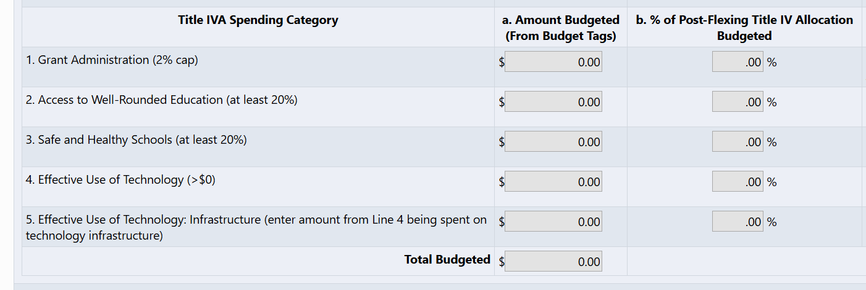
Title IVA Narrative
If a district receives more than $30,000 in Title IVA funds, they must fund specific amounts in each of the three Title IVA categories:
At least 20% of Title IV for Access to Well-Rounded Education
At least 20% for Safe and Supportive Schools
An amount greater than $0 for Effective Use of Technology
Only 15% of the funds allocated for the Effective Use of Technology may be directed toward technology infrastructure, which includes items such as, software licenses or hardware like Chromebooks.
Notes:
If your district receives $100,000 in Title IVA allocation:
at least $20,000 in well rounded
at least $20,000 in safe and supportive
reasonable amount in effective use in technology
$10,000 effective use of technology so $1500 is maximum you can spend effective use of technology infrastructure

Slide 19
Title IVA Budget
The line items on the budget must be clearly tagged to show which of the three Title IVA categories the expense falls under
All Title IVA expenses must be supplemental, and contribute to either establishing a new program, or expanding an existing one
Reminder to make sure your object and function codes are correct. Check the Chart of Accounts if you are unsure.

Slide 20
GEPA: Addressing Equity for Students, Educators, and other Program Beneficiaries
For Question 1, provide a thorough description of your mission.
For Questions 2, please provide a good-faith accounting of any barriers to equitable access.
You should not write that you don’t have barriers.
For questions 3 and 4, respond based on the projects and activities funded with your district's ESSA grant awards.
Question 4 should include a clear timeline with milestones.
Notes:
Need examples-southwick example

Slide 21
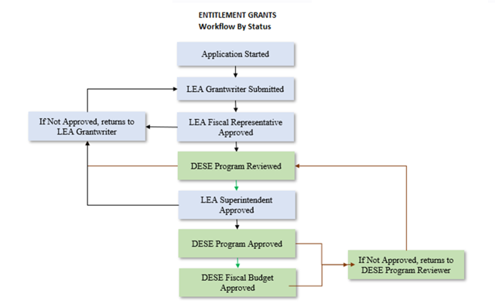
GEM$ Application Workflow
At least 2 different people completing the three main steps
Grantwriter Submission
LEA Fiscal Rep approval
Superintendent/Executive Director approval
Notes:
For more information about GEM$ LEA User Roles, review the Guidance and Forms resource at: https://mass.egrantsmanagement.com/DocumentLibrary/Default.aspx?ccipSessionKey=638844732149109968

Slide 22
Resources
Title I Quick Reference Guide on Allowable Costs
Other Title I Resources
Title II Quick Reference Guide on Allowable Costs
Other Title II Resources
Title III Quick Reference Guide on Allowable Costs
Other Title III Resources
Title IV Quick Reference Guide on Allowable Costs
Other Title IV Resources
Private School Equitable Services Resources
Federal Grant Programs Office Website
General Federal Grant Resource
GEM$ Resources
Notes:
Always remember you can reach out to the Federal Grant Liaison if you have specific questions.

