Slide 1
ESSA Family Engagement Spring Federal Grants Conference June 10, 2025

Slide 2
Family Engagement for Targeted Assistance Programs
Targeted involvement of families and guardians of students served by Title I funds in a targeted assistance program.​
Connecting with Families/Guardians of students served by TI funds Targeted Assistance Programs and services.
​
School Compacts ​
In a targeted assistance
program, compacts should identify specific grades and subject areas served and are only distributed to families/ guardians of students served by Title I funds. ​
​

Slide 3
Family Engagement Schoolwide Programs
What is a Schoolwide Program?
A schoolwide program permits an eligible school to upgrade the entire educational program of the school to raise the academic achievement of all the students. Schoolwide programs use the approach of improving the entire school program with the intent of meeting the needs of those students who are failing or most at risk of failing to meet the state’s academic achievement standards

Slide 4
Foundations to ESSA requirements
Policies
Notifications
Meetings
Capacity Building

Slide 5
Family/Guardian Policies
Describe specific rights of families/guardians
Provide information and opportunities for meaningful activities developed with families/guardians so the entire community is prepared to participate in student educational growth.
Describe how families/guardians are involved in an annual evaluation of the effectiveness of the family/guardian engagement in improving academic achievement

Slide 6
Family Engagement Policies and Capacity Building for Rural districts
Colin Shebar
Director of Learning & Teaching
Berkshire Hills Regional School District

Slide 7
Berkshire Hills

Slide 8
Annual TI Meeting
Schedule to inform participating families/guardians of students about Title I programs
Meeting Agenda Topics include: The state’s academic content standards and state student academic achievement standards State and local academic assessments, including alternative assessments The family/guardian engagement requirements (Engagement Policies and Compacts (distribute, evaluate and update), Families’ Right to Know, Report Cards and notifications) Sharing best practices and resources with families/guardians on how to monitor and improve student academic progress and achievement Additionally, districts and schools provide accessible tools to assist all families in understanding and collectively supporting student improvement and achievement.
File and save documentation of meeting, agenda topics and family participation and attendance

Slide 9
Family Engagement for a Targeted Assistance Program Fulfilling meeting requirements with meaningful participation

Slide 10
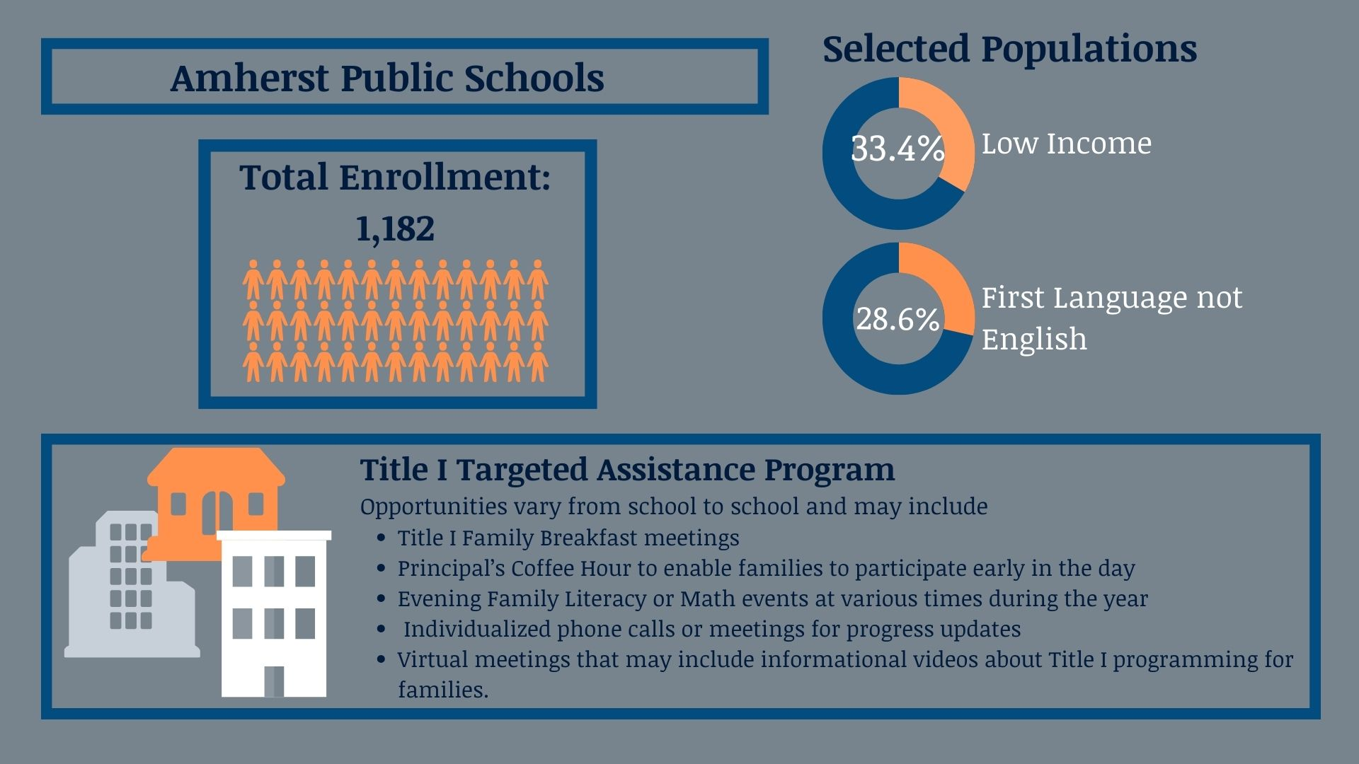
Amherst

Slide 11
Family Engagement for a Targeted Assistance Program
Stephanie Joyce
Title I District Coordinator
Amherst Public Schools

Slide 12
Fulfilling Meeting requirements in multiple formats
Formats and Outreach:
School Level meetings
Office Hours - bimonthly progress updates
Progress Reports (Targeted)
Evaluations specific to Families of TI students
Parent Square
Grade Level Family Events: “Tips from Title I”​ Building Reading Skills and 💗 of Reading Between Home and School

Slide 13
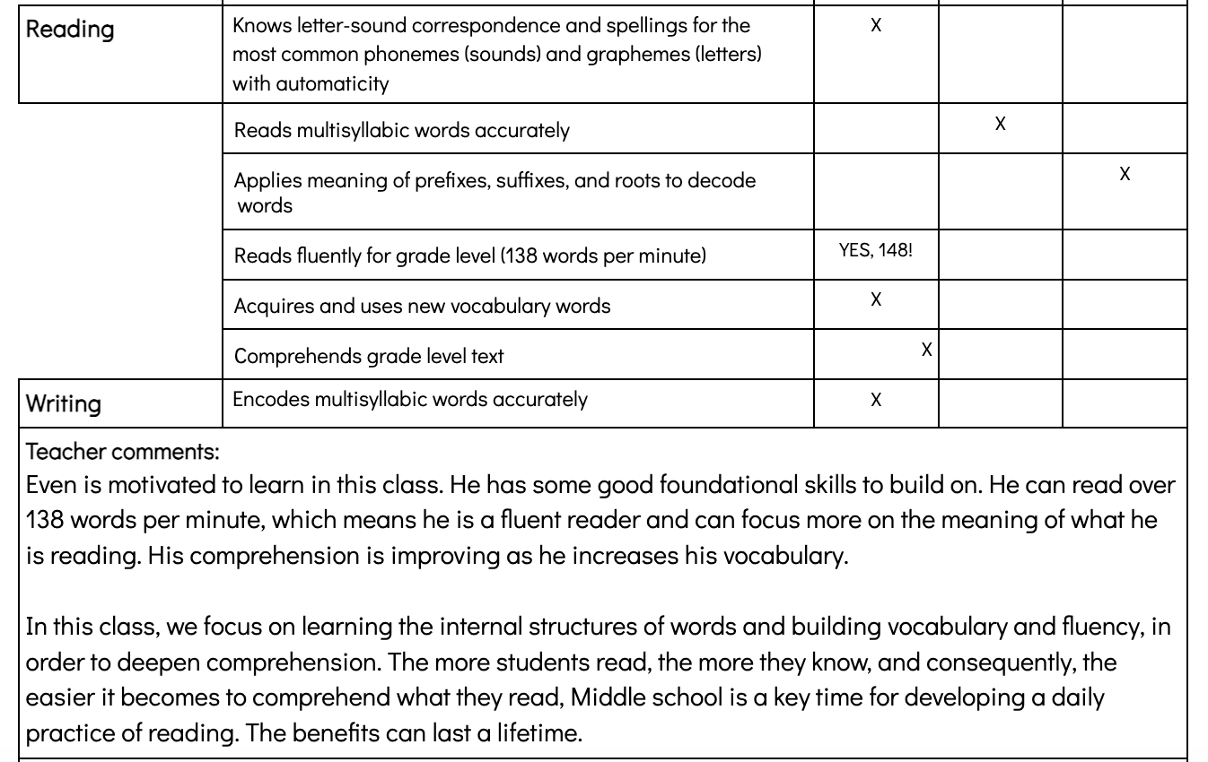
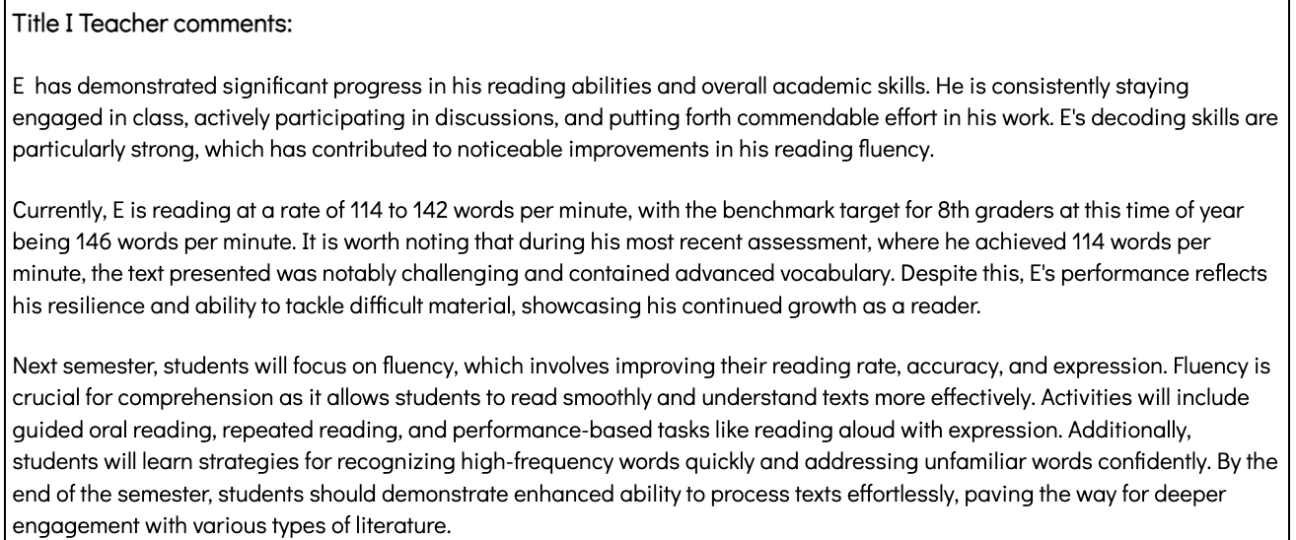
Sample Progress Reports
Meeting Formats and Outreach:
Office Hours - bimonthly progress updates
Progress Reports
Parent Square
January 2025

Slide 14
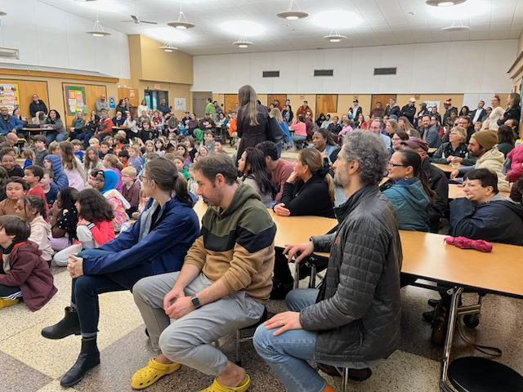
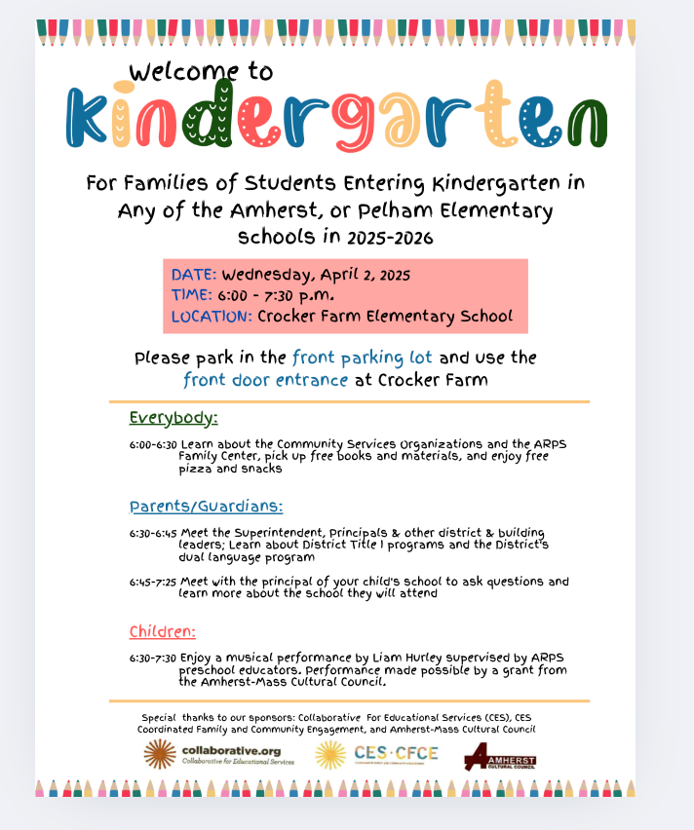
Family Engagement for a Targeted Assistance Program

Slide 15
Annual Family/Guardian Notifications
Distribute to families/guardians written family/guardian engagement policies and school-family/guardian compacts Publish and distribute annual report cards for district and all district schools Notify family/guardian of school and district accountability status as well as right to request teacher qualification information Notify (if applicable) families/guardian that student has been taught for four or more consecutive weeks by a teacher who does not meet licensure requirements

Slide 16
Family Engagement for High Schools Single School Districts

Slide 17
Notifications for High Schools and Single School Districts
Dr. Paul Bavuso​ Academic Director,
Blue Hills Regional Technical School​
pbavuso@bluehills.org

Slide 18
Overview Notifications Blue Hills
Overview
Strategic communication across multiple regions through both district-wide and local community channels
Full language accessibility built into every stage of communication, ensuring equal access for all families
Diverse outreach methods tailored to families' preferred communication styles and available technology
Carefully planned timeline that includes translation services and multiple family engagement opportunities before the presentation
Identification
Identification of the most common languages in your school community
Utilization of district translation services already in place
Use of bilingual staff members when available
Consideration of using QR codes linking to translated digital versions
Creation of materials in all identified primary languages
Use of universal symbols and icons when possible
Provision of translation services’ contact information on all materials

Slide 19
Blue Hills Notifications
Digital Outreach
Supporting Multiple Means of Engagement through…
School website announcements (multi-language toggle options)
Weekly email newsletters to all families
School's social media platforms (Facebook, Instagram)
School messaging system (texts/automated calls)
Local community Facebook groups for all nine towns
QR codes on printed materials linking to RSVP form
Traditional Media
Printed flyers sent home with students
Local newspaper announcements in all nine towns
Community bulletin boards:
Libraries
Community centers
Religious institutions
Local grocery stores
Laundromats
Coffee shops
Multi-Language Materials​
Creation of materials in all identified primary languages​
Use of universal symbols and icons when possible​
Provision of translation services’ contact information on all materials​
​
Personal Outreach​
Engage current parent volunteers to spread the word​
Use existing parent networks such as your Boosters Club or Parent-Teacher Association​
Leverage parent-teacher conferences, open houses, and back-to-school nights for face-to-face promotion​
​ ​

Slide 20
Capacity Building
Sharing best practices and resources with families on how to monitor and improve student academic progress and achievement.

Slide 21
Revere

Slide 22
Capacity Building for urban schools with multiple Schoolwide programs
Briana Tsoupas Director of Title I
Revere Public Schools

Slide 23
District-wide Initiative
District Needs Assessment Survey
Survey-Needs Assessment-Teachers and Students MCIEA
Next piloting one for families-user friendly dashboard, publicly available
District and School Level Events
Structures to Support Communication
Family Liaisons -12 across district Family Liaisons
Interpreters-Translation Devices
Parent Square-Two-Way Communication
Monthly Cabinet Meetings with all Administration
Weekly Meetings with Literacy and Math Coaches
Daily PGT (Professional Group Time) with Grade Level Teams

Slide 24
Revere Public Schools District Level Initiatives

Slide 25
Questions & Answers

Slide 26
New Resources to Review and Consider
ESSA Family Engagement Overview – NEW!
Documentation of Title I family/guardian
outreach and involvement - NEW!​ ​
Sample Title I Brochure for Families - NEW!

Slide 27
Resources
District and School Family Engagement & Required Policies (DESE Guidance)
School- family/guardian compact
Report Card Cover Letter and Right-to-Request (English)
Right-To-Know: Teacher Not Meeting State Licensure Requirements

