Slide 1
Federal Grants Update June 10, 2025

Slide 2
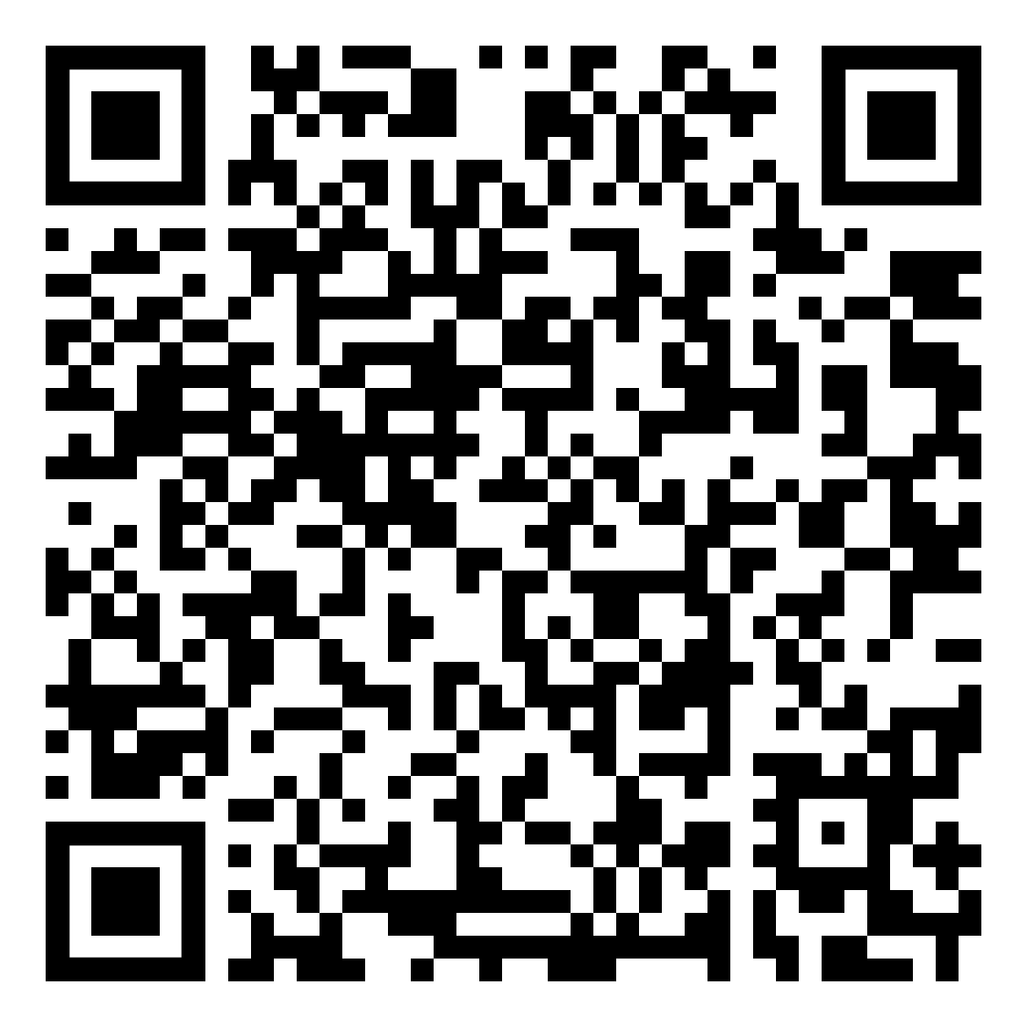
If questions come up during my presentation…
We’ve set up a Padlet!
Scan the QR code on your table or here:
Write down the question
We’ll get to it at the end, time permitting

Slide 3
DESE’s educational vision
DESE's Educational Vision
What outcomes do we envision as a result of our work?
Our vision is that as a result of their public education in Massachusetts, students will attain academic knowledge and skills, understand and value self and others, and engage with the world.
This will enable students to be curious and creative, shape their path, feel connected, and be empowered.

Slide 4
DESE's Strategic Objectives
DESE partners with districts, schools, and programs to:
Strategic Objective 2 - "Deeper Learning"
Strategic Objective 3 - "Diverse and Effective Workforce"
Develop and sustain a workforce that is diverse, culturally responsive, well-prepared, and committed to continuous improvement, so that all students have equitable access to effective educators.
Promote deeper learning so that all students engage in grade-level work that is real-world, relevant, and interactive.
Cultivate systems to support the whole student and foster joyful, healthy, and supportive learning environments so that all students feel valued, connected, nourished, and ready to learn.
Strategic Objective 1 - "Whole Student"
4
Notes:
The Department’s new educational vision sets an ambitious and long-term expectation of the learning experiences for students across the Commonwealth. The Department is deeply committed to providing aligned supports to districts, schools, and programs so that this vision may become a reality. As such, DESE has identified three key strategic objectives that it will focus on strengthening over the next four years.

Slide 5
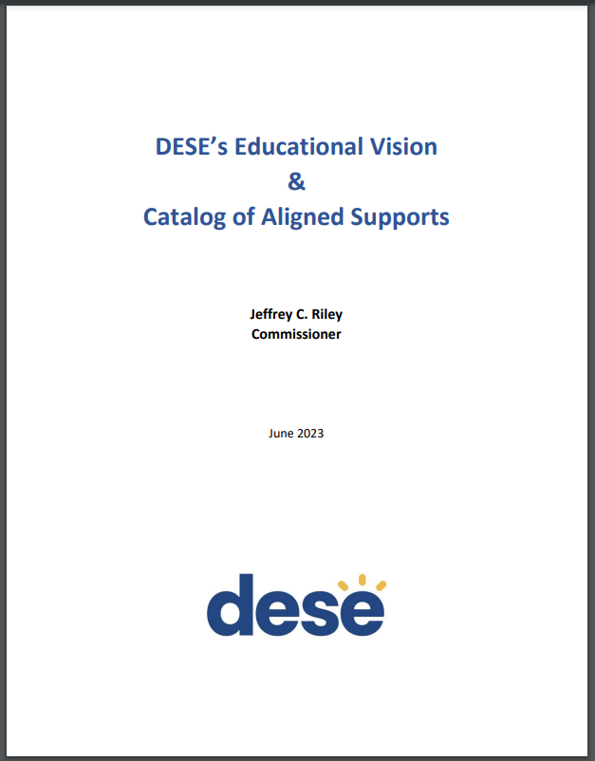
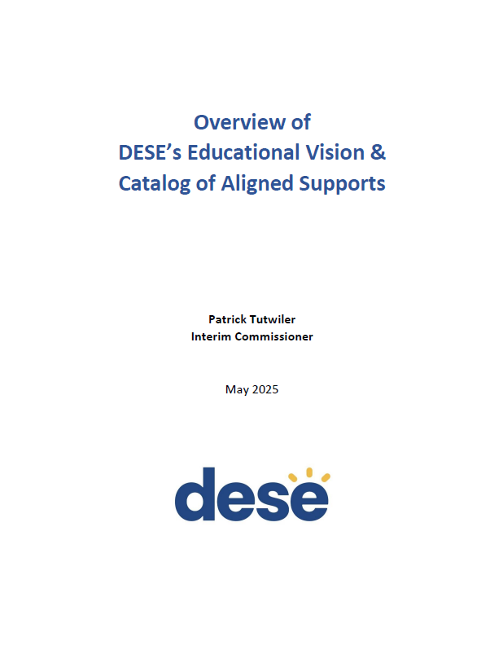
DESE's Educational Vision - Helpful Resources
Educational Vision
Catalog of Aligned Supports
www.doe.mass.edu/commissioner/

Slide 6
“Everything that’s going on”

Slide 7
Topics I’ll Cover
Federal funding status update and outlook
Presidential Executive Orders
Other Federal Actions

Slide 8
New Faces at US Dept of Ed
Linda McMahon
Secretary (confirmed 3/3/2025)
Penny Schwinn
Deputy Secretary (not yet confirmed as of 6/10/2025)
Kirsten Baesler
Assistant Secretary of Elementary and Secondary Education (not yet confirmed as of 6/10/2025)

Slide 9
Federal Funding - Overview
Federal grants make up ~5% of MA education spending statewide (~$1.3 billion)
However, that proportion varies greatly depending on what district you’re in

Slide 10
Federal Funding – Overview
While USED runs over 100 grant programs, the largest K-12 grants come from 3 laws
ESSA (Title I, IIA, III, IV)
IDEA
Perkins
Note that USDA, not USED, runs the national school meals programs (~$435 million)

Slide 11
Federal Funding – Overview
Almost without exception, federal grants are meant to be supplemental to state/local dollars
Additionally (almost without exception) they require districts to maintain effort from one year to the next with respect to state/local dollars. IDEA maintenance of effort is particularly rigorous.

Slide 12
Federal Funding – Overview
Federal fiscal years begin on October 1 and run through September 30
As of today, the federal government is funded through September 30, 2025. To avoid a government shutdown, Congress must approve appropriations bills by midnight on this date or pass a Continuing Resolution.
Typically, federal grants are forward-funded, creating a situation whereby federal fiscal years sound like they are a year behind our state fiscal years (i.e. federal FY25 dollars show up in state FY26).
DESE typically receives preliminary allocations in the late spring and grant award notices around July 1.

Slide 13
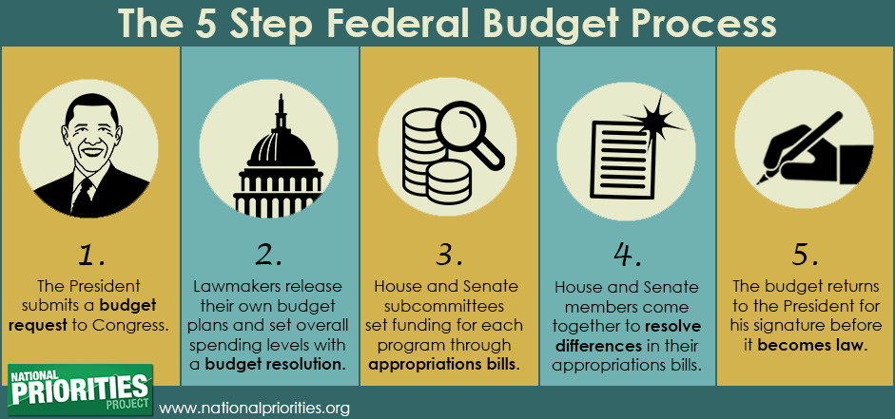
Federal Funding – Overview

Slide 14
Current Federal Education Award Status
FFY24, State FY25 – Received awards in summer 2024. Finishing up first year. Most FY25 federal grants are good for 27 months (until 9/30/2026)*.
FFY25, State FY26 – Signed into federal law in March 2025; expectation is level funding. However, we’re still waiting for preliminary allocations for Title I-C, Title II-A, Title III-A, and Title IV-B. The federal Office of Management and Budget and USED are running behind. Most FY26 federal grants are good for 27 months (until 9/30/2027).**
FFY26, State FY27 – Early days; President’s FFY26 Skinny Budget released 5/2/2025, and fleshed-out budget released 5/30/2025.
*Exceptions: LEAs may only carry over 15% of Title I; and Perkins funds are only good for 1 year
**Reconciliation for FFY25 (a.k.a. the “One Big Beautiful Bill”) does not directly affect education programs.

Slide 15
Federal Funding Process – Overview
For state FY27:

Slide 16
Highlights of the President’s Proposal
Reminder: this is the President’s budget proposal. It is Congress, not the President, that sets the budget and appropriates funds.
Level funding for Title I and Perkins
Minor increases to charter school grant and IDEA
Elimination of Title III (ELs) and Title I-C (Migrant Ed)
Cut all remaining programs (Title I-D, II-A, IV-A, IV-B, competitives, etc.) by ~70% and bundle them into one “Simplified Funding Program” (SFP).
https://www.ed.gov/media/document/fiscal-year-2026-budget-summary-110043.pdf

Slide 17
FFY26 (State FY27) USED Budget – President’s Proposal
Preserve Individually | Decrease and Consolidate (18) into “SFP” | Cut Entirely
ESSA Title I-A (level fund) | ESSA Title II-A (Educators) | ESSA Title III (ELs)
IDEA (minor increase)* | ESSA Title IV-A (Well-rounded/Enrichment) | ESSA Title I-C (Migrant)
Perkins (level fund) | ESSA Title IV-B (After school/21st Century CC) | Comprehensive centers
Charter Schools (increase) | 15 other K-12 grants: Comprehensive literacy; Innovative literacy; Title I-D programs; State assessments; Homeless; Native Hawaiian; Alaska Native; Rural; American history and civics education; Magnet schools; Arts; gifted and talented; family engagement centers; School safety national activities; and Promise neighborhoods. | Training/advisory, Innovation/research, Teacher-leader incentive, SEED, Ready to Learn, Full-service community schools
Impact Aid |  | Adult Education
Indian Education
*would combine Early Ed and K-12 IDEA grants

Slide 18
ED Federal Programs Current Status and FY27 Proposal (solid lines = we’ve received the grant award; everything else is an estimate)
Assumptions for FY26 and FY27:
FY26 is level-funded
FY27 Simplified Funding Program would consolidate remaining programs and cut them by ~70%
Note USDA School Lunch NOT included in estimate

Slide 19
ED Federal Programs Current Status and FY27 Proposal (solid lines = we’ve received the grant award; everything else is an estimate)
This graph removes the “preserved” programs and zooms in on K-12 programs most affected by the proposal.

Slide 20
USED Federal Programs Current Status and Outlook FY25-27

Slide 21
Cash Management reminders – for all grants
Everything is done on a reimbursement basis
District State Feds
*Example: Jan 26, 2025 OMB memo
spends, then claims from
spends, then claims from

Slide 22
We don’t receive federal money up front

Slide 23
Cash Management reminders – for all grants
Before districts claim funds from DESE in GEM$, they must have invoices in hand that have been paid, or payment is imminent (within a few days)
Districts may not draw funds for anticipated invoices, or simply when an encumbrance is made
Districts sign assurances each year, attesting that they understand and will follow cash management laws.
DESE/State Comptroller then pays districts with “temporary” state funds
Finally, DESE/State Comptroller submits claims to the federal government and gets reimbursed

Slide 24
Presidential Executive Orders and Status Updates

Slide 25
Presidential Executive Orders
While it’s important to understand what has been ordered for purposes of “staying in the know” about what might be on the horizon, it’s also important not to overreact.
Why?
Because Presidential Executive Orders are directed toward federal agencies, not you. Federal agencies receive these orders and then determine how, and the extent to which, they can implement them.

Slide 26
Presidential Executive Orders
Ending Radical and Wasteful Government DEI Programs and Preferencing
USED issued a communication indicating compliance with the EO.
https://www.whitehouse.gov/presidential-actions/2025/01/ending-radical-and-wasteful-government-dei-programs-and-preferencing/

Slide 27
Presidential Executive Orders
Improving Education Outcomes by Empowering Parents, States, and Communities
“The Secretary of Education shall, to the maximum extent appropriate and permitted by law, take all necessary steps to facilitate the closure of the Department of Education and return authority over education to the States and local communities while ensuring the effective and uninterrupted delivery of services, programs, and benefits on which Americans rely.”
Nearly half of USED staff were placed on leave (4,133 to 2,183). The reduction in force is currently being challenged in court.
https://www.whitehouse.gov/presidential-actions/2025/03/improving-education-outcomes-by-empowering-parents-states-and-communities/

Slide 28
Presidential Executive Orders (cont.)
Reinstating Common-Sense School Discipline Policies
“the education secretary shall issue new guidance to local educational agencies (LEAs) and state educational agencies (SEAs) regarding school discipline and their obligations not to engage in racial discrimination under Title VI in all contexts, including school discipline”
“the education secretary shall submit a report to the president…regarding the status of discriminatory-equity-ideology-based school discipline and behavior modification techniques in American public education.”
https://www.whitehouse.gov/presidential-actions/2025/04/reinstating-common-sense-school-discipline-policies/

Slide 29
Presidential Executive Orders
Advancing Artificial Intelligence Education for American Youth
“promote AI literacy and proficiency among Americans by promoting the appropriate integration of AI into education”
establishes “a White House Task Force on AI Education”
https://www.whitehouse.gov/presidential-actions/2025/04/advancing-artificial-intelligence-education-for-american-youth/

Slide 30
Presidential Executive Orders
Ending Radical Indoctrination in K-12 Schooling
“to advise the President in formulating future policy, the Secretary of Education, the Secretary of Defense, and the Secretary of Health and Human Services, in consultation with the Attorney General, shall provide an Ending Indoctrination Strategy to the President”
https://www.whitehouse.gov/presidential-actions/2025/01/ending-radical-indoctrination-in-k-12-schooling/

Slide 31
Presidential Executive Orders
Preparing Americans for High-Paying Skilled Trade Jobs of the Future
Calls for a report on a comprehensive worker investment and development strategy
Calls for expansion of registered apprenticeships
https://www.whitehouse.gov/presidential-actions/2025/04/preparing-americans-for-high-paying-skilled-trade-jobs-of-the-future/

Slide 32
Presidential Executive Orders
Expanding Educational Freedom and Opportunity for Families
“Secretary of Education shall issue guidance regarding how States can use Federal formula funds to support K-12 educational choice initiatives”
https://www.whitehouse.gov/presidential-actions/2025/01/expanding-educational-freedom-and-opportunity-for-families/

Slide 33
Presidential Executive Orders
Defending Women from Gender Ideology Extremism and Restoring Biological Truth to the Federal Government
Keeping Men Out of Women’s Sports
“policy of the United States to recognize two sexes”
“it is the policy of the United States to rescind all funds from educational programs that deprive women and girls of fair athletic opportunities”
Title IX enforcement will follow based on 2020 rules (Dear Colleague Letter from Feb 2025)
https://www.whitehouse.gov/presidential-actions/2025/01/defending-women-from-gender-ideology-extremism-and-restoring-biological-truth-to-the-federal-government/
https://www.whitehouse.gov/presidential-actions/2025/02/keeping-men-out-of-womens-sports/
https://www.ed.gov/media/document/title-ix-enforcement-directive-dcl-109477.pdf

Slide 34
Presidential Executive Orders
MA’s official responses to several of these orders, and more (ICE enforcement, Protecting Education funds, protecting international students, etc.), can be found on Attorney General Campbell’s website
https://www.mass.gov/orgs/office-of-the-attorney-general/news

Slide 35
Other Federal Actions

Slide 36
ESSER Rescission
On March 28, Secretary McMahon issued a letter that revoked late liquidation approvals, effective immediately
This affected 20 districts, DESE, and 2 private schools to the tune of ~$106 million
MA issued guidance to the districts and private schools to keep going
MA joined 16 other states in a lawsuit against USED’s letter. As of today, USED is preliminarily enjoined from enforcing that letter

Slide 37
ESSER Data Collection - Eliminated
On April 8, USED announced that it had permanently discontinued ESSER Data Collection.

Slide 38
Other Rescissions
Regional Educational Labs and Equity Assistance Centers (provided research support)
Comprehensive Centers (provided technical assistance)
89 ongoing research studies on funded through IES
Educator preparation grants (SEED, TQP)
Certain school lunch grants (Local Food for Schools, etc.)
School-Based Mental Health Services (SBMH) grant

Slide 39
Title VI – Letter, FAQ, and Certification
USED issued a Dear Colleague Letter and an FAQ that provides guidance about the USED Office of Civil Rights’ current interpretation of Title VI
USED then asked all states to certify, in writing, that they comply with USED’s interpretation of Title VI and SFFA v. Harvard (affirmative action case that ruled race-based admissions are unconstitutional). Certification would be in exchange for receiving federal funds.
The requirement to certify was struck down in court, and as a result, USED communicated: “the Department will take no further action concerning the Title VI Certification Letter unless and until further notice is provided.”
https://www.ed.gov/about/news/press-release/ed-requires-k-12-school-districts-certify-compliance-title-vi-and-students-v-harvard-condition-of-receiving-federal-financial-assistance
https://www.ed.gov/media/document/frequently-asked-questions-about-racial-preferences-and-stereotypes-under-title-vi-of-civil-rights-act-109530.pdf

Slide 40
FERPA Oversight
USED asked states to summarize how they ensure LEAs comply with the Federal Educational Rights and Privacy Act (FERPA)

Slide 41
Supreme Court Case of Note
Oklahoma Statewide Charter School Board v. Drummond
An attempt to create the nation’s first publicly funded religious virtual charter school and challenge the Establishment Clause.
Oklahoma’s Supreme Court ruled it was illegal, and the Supreme Court of the United States did not overturn that ruling.

Slide 42
Stay informed via our monthly newsletter
You can read about the latest federal grants updates, see claims status reports for your district, all via our monthly Federal Grant Programs newsletter
Not on the list? Email FederalGrantPrograms@mass.gov!
Because this comes out monthly, anything urgent will likely be delivered to you via an On-the-Desktop email directly to superintendents.

Slide 43
Questions and Answers
Let’s go to the Padlet!

