Slide 1
A Tour of Federal Grants’ Fiscal Requirements
June 10, 2025

Slide 2
Intended Outcomes for Today
Review Fiscal Requirements of the ESSA grants
To provide and connect you with available resources
Answers to your questions!

Slide 3
Tour Itinerary

Slide 4
Rules of the Road

Slide 5
Multi-Year Grants
ESSA (Title I, IIA, III & IVA) are multi-year grants.
27 – month lifespan
Multiple fiscal years of ESSA will be active at the same time.
The oldest funding should be used first (First in First out)
Keep in mind requirements of each grant
NOTE: This is the same timeline for IDEA (FC 0240/0262)

Slide 6
ESSA Grant Timelines
FY24
FY24 Year 3 7/1/25 to 9/30/25
FY25
FY25 Year 2 7/1/25 to 6/30/26
FY25 Year 3 7/1/26 to 9/30/26
FY26
FY26 Year 1 Grant start date to 6/30/26
FY26 Year 2 7/1/26 to 6/30/27
FY26 Year 3 7/1/27 to 9/30/27
NOTE: This is the same timeline for IDEA (FC 0240/0262)

Slide 7
Monthly Claim Status
There is a Monthly Claim Status at the bottom of each Federal Grants Monthly Newsletter.
The claim status is pulled as a certain date.
Emails are pulled from Directory Administration
Please keep DA up to date as personal change in your district
You can also sign up for the newsletter here
NOTE: Click here for the June Claim Status

Slide 8
Federal Funds and Supplement not Supplant
Federal funds must be used to augment the regular education program – i.e., what is provided by the district with state and local funds
Supplanting is using federal funds to substitute or replace funding by district/state
Supplement not Supplant Quick Reference Guide

Slide 9
Supplement Not Supplant

Slide 10
What is Supplement Not Supplant? – Title I
For Title I, compliance with SNS is no longer measured by looking at particular Title I expenditures. Instead, SNS compliance is measured by whether the district has a written methodology to ensure that each Title I school receives all of the state and local funds that it would have received if it were not a Title I school.
Title I funds therefore may be spent for any allowable expenditure regardless of what funds were used to pay for it in the past or whether state or local funds pay for the same expenditure in non-Title I schools.
NOTE: Districts should be reviewing their written methodology and updating in June each year if necessary.

Slide 11
What is Supplement Not Supplant? – Title IIA & IVA
Unlike for Title I, the test for Title IIA and IVA is an expense-by-expense measure
Supplanting is presumed if any of the following is true, according to federal fiscal guidance (2 CFR Part 200, Appendix XI):
A district uses federal funds to provide services that are required under other federal, state, or local laws.
A district uses federal funds to provide services that the district provided with non-federal funds in the prior year.
A district uses federal funds to provide services that the district would otherwise provide without federal funds

Slide 12
What is Supplement Not Supplant? – Title III & Immigrant Grant
Like Title II and IVA, the test for Title III and the Immigrant grant is an expense-by-expense measure:
In addition to supplementing state and local funds, Title III requires that funds supplement federal funds.
Because the education of English learners is heavily regulated by the state and federally, avoiding the first presumption of supplanting can be challenging.
For example, Title III, Part A funds may not be used to meet requirements of federal laws governing ELs (Title VI of the Civil Rights Act of 1964 and Equal Education Opportunities Act of 1974) and the Massachusetts LOOK Act (Chapter 138 of the Acts of 2017), among others.

Slide 13
Time and Effort: Who and When
Time and Effort documentation is required for all federal funded staff member and any federal funded stipend
In addition to ESSA (Title I, IIA, III/Immigrant Grant, & IVA), IDEA and Perkins also require Time and Effort
Reports should reflect actual time and should only be logged after the work is completed.
Time and Effort Resources

Slide 14
Time and effort: Types
Semi-annual certifications are required for ESSA (or IDEA or Perkins) personnel whose compensation is funded solely from the ESSA (or IDEA or Perkins).
Monthly reports are required for ESSA (or IDEA or Perkins) personnel whose time is charged in part to ESSA (or IDEA or Perkins) and in part to other revenue sources (split-funded staff).
Stipends (and other supplemental contracts) must also be reported on a monthly basis
This includes stipends for PD

Slide 15
Time and effort: Substitute System
Under the substitute system, semi-annual certifications can be used for staff that are funded through multiple sources or on multiple activities but maintain a consistent work schedule.
Districts choosing to use this system must complete and keep on file an Annual Management Certification form.
More information on this can be found on our website.

Slide 16
What is Flexing?
ESSA gave the new authority for districts to use funds in a more flexible manner. Flexing allows districts to ‘transfer’ funds from one Title to be spent on allowable costs for another Title.

Slide 17
Why would a district want to Flex Funds?
After completing their Needs Assessment, the district realize their needs would be better met if they were able to use funds in a more flexible way and concentrate on certain programs over others.

Slide 18
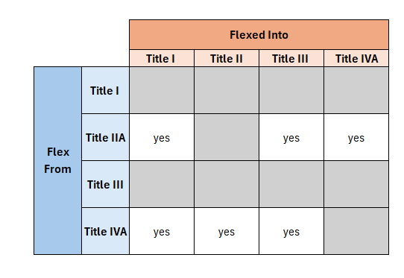
Flexing Funds Rules
Title II can be flexed into Title I, III, or IVA
Title IVA can be flexed into Title I, II, or III
Title I and Title III cannot be flexed.

Slide 19
Things to Remember about Flexing Funds
When funds are flexed, those flexed funds can be used for the program purposes they were flexed into.
The funds flexed will count towards the total amount of that program and those flexed funds will be subject to the program they are flexed into requirements.
Flexing will not affect your allocations for the next fiscal year.

Slide 20
Flexing Funds and GEM$
Flexed funds do not move budgets.
You use budget tags to identify which budget items are flexed
You will request funds from the funds’ original Title budget
Examples:
The district flexes all their Title IVA funds into Title I
The district flexes half their Title IVA funds into Title I
Title I Budget
Title IIA Budget
Title III Budget
Title IVA Budget
Title I Activities
Title IVA Activities
50% Title IVA Activities
50% Title I Activities
Title IIA Activities
Title III Activities
Title I
Activities

Slide 21
Flexed Funds and Equitable Services
Flexing is a decision made by the school district
Before a district flexes its funds, districts are required to conduct timely and meaningful consultation with affected private schools (if any) about the consequences of flexing funds on equitable services.
Equitable Services amounts are calculated after flexing

Slide 22
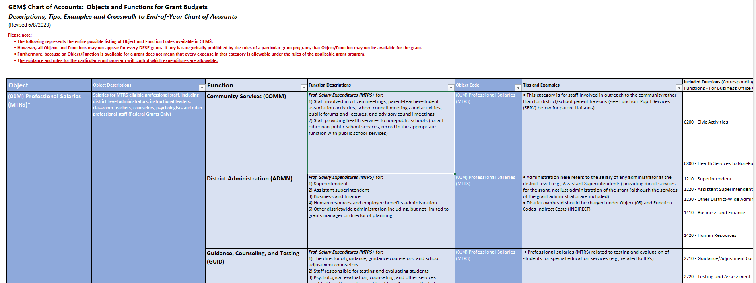
Chart of Accounts
The Chart of Accounts Excel Document can also be found in the GEM$ Resources
TIP: Use ctrl + F to search the document

Slide 23
Budget Narratives
Clear description of what the budget item is for
For staff lines include number of staff and FTE if part of a salary or stipend rate

Slide 24
Function Code: COMM
Staff involved in citizen meetings, parent-teacher-student association activities, school council meetings and activities, public forums and lectures, and advisory council meetings
Staff providing health services to non-public schools (for all other non-public school services, record in the appropriate function with public school services)
This category is for staff involved in outreach to the community rather than for district/school parent liaisons (see Function: Pupil Services (SERV) for parent liaisons)

Slide 25
Object Code: 03 – Other Salaries
Salaries/stipends for non-administrative support staff, including custodians, paraprofessionals, food service personnel, school bus drivers, crossing guards, and other staff not identified as professional or administrative support staff.
03 - Other Salaries are not for teacher/admin stipends

Slide 26
Stipends: Where to budget?
Stipends should be budgeted where that staff’s salary would be budgeted
Professional Stipends should be budgeted under object code 01-M/01-NM depending if the stipend is subject to MTRS
Paraprofessional stipends should be budgeted under object code 03-Other Salaries.
Budget narrative should include the stipend rate and/or number of staff

Slide 27
Object Code: 04- MC (Major Contracts)
Major Contracts are contracts over $25k
Must be budgeted in 04-MC
Best practice is to have one budget item per contract

Slide 28
06 - Other Expenses
Expenditures not chargeable to another object code, such as dues, subscriptions and travel for staff

Slide 29
Indirect Costs
Costs that benefit entire organization and cannot be specifically identified to one cost objective (sometimes referred to as "overhead", including but not limited to Human Resources, utilities, maintenance).
An applicant's indirect costs cannot exceed the maximum allowable based on its indirect rate and eligible grant allocation (see respective Budget pages for this maximum for any grant).

Slide 30
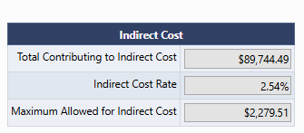
Where do find your district’s Indirect Cost Rate?
Grants Management’s Website
For Federal Grants, the restricted rate is used
District’s indirect rate is located on each grant’s budget page

Slide 31
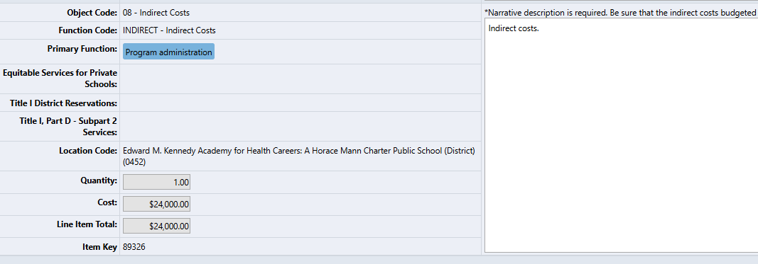
Budgeting Indirect Costs in GEM$
Object Code:
08 – Indirect Cost
Function Code:
INDRIECT – indirect cost
Budget Narrative:
Indirect

Slide 32
Title I Reservations & School Ranking
Total Title I Budget
Reservations made on your Title I reservation page must be budgeted in your Title I budget.

Slide 33
When is an amendment/revision needed?
There is any significant change in program objectives
There is any increase or decrease in the total amount of the grant
An increase in a line of the budget exceeds $100 or 10% of the line (whichever is greater) or exceeds $10,000

Slide 34
Title I Amendments
When revising your budget make sure to continue to align your Title I reservation and school ranking page to the budget
Title I Reservation page
School Ranking page
Total Title I Budget
For example: If your homeless reservation needs to change, make sure it is updated both in the budget and the reservation page.

Slide 35
Comparability: What is Title I Comparability and why is it important?
An annual requirement for each school district receiving federal Title I, Part A funds
A school district may only receive Title I funds if it uses state and local funds to provide services in Title I schools that, taken as a whole, are at least comparable to the services provided in schools that do not receive Title I funds.
The comparability requirement is intended to ensure that school districts do not spend less from state and local sources in higher poverty / Title I-funded schools than they do in lower poverty / non-Title I-funded schools.

Slide 36
How does a District Demonstrate Comparability?
Comparability is determined by looking at student/state-locally funded staff ratios and comparing them to schools within the same grade span within the district.
An automated excel form has been created for you to complete comparability. Additional comparability documents available
Comparability Webinar Recording available upon request. Email FederalGrantPrograms@mass.gov

Slide 37
What is the 15% Carryover Rule for Title I?
85% of Title I (including any flexed funds) must be spent in the first Federal Fiscal Year
Federal Fiscal Year ends 9/30
Example: 85% of FY25 Title I needs to be spent by 9/30/25
15% of Title I can be carried over into the second year
This only applies to Title I funds. There is no carryover limit on Title IIA, III, or IVA
Fiscal Year Reminder:
Federal Fiscal Year: October 1st – September 30th
State Fiscal Year: July 1st – June 30th

Slide 38
15% Carryover Rule Reporting
Reporting for the 15% Carryover will take place in GEM$ as FY25 Application Supplement in the fall.
Your district will be notified in the fall if they supplement needs to be completed.
Simple waivers can be awarded every 3 years and allows districts to carryover more than 15%.

Slide 39
Title I Reservations
Equitable Services
N/D Allocation

Slide 40
Title I: Homeless Reservation
All districts must reserve a homeless reservation regardless if the district has homeless students
The homeless reservation can be spent on any student experiencing homelessness in the district. They do not have to attend a Title I school.
For more information on allowable costs: Homeless Quick Reference Guide

Slide 41
Title I: Homeless Reservation Resource
Calculating Appropriate Reservations (see National Center for Homeless Education for guidance/resources)
Districts must rely on a needs assessment to determine an appropriate level of funding to meet needs of who are homeless. Title I applications must indicate the method used to determine the reservation amount, whether Title I funding alone is used or additional sources are used to meet needs. Suggested methods include:
Multiply the per pupil expenditure by the average number of students in the subgroup;
Determine the percentage of all students that fall in the subgroup and use an equal percentage of the total Title I funds;
Use an amount to cover a specific need as stated in the needs assessment (i.e., tutor, homeless liaison, POC); or
If the district is a McKinney-Vento grantee, match the funding level of the grant.

Slide 42
Title I: Family Engagement Reservation
Districts with a Title I allocation $500k or more after flexing must reserve at least 1% for family engagement.
This reservation will then be spent on the Title I schools within your district.
If your Title I allocation is increased during mid-year adjustments, your family engagement reservation must still meet the 1% minimum.
Resources:
ESSA Family Engagement Overview Module
District and school-level family/guardian engagement policies
School-family/guardian compact

Slide 43
Other Common Reservations
Administrative services
Preschool programs
MTRS
Indirect

Slide 44
MTRS
Districts are required to budget 9% of MTRS eligible salaries for MTRS.
MTRS Quick Reference Guide

Slide 45
MTRS – DESE Initial Payment
In January, Grants Management will pay MTRS 80% of the budgeted MTRS.
This is a one-time payment, and the amount will not change.
You can see the amount paid to MTRS in the same area that you submit reimbursement requests.
Districts are responsible for paying the remainder of MTRS to MTRS at the end of the grant.
If an overpayment was made to MTRS, a refund can be issued.
Districts will need to amend their grant first and then work with Grants Management.

Slide 46
School Ranking
This is the page you will designate which of your schools will be Title I for the current school year and what kind of Title I program they will be, Schoolwide or Targeted Assistance.
While we do not ask districts to assign budget items to individual to schools, the school ranking page should align with the budget.
TIP: School ranking page must equal $0.00. Any remaining $ or cents should be added an existing Title I Reservation on the Title I Reservation page

Slide 47
Title IIA
For professional development
Title IIA cannot be used for writing curriculum
Title IIA cannot be used for any supplies used in the classroom

Slide 48
Title III Fiscal Requirements
2% Admin Max (includes indirect & program management)
Professional Development
Supplemental Instruction
Family Engagement

Slide 49
Title IVA Fiscal Requirements
2% Admin Max (includes indirect)
Over $30k need to meet the following:
20% Access to Well Rounded
20% Safe and Healthy Schools
Something for Effective use of Technology
Only 15% of Effective use of Technology can be spent on technology infrastructure
There is no cap on technology infrastructure under Access to Well Rounded and Safe and Healthy Schools

Slide 50
Review: When is an amendment/revision needed?
There is any significant change in program objectives
There is any increase or decrease in the total amount of the grant
An increase in a line of the budget exceeds $100 or 10% of the line (whichever is greater) or exceeds $10,000

Slide 51
Remember Grant Requirements when Revising
In GEM$, the consolidated application is all together. We do expect districts to update more than the budget if needed when making a revision
Update narratives where needed
Adjust Title IVA SMART goals
Grant Administration Restrictions – check quick reference guides
Specific Grant Requirements
Equitable Services
Title I – Homeless & Family Engagement,
Title III – Family Engagement, Professional Development, & Supplemental Instruction
Title IVA – Over $30k need to meet the 20% Access to Well Rounded, 20% Safe, and Healthy Schools, and something for Effective use of Technology
Indirect Costs Limits

Slide 52
Final Reports
Final Reports should be completed 60 days after the final reimbursement request/end of the grant
Grants Management reviews and approves Final Reports
FR1: EdGrants
FER: GEM$
Final Financial Report
FY23 and prior for ESSA
If you are unable to see the FR1, please contact Grants Management
Final Expenditures Report
FY24 and on for ESSA
District initiate the FER

Slide 53
Who to Contact?
Federal Grant Programs
Grants Management
Programmatic questions
Allowable costs
Amendments/Revisions
Federal Grants Liaison List
Reimbursement requests
Filing FR1s/FERs
Email: EdGrants@mass.gov

Slide 54
GEM$ Workflow
Important Reminders:
Start Date: The date the LEA Fiscal Representative initially approves the Grant to DESE.
Checklist: If your grant was returned to you, please check the Checklist for your liaison’s feedback
LEA Superintendent: The district’s actual Superintendent/Charter School Leader must be the one to sign off unless there is preapproval from DESE
DESE Fiscal Budget Approved: Your grant is fully approved, Grant Award Notice (GAN) has been generated, and you can request funds

Slide 55
GEM$ Signoffs
The Superintendent/Chief Executive role must be held and should be exercised by the actual organizational leader.
The Superintendent/Chief Executive must approve funding applications in GEM$ unless unavailable to approve for a length of time that would unreasonably delay submission of the funding application.
All funding applications require at least 2 sets of eyes from an LEA – the Superintendent and at least one other (either the LEA Fiscal Representative or the LEA Grantwriter, or both).
In no case should a funding application be created/approved by the same person holding all three LEA roles.
Note: The same person may be assigned all three roles in GEM$ (although this would be unusual) but cannot exercise all three roles on the same funding application.

Slide 56
LEA Requirements for GEM$ User Roles - Guidance and Forms
DESE has created a GEM$ LEA User Role Resource Guide designed to describe the capabilities and responsibilities that each role has in GEM$, as well as DESE’s expectations for how these roles will be used and managed by each LEA. In addition to the resource guide, DESE has created several forms (linked below) that must be used if a district wishes to assign new roles to staff. Some forms will be sent directly to DESE, others uploaded to GEM$, and the majority will solely be kept on file with the LEA. The GEM$ LEA User Role Diagram for Use of Forms provides an overview and instructions for using the forms. User Role Forms for all GEM$ Roles: GEM$ First User Access Administrator Form GEM$ Alternate User Access Administrator form GEM$ LEA General User form GEM$ LEA Superintendent Chief Exec form GEM$ Vendor Authorization User form The forms, as well as the resource guide, are also posted on the DESE Resources page of GEM$.

Slide 57
Resources: Quick Reference Guides
ESSA
Title I
Title I Part D
Title IIA
Title III
Title III - Immigrant
Title IVA
IDEA
0240
0262
Perkins

Slide 58
Resources:
Federal Grants Program Monitoring
ESSA Private school services
ESSA Program Evaluation

Slide 59
Questions?
Email: colleen.e.holforty@mass.gov
General Email: FederalGrantPrograms@mass.gov
Federal Grant Liaisons: http://www.doe.mass.edu/federalgrants/liaisons.xlsx
Website: www.doe.mass.edu/federalgrants

Slide 60
Thank you!!

