Slide 1
How to use GEM$ data to your advantage
June 10, 2025

Slide 2
Today’s Agenda
GEM$ Dashboards
How they work, widgets, downloading data & tracker template
Downloading and Uploading Budgets
LEA User Report
New Report Brainstorm

Slide 3
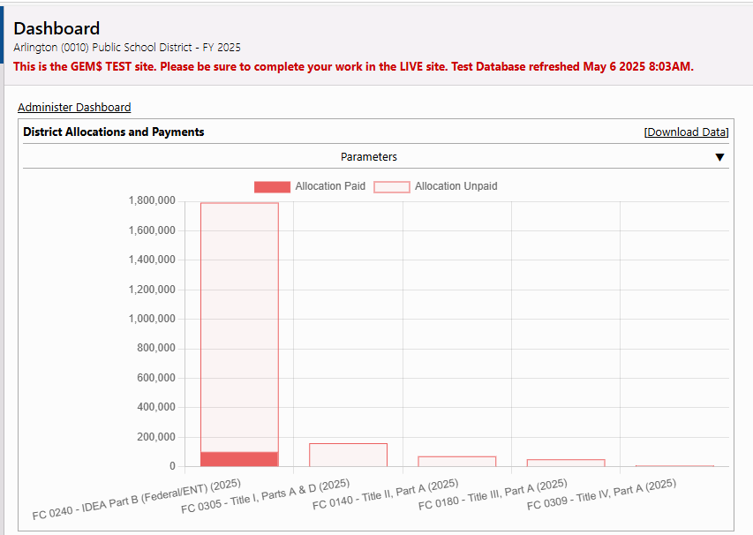
GEM$ Dashboards

Slide 4
Dashboard Basics
1. Only those with a role in GEM$ are able to use dashboards
2. Dashboards are personal to each user
3. Each dashboard component is called a “widget”
4. Dashboards keep your widget set-up from log-in to log-in
5. Choose to display some/all widgets on your dashboard
6. Order/re-order your widgets to suit your priorities

Slide 5
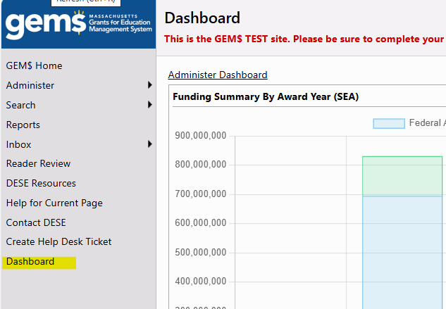
Where to find your dashboard
Log into your GEM$ User Account
The Dashboard can be accessed by clicking on the link in the lefthand gray menu from your GEM$ landing page

Slide 6
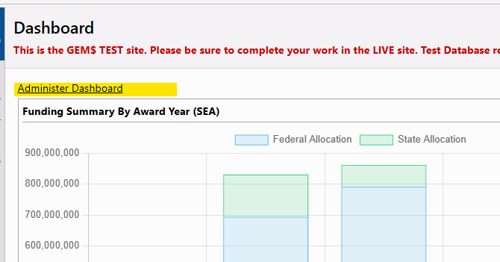
Choosing Widgets
Click on the “Administer Dashboard” link

Slide 7
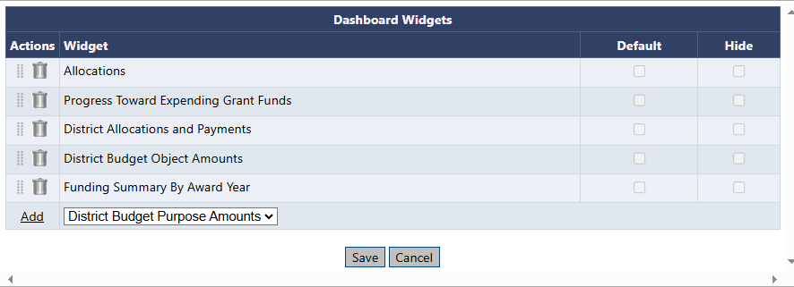
Choosing Widgets – cont.
A popout screen will appear, entitled “Dashboard Widgets”
The existing Widgets are listed first. To delete any from the Dashboard, click on the trash can to the left of the Widget name.
To add a Widget, select it from the “Add” dropdown menu and click Add to the left of the dropdown.
You can reorder the Widgets on this screen by grabbing the eight-dot track next to the trash can and dragging to a new spot.
When you have all the Widgets you want to see, click the “Save” button at the bottom of the Widget popout menu.

Slide 8
Available Widgets
LEA Allocations
Progress Toward Expending Grant Funds
Funding Summary by Award Year Widget
District Allocations and Payments Widget
District Budget Object Amounts
District Budget Purpose Amounts

Slide 9
LEA Allocations
What it shows:
The Allocations widget lists any of an LEA’s grants in GEM$ that have an allocation, by fiscal year (most recent first) and by total allocation.
Options:
The list can be reordered by column
fiscal year, fund code number, grant number, allocation amount
Can be downloaded

Slide 10
Progress Toward Expending Grant Funds
What it shows:
The Progress Toward Expending Funds widget lists all LEA grants in GEM$ for all fiscal years with some amount unclaimed.
Shows organization name, grant name, amount unpaid, and the project end data (from RFP).
If a district has claimed all fund, the grant will no longer show
Options:
The list can be reordered by column
grant number, amount unpaid, project end date (but not fiscal year)
Data can be downloaded.

Slide 11
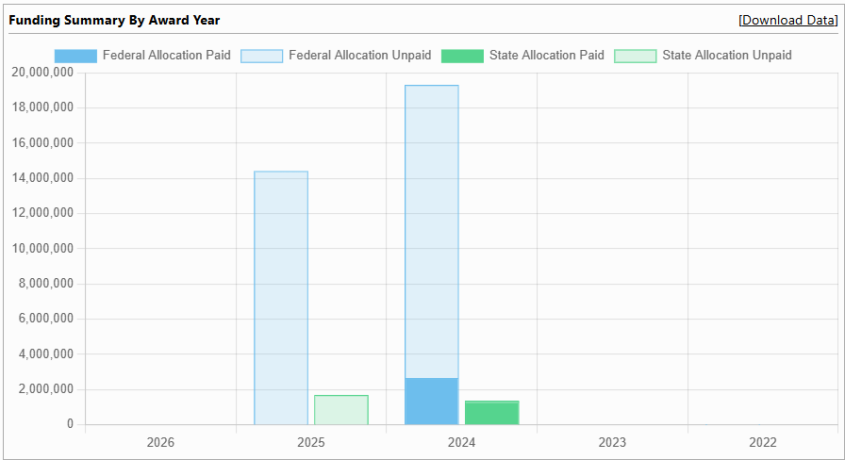
Funding Summary by Award Year Widget
What it shows:
The Funding Summary by Award Year widget is a bar chart showing a breakdown of the LEA’s total grant funding in GEMS by Award Year between state and federal for all grants, including the amount paid and unpaid (in total).
Hovering over the bars shows exact dollar amounts for paid, unpaid and total separated by federal and state funding.
Options:
None

Slide 12
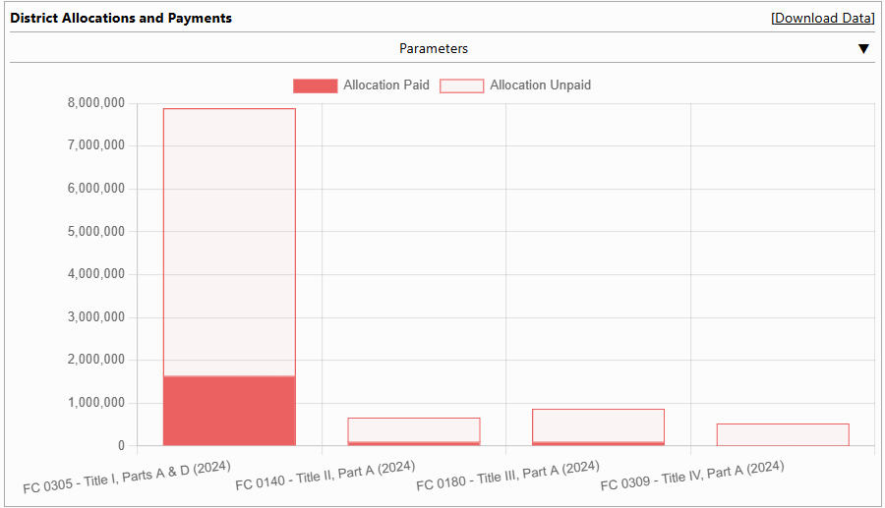
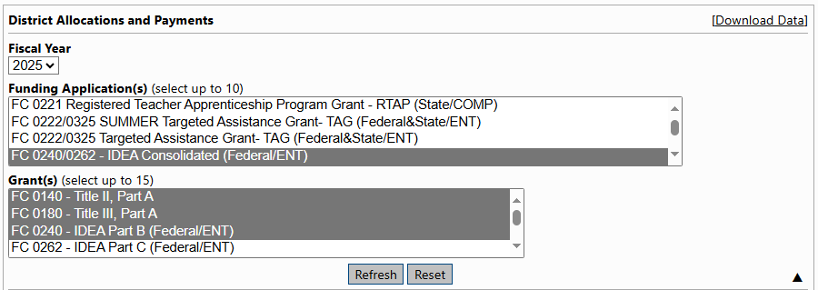
District Allocations and Payments Widget
What it shows:
The District Allocations and Payments Widget generates a bar chart showing allocation and amount paid and unpaid, by grant, for an award year.
Hovering over the bars shows exact dollar amounts unpaid and paid for each grant (but not total).
Options:
Parameters, when expanded, allows the user to choose award year (but not multiple) and then up to 15 grants.

Slide 13
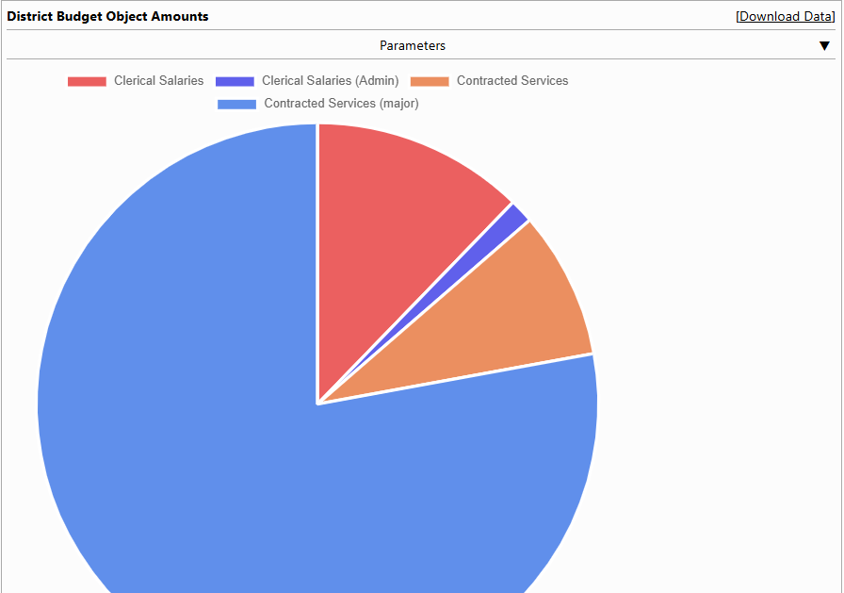
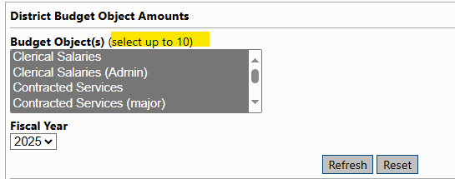
District Budget Object Amounts and District Budget Purpose (Function) Amounts Widgets
What it shows
The District Object Amount and District Function Amount Widgets generate pie charts that show all funds budgeted by either Object (e.g., Professional Salaries, Contracts Services vs. Contracted Services Major) or Purpose (Function) (e.g., MTRS, Paraprofessionals, Teachers).
The segments of the pie compare each category’s portion to the total of the categories selected rather than the total budgets.
Hovering over the wedge in the pie shows the dollar amount spent for that category.
Options
Parameters allow users to select up to 10 categories of Object or Function to compare, as well as fiscal year.

Slide 14
Claim Status Tracker Template

Slide 15
Tracker Template Using Dashboard Data
The Claim Status Tracker Template allows you to combine the data from the Allocations widget and Progress Towards Expending widget to create a claim status
Download the Tracker Template here.

Slide 16
Directions for Using the Claim Status Tracker
Login to GEM$
Go to ‘Dashboard’
Download the 'Allocations' widget
Paste Allocations data in the 'PASTE - Allocations' tab
Download 'Progress Towards Expending Grant Funds' widget
(You may need to add the 'Progress Towards Expending Grant Funds' widget to your Dashboard.)
Paste Progress Towards Expending Grant Funds data in the 'PASTE - Progress Towards' tab
Click on the Report tab

Slide 17
Claim Status Tracker Notes
The Progress Towards Expending widget will stop showing the grant once the grant has expired. You will see empty cells for grants that have ended.
For districts who have the IVAQ (FY24 0209) grant, it will not show on the Progress Towards Expending widget, but you may have funds remaining
If you decide to copy and paste the report into your own excel file, make sure you paste values. (shortcut: ctrl + Shift + V)

Slide 18
Uploading and Downloading Budgets

Slide 19
Why bother with downloading and uploading budgets?
Facilitate faster data entry for expenditures that remain on your grant from year to year
View large numbers of budget details at one time
Use/save budget data as an Excel file
Create ad hoc reports from budget details using Excel functions
Permit users who may not have permission to enter budget details directly into GEM$, such as school principals, to create a budget for their individual schools for upload to the district budget by authorized GEM$ role holders
Download and print filtered budget data. For example, budget details for a specific school if budget expenditures were entered by school location or all equitable services expenditures budgeted for a federal grant

Slide 20
Budget Download/Upload Basics
Where
The budget download and upload processes are launched from a budget page of a funding application.
When
Downloading works when application is in ANY status (e.g., LEA Fiscal Approved).
Who
How
Uploading can only be performed when the grant is in an editable status - Application or Revision Started or one of the Returned - Not Approved statuses.
Uploads must be made using the Budget Template.
Any person can create or modify an Excel budget file template, but only users with roles permitting them to create or edit a funding application can perform a budget upload.
Budget downloads appear on a Budget Template.

Slide 21
Downloading a Budget
When you download a budget, it comes as a complete handbook of the budget options for that grant
The Excel Budget Template has four tabs:
Budget Data – the actual budget data entered in the grant
Available Budget Cells – Object and Function Codes
Available Budget Tags – Budget Tag Groups, Tags, and Codes
Available Organizations – District and any schools (including private schools) associated with the district
Notes:
If you are downloading to use the budget data, the first tab is all you will look at most likely. The other tabs will be useful when you are creating a budget upload.

Slide 22
Downloading Filtered Budget Details
If you want to select a subset of your budget to download – just filter it first!
The filtering menu appears on the budget detail page.
You can filter your budget by any category and multiple categories if desired.
When you download the budget data with the filters set, you get those lines that are selected by your filtering.
The download button is located below the Indirect Cost box.

Slide 23
Creating the Template for Uploading
Start by downloading the budget for the preceding fiscal year for that grant
You can delete all of the budget data or, if you expect to have similar expenses, update existing expenses
The highlighted columns must have data – the others are optional (but see tips on the next screen)
Delete this Column

Slide 24
Tips for Creating the Budget Upload Template
Column:
Item Key – while this is a required column, it can be left blank for new budget items. It is necessary when revising or deleting a budget expense.
Action – Three possibilities: Update, Delete, or Create. The download defaults to Update. New budget details must use Create.
Object and Function Codes – the available object and function codes for this grant are found on the Budget Cells tab of the downloaded budget.
Budget Tags – While an optional column, depending on the grant, budget tags may be required and validations may be tied to these budget tags. Budget tags can be entered after the budget is uploaded by editing budget details on the budget page.
For more detailed instructions, see Uploadind and Downloading Budgets in GEM$ guidance posted in GEM$ on the DESE Resources page.

Slide 25
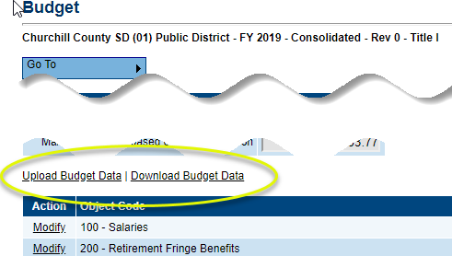
Steps for Uploading a Budget
Log in to GEM$ and make sure your funding application is in an editable state.
From the Budget page, click on Upload Budget Data.
Locate the file by clicking on Select and navigating to the place on your computer where you have saved the file, click Open. To upload, click on Create after choosing your file
If the file is missing any required data, an error message will appear, and the file will not be uploaded. Open the file in Excel, enter the missing data, save the file and upload again.
Note that the system stops reading the spreadsheet when it comes to a blank row. Be sure any blanks rows are intentional.

Slide 26
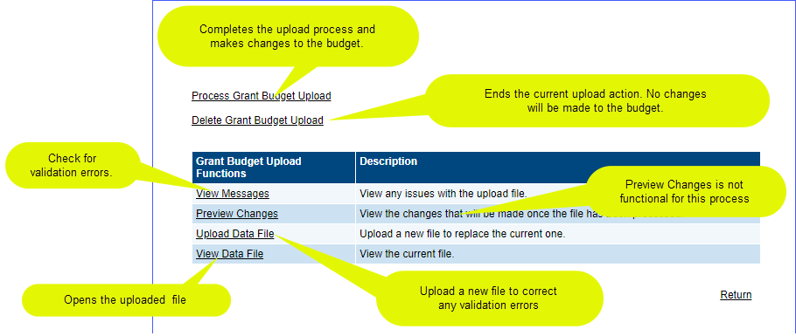
Steps for Uploading a Budget – Part 2
Budget Upload Screen
Once the uploaded, the system will display the Grant Budget Upload Screen.
Click on View Messages to see if there are any validation errors. An error will prevent the file from being processed. If errors exist, correct them in the Excel file and click on Upload Data from this screen to load the corrected file.

Slide 27
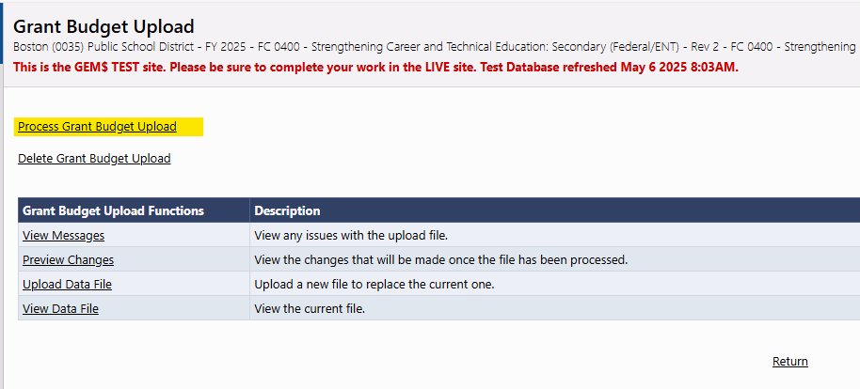
Steps for Uploading a Budget – Part 3
If there are no error messages, click Process Grant Budget Upload to complete the budget upload.
A budget upload must be processed before another one can be started. If a budget upload has been started but not completed, the Budget page will display a View Budget Upload link. If you do not want to complete the current budget upload process for any reason, click on Delete Grant Budget Upload. No changes will be made to the budget.
Note: Your budget upload worksheet can have as many worksheets as you want as long as the current upload appears as the first sheet. The system “reads” from the first worksheet only.

Slide 28
LEA User Report

Slide 29
What is the LEA User Report?
DESE contracted with the GEM$ vendor for 5 district facing GEM$ reports
The first report built is the LEA User Report
It is specific to your district and lists all those with at least one user role in GEM$
For each user, the report has a row for each role they have been assigned, their email address, the date the role was added, and the date of their last login in GEM$ (not role-specific)

Slide 30
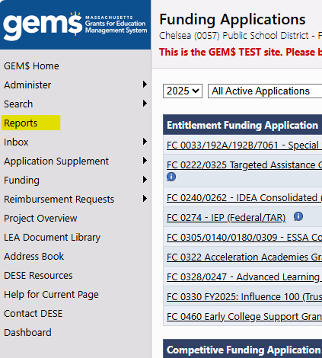
How to get to the LEA User Report?
Login to GEM$
On the left navigation bar, click “Reports”
Click on “LEA Users”

Slide 31
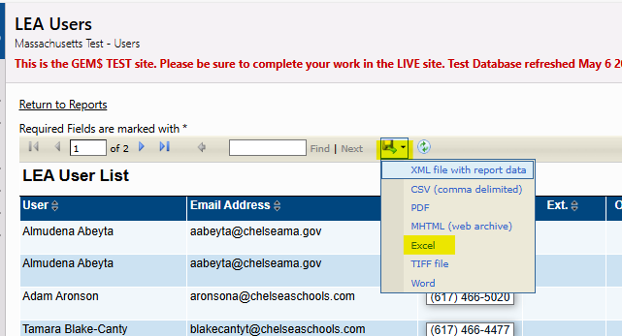
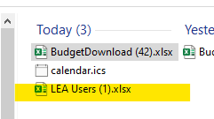
Downloading the User Report
Reports in GEM$ generally are much easier to use if downloaded as an Excel file and filtered.
To download, choose the floppy disc icon and select Excel.
The report will appear in your Browser’s and system downloads.

Slide 32
Downloading the User Report – cont.
Open the downloaded report in Excel and add a filter to the header line.
You will now be able to manipulate the data by any header category.

Slide 33
Uses for LEA User Report
User Access Administrators (UAAs) can use this report to keep roles current and be sure the correct people are assigned to user roles.
Remove inactive users - (e.g., a Director of Curriculum is assigned ESSA Consolidated grantwriter, but is no longer responsible for the grant).
Align roles and positions - Filter by role to ensure those with assigned roles are currently holding a relevant position (e.g., fiscal representative is your current School Business Official and that your retired SBO no longer has this role).
Annual inventory of your user group.

Slide 34
New Reports Brainstorm

Slide 35
What additional reports would you use?
Payment activity – transaction type, transaction date, transaction amount
Funding Summary – total allocation, total budget, total amount paid for any fiscal year.
Grant program details/grid and add-a-row details – pull data from any page of a funding application
Grant Status – what status your grant is at to see if revisions have been approved or sent back to the district & see what FERs need to be filed

Slide 36
Questions

Slide 37
Thanks for Attending!
Kathy Cross, RASP, Kathleen.Cross@mass.gov
Colleen Holforty, RASP, Colleen.E.Holforty@mass.gov

