Slide 1
Narrative and Strategies: How to Write an Effective ESSA Grant Application
Spring 2025 Federal Grants Conference
Notes:
Based on the following comment: Perhaps sessions geared toward newbies in terms of what to do and what not to do in the actual grant writing? Someone mentioned in passing during one of the sessions that the SOA plan should be written for the intended audience of family members viewing it from the website, and for some reason this little tidbit offered much greater clarity for me
in terms of my approach to the writing. I'm wondering if there are similar tips and tricks for writing the title grants that veterans could share to help make it less intimidating.

Slide 2
Agenda
Consider Your Audience
Writing a Narrative Page
Writing a Budget Detail Narrative
Writing a Title IV SMART Goal
Wrap-Up

Slide 3
Consider Your Audience

Slide 4
Who might read this grant?
Your DESE Federal Grant Liaison and other DESE staff are the first people outside of your district who will read your grant application, but bear in mind that your approved application and all revisions are public records.
That means other people may end up reading your grant as well, including:
Parents/Community Members
Students
Stakeholder and advocacy groups
United States Department of Education staff
District staff and organizations
Researchers and data scientists
Vendors
Journalists
Auditors
Anyone who wants to read it
Notes:
There are many people beyond your district team who may end up reading this grant. When you are writing the grant, think to yourself: is this written in a way that is clear and understandable to anyone who reads it?

Slide 5
What does that mean?
You should be writing your grant in a way that anyone who is reading it can clearly understand what is being funded and why.
Your narratives and budgets should be easy for any of the people listed on the previous slide to read and understand.
This holds for other written aspects of the grant as well. For example, it should be clear on the Districtwide Strategies page when and where the required annual Title I meeting is taking place and what will be covered.
Bottom line: Grantwriters need to find a balance between being clear and being concise.

Slide 6
Grant Writing Basics
Basic rules to keep in mind:
Keep your writing clear and concise
Avoid acronyms or references to district programs that are not otherwise explained
Use complete sentences and respond fully to what is being requested
Avoid ambiguity, clearly spell out what you are trying to say
Read each page of the application carefully to ensure you don’t miss any important details
Grantwriting is not an exact science, but following the advice in this presentation will help.
Notes:
Using writing that is clear and concise in your ESSA grant application will ensure that important information is communicated in a way that doesn’t lead to ambiguity or confusion.
Clear: If we don’t understand what you are trying to fund, we can’t approve your grant or might mistake an allowable cost for an unallowable one
Concise: If you include extraneous details, we may miss important aspects that we need to understand.

Slide 7
Writing a Narrative Page

Slide 8
Districtwide Strategies
This page provides the structure for each of the narrative pages in the ESSA grant and should be completed first.
In the second column, you should write broad, overarching descriptions of strategies that your district is pursuing that are relevant to ESSA
You should not be describing specific activities; those belong on the narrative pages.
Every ESSA grant must have at least one strategy.

Slide 9
District Reservations
Districtwide Strategies Page
Narrative Page
Broad, overarching strategies
Specific activities
Budget Page
Line items being funded

Slide 10
What is the purpose of the Narrative Pages?
On the ESSA application, you are required to describe what is being funded by the grant twice: once on the Narrative Page, and again on the Budget Detail Narrative.
Both are essential but have different purposes.
The Narrative Page should describe each activity that is being funded by that Title and why it is being funded/what needs it will address.
This is your chance to provide an accessible overview to the audience that will help them understand the district’s decisions and how they fit into this grant.

Slide 11
Narrative Page Sections
There are two main sections to the narrative page: “Districtwide Strategies & Activities” and “Title IA Strategies not on the Districtwide Strategies Page”
Use these sections to add a line for each distinct activity being funded by the grant.
It’s ok to group activities if they are directly related, for example stipends and transportation costs for a specific after-school program can be included together in a single narrative line
DO NOT list everything in a single narrative line unless only one thing is being funded by that budget
If you indicated on the Districtwide Strategies page that a specific strategy is associated with a Title, it must appear on the Narrative page with at least one activity that is clearly related to it
You can use the same strategy multiple times
Anything not related to a specific strategy but being funded by the Title should go in the second section

Slide 12
Narrative Page Sections (cont.)

Slide 13
Writing the Narrative Page
Every budget detail on the Title budget page should have a corresponding narrative line, except where it makes sense to group related items together.
When writing the narrative, you can use the following as a structure:
Who/What is being funded: Describe the staff, programs, materials, PDs, etc. that are being funded by this grant.
This should also describe what is being funded in a way anyone can understand. If you are using acronyms, write them out in full at least one time. If you are referring to a district program, please provide at least a one sentence description that anyone reading can understand.
Where: If this is taking place at a specific school or multiple schools, state that.
When: Is this a PD taking place one time? How long is this staff position being funded for? Are these materials that won’t be purchased until mid-year?
Why: Don’t forget to explain why this is being funded. You don’t need to provide the full results of your needs assessment, but your audience should understand why this is being funded with this specific grant and how it will benefit the district.
Notes:
The narrative line and the budget detail narrative should use the same language and names so that it is clear what is being described.

Slide 14
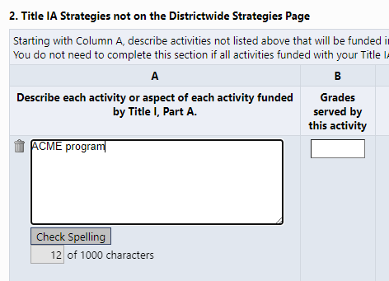
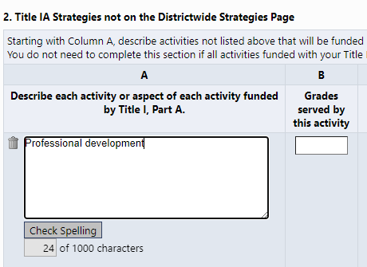
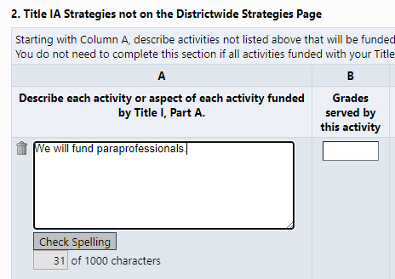
Narrative Page Error #1: Not a Narrative
The following narrative lines do not have sufficient information:
Notes:
#1 refers to a broad topic and does not give us insight into what is actually being funded in terms of professional development. Certain PD costs are allowable under Title I, but others are not. We are not getting a sense of whether or not the district is funding allowable Title I costs with its funds.
#2 refers to a specific program, but we do not have a sense of what it is or how it advances the goals of Title I. This program is probably very familiar to the district staff writing the grant, but those outside of the district who read the grant do not have that knowledge and do not know whether or not this is an allowable Title I cost.
#3 again refers to a broad topic and does not share specific details about the number of paraprofessionals that will be funded or how they will support Title I activities.

Slide 15
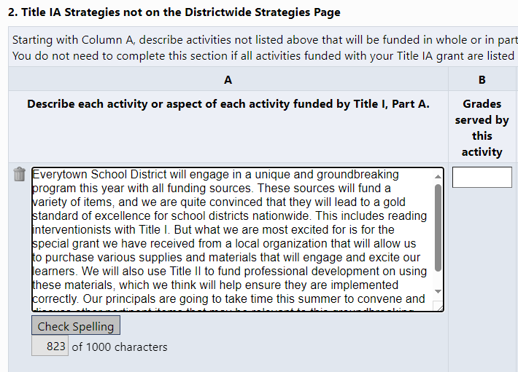
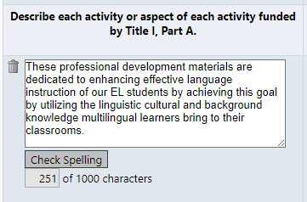
Narrative Page Error #2: Too Much Detail or Too Much Ambiguity
Too Much Detail
Too Much Ambiguity
Notes:
#1 contains too many extraneous details. In a sense, the intentions of this are good, the district is trying to ensure the reader has a full context for the spending. However, this goes too far by including other funding sources and including extraneous language (“unique and groundbreaking”). The actual activity being funded (reading interventionists) gets lost amid all the detail. Stick to clearly and concisely explaining what is being funded with just enough context to understand.
#2 is a real example from a district where it was not at all clear what was being funded. The words do not seem to connect to each other and the reader does not understand what types of materials will be purchased or how they relate to the grant.

Slide 16
Narrative Page Error #3: Describing Activities Not Found on the Budget Page
When you are adding narrative lines, do not create one for line items that do not appear on the budget page.
In addition, do not include activities that are being funded by other sources in your narrative descriptions.
Our recommendation is that you work directly off your planned budget: if a line item does not appear on the budget page, do not create a narrative line for it.
Notes:
This is related to Error #2, but is worth pointing out on its own. This sounds straightforward, but we do see this happen often.

Slide 17
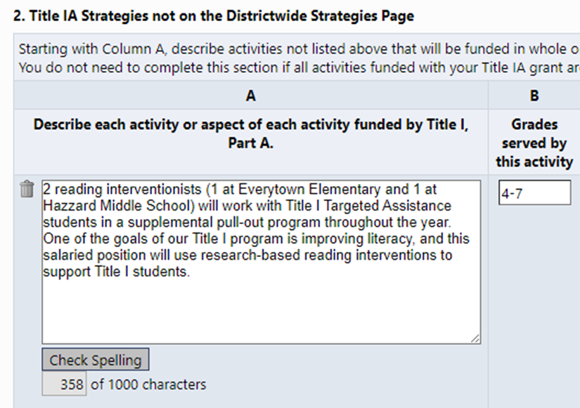
Exemplar Narrative
This narrative is an exemplar because it includes the following:
Who/What is being funded (2 reading interventionists) and basic information about what the activity being funded is (staff that work with TA students in a supplemental program)
Where the funding will go (Everytown Elementary and Hazzard Middle School)
When this expense will take place (across one year)
Why this expense is being funded (improves literacy with research-based interventions).
Written in a way that anyone can understand (does not include un-defined acronyms, is light on jargon, clearly connects the line item and the goals of the grant)

Slide 18
Writing a Budget Detail Narrative

Slide 19
What is the purpose of the budget detail narrative?
While the narrative gives the audience a sense of what is being funded in the budget, the budget detail narrative is a succinct overview the accompanies each budget line. It’s a shorter reiteration of the who/what, and (if needed) where and when to provide further clarity to the budget.
The budget detail narrative should have the following:
Who/What: A brief but precise description of what is being funded that matches terminology used on narrative page (ex. “2.0 FTE Reading Interventionists”)
Who/What for staff positions: Include relevant fiscal details: include full-time equivalence (FTE) that is being funded by this grant if this is a salaried position, or number of staff and rate if this is a stipend
Who/What for PD: Professional development can have a lot of associated costs. Is this a stipend for staff to attend? Stipend for staff to lead? A contract with a PD provider? Supplies for PD?
Where: If a location was provided in the narrative, include it in the budget detail narrative as well.
When: List how long staff positions will be funded for. If other timeline information was included in the narrative, include it in the budget detail narrative as well.
Notes:
If the Narrative page is done correctly, the budget detail narrative should be brief and precise. Think of it as having quick overviews of each line in your budget.

Slide 20
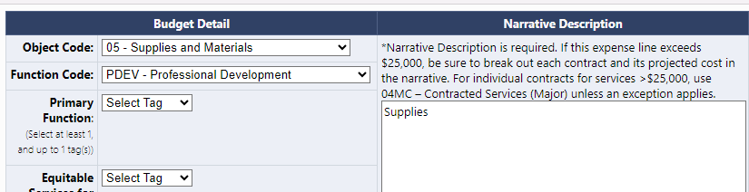
Budget Detail Narrative Error #1: Not Enough Information
Notes:
These budget details are too brief and do not provide enough information. The audience does not get a sense of what is specifically being funded by this grant when they read these budget detail narratives. Even though they generally know reading teachers are being funded, they do not know how many or the portion of their salary that is spent on Title I activities. Similarly, we know SEL PD is being funded, but what exactly? What is the contract covering: speaker’s fees, materials, etc. and how often will it be offered?

Slide 21
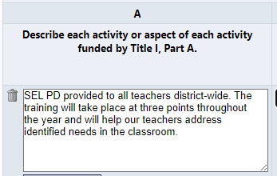
Budget Detail Narrative Error #2: Using Different Terms on Narrative and Budget Pages
Notes:
The narrative here is good, but the budget detail does not give any indication that it corresponds with this narrative line. A person reading the grant would be left wondering not only where the SEL PD was in the budget, but also who Laura Montez was and what she was receiving a stipend to do.

Slide 22
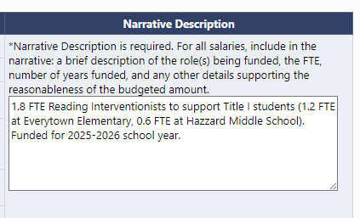
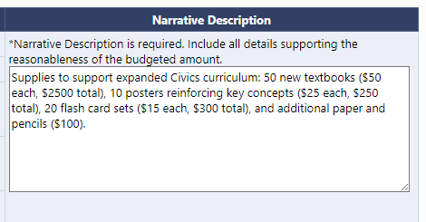
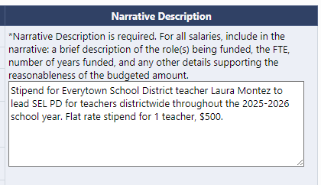
Exemplar Budget Detail Narratives
Notes:
These budget details include all the relevant information and are able to be easily understood by anyone who reads them.

Slide 23
Writing a Title IV Smart Goal

Slide 24
What is a SMART goal?
SPECIFIC
MEASURABLE
ACHIEVABLE
RELEVANT
TIME-BOUND

Slide 25
8 Tips for Writing Effective SMART Goals
Start with Specific Action Verbs: Begin the goal with a clear action verb (e.g., "increase," "reduce," "implement"). This makes the goal more precise and action-oriented.
Use Quantifiable Metrics: Include specific numbers, percentages, or dates (e.g., "increase by 15%", "complete within 3 months") to make your goals measurable.
Set Realistic Targets: Balance ambition with practicality by choosing targets that stretch your abilities but are achievable with available resources and time.
Focus on Relevant Outcomes: Make sure the goal aligns with broader objectives (e.g., student outcomes) to stay relevant to overall priorities.

Slide 26
8 Tips for Writing Effective SMART Goals (cont’d)
Define a Clear Timeline: Add deadlines or checkpoints (e.g., "by the end of the semester“ or “At the end of SY24/25”) to keep goals time-bound and help track progress over time.
Align with Stakeholders’ Needs: Make sure goals are relevant to the needs of key stakeholders (e.g., students, teachers, families) for greater impact and buy-in.
Specify Resources Needed: Identify any resources or support required to achieve the goal, such as professional development, technology, or partnerships. This can make the goal more realistic and attainable.
Include a Method of Evaluation: Define how you will measure success (e.g., “using end-of-term assessments” or “via monthly attendance tracking”). This makes the goal measurable and ensures you can evaluate progress.

Slide 27
Examples of Weak Intended Outcomes
We will utilize instructional strategies, technologies or materials that address the achievement gap among our subgroup data.
The intended outcome of this program is to improve math MCAS scores based on the instructional software programs chosen.
The intended outcome of this program is to see a higher number of students saying they are safe in the school building.
All staff who have not been trained in Responsive Classroom will be trained by the end of the year.
Provide new opportunities for students to engage with faculty during the school day.

Slide 28
SMART Goal Exemplars
The five elementary schools will offer at least one program for students identified as chronically absent. 80% of targeted participants will attend at least one session and by June 2025, each participant’s attendance will increase by 10%.
By June 2025, increase digital literacy for 7th graders by 20% (EOY assessment) through the integration of weekly coding and online safety lessons.
By June 2025, the middle school will observe a reduction of at least 10% of students referred to the PASS program more than once during the school year.
At least seven 10th or 11th grade students will attend the annual Youth At Risk Conference, and a minimum of 75% will report being engaged and that it helped to promote student voice at school (measured by the student engagement survey) at the end of the 2024-2025 school year.

Slide 29
Moving from Weak to SMART
The district will provide at least three activities or speakers targeted to school safety and student wellness, creating a culture that promotes a sense of belonging for all.
By holding these talks about student safety/wellness, what impact do you hope it will have on students? By when? How will it be measured?
100% of students provided assistive technology will be assessed every six months to evaluate participation, engagement, and achievement progress in their classrooms.
By providing these tech tools, what impact do you hope they will have on those students who used them? By when? How will it be measured?
All students in grades 5-12 will have access to the platform, where they can download audiobooks for use in class or for independent reading.
By providing students with access to the platform, what impact do you hope it will have on students? By when? How will it be measured?
Staff attending the safety and student well-being professional development will complete an exit ticket identifying at least two new items of learning resulting from the PD.
By having teachers attend this PD, what impact do you hope it will have on students? By when? How will it be measured?

Slide 30
Wrap-Up

Slide 31
Things to Remember
There are many written components to the ESSA application, but each one is included to help your district meet requirements under federal law.
Following the guidelines in this session will help ensure your grant is accurately telling the story of the staff, materials, and activities that you are seeking to fund.
Taking the extra time to write strong narratives and budget detail narratives makes it easier for DESE to review and will limit the number of times your grant is returned for edits.
Stop and ask yourself: would I know what I was talking about if I didn’t work for my district?

Slide 32
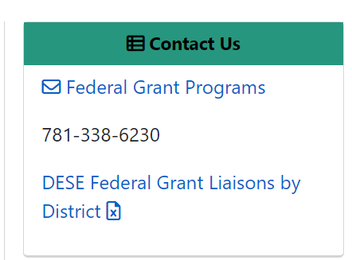
Keep in touch!
Key DESE contacts:
RASP Liaison: Reach out to your designated liaison for any questions about ESSA or IDEA grant programs, allowable costs, amendments, and/or ESSA monitoring.
Grants Management: Reach out to edgrants@mass.gov or 781-338-6595 for any fiscal questions about grants including reimbursements, final reporting, and/or grant balances.
Notes:
Ellie

