Slide 1
Grant Reimbursement
Grants Management Presenters
Jenn Ahern and Melissa Williams

Slide 2
Cash Management
  The expectation is that grantees are following sound cash management principles, including:
    Maintaining records on expenditures that align with the approved budget line items.
    Charging only allowable costs (as approved on the grant budget)
    Drawing funds as funds are expended or in the process of being expended (not obligated)

Slide 3
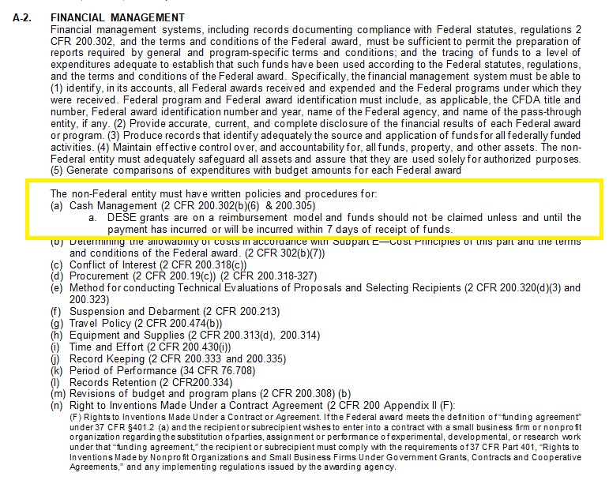
Federal Grant Assurances

Slide 4
Obligation end date
The grant end date or obligation end date is the date where all encumbrances, purchase orders and contracts must be in place.
Different types of contracts and services obligate at different times. (see chart)

Slide 5
Obligation and Liquidation for Federal Grants
Best Practice = Obligate Liquidate by the grant deadline.
Deadline for obligation depends on type of expense:
If the obligation is for: | The obligation is made:
Acquisition of real or personal property | On the date on which the State or subgrantee makes a binding written commitment to acquire the property.
Personal services by an employee of the State or subgrantee | When the services are performed.
Personal services by a contractor who is not an employee of the State or subgrantee | On the date on which the State or subgrantee makes a binding written commitment to obtain the services.
Performance of work other than personal services | On the date on which the State or subgrantee makes a binding written commitment to obtain the work.
Public utility services | When the State or subgrantee receives the services.
Travel | When the travel is taken.
Rental of real or personal property | When the State or subgrantee uses the property.
A pre-agreement cost that was properly approved by the Secretary [of Education] | On the first day of the grant or subgrant performance.

Slide 6
Grant Reimbursement Requests
  Reimbursement requests are based on actual expenditures, by line item (function code) not on obligations or projected future expenditures.
  Review the Grant Award Notice (GAN) for each grant to determine final reimbursement request timeframe/deadline
  Determine when you need all final invoices in so that reconciliation can be performed and final reimbursements requests are submitted by the deadline.

Slide 7
Grant Reimbursement Requests
  Reconcile frequently
    against the budget(s) to determine if a revision is needed (at a minimum quarterly)
    against payments to claim reimbursement (at a minimum quarterly)
  Do not wait until the end of the grant award to “clean up” budget line items and request reimbursement
    This gives the appearance that grant programming is not happening; DESE only has the reimbursement claims as insight into programs (no claims = red flag)
    Final revisions (amendments) are due 30 days before grant obligation end date to ensure approval and processing does not compete with final reimbursement deadline

Slide 8
Grant Reimbursement Requests
  Requesting reimbursement is available once the grant has been DESE Fiscal Budget Approved
    No payment request windows
    Payments will only be prevented if a payment is in process and has not yet cleared the state’s accounting system or if the available allotment has been exceeded.
    Access to Grant Award Notice (GAN)
  Reimbursement requests will adhere to the revision (amendment) thresholds

Slide 9
Revisions (Amendments) are Required when:
there is any significant change in program objectives; or
there is any increase or decrease in the total amount of the grant; or
an increase in a line of the budget exceeds $100 or 10% of the line (whichever is greater), or exceeds $10,000
Revision (amendment) validations are built into the reimbursement request form
Notes:
Validations – bullet 2 and 3. decrease – reimb request will not allow you to draw more than the new amount;

Slide 10
How to Request Reimbursement
LEA Fiscal Representative Role/Permission

Slide 11
DEMO Reimbursement Request

Slide 12
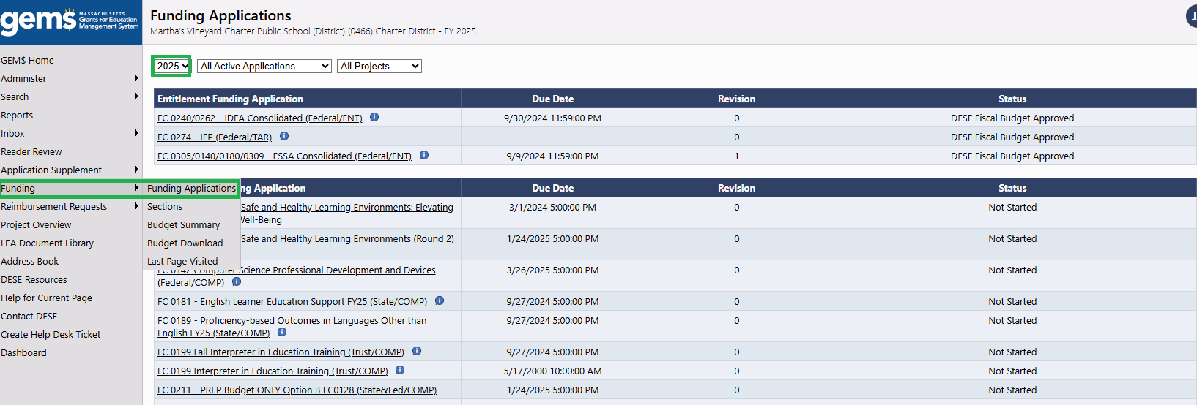
Funding Applications

Slide 13
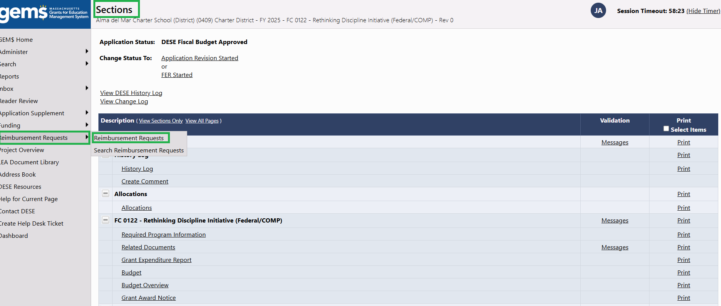
Sections

Slide 14
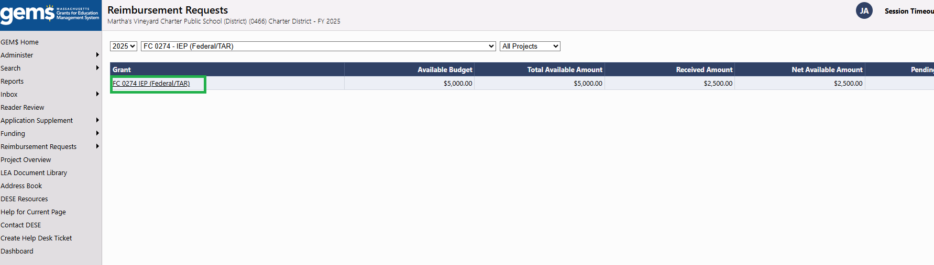
FC0274

Slide 15
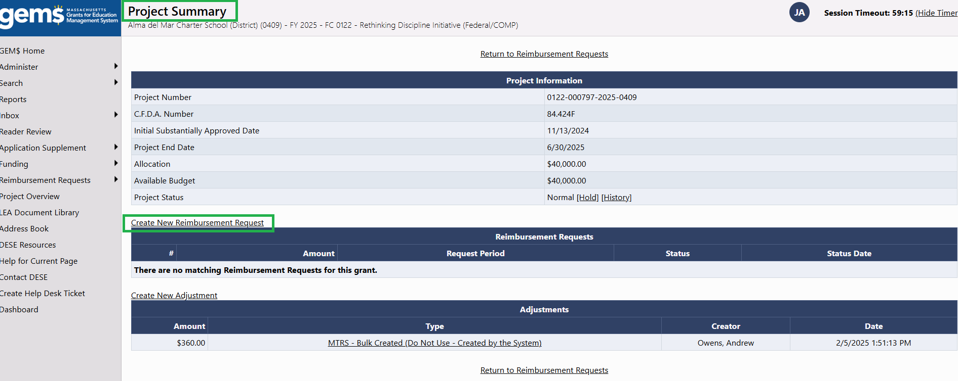
Project Summary

Slide 16
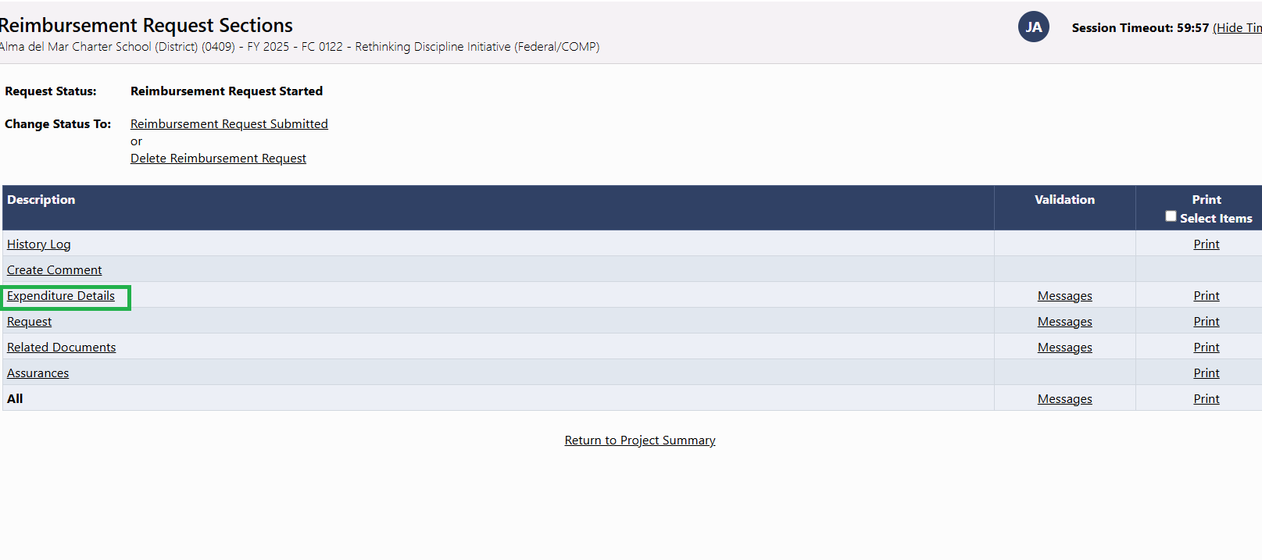
Expenditure Details

Slide 17
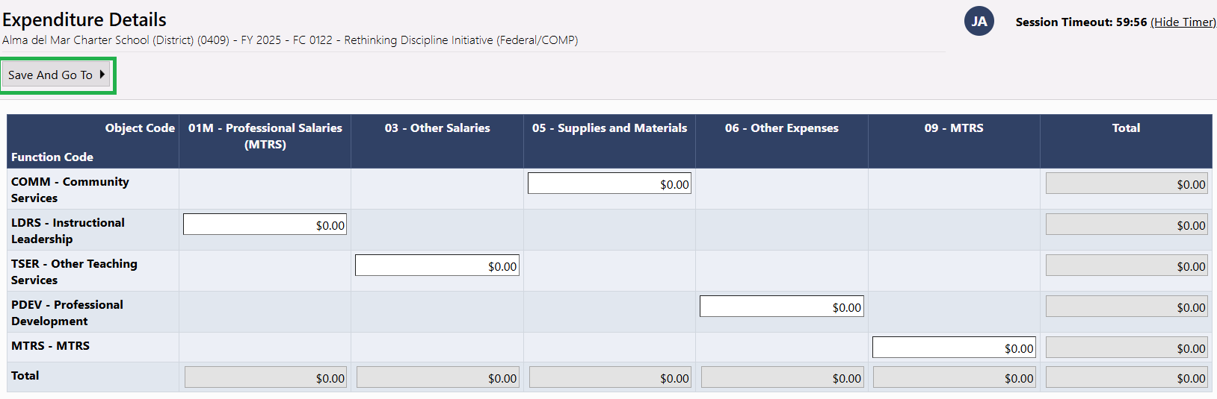
Save and Go To

Slide 18
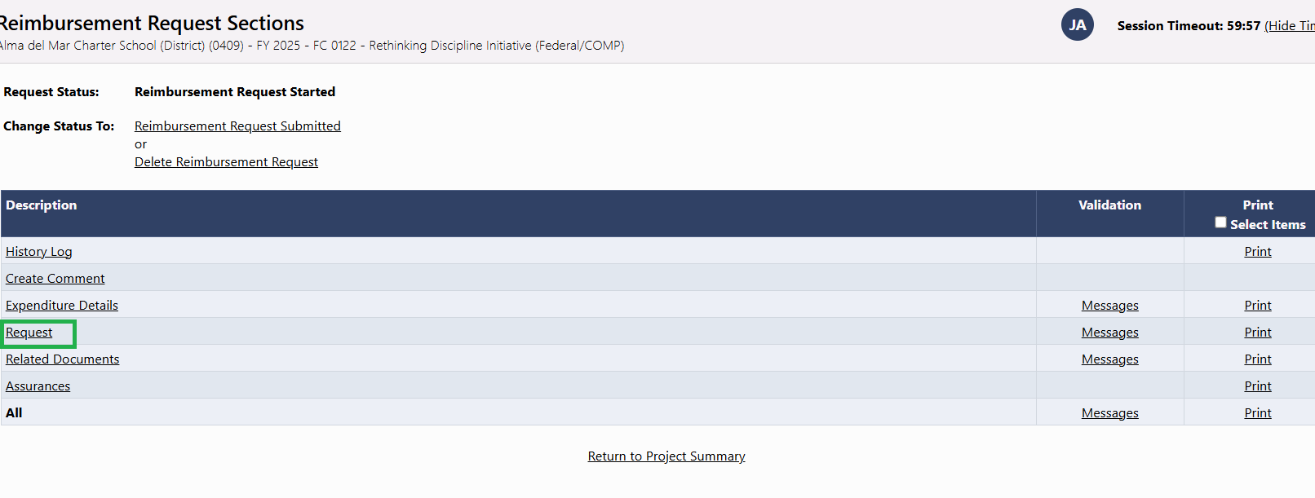
Request

Slide 19
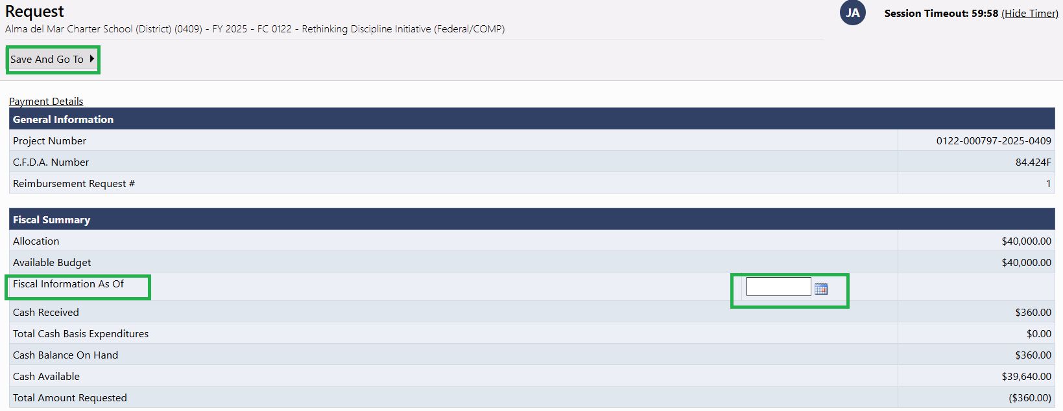
Fiscal Information As Of

Slide 20
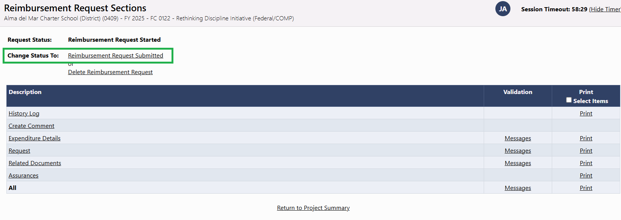
Change Status To

Slide 21
Liquidation & Grant Closeout Process

Slide 22
Grant Closeout Process
GEM$ closeout process is filing the Financial Expenditure Report (FER)
DESE will process any payments owed associated with any FER filing provided it is filed by the December 31st deadline (ESSA/IDEA)
Perkins grants have a 6/30 obligation end date so the deadline timeframe is different from ESSA and IDEA! Review the GAN!
Notes:
Take inventory of which FR-1s need filing; contact GM if the FR-1 is not allowing entry – these steps expire.

Slide 23
DEMO FER

Slide 24
Final Expenditure Report (FER)
Click on Funding (left hand column) and navigate to Funding Applications
Choose the grant fund code you want to file FER for. This brings user to the Sections area of the grant

Slide 25
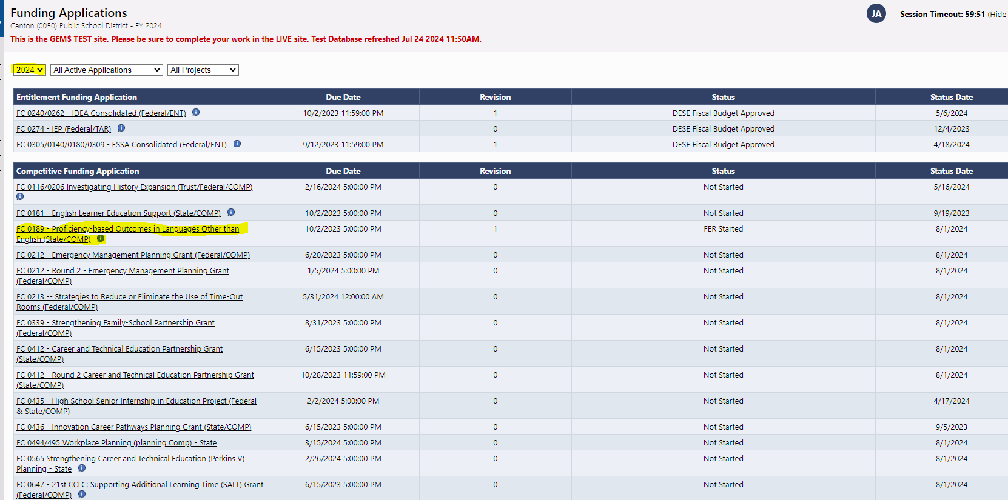
Funding Applications

Slide 26
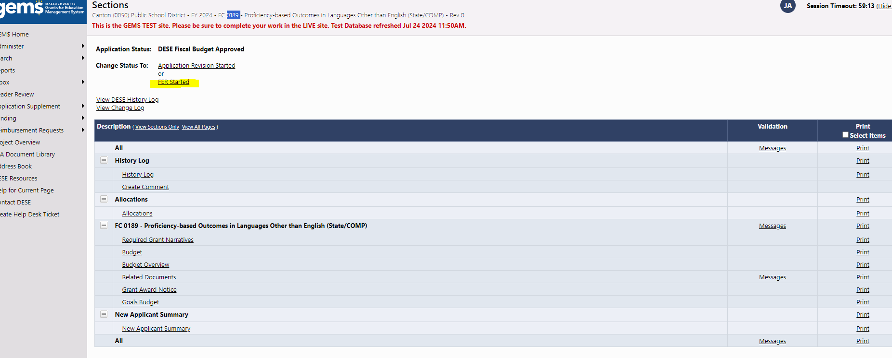
LEA Fiscal Rep role moves grant application to FER Started
FER Started is available once all funds are claimed OR once the obligation end date passes
If a grant is under revision, FER started will not be an option

Slide 27
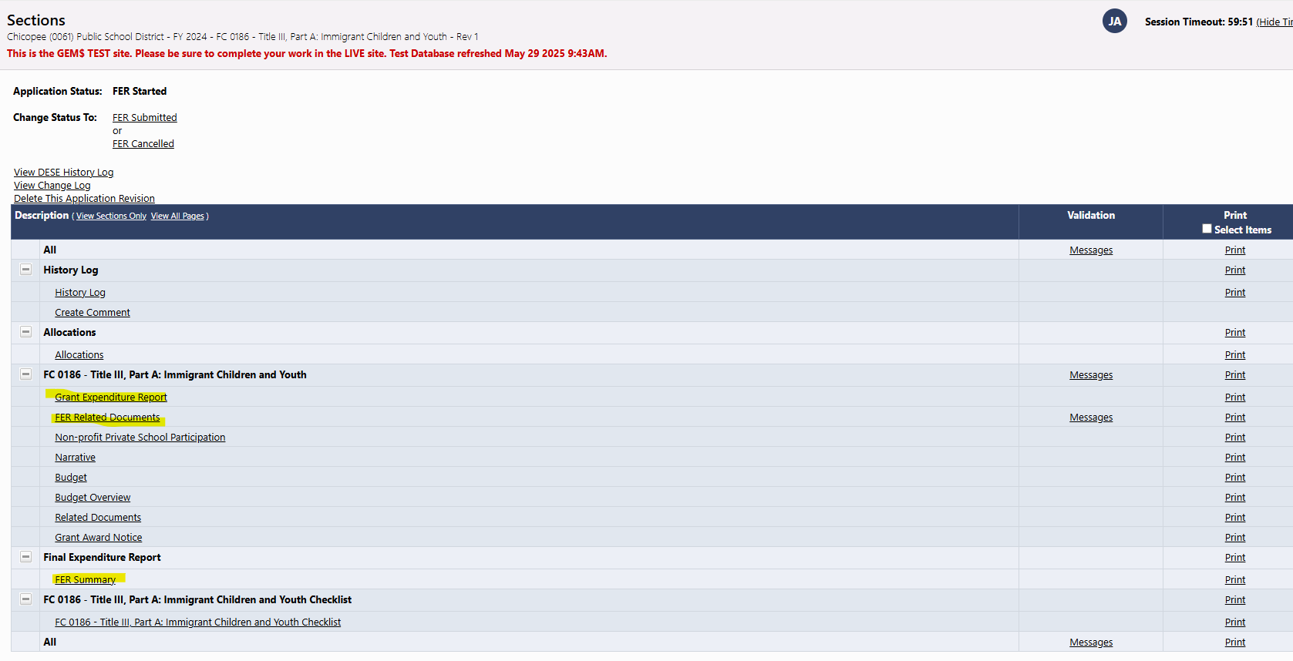
Sections 2

Slide 28
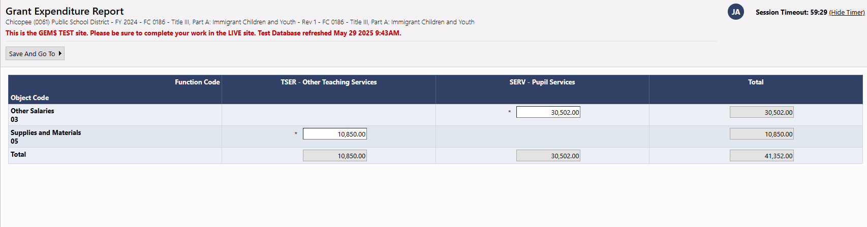
Grant Expenditures will pull in based on previous Reimbursement Requests
If all is accurate, click Save and Go to Sections

Slide 29
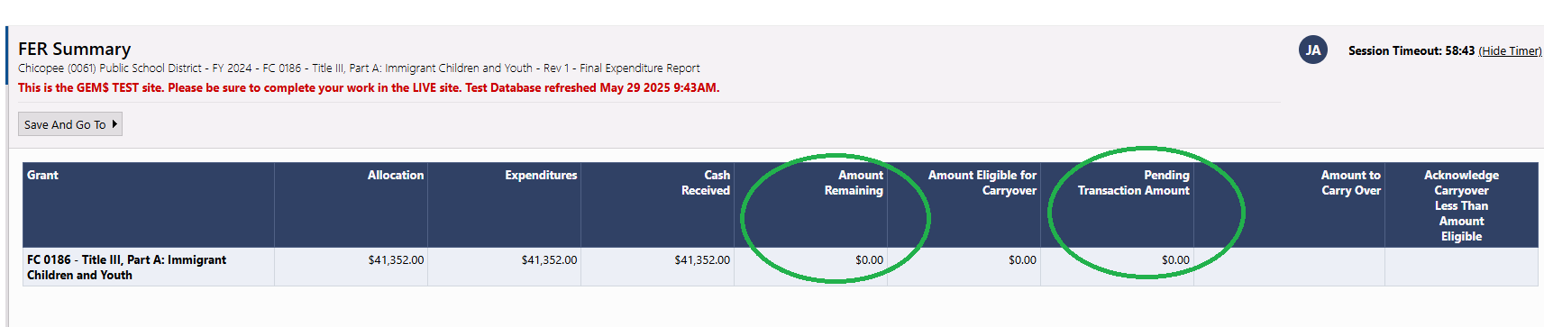
FER Summary will display any amount remaining and create a transaction based on reported expenditures
In this scenario, grantee has received and expended all grant funds.

Slide 30
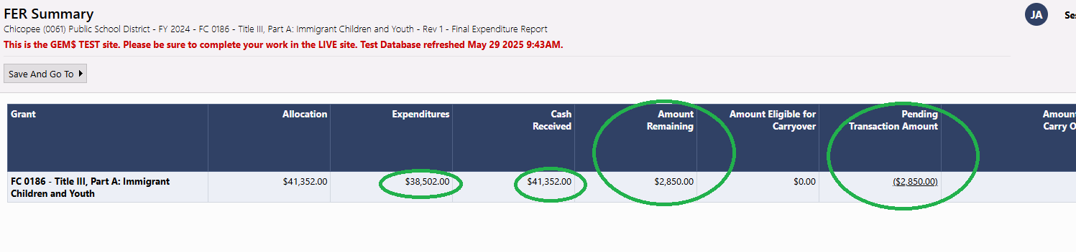
In this scenario, grantee has received more funding than expended and owes DESE a return (BAD!)

Slide 31
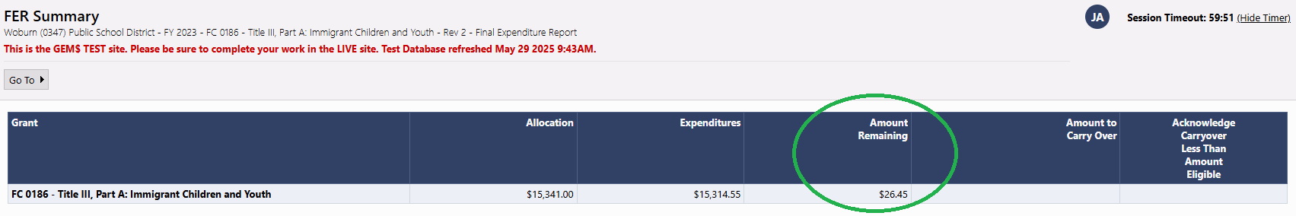
In this scenario, the grantee expended slightly less than the allocation amount and left funds unclaimed.

Slide 32
Obligation and Liquidation for Federal Grants (cont’d)
For contracts for services/goods, if necessary, grant recipients may take up to 90 days past the grant deadline for performance of the contract.
If you are not sure of deadlines, check your GAN!
Quick Reference Guide for Obligation/Liquidation: https://www.doe.mass.edu/federalgrants/resources/obligation-performance-liquidation.docx

Slide 33
FY2024 Important Deadlines: ESSA and IDEA
ESSA (0305/0140/0180/0309) Title III, Part A (0186) IDEA (0240/0262) | Status | Deadline
Final Revisions (Amendments) Submission deadline | LEA Fiscal Rep Approved | August 30, 2025
Obligation end date | LEA has all contracts and encumbrances in place | September 30, 2025
Reimbursement Request Deadline | Reimbursement Request Submitted | November 30, 2025
Final Expenditure Report (FER) | FER Submitted | December 31, 2025
Notes:
You must be an LEA Fiscal Rep to create, edit, and submit reimbursement requests. Other LEA Users will not even see the Create Reimbursement Request link – they can view existing requests but cannot create new ones or edit existing reimbursement requests.

Slide 34
FY2025 Important Deadlines: ESSA and IDEA
ESSA (0305/0140/0180/0309) Title III, Part A (0186) IDEA (0240/0262) | Status | Deadline
Final Revisions (Amendments) Submission deadline | LEA Fiscal Rep Approved | August 30, 2026
Obligation end date | LEA has all contracts and encumbrances in place | September 30, 2026
Reimbursement Request Deadline | Reimbursement Request Submitted | November 30, 2026
Final Expenditure Report (FER) | FER Submitted | December 31, 2026
Notes:
You must be an LEA Fiscal Rep to create, edit, and submit reimbursement requests. Other LEA Users will not even see the Create Reimbursement Request link – they can view existing requests but cannot create new ones or edit existing reimbursement requests.

Slide 35
FY2025 Important Deadlines: Perkins
Perkins (0400 / 0401) | Status | Deadline
Final Revisions (Amendments) Submission deadline | LEA Fiscal Rep Approved | May 30, 2025
Obligation end date | LEA has all contracts and encumbrances in place | June 30, 2025
Reimbursement Request Deadline | Reimbursement Request Submitted | August 28, 2025
Final Expenditure Report (FER) | FER Submitted | September 30, 2025
Notes:
You must be an LEA Fiscal Rep to create, edit, and submit reimbursement requests. Other LEA Users will not even see the Create Reimbursement Request link – they can view existing requests but cannot create new ones or edit existing reimbursement requests.

Slide 36
Resources
GEM$: Grant Award Notice (GAN) in Sections of each grant to determine important time frames
Federal Grant Programs - Massachusetts Department of Elementary and Secondary Education
https://www.doe.mass.edu/federalgrants/resources/grant-assurances.docx
Grants and Other Financial Assistance Programs - Massachusetts Department of Elementary and Secondary Education

Slide 37
Questions

