Slide 1
ESSA Grant Program Private School Outreach and Participation Process
Federal Grant Programs Spring Conference – June 10, 2025
Alex Lilley – DESE
Jennifer Buel – Springfield Public Schools

Slide 2
Services for Private School Students
The federal government uses census data to generate grant funds for Massachusetts under the Elementary and Secondary Education Act, most recently reauthorized as the Every Student Succeeds Act (ESSA)
This calculation includes data, and therefore funding, for all students regardless of whether they attend non-profit private schools or public district schools
Services under Titles IA, IIA, IIIA, and IVA must be meaningfully offered to nonprofit private schools to benefit their eligible students, educators, and families

Slide 3
Identifying Eligible Private School Students
Title IA
Students who reside in your district and would have attended a Title I-served school had they gone to their local public school.
Eligible students may be attending private schools inside or outside the district.
Titles IIA, IIIA, IVA
All students (and their teachers) at private schools inside district borders are eligible.

Slide 4
Outreach - obligation
Who is eligible? Who must you offer participation to?
  For Title I: Any private school that resident students are attending (even beyond your district) who would have attended a Title I school in district are eligible to participate in your Title I program
    Eligible students can participate in Title I if funds are generated (at least one is considered low-income) and there’s academic need for supplemental assistance.
  For Titles IIA, IIIA, and IVA: Every private school located in your district (all students and staff are eligible to participate)

Slide 5
Timeline
Data Collection
By 10/15
District submits individual student enrollment data through DESE’s SIMS collection
Private school submits aggregate student enrollment data through DESE’s Non-Public School Report data collection
Signed Decision
By 4/30
School Find
By 3/1
District determines private school(s) eligible to participate in ESSA Title grant programs
Offer of Consultation
By 3/15
Offer of Consultation sent certified/return receipt via US mail or other carrier, or a read-receipt email
Private school decides whether to participate and submits signed decision to the school district
Consultation
By 6/30
Private school officials complete and sign the form
Consultation meetings take place and a list of topics to be covered appears in the Consolidated Affirmation of Consultation
ESSA Application
Summer
Districts submit the Consolidated ESSA Grant Application
Provision of Services
SY
Upon grant approval:
Inform private school
Update plan and timeline for services
Begin provision of services.
Ongoing consultation and adjustment as needed to carry out full participation
Private school equitable share allocations revert to the district if private schools do not respond to attempts to fulfill implementation of services

Slide 6
Equitable Services Consultation
Annually, districts initiate consultations with eligible private schools
Districts and private schools are encouraged to consult regarding multiple ESSA entitlement grants at the same meeting
  Affirmation of Consultation and Agreement with Participating Non-Public School Officials under ESSA

Slide 7
Provision of Services in Eligible Private Schools
Districts must maintain control over funding, evaluation and supervision of services provided to private schools. Funds are never provided directly to a private school.
Carryover funds: funds for equitable services should be obligated in the first federal fiscal year of the grant cycle (by September 30 of the second school year).
  Circumstances might necessitate carrying services into following year to provide all generated/agreed upon.

Slide 8
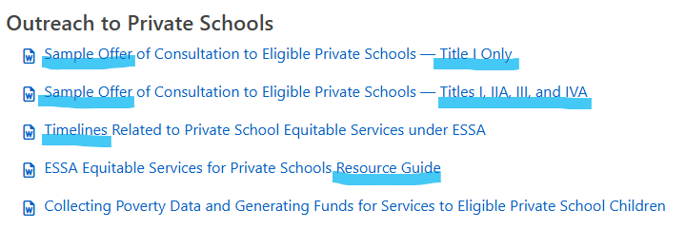
Outreach - resources
District Level Equitable Services for Private Schools - Federal Grant Programs (mass.edu)

Slide 9
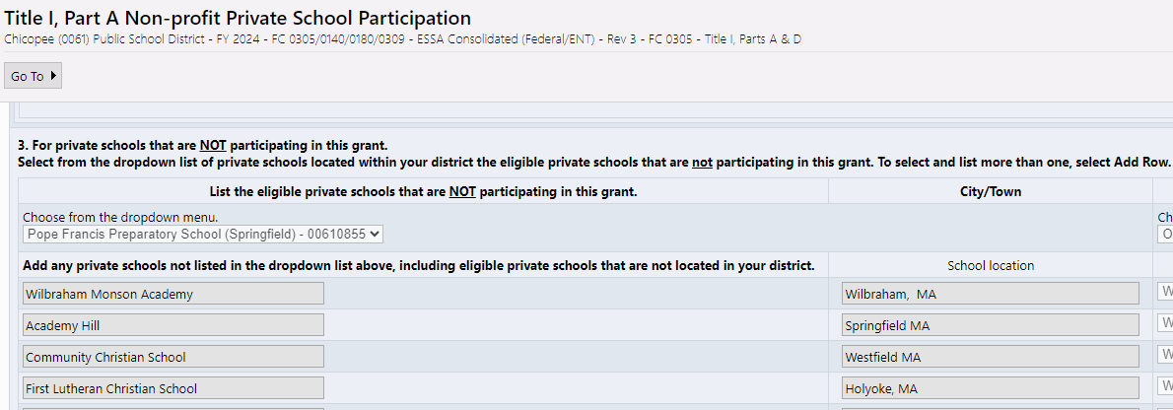
ESSA Application – list eligible schools not participating

Slide 10
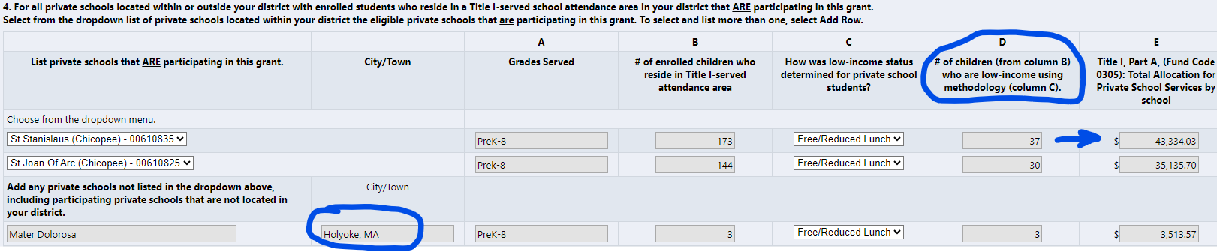
ESSA Application Title I – list participating schools…low-income count generates allocation

Slide 11
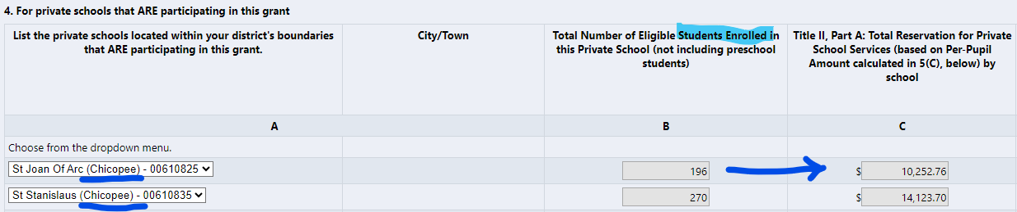
Title IIA and Title IVA – list participating schools…enrollment generates allocation (# of El’s for Title III)

Slide 12
Track and Document Outreach!
Send letters by return receipt (either snail mail or email)
Keep record of responses and receipts (if no response)
For those that choose to participate:
  Arrange for timely consultation (initial, then ongoing)
  Collect signed Affirmation of Consultation with Participating Schools
  Keep on file and upload with grant application
  Use to document agreed upon services

Slide 13
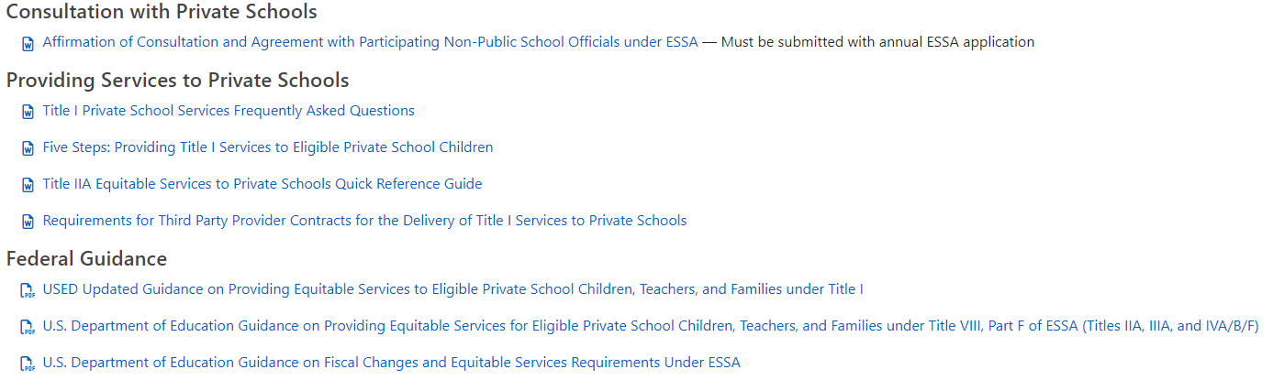
Consultation and Participation Resources
District Level Equitable Services for Private Schools - Federal Grant Programs (mass.edu)

Slide 14
Important Rules
Consultation must be “timely” and “meaningful”
  Complete before you finalize plans and consider/meet their needs
  Never pay the private school
    You must maintain control of public funds – no reimbursing…you hire, you own, you inventory…you take back at end
  Supplement, Not Supplant applies
      For Title I, it will always be a Targeted Assistance program for the eligible/participating students only
      All services and materials must be additional to what the school would provide without participating

Slide 15
Important Rules (a couple more)
Services and materials provided must be “secular, neutral, and non-ideological”
  Can hire non-secular group to provide secular services, though
Costs must be “allowable, necessary, and reasonable”
  You must adhere to regulations, seriously consider views of private school, and you have final say (and responsibility).

Slide 16
A few details
District Title I allocation exceeds $500,000?
  Must reserve 1% of private school allocation for family engagement
  Title IIA cannot be used for class-size reduction in private schools.
  Teachers hired by the district must meet state licensure requirements (teachers hired by third-party providers do not).

Slide 17
What’s allowable?
Title I: same allowability rules as district Targeted Assistance programs…supplemental assistance to eligible, targeted students
Title IIA: same as district, except cannot use for class-size reduction
Title IIIA: same as district
Title IVA: same as district, except do not need to spend on each priority area like districts with greater than $30,000 allocation must

Slide 18
Who determines what’s allowable?
You do…in consultation with private school officials
  Discuss needs and options for meeting needs
  Share Quick Reference Guides and other resources as needed
  Use topics of consultation in Affirmation of Consultation form
    Makes relationship clear…district runs program to meet needs of private school students/staff…in consultation with private school officials
    Seek help from liaison when in doubt

Slide 19
What happens if…?
I don’t hear back from the private school?
They say they want to participate, but I don’t hear from them again?
They change their mind later and want to participate?
I don’t think what they’re asking for is an allowable expense?
They don’t “spend” all of their allocation in Year 1?
I want to utilize unused equitable share set-aside funds for district purposes before they expire?

Slide 20
Reallocating unused funds: April 14th email via GEM$ (with attachment)
When:
  Private school has declined further services (won’t be used), or
  Private school is uncooperative or unresponsive after repeated, documented attempts to carry out consultation and services.
How allocate:
  Title I- goes back into private pool for redistribution (if no others, district can utilize funding)
  Other Titles- goes to private and public pool for redistribution
How expend:
  Contact your liaison to have generated amounts adjusted in application
  Revise narrative and budget

Slide 21
Some Tips
Send outreach by return receipt…document, document, document
Provide reasonable deadlines and clear consequences for non or late responses…yet allow some leeway
Document agreed upon plans in Affirmation of Consultation with Participating Private Schools form
Communicate, check-in on plans and spend-down…consultation is ongoing

Slide 22
Guidance and Resources
Equitable Services Webpage: www.doe.mass.edu/federalgrants/resources/equitableservices-essa/
  USED guidance – question and answer
  DESE resource guide – step-by-step guide
  Sample offer of consultation to private schools
  Suggested timelines related to equitable services
ESSA Ombudsman
  Alex Lilley
  ESEAequitableservices@mass.gov
ESSA statute
  Title I, Sec. 1117(a)(3)(B) and Title VIII, Sec. 8501(a)(3)(B)…for all other Title programs

Slide 23
How do you do this?
In context…
Jenn will share Springfield’s equitable services processes:
  Outreach and information sharing
  Efficient consultation practice
  Ongoing consultation/check-ins
  Evaluation

Slide 24

Private School Equitable Services under ESSA Consultation
Title I, Title IIA, Title III, & Title IV

Slide 25
Overview of Process
Offer of Consultation
District conducts outreach with private school officials regarding potential participation by sending a written ‘Offer of Consultation’ (electronically or by mail)
Consultation
District arranges initial consultation meetings from private schools Consultation meetings to take place before private school is out of session
Public school officials & private schools complete and sign the Consolidated Affirmation of Consultation
ESSA Application Period
DESE determines whether districts are eligible for ESSA funding/what amounts. Districts submit their Consolidated ESSA Grant Application, with a copy of a signed Consolidated Affirmation of Consultation
Inform each participating private school of its updated equitable share
Update and finalize plan and timeline for services/participation
Begin implementation of services
Implementation
Consolidated ESSA Grant Application is approved:

Slide 26
Timeline
Private School Find: Data Collection
January - March
  SAC Report
  Or other data collection on out of district students
Offer Of Consultation
March- May
  Outreach and Offer Letter
Consultation Period
May-July
  Signed Affirmations
  Multiple Meetings as needed
  Back and forth on flexing funds, eligible students, etc.
Application Period
July-August
  Budgeting
  Needs Assessments
  Student Eligibility List
Implementation
September – June
  Or otherwise agreed upon end of Summer
On-going Consultation
All year
*DESE’s timeline varies, this is what works best for our district

Slide 27
Determining Which Private Schools are Eligible:
Springfield utilizes the School-Attending Children (SAC) Report to determine what school have students that otherwise would attend the Public School. Annual Data collected Jan 1 annually.
 |  | PUBLIC | PUBLIC | PUBLIC | PUBLIC | PUBLIC | PUBLIC | PRIVATE | PRIVATE | PRIVATE | TOTAL
 |  | Column 1 | Column 2 | Column 3 | Column 4 | Column 5 | Column 6 | Column 7 | Column 8 | Column 9 | Column 10
Line No. | GRADE LEVEL | Local Public Schools | Academic Regional Schools | Vocational Technical Regional Schools | Collaboratives | Charter Schools | Out-of-District Public Schools | Home Schooled | In State Private and Parochial Schools | Out-of-State Private and Parochial Schools | TOTAL FULL-TIME RESIDENT STUDENTS
01 | Kindergarten
02 | Grade 1
03 | Grade 2
04 | Grade 3
05 | Grade 4
06 | Grade 5
07 | Grade 6
08 | Grade 7
09 | Grade 8
10 | Grade 9
11 | Grade 10
12 | Grade 11
13 | Grade 12
14 | TOTAL

Slide 28
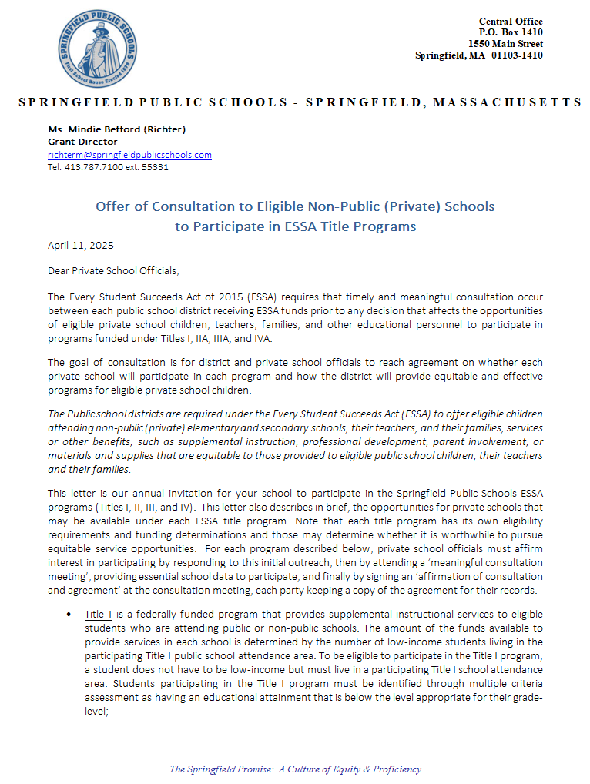
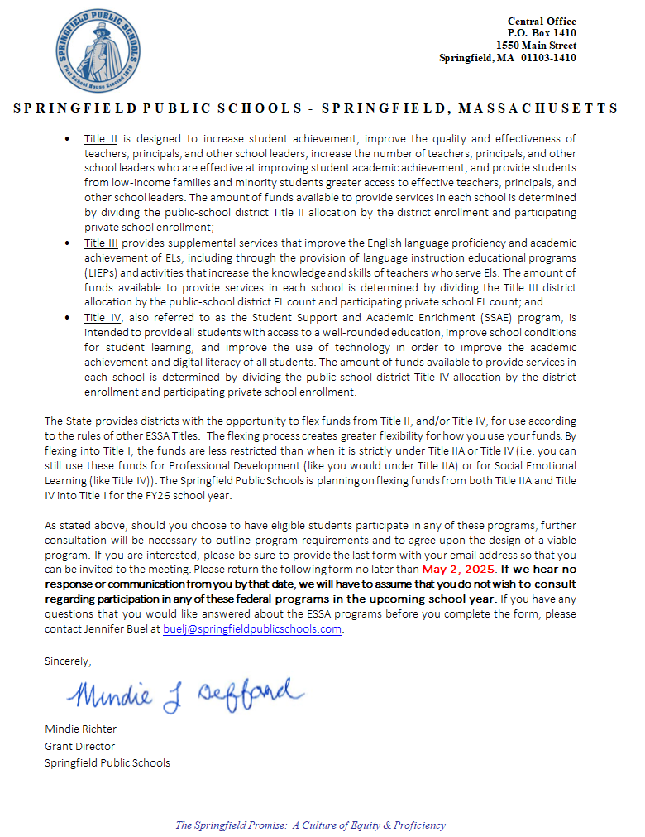
Initial Outreach Letter
  Springfield opts to email all initial outreach to Private Schools.
  It is important to include delivery receipts and read receipts when possible.
  Document all responses, even if it is just the read receipt or delivery. Reach out to those who do not respond to get verification that offer was received.
  Provide response date for Consultation.
  If no responses, helpful to invite parties to Consultation meeting.

Slide 29
Consultation Period
STEP ONE:
Outreach
-Virtual or in-person
-Keep track/record attendees
STEP TWO
Ensure providing all necessary information as listed on Affirmation of Consultation
-ESSA Program Overview
-Eligible Items
-Flexing Funds
-Determining Eligible Students
-Determination of Allocations
STEP THREE
Action Items
-Student Eligibility Form
Family Survey
-Needs Assessment
-In-District Order process/Payment Timeline/Other Administrative items
-Third Party Provider
-DESE/LEA timeline review
-Program Evaluation
-Affirmation of Consultation form

Slide 30
Flexing Funds
  The flexing of funds allows districts to indicate which funds, if any, it wants to flex from Title II, Part A and/or Title IV, Part A for use according to the rules of other ESSA Titles. The option to flex funds is decided by the district with prior consultation with the private schools.
  The flexing of funds are to be used as
  targeted assistance instead of school wide.
  This means funds should directly affect
  the Springfield students at your school
  instead of a school wide approach.
Title I
Title I
Title IIA
Title IV

Slide 31
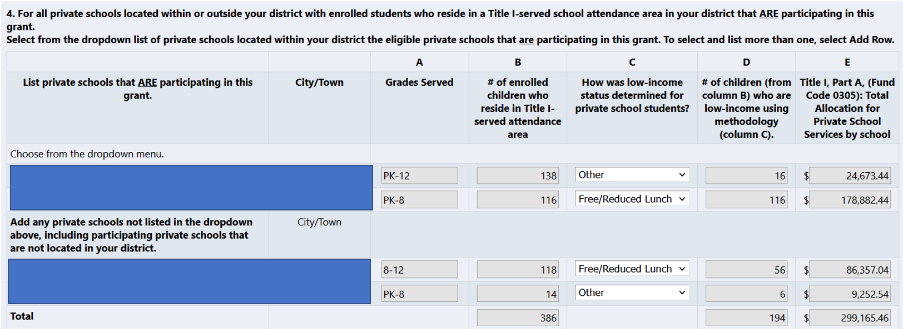
Allocation Determination
Equitable Services for Private Schools
Equitable services reservations are calculated through automated formulas in the consolidated application once districts supply the name of eligible schools, whether each would participate in one or more of the programs, and eligible private school enrollment data.
A proportional share of funds is calculated based on total amount of district grant, before any reservations.
A LEA (SPS) calculates the total number of Springfield students enrolled in Non-Public Schools.
The percentage of funds is determined by dividing the number of Non-Public Springfield student's enrollment by the Public-School enrollment.
10% of allocation to be used for Family Engagement.

Slide 32
Student Eligibility
Data is from previous year (same as with district student data in application). Data from students in 2024-2025 to determine eligibility. SPS collects data annually, which is how your schools were identified with Springfield students. This does not mean they are all low-income.
Methods for determining eligible students:
Free and Reduced Lunch Program Data / Community Eligibility Provision (CEP)
Family Survey – Per Federal Guidelines
Public Assistance Data (FRPL, CEP, TANF, Medicaid)
If you have food service through Sodexo, the District with your permission can gain access to this data for relevant schools.
If you use an alternative method, please enter student grades and address to the Family Income Eligibility Form.

Slide 33
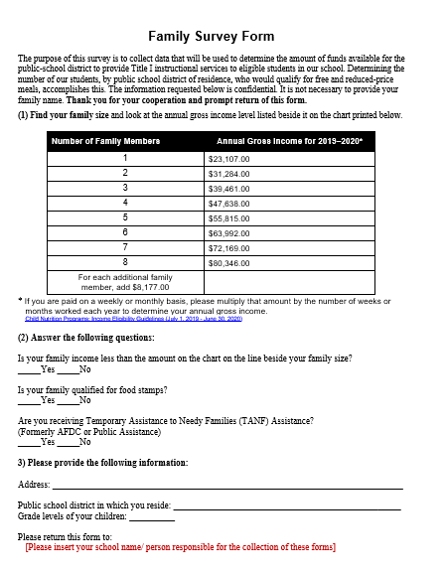
Student Eligibility
If needed, please survey families with the attached Federal family survey to determine if your school has eligible students.
Reminder: Springfield is only looking for your Springfield residing students that are low-income.

Slide 34

Needs Assessment
Needs Assessment: the systematic process the district and its schools conduct in order to establish priorities for action and decisions about the allocation of resources (e.g., people, materials, time).
-Will be asked to list activities and purchases intended for the current year, along with a justification.
*Assessments will be needed for each Title by June 10th, 2025. Any forms not received by this date will not be included in the initial application.

Slide 35
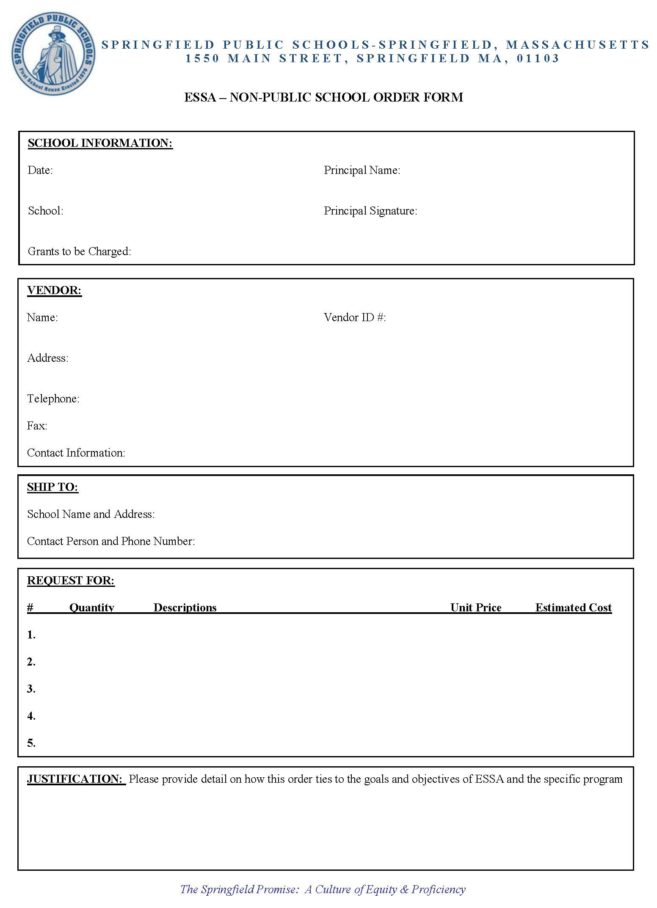
Placing an Order
Ordering Process:
Ordering Timeline:
1.) Fill out all fields on the “Request to Purchase” form
2.) Complete and send Vendor Set-up, W-9 for new vendor
4.) The Grants office will enter the order
5.) City Hall will send the PO number directly to the vendor for processing
3.) Send order form to SPS Grant Office
1.) Allow 1 week for order to be entered into the system
3.) From the time we receive a signed invoice, please allow 1 month for the order to be paid
2.) Once order is entered, please allow 1-2 weeks for Requisition to be turned into a Purchase Order
REMINDER!
Food, or furniture aren’t allowable expenses.
Schools can not be reimbursed for orders. Must order directly from the vendor.
Include shipping unless there is no charge.
As a district, SPS is tax-exempt, please do not include tax on orders.
*Please send all invoices to the A/P or Grants Office so that your PO can be paid*

Slide 36
If a district enters into a contract with a third party provider for the delivery of Title I services to the private school participants, their teachers, or families, such contracts must provide technical descriptions of the Title I services with detail sufficient to enable districts to determine that all Title I statutory and regulatory requirements will be met.
Third Party Provider
SPS is currently under contract with Catapult learning. If interested, SPS may seek to bid additional services for your schools.
RFP Timeline
For the past 5+ years, Catapult has been the third party vendor. SPS is currently in Year 3 of the current contract. A new RFP will be sent out to bid to contract with a vendor for the next three years.
September 1, 2023 – August 31, 2024
YEAR 2
September 1, 2024 – August 31, 2025
YEAR 3
September 1, 2025 – August 31, 2026
YEAR 1

Slide 37
Timeline
June 10
Student Data
June 10
Needs Assessment
June 15
SPS provides estimated allocations
June 15
Previous Year Surveys Due
Estimated new ESSA Award & Allocations
Oct
SPS conducts monitoring site visits
Sept 1
June 30
Budget breakout due
August 16
All final current year Orders Due
Nov
Option to Amend (Amendment 1)
March
Option to Amend (Amendment 2)
April
SPS conducts final monitoring site visits
May
Order deadline

Slide 38
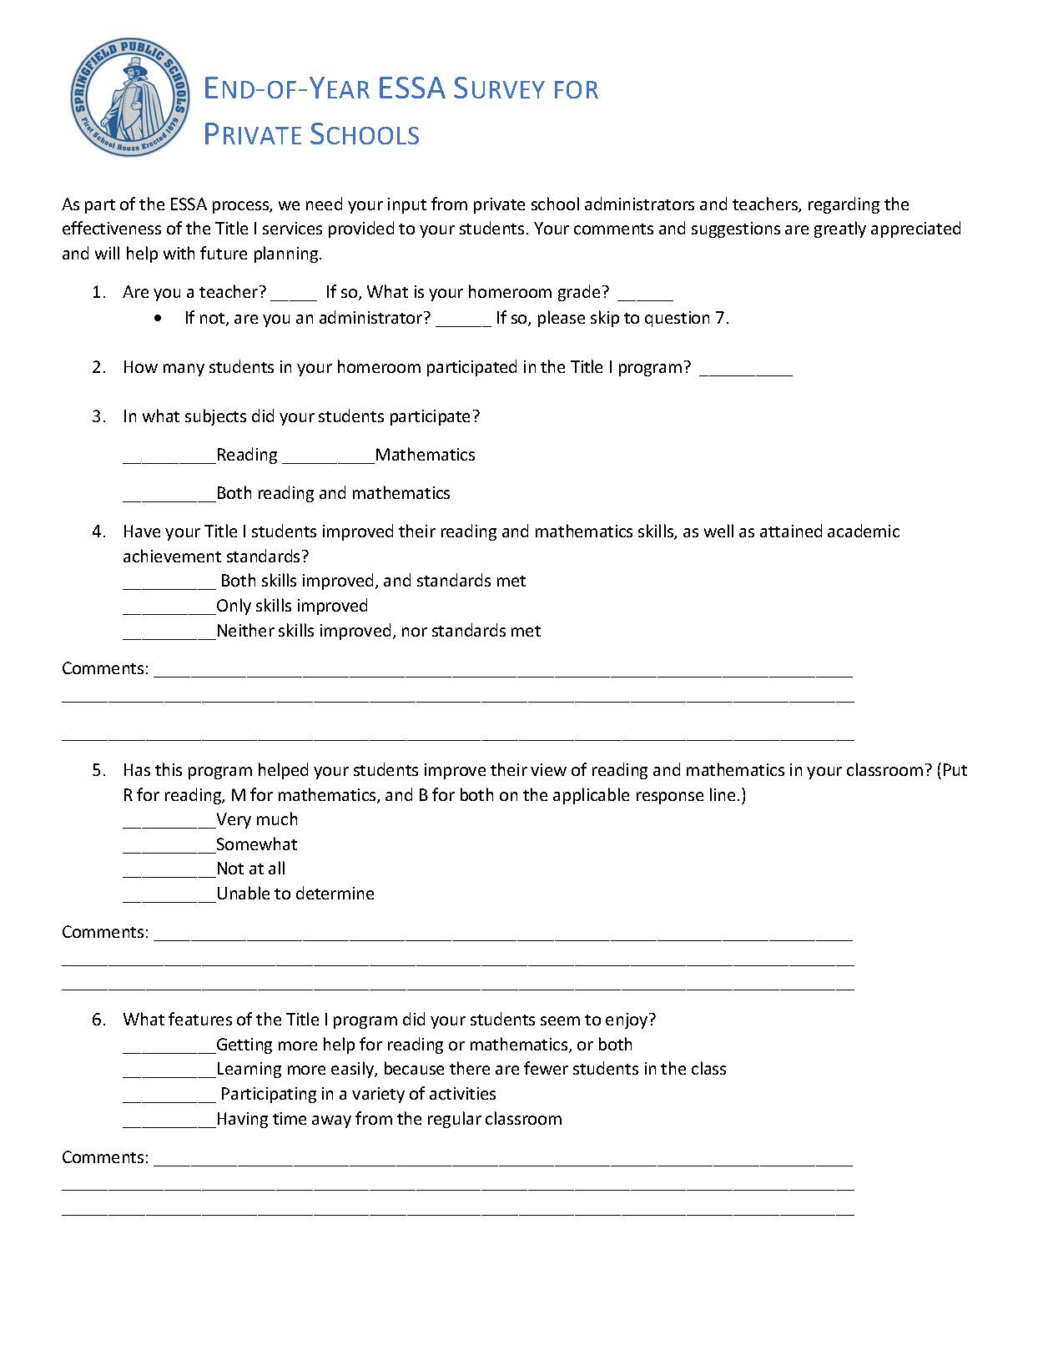
Program Evaluation
The monitoring process for equitable services in private schools is comprised of three main components:
Teacher Surveys: At the end of each year, teachers and administrators' complete surveys, providing essential feedback on the effectiveness of Title I services. Teachers report the number of students receiving Title I support and specify the subjects they teach. This data helps assess whether Title I funds are being used effectively to improve student achievement.
Semiannual Review Meetings: The Grants Department conducts semiannual meetings to ensure compliance with grant requirements. These meetings allow the SPS team to observe classroom practices, contractual services, and evaluate the implementation of instructional tools.
Inventorying: An essential part of the review process is ensuring that any materials purchased with Title I funds are accurately labeled and inventoried. This ensures that resources are tracked properly and are being used in compliance with grant guidelines.
Together, these components help monitor the success and compliance of Title I services in private schools, ensuring that resources are effectively supporting student outcomes and that grant guidelines are being followed.

Slide 39
Carryover Funds and Reallocating Budgets
Important to try and utilize funds within the school year.
If schools do not utilize in full, a new spending plan is developed for carryover use. If school does not want to continue or use funds, reallocate to other participants of Equitable Services.

Slide 40
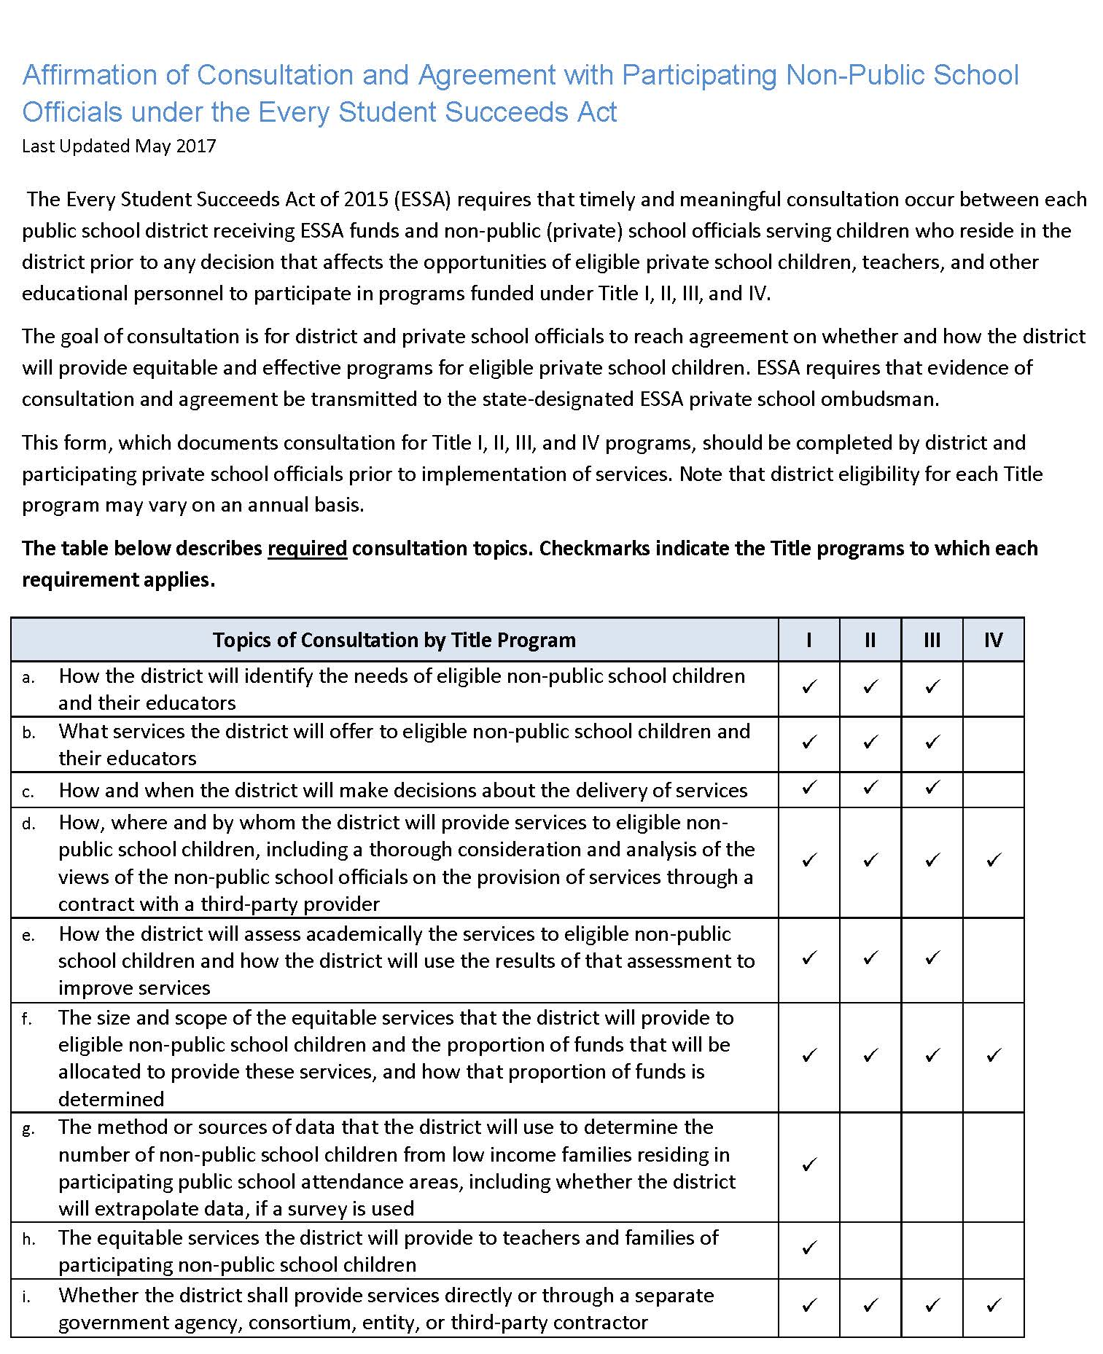
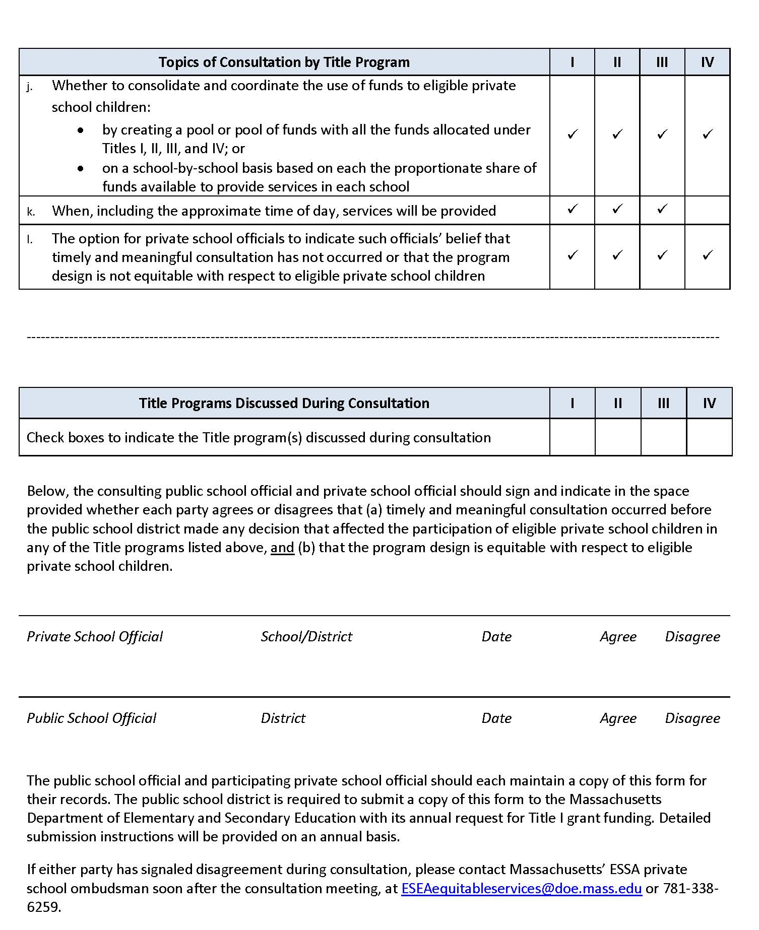
Affirmation of Consultation
Your signature signifies that you are satisfied that an equitable program has been designed to meet student needs and has a reasonable promise of being effectively implemented.

Slide 41
Thank you! Please reach out as needed!
Your liaison: http://www.doe.mass.edu/federalgrants/liaisons.xlsx
  General email address: federalgrantprograms@mass.gov
Website: www.doe.mass.edu/federalgrants

