Slide 1
PASS: Positive Alternative to Student Support
Spring 2025 Federal Grants Conference

Slide 2
Presenters
Michelle Muffett-Lipinski: Principal, Northshore Recovery High School
Rebecca Jackson: Director of Community Programs, Greater Beverly YMCA
Ariana Dembro: PASS Program Director, Greater Beverly YMCA
Mark Thomas: Principal, Beverly High School
AnnaEllen Lenart, LICSW: Outreach School Adjustment Counselor, Saugus Public Schools

Slide 3
PASS History
RHS has had ongoing support with the YMCA for the last few years. Looking for ways to expand this relationship and extend services to more families.
Convened meeting with YMCA, JRI (CFFS), HGC (Healthy Gloucester Collaborative), Beverly Public Schools, Gloucester Public Schools, Peabody Public Schools and Ipswich Public Schools
Initiated by NEC and high school administrators from districts to address substance use in the schools
Met monthly throughout the Fall 2017 to discuss options and look at handbooks/policies
The meetings were initiated by high school administrators who were becoming increasingly frustrated by the lack of resources around changing behaviors of suspended students. (Discipline/suspension data was being scrutinized by DESE and other entities)
Districts agreed that their current in-school suspension was mostly ineffective and out of school suspension results in students not accessing their education and negatively impacts student achievement/engagement.
Notes:
Most students on in school suspension are in a room for the day without any behavioral intervention to address the reason for the suspension.

Slide 4
PASS History.
Data shows that students who struggle with Mental Health and/or Substance Use Disorders tend to get suspended more often and rarely get the intervention and support they need to remain in school.
Three tiers of interventions emerged, Professional Development for all staff, Policy/Handbook review, and then making Student Suspension Meaningful.
In the spring of 2018, a Pilot Program was launched to address the Suspension Issue and created a therapeutic program providing clinical support, psychoeducational groups, academic support, and pro social skill time.
Following a successful pilot, PASS Year 1 started in the fall 2018

Slide 5
PASS Program Overview
Partners: Northshore Education Consortium (NEC), YMCA of the North Shore (YNS), Justice Resource Institute (JRI) - Children’s Friend and Family Services, & Essex County Outreach (ECO)
YNS and NEC set policy, operate the program and provide fiscal management, JRI delivers client/family-centered services, and ECO provides recovery coaching.
Districts: 12 Districts, 17 schools
Beverly, Salem (Salem High School, Salem Prep High School, New Liberty Innovation School), Salem Charter Academy, Ipswich, Lynn (Lynn Classical, Lynn English, and Lynn Tech), Northshore Recovery High School, Georgetown, Newburyport, Saugus, Greater Lawrence Tech, Northshore Academy, & Triton High School
On-Site Staff:
Ariana Dembro, Program Director
Siddi Kallon, LMHC, Outpatient Therapist
Wyatt Brennan, Student Coordinator
Greg Morales-Jones, Therapeutic Mentor
Faith Brock, Recovery Coach (M-W)
Funding:
BSAS/DPH Grant: School/Community Based Targeted Intervention Services.
BSAS/ MA Alliance of YMCAs Grant
School Contracts: Based on utilization

Slide 6
PASS Program Evolution
Original Program:
Districts now have a place to send a student they believe may need some social/emotional support and would benefit from a therapeutic environment where they are also able to access their academics.
PASS is designed as a program to serve as an early-intervention model for students who are getting suspended for non-violent offenses, since typically those are the students most likely to be struggling with substance use disorder, depression, anxiety and trauma.
Since the students are receiving psychoeducational support, in both group and individually, PASS in not counted as an Out-of-School Suspension or an In-School Suspension.
This is beneficial for end of year district reporting as well as for students applying for college.
Students who agree to attend get their suspension cut in half.
Students have the opportunity to sign on for additional services on demand with JRI or a with a more appropriate referral as needed.
Current Program: Evolving to address changing district and student needs.
More students experiencing anxiety and depression.
More students struggling with academics and are at risk of failing.
School suspension is no longer needed for a referral.
PASS offers an opportunity to be in person while providing academic support in a therapeutic environment.

Slide 7
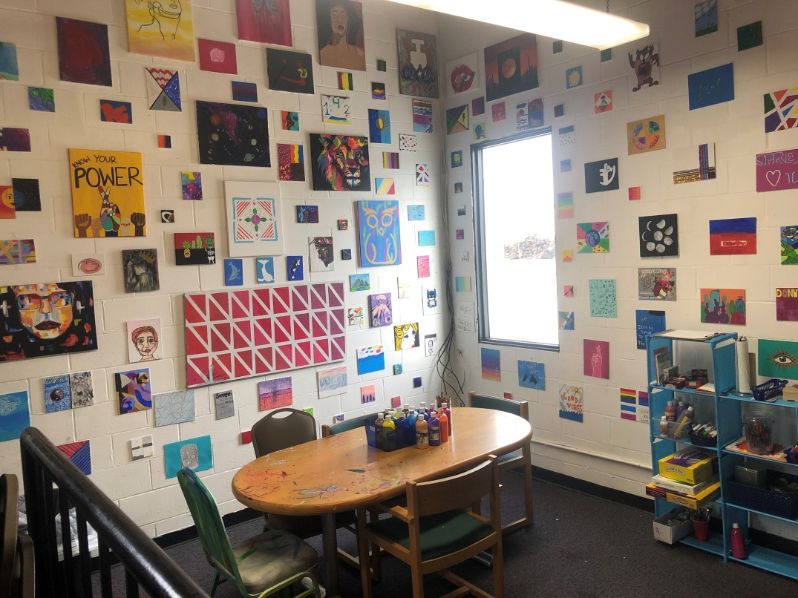
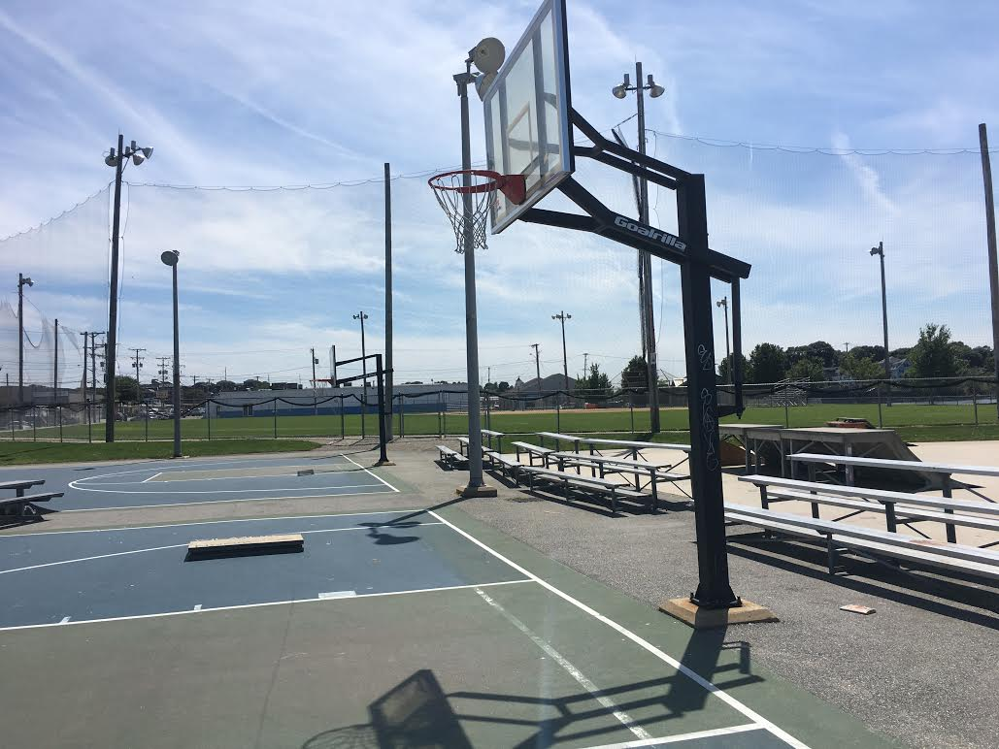
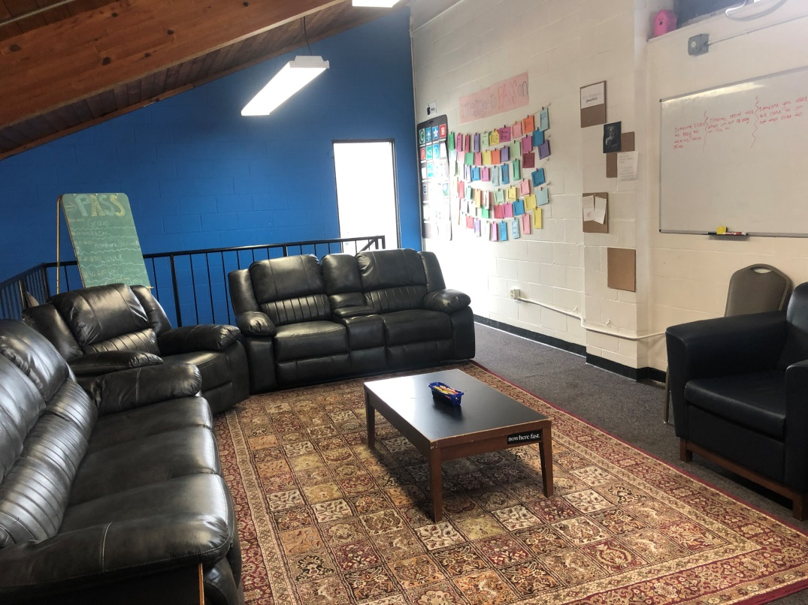
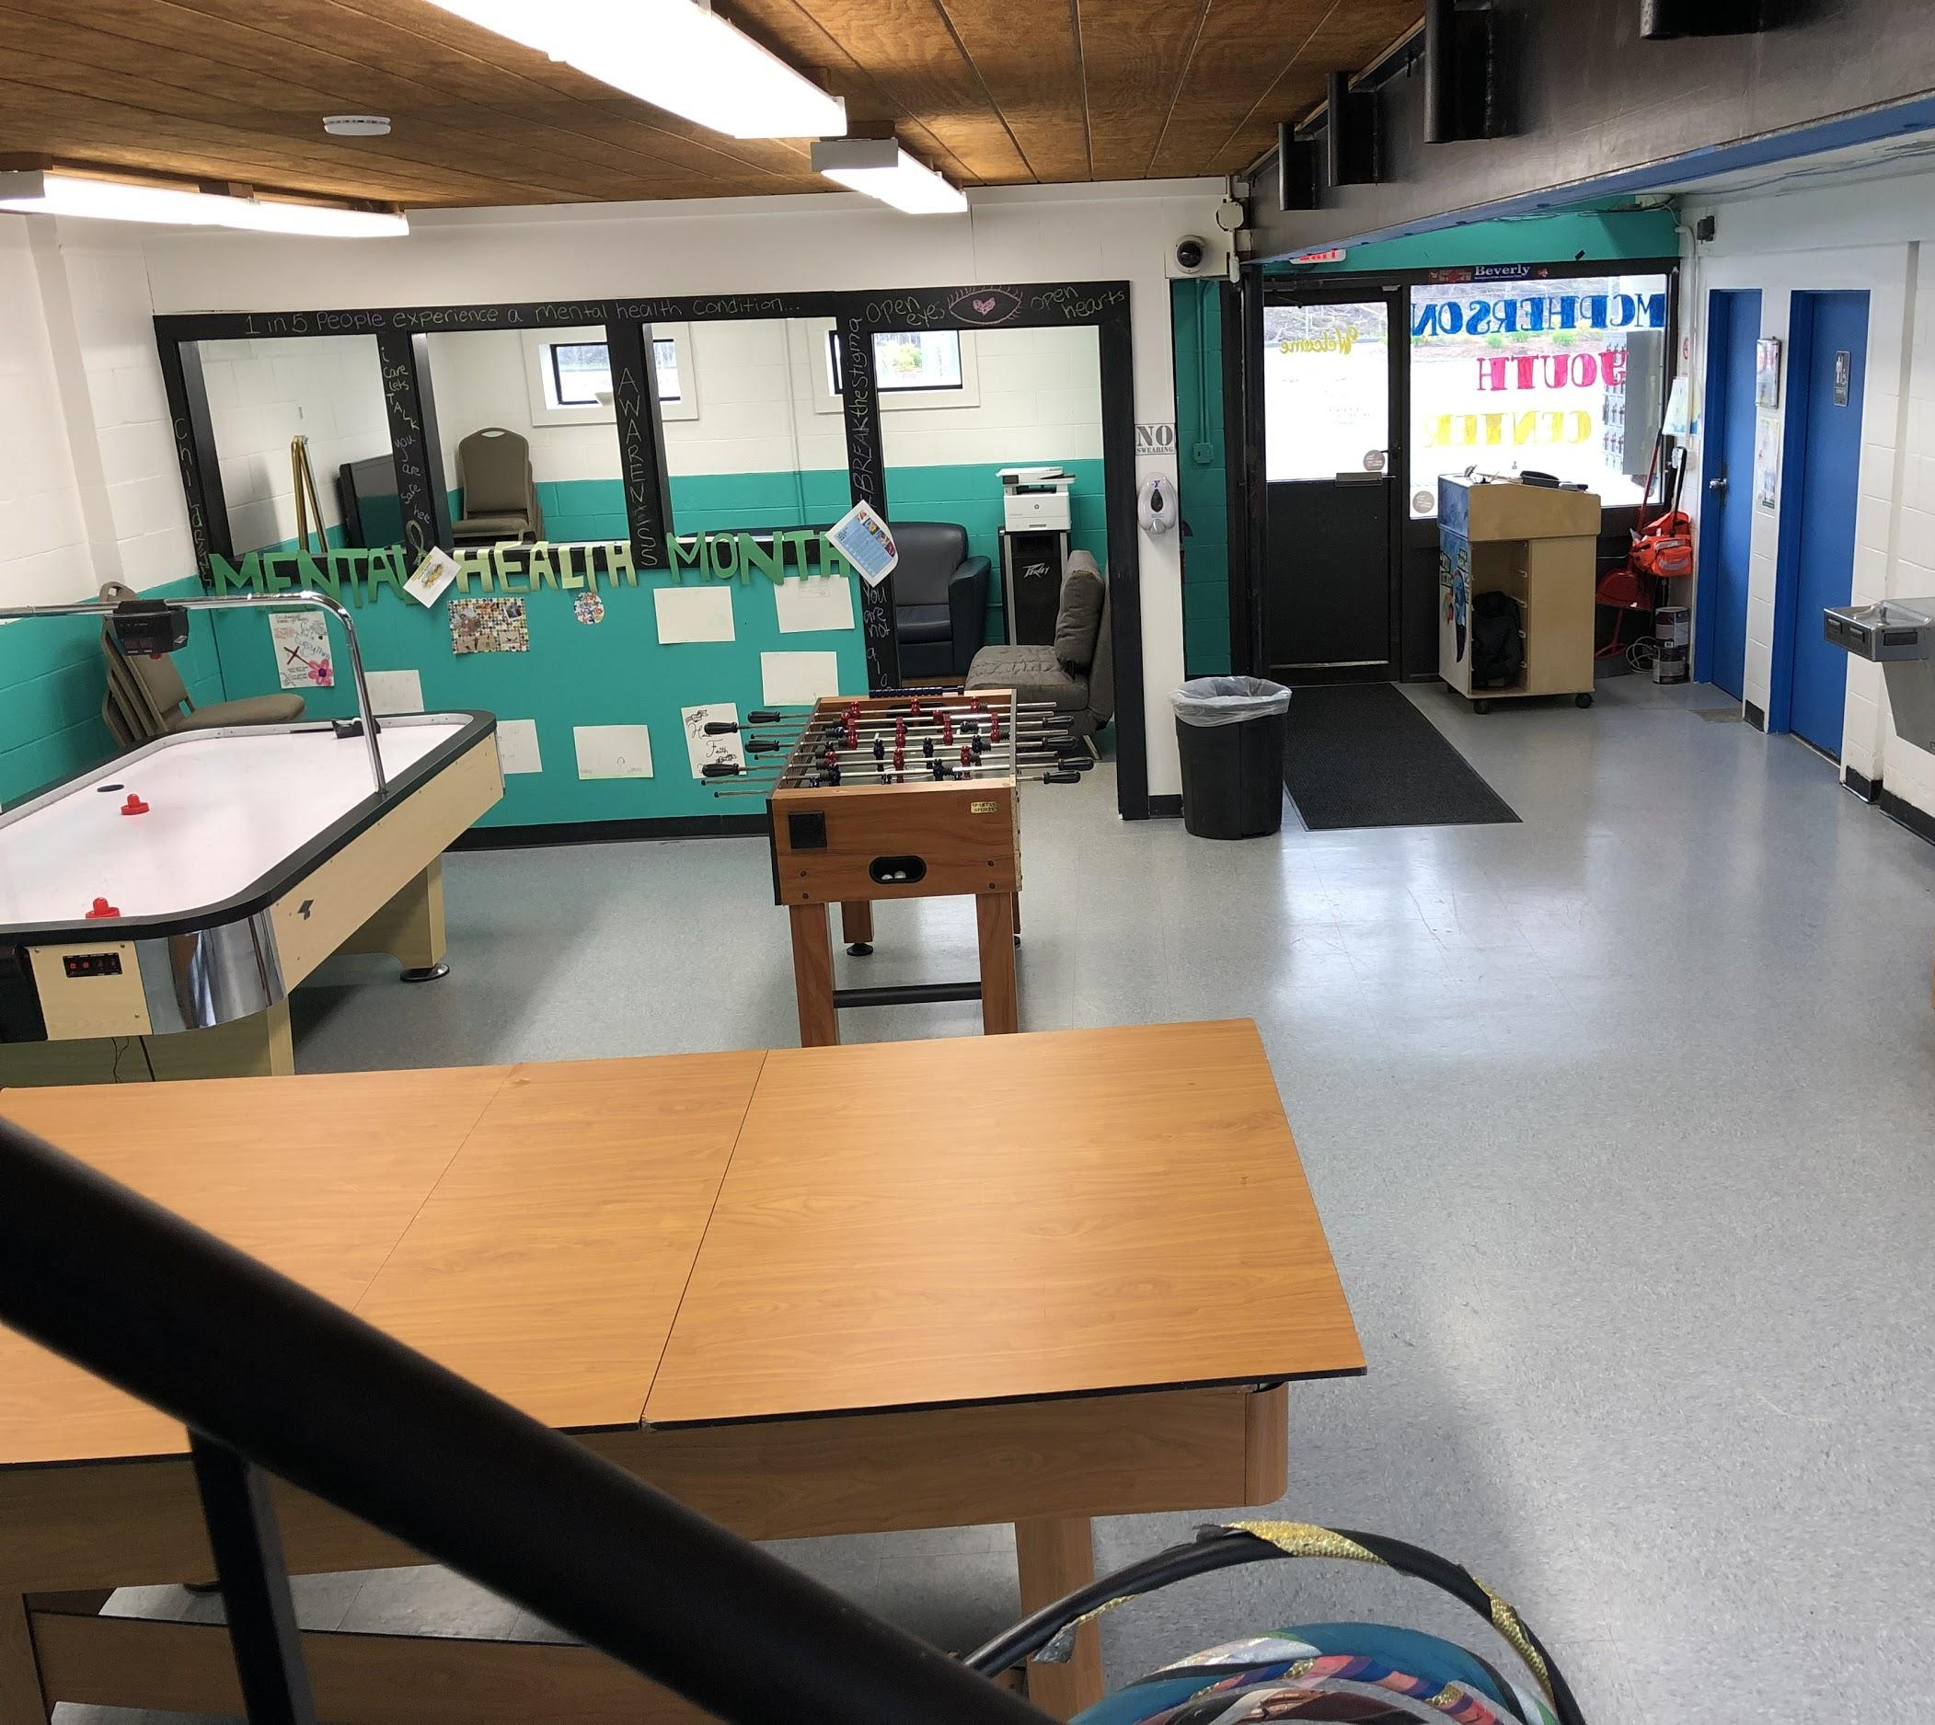
Our Temporary Facility
McPherson Youth Center Renovation
100 Cummings Center
Suite 521 E/F, Beverly MA, 01915
Highlights:
Ample space for pro-social activities
Opportunities in the larger Cummings Center location for individual growth
Multiple therapeutic counseling rooms
Secluded facility to limit distractions or interruptions
City of Beverly building under renovation until 2026.
Was used exclusively utilized for PASS between 8:30 AM- 2:30 PM.
At 3:00 PM it becomes a Drop-In Teen Center operated by the YMCA.
New facility will include increased meeting space and an indoor half basketball court

Slide 8
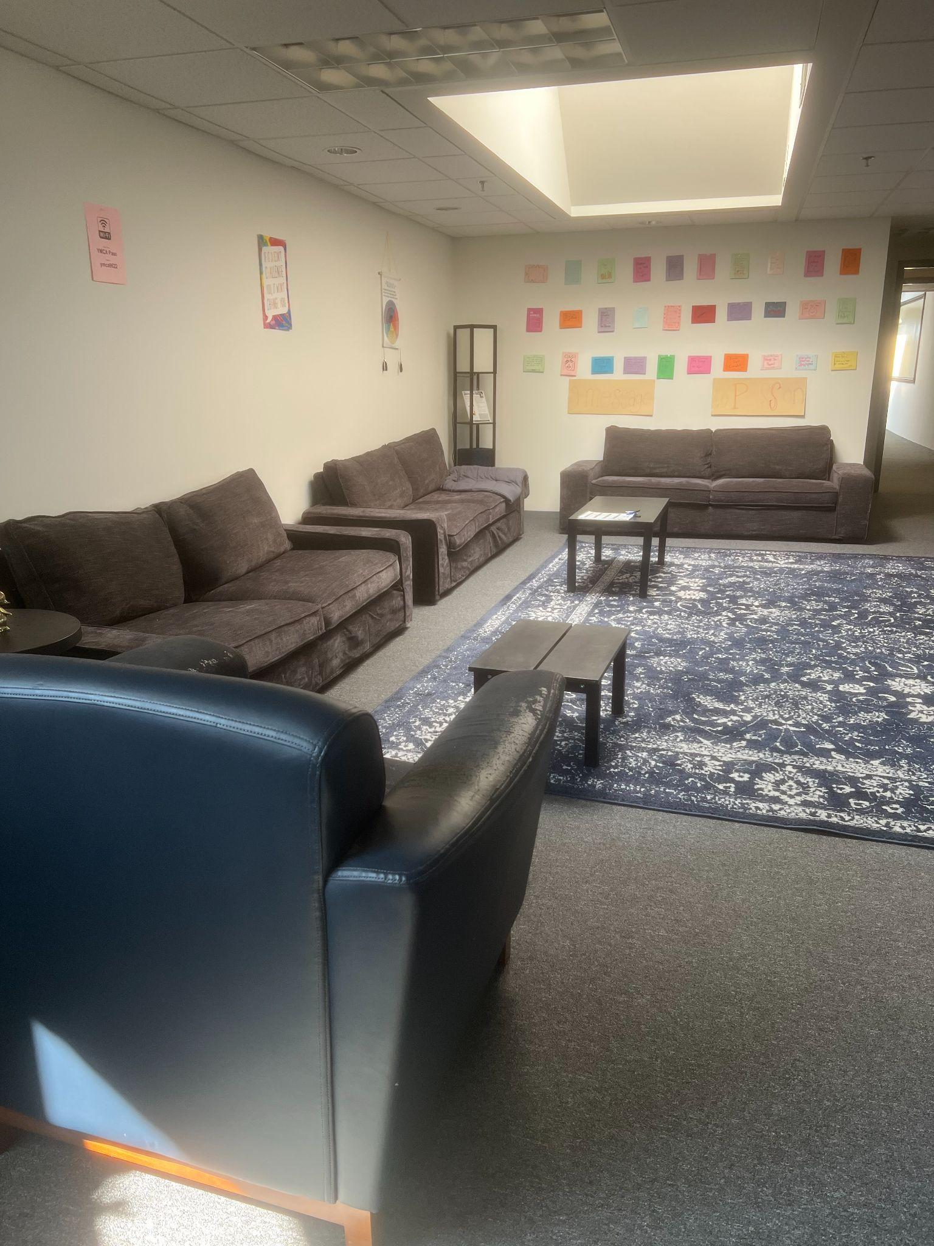
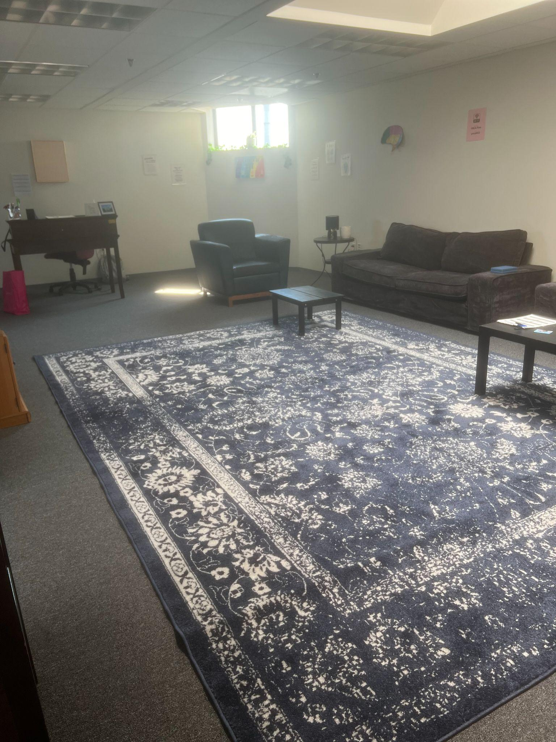
Group Space
This is a space where students and staff come together at the beginning and end of the day.
Highlights:
Fidget toys
Inclusive space for ALL
Alternative seating
Messages to PASS on
Snacks
Water

Slide 9
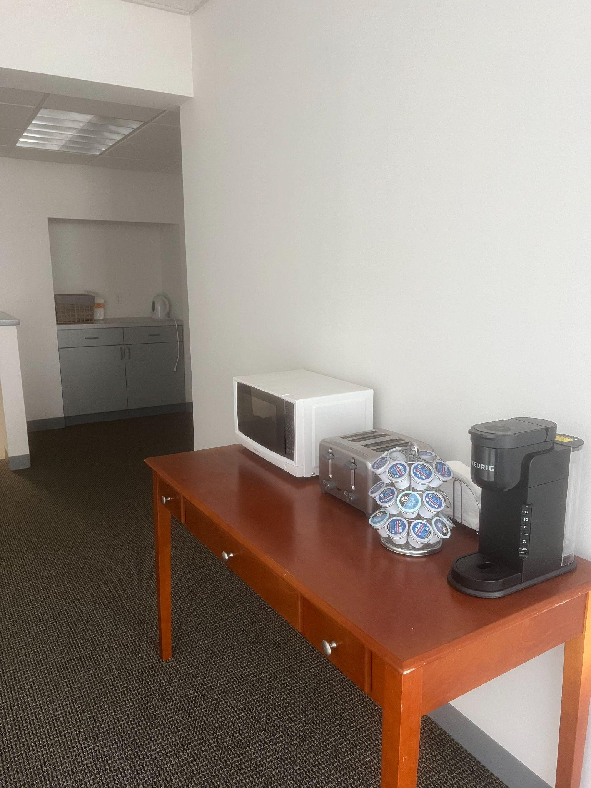
“Kitchen” Area
Breakfast, snacks, and lunch are provided
The PASS program provides students with many lunch choices that they can make themselves or staff will make it for them.
Our space is equipped with a microwave, air fryer, griddle, keurig (non-caffeinated), and refrigerator for student’s use.
Highlights:
Food & Drink always free and available
Common area
Life skills : cooking, social skills, cleaning

Slide 10
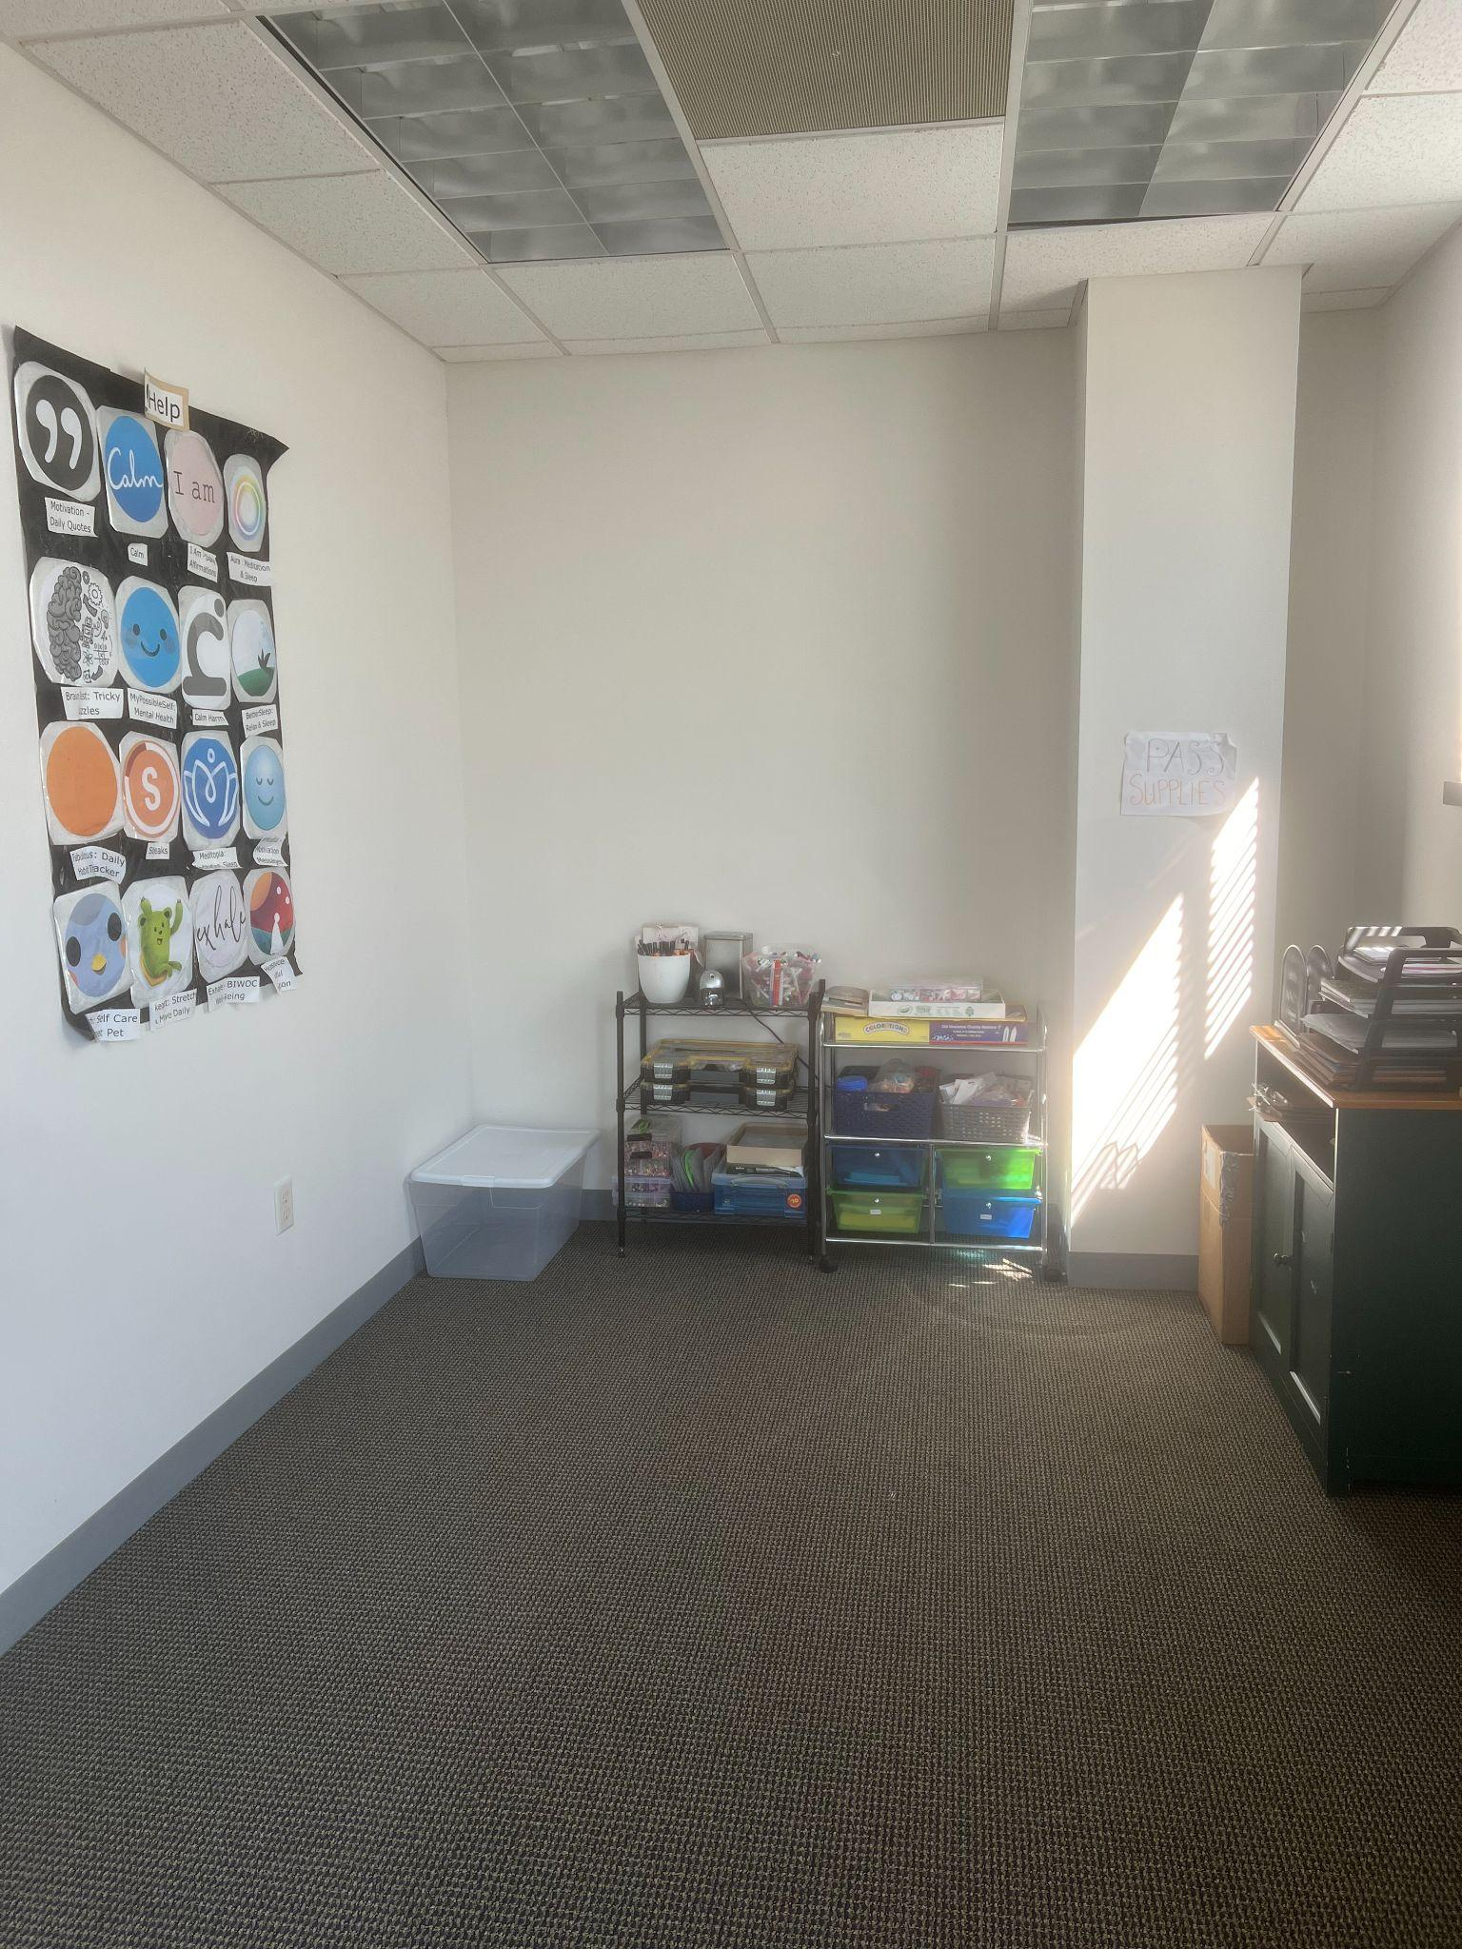
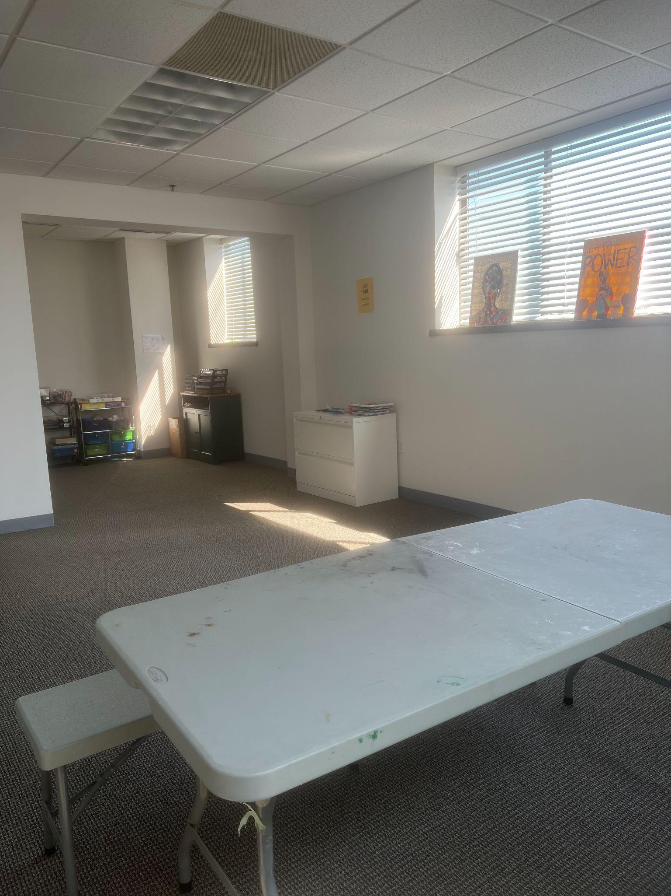
Art Space
Therapeutic art space
Art groups and recreation time
Painting, drawing, coloring, and craft space
Canvases of different sizes are free and available upon request
Highlights:
Art therapy is utilized weekly
Coping skill and solo activity of painting or design is developed
Peer artwork on display

Slide 11
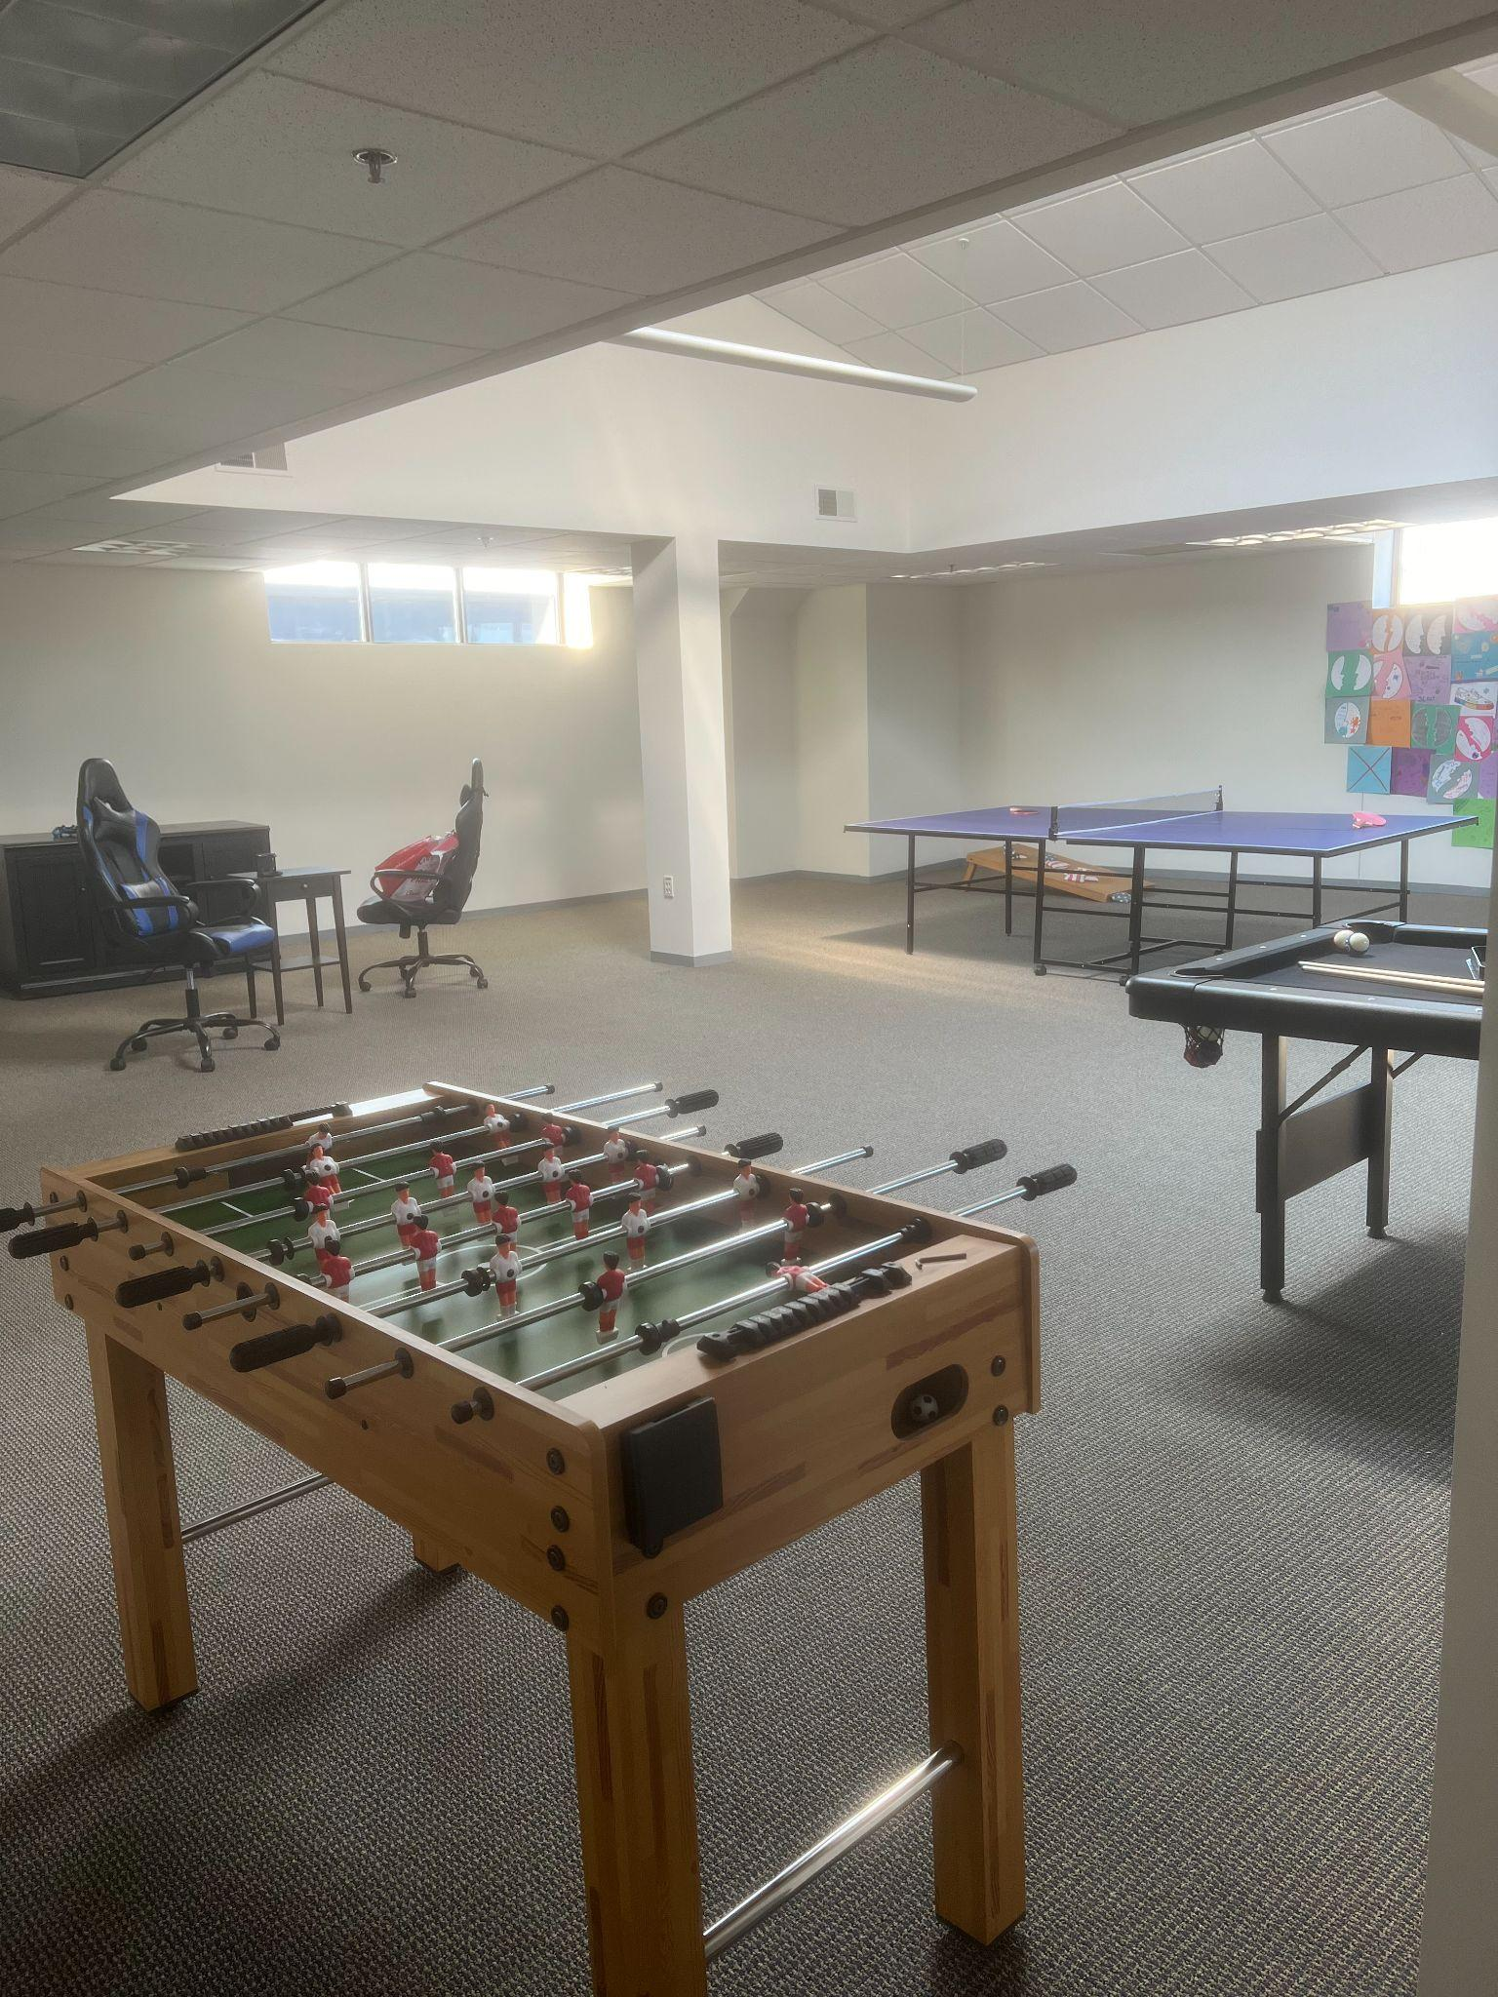
Game Space
Students enjoy the following during earned recreation time with peers and staff:
A game of pool
Air hockey
Ping Pong
Board games
Corn Hole
Puzzle table
Highlights:
Incentives for breaks
New interests
Friendly, competitive gaming
Sober activities

Slide 12
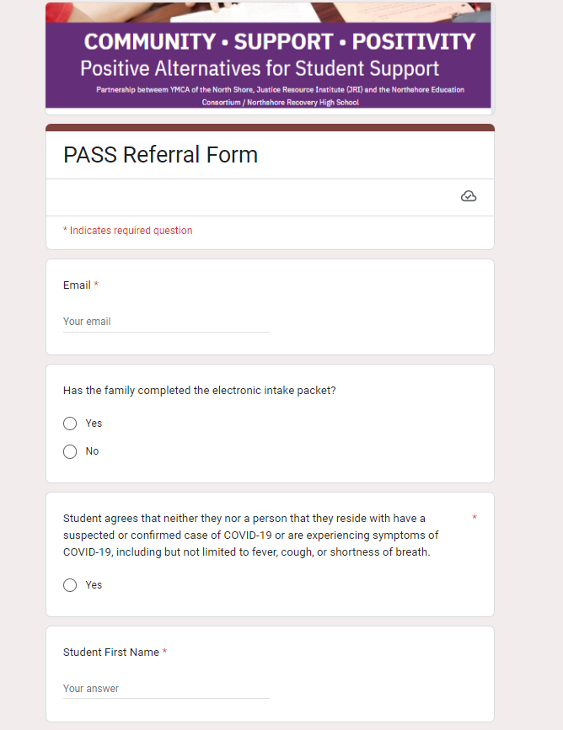
Referral Process
Google PASS Referral Form - Completed by School
Required Information:
Student’s name
Person/people making the referral
Referring school
Date (s) to attend
Number of days to attend
Behavior that led to referral/ suspension
Transportation needs
Concerns/areas to focus on while at PASS
Helpful Tips for Success:
Complete the Referral Form the day prior to start date
If possible, stagger start dates for peer or group infractions
The Referral Form can be filled out for a future start dates. For example, returning from vacation, after MCAS, etc so we can plan ahead.

Slide 13
Intake Packet
Our Intake Packet Folder Includes:
Our mission
Expectations
Schedule for the day
Student information
Consent forms
Transportation permission
Waivers from the YMCA, JRI, and ECO
Data consent
Resources, connections and information for student and families
Contact information for PASS Staff
*Health Insurance IS NOT billed, we ask for information to assist in the referral making process, if applicable

Slide 14
Transportation
Ride to Program: We strongly encourage that parents or guardians drop-off their student at PASS in order to meet the staff, see the space, and connect on program resources and progress. We understand our hours can interfere with day-to-day schedules. Phone calls can be set up with staff in order to connect if needed.
Drive to Program/ Walking to Program: Parking is available for students who drive themselves. Although we are OK with this option, we expect students to arrive on time and wait until 2 PM dismissal. Schools will be informed immediately if a student arrives late or leaves early. The school can then decide if the day will count as a full day completed at PASS. Students can also walk to and from the program. Permission needs to be given on the Intake Packet for this option.
Commuter Rail: We are located across the street from the Beverly Depot on the Newburyport/Rockport Line. Students may use the commuter rail as a means of transportation. Those with a Student ID will get reduced fare.
Taxi: We partner with Witch City Taxi to offer transportation for students. Witch City will pick-up the student(s) from their schools and drop students off at home or a requested destination. Vouchers are paid for by the program. The school will be billed for a missed ride if the student is not at school when the taxi arrives.

Slide 15
Daily Schedule
9:00-9:15 | Welcome/Breakfast- Attendance, Expectations, Responsibilities
9:15 - 10:30 | Check in, Daily Goals and Psychological Education Support Groups
10:30 - 10:45 | Break and Homework planning (Snacks are provided by the PASS Program)
10:45 - 12:15 | Academics, Individual counseling Student will have time to meet 1:1 with our clinician to complete assessments Student will have academic support provided to help complete school assignments
12:15 - 12:45 | PASS program provides daily lunch. Students are also welcome to bring their own food. It is encouraged that you bring your own food if you have allergies or food restrictions.
12:45 - 1:45 | Community Service/Recreation (Check out / Exit survey / Re-entry plan) An exit survey and re-entry plan is done at the end of the last day of the students time here at PASS The exit survey is a survey done by the student on their time at PASS Re-entry plans are made with PASS staff and the student
1:45 - 2:00 | Check Out / Exit Survey / Re-entry plan
2:00 | Dismissal/Check in with parents

Slide 16
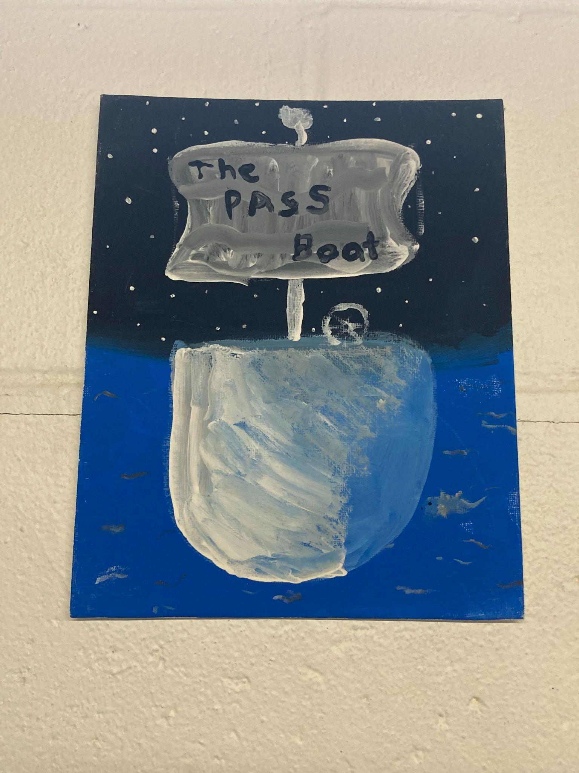
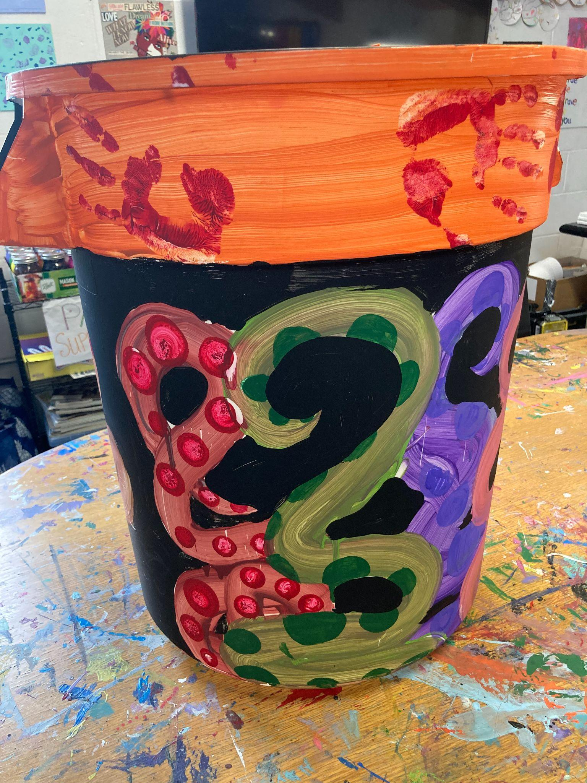
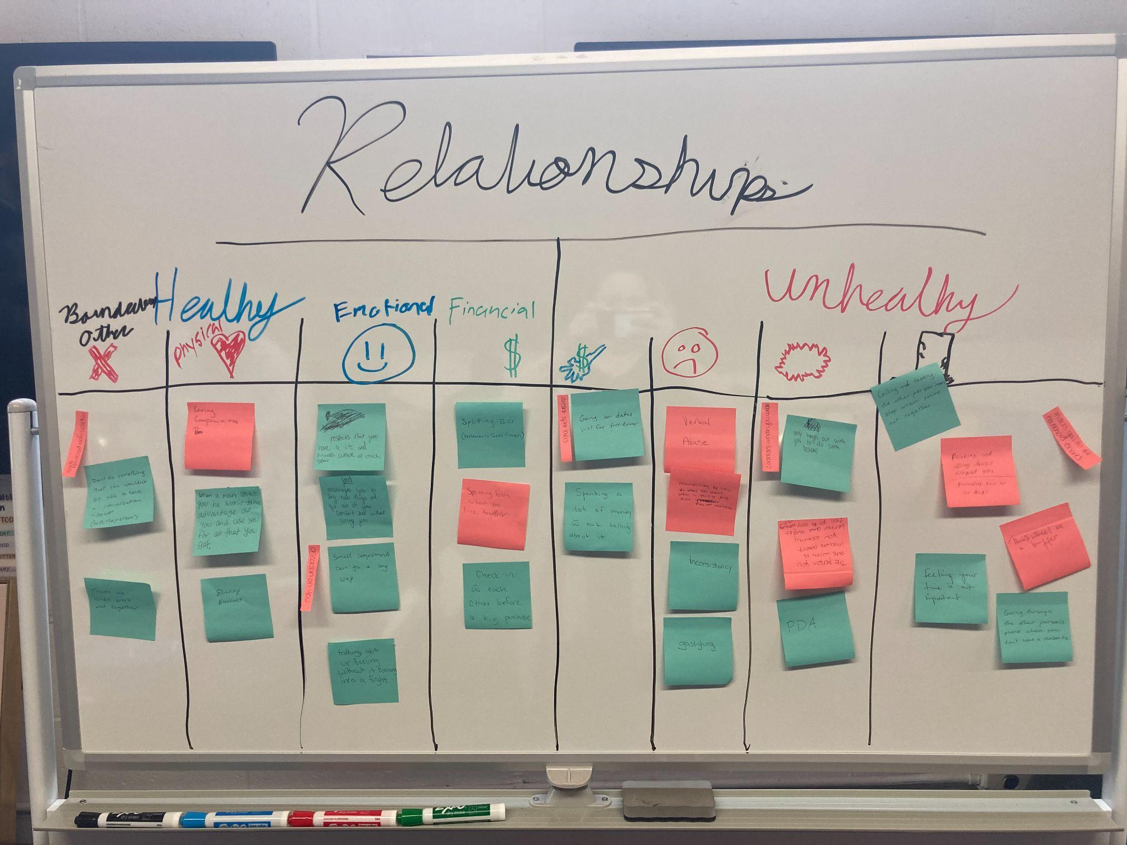
Rotating Psychoeducational Therapeutic Groups
Morning Check In’s :
Name
MI: Mood Scale 1:10 “Where are you at”
Goal for the day
Random Question
Music/Expressive Art
Lyric Work
Expression through Music
Art Therapy
Identify / Self Awareness Projects
Feedback Analysis
Letter Writing
Goal Setting
Substance Use and Mental Health
A-CRA approach on Substance Use
Vaping/E-Cigarette Groups
Coping Skills
Identifying / Problem Solving Stressors
Communication Skills
Relationship Building
Yoga and Mindfulness

Slide 17
Academics
Students have 1.5 -2 daily hours of academic time where they will receive 1:1 assistance, tutoring, and support in academic planning while they are out of school. This may vary due to students’ time with our clinician.
Fast Facts:
Additional staff are able to support in all additional subject areas
We provide Chromebooks that are able to access students’ emails, google classroom, moodle, aspen, schoology, etc.
We are able to print / copy / scan assignments
Tips for success:
To ensure an efficient use of academic time, the school personnel making the referral should email students’ current teachers, the PASS Director, and the Student Support Director to request a prioritized list of assignments to be completed at PASS. Using teacher’s responses, the PASS staff will create an academic plan for the students’ absence.
We are able to proctor quizzes, exams, midterms, and finals. These can be scanned directly to the Program Director, who will scan the finished assessment back.

Slide 18
Project Based Learning & Life Skills
Reflections:
Nature, Personal, Relationship, Significant Moments & Events, Decision Chain Strategy, Coping Skill Practice,
Life Skills and Opportunities:
Resume Building, Job Applications, Applying for Driver’s Permit / RMV appointments, Volunteer Opportunities, North Shore Youth Leadership, Community Service, and Summer Opportunities
Restorative Practices:
Strengthening Relationships, Social Connections within Communities

Slide 19
Individual Counseling:
Each student receives the following clinical assessments:
Substance Use
Adverse Childhood Experiences/Trauma
Severity Measure for Generalized Anxiety Disorder—Child Age 11–17
Severity Measure for Depression—Child Age 11–17
Suicidal Seversity scale, if applicable
Individual 1:1 Meetings with our Clinician Allow for:
Screenings
Substance / Mental Health Psychoeducation
Help with referrals and services
Discussion and practice of healthy coping skills, techniques and activities
Social Emotional Learning
Access to a Recovery Coach
Goal Setting (established by teen)

Slide 20
Services/ Referrals Supported Through PASS
Academic support/tutoring services
Addiction/recovery supports, schools and services
After school and summer programs (camps, leagues, etc.)
Art programs/art therapy
Basic needs services (food, housing, etc.)
Career/job training and education (including hi-set programs)
CBHI services
College prep classes and supports
Individual and family counseling
Disability services (DMH and other)
Domestic violence, sexual assault, sex ed and reproductive health
Drop in centers
Emergency service providers and mobile crisis
Family resource centers
Inpatient and outpatient services
Juvenile court clinics and diversion programs
Legal services/aid
Therapeutic mentoring services
Life skills
Parent support groups
Partial programs
Peer support groups and mentoring
Residential programs (substance abuse and mental health)

Slide 21
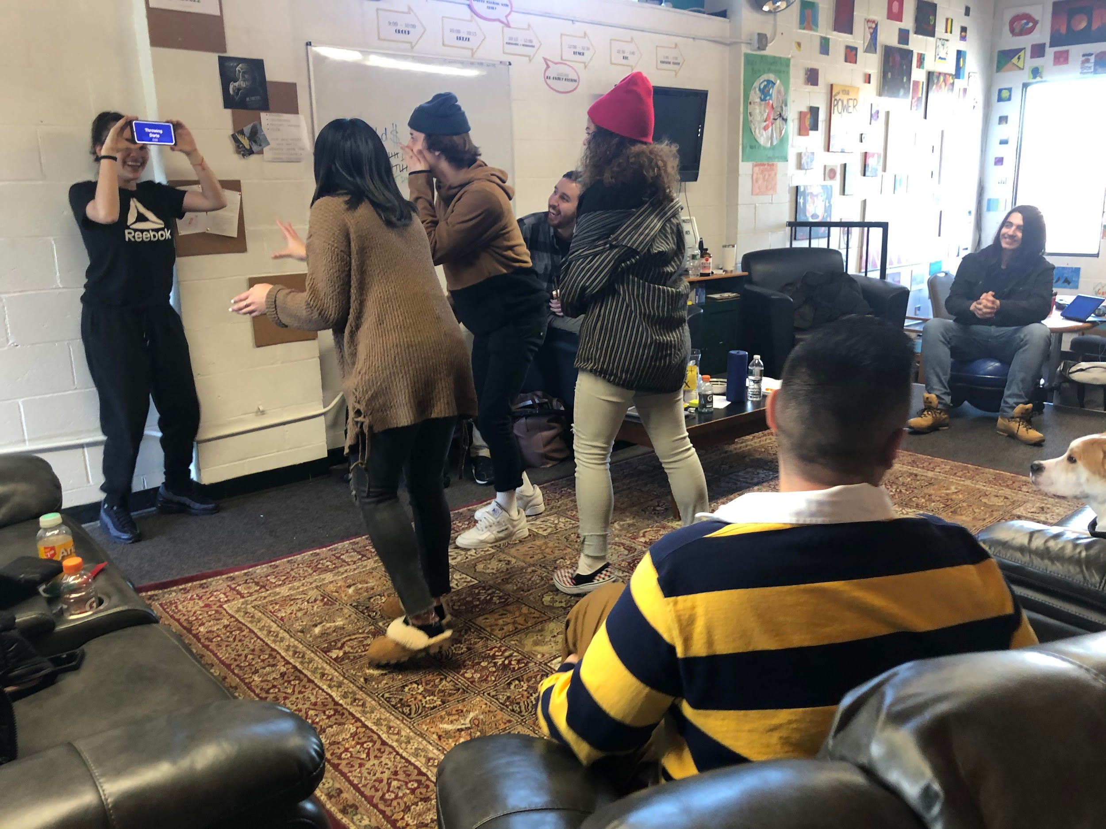
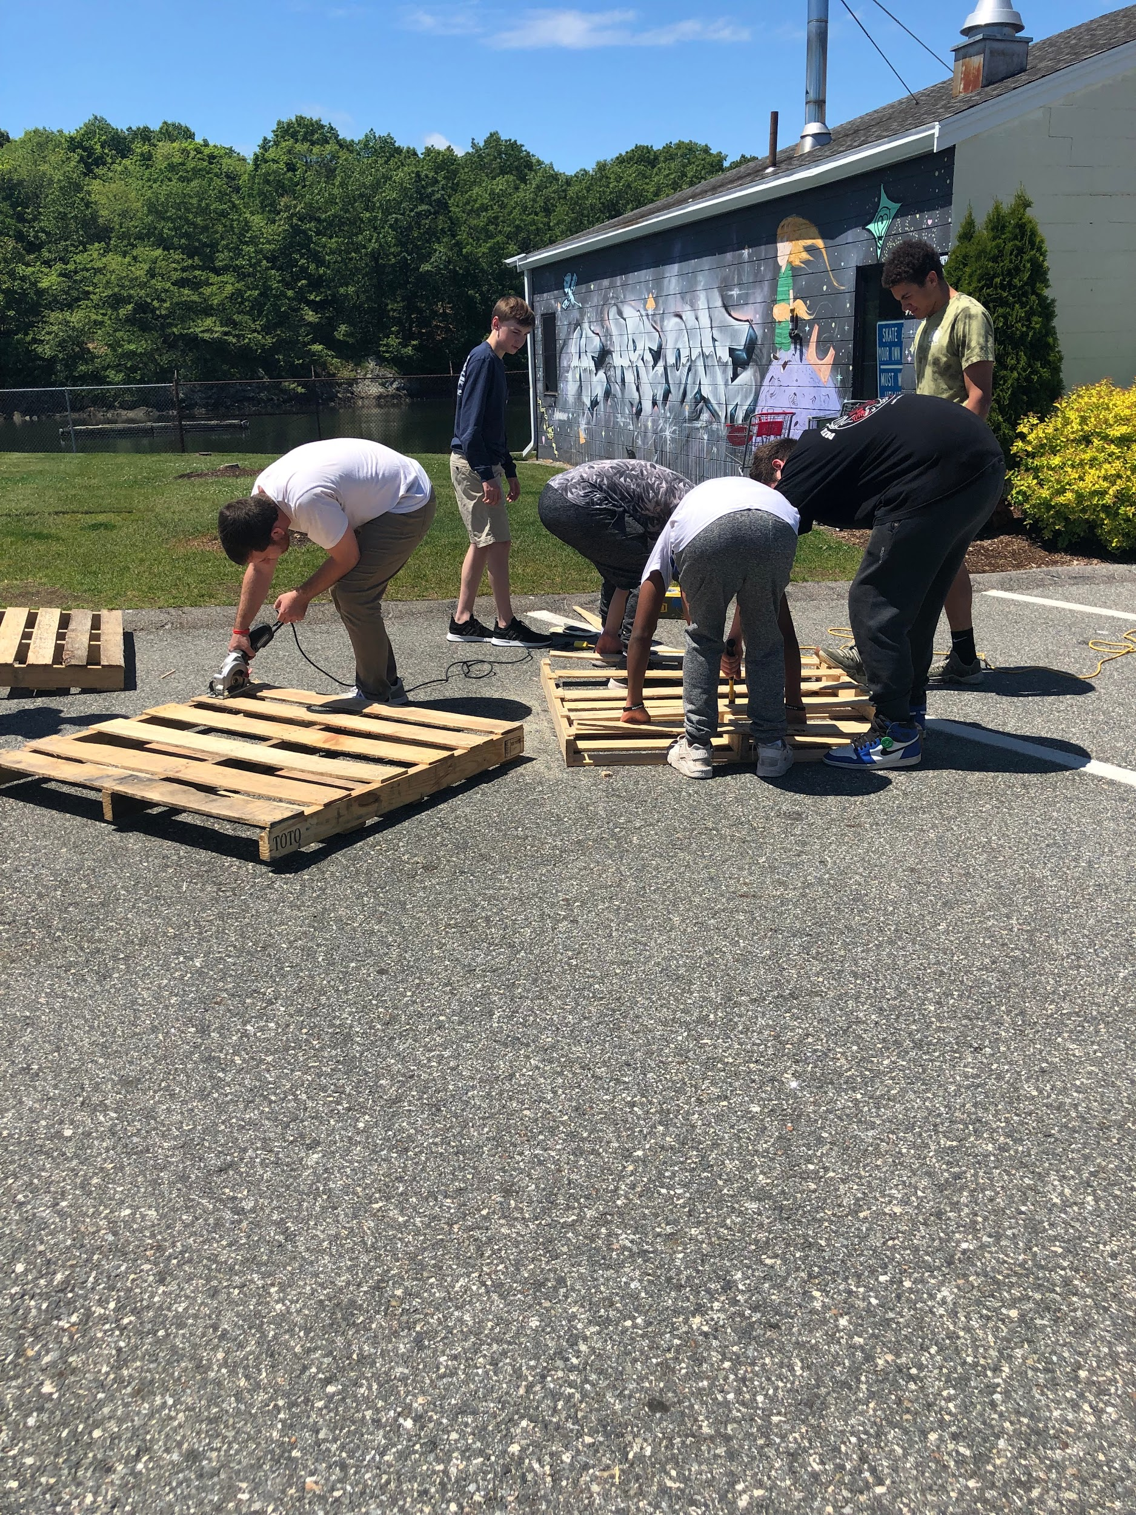
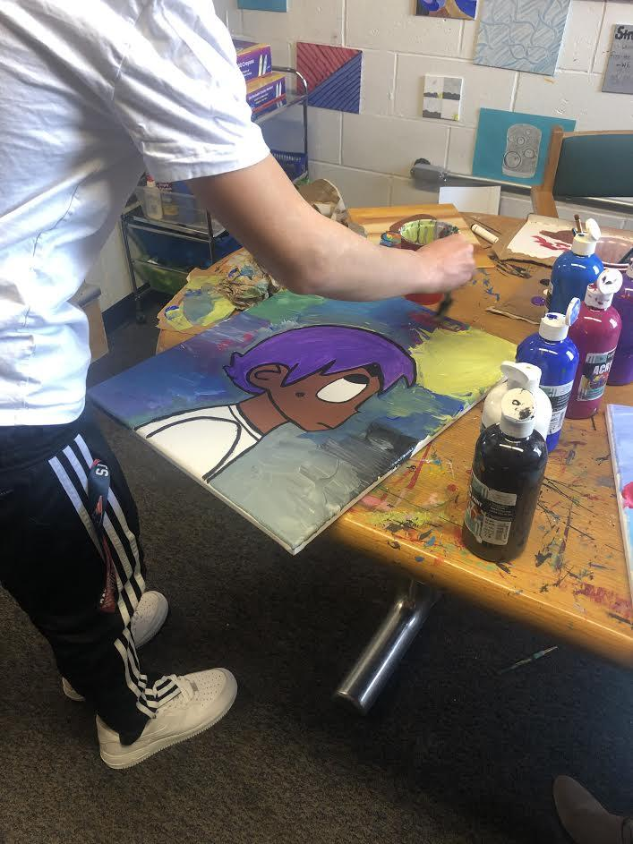
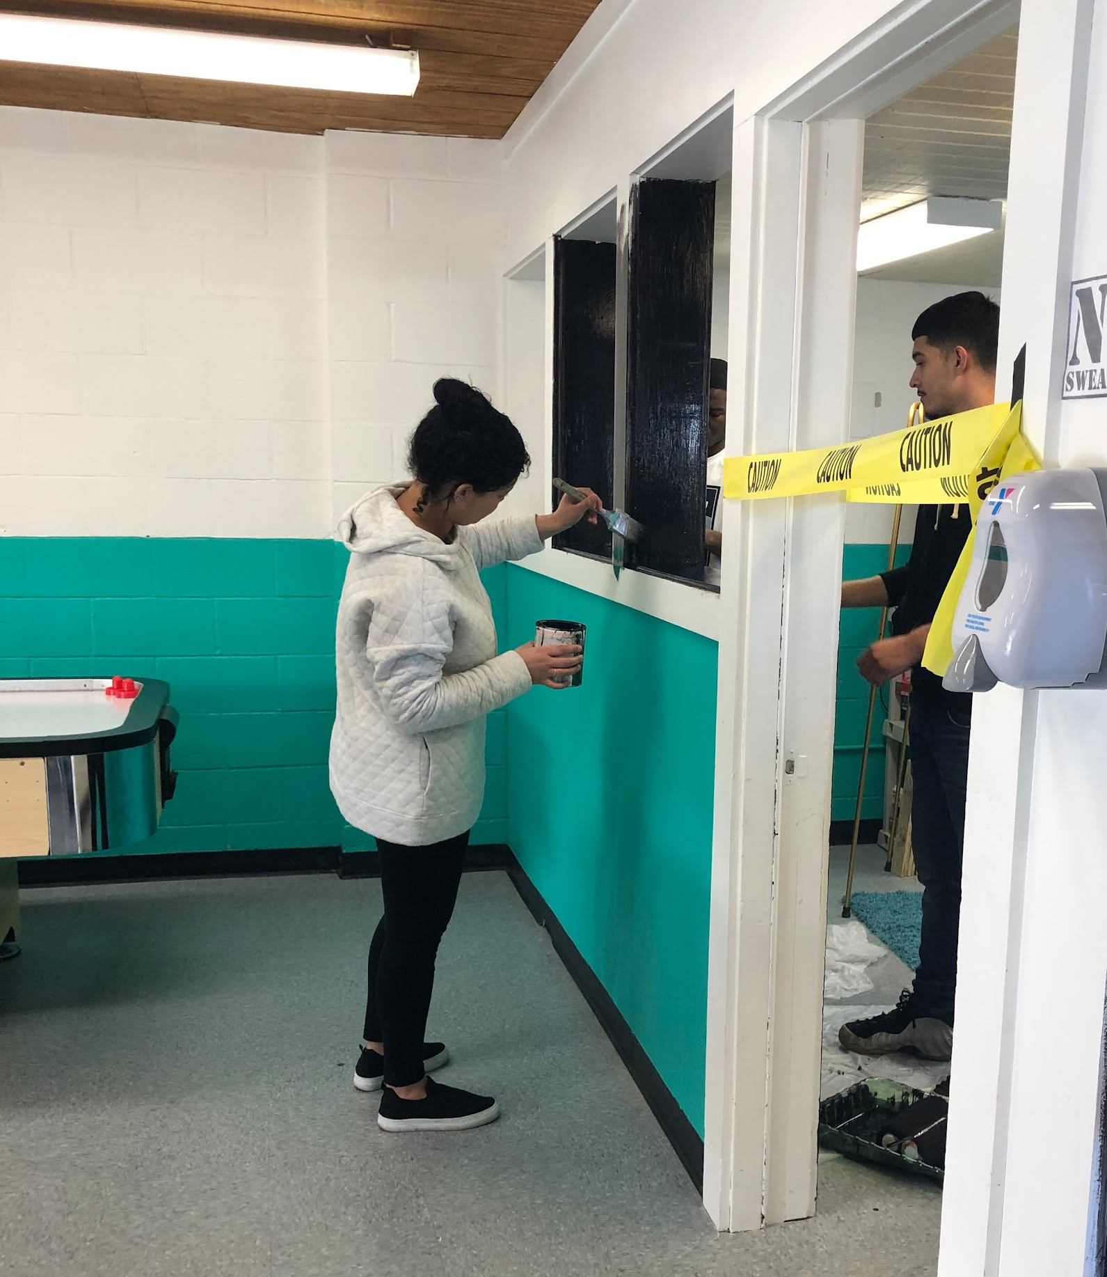
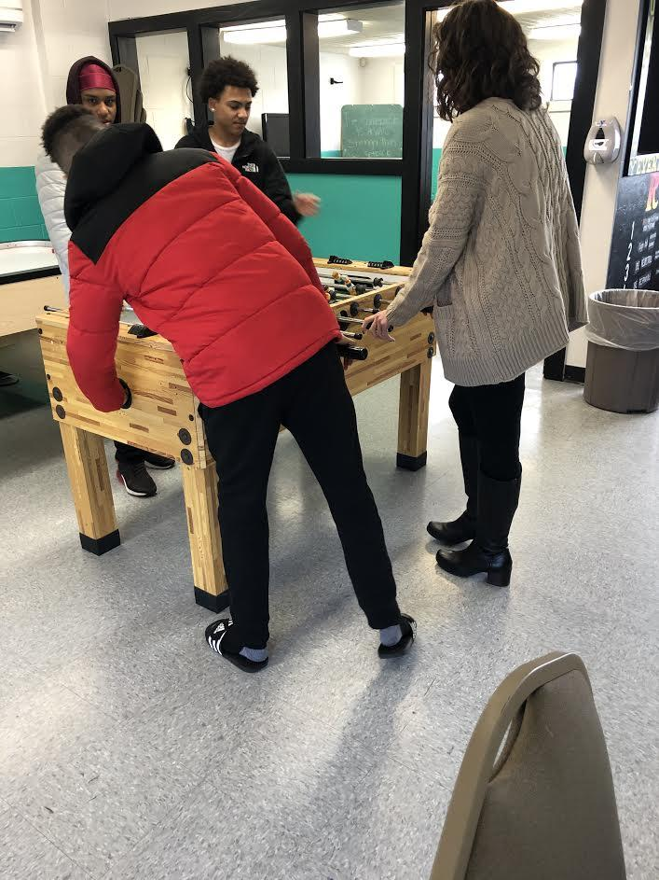
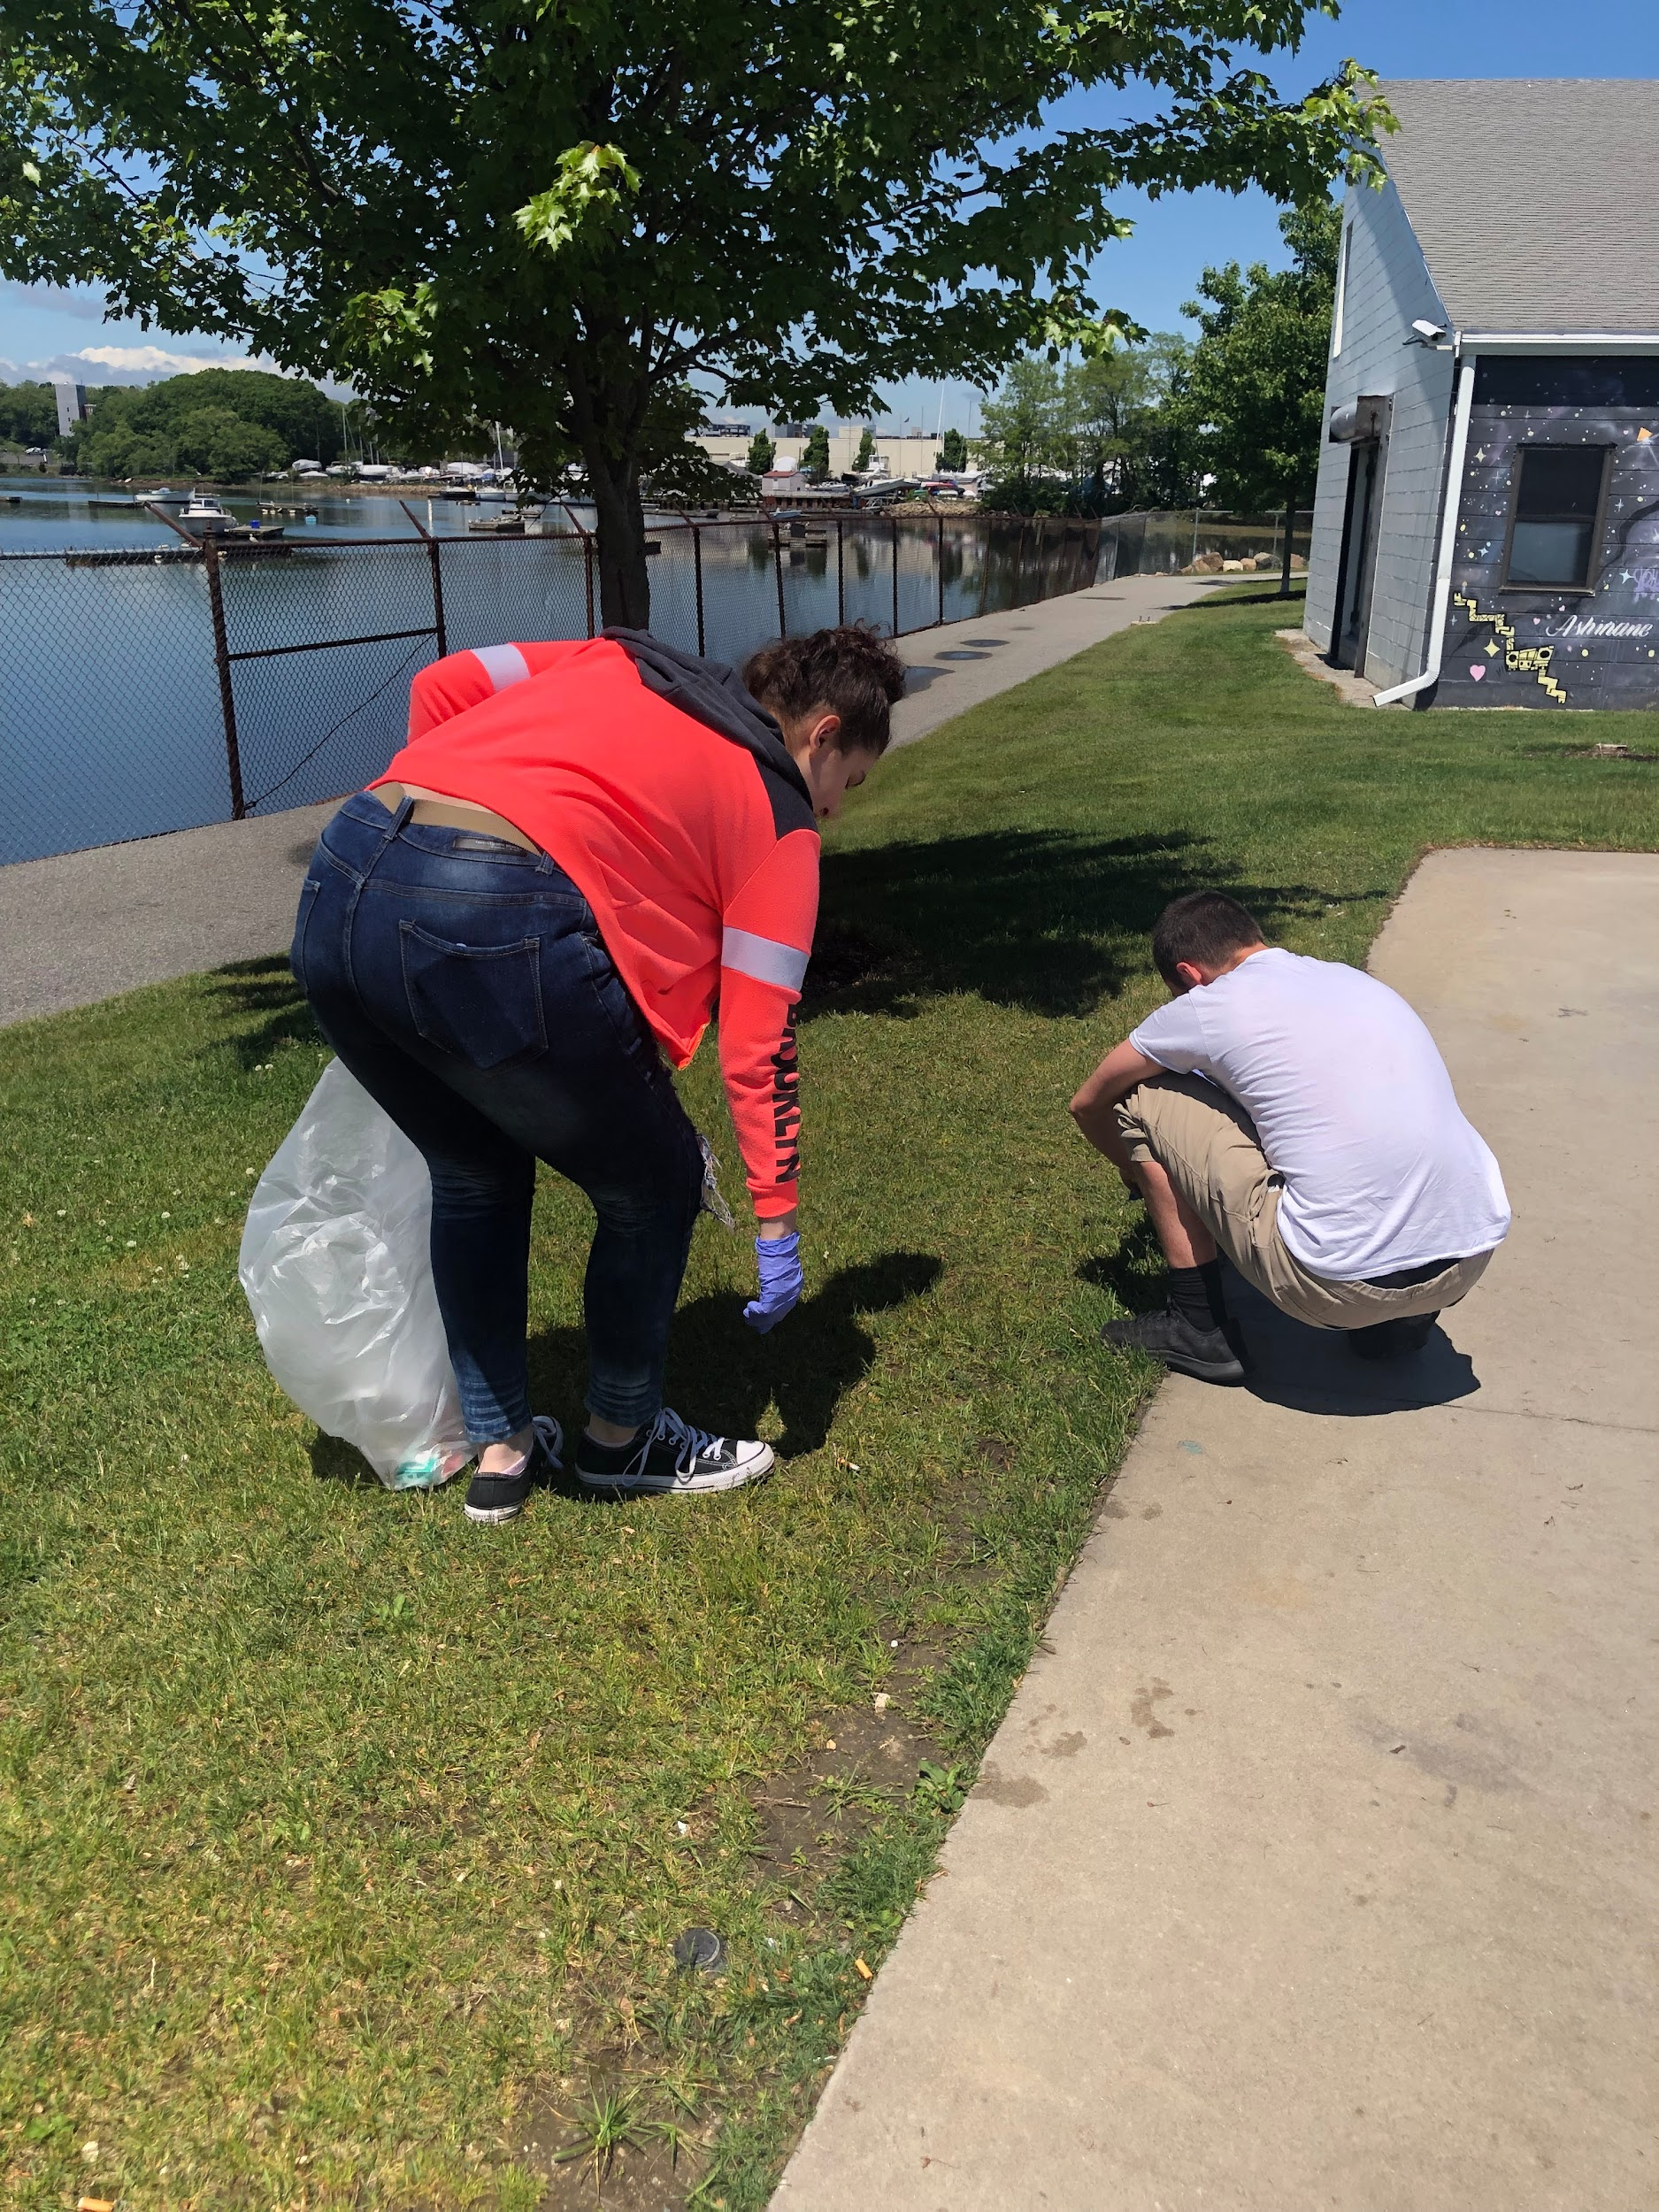
Therapeutic Recreation Time
Group Activities:
Pool, air hockey, foosball
Outdoor games
Corn Hole
Card games, board games
Interactive games, heads up, ACT it out
Painting and other art projects
Community Service Projects:
Community clean up
Beverly Main Streets

Slide 22
Re-Entry Plan
Student Name: | School: | Date(s):
Summary of student engagement at PASS:
Reason for suspension and ways to avoid future suspensions:
Identified in school supports to use in the future: | How the school can support me moving forward:
Identified out of school supports to use in the future:
PASS staff concerns for re-entry:
The Re-Entry Plan is created with the student on their last day and includes:
A summary of the student’s engagement at PASS
Reason for suspension and ways to avoid future suspensions
Identify school and out of school supports
Ways the school can support the student moving forward
PASS staff concerns for re-entry
This Re-Entry Plan will be sent to the school point person and parent/guardian (upon request) the AFTERNOON before their arrival back at school.
Using Restorative Practices, Motivational Interviewing and other tools to help facilitate a discussion, the staff and the student will:
Reflect on the infraction and time at PASS
Discuss best practices to avoid future suspensions
Identify and measure the effectiveness of existing supports
Discover additional supports and how they can be added and utilized
Learning and developing the skills to advocate and identify support from their school.

Slide 23
PASS Impact - Student Feedback
Total Students Served: 2,000+
2024 -2025 Data
Students: 363 referrals
Average Suspension: 2.76 Days
Infractions Categories:
Substance Use 58.4%
Mental Health 6.6%
Violence/Threats 12.9%
Skipping Class/Truancy 2.8%
Refusal to listen / do work 1.9%
Vandalism / Destruction / Theft 3.3%
Other (includes referrals for non suspensions) 14%
Clinical Referrals made: 12%, 7% Considering
Students with existing services: 11.8, 3% on Waitlist
Students with IEP and/or 504: 49.3%
Students scoring 3 or higher on CRAFFT: 54.5%
Students scoring 3 or higher on ACEs: 35.9%
Student Survey
85.7% found it a positive alternative
95% would attend again
60% felt ready to return to school
Reviews: What did you enjoy most about the PASS Program?
“The friendly staff and good, calm work environment”
“Sharing in groups because I got to know some of the kids in the program better”
“The staff was very comfortable to be around, the activities I did were very helpful and applicable to my life. Overall I enjoyed everything about the pass program.”
“I liked how the staff actually treated us like real people”
“I enjoyed being able to talk to the other students and to be able to build a relationship with the counselors”.
“how inclusive and understanding the staff and other students were”.

Slide 24
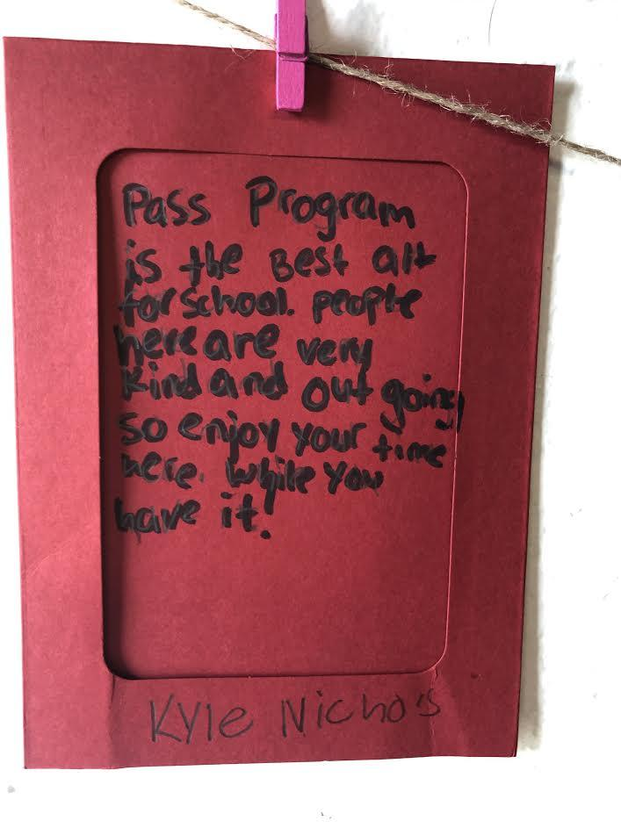
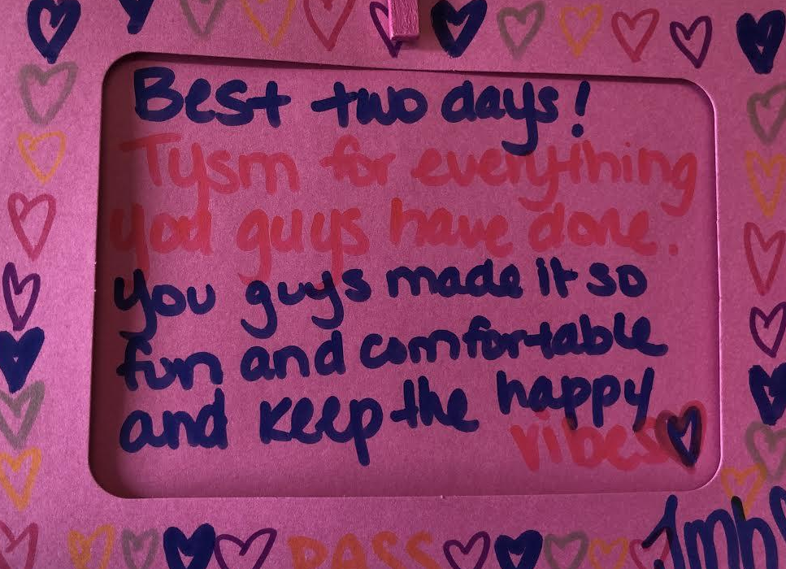
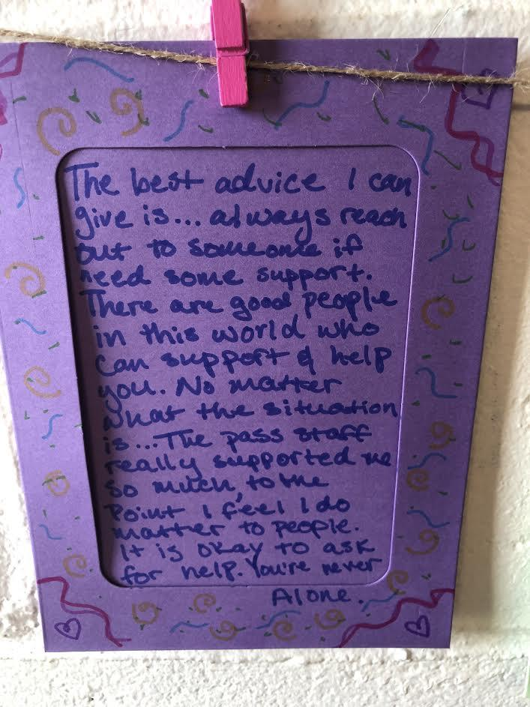
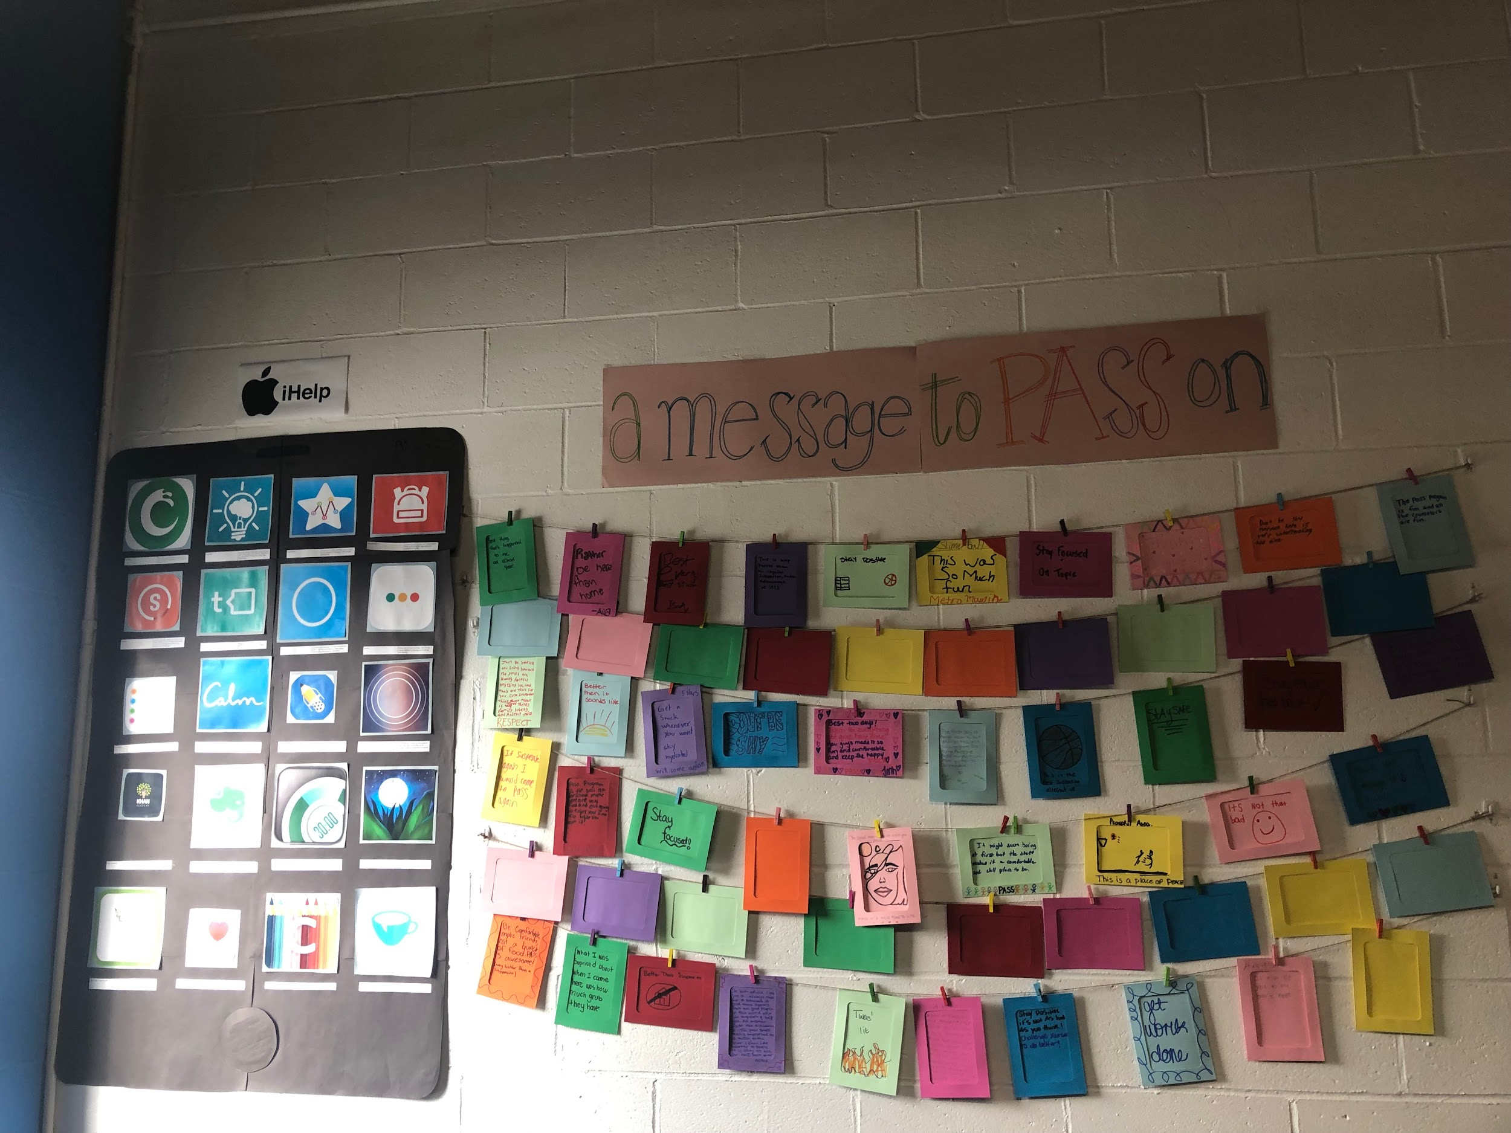
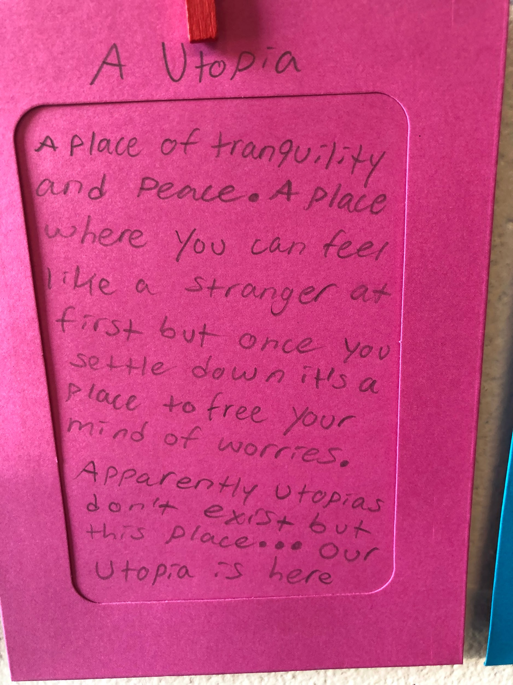
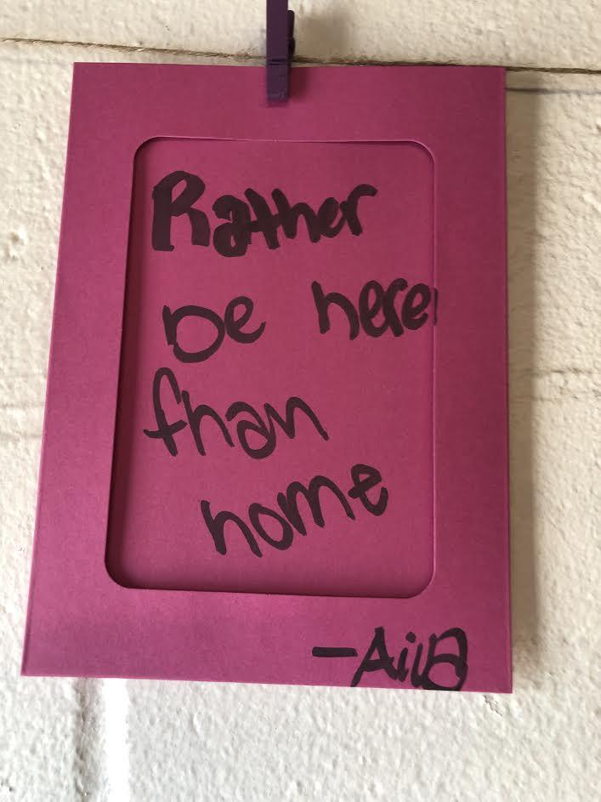
A message to PASS on

Slide 25
District Feedback
Midyear District Surveys
Annual Site Visits
Allows for personalized feedback and individualized support
Daily communication between schools and on-site staff
Video Link

Slide 26
.
PASS Collaboration Partnership:
Since 1837, Children’s Friend and Family Services has committed itself to a sustainable, long term vision of creating and cultivating a community of loving, caring, capable families. Throughout the years, we have been partnering with families in the face of difficulties, loss, trauma, and mental illness.
Founded in 1975, the Northshore Education Consortium was one of the first regional collaboratives in Massachusetts and is the largest provider of intensive special education services to children and youth with emotional, behavioral, and developmental disabilities on the North Shore. In addition to special education programs, NEC runs the Northshore Recovery High School, for students who have struggled with substance abuse disorders, and provides a wide range of Training and Professional Development for parents, teachers, and other specialists from area school districts.
Our Y welcomes all. We strengthen communities, educate and nurture children and promote healthy living in spirit, mind, and body.
Essex County Outreach is a collaborative effort involving all 34 police departments within Essex County, as well as the sheriff’s department. Together, we work with social service partners to assist individuals with substance use disorder (SUD), mental or behavioral health challenges, high-risk circumstances, and harm reduction goals. Additionally, we aim to provide resources and supports to families, loved ones, and further supports for impacted children and families, including those who have lost a loved one due to substance use disorder.

Slide 27
Questions?
Thank you!

