Slide 1
Program Evaluation: An Overview
June 10th, 2025

Slide 2
Introductions
Leif Jacobsen
DESE, Federal Programs Team
Kendra Winner
DESE, Research and Evaluation Coordinator

Slide 3
Session Goals
At the end of this session, participants will be:
Familiar with the DESE program evaluation resources
Able to use "strong examples" to guide development of required evaluation documents

Slide 4
Why is this important?
Federal law mandates that as a condition of accepting Title grant funding, a district must annually evaluate its Title grant programs.
You should be regularly using data to:
Ensure you’re addressing the needs you identified
Identify what’s going well
Identify what needs to improve
Use findings for planning and improvement.
Document progress against your goals

Slide 5
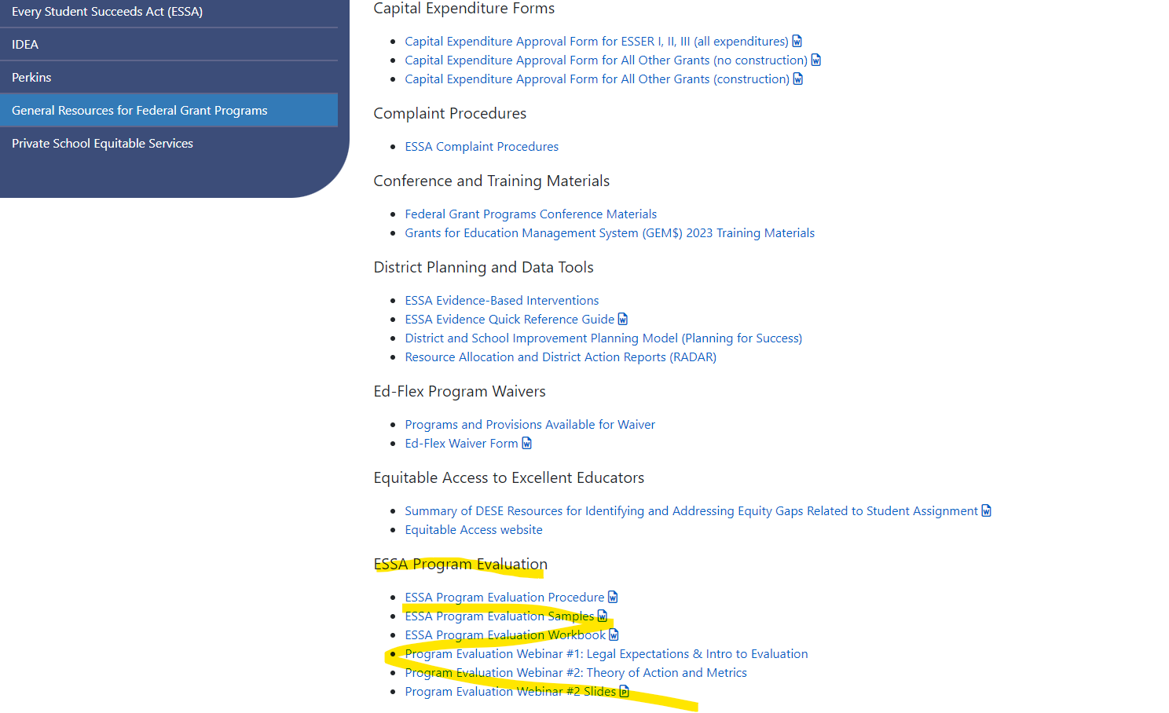
Where to Find Evaluation Resources
1. On DESE Website, go to
Federal Grant Programs
->
General Resources for Federal Grant Programs ->
ESSA Program Evaluation
Link to Evaluation Resources

Slide 6
Workbook Checklist
Step | Question | Done?
1. Identify members of the team | What skill(s) do we need on our team and who has those skills?
2. Conduct Needs Assessment and Design Theory of Action | What are the short- and long-term goals of our program? What key actions will get us to our goals?
3. Define program goal and evaluation questions | What did we design our program to do? What do we want to find out? How would we know? What is measurable and attainable?
4. Create a data collection plan | How and when do we collect the data?
5. Write Program Evaluation Procedure | What are the key components of this submission and how do we write it?
6. Analyze Data | How do we analyze our findings?
7. Write Program Evaluation Summary | What are the key components of this submission and how do we write it?
8. Report, discuss, and apply evaluation findings | How do we report our findings and what do we do because of our findings?
Notes:
Leif

Slide 7
Evaluation Timeline
Summer 1 | Fall | Winter | Spring | Summer 2
Create Theory of Action for program Establish goals of program Establish evaluation metrics | Meet with key stakeholders Set data collection plan | Collect data Draft program evaluation procedure | Collect data Draft program evaluation summary | Make final edits to documents & disseminate to key community stakeholders

Slide 8
Title I Required Evaluation Submissions
1) Document 1: Program Evaluation Procedure
This is where you explain the processes that your district uses to evaluation its program.
2) Document 2: Program Evaluation Summary
This is where you analyze your district’s data and discuss implications for future program cycles.
Notes:
LJ

Slide 9
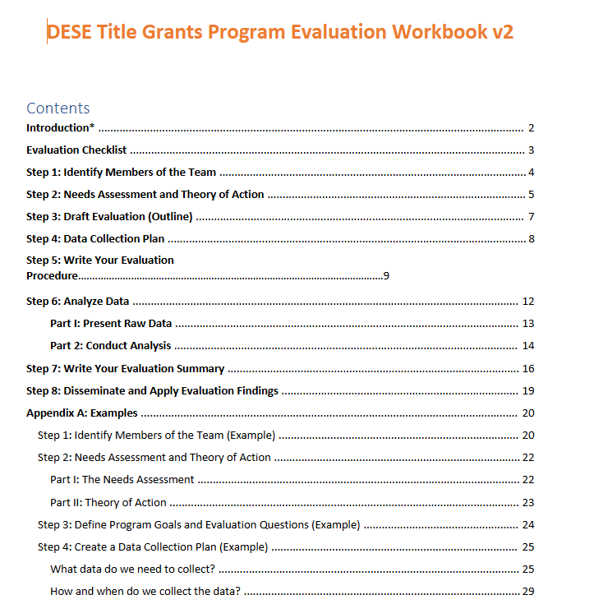
How to Use Program Evaluation Workbook
Provides structure to the evaluation process.
Key sections (such as the required monitoring documents) include graphic organizers to work through.
Link to Workbook

Slide 10
Using Our Evaluation “Strong Examples”
These are just individual examples. Every district’s program will be different, which should be reflected in these documents.
Note the annotations, which “zoom out” of the examples to provide more general guidance.

Slide 11
Program Evaluation Procedure: Strong Example
Key Components
Overview
Identifying Members of the Team
Needs Assessment and Theory of Action
Program Goal(s) and Metric(s)
Timeline
Data Collection Plan
Data Analysis Process
Disseminate and Apply Evaluation Findings
Strengths of This Plan
Thoroughly documents the district’s evaluation process over the course of the year
Aligns the Theory of Action, Program Goal, and Metric
Provides a set of rigorous questions guiding data analysis process

Slide 12
Program Evaluation Summary: Strong Example
Strengths of This Plan
States the data collected and why (e.g., to evaluate coaching)
Provides analysis by grade level and skill
Includes specific analysis, data and information about both to answer each question
Assesses whether questions could be answered including “no” and “we can’t tell” (e.g., not all answers are positive)
Discusses “why we think the data tells us this” for each question.
Key Components
Data Collected
Data Analysis
Key Insights from Data
Determination of whether program goals were met + discussion
Discussion of program’s strengths/weaknesses
Forward-looking discussion of changes going forward

Slide 13
Frequently Asked Questions
I’m new to evaluation and this has fallen off our district’s radar – where do you recommend I start?
How does Title I program evaluation differ if you are running a schoolwide program (SW) vs. a targeted assistance (TA) program?
Must districts complete evaluations every year, or just during monitoring years?
What if the data we collect tells a story (e.g. program goals not met) that we believe is contradicted by other contextual evidence (e.g. program goals moving achievement in right direction)?

Slide 14
Available DESE Support
2025-26 Pilot
One-Off Consults
Document Review
(Limited Capacity)

Slide 15
Feedback
Your feedback is critical to our improvement!
Before you leave, please complete our survey.

