Slide 1

Wachusett Regional School District
Jodi Brunelle, ELE Specialist
Kara Prendergast, ESL Teacher
Sara Root-Simone, ESL Teacher

Slide 2
Overview
Fiscal Year 2025 Title III Funding Overview
Total Allocation: $25,245
Mid Enrollment English Learner District
145 Multilingual Learners
ESL Teaching Staff: 8 Full-Time ESL Educators
6,557 students in 13 schools
Spanish, Portuguese, Arabic

Slide 3
Title III Goals
Support high-quality language instruction for MLs
Increase English proficiency and academic success
Promote parent involvement in education
Promote professional development for staff

Slide 4
Needs Assessment
Family Survey: collect data on needs
Student Focus: target after school support for groups facing greatest academic and social challenges
Staff Support: Ongoing PD support on ML strategies, cultural competencies, and data usage

Slide 5

Maximizing Title III Funds:
Enhancing English Learner Success
Before and After School Programs
Summer Programs
Transportation
ESL for Adults courses
Professional Development for District wide Educators
Private School Services
Materials to support programs
Notes:
These are the programs we offer to support those goals

Slide 6



Introduction- Sara Root-Simone
Picturing Writing: Sara Root-Simone
K-5 ESL teacher Wachusett Regional School District (WRSD)
LETRS Local facilitator for WRSD
Licenses held: Elementary Academic, ESL, Reading Specialist
Education
Undergrad.: Clark University - Environmental Science and Policy
Post-Bacc.: Worcester State University, Initial Licensure
Masters: Worcester State University, Reading Specialist
CAGS (in progress): Mount St. Josephs, Reading Science Certificate:

Slide 7
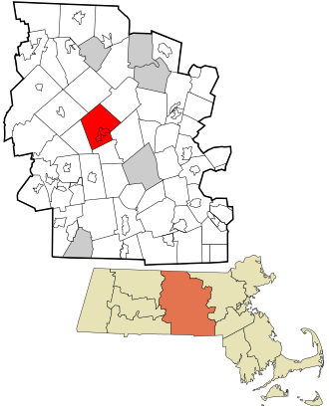
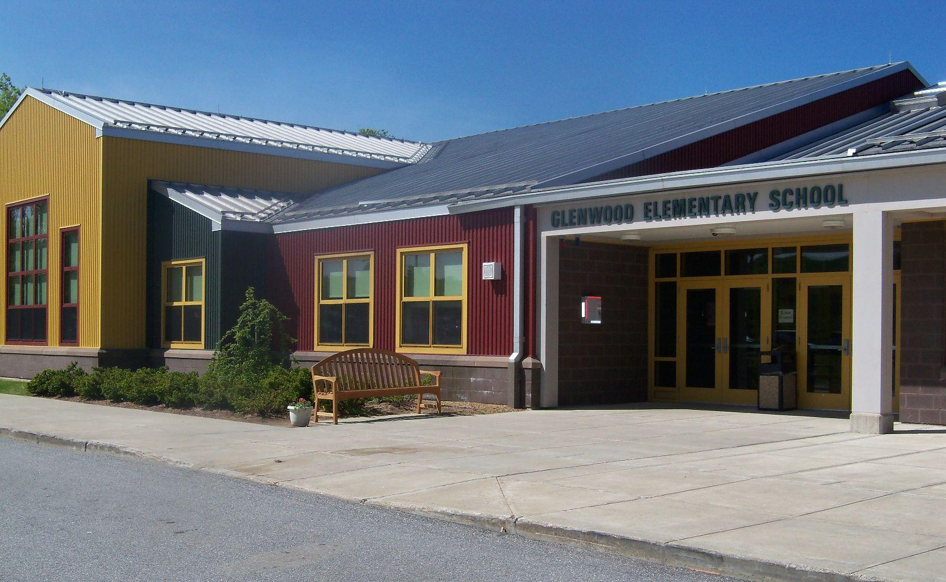
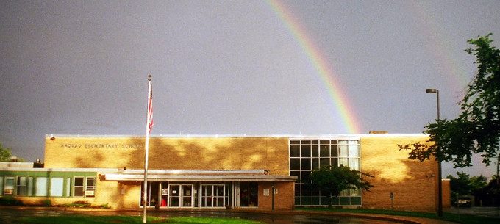
Schools and Students
Rutland population(2020): 9,049 people
Rutland, MA: two elementary Schools, one middle school
Naquag Elementary (Grades K-2)
#Students (2024-2025)
# MLLS (2024-2025)
Title 1: Yes
Languages Represented:
Arabic
French
Polish
Portuguese
Spanish
Twi
Glenwood Elementary (Grades 3-5)
#Students (2024-2025)
# MLLS (2024-2025)
Title 1: Yes
Languages Represented:
Arabic
French
Mandarin
Polish
Portuguese
Spanish
Twi
Ukrainian/Russian
Vietnamese

Slide 8
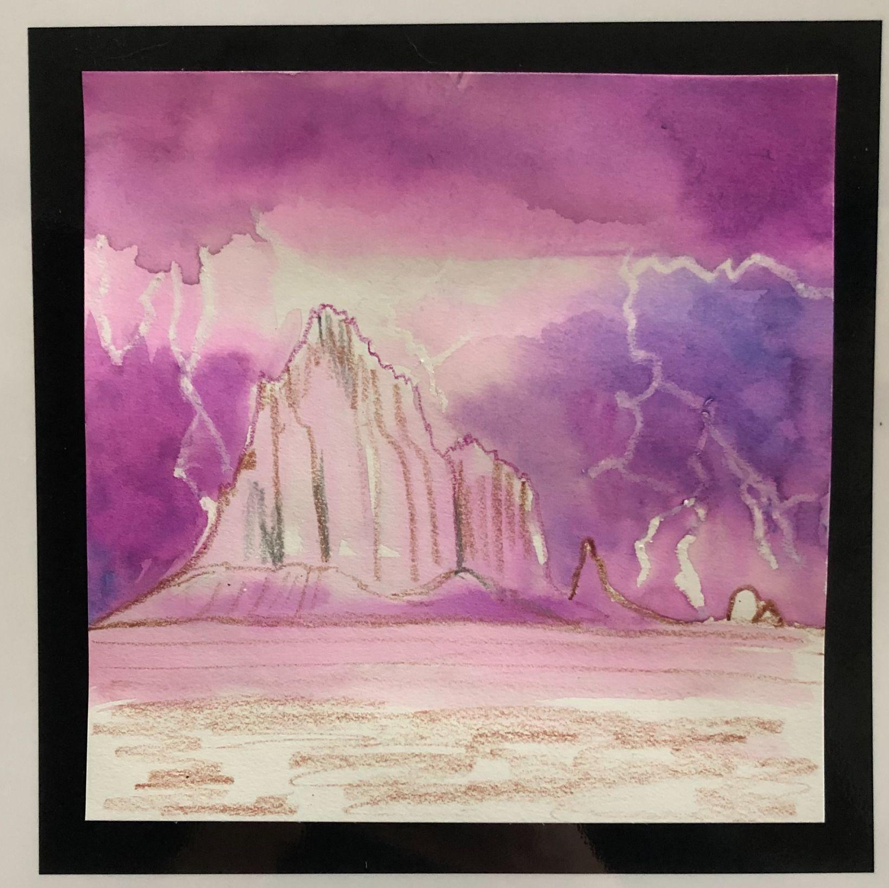
What is it?
Picturing Writing: Fostering Literacy Through Art® is a multimodal, evidence-based approach to literacy learning that uses simple crayon resist art techniques and the study of quality picture books to teach the art of writing.
Art techniques based on wax-resist and watercolor unlock students creativity to illustrate a wide range of projects that tie into state standards, English language development and Socio-emotional development.
Notes:
Drawn to it as an artist myself and the quality of writing that is created through the process.

Slide 9
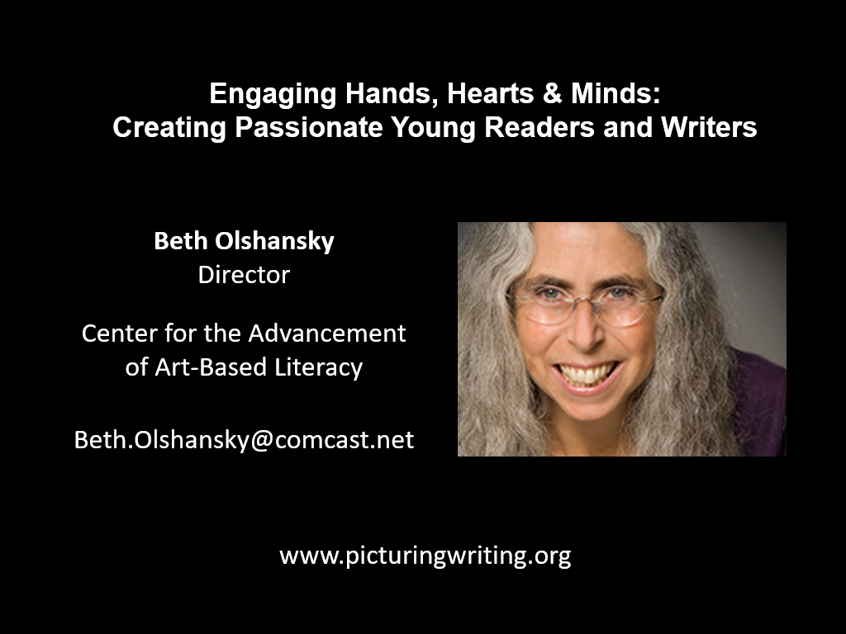
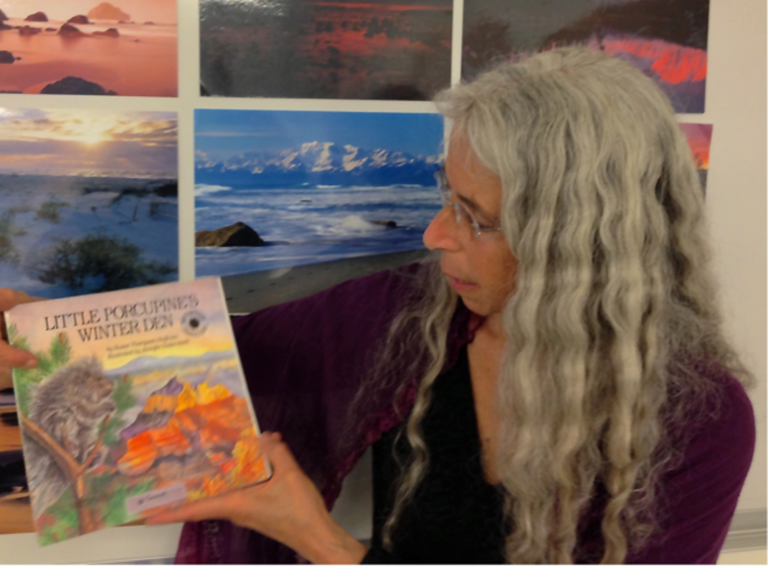
Beth Olshansky began researching and refining the process in NH at the Image- Making Within the Writing Process at the University of New Hampshire, Durham, New Hampshire, USA, as early as 1991
She continues to teach and train teachers in the Picturing Writing and Image-making processes through remote classes and summer institutes.
Notes:
I first heard of it through the MATSOL conference. Another participant mentioned it and I looked into it more. We still had Title 3 monies left so I was able to get into the Summer Institute that year. The Summer institute trains teachers in the process by going through the same steps as the students would. Bet was kind enough to support me when I offered to share her process through a professional development opportunity in our district.
References:
Olshansky, B. (1997). Picturing story: An irresistible pathway into literacy. The Reading Teacher, 50(7), 618-623.

Slide 10
***Please refer directly to the Picturing Writing Website dedicated to the research studies that evaluated the Picturing Writing Process.
When fully integrated into the curriculum:
Picturing Writing was used in a $1M Federal grants recipient program in New Hampshire between (2006-2010)
“Standardized reading scores of a third-grade class at the John C. Fremont School in Fowler, CA documented, on average, a 2.5 year gain in reading achievement over one school year.”
“Following two years of school-wide adoption of Picturing Writing and Image-Making at the Main Street School in Exeter, NH, standardized test scores revealed tremendous gains in reading comprehension and writing skills, particularly among Title I and Special Education students. Ten years of data support these findings.”
Research based instruction
Notes:
The Manchester School District (MANSD), a National Refugee Resettlement Community in Manchester, New Hampshire, received four years of federal funding (2006-2010) through a U.S. Department of Education Arts in Education Model Development and Dissemination (AEMDD) Grant to investigate the impact of Picturing Writing: Fostering Literacy Through Art® (PW) on 1500 students’ writing, visual literacy and reading skills. Statistically significant gains in writing and visual literacy were achieved by the treatment group each year when compared to the demographically matched comparison group within the district. This trend held true for all at-risk subgroups including “below benchmark readers,” Special Education students, EL mainstream students and EL Magnet students. This study also included standardized test scores in writing and reading across several at-risk subgroups.
As an evidence-based approach to literacy learning, teacher training as well as art and instructional materials can be paid for with Title I, II, III, IV-A & V Funds as well as ESSER I, II, & III Funds.

Slide 11
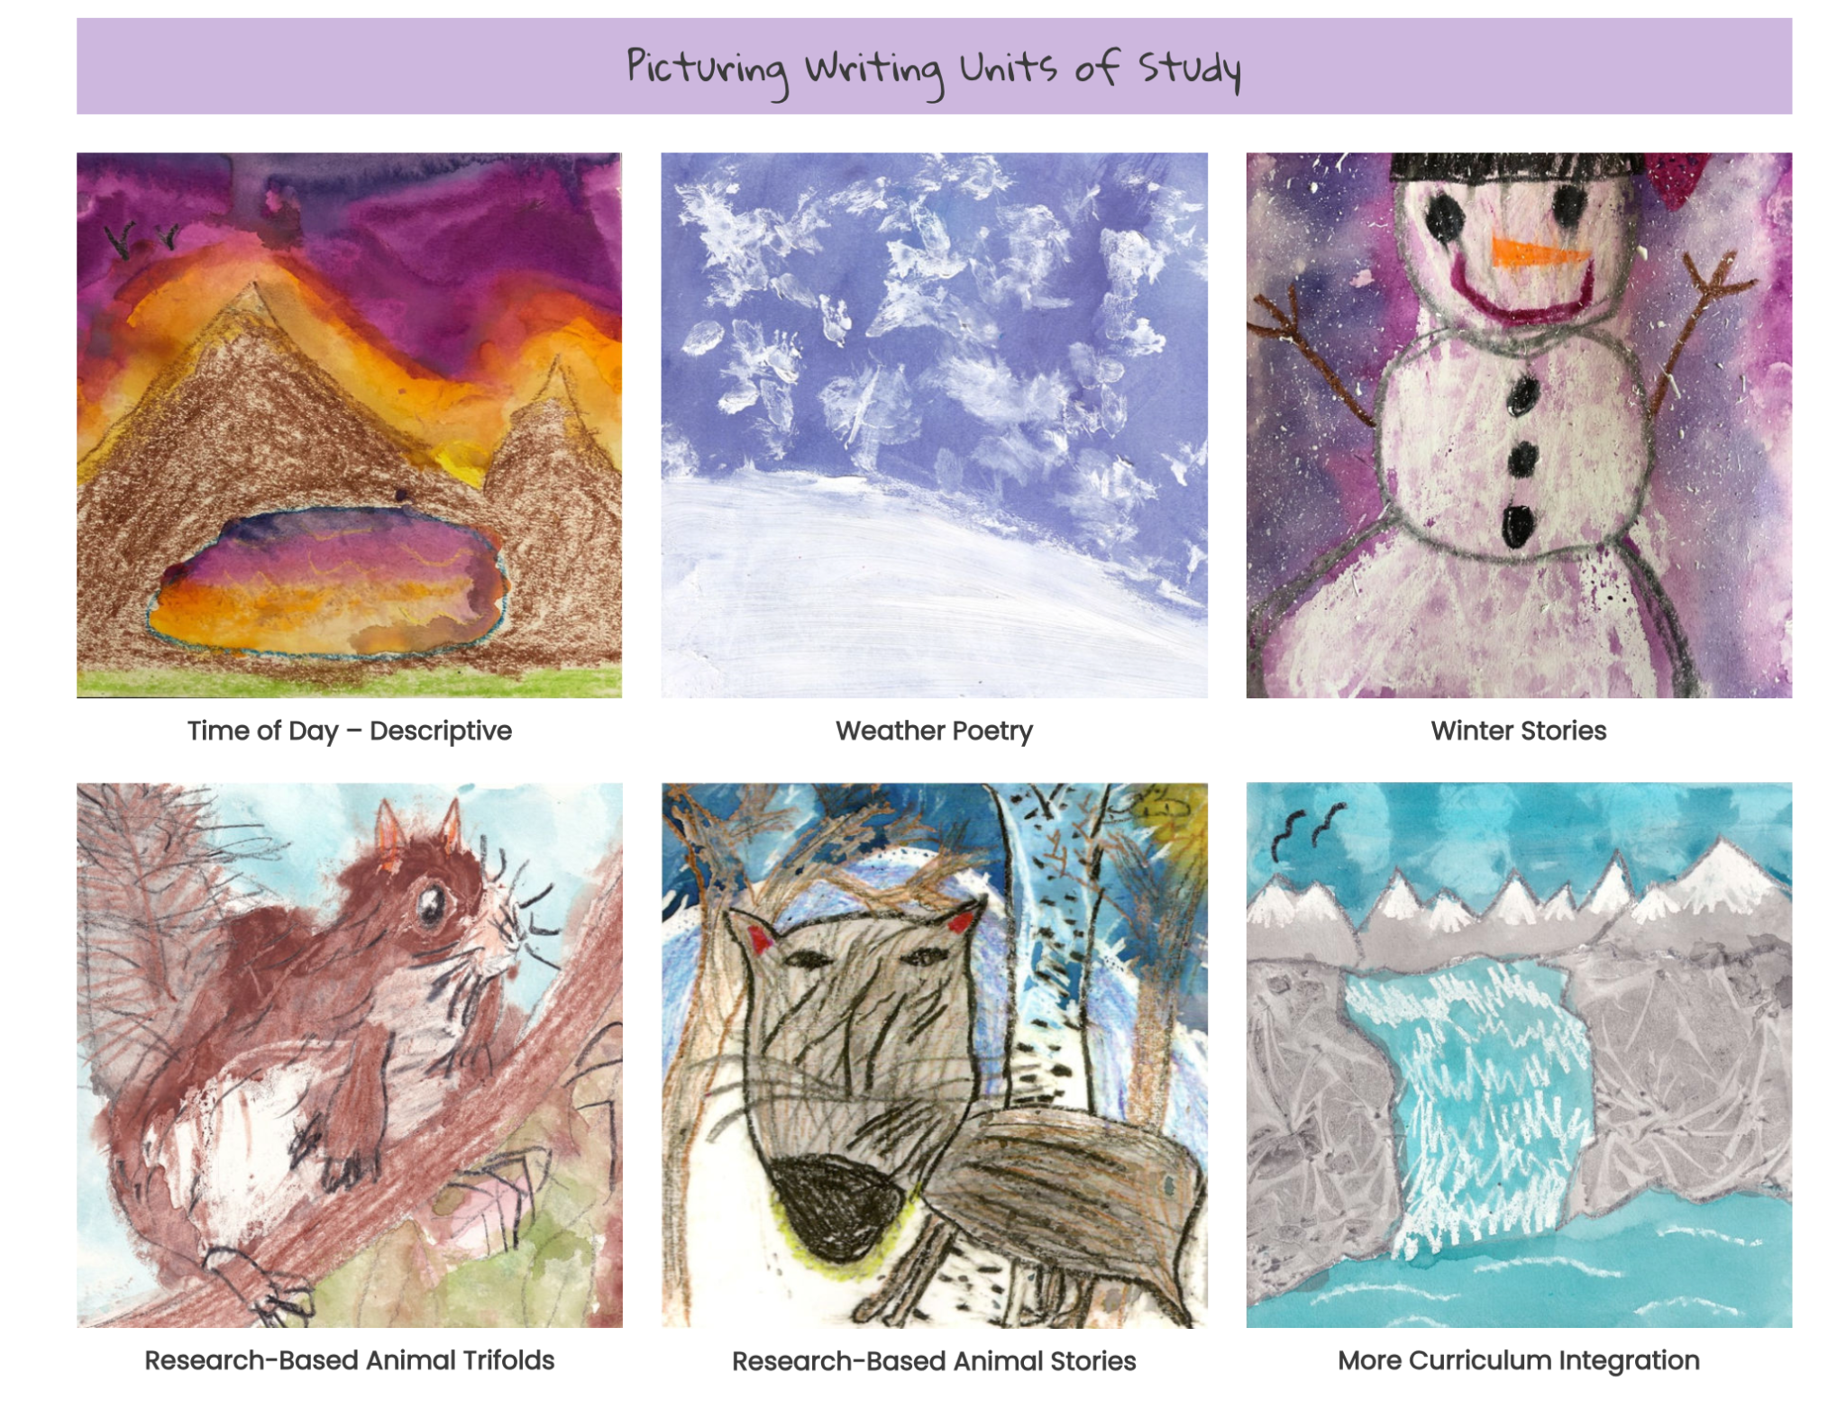
https://picturingwriting.org/picturing-writing/
Picturing Writing Topics
Weather Poetry *
Time of Day
Animal Research
Animal Research Trifold *
Pumpkin Life Cycle *
Immigration Stories
Notes:
There is also another collage-based image-making process that PicturingWriting offers training

Slide 12
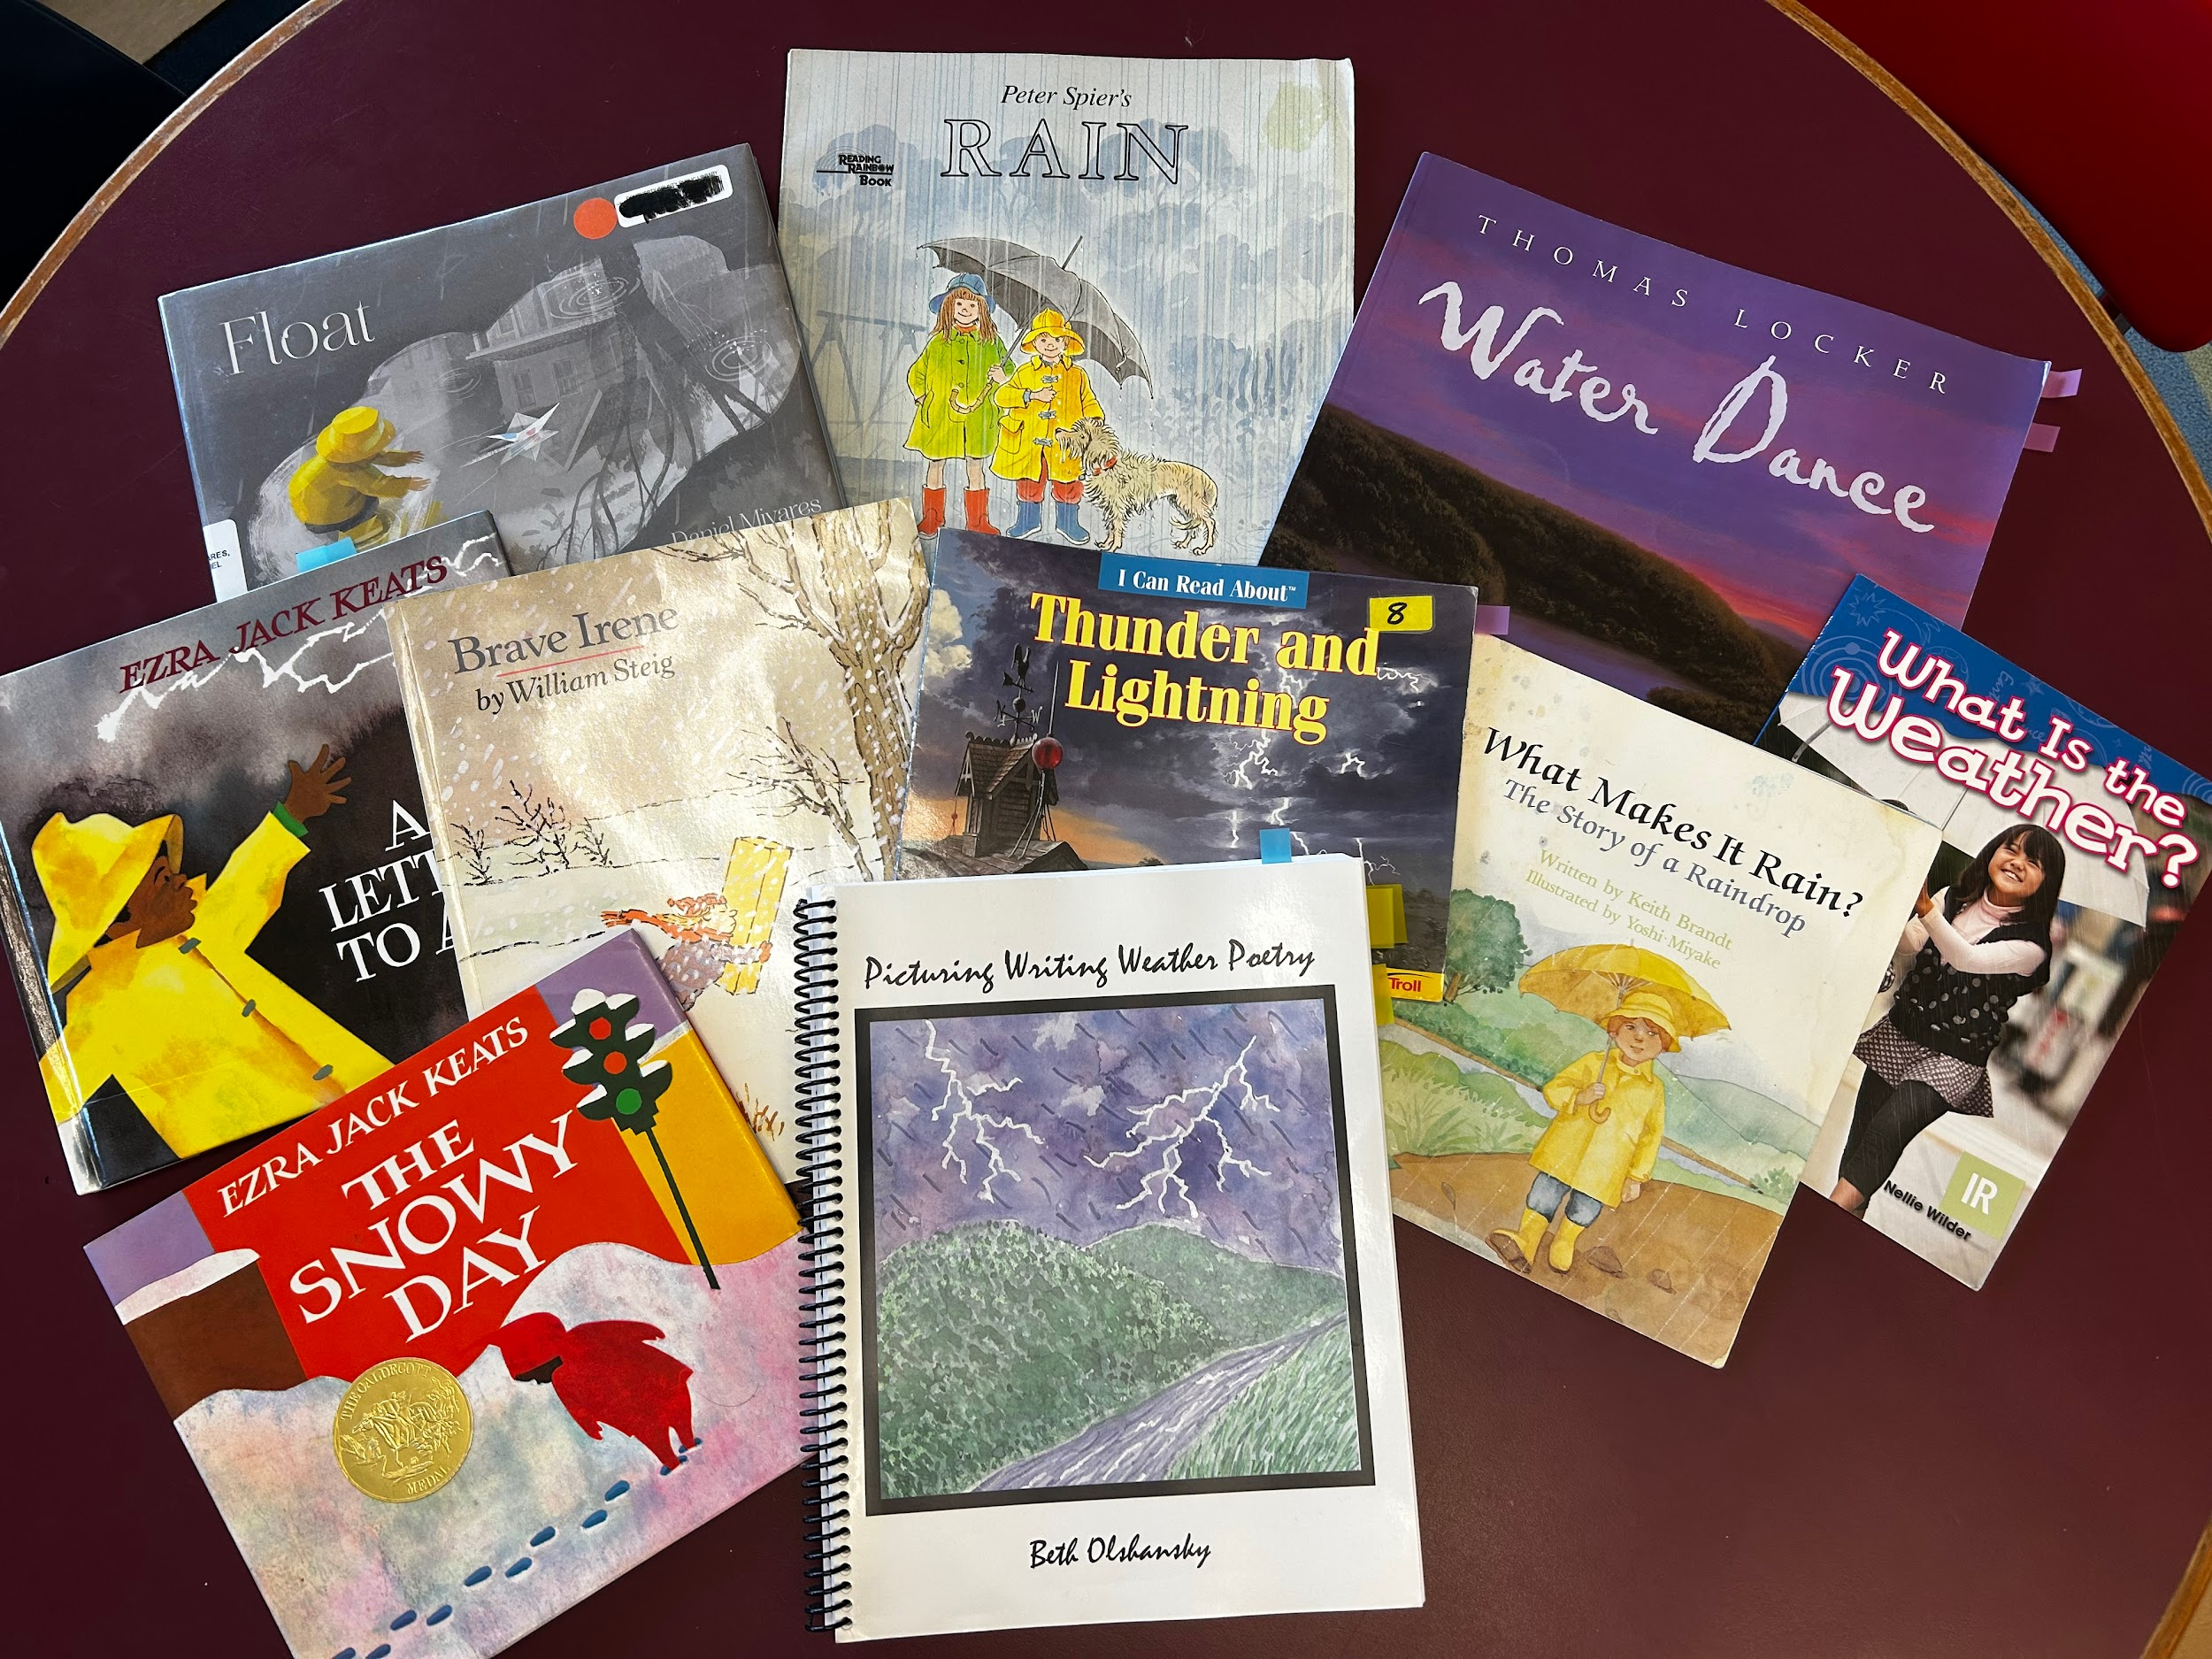
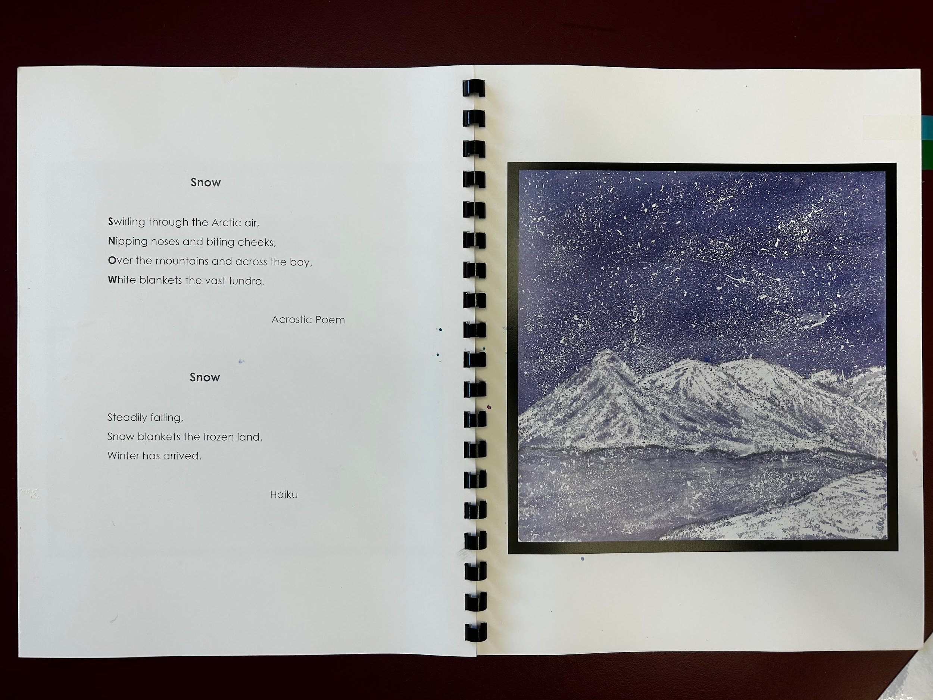
Units Explored to Date:
Weather Poetry
Animal Trifold
Pumpkin Life Cycle
Notes:
MIx of fiction and non-fiction mentor texts. To read and analyze for both print and visual information to inform poetry and paintings.

Slide 13
Scaffolds for Writing and Learning
Fiction and Non-Fiction Mentor texts (Close reading of text and illustrations
Graphic Organizers
Group brainstorming
Community Brainstorming
Topical vocabulary development multiple exposures, total physical response (TPR)
Sentence Expansion Charts
Analyzing text structure
Model, model, model!!! All art techniques and writing

Slide 14
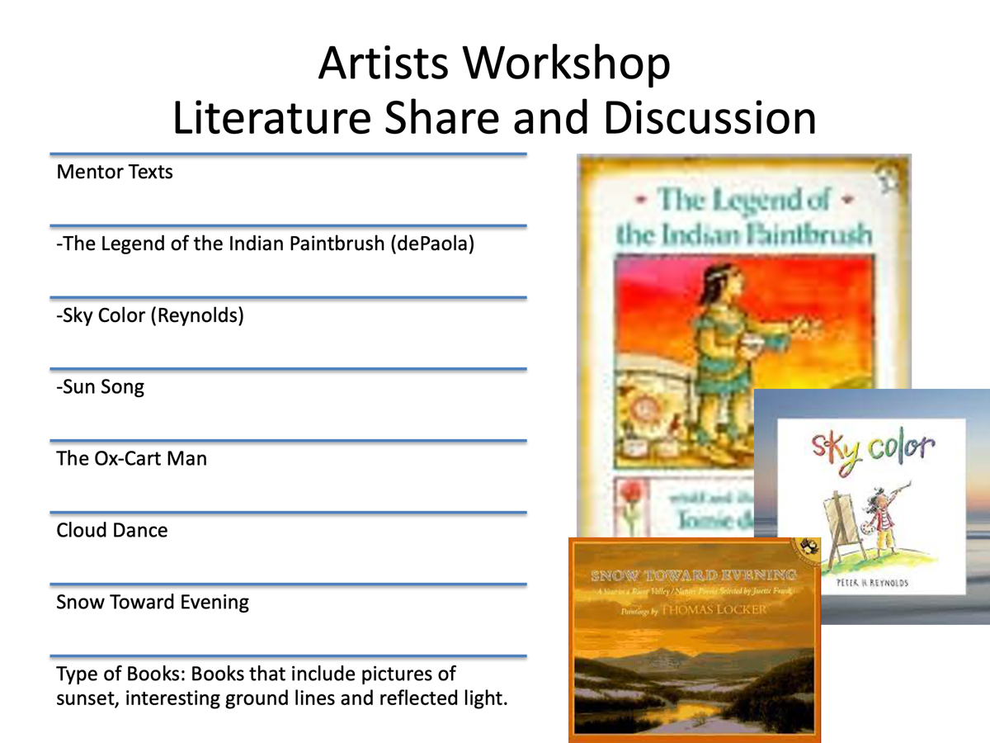
Artists Workshop
Notes:
From the time of day unit.
Close read of illustrations, what colors are used, how does the land, water and snow reflect the skies colors
Answered questions about whether the sky is alway blue.
I noticed students began to comment more on their noticings about the sky’s color at different times of day in our towns.
Building a sensitivity to the environment and being specific and intentional with their art and words

Slide 15
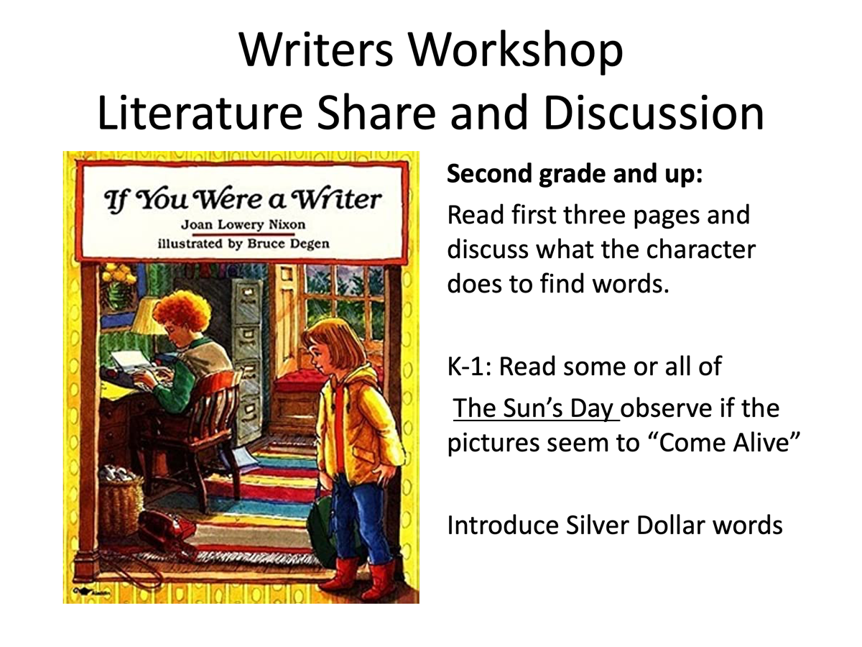
Writers Workshop
Notes:
Discuss use of Gradual release model I do we do you do
Exploring vocabulary from mentor text and crowd source from student,
Use of TPR and movement games like action charades to support the vocab acquisition

Slide 16
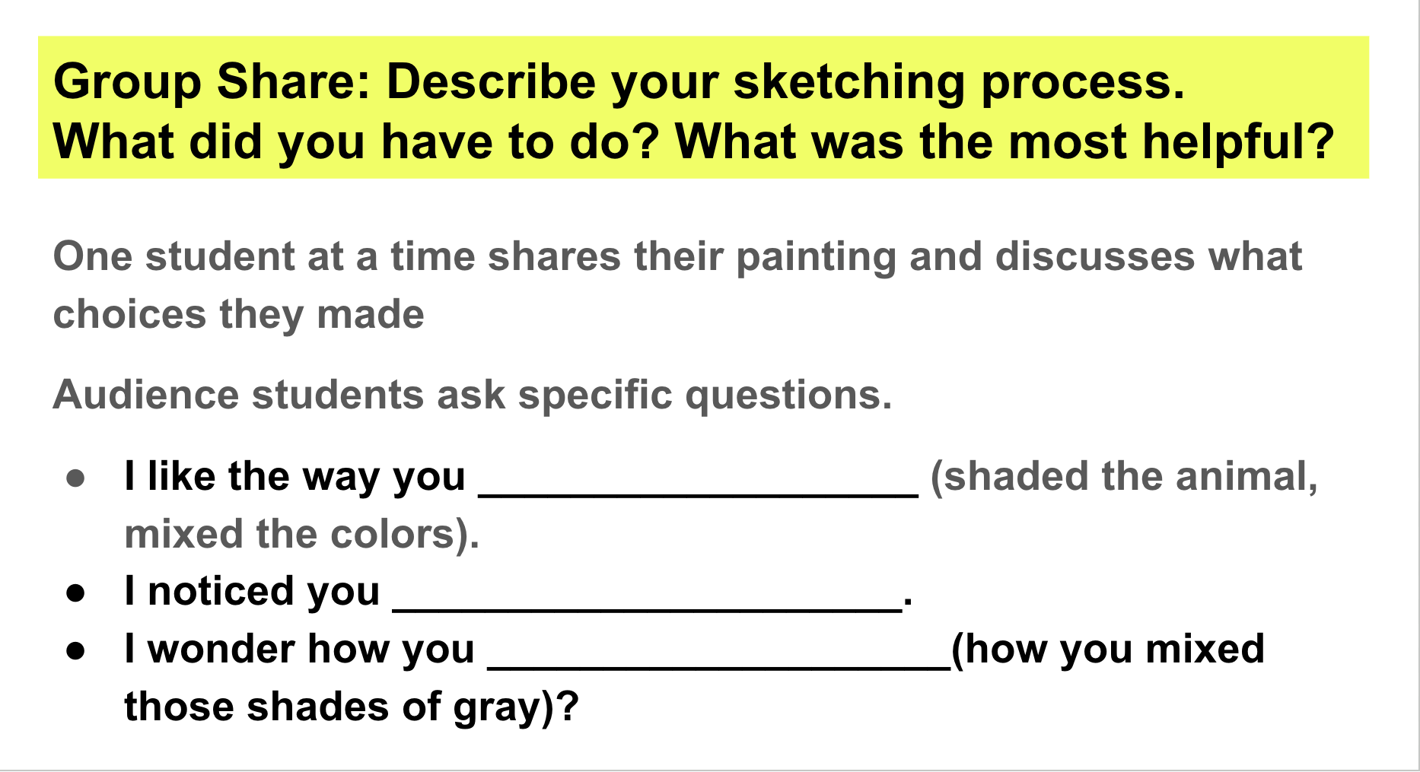
Socio-Emotional Learning- The Group Share
Notes:
At the end of each session, time for a group share is included. This is an integral pieces of the picturing writing process and best practice for any writing class. A few (not all) of the young artists and illustrators share their work with their peers each session. Their work is either placed on a frame and the artist sits opposite of it in the Artist’s or Writer’s chair. Alternatively, they hold their paintings up and read their writing and allow the picture to come alive as they direct their audiences eyes to specific parts of their paintings that their writing has highlighted. Peers are invited to share back any observations or questions they have for the artist/writer. I created a scaffold of sentence stems for the students to draw on if needed and to model the kind of language I was looking for. Students seem to really enjoy this process and the small group afforded a lower risk opportunity to practice this kind of feedback using the English language.

Slide 17
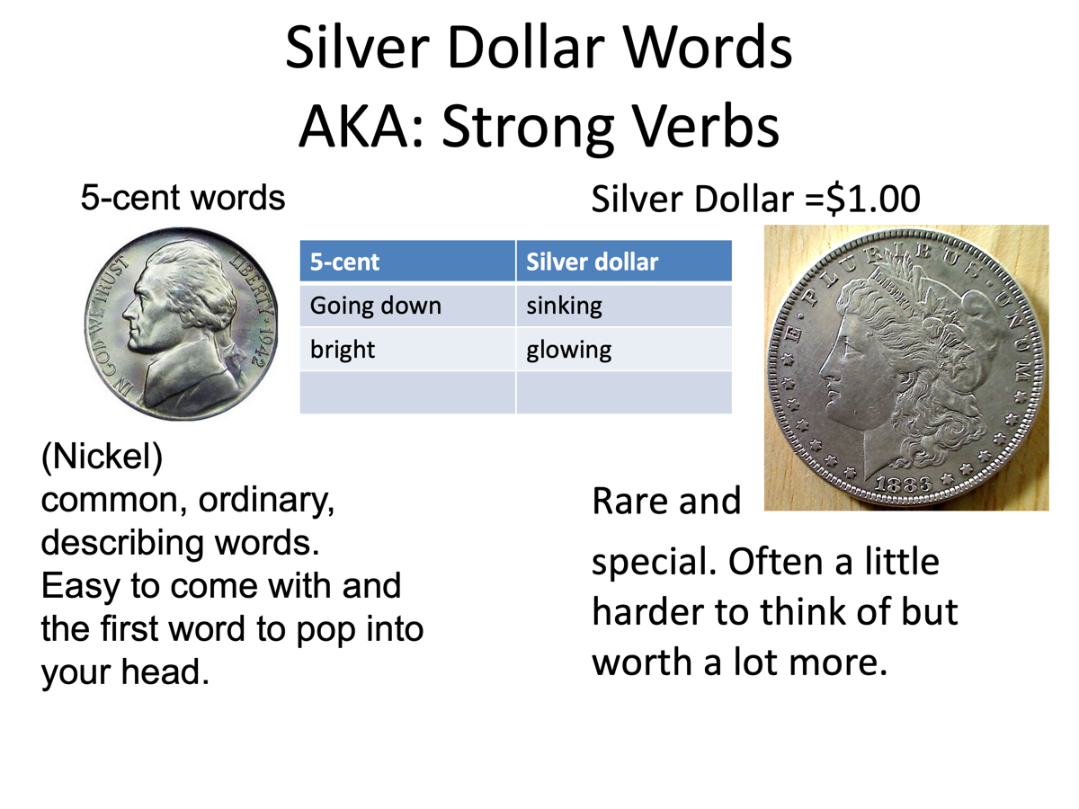
Silver Dollar Words
Notes:
Speaks for itself however its a great metaphor for helping students move away from overuse words
Often I’ll bring in a silver dollar like a Walking Liberty or Morgan dollar to show them the real coins (fascinating to them and builds on conversations of US currency!!!)

Slide 18
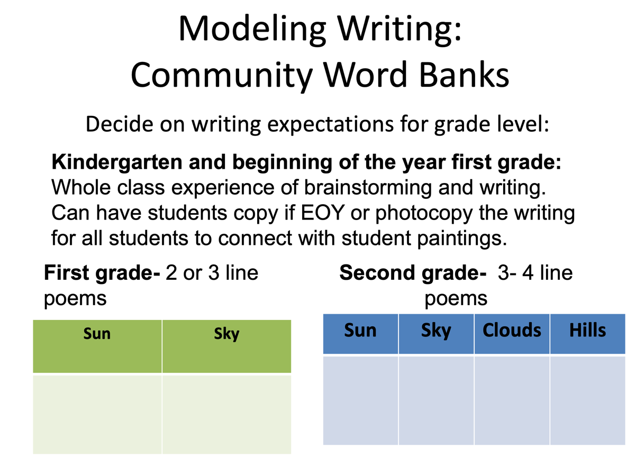
Modeling Writing

Slide 19
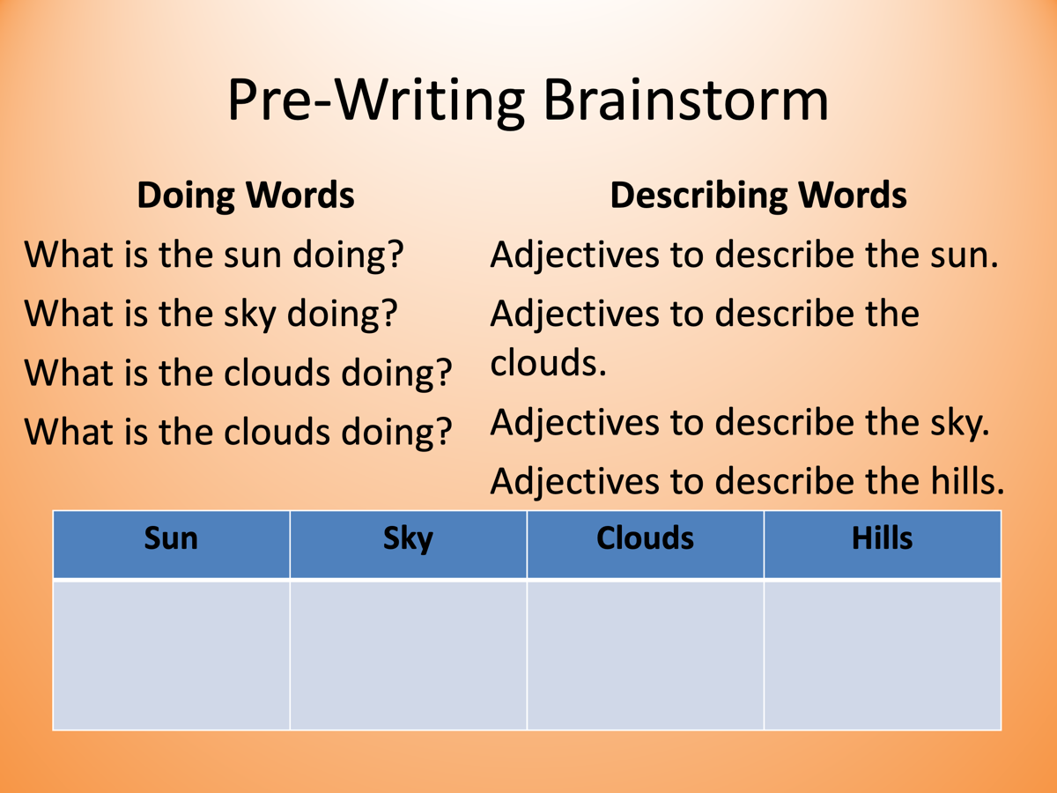
Pre-Writing Brainstorm
Notes:
Working on using parts of speech and sentence expansion.

Slide 20
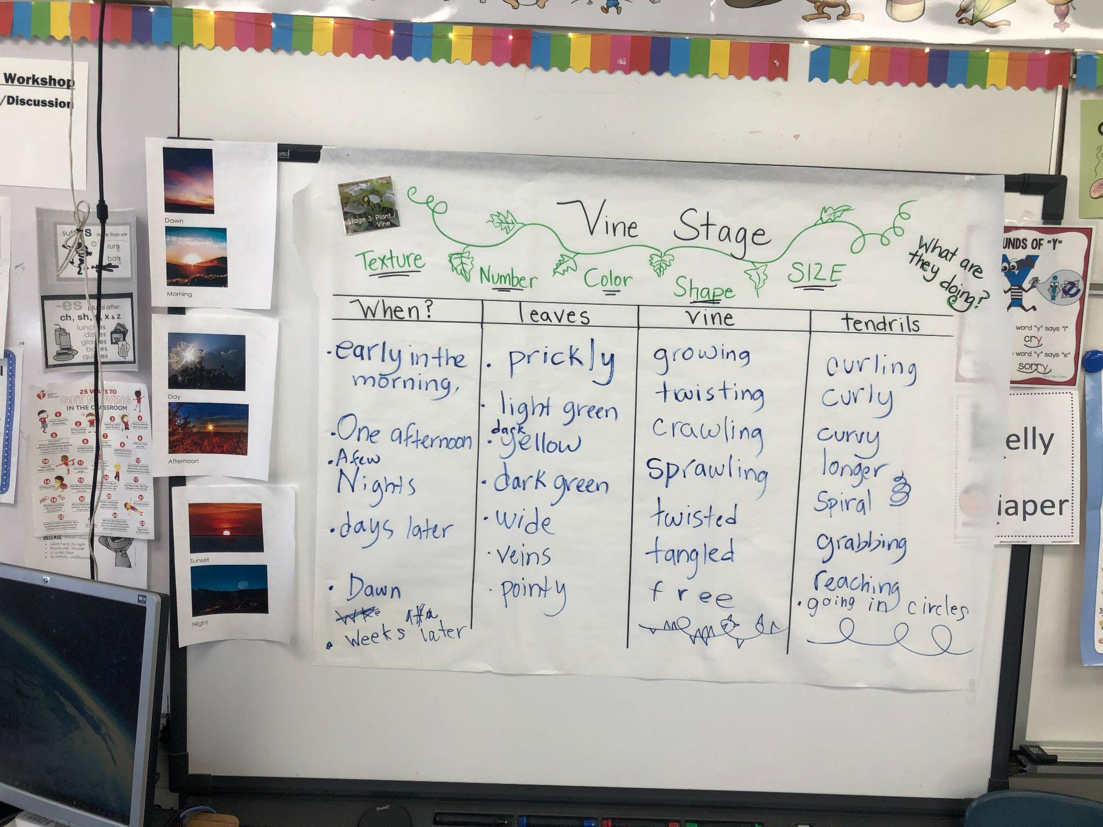
Community Word Bank
Notes:
We filled out community word banks for each stage of the pumpkin life cycle. This stayed hanging up in the classroom through this stage of the writers workshop. You can see the words varied from transition words that would later support their introduction sentences as well as adjectives and verbs. We kept the verb tense progressive because it helped to create a sense of current action. Students used a variety of mentor texts to close read the author’s choice of words and their own observations of the illustrations. Again the goal is to use high impact word choice eg the Silver Dollar words.

Slide 21
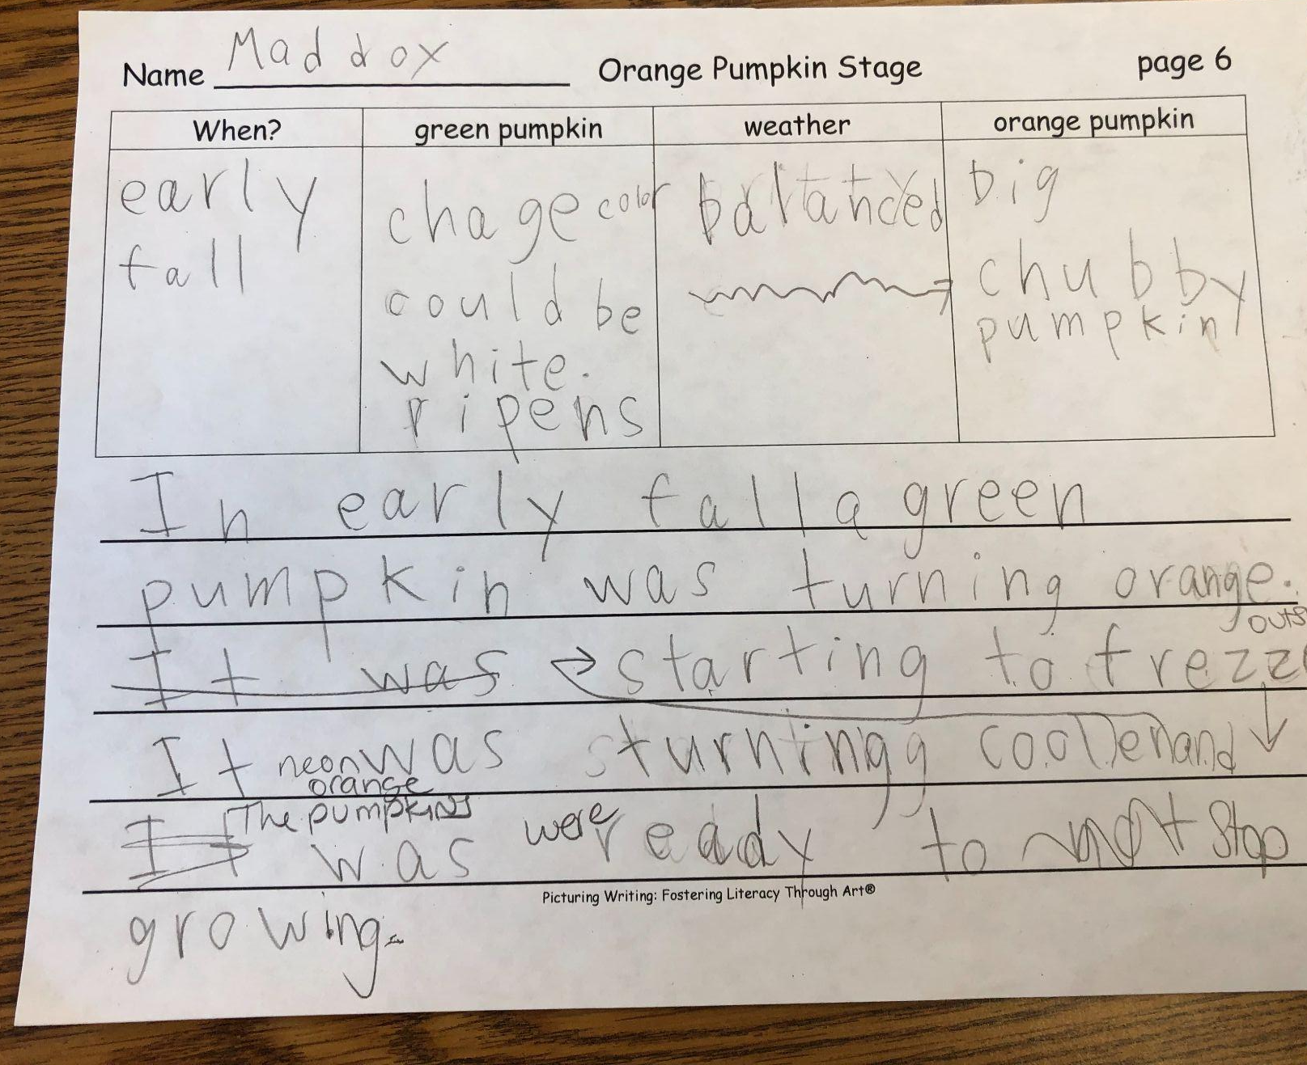
Community Word Bank
Notes:
We filled out community word banks for each stage of the pumpkin life cycle. This stayed hanging up in the classroom through this stage of the writers workshop. You can see the words varied from transition words that would later support their introduction sentences as well as adjectives and verbs. We kept the verb tense progressive because it helped to create a sense of current action. Students used a variety of mentor texts to close read the author’s choice of words and their own observations of the illustrations. Again the goal is to use high impact word choice eg the Silver Dollar words.

Slide 22
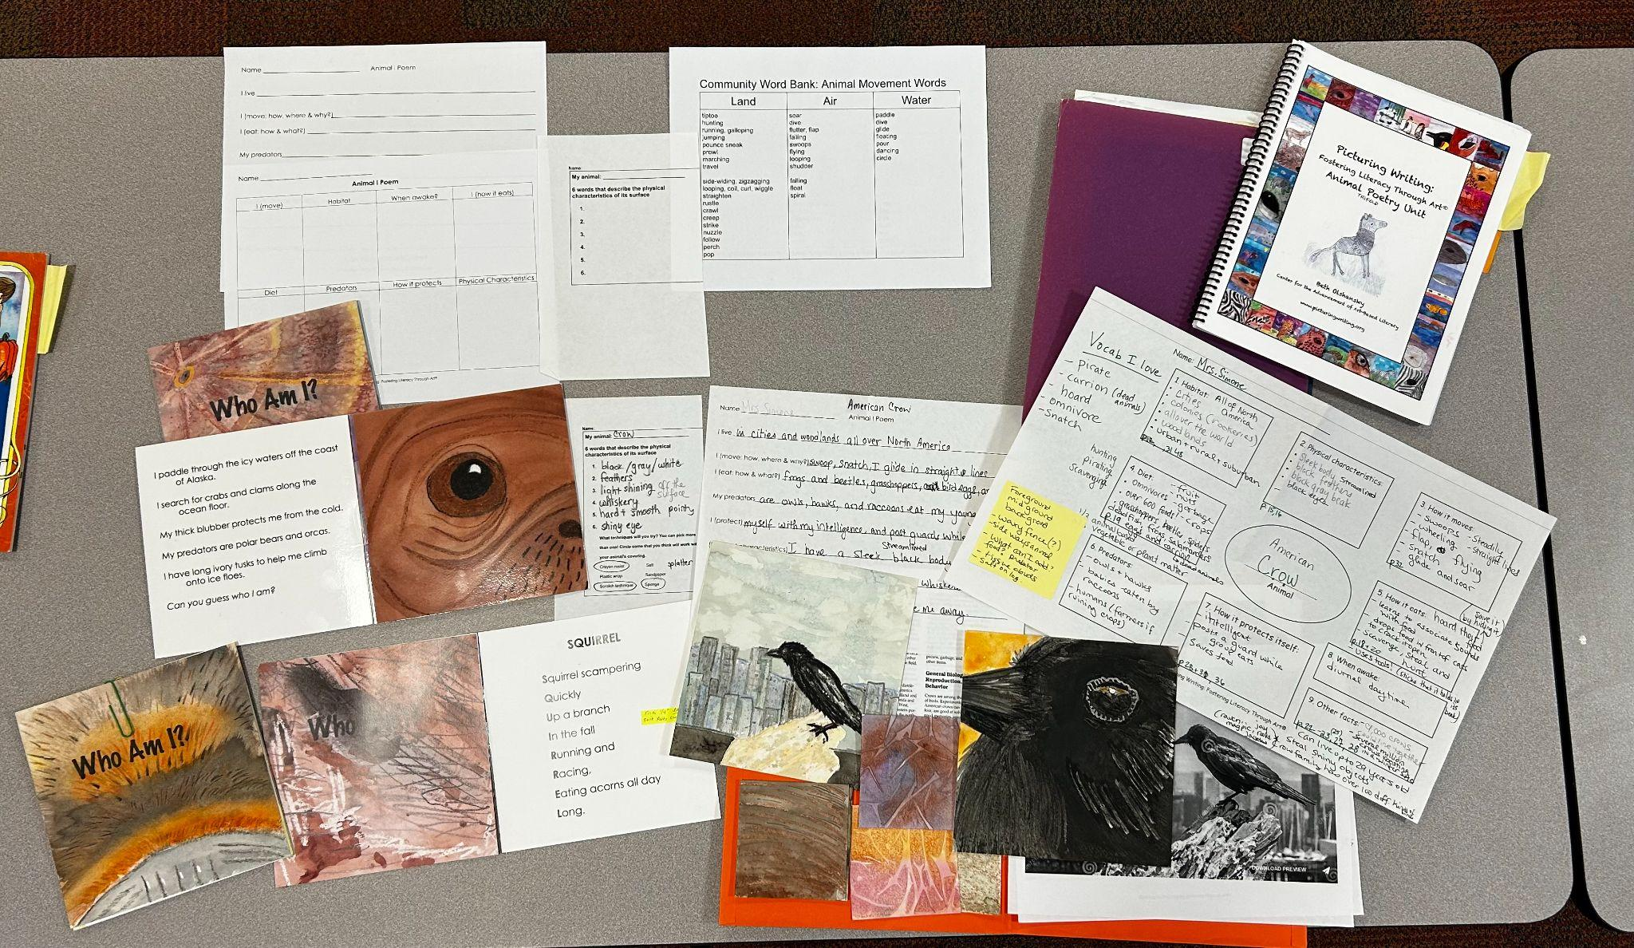
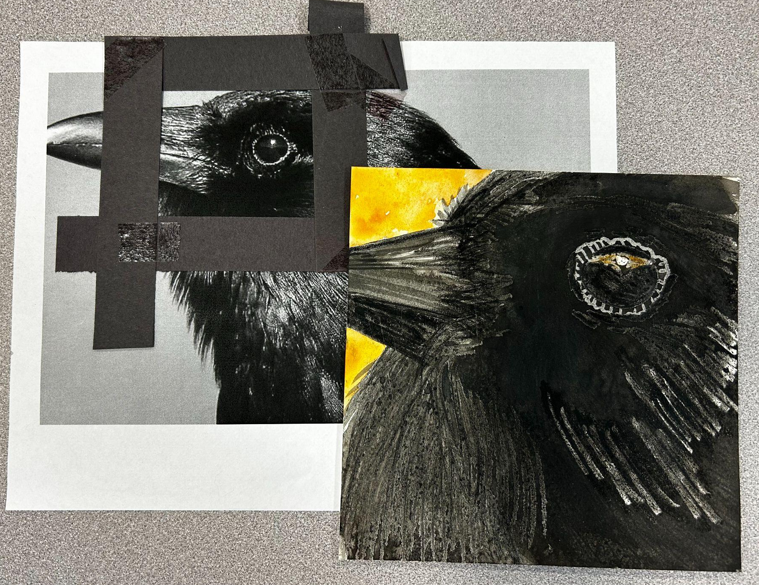
Animal Trifold Research Project
Notes:
The Trifold project is set up with a series of 12 lessons.
Describe more
I had to condense into 10. Predictably some students were absent so I had to be creative about supporting the students. A few students had fewer pages but all in all each student went home with a completed book.

Slide 23
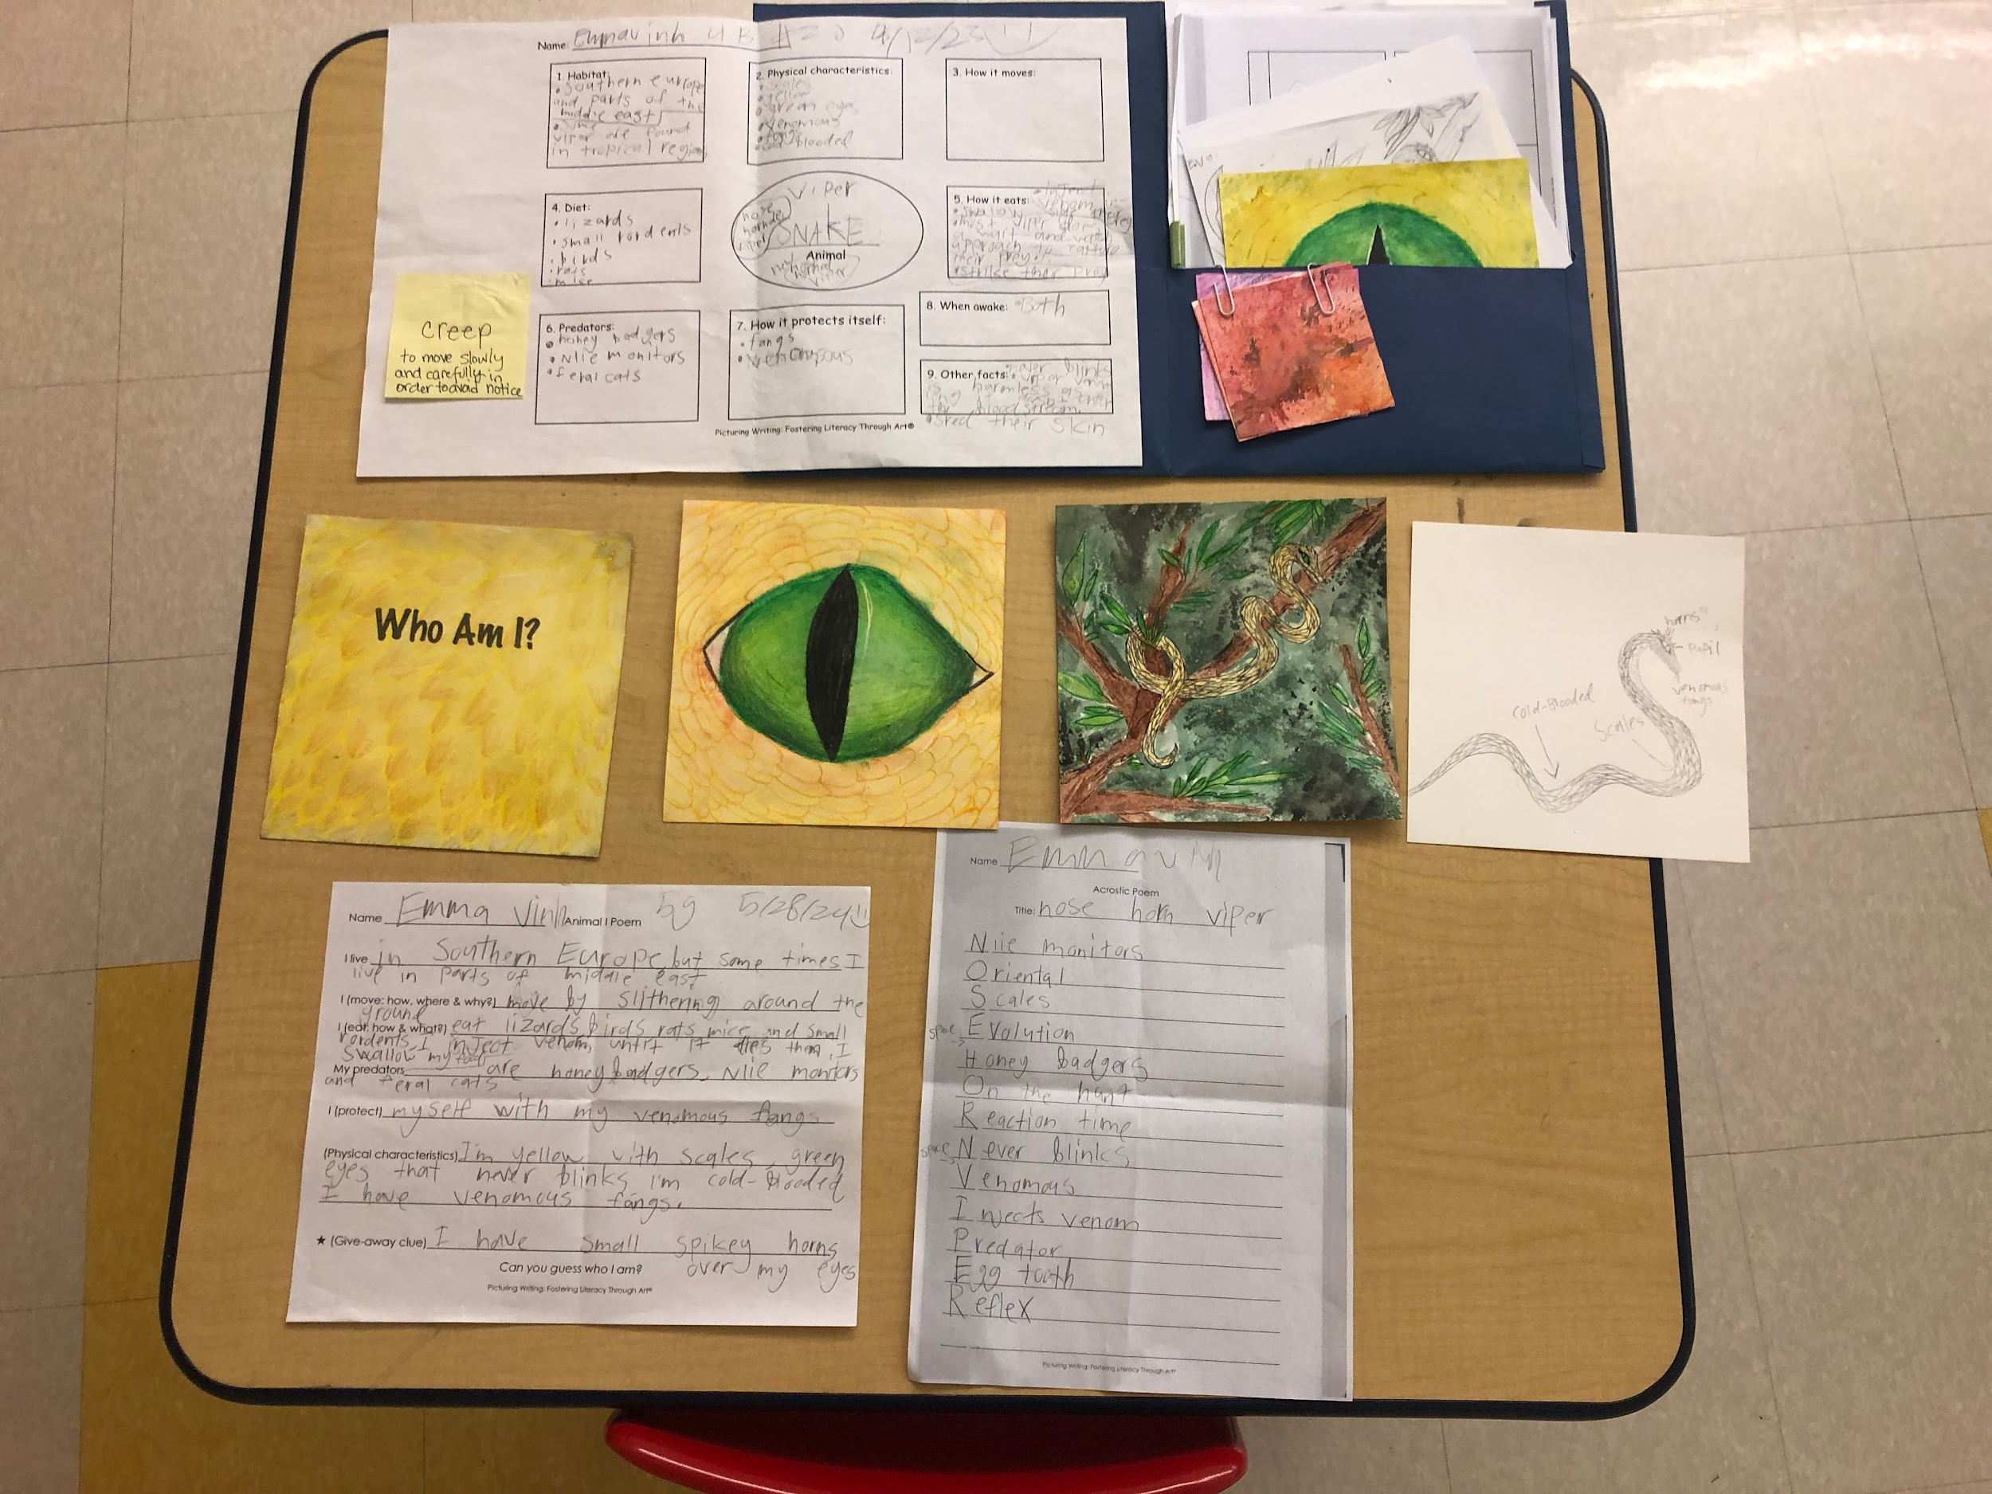
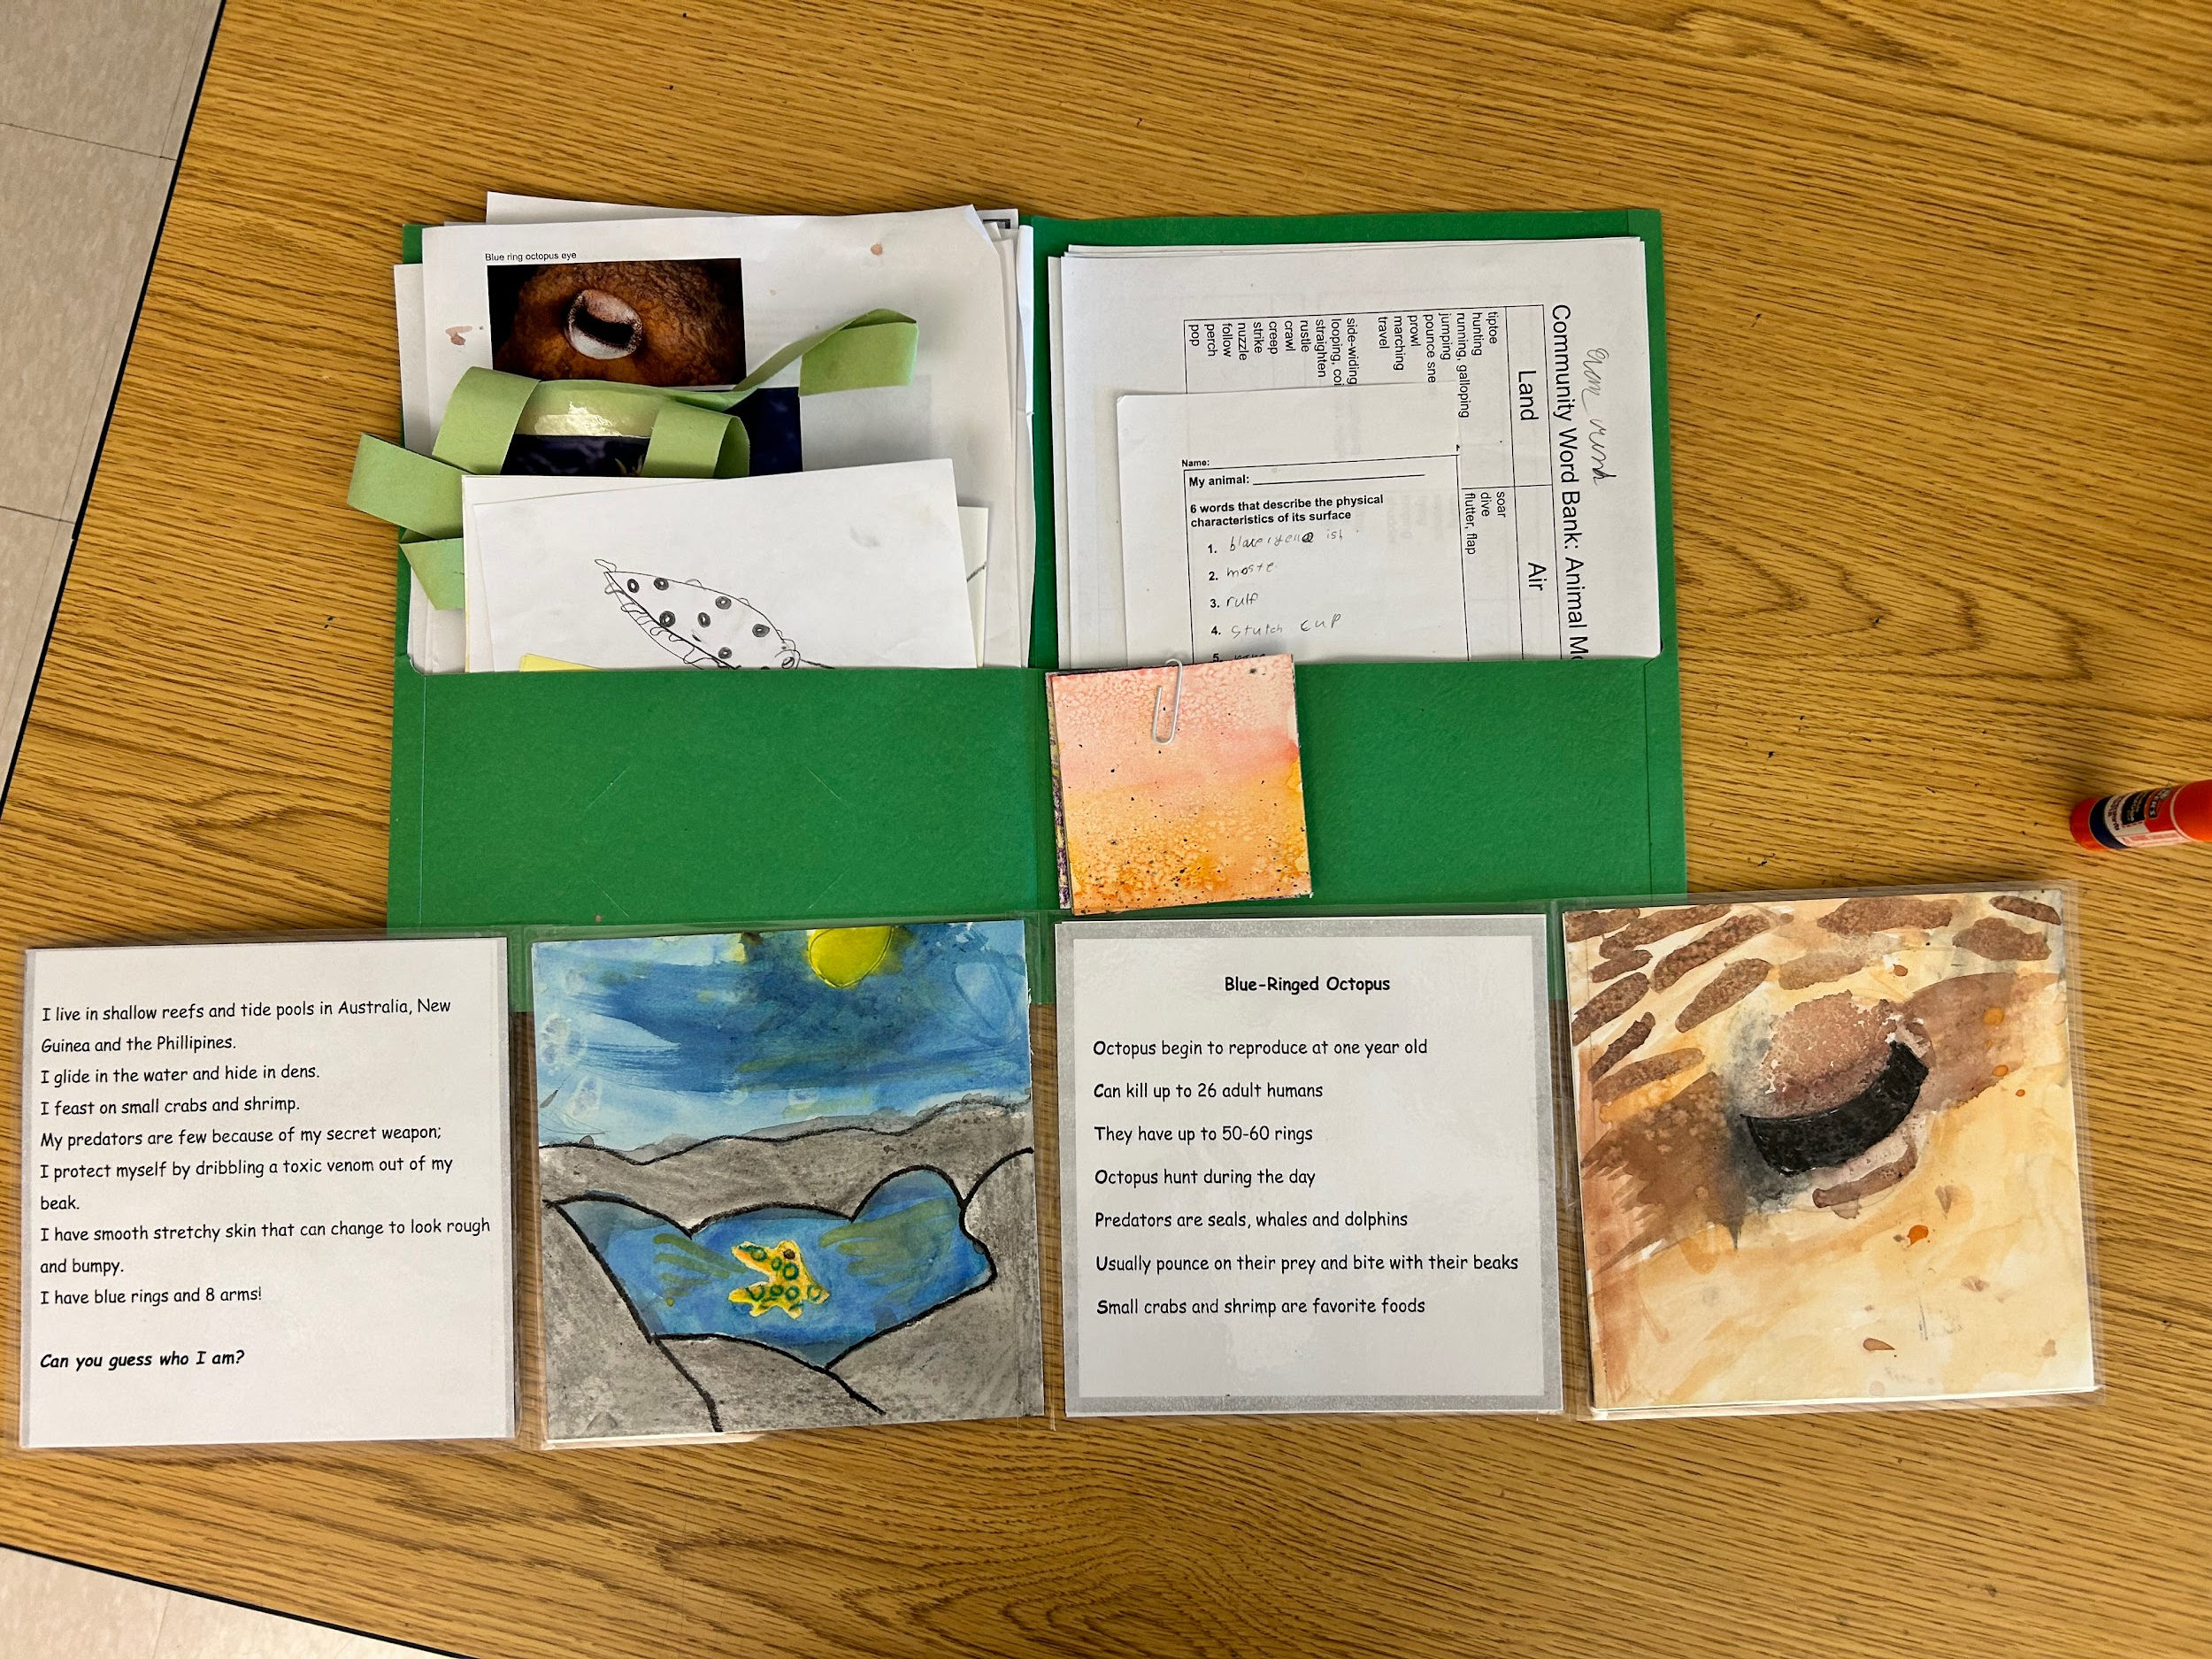
Animal Trifold Research Project
Notes:
Not an inconsiderable amount of organizing! Folders were necessary as were graphic organizers and paperclips!
Artwork from siblings (Brother and sister) Older sister was a very quiet individual with some speech challenges, but had the opportunity to really shine in her expressive writing and artwork. Both students have gone on to receive art awards in the district and have both exited ESL services.

Slide 24
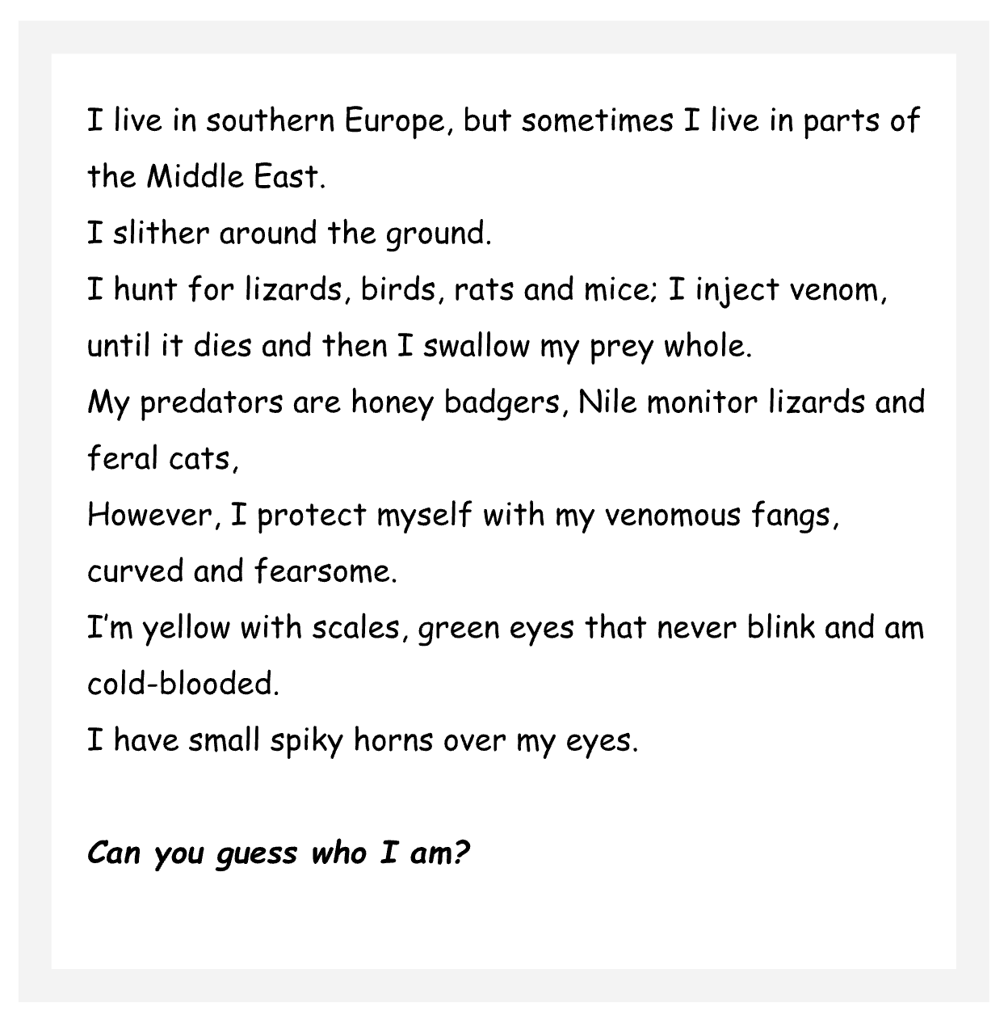
Animal Trifold Research Project
Notes:
This was a 5th grade student: very quiet individual with some speech challenges, but had the opportunity to really shine in her expressive writing and artwork.
Note the use of specific vocabulary and silver dollar verbs: slither, hunt, inject, protect, predators, and cold-blooded.
The Who Am I poem started with broad and general clues and the narrowed down to very specific.

Slide 25
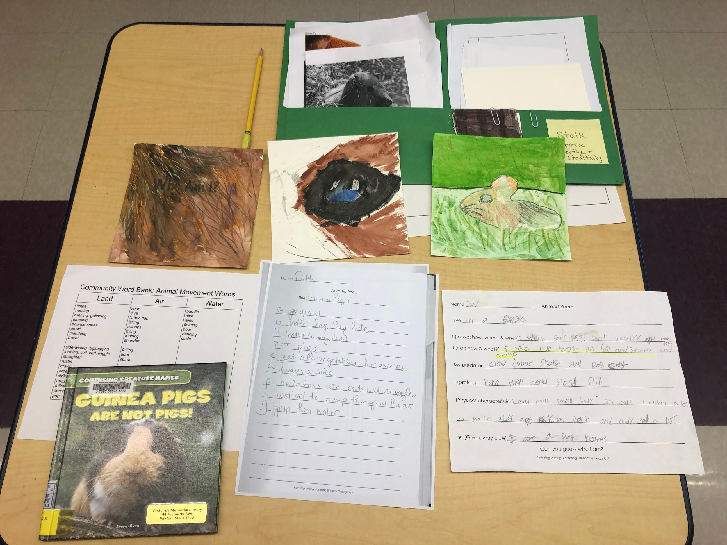
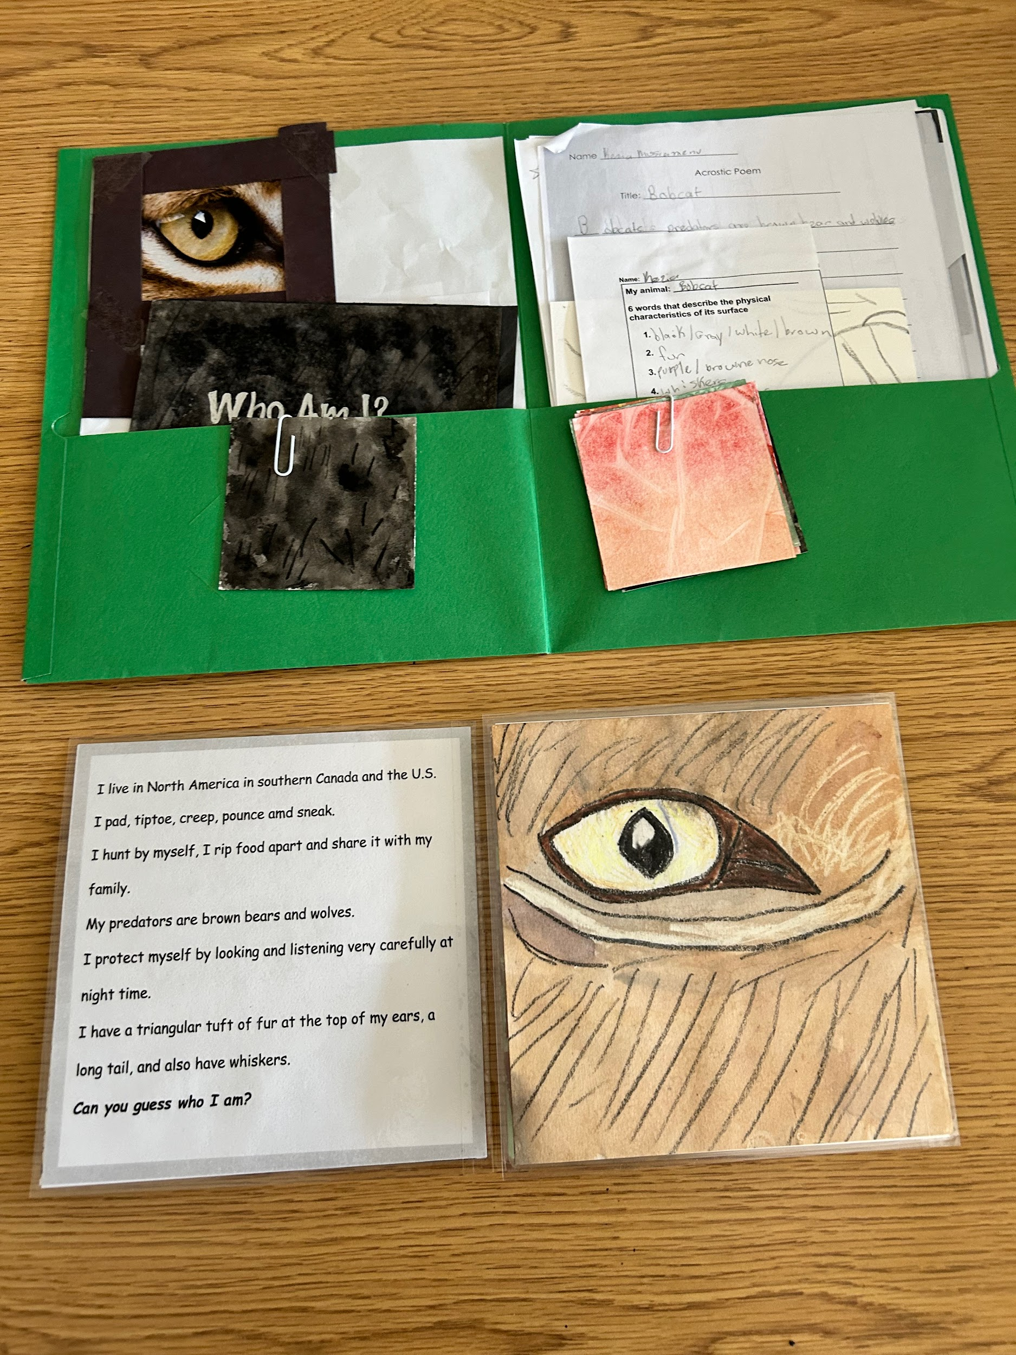
Animal Trifold Research Project
Notes:
This after school session included one student who traditionally opted out of services.
We were also able to provide transportation for another student who would have otherwise unable to attend. This was his second afterschool picturing writing program.
He later submitted a poem to a Library of Poetry organization that he wrote from the Weather Poetry unit.

Slide 26
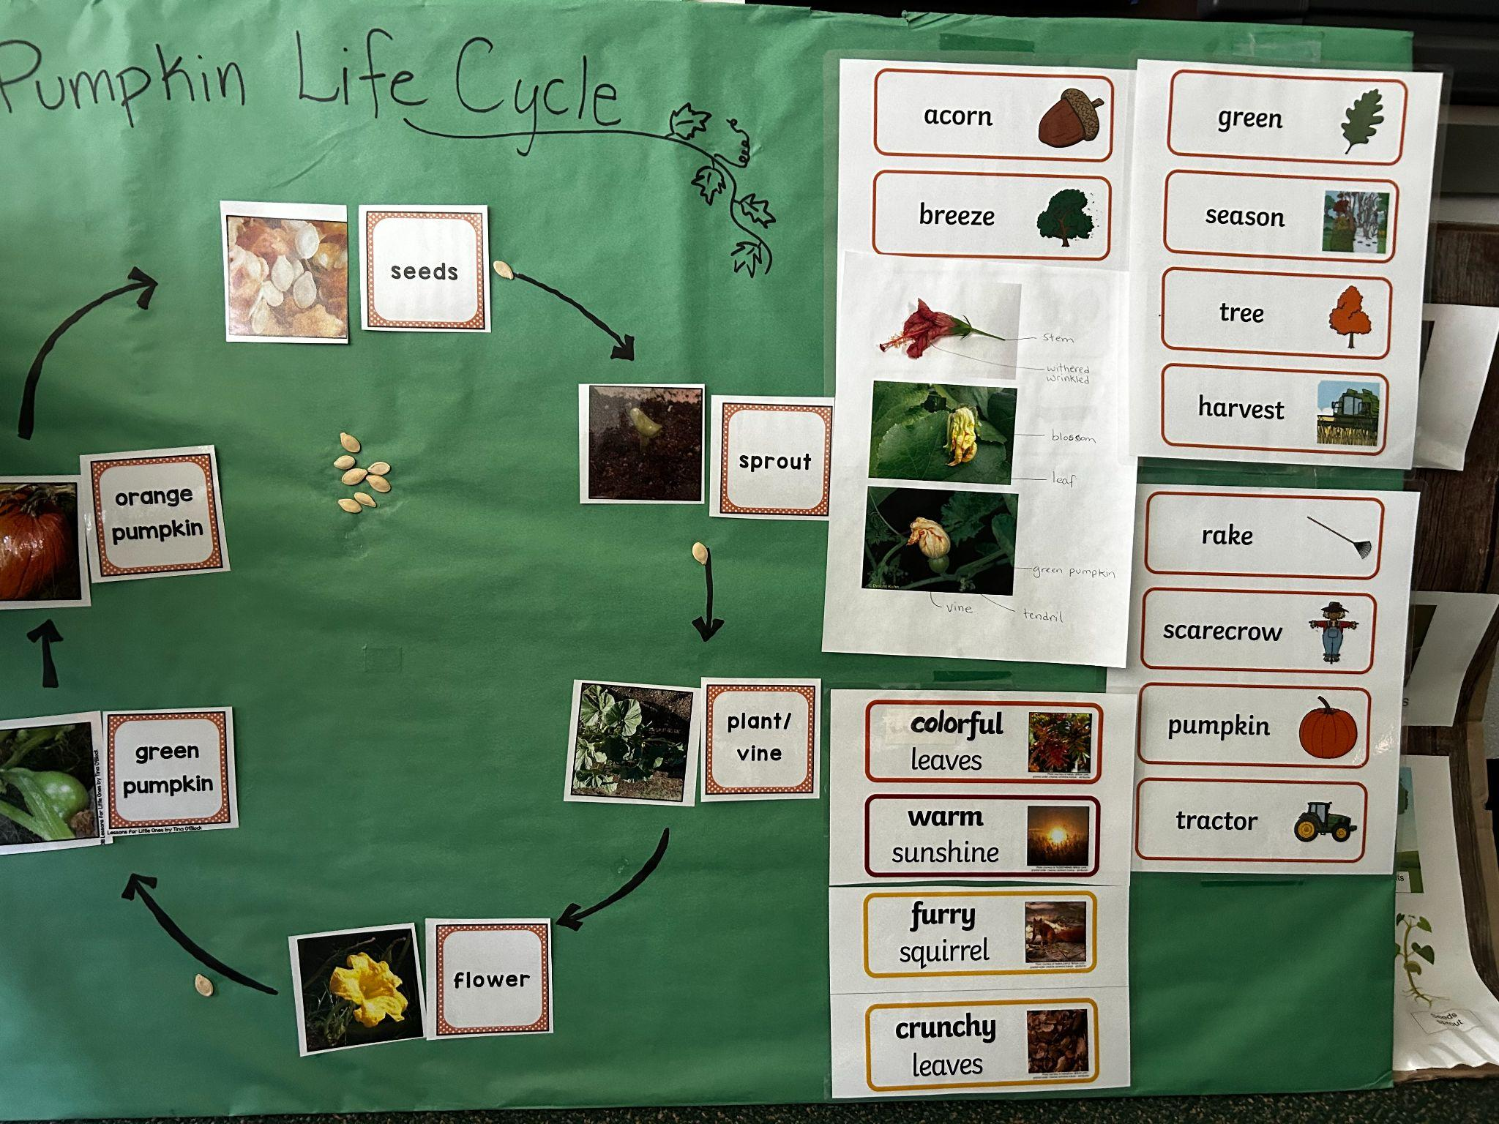
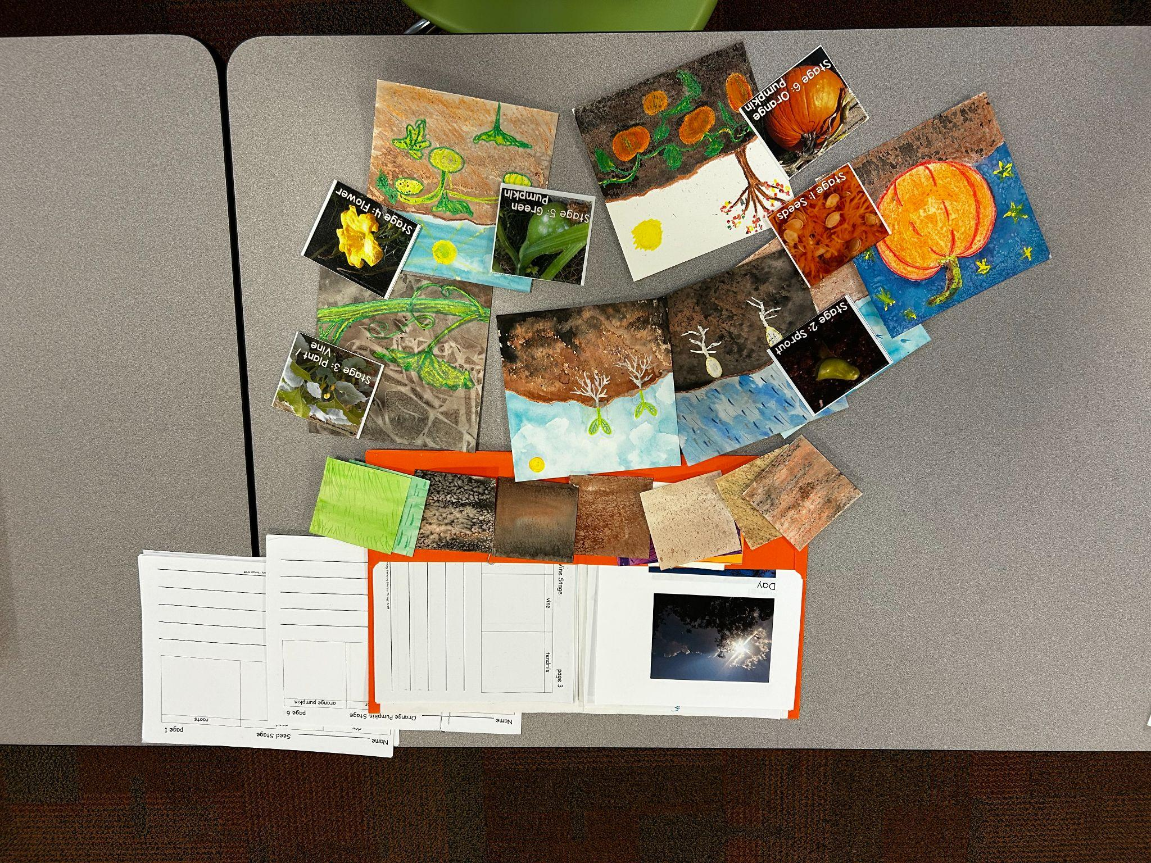
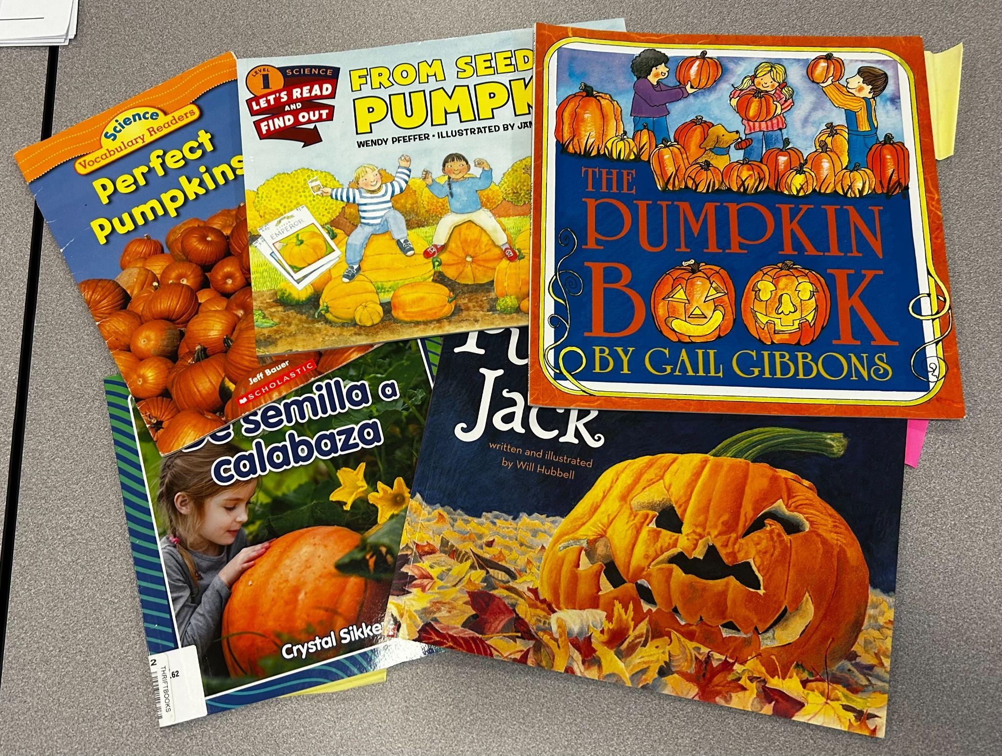
Pumpkin Life Cycle
Notes:
This was a project that was created during school hours, with kindergartners and second grade students

Slide 27
Pumpkin Life Cycle
Even the youngest of ML students can participate.
With modeling, scaffolding, and vocabulary building they can complete a project that they are proud of.
Notes:
In the course of this project we looked carefully at pumpkins, felt the seeds, grew pumpkin spouts, and admired the fuzzy leaves. Each student went home with pumpkin plants to put someplace outside.
(Permission received to use photo.)

Slide 28
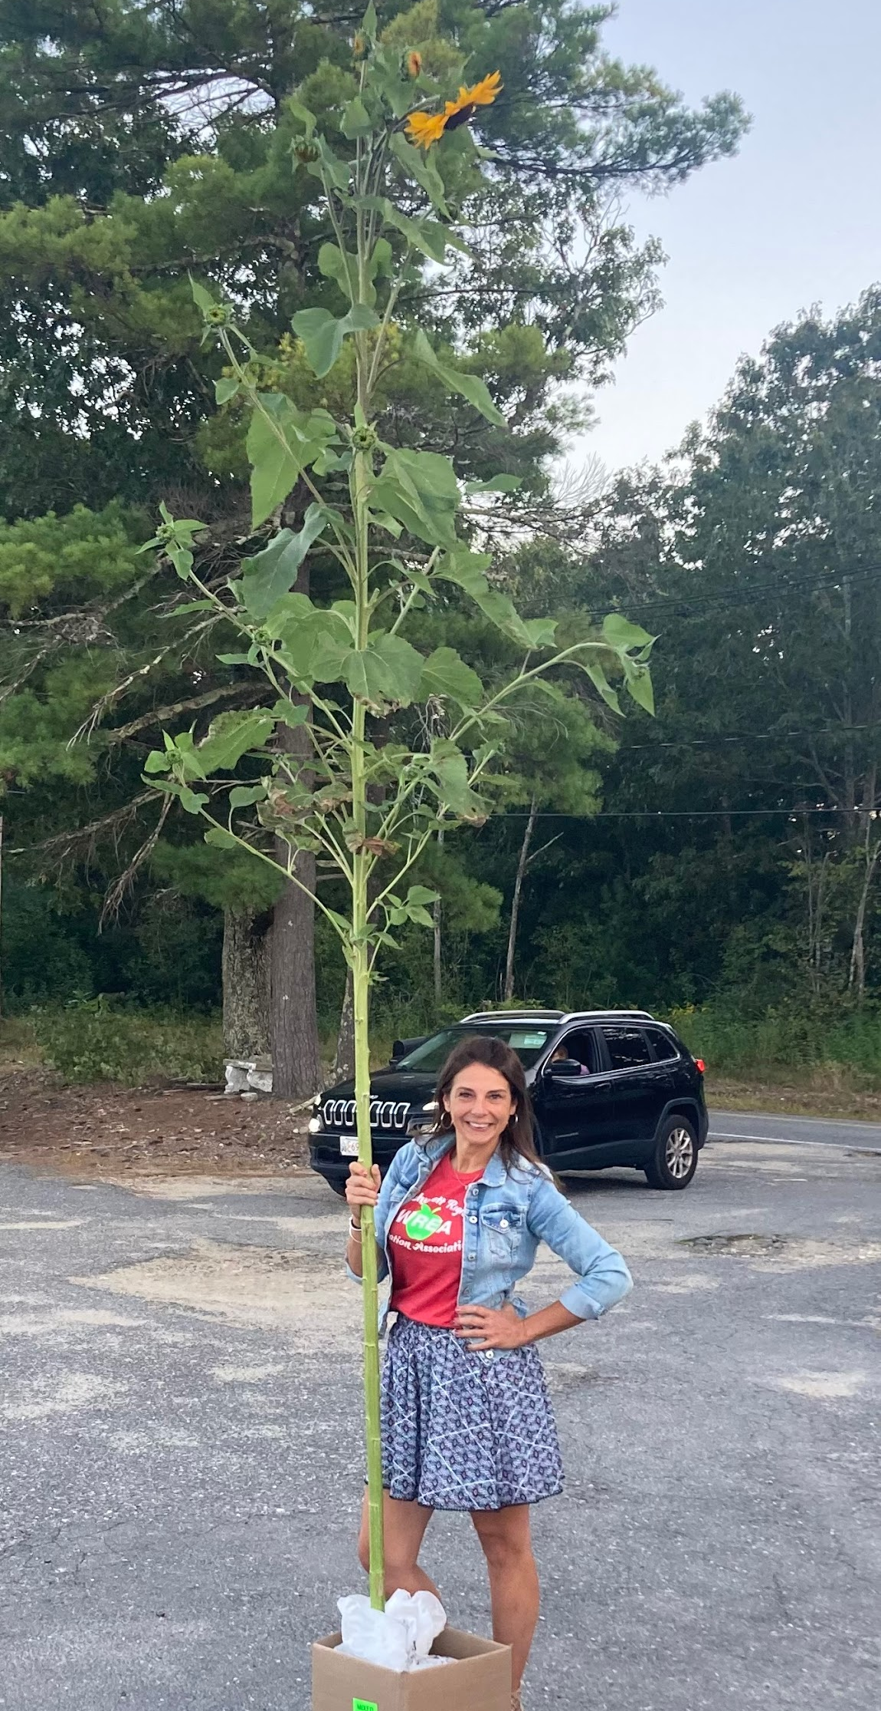
Hello! I’m…
Kara Prendergast
Dawson Elementary School
Holden MA
ESL Teacher Grades K-5

Slide 29
Types of programs
01
02
03
After school
Summer Fun
Back to School
During the school year
The week following the last day
The week before the new school year begins
Notes:
Typically fall or spring so we utilize the outdoors

Slide 30
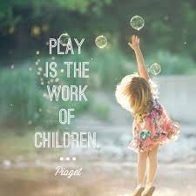


Play & language based programs
Jean
Piaget
Albert
Einstein
Maria Montessori

Slide 31
After School Adventures
Board games to promote engagement and turn taking
Card games (blink, go fish, UNO)
Open gym (duck duck goose, obstacle course, the floor is lava)
Outdoor nature hunt, kite flying, bubbles
Creative art related to literacy program
Free choice (puzzles, directed drawing, block building, magnets, playdough, creative art)
Notes:
Different models I have tired: 1 x week for 10 weeks, 2 x week for 6 weeks

Slide 32
Say hello to summer
Held the week following the last day
Strengthen relationships with peers
Conversational English skill builder
Fun in the sun (bubbles, water balloons)
Summer themed art projects and creative crafts
Beach and ocean thematic unit study
Plan for summer reading - personalized bookmarks
Notes:
3-4 days 3,5 hours

Slide 33

Welcome back
Held the week before school begins
Acclimate students back to school
Re-engage with peers
Build relationships & discuss new routines
Conversational skills builder
Visit new classroom, find name tag and desk
Complete an “All about me” poster for their classroom teacher
Notes:
3-4 days 3 hours each lessens anxiety, reassures students,

Slide 34
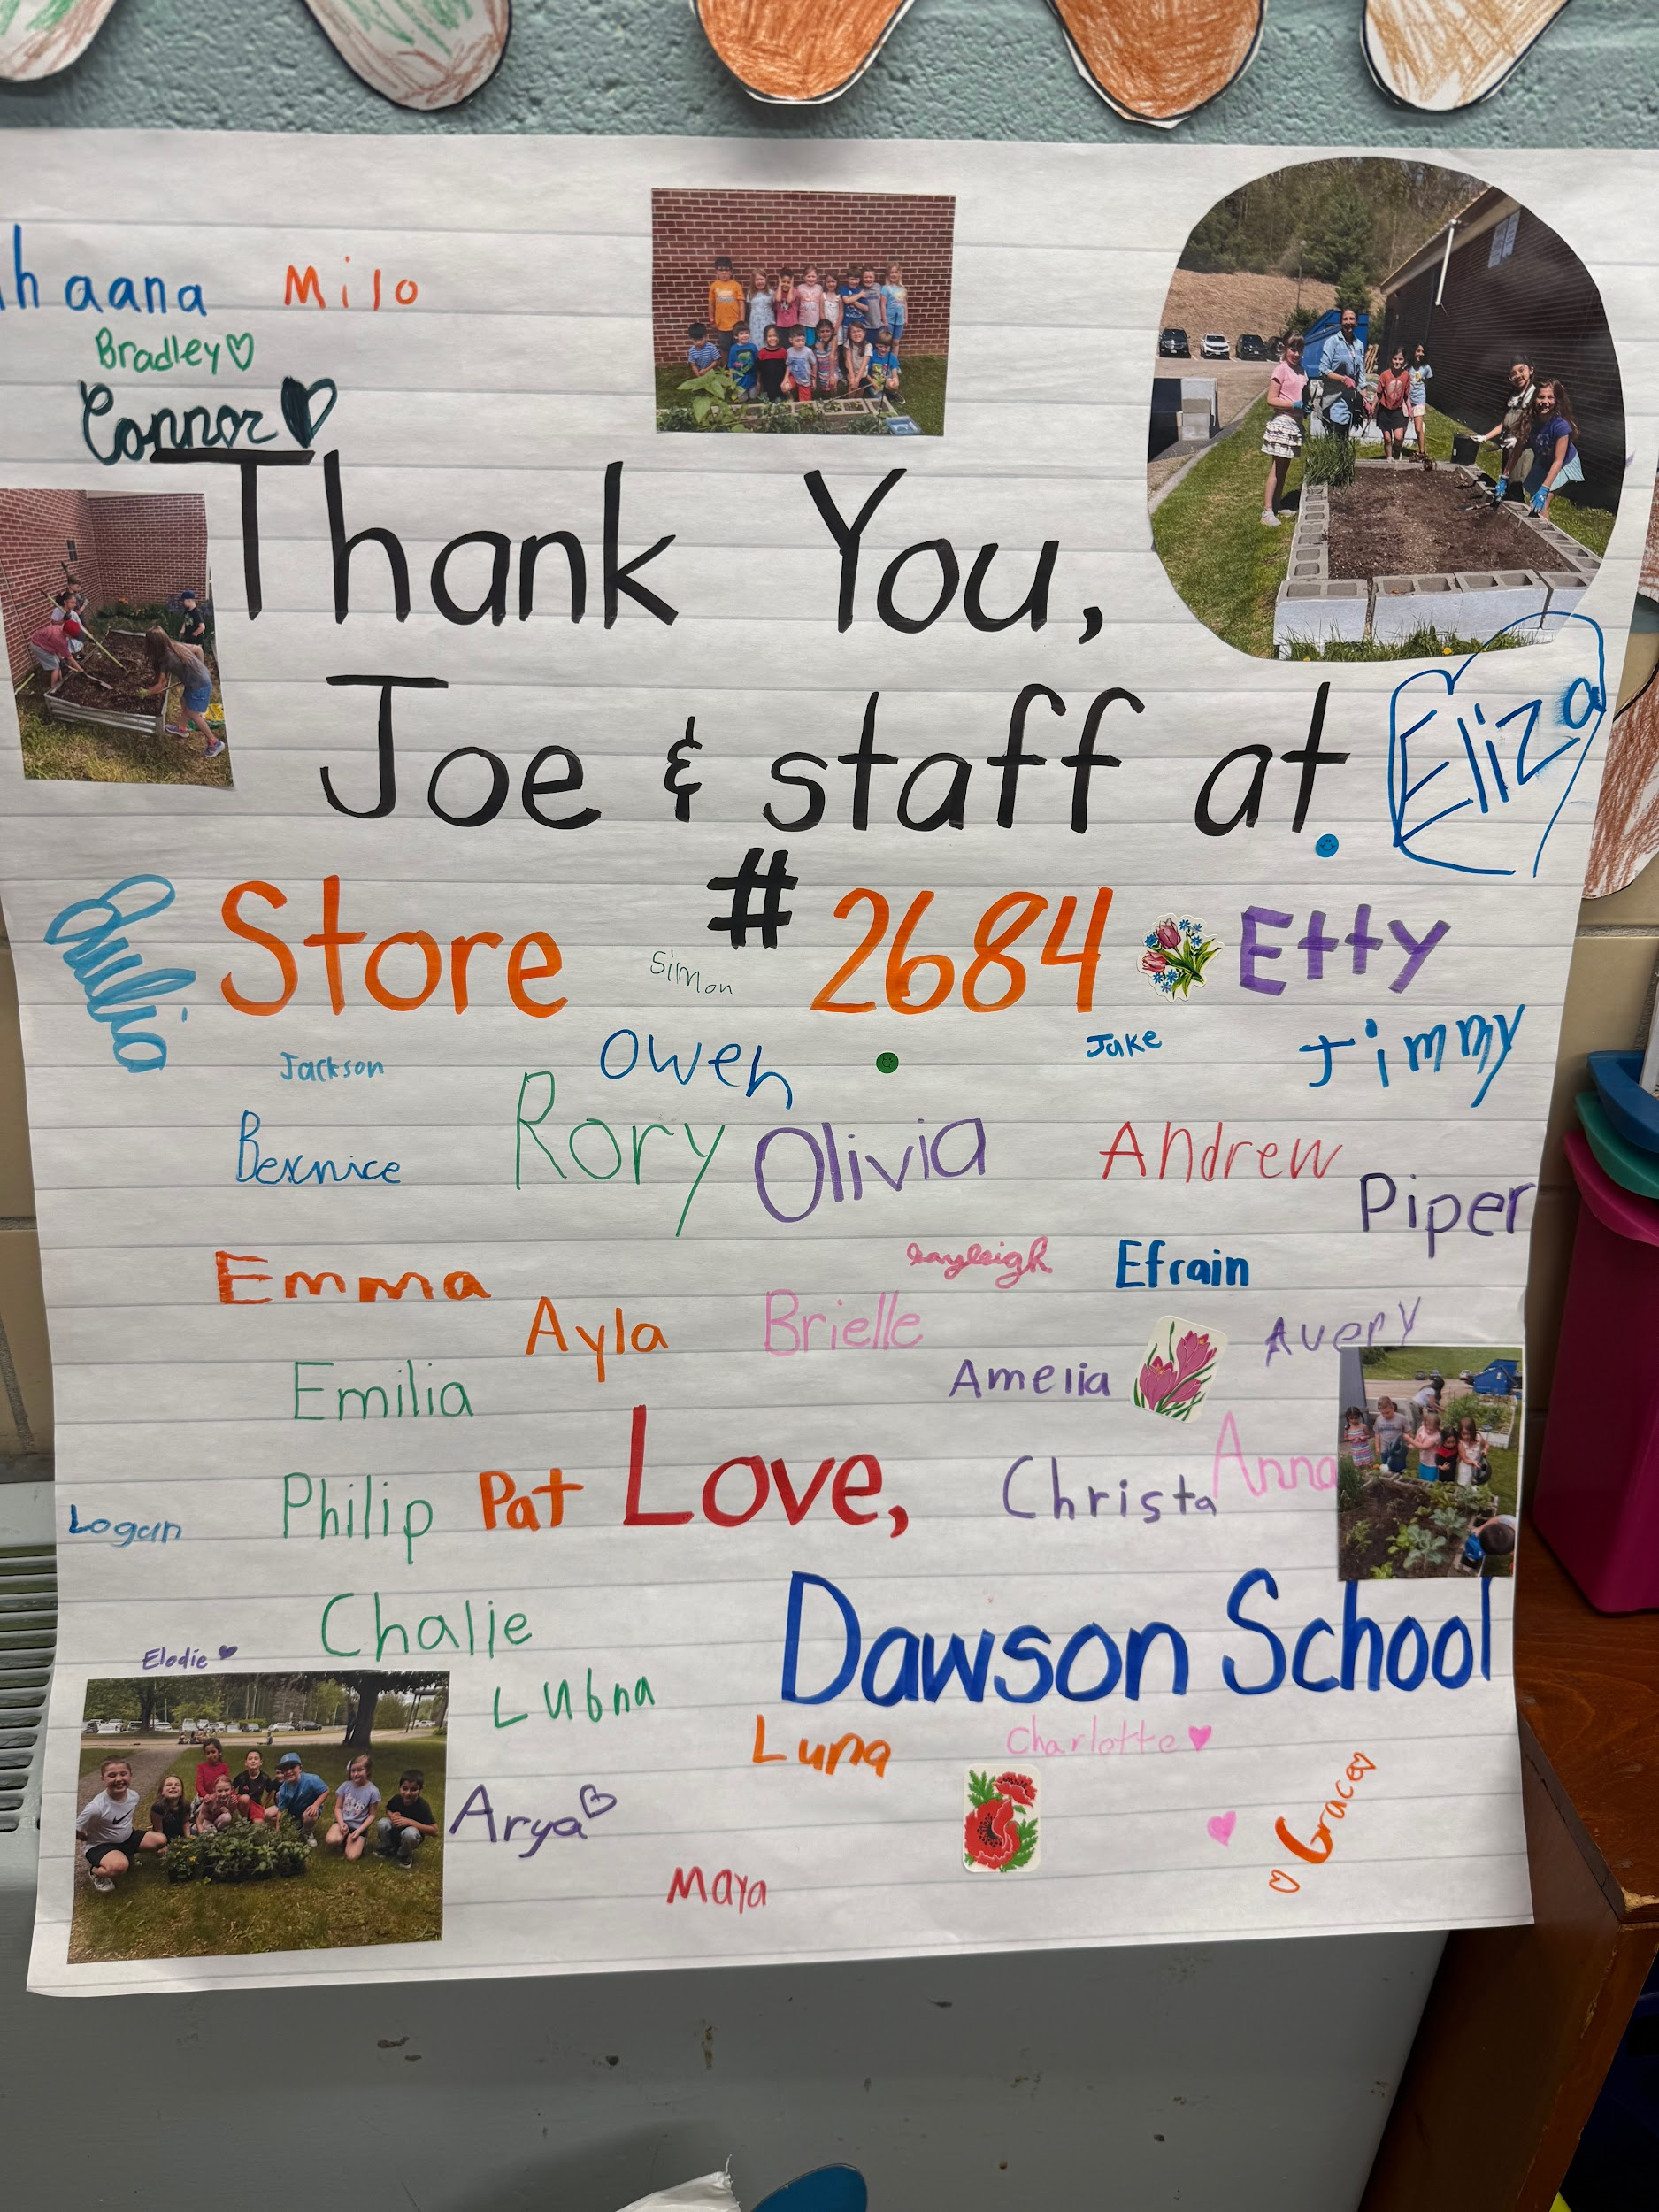
Community Connections
01
02
03
Holden Garden Club
Home Depot Worcester
Dawson School PTA
04
05
06
Parent Volunteers
Holden Department of Public Works
Local farms
Holden & Sterling MA
Notes:
While I do use some funding from Title III, I needed to go out to the community to support the garden

Slide 35
How can a garden support ML’s?
Promoting language acquisition
Cultural understanding
Academic engagement.
Authentic Language Practice:
Gardening provides real-world scenarios for language use, as students communicate about planting, caring for plants, and harvesting.
Vocabulary Building:
ELL students learn new vocabulary related to gardening, plants, and tools, enriching their language skills.
Cultural Sensitivity:
Incorporating cultural elements, such as growing foods from students' home countries or exploring different gardening traditions, can make learning more relevant and engaging.
Community Building:
Shared gardening experiences can foster a sense of belonging and community among ELL students.
Increased Motivation and Engagement:
Hands-on activities and tangible results, like growing plants and harvesting produce, can increase student motivation and engagement in learning.
Low-Stakes Communication:
The non-threatening environment of a garden allows ELL students to feel comfortable communicating and taking risks in language.
Notes:
Gardening provides authentic, hands-on learning experiences, fosters collaboration, and offers opportunities for communication and interaction in a low-stakes environment.

Slide 36
Math & Gardening
Measuring height of plants
Calculating area and perimeter
Estimating the height of the tallest sunflower
3rd & 4th grade winners

Slide 37
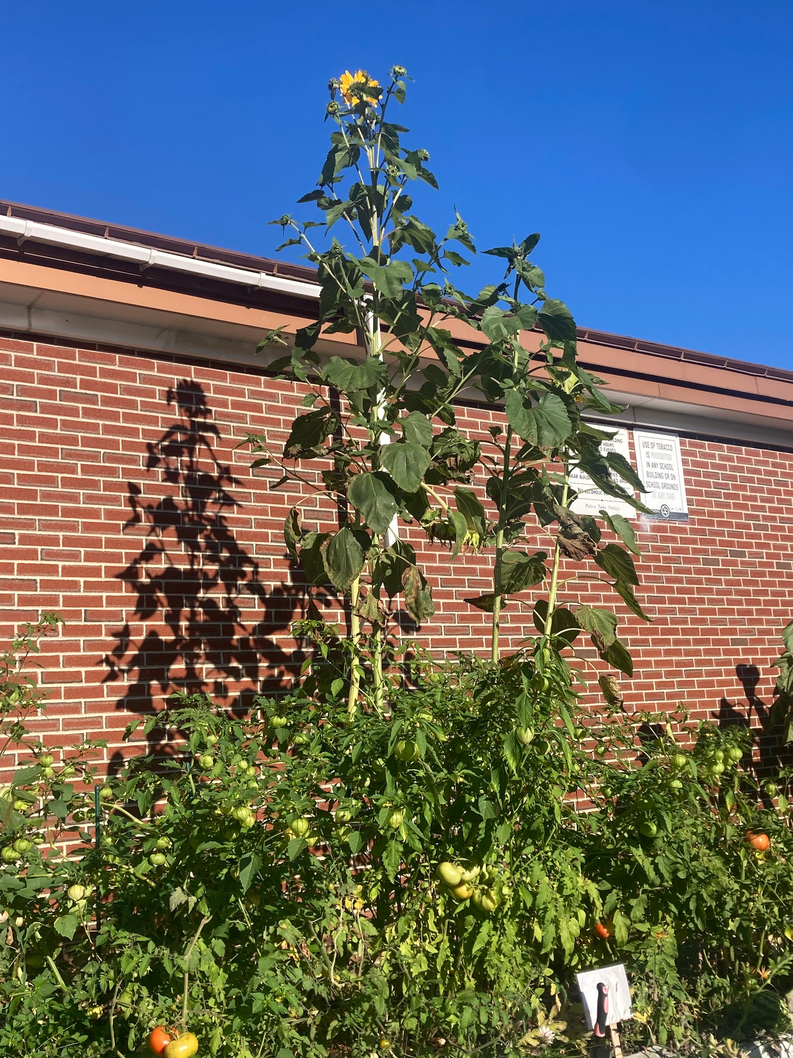
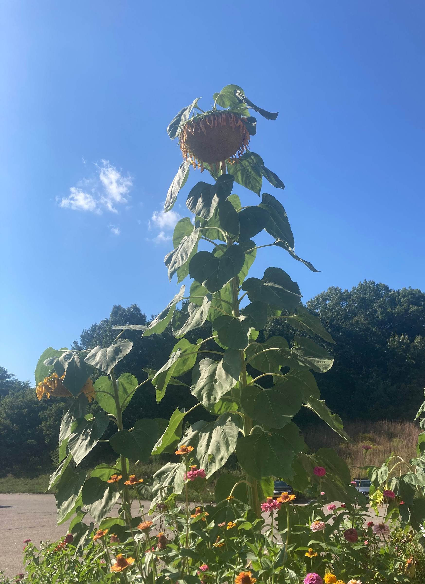
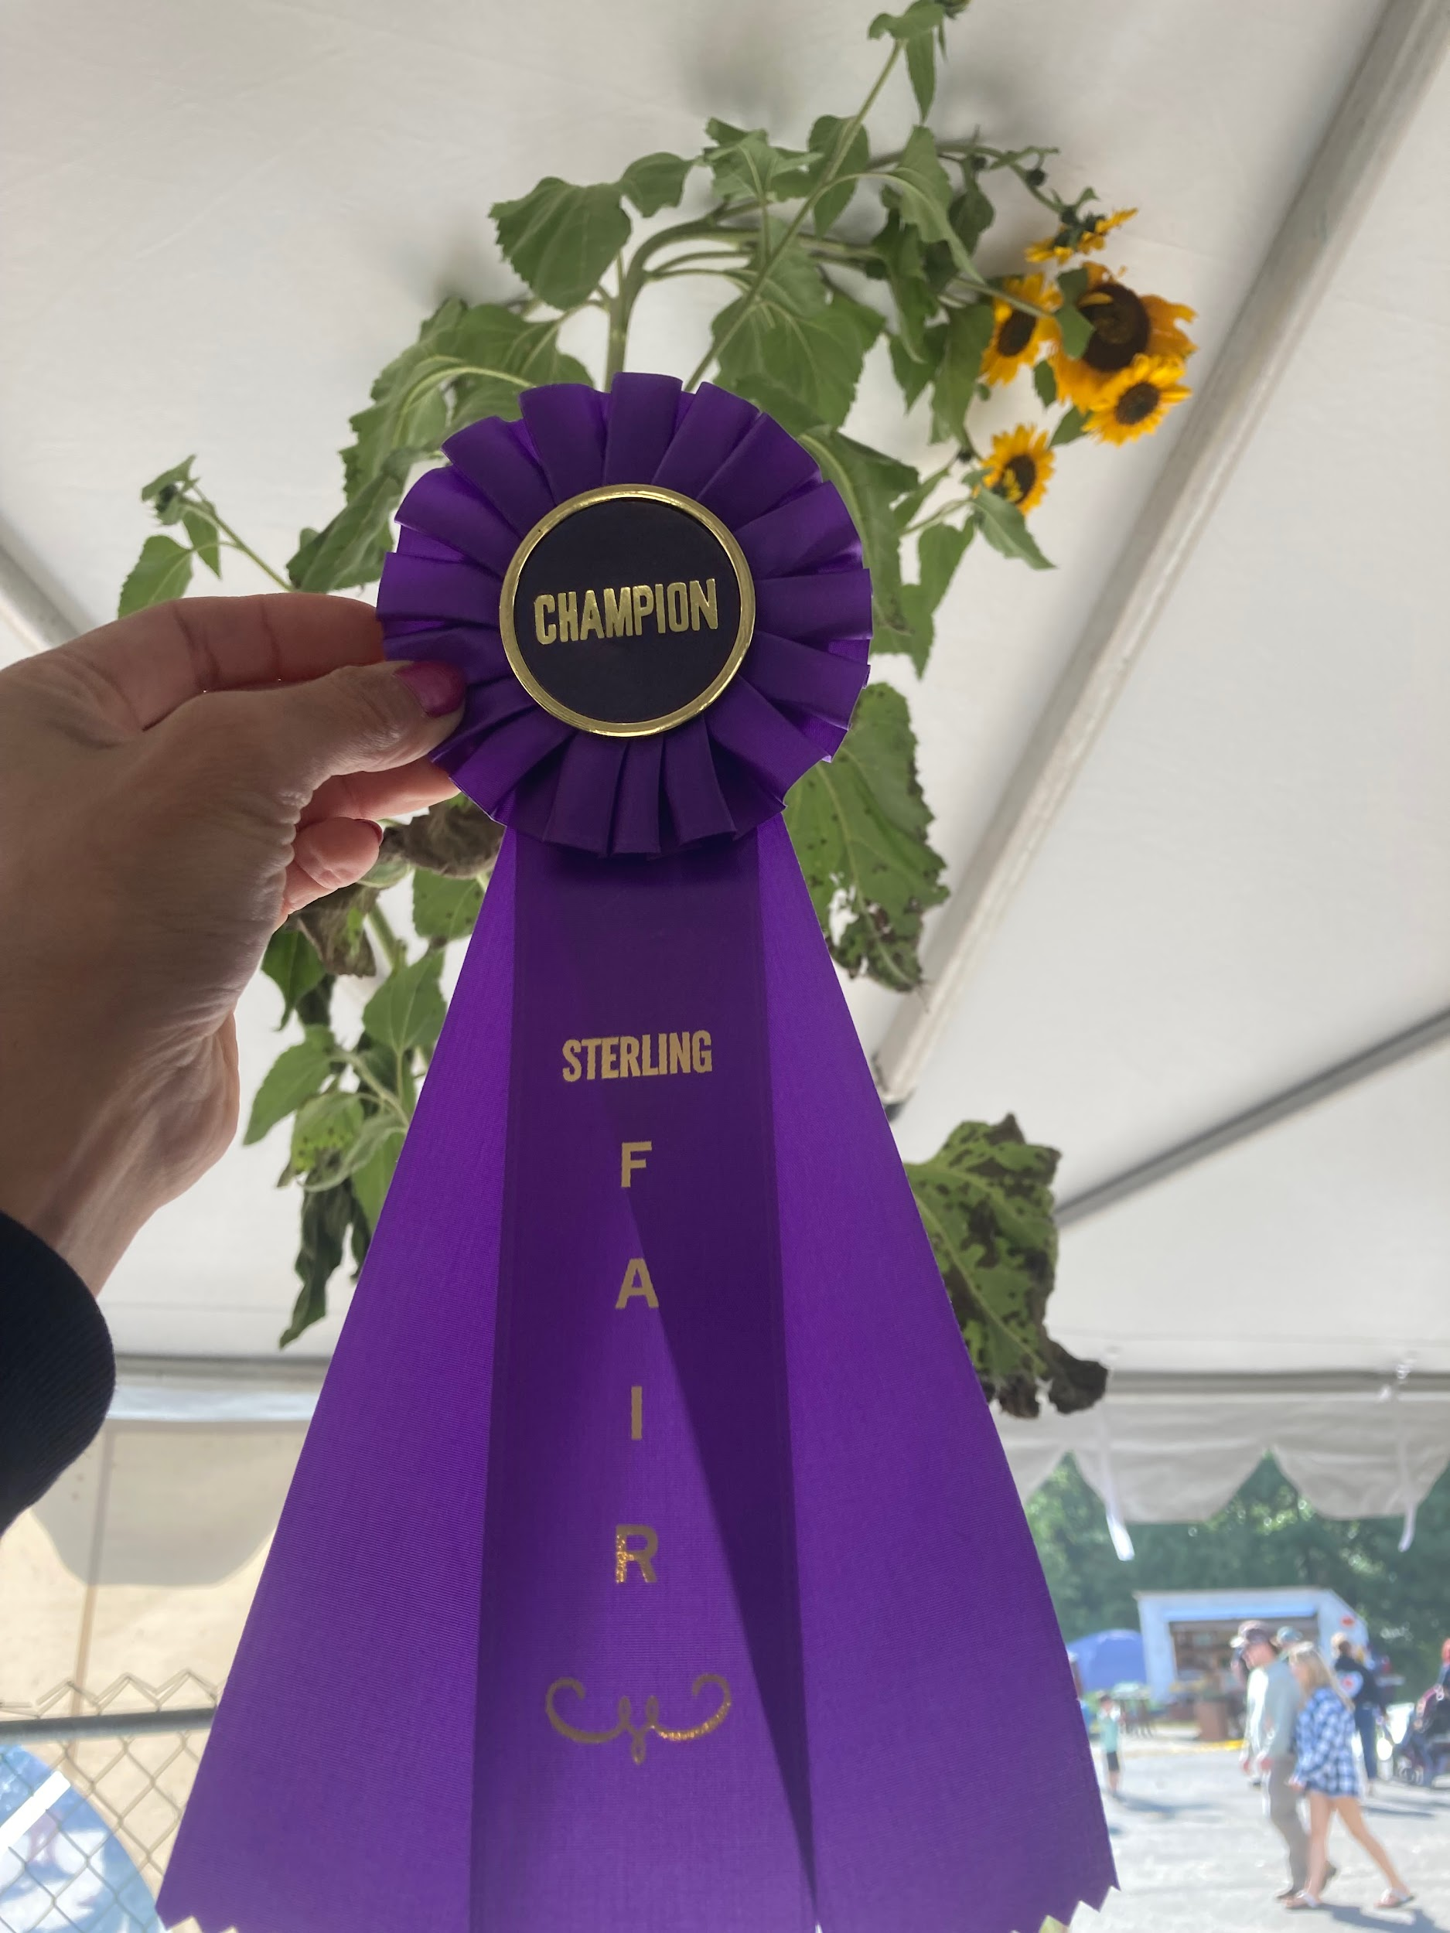
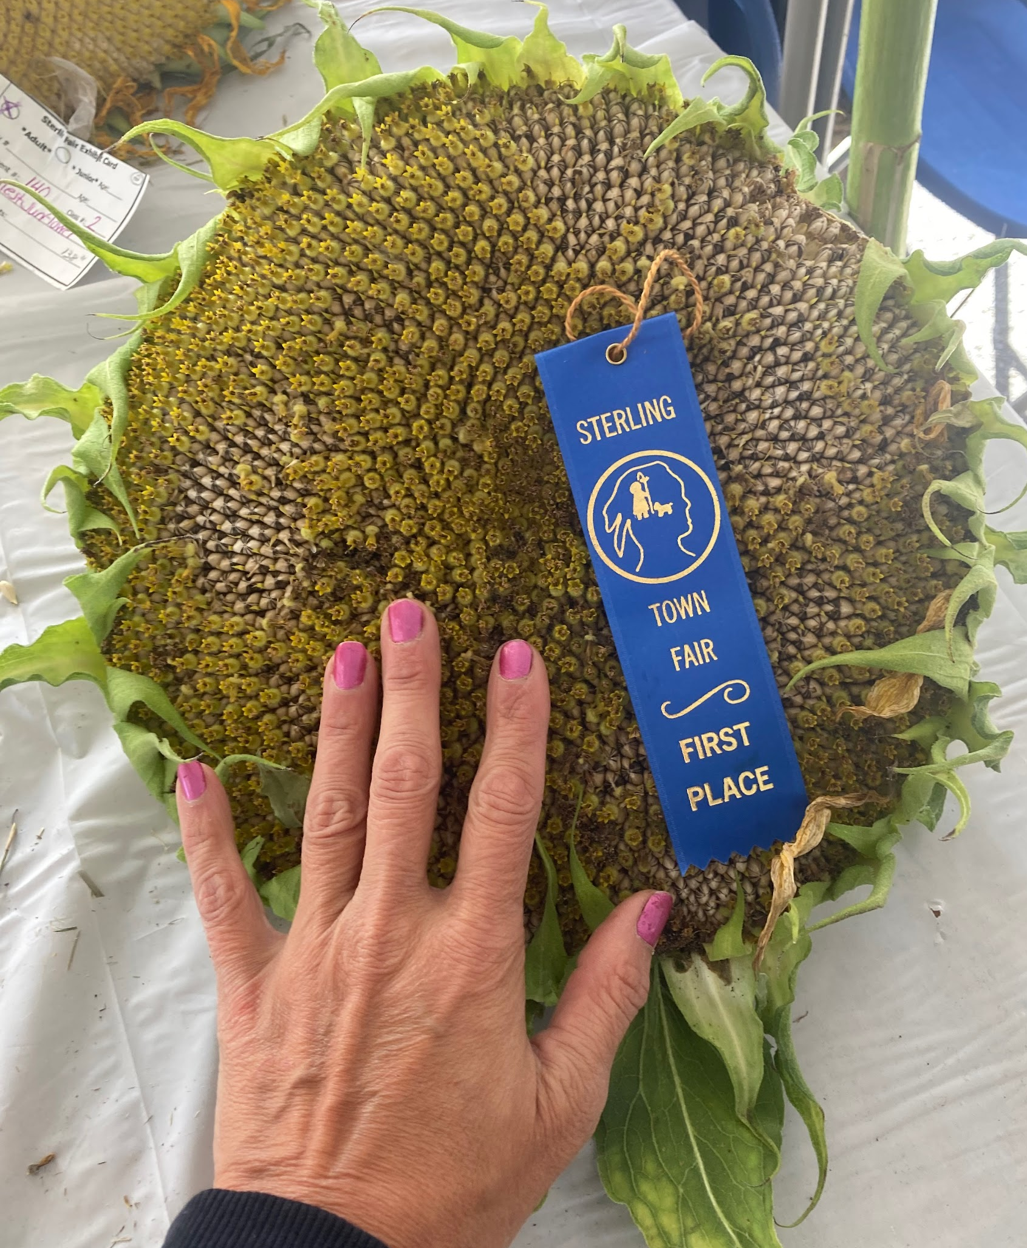
The Sterling Fair
Community Connections
2024 Tallest sunflower 138 inches
Largest sunflower 18 inches
2023 Tallest sunflower 129 inches

Slide 38

Questions or Comments

