Slide 1


AI and Education
Over the past three years, generative artificial intelligence (AI) tools have rapidly become accessible to students, educators, and school communities. These tools-ranging from large language models to image and audio generators-offer exciting opportunities as well as significant risks and challenges. This session will highlight DESE resources on this topic, uses of funds related to federal grants, and using AI in your role as a grant administrator.
November 2025
AJ Coté - Office of Educational Technology
andrea.j.cote@mass.gov

Slide 2
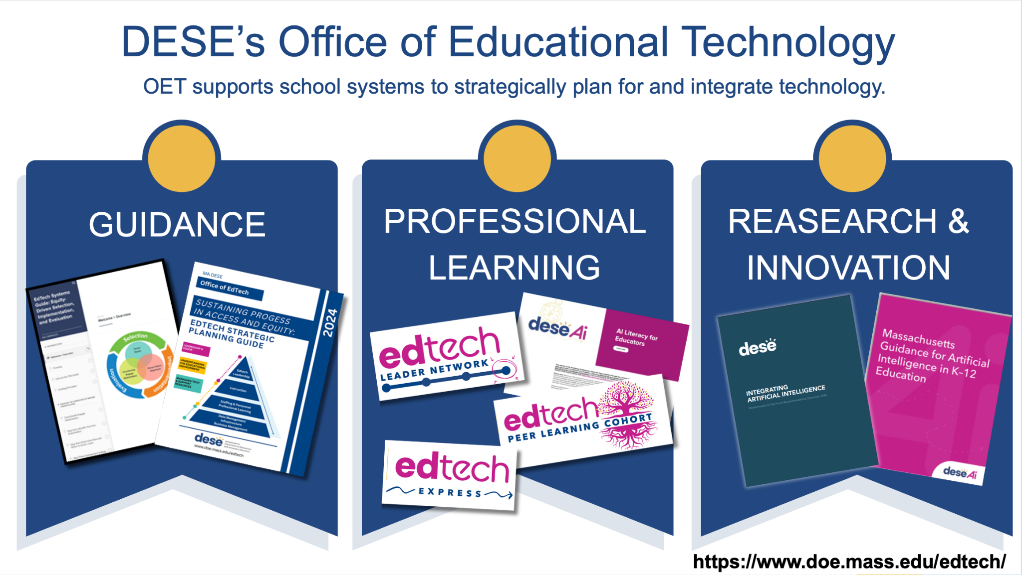
DESE Office of EdTech

Slide 3
Welcome & Agenda
What is AI?
DESE Resources: AI Guidance and AI Literacy
Principles for Ethical AI Use
AI Literacy Principles
AI & Federal Fund Use
AI & Your Role
AI & Your Role: Potential Opportunities
Prioritize People
Center Human Intelligence

Slide 4
Building Common Language
What is AI?
Notes:
Greg

Slide 5

Building Common Language
What is AI?
Notes:
Greg - shows an Agent in Action
Manus

Slide 6
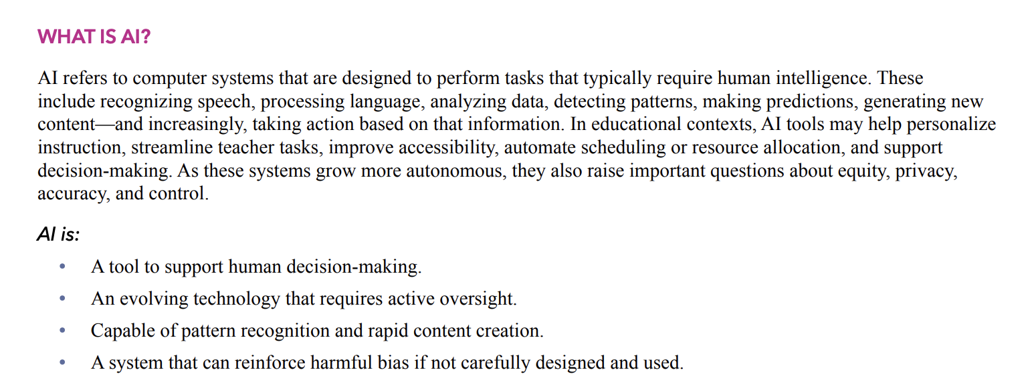
What AI is…
Notes:
AJ

Slide 7
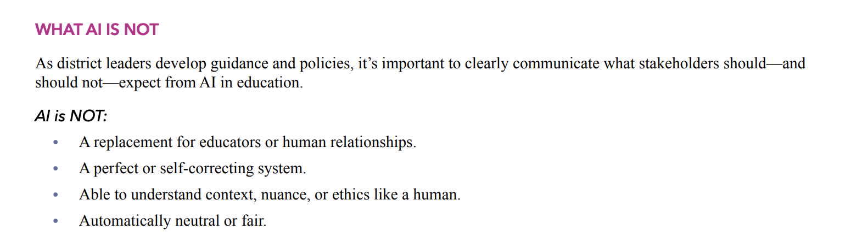
What AI is not…
Notes:
AJ

Slide 8

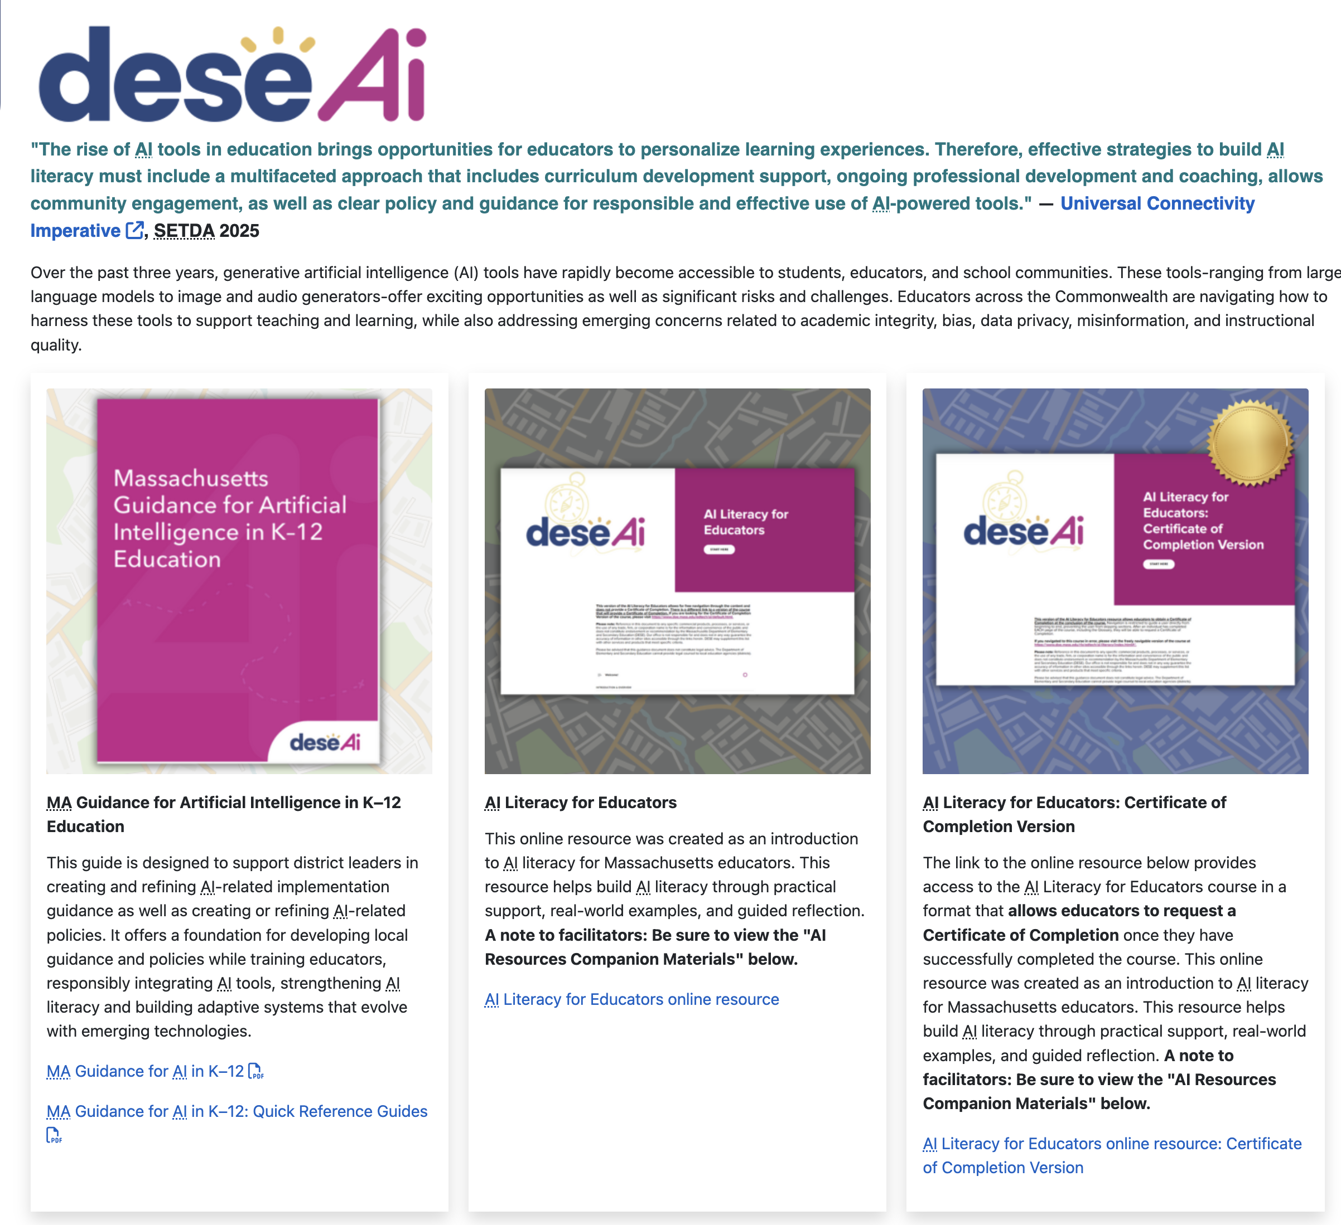
DESE AI Resources
http://www/doe.mass.edu/edtech/ai/
OR
bit.ly/MA-ai-guidance
Notes:
https://www.doe.mass.edu/edtech/ai/default.html

Slide 9
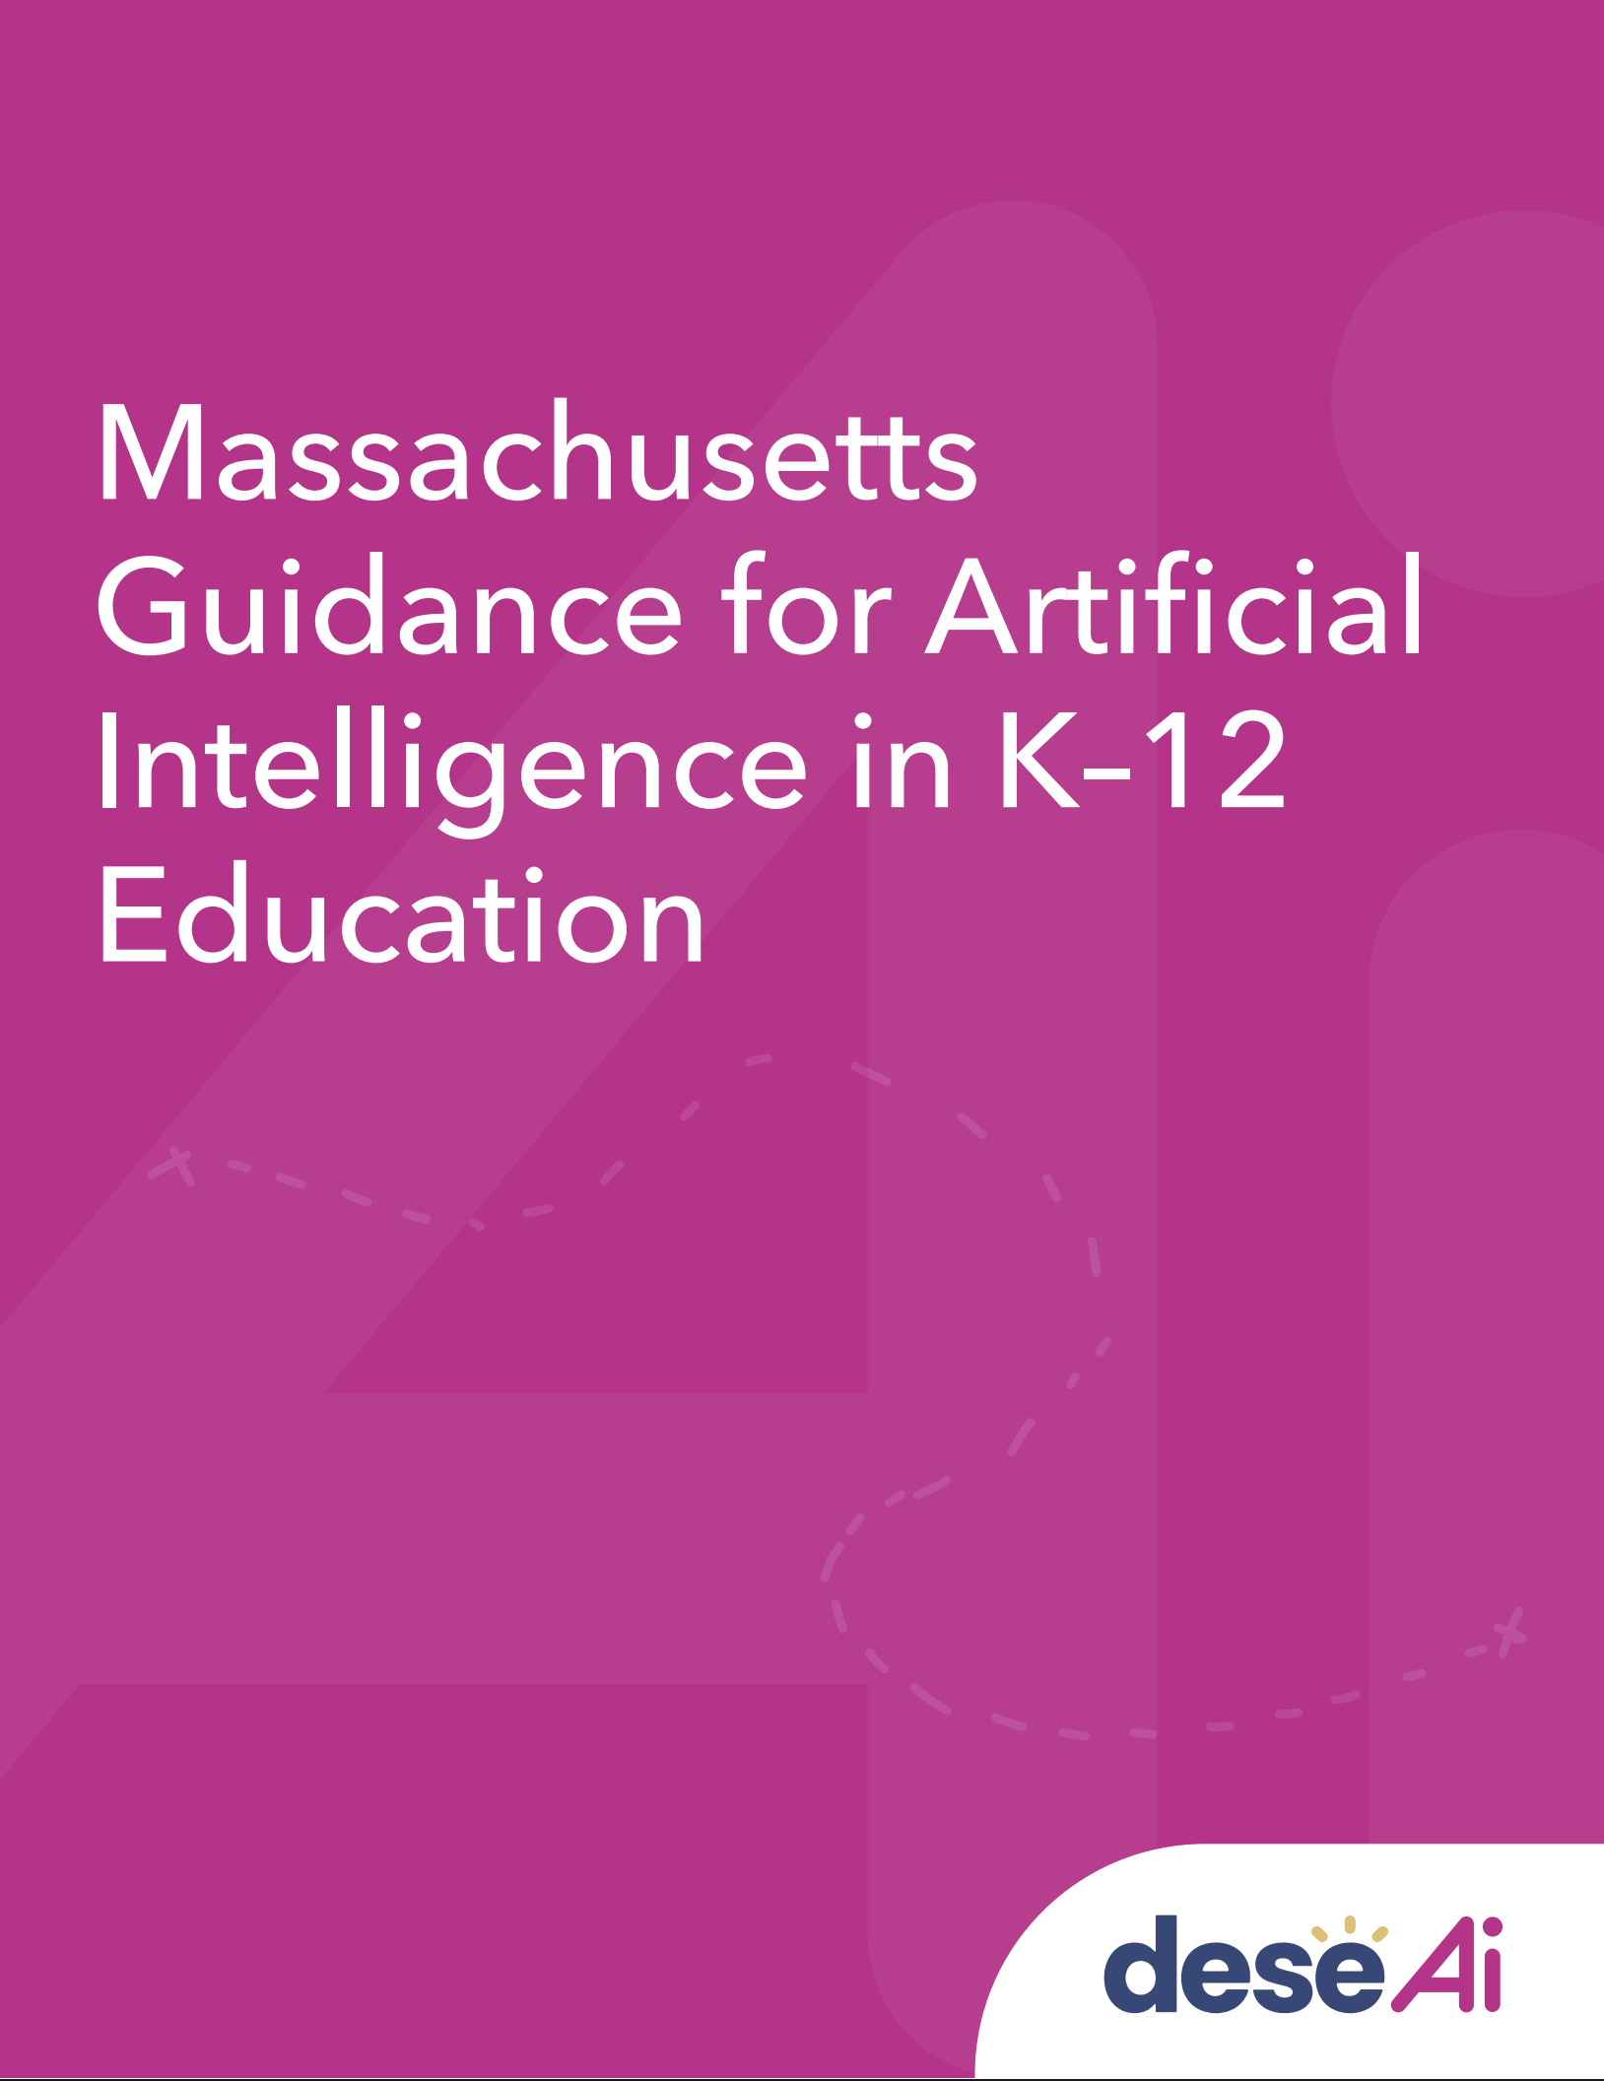
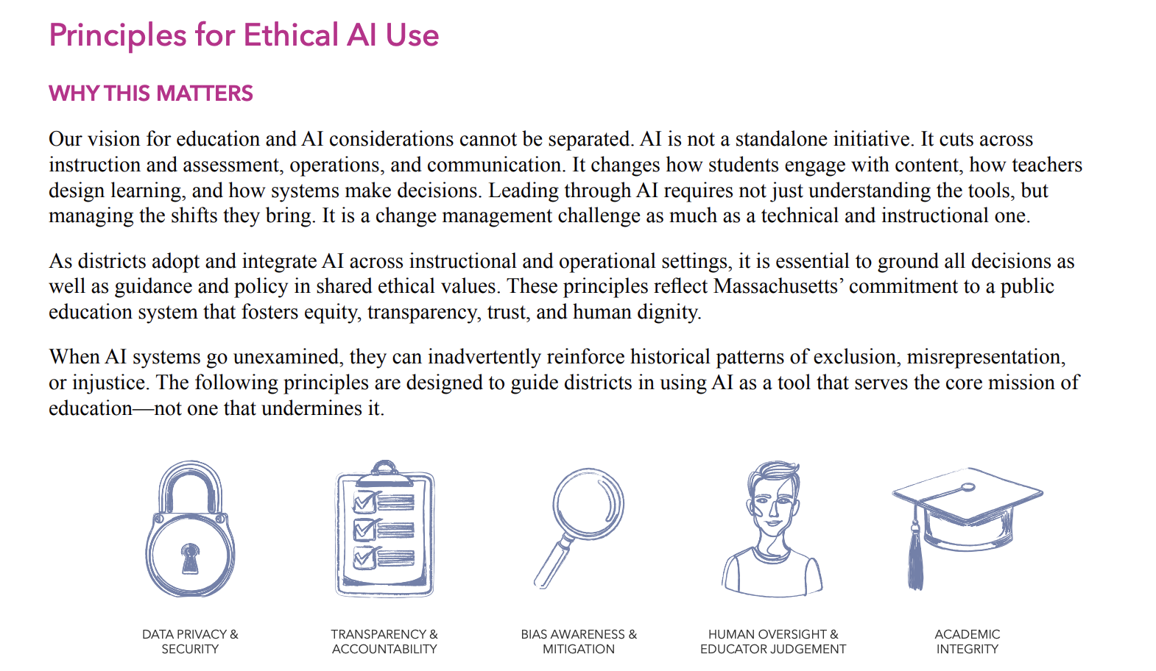
Principles for Ethical AI Use

Slide 10
Principles for Ethical AI Use
Notes:
Greg

Slide 11
Principles for Ethical AI Use
Notes:
Greg

Slide 12
Principles for Ethical AI Use (cont.)
Notes:
Greg

Slide 13
Principles for Ethical AI Use (cont.)
Notes:
Greg

Slide 14
Principles for Ethical AI Use (cont.)
Notes:
Greg

Slide 15
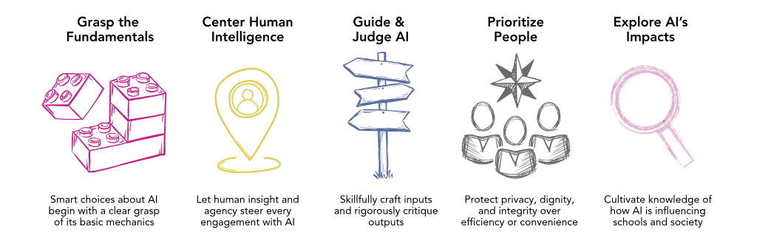
AI Literacy Resource: Principles
Notes:
AJ

Slide 16
AI & Federal Fund Use

Slide 17
Title Funds, IDEA, & AI
Title I, Part A (Improving Basic Programs)
Title II, Part A (Supporting Effective Instruction)
Title III, Part A (English Learners)
Title IV, Part A (Student Support and Academic Enrichment)
Individuals with Disabilities Education Act (IDEA)

Slide 18
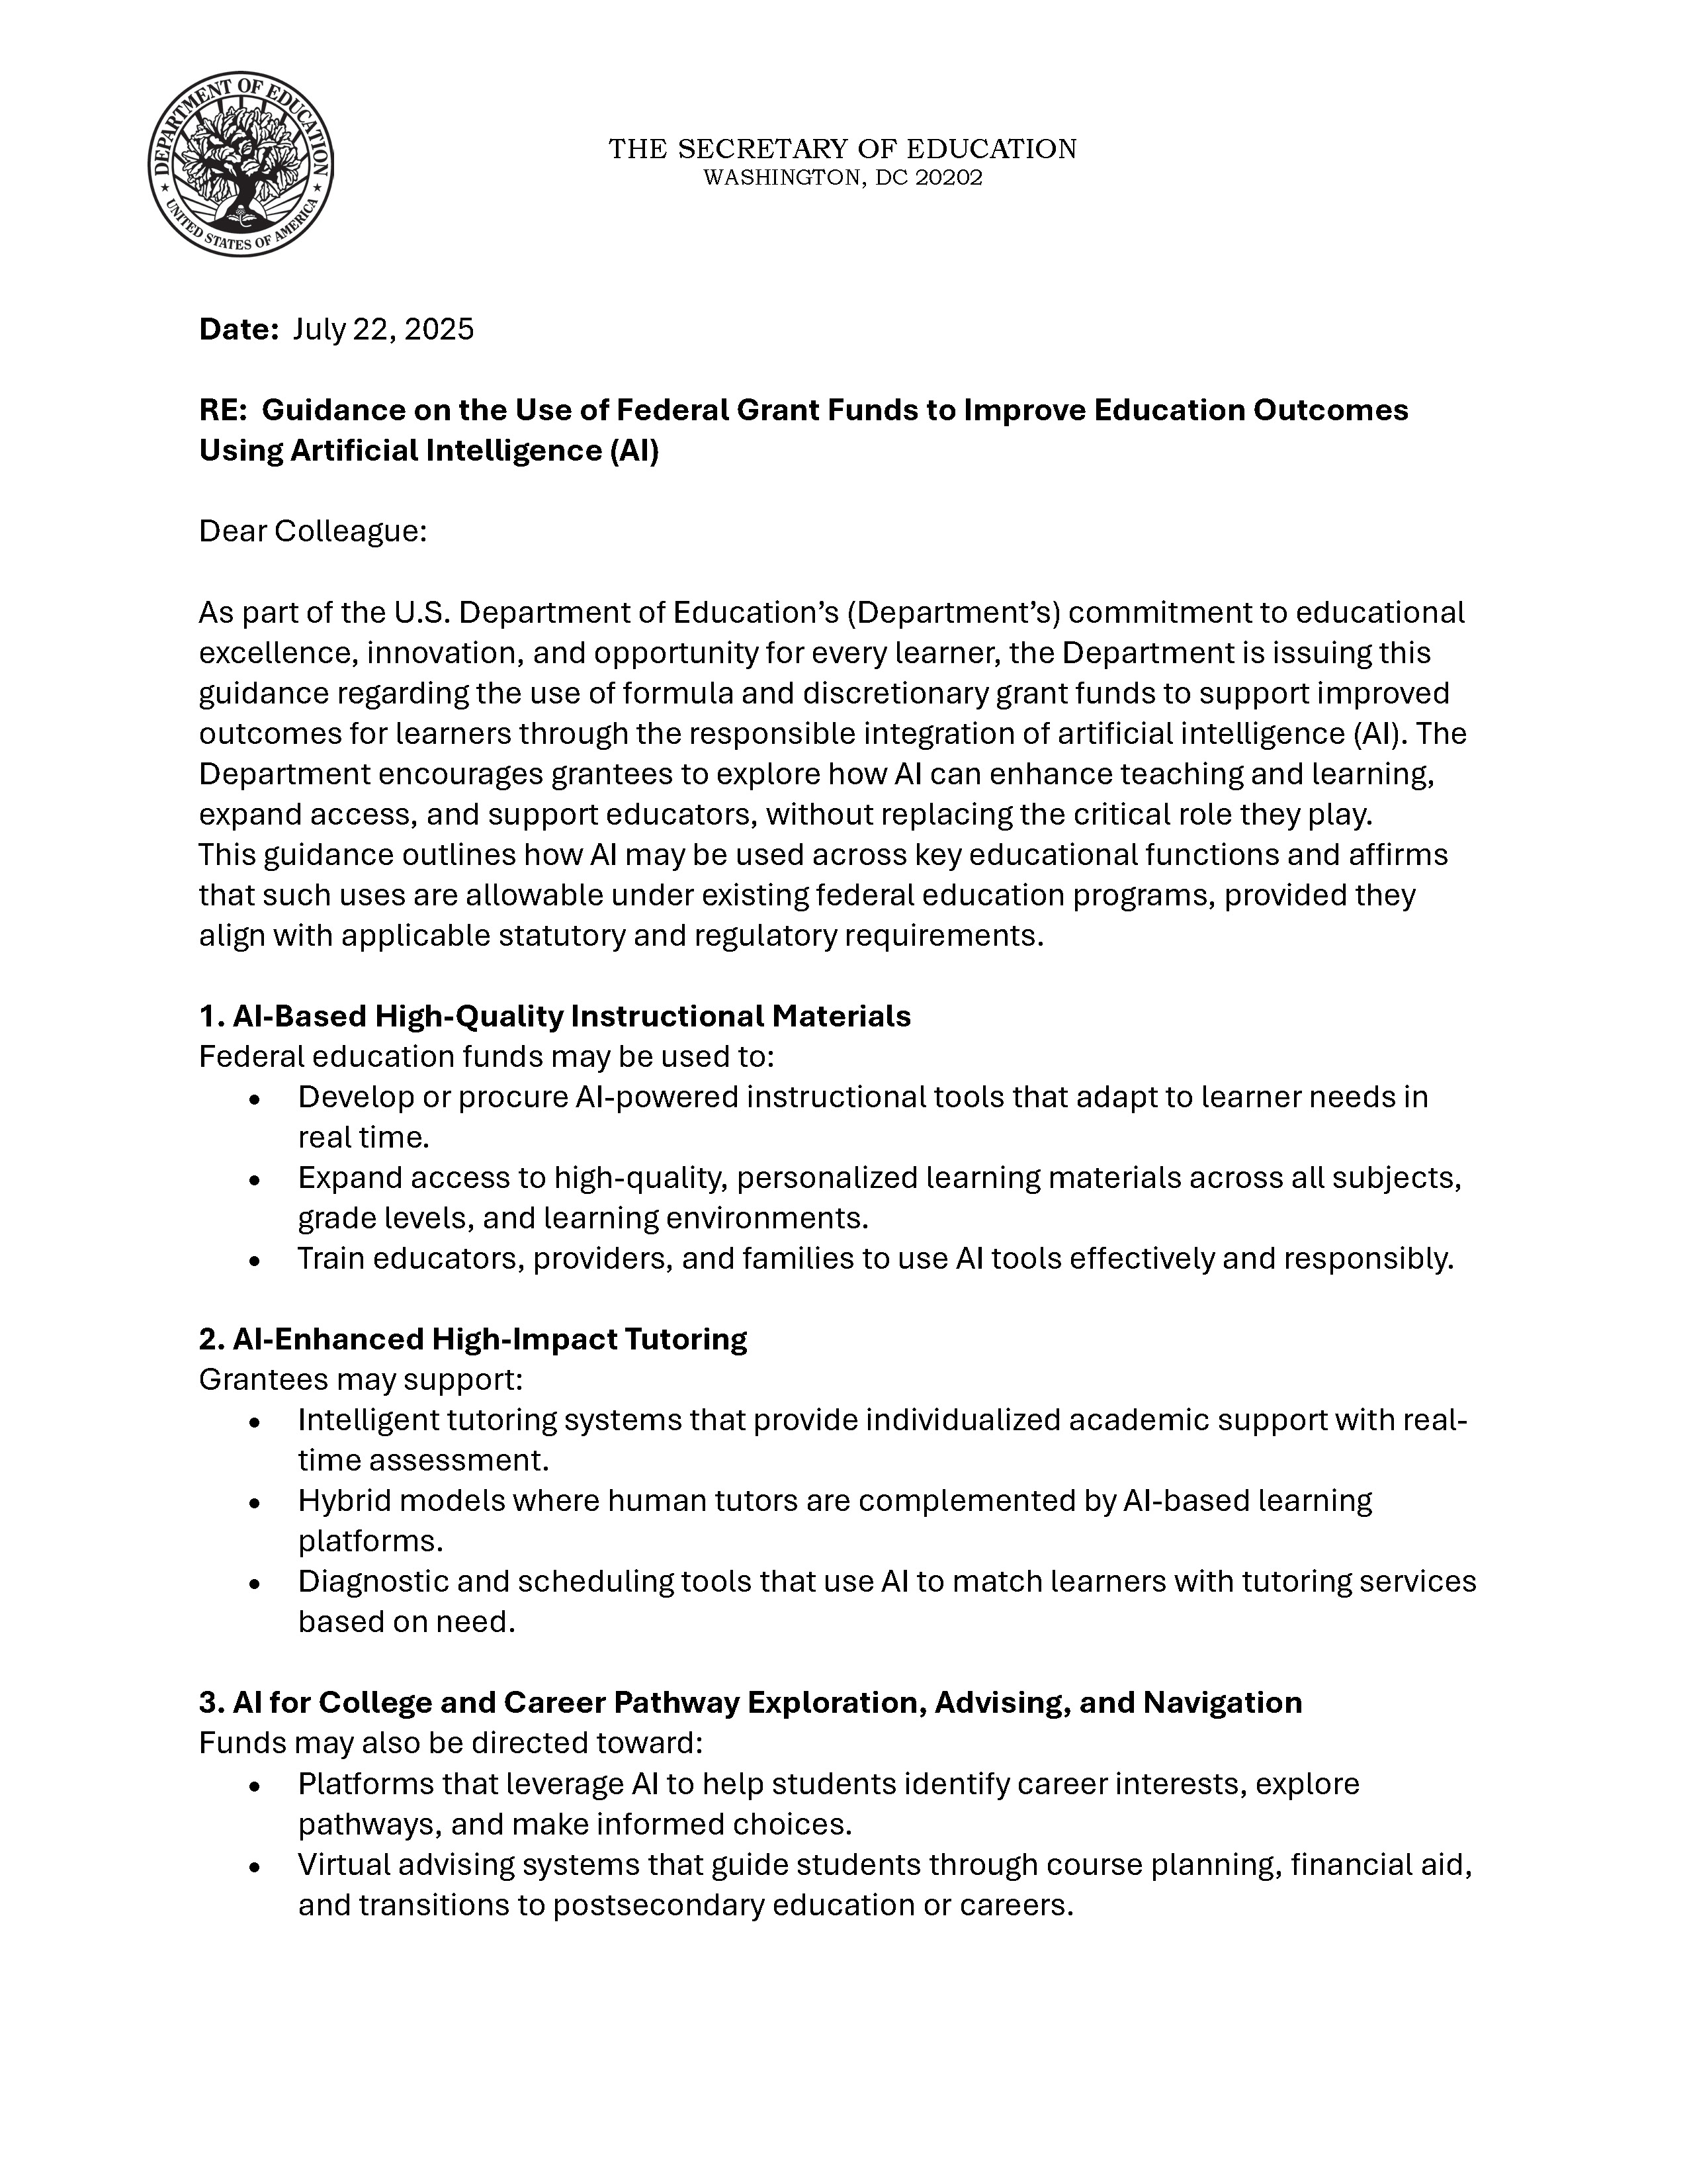
Federal Fund Use & AI
July 22, 2025, Dear Colleague Letter
Focus on Accountability and Ethics
Principles for Responsible Use, including being:
Educator-led
Data-protective
Transparent and explainable
Accessible
Ethical

Slide 19
Federal Fund Use & AI Quick Look
Focus | Federal funds may be used for:
AI-Based High-Quality Instructional Materials | Development and Procurement: Developing or procuring AI-powered instructional tools that adapt to learner needs in real time. Access Expansion: Expanding access to high-quality, personalized learning materials across all subjects, grade levels, and learning environments. Training: Training educators, providers, and families to use AI tools effectively and responsibly.
AI-Enhanced High-Impact Tutoring | Intelligent Tutoring Systems: These systems can provide individualized academic support with real-time assessment. Hybrid Models: Using AI-based learning platforms to complement human tutors. Diagnostic and Scheduling Tools: Using AI to match learners with tutoring services based on need.
AI for College and Career Pathway Exploration, Advising, and Navigation | Exploration Platforms: Leveraging AI to help students identify career interests, explore pathways, and make informed choices. Virtual Advising: Systems that guide students through course planning, financial aid, and transitions to postsecondary education or careers. Predictive Models: Tools that support educators in identifying students who are in need of additional advising or support services.

Slide 20
Title I, Part A (Focus on Academic Support to Low-Achieving Students)
AI Use Must Align With: | Examples | Key Allowability Criteria
Supplemental Academic Services | Purchasing AI-powered instructional software/licenses specifically for use by participating Title I students to accelerate their achievement. | AI-based tutoring systems for Title I students.
Professional Development (PD) | Funding stipends or contracted services for PD on effectively integrating AI technology into curricula and instruction. | PD for teachers on using AI tools to analyze student data (while ensuring data privacy) to improve instruction for Title I students.
Technology Purchase | Purchasing computers and AI-enabled software/licenses for use by Title I students. | Any purchase of equipment must be used for Title I programs.
*In a Targeted Assistance program, Title I funds may only be spent on the identified Title I students and their teachers. In a Schoolwide program, Title I funds may be spent on any and all students and teachers in the school.

Slide 21
Title II, Part A (Focus on Educator Capacity)
AI Use Must Align With: | Examples | Key Allowability Criteria
Professional Development (PD) | Funding high-quality, personalized, evidence-based PD for educators on AI integration into curriculum and instruction. | PD must be sustained, intensive, collaborative, job-embedded, data-driven, and classroom-focused.
Technology Integration | Training teachers/leaders to effectively integrate technology into curricula, which may include training on blended learning projects assisted by AI. | This training must address important topics like digital health, safety, citizenship, and accessibility.
Educator Data Systems | Purchasing technology systems or software to support educators or assist in the management of educator data related to evaluation or performance. | Funds may not be used for purchasing software intended for student use. The purpose must align with the goal of improving educator effectiveness (e.g., training on using AI outputs/data for instructional improvement).
Recruitment/Retention | Using AI-supported platforms for more effective recruitment and screening of effective teachers, especially for high-need schools. | Initiatives must aim to hire and retain effective teachers.
*Title IIA funds cannot be used for purchasing software intended for student use. The expenditure must primarily benefit the adult staff member or the administration of the program. All activities, software, and materials funded with Title IIA must be supplemental.

Slide 22

SETDA Resource Improving Professional Learning Systems to Better Support Today’s Educators: How Title II, Part A Offers a Model for State and Local Leadership
Developed in partnership with FullScale, ISTE+ASCD, and Learning Forward and supported by Google.org
Draws on national research with 24 state education agencies and 76 local education agencies.
Provides evidence-based strategies for leveraging Title II-A and other funding streams to support sustained, high-quality professional learning focused on technology and AI integration.
https://www.setda.org/wp-content/uploads/2025/11/Improving-Professional-Learning-Systems-to-Better-Support-Todays-Educators-2.pdf

Slide 23
Title III, Part A (Focus on English Learners)
AI Use Must Align With: | Examples | Key Allowability Criteria
Language Instruction Educational Programs (LIEPs) | Acquisition of educational software and technologies specifically designed to accelerate student performance in English language acquisition, supplemental to core instruction. | The AI must be used to enhance effective instruction and improve English language skills.
Professional Development (PD) | Providing effective PD for classroom teachers, principals, and administrators on using AI tools to improve the instruction and assessment of ELs (supplemental to all other AI staff training). | PD must focus on enhancing the ability of educators to understand and implement curricula/strategies for ELs to meet academic standards and increase proficiency.
Title III Immigrant Grant (FC 186) | Acquisition of educational software and technologies to provide enhanced instructional opportunities for immigrant children and youth. | AI tools could differentiate and scaffold curriculum and materials to provide newcomers greater access to information. Note that immigrant grant funds must be used for purposes separate and distinct from Title III EL funds.
* All activities, software, and materials funded with Title III must be supplemental.

Slide 24
Title IV, Part A (Focus on Effective Use of Technology)
AI Use Must Align With: | Examples | Key Allowability Criteria
Effective Use of Technology | Supporting high-quality professional development for educators, school leaders, and administrators to personalize learning and improve achievement using AI. | Activities include carrying out innovative blended learning projects, delivering specialized or rigorous academic courses and curricula using technology, or implementing personalized learning programs (often AI-driven).
Technology Infrastructure Cap | Purchasing devices, equipment, software applications, platforms, and digital instructional resources (AI systems). | No more than 15% of funds used for the "effective use of technology" category can be spent on purchasing technology infrastructure. The focus must be on professional learning (how to use the tech effectively), not just procurement.
Well-Rounded Education | Using AI platforms to support college and career counseling and pathway exploration. | The AI platform should improve student access to well-rounded educational experiences.
* All activities, software, and materials funded with Title IVA must be supplemental.

Slide 25
Individuals with Disabilities Education Act (IDEA) (Focus on Unique Needs)
AI Use Must Align With: | Examples | Key Allowability Criteria
Specialized Instruction/Supports | AI-powered assistive technology or instructional equipment/software that is clearly related to the unique needs of individual students as documented in their Individualized Education Programs (IEPs). | This includes delivering specialized or rigorous academic courses and curricula using assistive technologies.
Personnel Preparation/PD | Providing professional development and training to special education and regular education teachers on using AI tools and adaptive technologies to meet the unique needs of students with disabilities. | The PD could be co-funded with Title II, Part A to ensure joint learning between general and special education staff on implementing evidence-based instructional strategies, including those leveraging AI.
Unallowable Costs | AI software/technology not solely related to the unique needs of individual students/special education costs. | AI tools cannot fund routine costs or instructional materials meant for general classroom use.

Slide 26
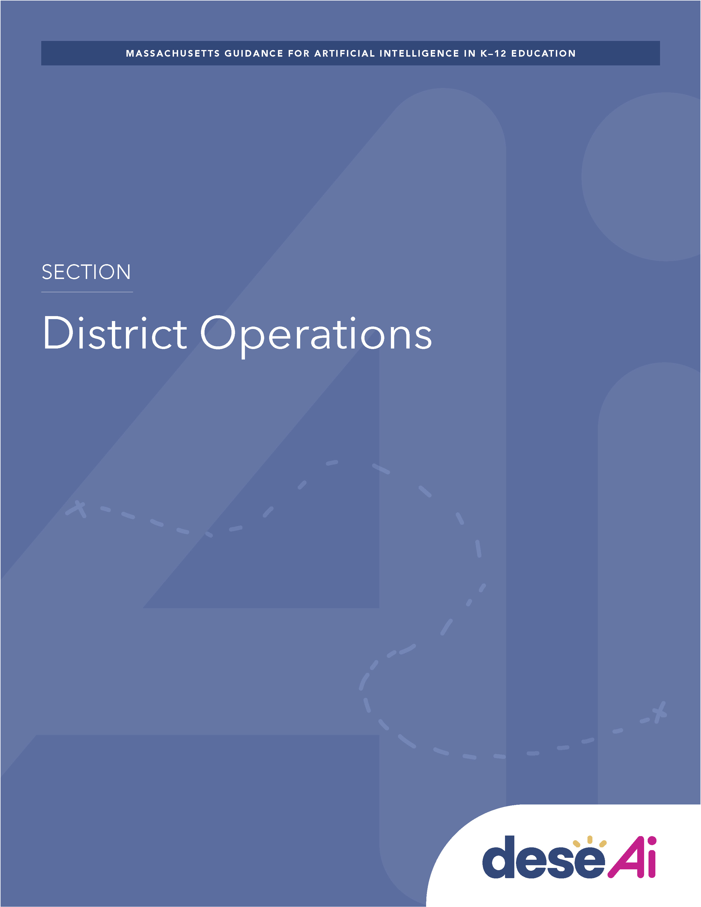
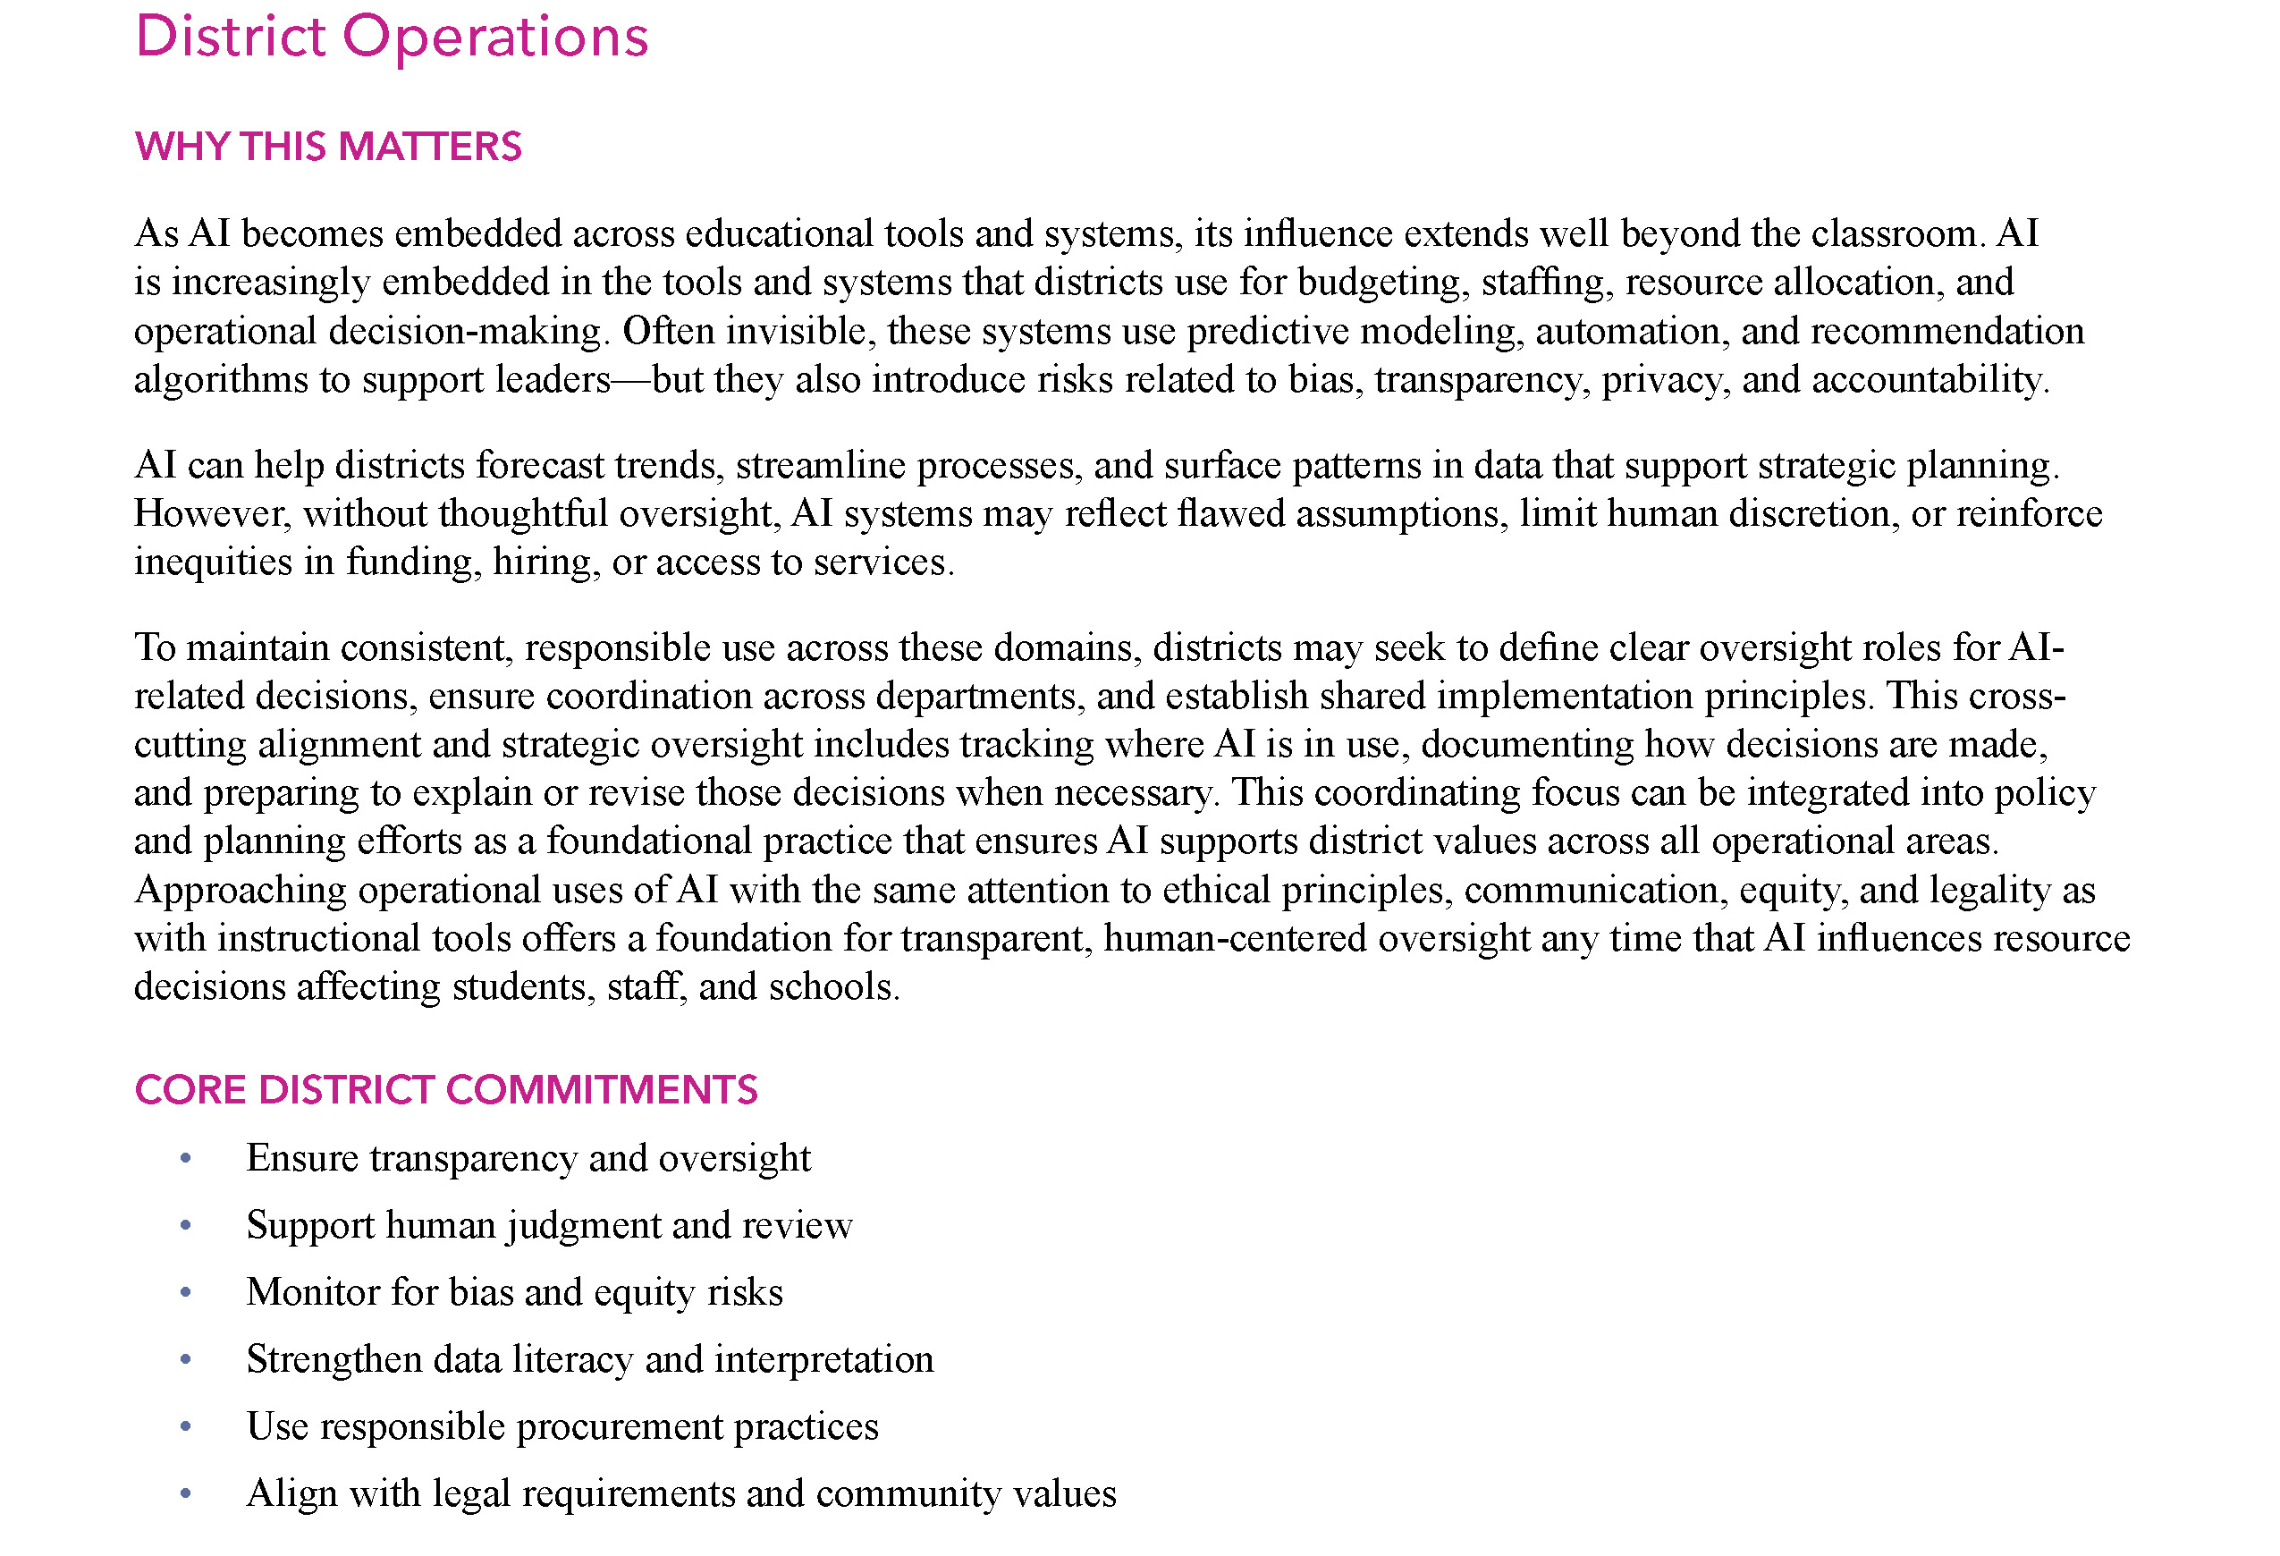
AI & Your Role

Slide 27
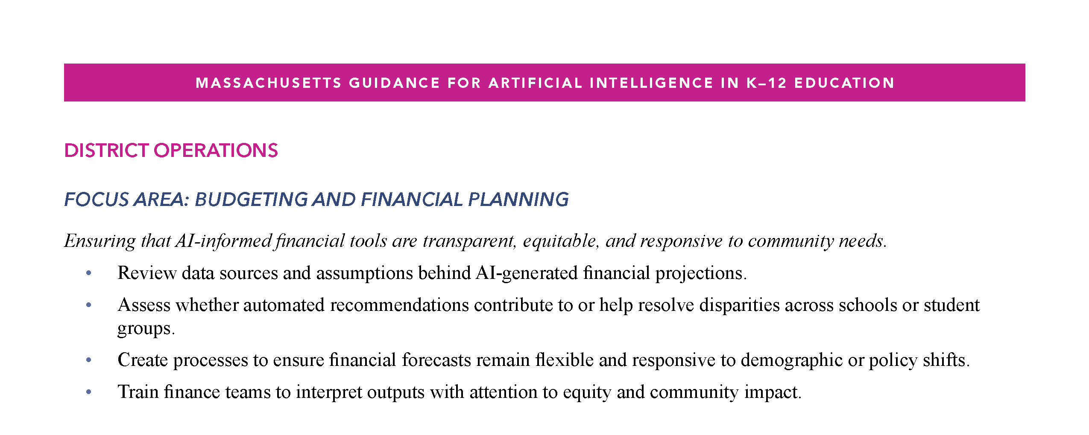
Action Steps to Get Started
Addresses the integration of AI into district operations such as budgeting, staffing, and resource management.

Slide 28
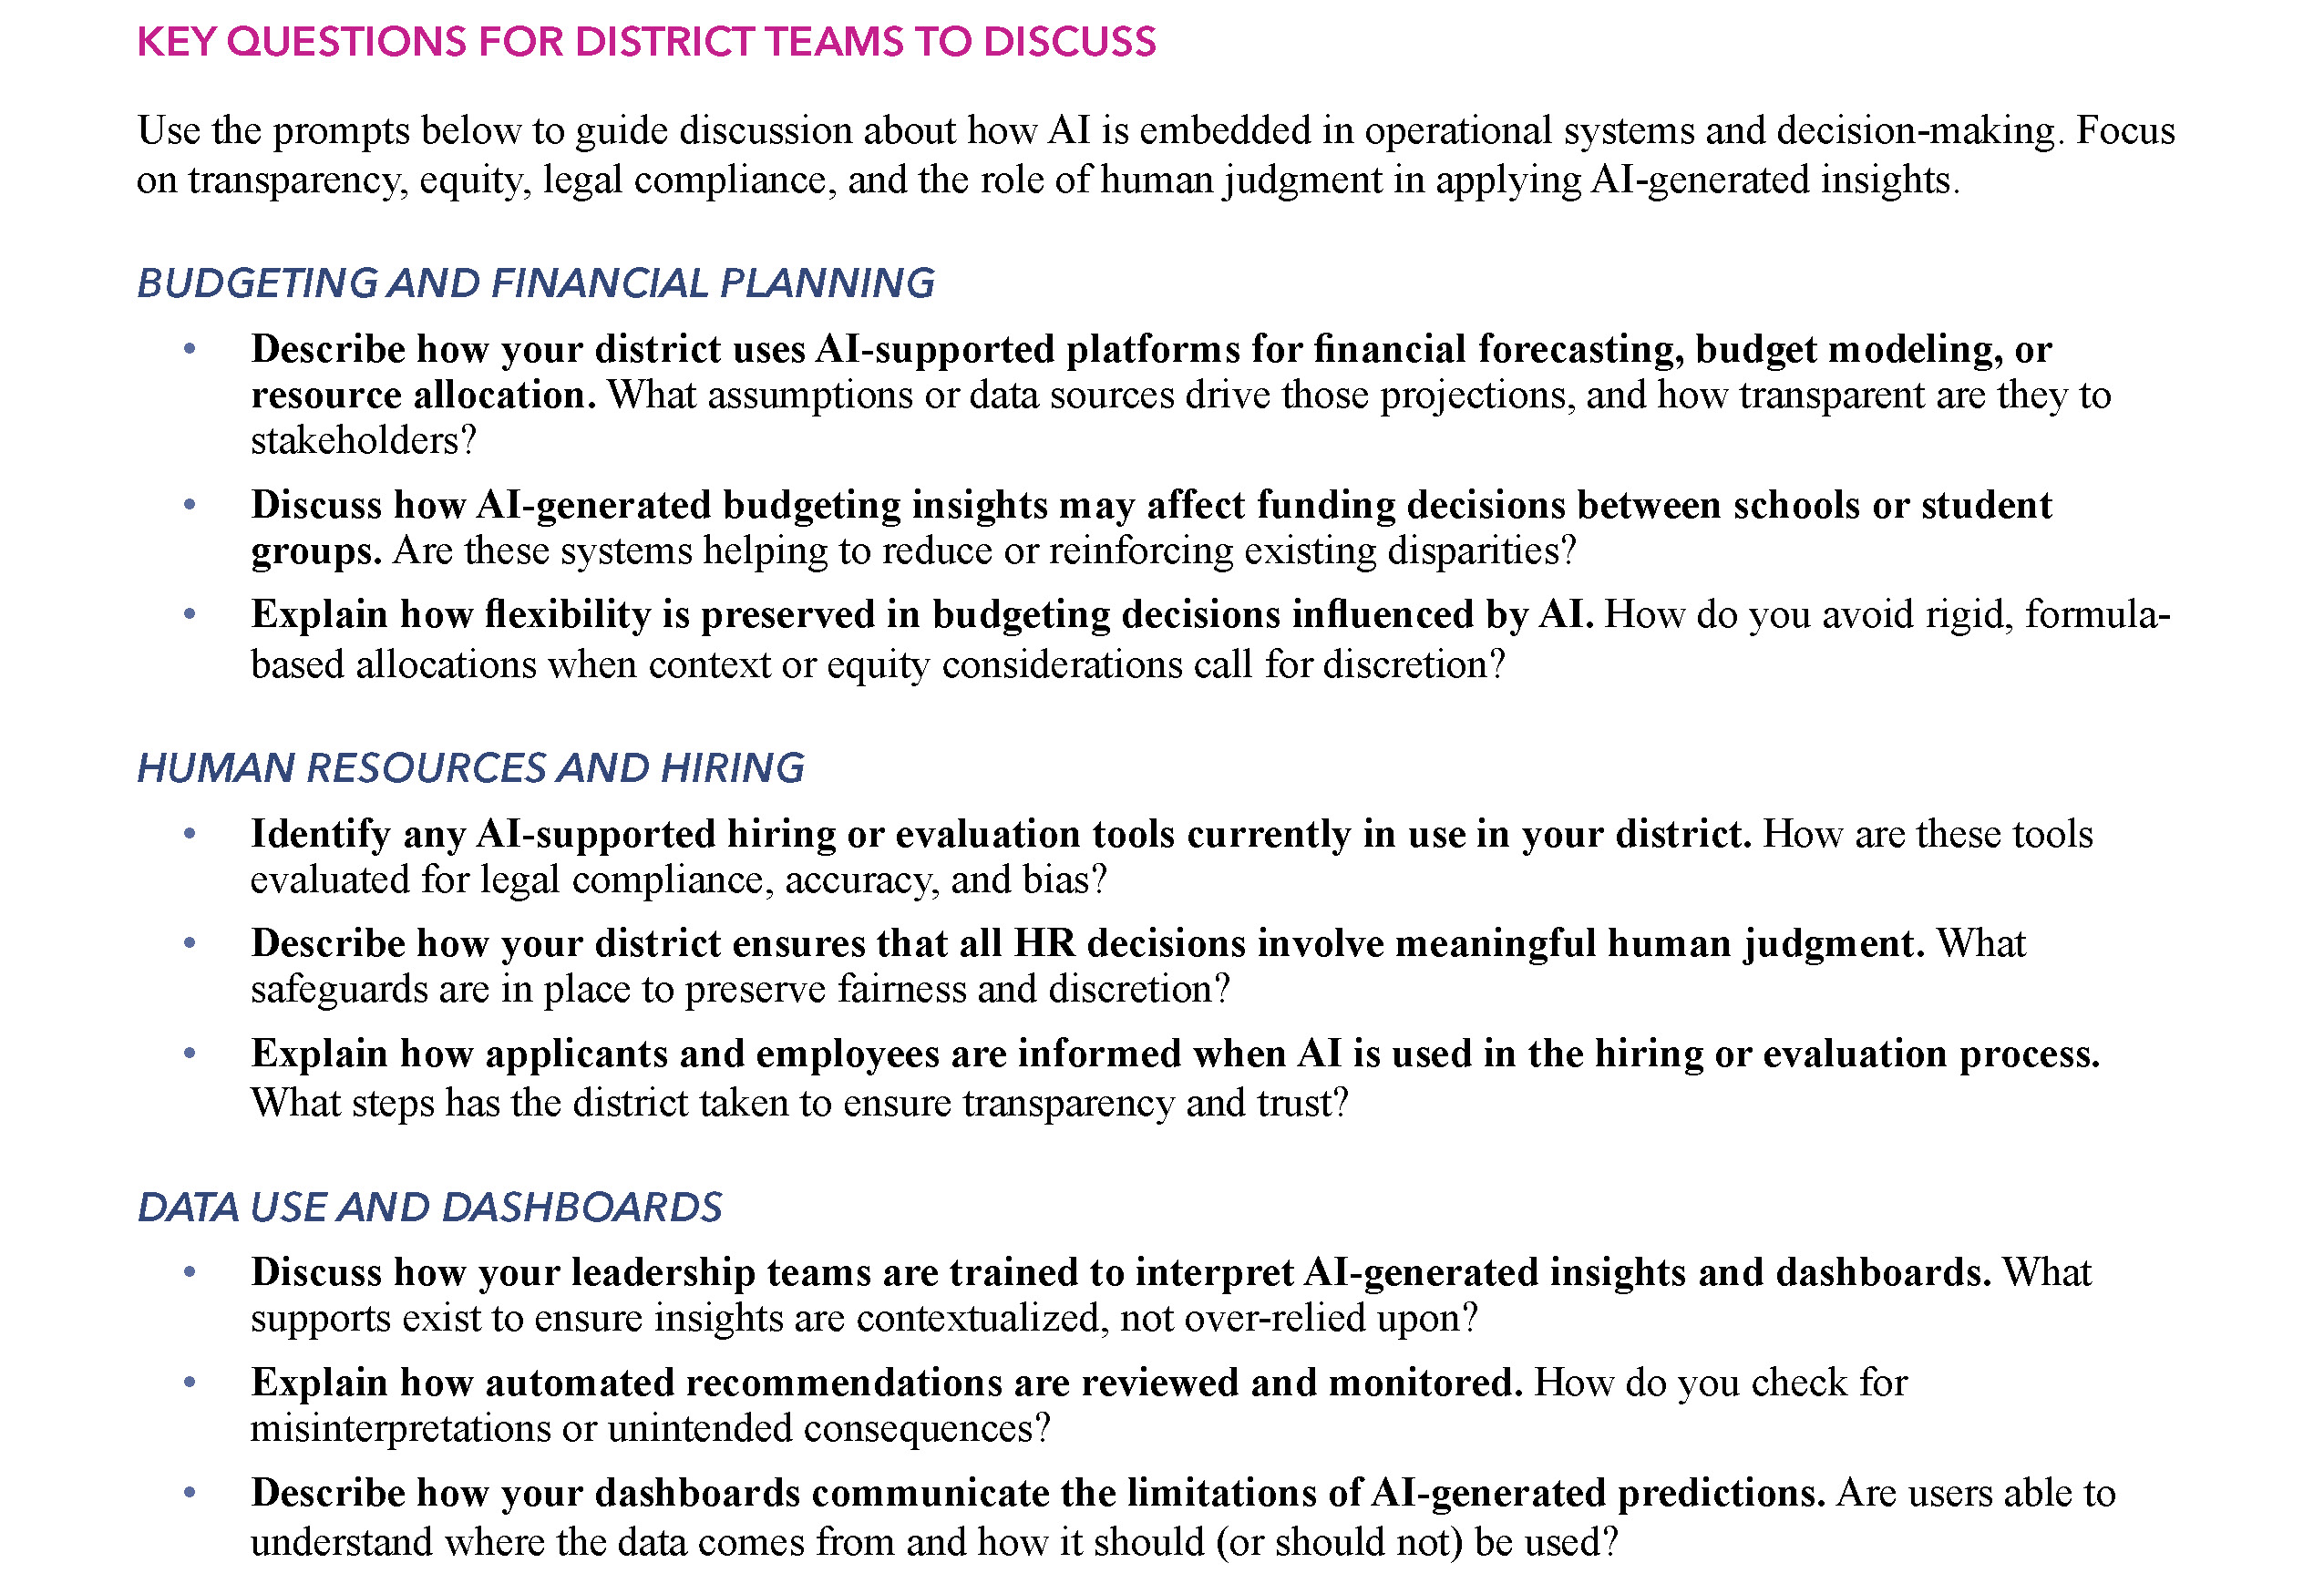
Key Questions
Budgeting and Planning
Human Resources and Hiring
Data Use and Dashboards
Procurement and Vendor Management
Cross-Cutting and Strategic Oversight

Slide 29

AI & Your Role: Potential Opportunities
Drafting emails and reports
Supporting reporting requirements
Quick Data Analysis
Performance Reporting
Scheduling & Task Prioritization
Documentation, resource, and knowledge-base management
Internal Knowledge Search
Workflow automation
Meeting transcription & summaries (*only if permitted by your LEA)
Support for grant writing

Slide 30
AI Literacy Resource: Principles (cont.)
Notes:
AJ

Slide 31
Prioritize People
Does your district have a list of approved AI tools (that meet FERPA, COPPA, and other data privacy regulations) you can select from?
If not, how do you know what is acceptable to use and safe?
Could I be risking student data or privacy?
Notes:
AJ - turn & talk

Slide 32
Prioritize People (cont.)
How are students and parents made aware of what AI tools are being used and what student information is shared with the tool?
Could I be risking student data or privacy?
Notes:
AJ - turn & talk

Slide 33
Prioritize People (cont.)
“I used an AI tool to help write a grant proposal.”
Do I disclose this use of AI on my application?
Am I using AI in ways that respect others and build trust?
Notes:
AJ - turn & talk

Slide 34
Center Human Intelligence
Notes:
Greg - Prompt Example Goes HERE

Slide 35
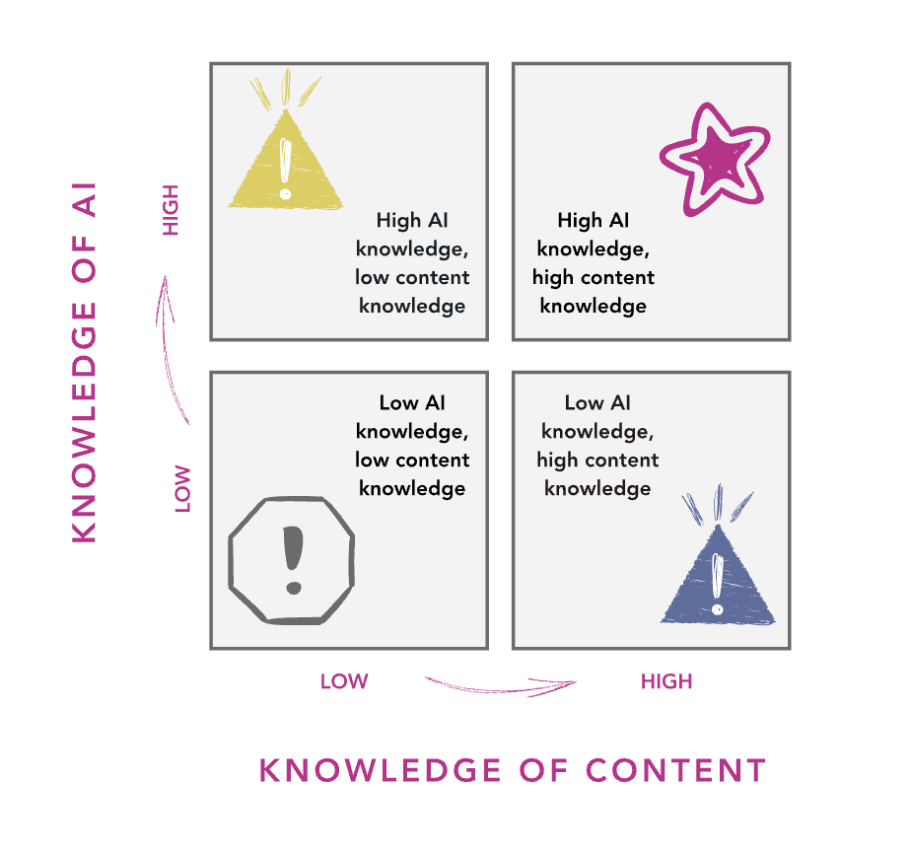
Center Human Intelligence (cont.)
Notes:
AJ

Slide 36
Center Human Intelligence (cont.)
Notes:
AJ

Slide 37
Center Human Intelligence (cont.)
Notes:
AJ

Slide 38
Center Human Intelligence (cont.)
Am I prepared to use AI well?
Am I still the one doing the real work?
Notes:
Greg - Prompt Example Goes HERE

Slide 39
DESE AI Resources (cont.)
http://www/doe.mass.edu/edtech/ai/
OR
bit.ly/MA-ai-guidance
Notes:
https://www.doe.mass.edu/edtech/ai/default.html

Slide 40
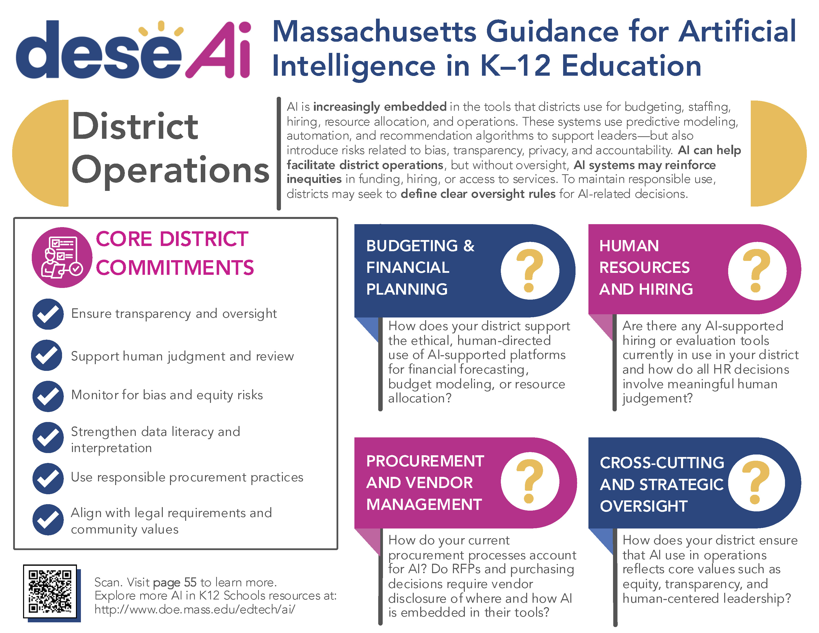
Quick Reference Guides
bit.ly/MA-ai-qrgs

Slide 41
Thank You!
November 2025
AJ Coté - Office of Educational Technology
andrea.j.cote@mass.gov

