Slide 1
Charter School Finance
Joanna Laghetto
Finance Coordinator
Office of Charter Schools and School Redesign (OCSSR)

Slide 2
Agenda
Charter School Updates
DESE Expectations for Charter Schools relative to Federal Grants
Clarify who at DESE should be contacted for various grant and financial questions
Questions

Slide 3
Charter School Updates
FY25 CSEOYFR due
Friday November 21st
FY25 Audit & Single Audit Update
Quarterly Business manager meetings beginning January 2026

Slide 4
DESE Expectations: Careful Planning
  Communication amongst school staff (very important!):
    Ensure grant program manager and finance staff work closely together when completing the grant application and developing the program.
  Thoughtfulness in application outlining program activities and the goals that will be achieved by the program.
    The dollar amount awarded is specifically aligned with the activities promised in the application.
    Schools are required to implement the exact program outlined in the school’s grant application.

Slide 5
DESE Expectations: Careful Planning (Cont.)
Timely grant application submissions by posted due date.
Timely and appropriate spending, reimbursement requests and drawdowns.
Assurance that ALL funds are spent. Please do not return grant funds.
Best Practice: Please document the policies & processes for consistency and to prepare future staff.

Slide 6
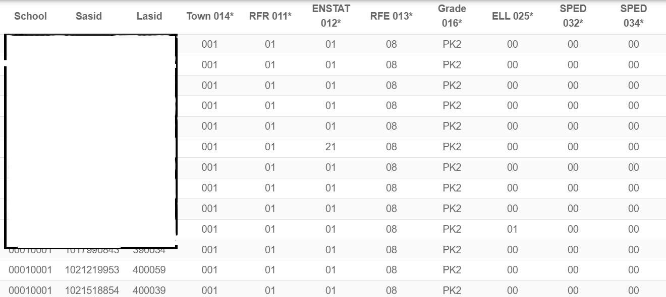
OCSSR’s Role
Administers Charter School Program Grant (CSP).
Grant Spending on CSEOYFR.
CSEOYFR amendments (often needed for Maintenance of Effort (MOE) issues).
Liaison with SEPP on MOE.
Liaison with RASP & Grants Management to help work with specific and general charter school issues.

Slide 7
Finance Offices at DESE Who does what?
School Finance Office
Kimberly.Hunter2@mass.gov Charter School tuition calculations, local transportation tuition, charter school claim form
johnj.sullivan@mass.gov
Regional transportation reimbursement rates
OCSSR
Joanna.C.Laghetto@mass.gov
Audits, Charter School Program Grant (CSP), loans that extend beyond the charter term approvals, transportation reimbursement questions
James.DiMaio2@mass.gov
CSEOYFR including amendments,CHAMP
Audit & Compliance Office: Usually selects several charter school single audits each year for additional review.

Slide 8

Who should you contact?
All non-RASP & CSP grant program related questions should go to the DESE contact on the RFP.
Some examples of other programs include grants on nutrition, literacy, Early College or Deeper Learning.
For example: Summer Food Service Program RFP:
        Contact:
        Kristen Torres Powers
        Sally Teixeira

Slide 9

Who should you contact?
Questions for the appropriate program contact include:
Allowable costs
Budget Approval and Revisions
Amendments
Approvals on the above
Due Dates

Slide 10
Reasons to contact Grants Management Office:
Grant Payments
Reimbursements & Drawdowns
Final Reports
  GEM$-FERs
  EDGrants-FR1s
Indirect costs
Request for Grants Training
Please contact your liaison in the Grants Management Office, edgrants@mass.gov.

Slide 11

Maintenance of Effort (MOE) Contacts:
Maintenance Of Effort (MOE) questions and issues should be directed to Special Education Policy & Planning. Contacts: Patrick.G.Fitzgerald@mass.gov Etse.E.Oriakhi2@mass.gov
If an amendment is needed, please follow the instructions on CHAMP. Here is the accompanying training video CHAMP EOYFR – Submitting an Amendment Contact: James.DiMaio2@mass.gov

Slide 12

Office of Charter Schools & School Redesign (OCSSR)
Do you have examples where it is unclear who charter schools should contact at DESE?

Slide 13
Questions and Contact info
OCSSR Finance Team
Joanna.C.Laghetto@mass.gov
James.DiMaio2@mass.gov

