Slide 1
Federal Funding Update
November 17, 2025

Slide 2
Today’s Topics
DESE’s Vision and Strategic Objectives
Updates on federal funding, policies, areas of focus

Slide 3
DESE’s Educational Vision
What outcomes do we envision as a result of our work?
Our vision is that as a result of their public education in Massachusetts, students will attain academic knowledge and skills, understand and value self and others, and engage with the world.
This will enable students to be curious and creative, shape their path, feel connected, and be empowered.

Slide 4
DESE’s Strategic Objectives
DESE partners with districts, schools, and programs to:
Strategic Objective 2 - "Deeper Learning"
Strategic Objective 3 - "Diverse and Effective Workforce"
Develop and sustain a workforce that is diverse, culturally responsive, well-prepared, and committed to continuous improvement, so that all students have equitable access to effective educators.
Promote deeper learning so that all students engage in grade-level work that is real-world, relevant, and interactive.
Cultivate systems to support the whole student and foster joyful, healthy, and supportive learning environments so that all students feel valued, connected, nourished, and ready to learn.
Strategic Objective 1 - "Whole Student"

Slide 5

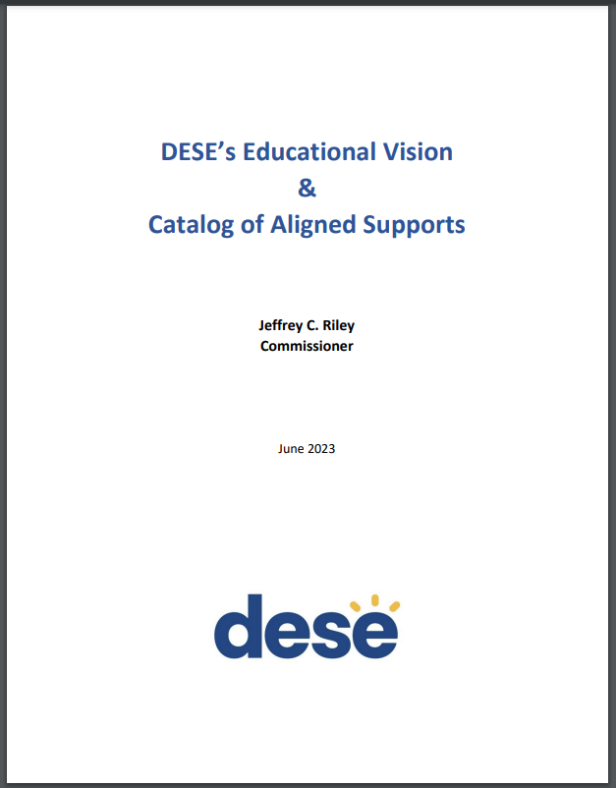
DESE's Educational Vision - Helpful Resources
Educational Vision
Catalog of Aligned Supports
www.doe.mass.edu/commissioner/

Slide 6
Federal Update Topics I’ll Cover
Federal funding status update and outlook
Policy priorities of the new administration
One Big Beautiful Bill Act implications for USED programming

Slide 7
Federal Funding - Overview
Federal programs make up ~4% of MA education spending statewide (~$1.3 billion)
However, that proportion varies greatly depending on what district you’re in

Slide 8
Federal Funding – Overview (cont.)
While USED runs over 100 grant programs, the largest K-12 grants come from 3 laws
ESSA (Title I-A, I-C, I-D, II-A, III-A, IV-A, IV-B)
IDEA Part B
Perkins
Note that USDA, not USED, runs the national school meals programs (~$435 million)

Slide 9
Federal Funding – Overview (cont.)
Almost without exception, federal grants are meant to be supplemental to state/local dollars
Additionally (almost without exception) they require districts to maintain effort from one year to the next with respect to state/local dollars. IDEA maintenance of effort is particularly rigorous.

Slide 10
Federal Funding – Overview (cont.)
Federal fiscal years begin on October 1 and run through September 30
As of today, the federal government is funded through January 30, 2026. To avoid another government shutdown, Congress must approve remaining appropriations bills by midnight on this date or pass a Continuing Resolution.
Typically, federal education grants are forward-funded, creating a situation whereby federal fiscal years sound like they are a year behind our state fiscal years (i.e. federal FY25 dollars show up in state FY26).
DESE typically receives preliminary allocations in the late spring and grant award notices around July 1.

Slide 11
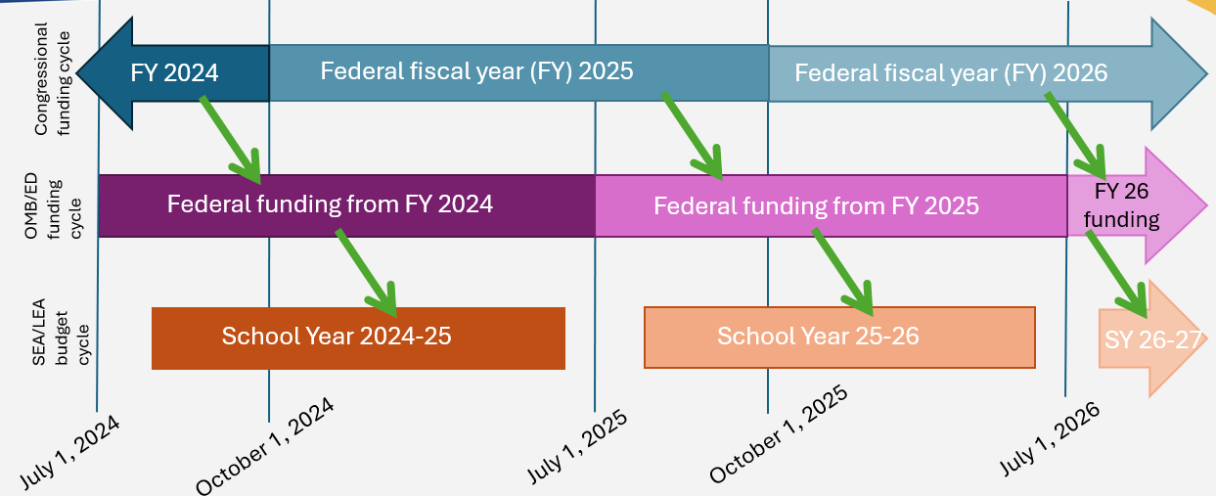
Federal (forward) funding cycle

Slide 12
Federal Education Award Status FY25, FY26
FFY24, State FY25 – Received awards in summer 2024. We’re now in the second year of this funding. Most FY25 federal grants are good for 27 months (until 9/30/2026)*.
FFY25, State FY26 – Signed into federal law in March 2025; level funded (at the state level). OMB refused to allow USED to release funding on July 1. Grant awards were held for ~4 weeks for several programs. After much advocacy (and legal action), the funds were released to states in late July, and DESE made them available to districts on August 1. Most FY26 federal grants are good for 27 months (until 9/30/2027).
*Exceptions: LEAs may only carry over 15% of Title I; and Perkins funds are only good for 1 year

Slide 13
Grant Applications for FY26

Slide 14
US Congress Breakdown
House of Representatives
Republican: 219
Democrat: 214
Vacant: 2
Senate
Republican: 53
Democrat: 45
Independent: 2 (both caucus with Democrats)

Slide 15
Policy Priorities – 119th Congress
House Subcommittee Hearings
Reading and math instruction
Spread of Antisemitism
Senate Subcommittee Hearings
State of K-12 Education
Artificial Intelligence
Future reauthorizations
Education Sciences Reform Act of 2002 (NAEP, IES)
Elementary and Secondary Education Act (ESSA)
Telecommunications Act of 1996 (e-rate)

Slide 16
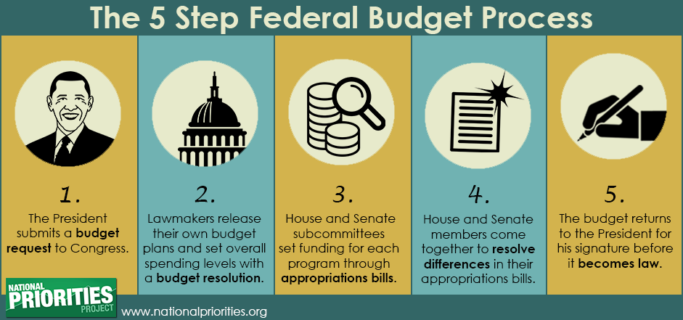
Congressional Funding Cycle

Slide 17

Congressional Funding Cycle – Current Status
For state FY27:

Slide 18
President’s Spending Proposal (State FY27)
Reminder: this is the President’s budget proposal. It is Congress, not the President, that sets the budget and appropriates funds.
Level funding for Title I and Perkins
Minor increases to charter school grant and IDEA
Elimination of Title III (ELs) and Title I-C (Migrant Ed)
Cut all remaining programs (Title I-D, II-A, IV-A, IV-B, competitives, etc.) by ~70% and bundle them into one “Simplified Funding Program” (SFP).
https://www.ed.gov/media/document/fiscal-year-2026-budget-summary-110043.pdf

Slide 19
President’s Spending Proposal (State FY27) - Comparison
Preserve Individually | Decrease and Consolidate (18) into “SFP” | Cut Entirely
ESSA Title I-A (level fund) | ESSA Title II-A (Educators) | ESSA Title III (ELs)
IDEA (minor increase)* | ESSA Title IV-A (Well-rounded/Enrichment) | ESSA Title I-C (Migrant)
Perkins (level fund) – DOL? | ESSA Title IV-B (After school/21st Century CC) | Comprehensive centers
Charter Schools (increase) | 15 other K-12 grants: Comprehensive literacy; Innovative literacy; Title I-D programs; State assessments; Homeless; Native Hawaiian; Alaska Native; Rural; American history and civics education; Magnet schools; Arts; gifted and talented; family engagement centers; School safety national activities; and Promise neighborhoods. | Training/advisory, Innovation/research, Teacher-leader incentive, SEED, Ready to Learn, Full-service community schools
Impact Aid |  | Adult Education
Indian Education
*would combine Early Ed and K-12 IDEA grants

Slide 20
President’s Spending Proposal (State FY27) – President’s Rationale
Why the cuts?
Language repeated 24 times in ED “budget justifications” document: “States and localities, not the Federal government, are best suited to determine whether to support the activities authorized under this program or similar activities within their own budgets and without unnecessary administrative burden imposed by the Federal government.”
Also: “These eliminations are part of the Administration’s overall effort to restore fiscal discipline and reduce the Federal role in education.”

Slide 21
Senate Appropriations (State FY27)
Senate Committee approved bill first week of August
Level funding across the board
New “bill-strengthening” language requires funding to be provided to States “on the date such funds become available for obligation” (i.e. July 1) for certain programs (ESEA, IDEA, Perkins, McKinney-Vento)
Would prohibit any enacted funding from being used to transfer Title I or special education programs out of ED
Would require the agency to maintain sufficient staffing “to fulfill its statutory responsibilities.”

Slide 22
House Appropriations (State FY27)
House Subcommittee approved bill in early September
Significant cuts to Title I (27%)
Plus proposed rescission of almost $1 billion in FY 2025 funding
Increase to charter school grants program ($60 million)
Cuts to USED administration
“Zero out” programs including Migrant, AEFLA, Title II-A, Title III-A

Slide 23
Senate and House Must Compromise
Significant differences between the Senate bill and the House bill make it difficult to pass single legislation
Most differences were not resolved during the shutdown

Slide 24
Discrepancies Still to Resolve
Program | FY 2026 Final | FY 2027 President’s | FY 2027 Senate Bill | FY 2027 House Bill
ESSA Title I-A | $18,407 | $18,407 | $18,457 | $14,626
ESSA Title I-C | $376 | $0 | $376 | $0
ESSA Title II-A | $2,190 | $0 | $2,190 | $0
ESSA Title III-A | $890 | $0 | $890 | $0
ESSA Title IV-A | $1,380 | $0 | $1,380 | $1,385
ESSA Title IV-B | $1,330 | $0 | $1,330 | $1,330
IDEA | $14,214 | $14,891 | $14,264 | ~$14,242
Perkins | $1,440 | $1,440 | $1,440 | $1,465
AEFLA | $715 | $0 | $715 | $0
Pell grant max (in dollars) | $7,395 | $5,710 | $7,395 | $7,395
Head Start | $12,272 | $12,272 | $12,357 | $12,272

Slide 25
What Happens when the House and Senate Don’t Agree?
Congress hasn’t passed an on-time Oct. 1 spending bill since 1997.
Two choices:
Pass a short-term spending measure (a Continuing Resolution) while they figure it out
Shut down the government while they figure it out

Slide 26
Pros and Cons of a Continuing Resolution
Pros
Keeps the government from shutting down (at least temporarily)
Continues funding at prior year levels, which level-funds education
Makes clawing back prior year funding logistically difficult/maybe impossible?
Cons
Doesn’t eliminate potential for shutdown
Delays decision on final funding levels, meaning potential for late adjustments
May not work to include “bill strengthening” provisions

Slide 27
What (Typically) Happens in a Government Shutdown?
Health, safety, and national security functions continue to operate
TSA, DHS/border crossings, USDA food inspectors, military
White House and Congress continue to operate
Agencies keep “essential” staff in the office (others are not permitted to work)
In prior years, this has included ED staff disbursing all funds through G5/G6
USDA has about 3 months of cash on hand for reimbursements
Usually agencies write “shutdown memos” to detail what will continue to function and what won’t

Slide 28
Federal Shutdown Ended November 12
Congress failed to approve appropriations by October 1
As a result, the federal government “shut down”
43 days – longest in history

Slide 29
Shutdown Implications for Education
USED staff were designated as essential or not essential
Essential staff remained on duty to carry out functions required by statute
Non-essential staff were furloughed
No new grants were awarded
Forward-funded grant funds continued to flow (most of the major grants like ESSA, IDEA, Perkins)
Federal Impact Aid was unavailable
USDA school nutrition funds are not forward funded – MA had enough funds to cover reimbursements through November/December
USED technical assistance, support, monitoring largely ceased

Slide 30
Shutdown Implications for Education (cont.)
School meals
Initial disruption, but USDA made reimbursements
Head Start
November 1 – no funds for 141 programs in 41 states serving 65,000 students

Slide 31
So, what finally passed?
Senate 60-40; House 222-209
A continuing resolution that keeps the government open through January 30, 2026. No changes to ESSA, IDEA, Perkins.
Important: A few full-year appropriations were passed, among them: school meals were funded through 9/30/2026
Provides backpay to USED staff
Reverses Reductions in Force and prevents additional reductions before January 30, 2026

Slide 32
Speaking of US Dept of Ed
Linda McMahon
Secretary (confirmed 3/3/2025)
Penny Schwinn
Deputy Secretary (withdrawn)
Kirsten Baesler
Assistant Secretary of Elementary and Secondary Education (confirmed, not yet sworn in)

Slide 33
US Dept of Ed staffing
January: 4,133
March – Reduction in Force (RIF) of 1,950 staff: 2,183
Sept – Reinstatement of about 260 staff: 2,447
Oct – RIF 450 staff (blocked by the courts within 3 weeks)
Continuing resolution reverses the October RIF in statute, prevents additional RIFs through January 30, 2026.

Slide 34
US Dept of Ed Policy Priorities
“Give education back to the states”
Flexibilities and Waivers
Nothing new. Reminders of what we already have, like Ed Flex, ability to use Titles II-A, IV-A for Title I purposes, use various rank and serve options for Title I, understand supplement not supplant rules, school choice, etc.
Prohibition of using federal funds for lobbying, including membership fees/dues that go to lobbying organizations
Private School Equitable Services
FERPA
Use of A.I.

Slide 35
Moving USED Functions?
USED is exploring partnerships with federal agencies
Department of Labor - Perkins CTE
USED transitioned states to a grants management system run by the Department of Labor
Department of Health and Human Services for special education programs
USED is engaged in discussions with HHS. As of today, no agreements have been made and nothing has moved from USED/OSERS.
Administration says it’s committed to meeting statutory obligations

Slide 36
One Big Beautiful Bill Act
The OBBBA establishes a “voucher” program.
States have the option to participate in this program. To date, no formal decision has been made as to whether MA will opt-in, because…it hasn’t been developed yet.
This federal program is being run by the Treasury (not by USED).
How it would work: taxpayers can receive a federal tax credit up to $1,700 per year for a donation to a qualified Scholarship Granting Organizations. In turn, these scholarship organizations make funds available in the form of scholarships for eligible students (limited to households earning up to 300% of the area's median gross income)

Slide 37
One Big Beautiful Bill Act - Cuts
Cuts to Safety Net Programs
Potential negative impacts via cuts to social safety net programs like Medicaid and SNAP.
Cuts to Medicaid: The OBBBA implements stricter eligibility requirements and significant cuts to federal Medicaid funding. This could impact students who rely on Medicaid and potentially reduce funding for school-based health services.
Cuts to SNAP: The OBBBA also makes a funding cut to the Supplemental Nutrition Assistance Program (SNAP), potentially impacting food assistance for children and low-income eligibility counts.

Slide 38
E-rate Update
The existence of e-rate was challenged in court. SCOTUS affirmed its legality.
However, on September 30, FCC voted to overturn COVID-era rules that allowed funds to be used for Wi-Fi on school buses and mobile hotspots for students
Reauthorization discussions are under way for e-rate’s authorizing statute: Telecommunications Act of 1996.

Slide 39
Major Funding Takeaway
ESSA, IDEA, Perkins: no resolution on appropriation amounts for our state FY27. Congress has until January 30 (74 days from now) to figure it out. Otherwise: shut down again or pass a continuing resolution to temporarily keep the government open.
School meals funded for another year, through September 30, 2026

Slide 40
Stay informed via our monthly newsletter
You can read about the latest federal grants updates, see claims status reports for your district, all via our monthly Federal Grant Programs newsletter
Not on the list? Email FederalGrantPrograms@mass.gov!
Because this comes out monthly, anything urgent will likely be delivered to you via an On-the-Desktop email directly to superintendents.

Slide 41
Questions and Answers
??

