Slide 1
Five Things to Remember When Revising Your Grant
Fall 2025 Federal Grants Conference

Slide 2

About this Session
The ESSA grant application is made up of several interlocking sections that must be preserved beyond the initial application submission
In addition, important laws about ESSA allowability and program management remain in effect for the duration of the grant, not just during the initial submission
We will use this session to remind you of 5 key ESSA topics to keep in mind as you amend your grants over their 27-month life cycle
If you have questions throughout, use the Q&A function. Kathy and Jake will either respond via text or on video when time permits.

Slide 3
Supplement, Not Supplant (Title I)
The test: For Title I, compliance with SNS is no longer measured by looking at particular Title I expenditures.
Instead, SNS compliance is measured by whether the district has a written methodology to ensure that each Title I school receives all of the state and local funds that it would have received if it were not a Title I school.
Once this methodology is in place, Title I funds therefore may be spent for any allowable expenditure regardless of what funds were used to pay for it in the past or whether state or local funds pay for the same expenditure in non-Title I schools.
A provision of ESSA grants that should be incorporated into the decision-making process for any new revisions

Slide 4
Supplement, Not Supplant (Titles II, III, and IV)
Unlike for Title I, the SNS test is an expense-by-expense measure for these Titles.
Supplanting is presumed if any of the following is true, according to federal fiscal guidance:
A district uses federal funds to provide services that are required under other federal, state, or local laws.
A district uses federal funds to provide services that the district provided with non-federal funds in the prior year.
Title III only: In addition to supplementing state and local funds, Title III requires that funds supplement federal funds.
A district uses federal funds to provide services that the district would otherwise provide without federal funds.
Note: These presumptions may be overcome if the district can demonstrate that it would not have provided the services absent the availability of these federal funds
A provision of ESSA grants that should be incorporated into the decision-making process for any new revisions

Slide 5
Federal Funds Must Not Replace:
Grant | Federal Funds | State Funds | Local Funds
Title I, Part A |  | ✓ | ✓
Title II, Part A |  | ✓ | ✓
Title III, Part A | ✓ | ✓ | ✓
Title IV, Part A |  | ✓ | ✓

Slide 6
Supplement, Not Supplant – Implications for Revisions
You cannot move items that are currently funded by your LEA’s general fund or other grants onto the Title II, III, or IV budget mid-year, this is a clear case of supplanting.
Additionally, you cannot add items to Title III mid-year that were previously funded by other federal grants.
DESE may not always be able to flag violations of Supplement, Not Supplant from the information in your application, you will need to be vigilant and make sure you are checking for this requirement. If not, it could come up in a future audit.

Slide 7
Flexing Funds
If LEAs follow the rules governing flexing, it is a great way to ensure your money is being spent where it is most needed
For example: an LEA who doesn’t have a clear Title IV need might flex those funds into Title II to pay for a PD contract.
To flex, you need to add a budget tag to each individual budget detail, and then complete the Program Allocations and Flexing page.
One consideration: if you have participating private schools, you must discuss your plans to flex with them in advance, since it will impact the allocation available for services.
An option that allows LEAs to use funds from one grant on costs usually only allowable under a different grant

Slide 8
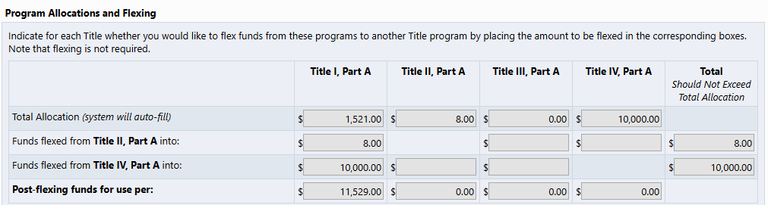
Program Allocations and Flexing Page in GEM$

Slide 9
Flexing Funds - Implications for Revisions
If you are changing the amount being flexed into or out of Title I, it will impact your School Ranking page. You will need to re-adjust the per-pupil amounts
Changed flexing amounts will also impact any participating private schools, and they must sign off on the new allocation amounts before you can adjust the flexing.
Also, while GEM$ does not yet prevent it, please do not transfer an amount that exceeds the grant allocation (e.g., if $45,000 in Title IV, do not flex $46,000 from Title IV to Title I).

Slide 10
School Ranking
The School Ranking page represents how Title I funds must be allocated to eligible schools based on their percentages of low-income students and the methodology for distributing funds that the district chooses.
This page only exists for Title I
In addition to allocating money on a per-pupil basis, you will also determine which Title I program the schools receiving funds will run
Schools with 40% or greater low-income usually run a Schoolwide program, schools under 40% must run a Targeted Assistance program unless they qualify for a waiver
Your Title I budget page should not contain expenses for schools that are not served on the School Ranking page
A crucial, but incredibly complex, part of the Title I application where LEAs prioritize schools for Title I funding.

Slide 11
School Ranking Methods
Option 1: District-wide low-income percentage method: Under this qualifying method, schools at or above the district-wide poverty average are eligible for services; as such, money may run out before serving all these schools. If selected, the School Ranking page will automatically sort all schools in rank order by low-income percentage based on the data source used to determine eligible Title I school attendance areas.
Option 2: 35% rule: Under this qualifying method, all district schools at or above 35% poverty are eligible for services; as such, funds may be insufficient to serve all schools down to the 35% poverty level.
Option 3: Grade span grouping/district-wide percentage method: Under this qualifying method, schools serving the same grades are grouped together, and any school at or above the district-wide poverty average in each group is eligible for services. If selected, the School Ranking page will automatically sort the schools by grade span and then by low-income percentage based on the data source used to determine eligible Title I school attendance areas.
Option 4: Grade span grouping/35% rule: Under this qualifying method, schools with similar grade spans are grouped together and any school at or above 35% poverty in each group is eligible for services.
Option 5: Grade span grouping/group-wide percentage method: Under this qualifying method, schools serving the same grades are grouped together and any school at or above the group-wide poverty average in each group is eligible for services.
Options 3-5: Grade Span Groupings – Outliers: For districts that have schools grouped within the grade-span grouping (e.g., "ES", "MS/HS," "MS"), but the grade served overlap by less then 50% (e.g., ES serving grades K-3 and ES serving grades 4-6), you may opt to separate these schools into different grade spans, each with their own low-income average. To do so, contact your federal grants liaison, who can facilitate a change to your application that will reflect a new grade span.
Option 6: Districts with <1,000 students: If the total enrollment of the district is less than 1,000 students, then the district is not required to rank-order schools and consequently may serve any school. Districts in this category with more than one school should be able to justify which schools will be served by Title I.
Option 7: One School Per Grade Span: Districts with one school per grade span must serve any school at or exceeding 75% low-income enrollment, but then may serve any school with less than 75% low income, regardless of rank order.
LEAs must choose which method they will use to rank schools.

Slide 12
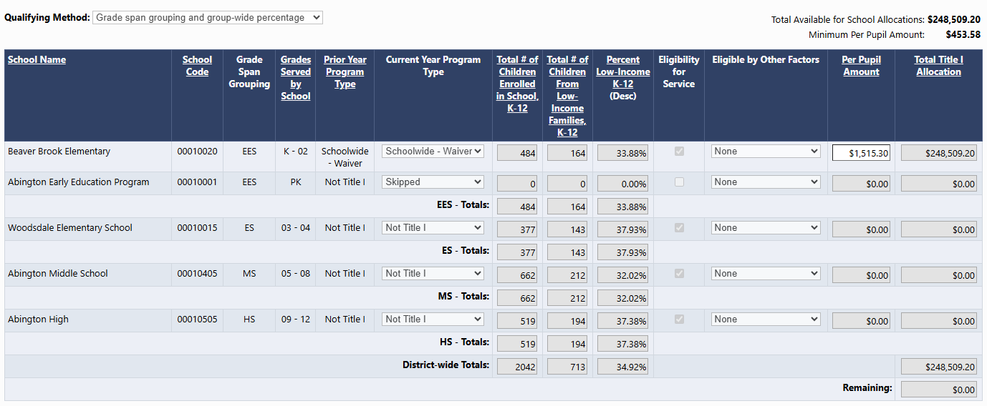
Example School Ranking Page in GEM$
Notes:
Discuss:
Qualifying method
Order
Minimum per pupil
Schoolwide waiver
Remaining/reservations page

Slide 13
Things that Impact School Ranking
The School Ranking page and the amount of funds being distributed on it are dependent on a few other pages in the application:
Title I Flexing: If you flex funds into Title I, it increase the overall Title I allocation. That means there will be more money on the SR page to distribute.
Title I Reservations Page: When you reserve money on this page, you are applying it to the whole district. This means that amount of money is removed from the SR page, reducing the amount of money that must be distributed.
Title I Equitable Services: One specific type of reservation that is automatically calculated is Title I equitable services.
If you add more private school students or add a private school, the amount on the School Ranking page will decrease.
If you serve fewer students or remove a private school, the amount on the SR page will increase.
Title I flexing, reservations, and equitable services can all impact the School Ranking page.

Slide 14
School Ranking - Implications for Revisions
If you reduce your homeless reservation or other required reservations on the Reservations Page, that money will be added back to the School Ranking page and you will need to re-adjust the per-pupil amounts.
If something changes with private school equitable services, be advised that this will also impact the School Ranking page.
If you flex into Title I in a revision, your School Ranking page will be impacted.
Any time the School Ranking page is impacted in a revision, you must get the amount remaining back to $0, likely by adding to a reservations.
You cannot change a School’s Title I status (either Schoolwide, Targeted Assistance, or Not Title I) after the initial application has been submitted.

Slide 15
Indirect Costs
Indirect are commonly thought of as district overhead – such as:
HR
Legal
Payroll
Utilities
Maintenance
Finance & Accounting
Executive costs
A portion of these costs may be associated with grant activities, but are not costs solely and directly allocable to the grant.
Indirect costs are chargeable to grants based on a negotiated rate assigned to your district.
This rate ensures that each grant is picking up its fair share of indirect costs.
Charging indirect costs is optional with each grant and district.
Indirect costs are those expenses that are incurred for a common or joint purpose benefitting the entire district that are not specifically grant-related.

Slide 16
Indirect Costs – Some Basics
DESE sets indirect rates for districts (EDGAR §75.561 (b) and 76.561 (b)).
In order to charge indirect costs on your federal grants, you must have an indirect rate approved by DESE.
There may be two indirect cost rates – restricted and unrestricted.
For grants that have a “supplement not supplant” provision, districts must use the restricted indirect rate (which is automatically loaded in GEM$).

Slide 17
Indirect Costs – Not to be confused with Grant Management Costs
Grant administration costs – costs to manage the grant directly – are not indirect costs, but may be charged directly to the grant (if necessary and reasonable).
Examples:
Overall program management and program coordination of the grant
Monitoring of programs, projects, and other grant-related systems and processes
Evaluating program results against stated grant goals
Administrative services such as grant-specific accounting, auditing or legal activities
Costs for goods and services required for administration of the grant, including the rental or purchase of equipment, utilities, office supplies, postage, and rental of office space
Travel costs incurred directly related to grant activities

Slide 18
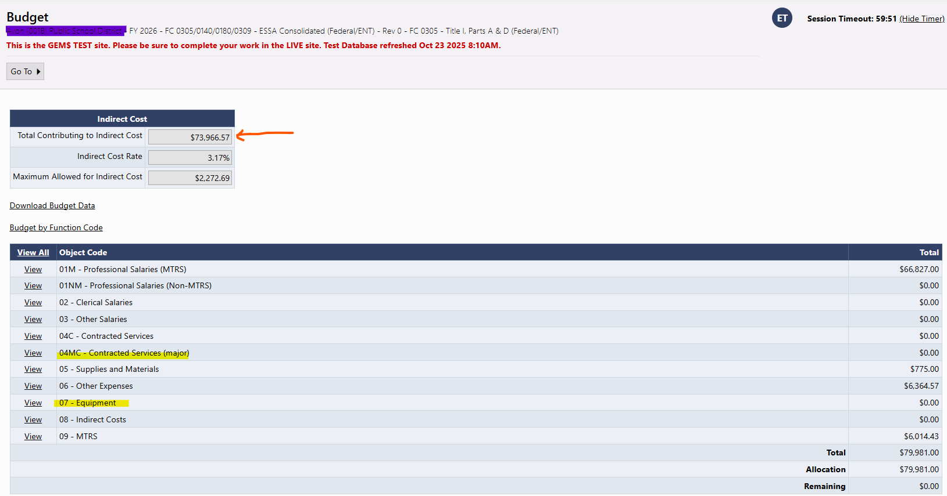
Indirect Costs – Your Indirect Rate is Not Applied to All Grant Expenditures
By regulation (2 CFR 200.1), there are some costs that are not eligible for your indirect cost pool (the amount to which your indirect rate is applied, also called the Modified Total Direct Cost (MTDC)):
Equipment
Capital Expenditures
The portion of contracts exceeding
$25,000 (will be raised to $50,000,
see next slide)
amount over $25,000 excluded
excluded

Slide 19
Indirect Costs – Major Contract Threshold to Increase
The Uniform Grant Guidance has been amended so that the amount that “counts” for indirect for major contracts has been raised from $25,000 to $50,000.
However, GEM$ automatic budget calculations was not updated in time to calculate for FY26 grants.
The new threshold will be instituted for FY27 grants and, at that time, those districts with FY26 grants and major contracts above $25,000 will be allowed to claim additional indirect (up to $50,000 on each contract) retroactively if they choose.
We will notify federal entitlement role holders when the retroactive indirect for
FY26 is available.

Slide 20
Indirect Costs – Implications for Revisions and Drawing Funds
Remember if your district takes indirect and you revise a grant changing Major Contracts (Object Code 04C) or Equipment (Object Code 07) – either increasing or decreasing – these revisions will change the amount of indirect you may take.
You will get an error if you have budgeted more for indirect than is allowed post-revision and need to rebudget indirect as well.
Remember that indirect, like all grant expenses, must be drawn on a reimbursement basis. Therefore, drawing the entire budget for indirect at the outset of the grant will raise red flags for auditors and monitors.

Slide 21
Budget Tags (Private School Equitable Services and Title I)
We discussed budget tags briefly under the Flexing section, but they are used throughout ESSA and IDEA applications to indicate which funds are being used to provide services to participating private schools
These tags are used to generate reports that are published indicating the amount reserved for equitable services for each of your eligible, participating private schools.
If budget details in the exact amount of the equitable services allocation are not tagged with the Private School Services tag, you will be unable to submit your application
Title I also has unique budget tags for items that are part of a Title I reservation. While you can submit your grant without these in the exact amount as the reservations, your liaison will not approve without proper Title I reservation tagging.
A feature within GEM$ that helps further define the purpose of a budget detail.

Slide 22
Budget Tags (Title III and IV)
Titles III and IV each have three required categories that must be accounted for in the budget (though this is only true for Title IV allocations greater than $30,000). We confirm these groups are funded via budget tags.
You must use all required budget tags in order to submit your application. In addition, your liaison will return your grant if you tag a budget item in the wrong category.
For Title IV, the budget tags also auto-calculate the amount for each category on the Title IV narrative page.
A feature within GEM$ that helps further define the purpose of a budget detail.

Slide 23
Budget Tags - Implications for Revisions
If you are removing a budget detail with a required budget tag, make sure that tag still appears in a different budget detail, or you will not be able to submit your revision.
For Title IV, check the Narrative page to make sure you are still funding each category at the required amount before submitting your revision.
If some amount of private school funds are reverted to the district, you must ensure that the new total equitable services amount is tagged in the budget.

Slide 24

Questions?
Use the Q&A feature to ask any outstanding
questions about the topics covered today.

Slide 25
Resources
Supplement, Not Supplant QRG
Indirect Costs
A Simplified Approach to Indirect Cost Rates (USED slide presentation)
Office of Finance and Operations (OFO) | U.S. Department of Education | U.S. Department of Education, Indirect Cost Division
Essential Information - Grants and Other Financial Assistance Programs, Indirect Cost Rates for Massachusetts LEAs
FY26 Title I Webinar Slides (contain information about School Ranking and Budget Tags)

