Slide 1
Progress Monitoring for Gap Closing
Federal Grants Conference
November 19, 2025
Karen Johnston, Moira Connolly, and Erica Champagne

Slide 2
Today’s session
Welcome and Introductions
High-level summary of overlapping requirements of ESSA grants, District Improvement Plans, and SOA Plans
A closer look at progress monitoring for gap closing
Breakout: Review Samples
Notes:
Do a poll on
how many involved developing DIPs, EBPs in SOA Plans, Title I programs/plans
implementing and progress monitoring/evaluating DIPs, EBPs in SOA Plans, Title I programs
Roles?

Slide 3
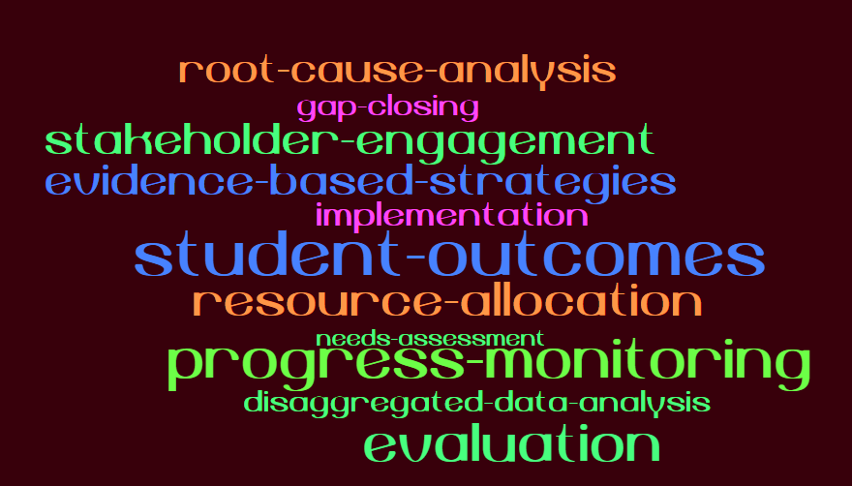
Overlapping requirements of ESSA grants, District Improvement Plans, and SOA Plans

Slide 4
Overlapping requirements: district planning processes
Requirement | ESSA Funding | District Improvement Plans | Student Opportunity Act Plans
Stakeholder engagement | X | X | X
Needs Assessment/disaggregated data analysis by student group to identify:
Overall needs and disparities by student group that need to be addressed | X | X | X
The underlying reasons for that need (aka root cause analysis) | X | X | X
Evidence-based approaches to improvement based on underlying causes | X | X | X
Resource allocation to support implementation (e.g. funding, staffing) | X | X | X

Slide 5
Overlapping requirements: District submission and DESE review
Requirement | ESSA Funding | District Improvement Plans | Student Opportunity Act Plans
Submission of plans/ESSA grant applications | Annual | Every 3 years | Every 3 years
Districts: progress monitoring/evaluations | Annual | Annual | Annual
DESE Reviews | Grant submission: Annually | Roughly every 6 years, as part of overall district review process | Plans: every 3 years
 | Program monitoring: Every 6 years |  | Progress reports: annually

Slide 6
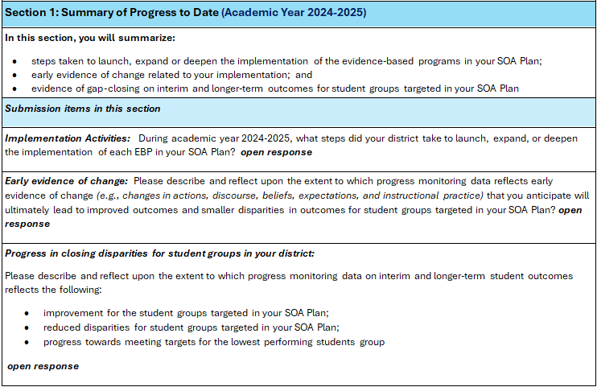
A closer look at progress monitoring for gap closing in SOA Plans
Notes:
Quick refresher of expectations for progress reports (since districts will be expected to submit an FY26 update on April 1, 2026).
Districts generally did a good job of describing implementation. Most often returned to districts for revisions because did not describe implementation strategies/supports for targeted student groups (e.g., Els, SWD).
Early evidence of change not as strong – either because this type of evidence isn’t as well understood, or possibly because district doesn’t collect it. Evidence you are on the right track.
Progress in closing disparities for student groups. Section most in need of improvement.
Often cited MCAS data weren’t available. Our reviewers didn’t push too hard on this, but in upcoming FY26 plans, we will expect to see outcomes data. This can include formative data from iReady, etc, which many districts included in early evidence of change.

Slide 7
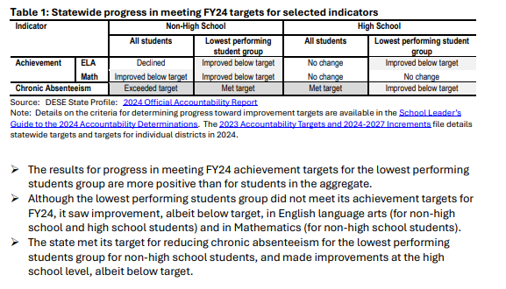
Statewide gap-closing: lowest performing students group
Notes:
From FY24 Legislative Report

Slide 8
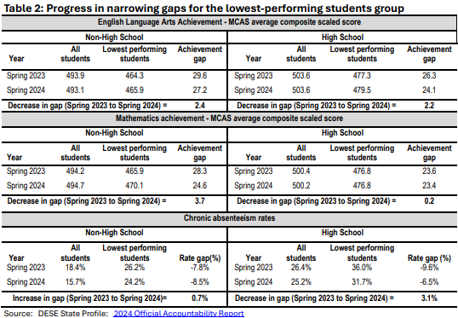
Statewide gap-closing: lowest performing students group
Notes:
➢ Between spring 2023 and spring 2024, the lowest performing students group saw
modest improvements relative to students in the aggregate in average composite
scaled scores in English language arts for non-high school and high school students
and in Mathematics for non-high school students.
➢ The gap in the chronic absenteeism rate for non-high school students in the lowestperforming students group increased relative to that of students in the aggregate.
Even though the lowest performing students group met its targets for reducing
chronic absenteeism, students in the aggregate exceeded the target for reducing
chronic absenteeism; as a result, the gap widened.
➢ Chronic absenteeism for high school students in the lowest performing students
group resulted in a more robust narrowing of disparities than for high school
students in the aggregate.
Tables 1 and 2 track progress for a single year and generally reflect positive progress for the
lowest-performing students group.

Slide 9
Breakout groups: glows and grows
District checklist

Slide 10
Breakout groups
Analytic glows and grows
 | What did analysis do well | What could district do to strengthen this analysis in FY26?
Implementation
Early evidence of change
Gap-closing for targeted student groups

Slide 11
Aligning analyses across reporting requirements
Considerations for districts:
To what extent do the EBPs in your current SOA Plan align to:
the Title I strategies you are annually evaluating?
Other grants you are implementing?
How might your district utilize/expand upon analyses for Title I program evaluation and other grant programs related to the EBPs in your SOA Plan?
To what extent can you consolidate progress monitoring and program evaluation in ways that satisfy multiple reporting requirements?

Slide 12
Timeline for FY26 SOA Plan Progress Reports
January 2026:
Updated template and guidance posted on DESE website
Overview Webinar
Data collection opens GEM$
January – March 2026
Updated Student Outcomes Comparison Tool
One-on-one district consultations (by request) with SOA team member
Questions can be submitted to SOAPlans@mass.gov
April 1, 2026: FY26 SOA Plan Progress Reports due in GEM$

Slide 13
Contact us
Karen Johnston, SOA Coordinator
Karen.S.Johnston@mass.gov
Erica Champagne, Director, Office of Effective Practices Erica.Champagne@mass.gov
Moira Connolly
Moira.Connolly@mass.gov

