Slide 1
The Registered Teacher Apprenticeship Program (RTAP)
A Job-Embedded Pathway to Teacher Licensure in Massachusetts
Presented by: Claire Abbott & Lakia Baymon

Slide 2
Welcome and Framing

Slide 3
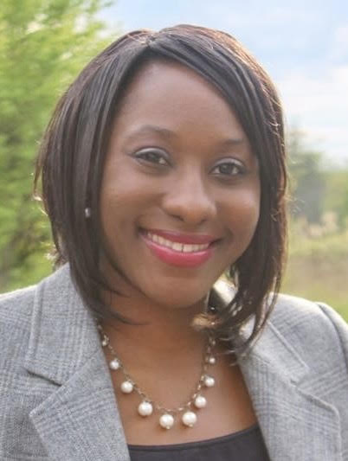
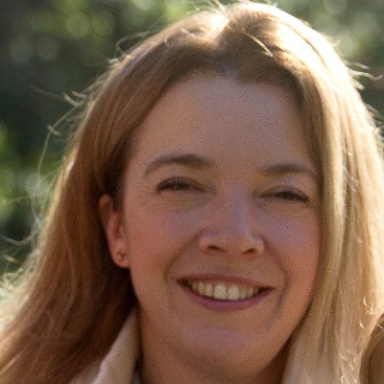
Welcome and Introductions
Lakia Baymon
Registered Teacher Apprenticeship
Program Coordinator
Claire Abbott
Director of Educator Effectiveness

Slide 4
Purpose of Today’s Session
We will:
Ground RTAP in DESE’s educator workforce vision
Understand what RTAP is and who it serves
Review statewide progress and national context
Explore funding and sustainability strategies
Walk through grant opportunities and district planning tools
Outcome:
Clear understanding of RTAP as a high‑quality, job‑embedded pathway that diversifies and strengthens the educator workforce in Massachusetts.

Slide 5
DESE Educational Vision
Strategic Objective 3 - "Diverse and Effective Workforce"
Develop and sustain a workforce that is diverse, culturally responsive, well-prepared, and committed to continuous improvement, so that all students have equitable access to effective educators.
Development
Recruitment
Retention
3.1 Develop an increased and robust pipeline of diverse and well-prepared educators and leaders
3.2 Create the conditions to sustain and retain diverse and effective staff, particularly those who entered the field through alternative pathways
3.3 Implement opportunities for all staff to engage in a cycle of continuous improvement, utilizing effective teaming structures
Notes:
Our Goal – the way we are going to do this is expand equitable access to the pipeline – contextualized by that – where are there equity gaps in entering the profession –
Point: we don’t have a teacher shortage, but we DO have role-specific shortages, regional pipeline deserts, and an urgent need to diversify our workforce to better reflect and be responsive to the rapidly diversifying student population throughout the state.

Slide 6
Why This Matters

Slide 7
Why Do We Need to Diversify?
10% of MA teachers are educators of color (2023).
Students of color = 43% of enrollment statewide.
RTAP helps close the student-teacher demographic gap.

Slide 8
National and State Landscape
National Landscape:
The National Center for Grow Your Own (NCGYO) leads efforts to expand equitable teacher pathways rooted in local communities.
NCGYO partners with states and districts to design, scale, and sustain Grow Your Own programs that align with apprenticeship models.
Focus areas include strengthening candidate supports, increasing access for BIPOC educators, and improving long‑term funding and workforce pipelines.
NCGYO is currently working with over 30 states
State Landscape:
MA RTAP is supported through the MA Executive Office of Labor and Workforce Development (EOWLD) and the Division of Apprentice Standards (DAS).
DAS registers apprenticeship programs and ensures compliance.
DESE serves as the education intermediary for RTAP.
DESE supports districts and educator preparation programs with program design, registration, and implementation.
DESE provides guidance, technical assistance, and funding to build strong and sustainable teacher apprenticeship pathways.

Slide 9
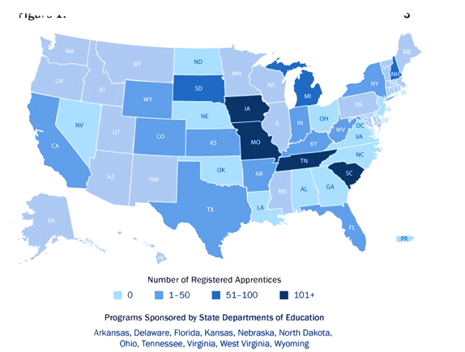
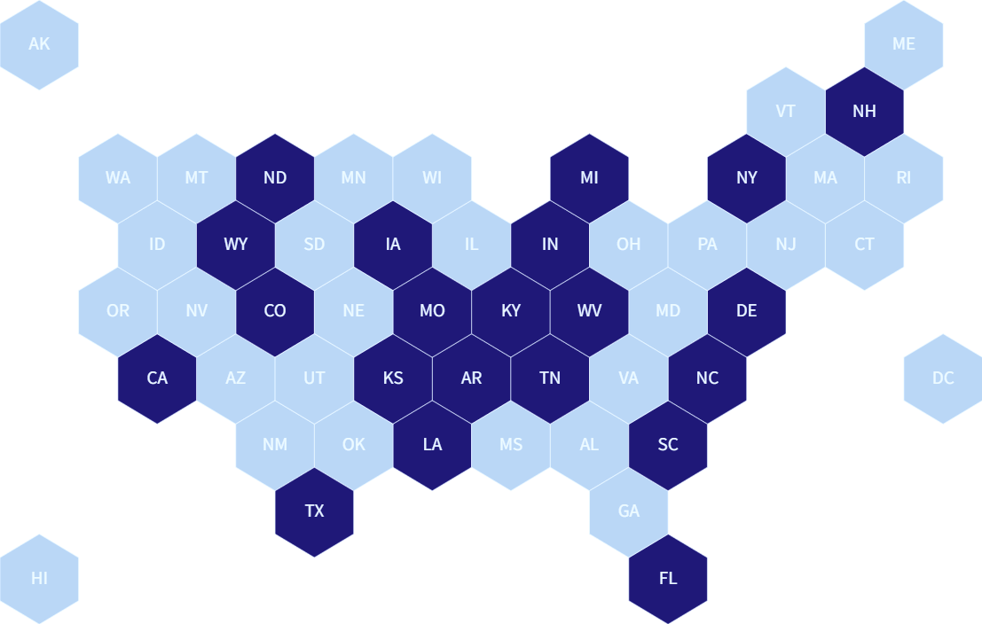
Apprenticeship Programs Across Country
Source: Apprenticeship USA, U.S. Department of Labor. Data and statistics; Apprenticeship USA, U.S. Department of Labor. Partner finder; Personal email with U.S. Department of Education, Office of Planning, Evaluation, and Policy Development (2024, February 20).
Registered Teacher Apprenticeship Programs By State in 2023
SOURCE: U.S. Department of Labor

Slide 10
What is RTAP?

Slide 11
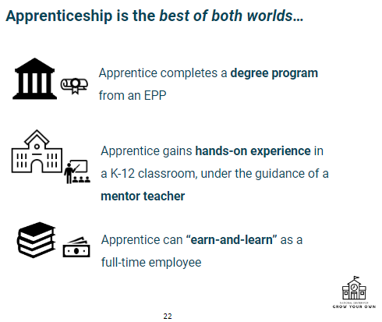
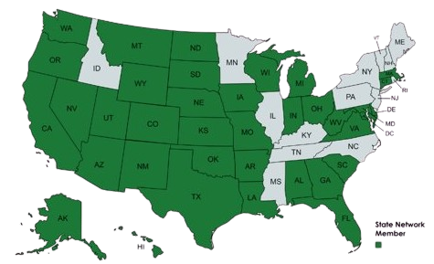
What is a Registered Teacher Apprenticeship Program (RTAP)?
A clear, articulated pathway for an aspiring educator to become a teacher for free and get paid to do so.

Slide 12
Registered Teacher Apprenticeships in MA
Educator Diversity
Educator Quality
Educator Pipeline
RTAP strengthens the educator workforce in three important ways:
Expands pathways for diverse, community‑rooted future educators.
Paid, job‑embedded pathway combined with college coursework.
Focus on SPED, ESL, STEM, and Early Childhood with strong mentorship.

Slide 13
Massachusetts RTAP Goals
Diversify the teaching workforce.
Remove financial barriers.
Strengthen district-EPP partnerships.
Sustain programs through braided funding.

Slide 14
Program Foundations & Timeline

Slide 15
Timeline
Summer/Fall 2024 (FY25)
Application & Selection
Summer/Fall Grant Application
Winter Selection & Notification
Winter/Spring 2025 (FY25)
Preparation
Mentor Selection & Training
Apprenticeship Recruitment
Summer/Fall 2025 (FY26)
Cohort 1 Launch
Summer Coursework
Fall Employment/ Apprenticeship Launch
SY2025-2026 (FY26)
Cohort 1 Year 1 Implementation
Fall/Winter Vendor Selection
Cohort 2 Grant Application Opens
Summer/Fall 2026 (FY27)
Cohort 2 Planning Grant/RFP in December 2025
Cohort 1 Continuation Grant/RFP in Spring 2026
SY 2026–2027 (FY27)
Cohort 2 Planning & Cohort 1 Continuation
Summer/Fall 2027 (FY28)
Cohort 3 Planning Grant/RFP in December 2026
SY 2027–2028 (FY28)
Cohort 1 & 2 Implementation Continuation Grant/RFP in Spring 2027

Slide 16
FY25 & FY26 Focus
FY25 Focus:
Program establishment
Recruitment & training
Initial setup
Budgets aligned to RTAP goals
FY26 Focus:
Sustainability & growth
Support for apprentices & mentors
Strengthen district & EPP collaboration

Slide 17
Funding & Sustainability

Slide 18
Five Principles for Sustainable Funding
1. Identify sustainable sources to braid with.
2. Align with LEA budget cycles.
3. Reduce EPP operating costs.
4. Leverage student aid (Pell, TEACH, WIOA).
5. Transition from one-time to recurring funds.

Slide 19
Overview
RTAP allows aspiring educators to earn while they learn through paid classroom experience and approved coursework in partnership with educator preparation providers.
Highlights:
Sustainable funding principles
Guidance for 9408-eligible districts
RTAP grant and funding opportunities

Slide 20
Expense Categories
Principle1 – Expense Categories & Funding
Potential Funding Sources
RAP design & implementation – Design costs, Admin
SAEF, SEED, TQP, ABA, State Funds, Philanthropic Funds
Related Technical Instruction – Tuition, fees, books
Pell, TEACH, WIOA, IHE-based aid
Progressive wages – Wages (must be W-2), fringe pay, other compensation
District General Funds, State funds, ESSA T1, T2
Notes:
Erica
There are several broad categories of expenses to consider when designing and implementing an educator RAP:
RAP design & implementation: Funds that support program design, program recruitment, ongoing implementation costs, program scale-up costs, and program operations staff.
Supplemental education: Funds used for the apprentice’s education or certification such as loan forgiveness, tuition reimbursement, certification fees, textbooks, and supplies.
Progressive wages: Wages provided to apprentices for their clinical apprenticeship hours.
School-based personnel supports for apprentices: Any additional costs for school-based personnel, such as teacher mentors for apprentices, or school principals who oversee RAP administration or provide instructional support for mentors.
Basic need supports: Funds used for basic apprentice living expenses, such as transportation, housing, childcare, and food, etc.
Other: Expenses that are not part of the categories above and may be program specific.

Slide 21
Principle 2 – LEA Budget Alignment
Integrate apprenticeships into budgets
Plan ahead for vacancies
Leverage existing staff roles
Use unrestricted funds for coordination and support

Slide 22
Principle 3 – Reducing EPP Costs
Consider dual enrollment for high school students
Partner with community colleges to align and map out a transfer plan
Seminar + work experience model to maximize units each quarter
Fold apprenticeship coursework into existing EPP course offerings
Sequencing courses to be accelerated

Slide 23
Principle 4 – LEA Budget Alignment
Pell Grants, TEACH Grants, WIOA, and negotiating university level aid caps
Supports low-income, unemployed, and transitioning workers
Reduces costs for apprentices and districts

Slide 24
Principle 5 – Transitioning from one-time funds to sustainable funding
Catalogue current funding sources as recurring v one-time
Identify expiration dates for one-time funds
Locate replacement or replenishment funding sources that match the structure of 1x funds
Sunset 1x funds and replacing with new sustainable sources (Cross Titrate)

Slide 25
Massachusetts Funding Opportunities

Slide 26
RTAP Grant Overview
Eligibility: Public, charter, collaborative schools
Priority: Title I/9408 districts
Funding: $2M FY25 + $2M FY26
Awards: $50K–$500K
Uses: Salaries, tuition, stipends, recruitment

Slide 27
DAS Funding: Registered Apprentice Tax Credit
State tax credit equal to 50% of the wages paid to an apprentice in a taxable year, up to a maximum of $4,800 per apprentice.
Employer may qualify for a maximum of $100,000 in total RATC credits per calendar year.
The tax credit can be taken for up to two taxable years for the same apprentice, if otherwise, eligible. The two years must be consecutive.
If the tax credit exceeds the tax otherwise due, 100% of the balance of the RATC credit may, at the option of the taxpayer, be refundable to the taxpayer.
Notes:
Claire

Slide 28
Budget Planning Examples

Slide 29
FY25 Expenses and Funding
FY25 funding focuses on:
Budgets must align with RTAP objectives and detail costs & funding sources.
Program Establishment
Recruitment & Training
Initial Program Setup

Slide 30
FY26 Expenses and Funding
FY26 funding focuses on:
Budgets must align with RTAP objectives and detail costs & funding sources.
Personnel Support
Program Implementation
Apprentice and Mentor Support

Slide 31
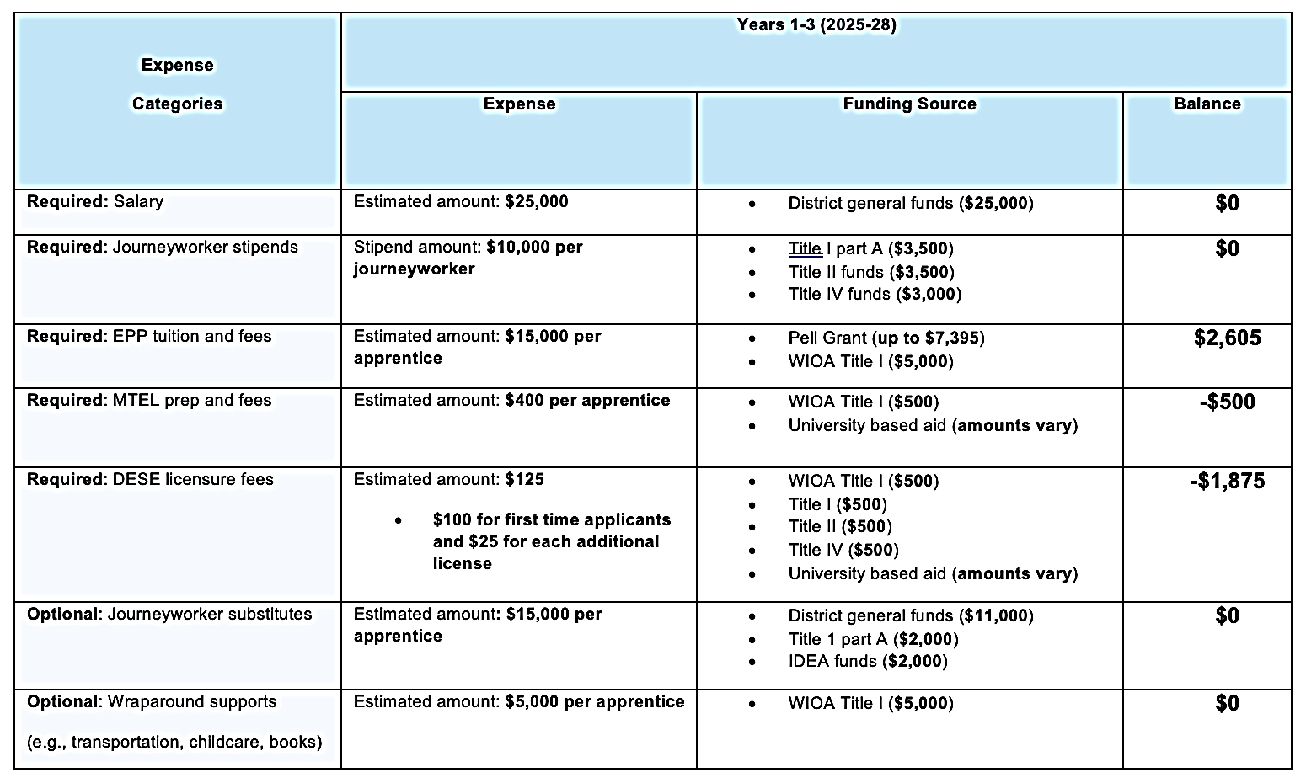
Expenses and Funding Planning Example
Notes:
Nicole talk through

Slide 32
Expenses and Funding Outline
Districts must outline the following expenses:
Clerical Salaries
Apprentice: Wages
Marketing/Promotion
Professional Salaries
Apprentice: Tuition and Fees
Other Salaries
Contracted Services (Projects/Initiatives)
Mentor: Professional Development
Mentor: Stipends
Program Sustainability (Supplies/Operations)
Other Expenses
Notes:
Lakia:
As it relates to expenses and funding, districts must outline key expenses for effective funding allocation. This includes salaries (professional, clerical, and other staff), contracted services, and marketing. Apprentices need wages, tuition, and fees covered, while mentors require professional development and stipends. Sustainability is key. Supplies, operations, and other costs keep the program running. A clear budget supports a strong, lasting apprenticeship program.

Slide 33
RTAP and DESE’s Educational Vision
DESE Vision:
To ensure that all students receive an equitable education, we must ensure that all educators are prepared to be effective, using evidence-based and culturally sustaining practices that help all students thrive.
How RTAP Supports This Vision:
Expands access to teacher licensure through paid, job-embedded preparation.
Cultivates a diverse educator workforce reflective of Massachusetts’ students.
Promotes equity and inclusion through culturally and linguistically sustaining practices.
Strengthens educator effectiveness through mentorship and classroom experience.
Ensures sustainability through collaborative district–EPP partnerships and braided funding.

Slide 34
Key Takeaways
RTAP = Earn while you learn.
Innovative funding model for workforce diversity.
Plan early, braid funds, focus on sustainability.

Slide 35

Resources and Additional Information
Questions & Information:
For more information, please visit the DESE RTAP website.
For questions to DESE, email:
EducatorApprenticeships@mass.gov
Resources:
Registered Teacher Apprenticeship Tax Credit
RTAP Grant/RFP (Fund Code 221)
MA Division of Apprentice Standards: Funding Opportunities
Notes:
Claire
On behalf of ERA, DESE, and the RTAP team, we thank you for your engagement and participation in today's webinar! We hope you found the information helpful. If you'd like to follow up with any questions or be added to our mailing list to receive updates about the program, please feel free to contact us at educatorapprenticeships@mass.gov.
You can also visit the DESE RTAP website for more details and resources. We will provide the link in the chat. We look forward to staying connected and supporting your efforts to build a diverse and effective teaching workforce! [end recording]

Slide 36
Questions?
Notes:
15 min

