Slide 1
Fiscal Requirements for Title IIIA
November 17, 2025

Slide 2
WELCOME: 5 minutes
Please answer in the chat!
What is the #1 thing Title III brings to your EL students in 2025-26?

Slide 3
Housekeeping Items
Before we begin:
  These slides are posted, with all other slides from this virtual conference, on our website.
  To preserve bandwidth, your video and microphone are turned off.
  Use the Q&A feature at the bottom of the screen to ask questions (not Chat).

Slide 4
Contents
01
Title IIIA Overview
02
Title IIIA Fiscal Requirements
CONTENTS
03
Title IIIA Allocations and Spending
04
Guidance and Resources
05
Q&A

Slide 5
Title IIIA Overview
01
Title IIIA Overview

Slide 6
What is the Purpose of Title IIIA English Learner Grant?
Title IIIA is a supplementary grant for English learners (ELs)
It helps ensure that ELs develop English proficiency and can attain high levels of academic achievement

Slide 7
Title IIIA English Learner Grant Requirements
Title IIIA program requirements:
Increase the English proficiency of ELs by providing supplemental effective language instruction
Provide effective professional development
Provide effective parental engagement strategies and activities for ELs families
Title IIIA, Section 3115(c)
https://www.doe.mass.edu/federalgrants/titleiii-a/resources/activities.docx
Effective Language Instruction
Parent and Family Engagement
High Quality Professional Development

Slide 8

Title IIIA Supplement Not Supplant Provision
SUPPLEMENT, NOT SUPPLANT: Section 3115(g) –
Federal funds made available under this subpart shall be used so as to supplement the level of Federal, State, and local public funds that, in the absence of such availability, would have been expended for programs for English learners and immigrant children and youth and in no case to supplant such Federal, State, and local public funds.

Slide 9

How to Test the Supplement Not Supplant Provision?
Would this activity be funded in the absence of the Title IIIA grant?
Title IIIA, Part A funds may not be used to meet requirements of federal laws governing ELs (Title VI of the Civil Rights Act of 1964 and Equal Education Opportunities Act of 1974) and the Massachusetts LOOK Act (Chapter 138 of the Acts of 2017), among others.
Supplement, Not Supplant Quick Reference Guide

Slide 10
Let’s Test It Together
Can the Title IIIA grant pay for our Lexmark translation software?
Title IIIA funds can be used for supplemental translation and interpretation activities that are specific to the program and not provided for all students. For example, Title IIIA funds can be used to translate parental notifications, postage for mailing notices, and personnel costs for meetings with families of eligible Title IIIA students.
However, Title IIIA funds cannot be used to pay for translation and interpretation costs on state academic achievement assessments, including report cards. They also cannot be used to meet Civil Rights obligations to ensure meaningful communications with English learners’ parents/guardians.

Slide 11
Title IIIA Fiscal Requirements
02
Title IIIA Fiscal Requirements

Slide 12

First-in First-out Rule
Title IIIA is a Multi-Year Grant with a 27-month lifespan
Multiple fiscal years of Title IIIA funding will be active at the same time
The oldest funding should be expended first

Slide 13
Administrative Cost Cap
DIRECT ADMINISTRATIVE EXPENSES: Section 3115(b) –
School districts receiving Title IIIA funds may use no more than 2% of their allocation for the cost of administering the program.
Required and Authorized Activities
Administrative expenses are those expenses used for running the grant, not expenses related to providing direct grant services to students.
Indirect costs are always administrative expenses.
Some examples of Title IIIA administrative expenses are costs associated with:
  Developing the Title IIIA portion of the consolidated ESSA application
  Ensuring compliance with applicable federal laws and regulations
  PD for Title III administrators re: administering the grant.

Slide 14

Private Schools Participation in Title IIIA
Eligibility: Private schools within the geographic boundaries of the school district.
Fiscal Management: Districts maintain control over the Title IIIA funding. Funds are never provided directly to a private school.
Equipment: Districts retain ownership of any equipment or supplies purchased for equitable services and should remove them from private schools if no longer used for equitable services.
Allocations: DESE will publish district allocations for equitable services by private school annually.
Consultation: Districts should estimate the available funds for equitable services for the next school year based on the prior year’s reservation for initial consultations. Once final reservations have been calculated, districts must notify participating private schools.
ESSA Equitable Services for Private Schools Resource Guide
Notes:
Massachusetts Department of Elementary and Secondary Education
14

Slide 15
Title IIIA Consortia
What is a Title IIIA Consortium? A school district is eligible for a Title IIIA grant if the calculated per-pupil amount adds up to an allocation greater than or equal to $10,000 (Title IIIA, Section 3114(b)). If a school district does not reach this eligibility threshold, they may apply for a Title IIIA grant jointly with other districts in a consortium in order to be eligible to participate in Title IIIA.
The Consortium Fiscal Lead is responsible for all financial transactions of the consortium (requisitions, purchases, payments, etc.) and for maintaining records of all financial transactions carried out on behalf of the consortium. This covers signing of all contracts and hiring of the Title IIIA program staff.
A Title IIIA Consortium fiscal lead agency may not subgrant Title IIIA funds to other members of the consortium. No reimbursements for member districts are allowed.
Title III Consortia Quick Reference Guide

Slide 16

Title IIIA Consortia - Continued
The Consortium Fiscal Lead is responsible for initiating all Title IIIA grant revisions in GEM$, and ensuring the Memorandum of Understanding (MOU) is re-signed by all member districts with each Title IIIA program modification and GEM$ revision.
The re-signed MOU must correctly reflect the Title IIIA budget in GEM$.

Slide 17
Title IIIA Allocations and Spenidng
Title IIIA Allocations and Spending
03
Title IIIA Allocations and Spending

Slide 18
Trend in Title IIIA Funding
Per DESE’s Grant Allocations & Awards page

Slide 19
Trend in Title IIIA Spending
38%
11%
61%
3%

Slide 20
Spending Reminders
The Monthly Claim Status report is at the bottom of each Federal Grants Monthly Newsletter. You can also sign up for the newsletter here
FY24 funds have expired on 9/30/25, but districts have until 11/30/25 to claim funds
Please check your district’s November 2025 claim status report balance for Title IIIA and reach out to your DESE Federal Grant Liaison with any questions you might have

Slide 21
Guidance and Resources
Guidance and Resources
04
Guidance & Resources

Slide 22
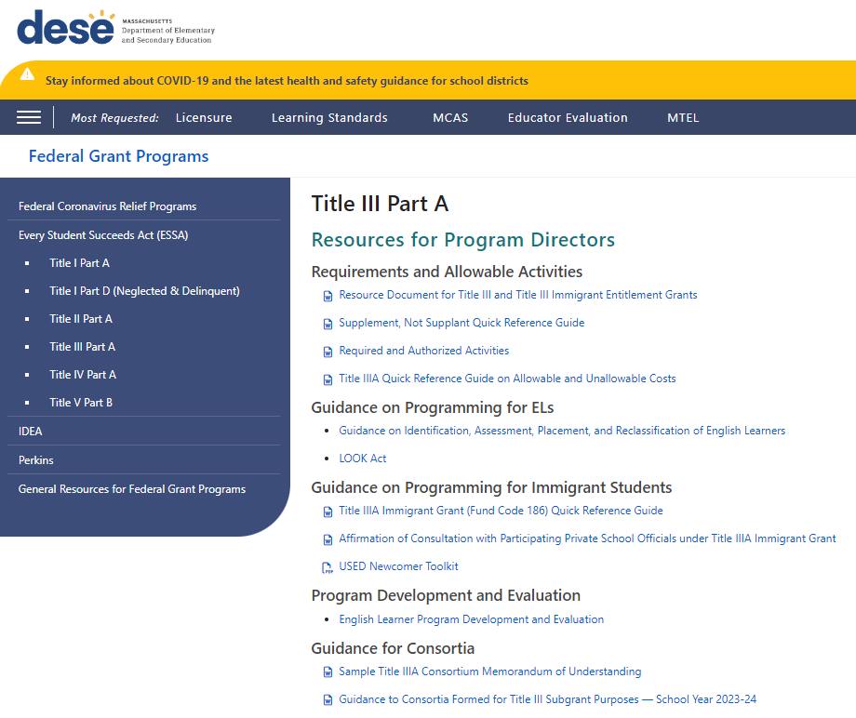
Important Resources
Federal Grant Programs Title III Part A webpage
Resource Document for Title III and Title III Immigrant Entitlement Grants
Supplement, Not Supplant Quick Reference Guide
Required and Authorized Activities
Title IIIA Quick Reference Guide on Allowable and Unallowable Costs
Sample Title IIIA Consortium Memorandum of Understanding

Slide 23
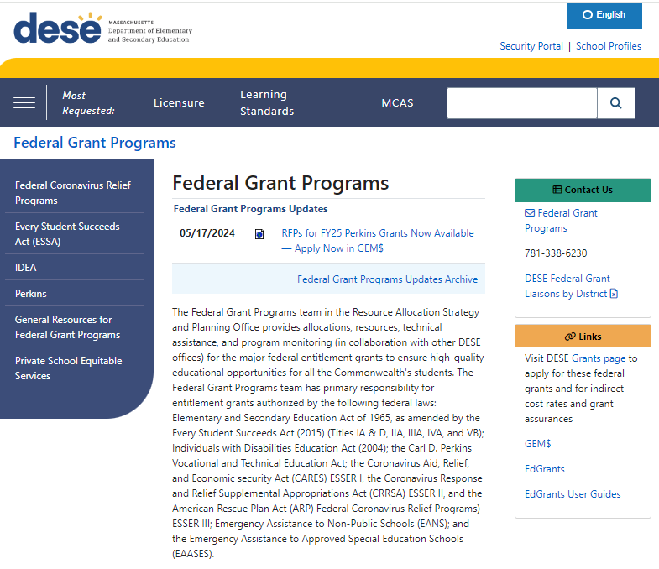
Questions?
Dessi Kirova – dessi.g.kirova@mass.gov
RASP team: Federal Grant Liaisons by District

Slide 24
Q&A
05
Q&A

Slide 25

Post Your Questions in the Q&A

Slide 26




Thank you
THANK YOU
781-338-6230
federalgrantprograms@mass.gov
www.doe.mass.edu/federalgrants
135 Santilli Highway, Everett, MA 02149

