Slide 1

Spring 2026 Federal Grants Conference
Presented by:
Cynthia Schonagel, Director of ELE and ML Services
Ellen Ferris, ELE Educator & EL Evaluator Committee Member
Cathryn LaDuke, EL Evaluator, ELE Educator & EL Evaluator Committee Member
Panel guest:
Kris Theriault, Grants Director
Title IIIA Programming

Slide 2
Introduction
In this session, the Chicopee Public Schools’ Director of ELE and ML Services, along with two teachers and EL Evaluators from the district, will share how they used Title IIIA funds to create a dedicated committee that works year-round to assess English learners’ needs, analyze language proficiency and performance data, and strengthen ELE programming district-wide.
Participants will take part in an applied workshop that highlights the committee's process of identifying needs, examining data, identifying gaps, and working through the same decision-making framework used by the presenting team.
The participants in this session will walk away with tools to customize and incorporate a rippling effect in their own school districts.

Slide 3

CHICOPEE AT-A-GLANCE

Slide 4
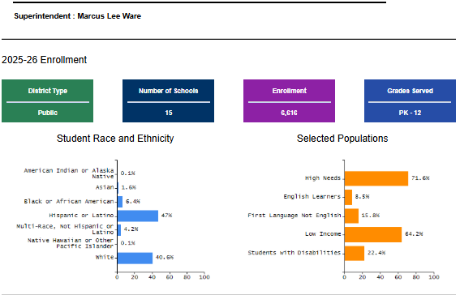
Chicopee Profiles Data
LANGUAGES
OVER 25
ELE STAFF
28
SCHOOLS
15
ML
ELs / LTELs / SLIFE / NEWCOMERS

Slide 5
Grant Item
Overview

Slide 6

Grant Language

Slide 7
Purpose
TIII Grant approved activity to support our English Learners, engage with data, evaluate the needs of the District, and supplement core work.
Activities are focused on ways to make a better experience for our ELs and their families through the identification of feedback received from families, staff, leadership and community.
Identifies short term and long term goals and addresses them to improve programs and student learning environments.

Slide 8
Overview
How/why it was developed:
Began as a way to assess needs, increase communication, and move us forward as District needs and changes were being identified
How it has evolved:
Became a useful way to plan and make improvements that directly support our students by focusing on areas of need through discussion with a data lense
Informed areas and focused decisions in the areas of: SLIFE / ELSP / LAT / Intervention, etc.

Slide 9
Overview, continued
Current:
Data analysis tied to Ellevation, ELSP intervention recommendation and analysis, District supports and timelines
Streamline procedures, communicate effectively district-wide, and respond to topics
Long Term continued focus:
Continue with Data linked to Ellevation, intervention & benchmarking platforms, discuss trends, communicate out to stakeholders

Slide 10
Highlights
The committee is comprised of teachers from both secondary and elementary so we are able to discuss data and the importance and impact during transition years, as well as vet, research, and make recommendations for all interventions.
We discuss the issue to be addressed and pros and cons of each intervention as a group and leadership and colleagues take our thoughts into consideration for decision making and improvement for the department and District with a goal of strengthening our services and impact to our students and families.
We offer an important perspective as we are directly working with students, families, teachers, staff, leadership and members of the school community.

Slide 11
The
Process

Slide 12
Examine Data & Identify Gaps
How the work starts…
Identifying Needs
Strengthen ELE
Programming

Slide 13
The Conversation
What needs our focus and attention?
  How do we know:
      Observation, Feedback, Meetings, Surveys, District and State trends and changes
Examine the issue?
    Discuss
      What does the data look like?
      Are we seeing patterns across the board re: the issue(s).
    Discuss
      What needs to be completed, why? And when?

Slide 14
The Work –Example 1
The Feedback:
ELSP review showed lack of intervention options directly supporting target language domain areas and lack of tracking tool.
The Analysis:
Complete data & brainstorm solutions

Slide 15
The Work –Example 1, cont.
The Outcomes:
Create electronic ELSP tracking tool
  Individual school English Learner Success Plan google docs are used to document and review student’s on plans, end of the year progress, goals made, and outcomes of the previous years.
Review the tool to identify committee focus and drive resources and decision making
  Intervention review and make recommendations
    Flashlight, Imagine Learning, Off2CLass
  Review Intervention use and evaluate data trends to guide intentional intervention planning per student

Slide 16
The Work cont. – Example 2
The Feedback:
Not all teachers are on the same page for systems, school staff lack familiarity with procedures, LATs need support and direction, and Leadership needs information. as to what, when and who to support– Ex. New ELE sites, teachers, LATs

Slide 17
The Work cont. – Example 2, cont.
The Analysis:
Identify and discuss needs and determine ways to disseminate information.
Ex. Are EL interventionists completing their ELSP data forms to review their data? What supports and resources are needed?
Ex. Are LATs focused on topics and timelines? How can we improve upon this?
Ex. Does leadership and ELE staff aware of important information and timelines?
The Outcome:
Electronic Handbook, Website linked resources, On site re-training for all LAts
Creation of comprehensive ELE Yearly Checklist

Slide 18
The Action Plan & Effect
How do we get the outcomes integrated into the district?
Beginning of the year professional development
Explanation and resources to principals
All department meetings
Site check-ins throughout the school year
The ELE Department website
The impact on students and families:
Teachers have more energy and confidence
Schools have process for ensuring family translation needs
Clarified communication between teachers and school staff
Families ensured that all student monitoring and progress reports are complete

Slide 19
Your
District

Slide 20
Reflection, Planning and Tools:
At your tables:
What are your anticipated needs
  How to identify
How can TIII Funding assist with your goals
  Short term / long term – What can my committee do?
  What does my committee look like?
  Participants , facilitator, duration, etc.
Title III Planning Template
Sample DISTRICT ELE/ML General Checklist Template

Slide 21
Questions

Slide 22

THANK YOU!
Contact Information:
cschonagel@cpsge.org

