Slide 1
Spring Federal Grants Conference: Grants Management Housekeeping
June 9, 2026
Jennifer Ahern, Grants Management Supervisor
Andrew Owens, Grants Specialist

Slide 2
DESE as an Organization
An organization based on function
Program units - can we? / Allowable costs (applications)
Grants Management - procurement for grant programs all grants flow through - $

Slide 3
Federal Entitlements (ESSA, IDEA)
Covers 2 ¼ state fiscal years ~
  Year 1: 7/1* – 6/30
  Year 2: 7/1 – 6/30
  Year 3: 7/1 – 9/30 (3 months)
  DESE rolls unclaimed balances from Year 1 into Year 2 and into Year 3 if not liquidated. (NOT PERKINS!)
  *Actual start date depends on grant submission by the LEA

Slide 4
FY2025 & FY2026 ESSA / IDEA
FY25 Year 3 – (as of July 1)
Last date to submit final revisions 8/31/2026
Reimbursement Requests close 11/30/2026
FER filing due 12/31/2026
Can use FER filing to claim final balances, if needed
FY26 Year 2 – (as of July 1)
7/1/2026 – 6/30/2027
DESE will roll unclaimed balances into Year 3 in July of 2027

Slide 5
Obligation for Federal Grants
Deadline for obligation depends on type of expense:
If the obligation is for: | The obligation is made:
Acquisition of real or personal property | On the date on which the State or subgrantee makes a binding written commitment to acquire the property.
Personal services by an employee of the State or subgrantee | When the services are performed.
Personal services by a contractor who is not an employee of the State or subgrantee | On the date on which the State or subgrantee makes a binding written commitment to obtain the services.
Performance of work other than personal services | On the date on which the State or subgrantee makes a binding written commitment to obtain the work.
Public utility services | When the State or subgrantee receives the services.
Travel | When the travel is taken.
Rental of real or personal property | When the State or subgrantee uses the property.
A pre-agreement cost that was properly approved by the Secretary [of Education] | On the first day of the grant or subgrant performance.

Slide 6
Liquidation (Final Reimbursement & Closeout)
Liquidation = final reimbursement request process
  Extends beyond the grant obligation end date by approx. 60 days (not true for state funded or Perkins/other fed grants!)
  This varies by grant type; Check the Grant Award Notice (GAN)
Closeout – Final Expenditure Report (FER) filing
  90 days post obligation end
  Can sometimes use the FER filing to claim final balances*
Federal entitlements (Titles, IDEA) have 60 days to liquidate using Reimbursement Request form; Additional 30 days to liquidate using FER filing.
Timing final requests and revisions – have a plan!
*Know when the FER CANNOT be used to claim final balances.

Slide 7
Grant Award Notice (GAN)
The Grant Award Notice (GAN) end date determines the timing of deadlines:
  Final Revisions (amendments): 30 days prior to grant end date.
  Final Reimbursement Requests: 60 days post grant end date (approx.).
  Final Expenditure Report: 90 days post grant end date.
Grants that end 6/30 have approx. 46 days to request final reimbursement depending on what day Accounts Payable ends. (PERKINS!)
  Mid-August final reimbursement request deadline.
  Mid-August FER filing IF using FER to claim final balances.
Grant obligation end date drives the final reimbursement and FER closeout timeframe
If a GAN is showing dates that look incorrect, please let us know!

Slide 8
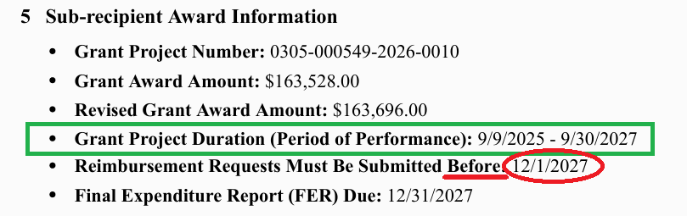
Grant Award Notice (GAN) continued

Slide 9
FY2027 Federal Entitlements
FY2027 federal entitlements RFPs are posted!
  Year 1: 7/1/2026* – 6/30/2027 (FY27)
  Year 2: 7/1/2027 – 6/30/2028 (FY28)
  Year 3: 7/1/2028 – 9/30/2028 (FY29 - 3 months)
  (Perkins does not follow the multi-year timeline)
*Actual start date depends on grant submission by the LEA

Slide 10
Federal Entitlement Grants
The grant start date for entitlements is based on when the grant is submitted through LEA Fiscal Representative Approved step in GEM$.
  Only grants submitted through this step on or before 7/1 will get 7/1 as a start date.
  Superintendent must be the one to submit the Super step.
  Have a plan for submission timeframes at the district level.
Notes:
Best practice for ALL grants have the super submit but if it is someone authorized to sign contracts for the district as the super’s designee this is ok; in general have a PLAN for transition of information and roles as people leave the district; have backup folks in place. COMP GRANTS!

Slide 11
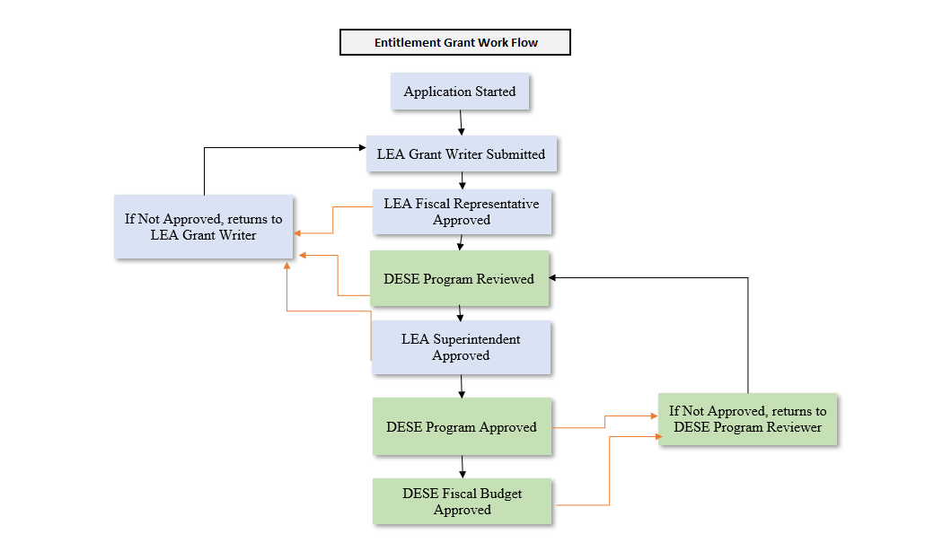
Entitlement Grant Workflow
UAAs and Grantwriters can start applications
Only Grantwriters connected to that specific app can submit
LEA fiscal is universal role to LEA; business manager or their designee (Start date tied to this step!)
Must be Superintendent
Grants Management
Access to GAN once DESE fiscal Budget Approved
Notes:
Grant will follow this workflow each time (orig + revisions); roles are not meant to be everyone in the district who touches a grant it is designed to only give access to the people who need access to that grant.

Slide 12
GEM$ User roles
User assigned roles serve as controls within the grant system
User roles should only be assigned to those who need access to those roles to perform their job duties
User roles serve as an efficient way for DESE to be able to communicate with the appropriate person within an LEA
User roles must be kept accurate and up to date/relevant within an LEA

Slide 13
User Access Administrator (UAA)
User Access Administrator (UAA) is responsible for creating and maintaining LEA user roles
District level user
Expectations:
  Roles are being deactivated as needed
  Once yearly review/maintenance (at a minimum)
  Backup UAAs established (within reason)
Strict policy around DESE staff NOT connecting users for LEAs
Notes:
Like an admin level user for LEA – holds the power!

Slide 14
LEA Grantwriter(s)
Role assigned by UAA in the system
Connected to grant(s) they need to complete/submit
Responsible for initial grant submission and any revisions to grants that they are assigned grantwriter
Works with LEA fiscal rep to get budgets aligned and categorized properly
Can move the grant from “Not Started” to “Application Started” (UAAs can change this status as well)

Slide 15
LEA Fiscal Representative
Role assigned by UAA in the system
District level user (across all grants/clearinghouse)
Responsible for reviewing budgets and approving all grant submissions from the LEA
Should be assigned to the highest-level business officer at the organization (i.e., School Business Official, or their direct reports)

Slide 16
LEA Superintendent / Chief Executive
Role assigned by UAA in the system
This role must be assigned to the superintendent/chief executive/leader of your organization
Changing the grant status to LEA Superintendent/Chief Executive Approved is considered a contractual sign-off on the grant submission
This role should be limited within an LEA
Any surrogate for the actual superintendent/chief executive holding this role must be authorized to sign contracts and must be designated on the LEA’s CASL form (Contractor Authorized Signatory Listing) on file with DESE’s Grants Management office.

Slide 17
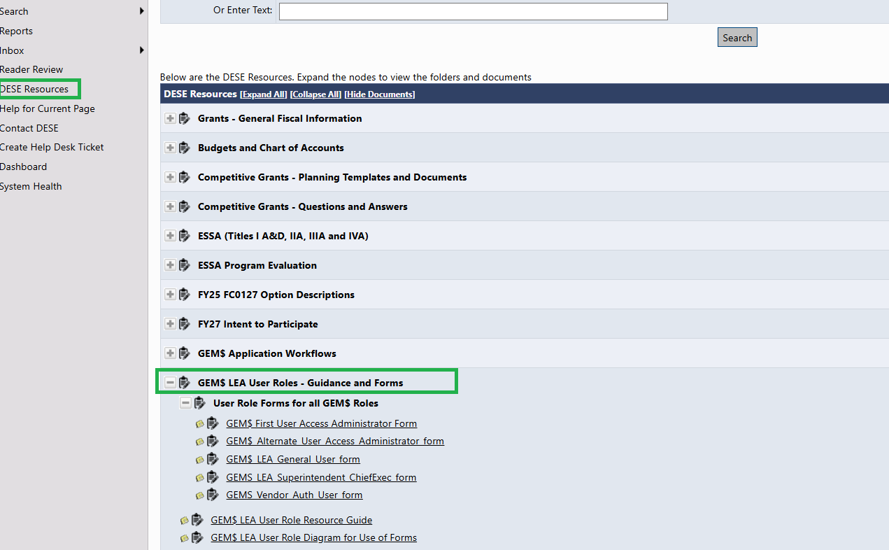
DESE Resources Page in GEM$

Slide 18
Fiscal Time Clock

Slide 19
Fiscal Time Clock: July - Sept

Slide 20
Fiscal Time Clock: April - June
Current FY Established Fed Awards:
1. Ensure mid-year adjustments are processed
2. Finalize June reimbursement requests (if needed)
3. 6/30 end grants: final revisions due 5/30

Slide 21
Fiscal Time Clock: July – Sept Annotated
Year Close / End: (FY25)
1. DESE rolls unclaimed balances early July
2. Final Revisions for FY25 entitlements due 8/31
3. Reconcile! Claim funds!
Year Open / New Fed Awards: (FY27)
1. Apply for new fed grant awards (+)
2. Ensure LEA roles are in place and accurate
3. All LEA involved roles are aware of submission deadlines
4. Complete necessary follow-up to ensure grant processing

Slide 22
Year Open / New Fed Awards: (FY27)
1. Ensure GANs are in place/awards established
2. Assess if revisions are needed (October)
3. Reconcile and claim grant funds as expended
4. DESE makes MTRS payments (80% of MTRS budgeted)
Year Close / Fed Award End: (FY25)
1. Final invoicing and reconciliation (FY25 entitlements)
2. Liquidation timeframe begins (60 days post obligation end)
3. Final Reimbursement Requests due by 11/30
4. MTRS payments made by LEA to MTRS (20% owed +/-)
5. FER filings due 12/31 – can use to claim final balances

Slide 23
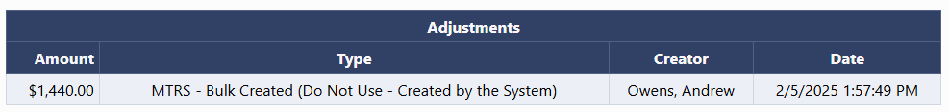
MTRS
First week of December – DESE makes annual payment to MTRS
Record of payment found in the Adjustments section of the Project Summary (Reimbursement Requests)

Slide 24
MTRS continued
After DESE has made its payment to MTRS, you must report the expenditure in subsequent reimbursement requests.
If a revision decreases MTRS budget to an amount less than what DESE paid, report the lower figure as your MTRS expenditure.
Refunds/reconciliations are done in conjunction with the filing of the FER, after the period of performance. MTRS refunds LEA directly, not through GEM$.

Slide 25
Revisions (fka amendments) are Required when:
There is a significant change in program objectives; or
There is an increase or decrease in the total award amount of the grant; or
An increase in a line of the budget that exceeds $100 or 10% of the line (whichever is greater), or exceeds $10,000
A change to MTRS salaries resulting in an increase/decrease to MTRS owed
Amendment validations are built into the reimbursement request form in GEM$.
Notes:
Validations – bullet 2 and 3. decrease – reimb request will not allow you to draw more than the new amount;

Slide 26
Revisions continued
Amendments are due 30 days prior to grant end date (check your GAN!).
Reimbursement requests will prevent reporting expenditures over the allowable amendment thresholds based on the last approved budget on file.
Revisions should be completed before you are in liquidation / final reimbursement timeframe as DESE may not be able to honor reimbursements on expenses that were not previously approved.
Notes:
Fiscal and program need to work together to be on the same timeline and ensure all necessary revisions are completed.

Slide 27
Final Expenditure Report (FER)
Final Expenditure Report (FER) = report out of true actual expenditures
FER is required to close the grant
FER is due 90 days after grant obligation end date. Failure to submit on time may result in a suspension of your ability to submit reimbursement requests.
FER can SOMETIMES be used to claim final balances left on grants

Slide 28
Current FY Established Fed Awards:
1. Assess if revisions are needed
2. Reconcile and claim grant funds as expended!
3. Mid-Year adjustments (March - adjust line items if needed

Slide 29
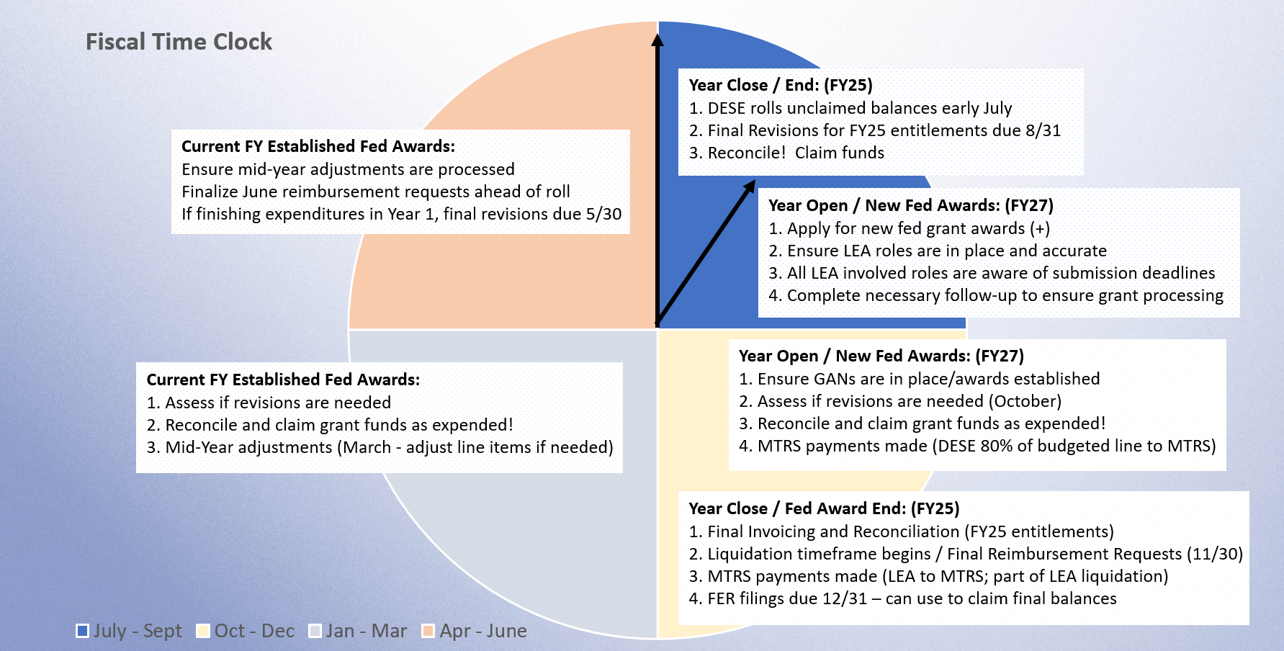
Fiscal Time Clock continued

Slide 30
Cash Management
  The expectation is that grantees are following sound cash management principles, including:
    Maintaining records on expenditures that align with the approved budget line items.
    Charging only allowable costs (as approved on the grant budget).
    Drawing funds as funds are expended or in the process of being expended (not obligated).
    Grant funds are deposited into the correct accounts at the city/town level.
Notes:
Find common ground with city/town contacts to ensure that the grant funds are applied to the right grant. More common with district who take advantage of A LOT of DESE grant funds. Code by project number; entitlement grants must have a way to be carried into the next FY – code it accordingly; we must give 27-month so that there are ZERO returns.

Slide 31
Grant Reimbursement
  Reconcile frequently
  Against the budget(s) to determine if a revision is needed (at a minimum quarterly).
  Against payments to claim reimbursement (at a minimum quarterly).
  Do not wait until the end of the grant award to “clean up” budget line items and request reimbursement.
  Gives the appearance that grant programming is not happening
  DESE only has the reimbursement claims as insight into programs (no claims = red flag ).
  Final revisions (amendments) are due 30 days before grant obligation end date to ensure approval and processing does not compete with final reimbursement deadline.
Notes:
No limit to revisions but 4 per fiscal year is probably reasonable (not counting any we require of LEAs)

Slide 32
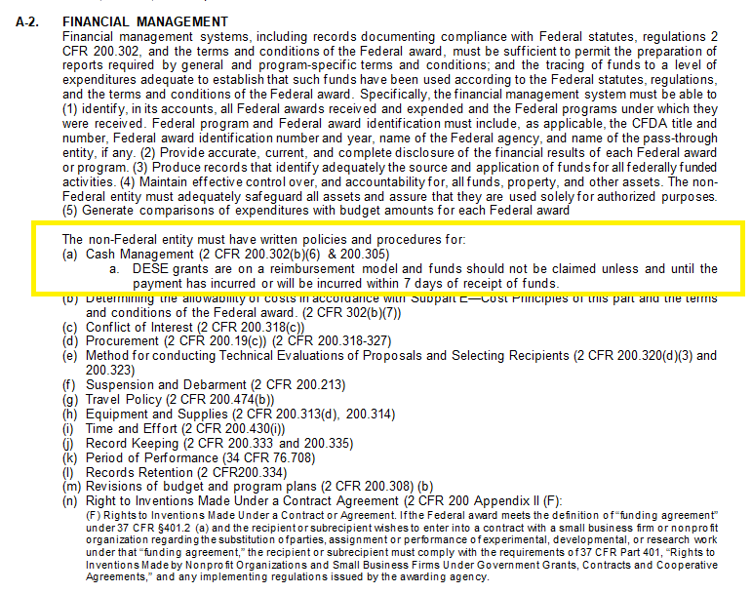
Federal Grant Assurances

Slide 33
Takeaways
Finite time with grant funding
Cadence of the fiscal year / when to do what
GEM$ user roles carry weight and meaning
Deadlines driven by obligation end date by grant (review GAN)
Check in quarterly on your grant needs (revisions / reimbursements)
Rely on the resources and tools provided to assist. (Call your fed grants liaison!)
Notes:
DESE Resources in GEM$; RFP Postings; Communications from program units; GEM$ communications from GM; Trainings

Slide 34
Links
Grants Management Website (RFP postings and more)
Grants for Education Management System (GEM$)
Reimbursement Requests
How to file Final Expenditure Report (FER) – GEM$

