Slide 1
Spring Federal Grants Conference
IDEA Part B LEA Fiscal
Universal, Cyclical, and Targeted Monitoring
June 9, 2026

Slide 2
Agenda
Introductions
General Supervision
IDEA Part B Fiscal Monitoring
  Tier I – Universal Monitoring
  Tier II – Cyclical Monitoring
    LEA Experiences
  Tier III – Targeted Monitoring
  IDEA Part B Risk Assessment
Question and Answer

Slide 3
IDEA Part B Fiscal Staff
Patrick Fitzgerald
  Assistant Director, Special Education Planning and Policy
Renée Labrecque Simon
  IDEA Fiscal Manager
Etse Oriakhi
  IDEA Fiscal Auditor
Michael McDonald
  IDEA Fiscal Monitor
IDEAfiscal@mass.gov

Slide 4
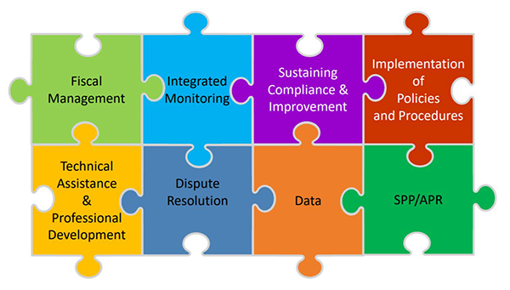
General Supervision
As the State Educational Agency, the Massachusetts Department of Elementary and Secondary Education (DESE) has responsibility for general supervision under Part B of the Individuals with Disabilities Education Act (IDEA).
DESE provides technical assistance and monitors local education agencies’ (LEAs) implementation of IDEA and state special education law. General supervision has eight distinct but interconnected components, creating a cohesive system

Slide 5
IDEA Fiscal Regulatory Requirements
2 CFR Part 200, Uniform Administrative Requirements, Cost Principles, and Audit Requirements for Federal Awards (Uniform Guidance)
DESE must monitor its own activities, and those of its local educational agencies (LEAs), to ensure compliance with applicable federal requirements and performance expectations are achieved. Monitoring by the SEA must cover each program, function, or activity (See 2 CFR §200.329(a))
DESE is responsible for monitoring the activities of its subrecipients to ensure that IDEA Part B program is effectively implemented and funds are used for authorized purposes in accordance with federal statutes, regulations, and the terms and conditions of the subaward 34 CFR § 300.600 and 2 CFR § 200.332

Slide 6
IDEA Part B Fiscal Monitoring
Local Education Agency (LEA) Annual Fiscal Risk Assessment
Tier I – Universal Annual Monitoring
Tier II – Cyclical Monitoring every six (6) years
  Monitoring occurs the same year as the LEA's Group B Integrated Monitoring Review (IMR) with the Office of Public School Monitoring (PSM)
Tier III – Targeted Monitoring for LEAs with the highest relative risk based on annual fiscal risk assessment, credible allegation(s) of noncompliance, or any other reason at the Department's discretion

Slide 7
IDEA Fiscal Monitoring: Tier I – Universal
Review and approval of IDEA Part B Consolidated grant application and budgets, and required assurances under 34 CFR § 300.200
GEM$ budget revision review and approval
Submission and review of final expenditure reports (FER)
Maintenance of effort (MOE) compliance determination and substantiation of exceptions and adjustments
Excess cost calculation submission review
Monitoring the timely obligation of funds
Annual risk assessment
Review of Single Audit reports (if applicable)
Review of proportionate share for equitable services expenditure and carryover, and timely and meaningful consultation at least three (3) times each year (fall, winter, spring)
Review and audit of CCEIS expenditures against approved action plan and budget
Annual training provided to LEAs on IDEA fiscal compliance requirements

Slide 8
IDEA Fiscal Monitoring: Tier II – Cyclical
Cyclical Monitoring revolved around the IDEA Part B LEA Fiscal Cyclical Monitoring Submission in GEM$:
  Written, board-approved, fiscal policies and procedures required by Uniform Grant Guidance, 2 CFR Part 200, and IDEA Part B, 34 CFR Part 300
  Grant award letters, procurement files, documents, and related correspondence
  Equipment purchases/inventory lists
  Time and effort documentation
  LEA budget, general ledger, and or expenditure documentation for FC 240, 262, 213, and 274 funds
  IDEA Part B GEM$ applications, budgets, and budget revisions
  Excess cost calculation detail
  Financial Management Assurance Statement(s) and Audit reports
  Proportionate share for equitable services expenditure documentation
  Voluntary Coordinated Early Intervening Services (CEIS) expenditure documentation and data collection (if applicable)

Slide 9
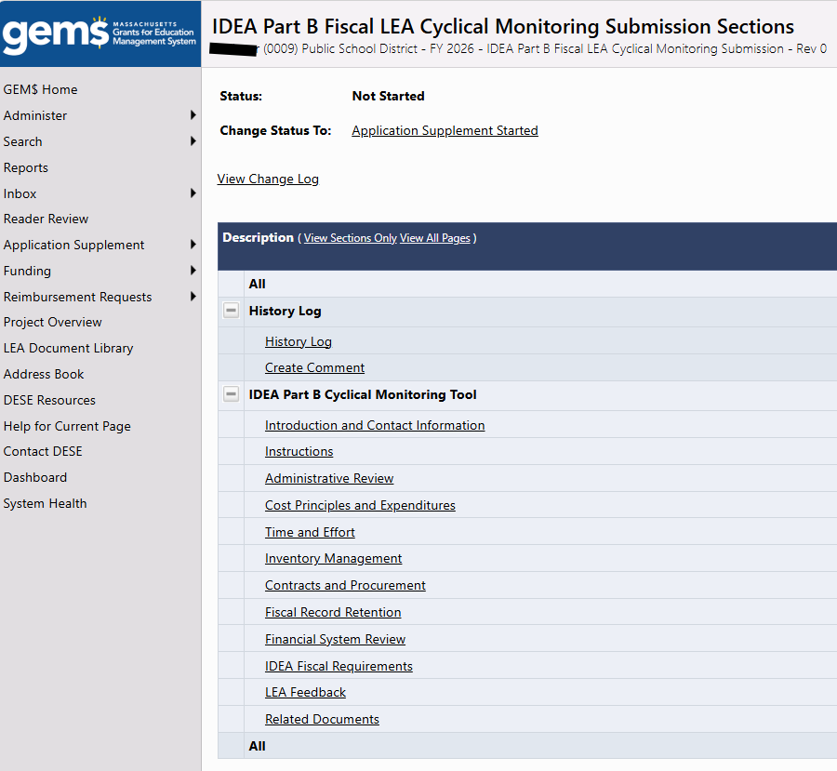
IDEA Part B LEA Cyclical Monitoring Submission GEM$ Application Supplement
Contact Information
Administrative Review
Cost Principles and Expenditures
Time and Effort Reporting
Inventory Management
Contracts and Procurement
Fiscal Record Retention
Financial System Review
IDEA Part B Fiscal Requirements
LEA Feedback
Attestation

Slide 10

LEA Experiences with Cyclical Monitoring
We are fortunate to have LEA representatives with us today to share their experiences participating in Tier II cyclical monitoring during the 2025–2026 school year.

Slide 11
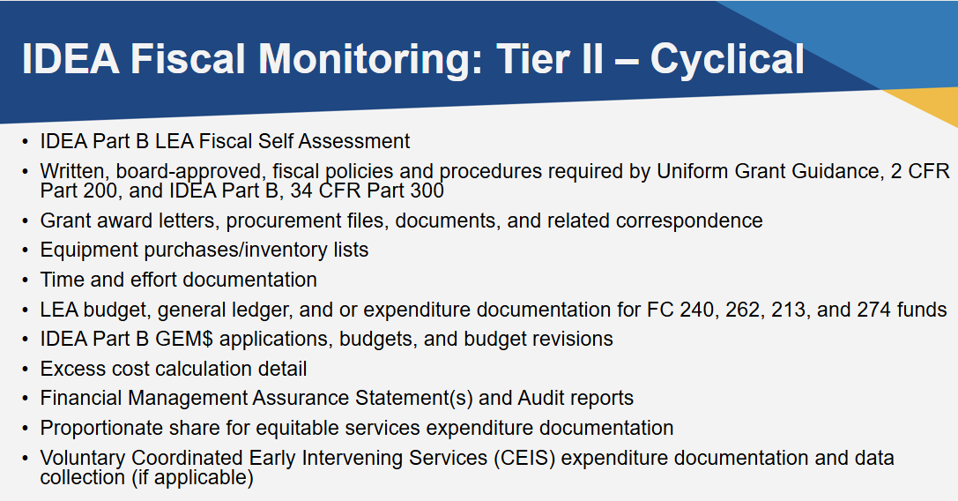
IDEA Fiscal Monitoring: Tier III – Targeted
During a Tier III Targeted Review, the IDEA fiscal team may examine all, or a targeted subset, of the components from the Tier II Cyclical Review, with the selection guided by identified areas of risk. Sample size for some of the requests may exceed what is typically required during a Tier II Cyclical Review.

Slide 12
FY26 Annual IDEA LEA Fiscal Risk Assessment
Turnover in personnel
Length of time in operation and receiving IDEA Part B grant funding
Timely and accurate of end of year financial reporting
Significant Disproportionality identification and CCEIS required reservation
Amount of IDEA Part B allocations
Single Audit participation and findings
Maintenance of Effort (MOE) Compliance
Full and timely expenditure and claim of IDEA Part B funds, including FCs 240, 262, 213, and 274, and required CCEIS and proportionate share funds for equitable services
Timely, complete, and accurate child count submissions
Changes in child count and proportionate share allocations
Timely completion of annual excess cost calculation

Slide 13
Fiscal Monitoring for SY 2026-2027
Schools and Districts going through a Group B Integrated Monitoring Review during SY 2026-2027 will take part in a Tier II, Cyclical Monitoring Review.
Virtual orientations for those schools and districts undergoing a Cyclical Monitoring Review will be offered over the summer.

Slide 14
Virtual Orientation Dates and Registration Links
- Wednesday, June 24 at 11:00 am https://us02web.zoom.us/webinar/register/WN_g2oIeWPoQ56UjRmQhCBbKg
- Wednesday, July 8 at 1:00 pm https://us02web.zoom.us/webinar/register/WN_TZjxiMdWTpiLZpGt5ZJTFQ
- Wednesday, July 22 at 11:00 am https://us02web.zoom.us/webinar/register/WN_AD-lZ1DATo2UkrsYGR4x9A

Slide 15
Question
and
Answer

