Slide 1
Equitable Services: Outreach and Participation
Presentation and Panel
Spring Federal Grant Programs Conference - 2026

Slide 2
Agenda
Rules and Resources:
Alex Lilley, DESE – ESSA Equitable Services Ombudsman
Process and Practice:
Ludlow PS: Tara Brandt, Director of Curriculum and Instruction
Worcester PS: Danielle Parrillo, Director of Grants Kaylee DeGrace, Grant Developer
New Bedford PS: Susana Mattos, Grants Manager
Nazarene Christian Academy: Susan Helm, Principal

Slide 3
Who must be offered grant participation?
Title IA
Students who reside in your district and would have attended a Title I-served school had they gone to their local public school.
Eligible students may be attending private schools inside or outside the district.
  funds are generated (at least one eligible student is considered low-income) and
  there’s academic need for supplemental assistance
Titles IIA, IIIA, IVA
All students (and their teachers) at private schools inside district borders are eligible.

Slide 4
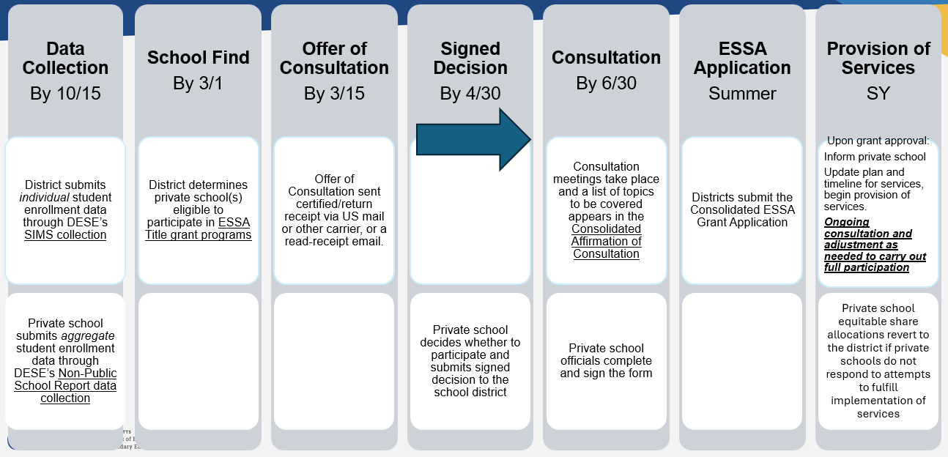
Timeline of Actions for FY27

Slide 5
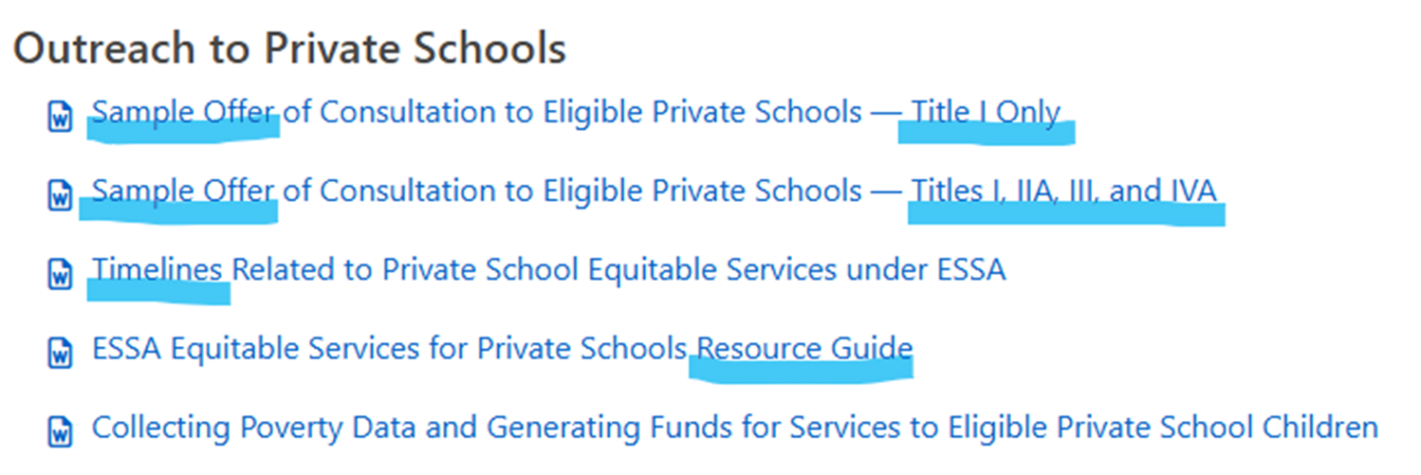
Outreach - Resources
District Level Equitable Services for Private Schools - Federal Grant Programs (mass.edu)

Slide 6
Track and Document Outreach!
Send letters by return receipt (either snail mail or email)
Keep record of responses and receipts (if no response)
For those that choose to participate:
  Arrange for timely consultation (initial, then ongoing)
  Collect signed Affirmation of Consultation with Participating Schools
  Keep on file and upload with grant application
  Use to document agreed upon services

Slide 7
Important Rules/Reminders
Consultation must be “timely” and “meaningful”
  Complete before you finalize plans and consider/meet their needs
Never pay the private school
  You must maintain control of public funds – no reimbursing…you hire, you own, you inventory…you take back at end
Supplement, Not Supplant applies
  For Title I, it will always be a Targeted Assistance program for the eligible/participating students only
  All services and materials must be additional to what the school would provide without participating

Slide 8
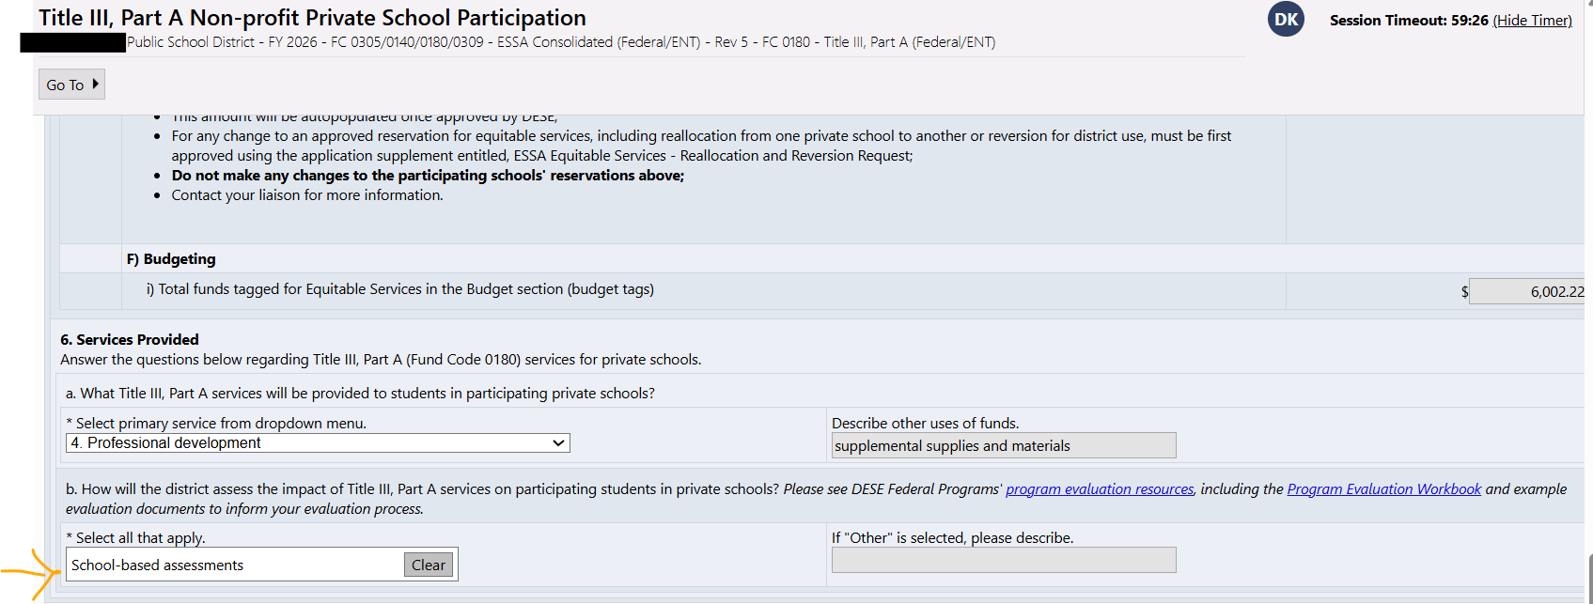
Private School Title Services Evaluation
How will the Title services to private schools get assessed?
Notes:
Massachusetts Department of Elementary and Secondary Education
8

Slide 9
What's Allowable for Private Schools?
Title I QRG: same allowability rules as district Targeted Assistance programs…supplemental assistance to eligible, targeted students
Title IIA QRG: same as district, except cannot use for class-size reduction
Title IIIA QRG: same as district, except funds can be used for private school screeners
Title IVA QRG: same as district, except do not need to spend on each priority area like districts with greater than $30,000 allocation must

Slide 10
Who Determines What's Allowable?
You do…in consultation with private school officials
  Discuss needs and options for meeting needs
  Share Quick Reference Guides for each program and other resources as needed
  Use topics of consultation in Affirmation of Consultation form
  Makes relationship clear… district runs program to meet needs of private school students/staff… in consultation with private school officials
  Seek help from liaison when in doubt

Slide 11
Upcoming and Ongoing Tasks
Prepare for FY27 outreach to eligible schools
  Find eligible students and schools
  Plan distribution and collection of offers
    Sample Offer of Consultation to Eligible Private Schools — Title I Only
    Sample Offer of Consultation to Eligible Private Schools — Titles I, IIA, IIIA, and IVA
    Contact all local private schools to remind them of the importance of submitting "Non-Public School Report" to DESE data services.
Check-in on activity plans and spend-down of FY26 program participants
  Are agreed upon activities and spending on track for completion by end of summer?
  Will any unused/unspent allocations need to be carried over to next fiscal year or reallocated?
    See Quick Reference Guide for eligibility and directions on how to do carry this out
  Prepare for annual evaluation of program activities
    What data will be used? What is needed from private school officials and by when?

Slide 12
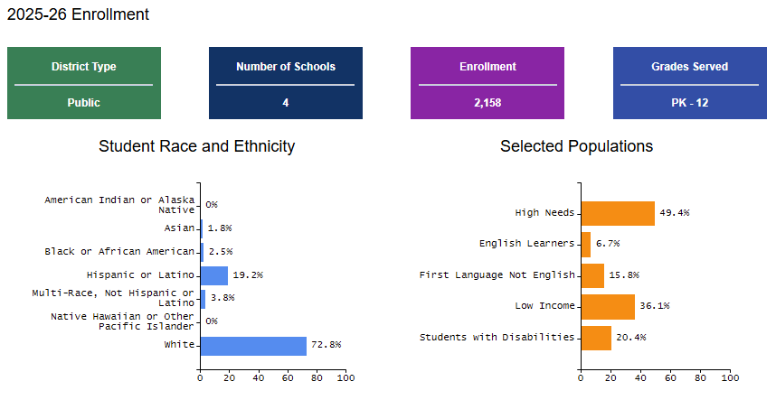
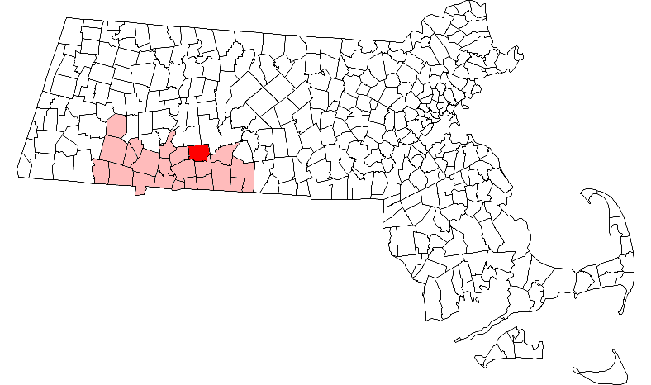
Ludlow Public Schools
Tara Brandt, Director of Curriculum & Instruction

Slide 13
Equitable Share Outreach
Approximately a half-dozen schools across just as many cities
  Only one typically participates – Title I, II, & IV
  Annual allotment is around $30,000
  PK-8 (183 students excluding the PK)
School Attending Children Report
  Database for all private and charter schools that our students attend

Slide 14
Documentation
Certified Mail
Email Read Confirmations
Calendar of Communications and Actions

Slide 15
Services & Evaluation
In-depth conversations about need
Shared PD or duplicable ones
Parent Liaison
Regular check-in emails

Slide 16
Worcester Public Schools
25,078 current students across 47 schools (Pk-12)
ESSA Programs: Title I (schoolwide), Title II, Title III (8,000 MLL students), Title IV
WPS currently has 17 private schools in the city/catchment area
  12 in Worcester, 5 across four neighboring towns
WPS has a dedicated Office of Grants Management
WPS has financial analysts dedicated to grants as well.

Slide 17
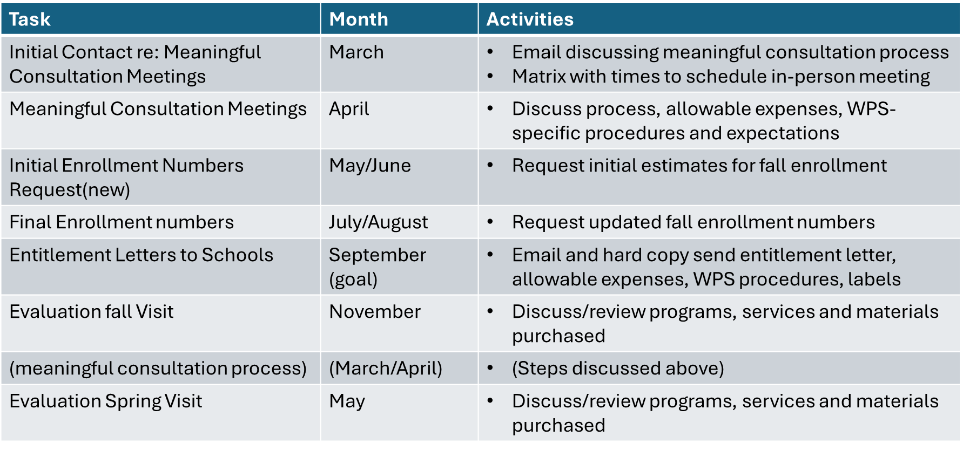
Outreach – Who and When
Maintain an excel sheet with schools and main points of contact
  Institutional knowledge, basic area searches, communication with PIC
Contact early and often
Review points of
contact at each visit

Slide 18
Consultation, Participation and Services
Meaningful Consultation meetings
  In-person, on site. Discuss the following:
    ESSA Funding Overview, School Needs, WPS Policies and Procedures, Timelines and Deadlines, Contact Information and Current Balances.
    Plan for evaluations – available springs dates, discuss fall as well.
Participation
  At least one school representative, sometimes more depending on size.
    Typically principal, business manager, department heads
Services
  Availability and allowability of what the school is looking to do.
    Contracts can be an issue, recommend early communication

Slide 19

Process and Oversight
WPS Private School Portal
  Google Site that has all the resources for private school partners in one place

Slide 20
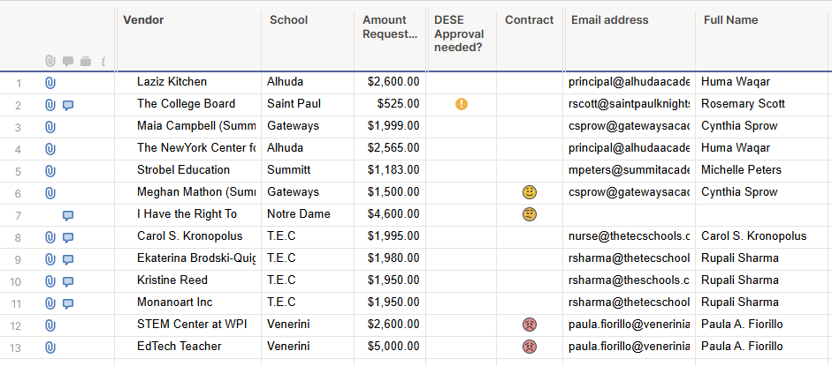
Process and Oversight - tracking
WPS Private School Portal
  Private school requests are tracked and fulfilled using the Smartsheets platform
Schools fill out an online form to populate each row
Keeps request forms, quotes, POs, and evaluation documents attached to each request

Slide 21
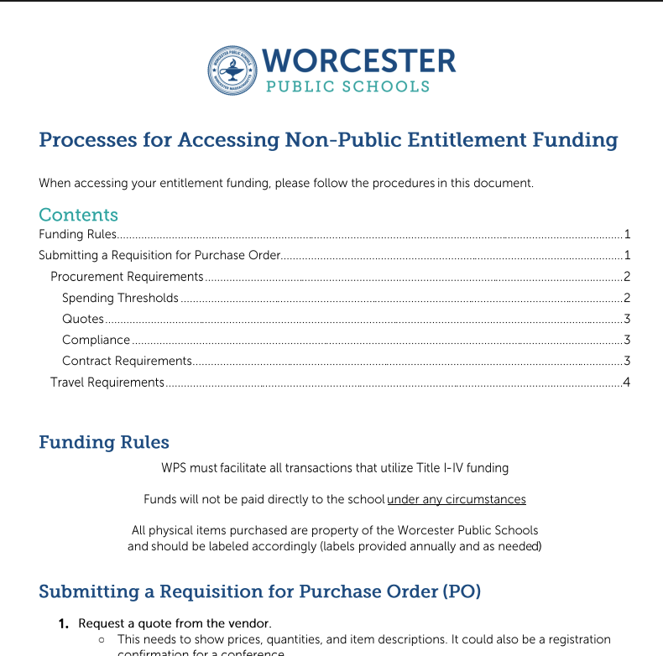
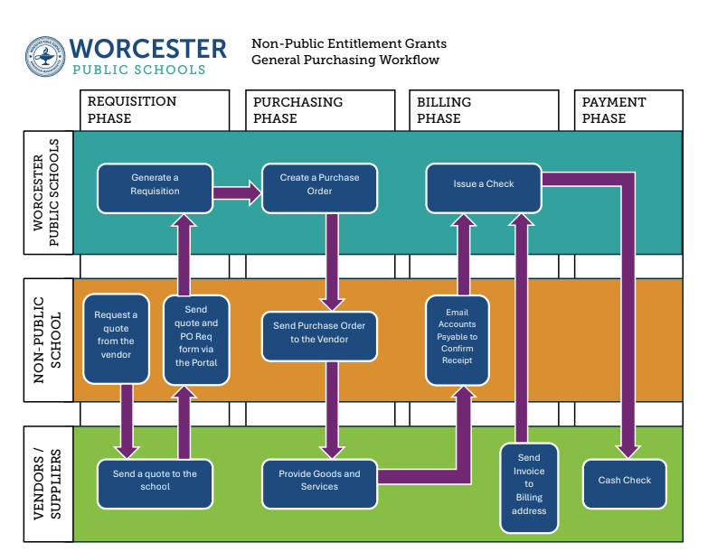
Process and Oversight - purchasing

Slide 22
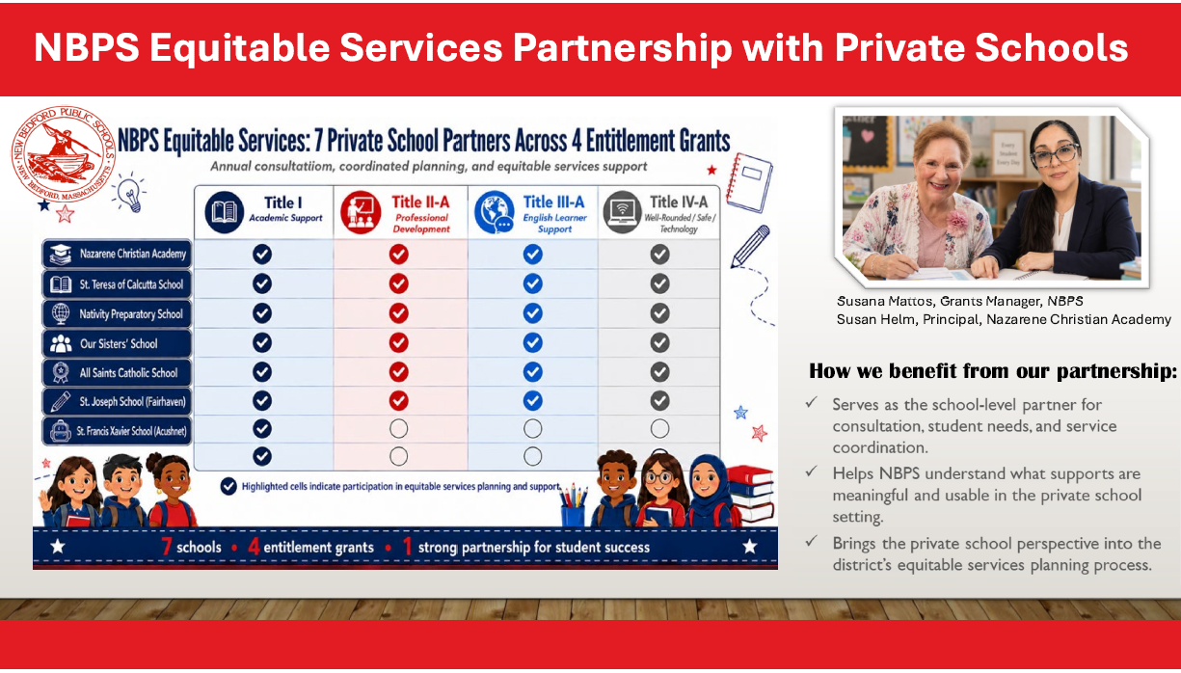
NBPS Equitable Services Partnership with Private Schools

Slide 23
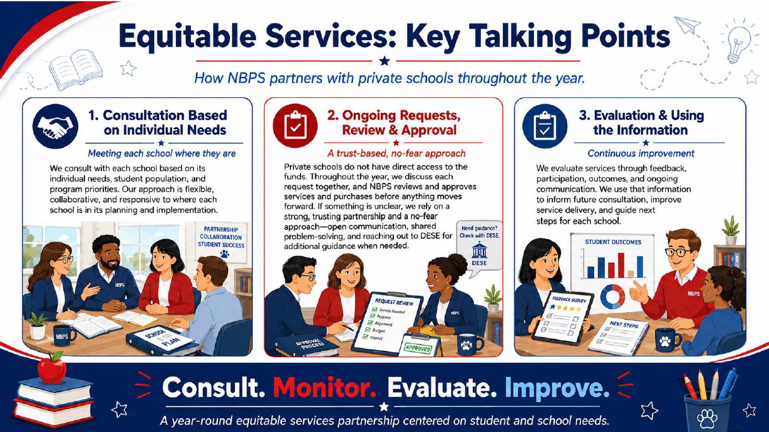
Equitable Services: Key Talking Points

Slide 24
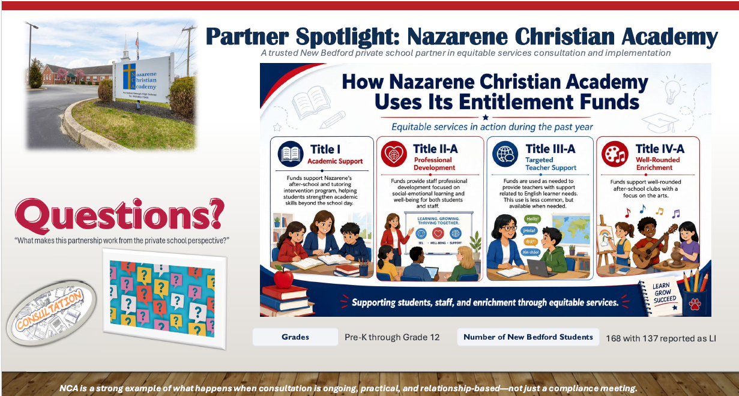
Partner Spotlight: Nazarene Christian Academy

Slide 25
Questions?
Contact your Federal Grants Liaison
https://www.doe.mass.edu/federalgrants/liaisons.xlsx
Or
federalgrantprograms@mass.gov

