Slide 1
Supporting the Whole Student:
District Leadership Perspectives on Safe & Supportive Schools

Slide 2
AI Notice
Please be advised that DESE does not authorize attendees to record or to use AI transcription tools during the meeting and DESE does not endorse any unauthorized transcripts created by third parties of its meetings.

Slide 3
Presenters:
Emily Taylor, DESE, Early Learning & Safe Supportive School Specialist
Coleen DeBari, Tantasqua Regional/School Union 61 Districts, Compliance and Equity Coordinator/Support Services
Lara Ramsey, Frontier Regional and Union 38 School Districts, Curriculum Director, Elementary Focus
Amy Kamm, Gloucester Public Schools, Director of Mental Health and Social-Emotional Learning

Slide 4
Agenda
Overview of the Safe and Supportive Schools Grant
District Panel
Q&A

Slide 5
Safe and Supportive Schools Grants
The purpose of this state funded competitive grant program is to: ​
Provide funding to school districts (and their selected schools) to organize, integrate, and sustain school and district-wide efforts to create safe and supportive school environments. ​
Assist school districts to coordinate and align student support initiatives based on their findings from completing the Safe and Supportive Schools (SaSS) Framework and Self-Reflection Tool

Slide 6
Priorities:
The main priorities for this grant are to ensure that participating schools: ​
create an equitable, safe, positive, healthy, culturally-competent, and inclusive whole-school learning environment for all students, and ​
make effective use of a system for integrating services and aligning initiatives that promote students' behavioral health and wellness

Slide 7
Safe and Supportive Schools Framework and Tool
SaSS Implementation Guide
SaSS Framework and Tool-at-a-Glance

Slide 8
Implementation Guide Phases:
Phase I - Build a Foundation and Strengthen Readiness
Phase II - Reflect on the Current State of the School and Identify Priorities
Phase III - Action Planning for a Safe and Supportive School
Phase IV - Implementing for Success
Phase V - Develop a Cycle of Continuous Inquiry and Improvement

Slide 9
Self Reflection Implementation Levers
Lever 1: Leadership and Culture
Lever 2: Family and Community Engagement
Lever 3: Professional Learning Opportunities
Lever 4: Access to Resources and Services
Lever 5: Teaching and Learning
Lever 6: Policies and Procedures

Slide 10
Action Planning and Implementation
Participate in DESE-provided asynchronous equity focused PD or show evidence of previously completing similar PD (phase I);​
Convene a school team, including students when appropriate (phase I); ​
Complete the SaSS Self-Reflection (phase I and II); ​
Identify school and district areas to prioritize for improvements using the SaSS Tool (phase II); and ​
Finalize a school action plan that is aligned to school and district priorities, and a district action plan that supports the schools' efforts (phase III).
Begin or continue to implement school-focused action plans (and associated district-support plans) that were created in prior years using the SaSS Tool (phase IV).. ​
Begin or continue to develop a cycle of continuous inquiry and improvement (phase V).
Serve as supports for: ​
  Option One grantees, ​
  Other new SaSS Tool users, ​
  Schools and districts that are new to implementation, and/or ​
  The Department, Commission, and others as needed and appropriate. ​

Slide 11
SaSS Grantee Panel
Presentation (5-7 minutes each)
  District introductions – self and district background
  How/why SaSS work started
  Creating an action plan
Panel Questions:
  How did you prioritize what you implemented?
  How did you fund the implementation?
  How did you incorporate SaSS work across systems
Sustainability and moving forward (3-5 minutes each)

Slide 12
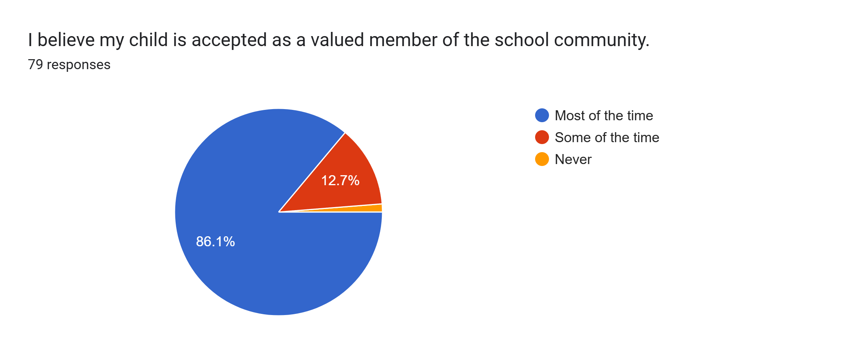
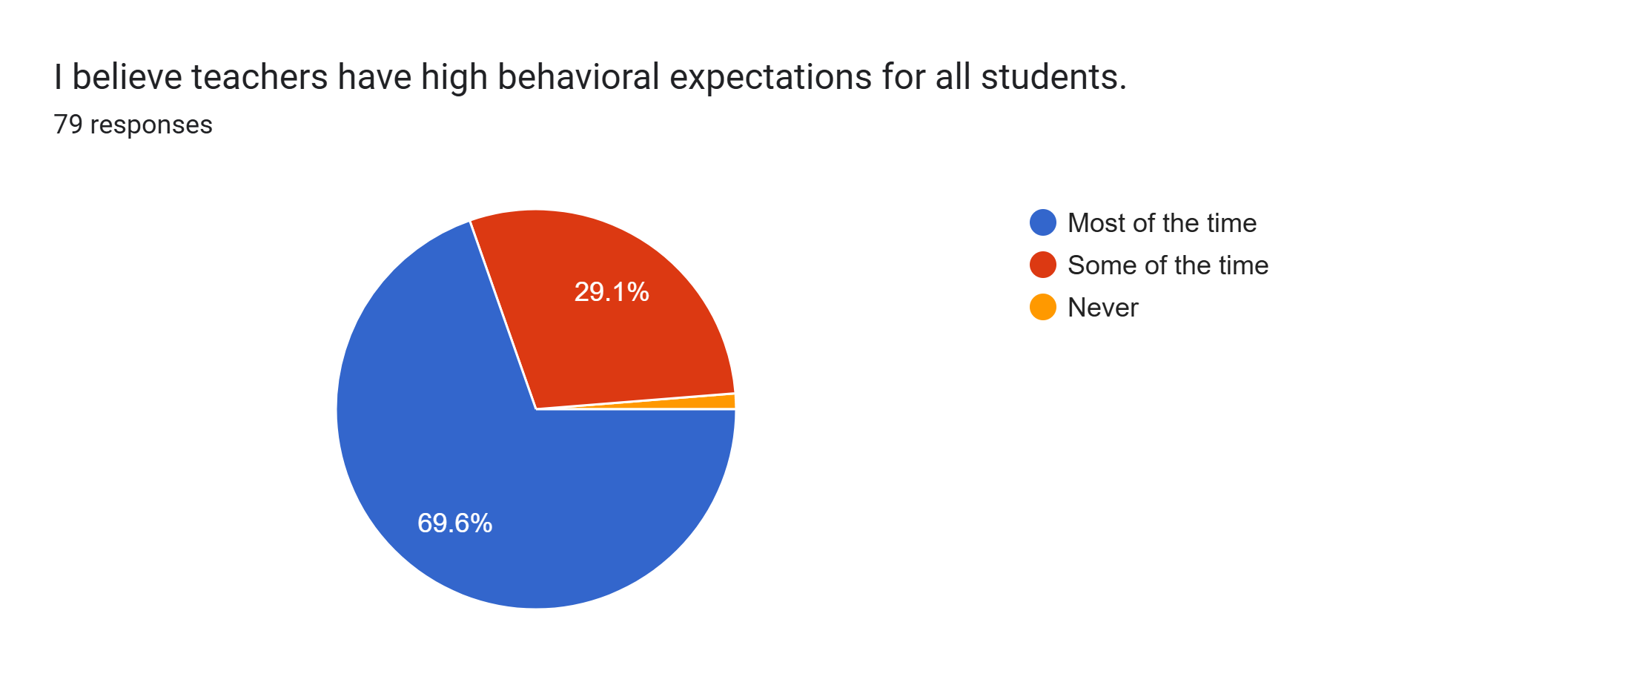
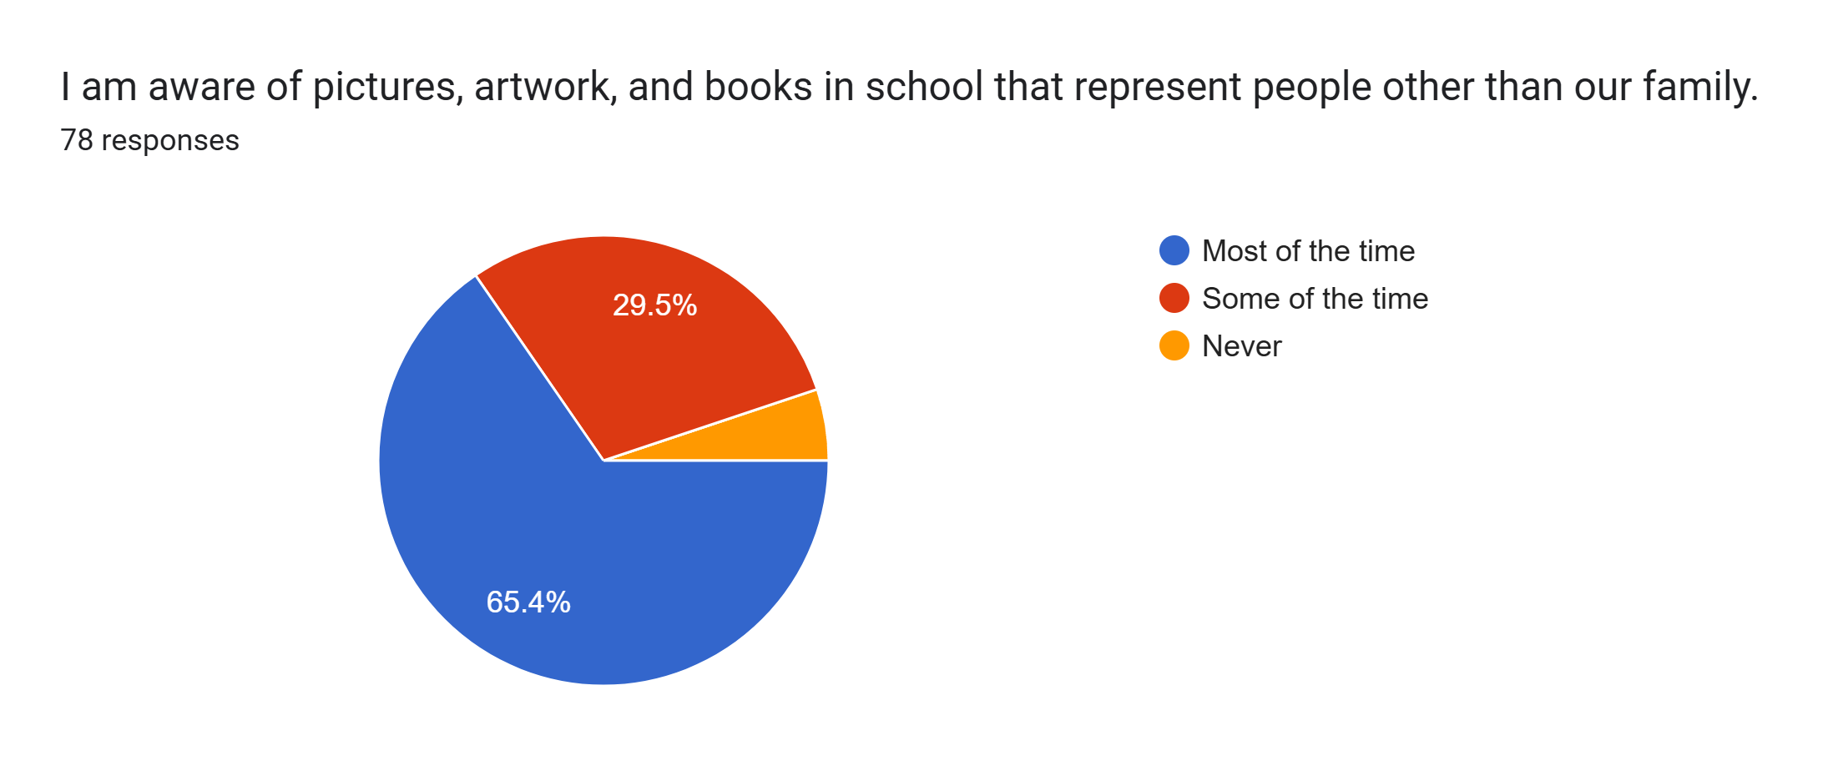
Frontier
Our Team
Librarian
School Nurse
Principal
Classroom Teacher (upper grades)
Classroom Teacher (lower grades)
Director of Curriculum
School Psychologist
We are in Year 3. In 2022, Head Nurse for district saw the grant and saw the multiple areas of overlap between grant goals and SIP goals.
We surveyed caregivers, students, and staff to determine our priorities.

Slide 13
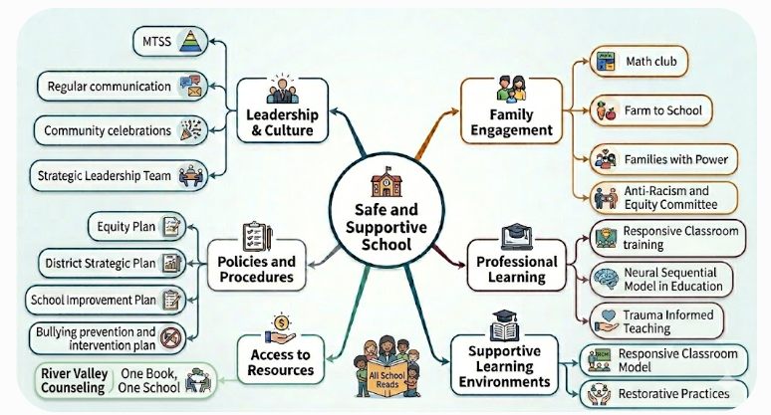
Frontier SaSS Model

Slide 14
Frontier Going Forward
Going forward:
It's time to re-administer the survey, use the tool, and re-assess our goals. Have our areas for growth been growing? Are new things needing attention?
Continue our 'One Book, One School' program; grow program (1) getting trained in facilitating book talks (connections, similarities and differences) and building an anti-racist school community (Story-Starters.org) and (2) working with school psychologist to pair One Book, One School with Trait of the Month (YouTube link to One Book, One School)
Learn more about Family Engagement. What does satisfactory engagement look like? Who decides?.

Slide 15
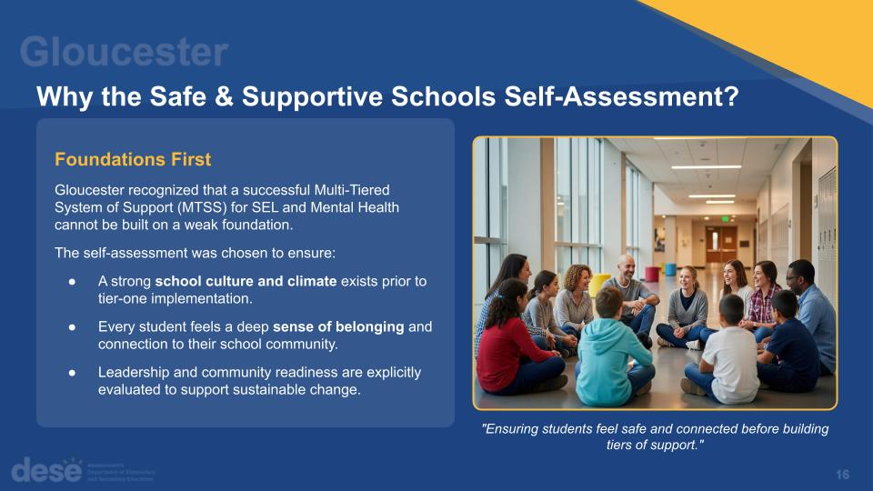
Why the Safe and Supportive Schools Self-Assessment?

Slide 16
Activating Youth Voice Through Data-Driven Insights
The Foundation of Our Action Plan
Gloucester launched its Safe & Supportive Schools (SaSS) work by triangulating diverse data sources to identify systemic needs.
Collaborative Self-Reflection: Assessments conducted by dedicated teams at both O’Maley Middle School and Gloucester High School.
Health & Risk Data: Integration of Youth Risk Behavior Survey (YRBS) trends showing increased student anxiety.
Targeted Focus Groups: In-depth sessions with LGBTQ+ youth to address specific belonging and safety concerns.
This data revealed a critical need to activate student voice to authentically improve school culture and climate.
"We needed to ensure that we had strong foundational pieces... promoting culture, climate, and a deep sense of belonging."

Slide 17
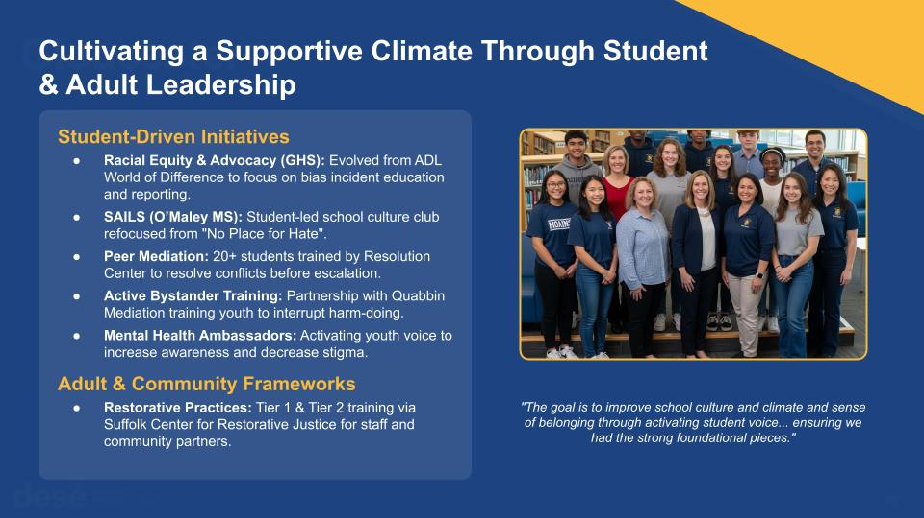
Cultivating a Supportive Climate Through Student and Adult Leadership

Slide 18
Tantasqua & Union 61
Building Sustainable Safe & Supportive School Communities
Our District
5 Elementary Schools; 1 Regional Junior High School;
1 Regional High School & Vocational Techical School
Rural district serving five communities
Approximately 3,000 students; 600 staff
Union 61 SaSS Team
30 members (includes principals, teachers, specialists and counselors)
Tantasqua Sass Team
25 members (includes all 5 assistant principals, teachers, nurses,
Counselors and social workers)

Slide 19
Tantasqua & Union 61 continued
Moving From Individual Initiatives to a Unified System
What We Noticed
Strong programs existed across schools (in silos)
Efforts often operated independently
Student, family and staff voices needed greater influence
Growing need for belonging, connection and equity-focused supports
Our Guide
School climate data
Student/Staff/Family Feedback
Discipline, attendance and belonging data
The Goal
Create a district-wide framework where every student feels safe, supported,
connected and valued.

Slide 20
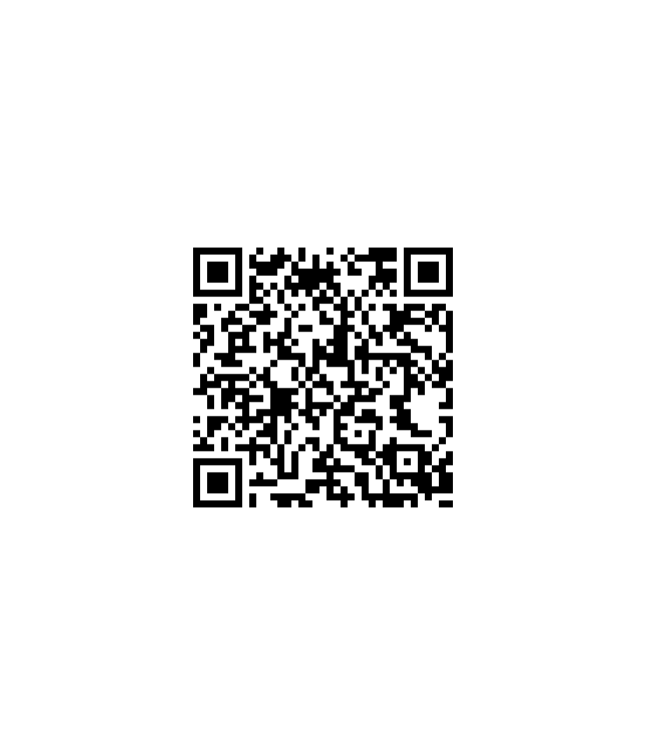
Tantasqua & Union 61: From Reflection to Action
From Reflection to Action
Step 1: Self-Reflection
Completed the SaSS Tool
Reviewed the six implemenation levers
Gathered feedback from students, families and staff
Step 2: Identify Priorities
Family & Community Engagement; Equity Review; Restorative Practices (T/U61)
Student Relations; Peace Pals, Bullying Prvention (Union 61 only)
Student Town Hall; Student Assembly; Holistic Peer Mediation (Tantasqua only)
Step 3: Build Sustainable Teams
School staff, building and district administrators, community partners
Results
3 year action plan focused on sustainability, systems alignment and
student belonging.

Slide 21

Questions
Contact us:
Emily Taylor – emily.m.taylor@mass.gov
Amy Kamm – akamm@gloucesterschools.com
Coleen DeBari – debaric@tantasqua.org
Lara Ramsey – lara.ramsey@frsu38.org

