Slide 1
Title I and High Schools
June 9, 2026

Slide 2
Global Learning Charter Public School
Derek Michael, Director of Academics

Slide 3
GLCPS Background
Located in New Bedford
500 students in grades 5 – 12.
~170 enrolled in our High School grades
Schoolwide Program: 70% of students identified as low-income

Slide 4
Federal Grants Planning Process
Our Process to Determine Priorities:
  Complete our yearly Needs Assessment
  Conversations/Surveys with our Board, Administrators, Staff, Families and Students
  Ensure compatibility with our mission and two key design elements:
    21st Century Skills with a focus on Project-Based Learning
    College and Career Readiness with a focus on Academic Excellence

Slide 5
Using Title I to Supplement College and Career Readiness through Academic Excellence
Access to Advanced Coursework
Enhance our MTSS Structures

Slide 6
Access to Advanced Coursework
Purchasing of Dual Enrollment courses through our relationships with Bristol Community College and UMASS-Dartmouth.
  Whole Sections
  Individual Seats
Purchasing of Virtual High School (VHS) AP Course Seats

Slide 7
Enhance Our MTSS Structures
Academic Component
  Tier II Staff – Provide instruction during our Algebra and Writing Lab support sections
  Tier III Staff – Reading Specialist who provides Orton Gillingham services to qualified students
Social Emotional Component
  Tier I Screener and Data Gathering Software (Panorama)

Slide 8
Other Possible Uses of Title I at the High School Level
Developing/Supplementing MyCap programming
Supplemental resources for WIN block programming
Supplementing Family Involvement programming

Slide 9
Contact Information
Questions or thoughts?
Derek Michael – dmichael@glcps.org

Slide 10
Southbridge High School
Southbridge High School
Credit Recovery Programs as a Pathway to Student Success

Slide 11
Credit Recovery Programming
Began implementation SY 2023-2024
February & April Vacation
  Tuesday-Friday 9am-1pm
Summer Vacation
  3 weeks, 4-5 days/week
After School Credit Recovery

Slide 12
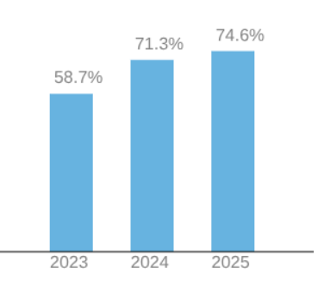
Grade 9 Course Pass Rate

Slide 13
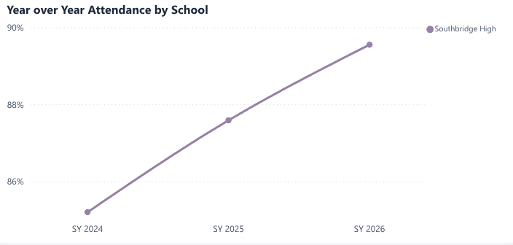
Attendance

Slide 14
Quarterly Failure Rates
Year | Q1 Fail Rate (all grades) | Q2 Fail Rate (all grades) | Q3 Fail Rate (all grades) | Q4 Fail Rate (all grades) | Cumulative Fail Rate
SY26 2025-2026 | 6% | 8% | 6%
SY25 2024-2025 | 12% | 13% | 8% | 8% | 5%* *6.7% before Summer Credit Recovery
SY24 2023-2024 | 12% | 12% | 13% | 14% | 7%

Slide 15

Graduation Rates

Slide 16

Brockton Public Schools
Beyond the Bell: Academic Recovery, Enrichment, and Career Pathways at Brockton High School

Slide 17
The Brockton Public Schools
Over 14,600 students
Students and families in Brockton represent a broad range of cultural backgrounds,, languages, and lived experiences, contributing to a vibrant school community.
Twenty-four Schools
  11 elementary schools
  1 early childhood center
  1 K-8 school
  6 middle schools
  Brockton High School; PROMISE Career & College Academy; Brockton Virtual Learning Academy; Champion High School; Brockton Therapeutic Day School

Slide 18
Beyond the Bell: The Program
Learning Recovery AND Enrichment Program
Courses offered:
  Math (Math I – III, Trigonometry)
  English (ELA I – IV, World Literature, Creative Writing)
  ESL (ESL I – IV, Content and Literature)
  Science (Biology, Chemistry, Physics)
  Social Science (US History I & II, Modern World History)
  Health & Wellness (Health, Physical Education, Yoga)
  CTE (Automotive, Biotechnology, Culinary, Carpentry)
  Languages (Spanish I & II, Mandarin I & II)
  Arts (Visual Arts, Mural Class)
  Independent Studies
  Teaching Assistant Positions
  *Courses ran based on student need & enrollment

Slide 19
Beyond the Bell: Staff & Schedule
Staff:
  34 certified teachers
  4 safety & security staff
  1 substitute teacher
  3 administrative assistants (job share)
  1 supervisor
Schedule:
  Each class 90 minutes, one face-to-face meeting per week
  Monday, Tuesday, Wednesday 2:20 – 3:50
  Saturday (2 periods) 8:30 – 10:00 & 10:00 – 11:30
  4 sessions in a year, approximately 8 weeks per session
  3 credits per course / some courses offered as a part A and part B (core content classes)
Requirements:
  Students have face-to-face time, plus work to complete outside of class

Slide 20
Beyond the Bell: Supporting All Learners
Support for MLLs:
  12 teachers who are bilingual or multilingual on staff, additional bilingual staff in other positions
  Students scheduled with a content teacher that can support their language
  - OR - language support staff co-taught with content area staff
Support for SWDs:
  6 certified special education staff
    4 moderate special needs teachers
    2 specialized staff certified in moderate special needs and support for life skills students
  Push-in and pull-out supports provided
  Staff communicated with teachers, provided IEPs and 504s, handled specialized transportation
Supports for Students with Special Considerations:
  1 teacher was dedicated for virtual support
  6 students deemed “special consideration” cases, and were partially or fully virtual

Slide 21
Beyond the Bell: The Impact
Sessions 1-3 have finished
  457 students have earned credits
  An additional 90 students attempted, but did not earn credits
Session 4 is in progress!
Credits Earned | 3 | 6 | 9 | 12 | 15 | 18 | 21 | 24 | 30 | 33 | 36
Number of Students | 196 | 119 | 56 | 44 | 23 | 5 | 4 | 2 | 1 | 2 | 1

Slide 22
Beyond the Bell: Lessons Learned
Considerations/Adjustments for Next Year:
  Start early, align with the terms during the day
  Consider hiring a school counselor to complete graduation plans with students and communicate progress to BHS school counselors for improved communication
We offered open spots to students for enrichments but want to expand offerings for students to enroll in more classes for fun!
  Exploring horticulture
  Yoga and CTE electives were VERY popular

