Slide 1
Program Evaluation:
An Overview
June 9th, 2026

Slide 2

Introductions
Leif Jacobsen
DESE, Federal Programs Team
Kendra Winner
DESE, Research and Evaluation Coordinator

Slide 3
Session Goals
At the end of this session, participants will be:
Familiar with the DESE program evaluation resources
Able to use the Title IIA “strong example” to guide development of required Title IIA evaluation documents

Slide 4
Why is this important?
Federal law mandates that as a condition of accepting Title grant funding, a district must annually evaluate its Title grant programs.
You should be regularly using data to:
Ensure you’re addressing the needs you identified
Identify what’s going well
Identify what needs to improve
Use findings for planning and improvement.
Document progress against your goals

Slide 5
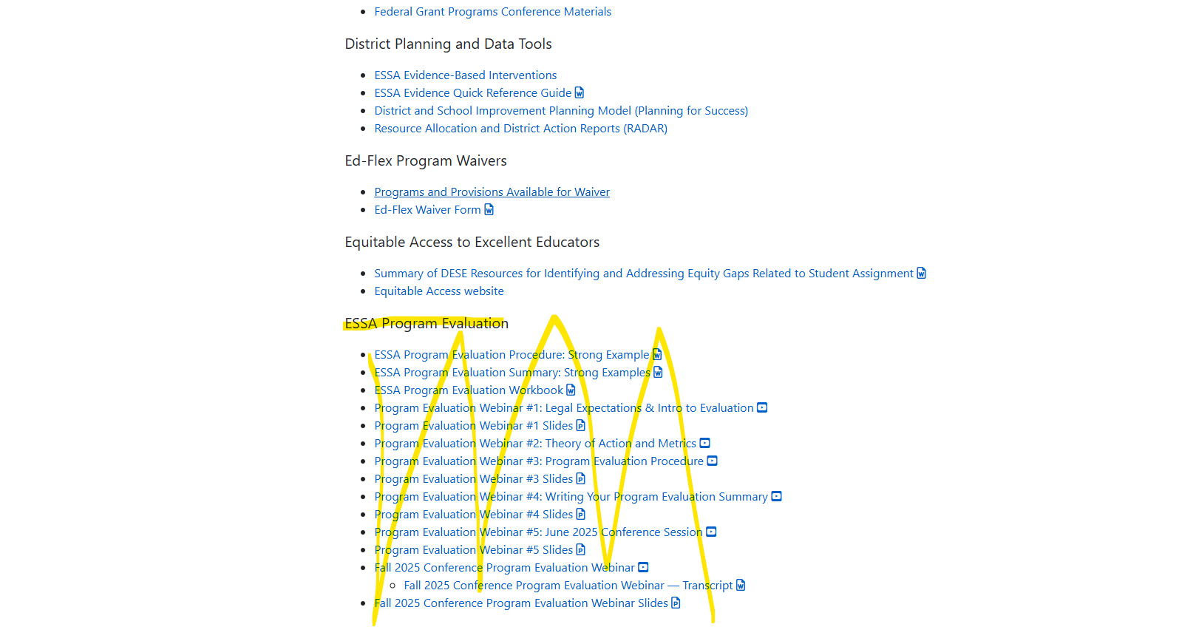
Where to Find Evaluation Resources
1. On DESE Website, go to
Federal Grant Programs
->
General Resources for Federal Grant Programs ->
ESSA Program Evaluation
Link to Evaluation Resources

Slide 6
Title Grant Required Evaluation Submissions
Title Grant | Required Submissions during Monitoring
Title IA | Two submissions Submission 13: Program Evaluation Procedure Submission 14: Program Evaluation Summary
Title IIA | Submission 23: Program Evaluation Summary
Title IVA | Submission 25: Program Evaluation Summary

Slide 7
Evaluation Timeline
Summer 1 | Fall | Winter | Spring | Summer 2
Create Theory of Action for program Establish goals of program Establish evaluation metrics | Meet with key stakeholders Set data collection plan | Collect data Draft program evaluation procedure | Collect data Draft program evaluation summary(s) | Make final edits to documents & disseminate to key community stakeholders

Slide 8
Workbook Checklist
Step | Question | Done?
1. Identify members of the team | What skill(s) do we need on our team and who has those skills?
2. Conduct Needs Assessment and Design Theory of Action | What are the short- and long-term goals of our program? What key actions will get us to our goals?
3. Define program goal and evaluation questions | What did we design our program to do? What do we want to find out? How would we know? What is measurable and attainable?
4. Create a data collection plan | How and when do we collect the data?
5. Write Program Evaluation Procedure (Title I only) | What are the key components of this submission and how do we write it?
6. Analyze Data | How do we analyze our findings?
7. Write Program Evaluation Summary | What are the key components of this submission and how do we write it?
8. Report, discuss, and apply evaluation findings | How do we report our findings and what do we do because of our findings?

Slide 9
Evaluation Resources
Program Evaluation Workbook (Released 2025)
Title I Strong Examples: Procedure and Summary (Released 2025)
Title II Strong Example (NEW)
Title IVA Strong Example: Forthcoming

Slide 10
Using Our Evaluation “Strong Examples”
Today’s focus: Title IIA
These are just individual examples. Every district’s program will be different, which should be reflected in these documents.

Slide 11
Title IIA Evaluation Summary: Strong Example
Strengths of This Plan
Evaluation is anchored at beginning by summary of program and goals
Qualitative data is organized into coherent data displays
Data is thoroughly discussed in context, with program shortcomings frankly acknowledged
Clear and specific next steps for program are identified based on analysis of data
Key Components
Summary of program and program goals
Overview of data collected
Analysis of data and key insights explained
Determination of whether program goals were met
Identification of program’s biggest strengths and weaknesses
Discussion of program changes going forward

Slide 12
Frequently Asked Questions – Title IIA
I’m new to evaluation and this has fallen off our district’s radar – where do you recommend I start?
What if I am evaluating something that doesn’t have a direct thru-line to student achievement, such as a mentorship program? What should I be measuring?
For Title IIA, would you recommend quantitative or qualitative measures? How will this impact the analysis?
What if the data we collect tells a story (e.g. program goals not met) that we believe is contradicted by other contextual evidence (e.g. program goals moving achievement in right direction)?

Slide 13
Available DESE Support
If you would like support with your program evaluation process, please email leif.jacobsen@mass.gov.

Slide 14
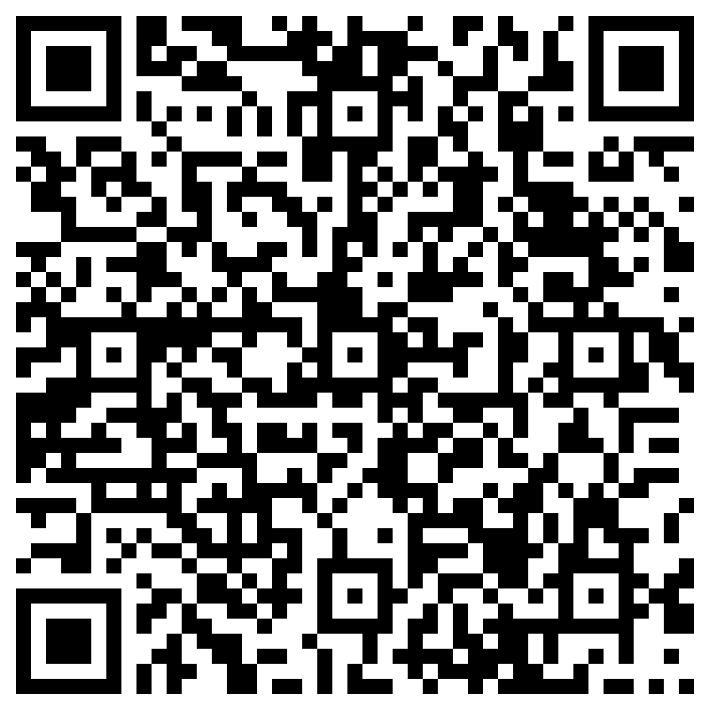
Feedback
Your feedback is critical to our improvement!
Before you leave, please complete our survey.

