Slide 1
Writing a Successful ESSA Grant Application in GEM$
Spring 2026 Federal Grants Conference

Slide 2
Agenda
Consider Your Audience
Writing a Narrative Page
Writing a Budget Detail Narrative
Writing a Title IV SMART Goal
Common Errors to Avoid When Completing Your ESSA Application
Wrap-Up

Slide 3
Consider Your Audience

Slide 4
Who might read this grant?
Your DESE Federal Grant Liaison and other DESE staff are the first people outside of your district who will read your grant application, but bear in mind that your approved application and all revisions are public records.
That means other people may end up reading your grant as well, including:
  Parents/Community Members
  Students
  Stakeholder and advocacy groups
  United States Department of Education staff
  District staff and organizations
  Researchers and data scientists
  Vendors
  Journalists
  Auditors
  Anyone who wants to read it

Slide 5
What does that mean?
You should be writing your grant in a way that anyone who is reading it can clearly understand what is being funded and why.
Your narratives and budgets should be easy for any of the people listed on the previous slide to read and understand.
This holds for other written aspects of the grant as well. For example, it should be clear on the Districtwide Strategies page when and where the required annual Title I meeting is taking place and what will be covered.

Slide 6
Grant Writing Basics
Basic rules to keep in mind:
  Keep your writing clear and concise
  Avoid acronyms or references to district programs that are not otherwise explained
  Use complete sentences and respond fully to what is being requested
  Avoid ambiguity, clearly spell out what you are trying to say
  Read each page of the application carefully to ensure you don’t miss any important details
  Bottom line: Grantwriters need to find a balance between being clear and being concise.
Grantwriting is not an exact science, but following the advice in this presentation will help.

Slide 7
District Reservations
Districtwide Strategies Page
Narrative Page
Broad, overarching strategies
Specific activities
Budget Page
Line items being funded

Slide 8
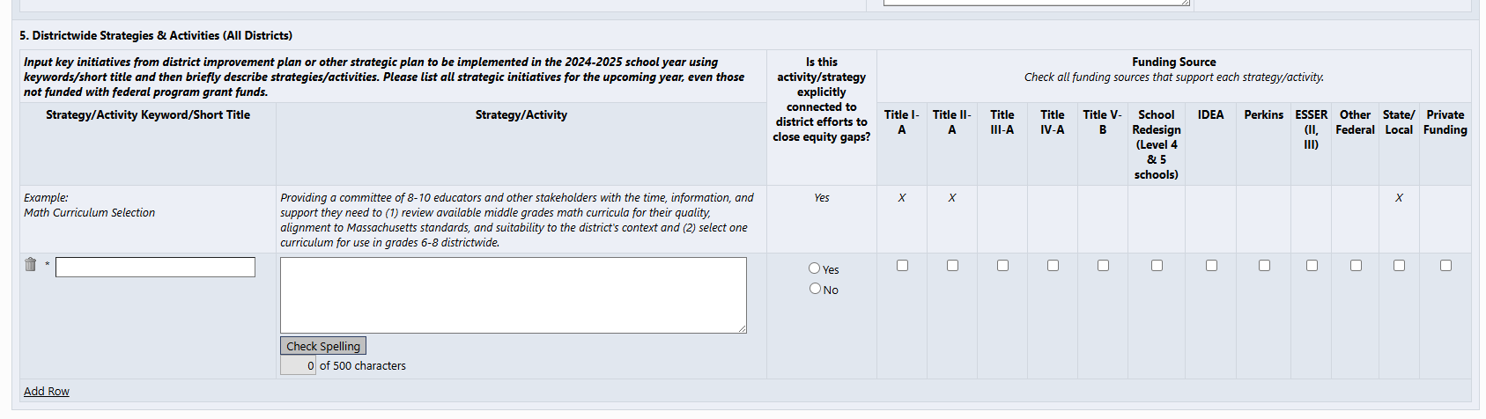
Districtwide Strategies Page
This page provides the structure for each of the narrative pages in the ESSA grant and should be completed first.
In the second column, you should write broad, overarching descriptions of strategies that your district is pursuing that are relevant to ESSA
You should not be describing specific activities; those belong on the narrative pages.
Every ESSA grant must have at least one strategy.

Slide 9
Writing a Narrative Page

Slide 10
What is the purpose of the Narrative Pages?
On the ESSA application, you are required to describe what is being funded by the grant twice: once on the Narrative Page, and again on the Budget Detail Narrative.
Both are essential but have different purposes.
The Narrative Page should describe each activity that is being funded by that Title and why it is being funded/what needs it will address.
This is your chance to provide an accessible overview to the audience that will help them understand the district’s decisions and how they fit into this grant.

Slide 11
Narrative Page Sections
There are two main sections to the narrative page: “Districtwide Strategies & Activities” and “Title IA Strategies not on the Districtwide Strategies Page”
Use these sections to add a line for each distinct activity being funded by the grant.
  It’s ok to group activities if they are directly related, for example stipends and transportation costs for a specific after-school program can be included together in a single narrative line
  DO NOT list everything in a single narrative line unless only one thing is being funded by that budget
If you indicated on the Districtwide Strategies page that a specific strategy is associated with a Title, it must appear on the Narrative page with at least one activity that is clearly related to it
  You can use the same strategy multiple times
  Anything not related to a specific strategy but being funded by the Title should go in the second section

Slide 12
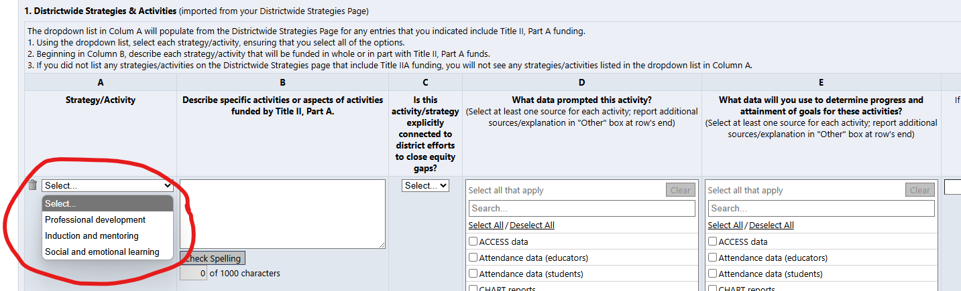
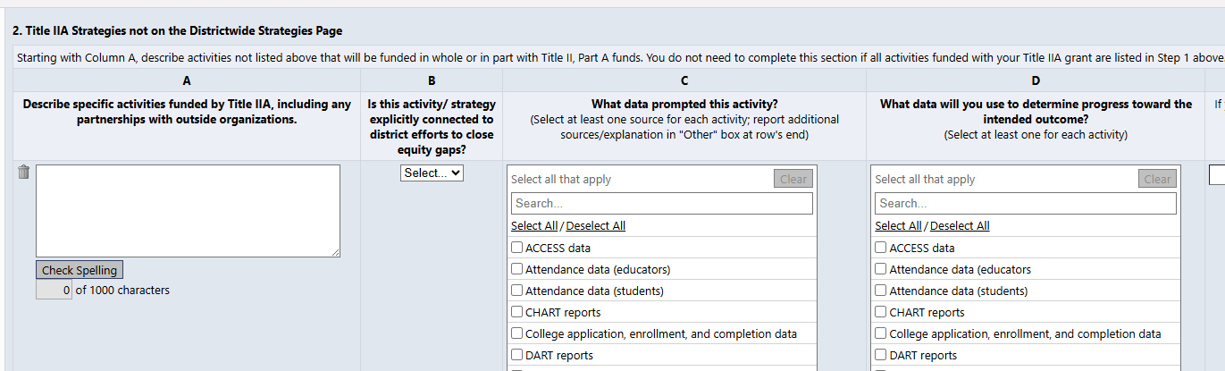
Narrative Page Sections (cont.)

Slide 13
Writing the Narrative Page
Every budget detail on the Title budget page should have a corresponding narrative line, except where it makes sense to group related items together.
When writing the narrative, you can use the following as a structure:
  Who/What is being funded: Describe the staff, programs, materials, PDs, etc. that are being funded by this grant.
    This should also describe what is being funded in a way anyone can understand. If you are using acronyms, write them out in full at least one time. If you are referring to a district program, please provide at least a one sentence description that anyone reading can understand.
  Where: If this is taking place at a specific school or multiple schools, state that.
  When: Is this a PD taking place one time? How long is this staff position being funded for? Are these materials that won’t be purchased until mid-year?
  Why: Don’t forget to explain why this is being funded. You don’t need to provide the full results of your needs assessment, but your audience should understand why this is being funded with this specific grant and how it will benefit students in the district.

Slide 14
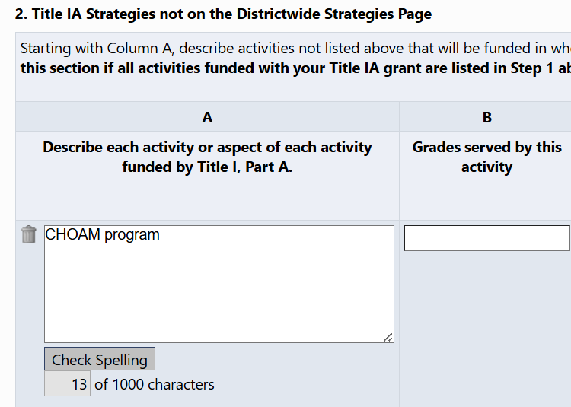
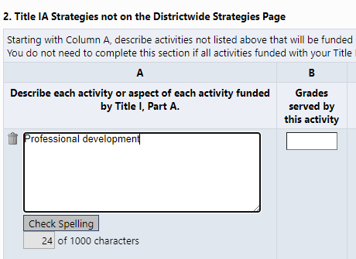
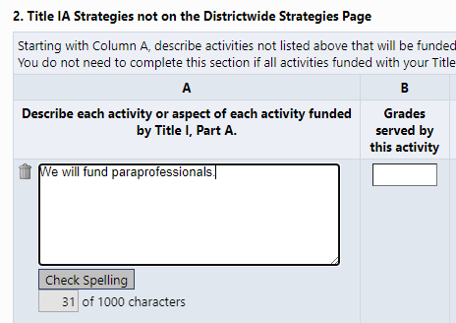
Narrative Page Error #1: Not a Narrative
The following narrative lines do not have sufficient information:

Slide 15
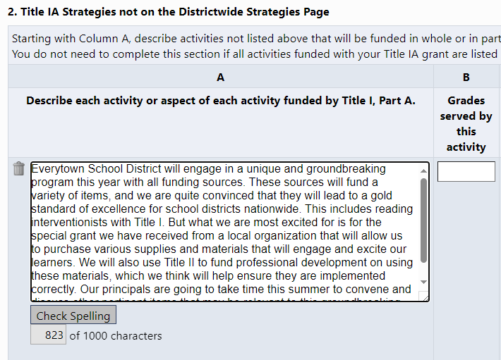
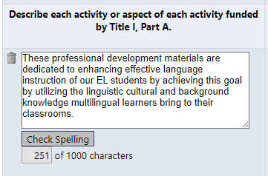
Narrative Page Error #2: Too Much Detail or Too Much Ambiguity
Too Much Detail
Too Much Ambiguity

Slide 16
Narrative Page Error #3: Describing Activities Not Found on the Budget Page
When you are adding narrative lines, do not create one for line items that do not appear on the budget page.
In addition, do not include activities that are being funded by other sources in your narrative descriptions.
Our recommendation is that you work directly off your planned budget: if a line item does not appear on the budget page, do not create a narrative line for it.

Slide 17
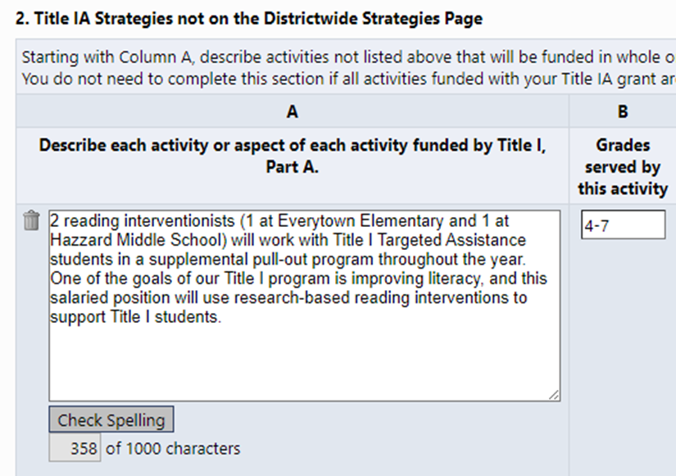
Exemplar Narrative
This narrative is an exemplar because it includes the following:
  Who/What is being funded (2 reading interventionists) and basic information about what the activity being funded is (staff that work with TA students in a supplemental program)
  Where the funding will go (Everytown Elementary and Hazzard Middle School)
  When this expense will take place (across one year)
  Why this expense is being funded (improves literacy with research-based interventions).
  Written in a way that anyone can understand (does not include un-defined acronyms, is light on jargon, clearly connects the line item and the goals of the grant)

Slide 18
Writing a Budget Detail Narrative

Slide 19
What is the purpose of the budget detail narrative?
While the narrative gives the audience a sense of what is being funded in the budget, the budget detail narrative is a succinct overview the accompanies each budget line. It’s a shorter reiteration of the who/what, and (if needed) where and when to provide further clarity to the budget.
The budget detail narrative should have the following:
  Who/What: A brief but precise description of what is being funded that matches terminology used on narrative page (ex. “2.0 FTE Reading Interventionists”)
    Who/What for staff positions: Include relevant fiscal details: include full-time equivalence (FTE) that is being funded by this grant if this is a salaried position, or number of staff and rate if this is a stipend
    Who/What for PD: Professional development can have a lot of associated costs. Is this a stipend for staff to attend? Stipend for staff to lead? A contract with a PD provider? Supplies for PD?
  Where: If a location was provided in the narrative, include it in the budget detail narrative as well.
  When: List how long staff positions will be funded for. If other timeline information was included in the narrative, include it in the budget detail narrative as well.

Slide 20
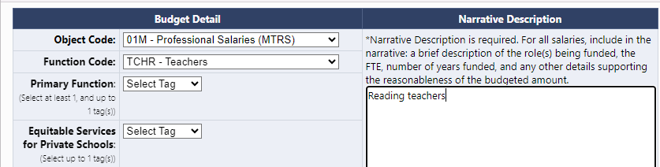
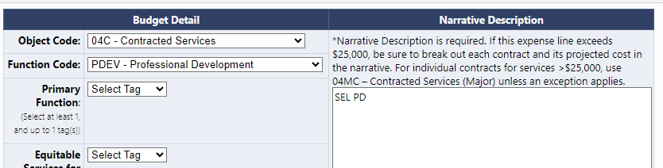
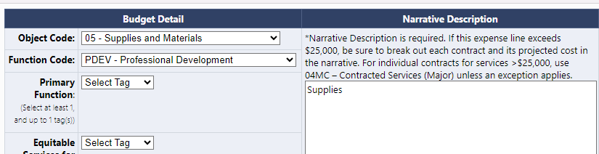
Budget Detail Narrative Error #1: Not Enough Information

Slide 21
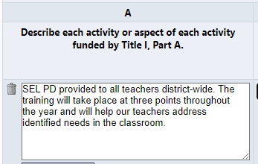
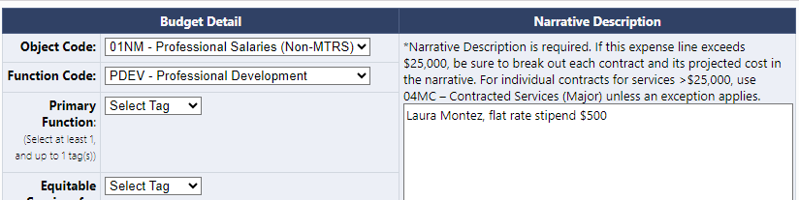
Budget Detail Narrative Error #2: Using Different Terms on Narrative and Budget Pages

Slide 22
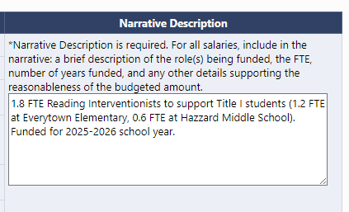
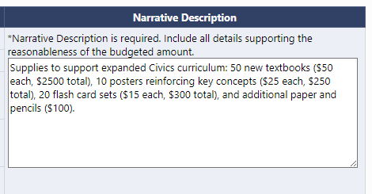
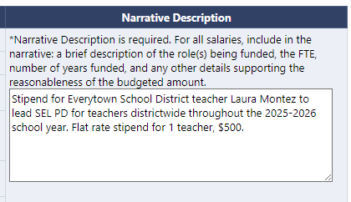
Exemplar Budget Detail Narratives

Slide 23
Writing a Title IV SMART Goal

Slide 24

What is a SMART goal?
      SPECIFIC
      MEASURABLE
      ACHIEVABLE
      RELEVANT
      TIME-BOUND

Slide 25
8 Tips for Writing Effective SMART Goals
Start with Specific Action Verbs: Begin the goal with a clear action verb (e.g., "increase," "reduce," "implement"). This makes the goal more precise and action-oriented.
Use Quantifiable Metrics: Include specific numbers, percentages, or dates (e.g., "increase by 15%", "complete within 3 months") to make your goals measurable.
Set Realistic Targets: Balance ambition with practicality by choosing targets that stretch your abilities but are achievable with available resources and time.
Focus on Relevant Outcomes: Make sure the goal aligns with broader objectives (e.g., student outcomes) to stay relevant to overall priorities.

Slide 26
8 Tips for Writing Effective SMART Goals (cont.)
Define a Clear Timeline: Add deadlines or checkpoints (e.g., "by the end of the semester“ or “At the end of SY24/25”) to keep goals time-bound and help track progress over time.
Align with Stakeholders’ Needs: Make sure goals are relevant to the needs of key stakeholders (e.g., students, teachers, families) for greater impact and buy-in.
Specify Resources Needed: Identify any resources or support required to achieve the goal, such as professional development, technology, or partnerships. This can make the goal more realistic and attainable.
Include a Method of Evaluation: Define how you will measure success (e.g., “using end-of-term assessments” or “via monthly attendance tracking”). This makes the goal measurable and ensures you can evaluate progress.

Slide 27
Examples of Weak Intended Outcomes
      We will utilize instructional strategies, technologies or materials that address the achievement gap among our subgroup data.
      The intended outcome of this program is to improve math MCAS scores based on the instructional software programs chosen.
      The intended outcome of this program is to see a higher number of students saying they are safe in the school building.
      All staff who have not been trained in Responsive Classroom will be trained by the end of the year.
      Provide new opportunities for students to engage with faculty during the school day.

Slide 28
SMART Goal Exemplars
      The five elementary schools will offer at least one program for students identified as chronically absent. 80% of targeted participants will attend at least one session and by June 2025, each participant’s attendance will increase by 10%.
      By June 2025, increase digital literacy for 7th graders by 20% (EOY assessment) through the integration of weekly coding and online safety lessons.
      By June 2025, the middle school will observe a reduction of at least 10% of students referred to the PASS program more than once during the school year.
      At least seven 10th or 11th grade students will attend the annual Youth At Risk Conference, and a minimum of 75% will report being engaged and that it helped to promote student voice at school (measured by the student engagement survey) at the end of the 2024-2025 school year.

Slide 29
Moving from Weak to SMART
      The district will provide at least three activities or speakers targeted to school safety and student wellness, creating a culture that promotes a sense of belonging for all.
          By holding these talks about student safety/wellness, what impact do you hope it will have on students? By when? How will it be measured?
      100% of students provided assistive technology will be assessed every six months to evaluate participation, engagement, and achievement progress in their classrooms.
          By providing these tech tools, what impact do you hope they will have on those students who used them? By when? How will it be measured?
      All students in grades 5-12 will have access to the platform, where they can download audiobooks for use in class or for independent reading.
          By providing students with access to the platform, what impact do you hope it will have on students? By when? How will it be measured?
      Staff attending the safety and student well-being professional development will complete an exit ticket identifying at least two new items of learning resulting from the PD.
          By having teachers attend this PD, what impact do you hope it will have on students? By when? How will it be measured?

Slide 30
Common Errors to Avoid When Completing Your ESSA Application

Slide 31
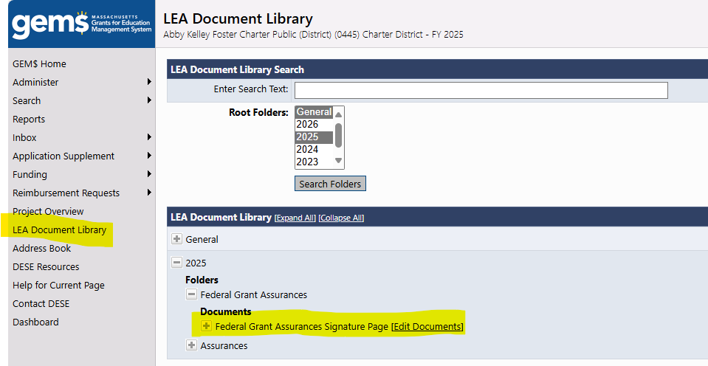
FY27 Grant Assurances
The FY27 Grant Assurances signature page should be uploaded in the LEA Document Library
Only upload the first two pages, and make sure you have checked the appropriate box in each three sections (unless your district is not receiving Title III in FY27)

Slide 32
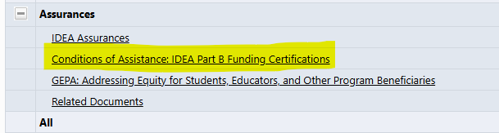
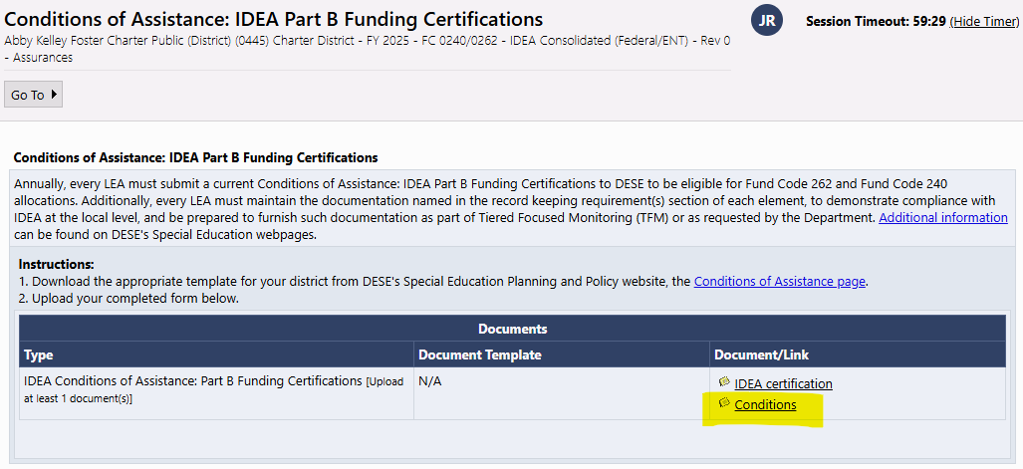
Grant Assurances vs. Conditions of Assistance
The IDEA Application has a similar sounding document called the “Conditions of Assistance.”
Do not upload the Conditions of Assistance document in the LEA Document Library, it has a specific upload link within the IDEA application.
Unlike the Grant Assurances, you must upload the entire document and ensure you have filled out all required signatures/dates on the first and last two pages.

Slide 33
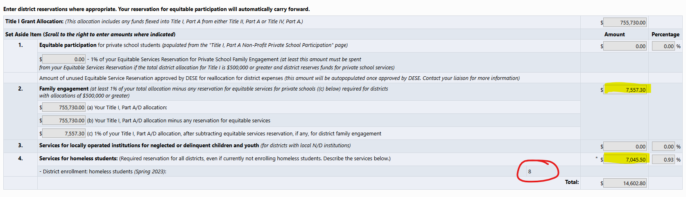
Title I Reservations
Notes:
Required reservations have not been made
Every district must reserve a “reasonable amount” for homeless student services, even districts that currently have no students experiencing homelessness
Districts receiving more than $500,000 in Title I funds must reserve 1% of their Title I budget for family engagement activities

Slide 34
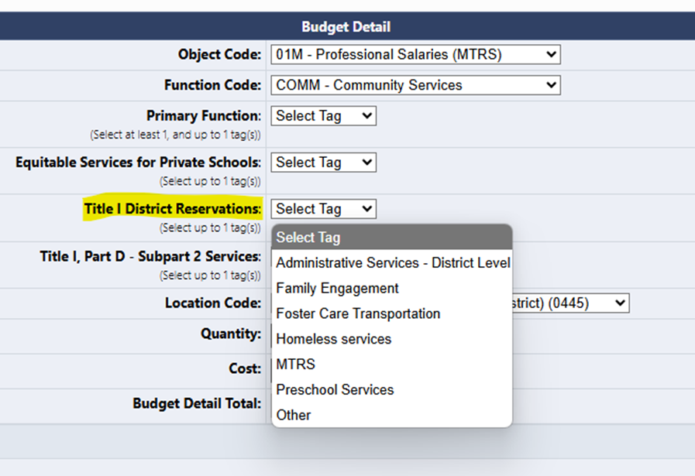
Tagging Title I Reservations in the Budget
Amounts reserved on Reservations page must always appear as the exact same number on the Title I budget page
You can use budget tags to make clear which expenses relate to specific Title I reservations
Notes:
Reservations should always be a part of the Title I budget, they just usually refer to district-wide costs so they are “reserved” from the School Ranking page. If you reserve $5,000 for homeless services, I should be able to clearly understand where on your budget this money is being allocated.

Slide 35
Title I Budget
The main reasons a Title I budget page might be returned are the following errors:
  There are Schoolwide costs for a Targeted Assistance program
  Private school equitable services costs not directly tailored to the needs of the specific students who would have attended a Title I program in your district
  Reservation amounts not appearing or being tagged unclearly on the Title I budget page
Reminder to make sure your object and function codes are correct. Check the Chart of Accounts if you are unsure

Slide 36
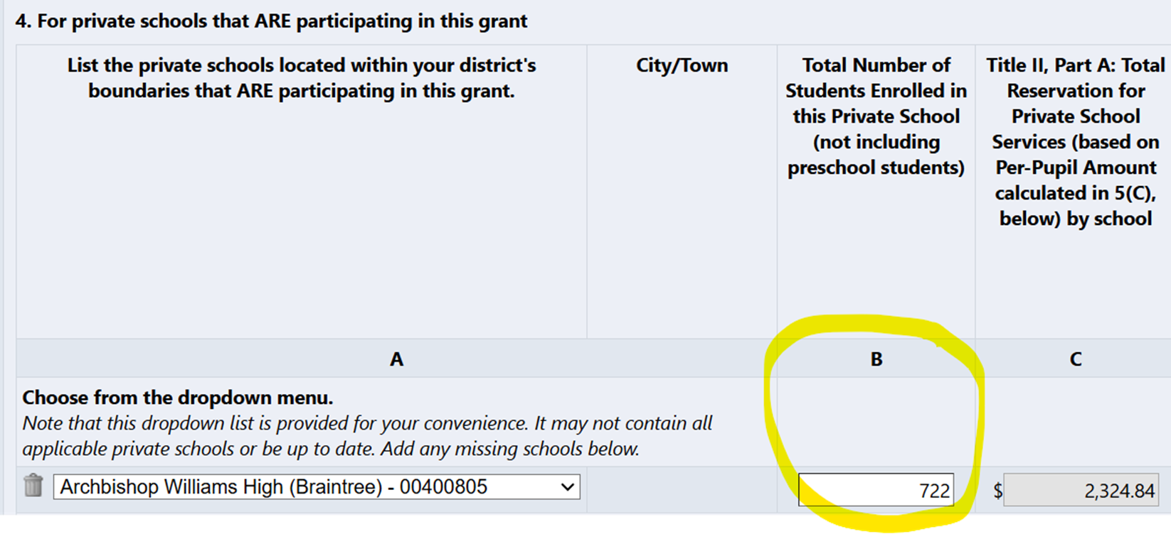
Title IIA, III, IVA Equitable Services
Unlike Title I, Titles IIA, III, and IVA equitable services are based on the TOTAL enrollment of the private school.
This number should not match the Title I (or be more than Title I) private school student number and should be the same across all three grants (if the private school is participating in more than one grant).

Slide 37
Title II Budget
Reminder to make sure your object and function codes are correct. Check the Chart of Accounts if you are unsure
High quality professional development activities
  Sustained (not stand-alone, 1 day or short-term workshops)
  Intensive
  Collaborative
  Job Embedded
  Data Driven
  Classroom focused
Cannot fund stipends for developing, aligning, or revising curriculum materials

Slide 38
Title III Narrative
Your Title IIIA narrative should clearly identify specific costs the district is funding to meet the three required Title III activities:
  Provide direct supplemental instruction
  Provide effective professional development
  Provide parent, family, and community engagement activities
Everything Title III funds must be supplemental activities.
Any services required for ELs by law (such as translation) or any costs that would be funded anyway if the district did not receive Title III are not allowable.

Slide 39
Title III Budget
Again, it must be clear which budget items the district is funding to meet the three required activities, and it must be clear all costs are supplemental.
The FY27 application has tags for each required activity, please use them.
Reminder to make sure your object and function codes are correct. Check the Chart of Accounts if you are unsure.

Slide 40
Wrap-Up

Slide 41
Things to Remember
There are many written components to the ESSA application, but each one is included to help your district meet requirements under federal law.
Following the guidelines in this session will help ensure your grant is accurately telling the story of the staff, materials, and activities that you are seeking to fund.
Taking the extra time to write strong narratives and budget detail narratives makes it easier for DESE to review and will limit the number of times your grant is returned for edits.
Stop and ask yourself: would I know what I was talking about if I didn’t work for my district?

Slide 42
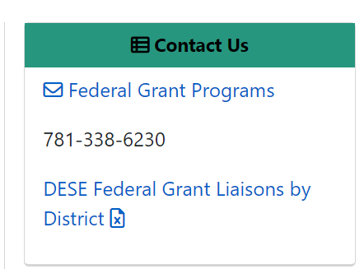
Keep in touch!
Key DESE contacts:
  RASP Liaison: Reach out to your designated liaison for any questions about ESSA or IDEA grant programs, allowable costs, amendments, and/or ESSA monitoring.
  Grants Management: Reach out to edgrants@mass.gov or 781-338-6595 for any fiscal questions about grants including reimbursements, final reporting, and/or grant balances.
Notes:
Ellie

