Slide 1
Program Evaluation
Webinar
November 18th, 2025

Slide 2
Introductions
Leif Jacobsen
DESE, Federal Programs Team
Kendra Winner
DESE, Research and Evaluation Coordinator

Slide 3
Objectives
By the end of today’s convening, participants will understand how to:
Use DESE’s program evaluation resources
Align programming, goals, and metrics
Plan data collection and analysis

Slide 4
Why is this important?
Federal law mandates that as a condition of accepting Title grant funding, a district must annually evaluate its Title grant programs.
You should be regularly using data to:
Identify the current/right needs
Ensure you’re addressing the needs you identified
Identify what’s going well
Identify what needs to improve
Use findings for planning and improvement.
Document progress against your goals

Slide 5
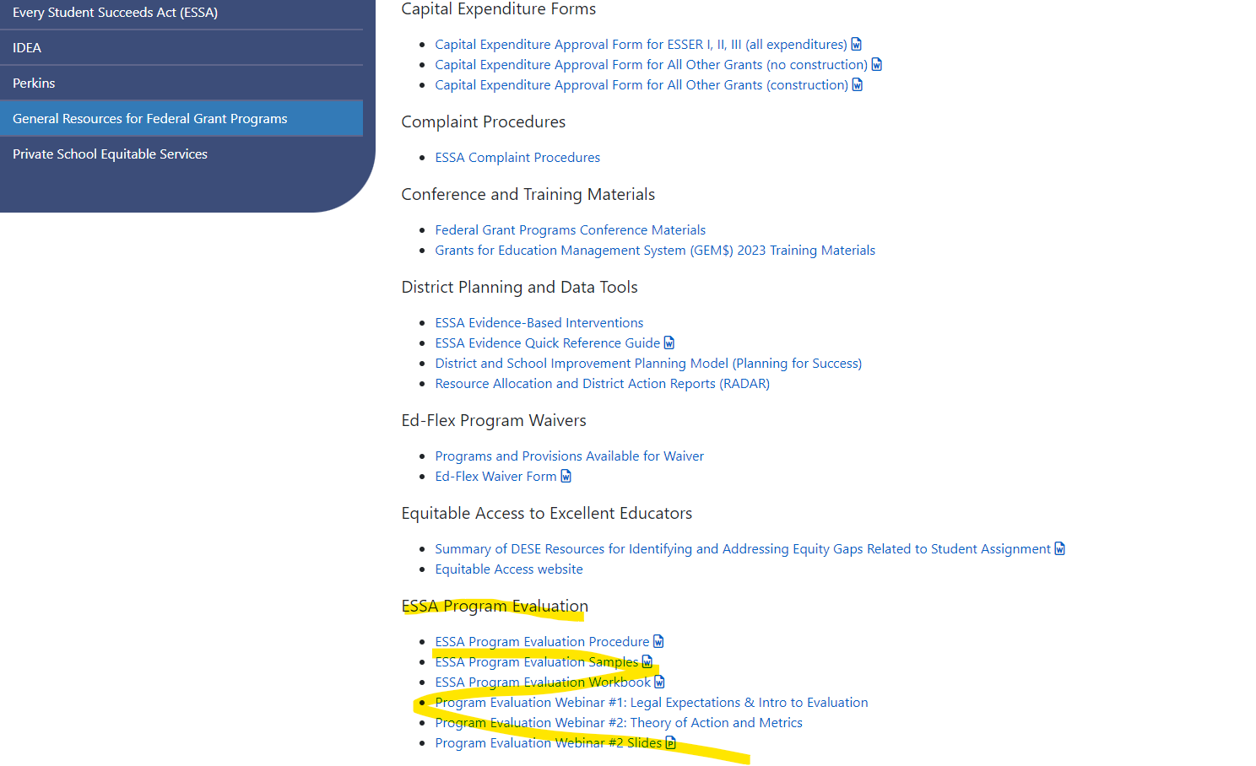
Where to Find Evaluation Resources
1. On DESE Website, go to
Federal Grant Programs
->
General Resources for Federal Grant Programs ->
ESSA Program Evaluation

Slide 6
Resources: What’s New?
Title I Evaluation “Strong Example”
Coming Soon: Working on a Title II “Strong Example”
Slides and recording of this webinar
What else would be helpful?

Slide 7
Workbook Checklist
Step | Question | Done?
1. Identify members of the team | What skill(s) do we need on our team and who has those skills?
2. Conduct Needs Assessment and Design Theory of Action | What’s the problem we are trying to solve? What data tells us it’s a problem? What are the short- and long-term goals of our program? What key actions will get us to our goals?
3. Define program goal and evaluation questions | What did we design our program to do? What do we want to find out? How would we know? What is measurable and attainable?
4. Create a data collection plan | How and when do we collect the data?
5. Write Program Evaluation Procedure | What are the key components of this submission and how do we write it?
6. Analyze Data | How do we analyze our findings?
7. Write Program Evaluation Summary | What are the key components of this submission and how do we write it?
8. Report, discuss, and apply evaluation findings | How do we report our findings and what do we do because of our findings?

Slide 8
Evaluation Timeline
Summer 1 | Fall | Winter | Spring | Summer 2
Establish goals of program Create Theory of Action for program Establish evaluation metrics | Meet with key stakeholders Set data collection plan | Collect data Draft program evaluation procedure | Collect data Draft program evaluation summary | Make final edits to documents & disseminate to key community stakeholders

Slide 9
Data Collection – Check In
Here’s where you should be at this point in the year:
  Evaluation team members identified
  Needs assessment based on data completed
  Program goals and metrics established
  Data collection plan developed:
    Calendar for when student testing and other (e.g., survey) administration will happen based on your specific plan
    Team members identified who will clean and analyze the data

Slide 10
Here’s what I’m going to talk about with my time
Aligning programming, goals, and metrics
Planning data collection and analysis

Slide 11
Aligning programming, goals, and metrics
How do we align programming, goals, and metrics?
What’s essential for a good theory of action?
Our Title I funds lots of different things. How do we identify our goals?
What makes a good metric?

Slide 12
How do we align program activities, goals, and metrics?
Theory of action ties everything together
Why you’re going where you’re going (Needs Assessment)
Where you’re going (Goal)
How you’re going to get there (Program activities)
How you’re going to know if you made progress and what needs to be improved (Metrics)

Slide 13
What’s essential for a good theory of action?
Enough explicit detail
Well articulated cause and effect: why/how program activities will get us where we want to go

Slide 14
Explicit Detail
Where the work happens
Where the work
happens
IF: … We provide Literacy Coaching
and training
THEN … Classroom instruction
changes
SO THAT … student MCAS scores improve

Slide 15
Explicit Detail
Explicit Key Actions
We create evaluation supports: a workbook that explains a step-by-step approach to evaluation and we provide and recorded webinars ; AND We get feedback from districts to improve the workbook and the webinars; AND We work with volunteer districts to provide them with targeted support and get their feedback on the workbook and webinars; AND We revise the workbook to address feedback; AND We revise existing/provide new webinars to address feedback; AND We get more feedback to improve the workbook and the webinars and ideas for new supports AND SO ON
Original “General” Key Actions
DESE improves support to districts to conduct program evaluations and provides additional targeted assistance on program evaluation to districts.

Slide 16
Cause and Effect
What changes? Why do we think this will help get to the long-term outcome?
What changes? | Districts have access to written resources that provide a step-by-step how to conduct a federal grants evaluation that’s aligned to federal requirements. The workbook includes a checklist and examples of what each step looks like when it’s completed.
Why does it lead to the outcome? | These new resources fill a gap in the supports that have been available to districts. These new resources provide more detailed information and instructions that were previously not available.
Page 6 of the Workbook

Slide 17
Our Title I funds lots of different things. How do we identify our goals?
Federal law mandates that Title grant funded programs/activities are evaluated annually.
Answer these questions about each of the funded programs/activities:
  Why you’re going where you’re going (Needs Assessment):
  Where you’re going (Goal)
  How you’re going to get there (Program activities)
  How you’re going to know if you made progress and what needs to be improved (Metrics)

Slide 18
What makes a good metric?
A good metric aligns with your identified needs and goals.
  For example don’t use DIBELS or MCAS data to measure family engagement wouldn’t make sense.
A good metric answers the following questions:
  Is our program is making progress toward or meeting our goals? In what ways?
  What’s working well?
  What do we need to improve?

Slide 19
What makes a good metric?
Answers your questions.
Collecting family attendance at events does not help you know:
  Whether home-school communication about a child’s academic or other issues is working well?
  Whether parents understand and engage in activities at home to help and encourage schoolwork?
  Whether families understand and support the Title services their child is eligible to receive?

Slide 20
What makes a good metric?
The data you used to identify the problem could be the same as the data you use to track progress, etc.
NEEDS ASSESSMENT
What data identified the problem? (Metrics)
METRICS
How will we know if we made progress?

Slide 21
Stop and Reflect: For all your Title Funded Programs/Activities …
Has your team used data to identify a problem or need?
Has your team defined your goals? What part of the problem or need did you design your program to address?
Does everyone on your team understand how your program activities and actions are going to address your problem or need(s)? Is your team’s theory of action detailed and explicit?
Is your metric aligned with your identified needs and goals? Will your metric indicate if you’re making progress toward/meeting your goals and what needs to be improved?

Slide 22
Planning data collection and analysis
  What can we do on the front end to make data collection go smoothly?
  What’s the best timeline for collecting data? What do we do if we’re starting late?
  For targeted programs, do we compare students receiving services to those not?
  For school-wide programs, how do we think about measuring growth if services touch the entire student body?

Slide 23
What can we do on the front end to make data collection go smoothly?
Create a Data Collection Plan: page 8 of the workbook
Do it well in advance
Give yourself plenty of time
Put together the right team

Slide 24
What’s the best timeline for collecting data to measure growth?
As close to the beginning of the year as makes sense
As close to the end of the year as makes sense
Middle of the year depends on your program
  Gut check
  Course Correction

Slide 25
What do we do if we’re starting data collection late?
Plan now for next year
Do what you can now
  Establish a metric and a data source
  Compare middle of the year to end of the year

Slide 26
What specific students should we collect data for?
  Two Questions:
  For targeted programs, do we compare students receiving services to those who are not?
  For school-wide programs, how do we think about measuring growth if services touch the entire student body?
  Same answers for both questions:
  Compare students to grade-level achievement
  Measure how much students grow, on which skills, and how close they come to benchmark
  Disaggregate data simultaneously by grade and by skill
Because the goal is for students to achieve grade level skills.

Slide 27
Stop and Reflect: For all your Title Funded Programs/Activities
Have you created a data collection plan with the right team and enough time?
Do you know what data you need to collect and when? Have you allowed enough time between BOY and EOY to give you the best chance to see growth?
If you started late this year, do you have a concrete timeline to plan your evaluation and data collection in advance for next year?
Does your analysis plan include understanding how students are progressing towards appropriate benchmarks?

Slide 28
QUESTIONS?

Slide 29
Collaboration and Thank You
If you would like to participate in a support consult to improve your evaluation practice, email leif.jacobsen@mass.gov!
That concludes today’s webinar – have a great day!

