Slide 1
Program Evaluation
Webinar #3
January 29th, 2025

Slide 2

Introductions
Leif Jacobsen
DESE, Federal Programs Team
Kendra Winner
DESE, Research and Evaluation Coordinator

Slide 3
Objectives
By the end of today’s convening, participants will...
Know where to find resources to support choosing metrics and measures
Understand foundation data analysis concepts including how to compare beginning and midyear data
Understand the key components of the Program Evaluation Procedure document.
Be familiar with revisions to the DESE Title Grants Program Evaluation Workbook
Be familiar with the answers to frequently asked questions about program evaluation.
Notes:
LJ

Slide 4
Why is this important?
Federal law mandates that as a condition of accepting Title grant funding, a district must annually evaluate its Title grant programs.
You should be regularly using data to:
Ensure you’re addressing the needs you identified
Identify what’s going well
Identify what needs to improve
Use findings for planning and improvement.
Document progress against your goals

Slide 5
Your Feedback and Upcoming DESE Support
Upcoming Webinars
As a result, we are planning five webinars in the upcoming year: August: Overview of Program and Evaluation Goals November: Theory of Action & Data Collection Today: Writing Your “Program Evaluation Procedure” Document March 26th: Writing Your “Program Evaluation Summary” Document June 10th (Federal Grants Conference): Connecting All the Pieces & External Communication Plan
Notes:
LJ & KW: when you sign your federal grant assurance, it has all sorts of conditions and one is that they will follow all the expectations of the grant. We will circle back to these. While subject to change, here’s what we’re thinking for November, December, February and May to support your evaluation work.

Slide 6
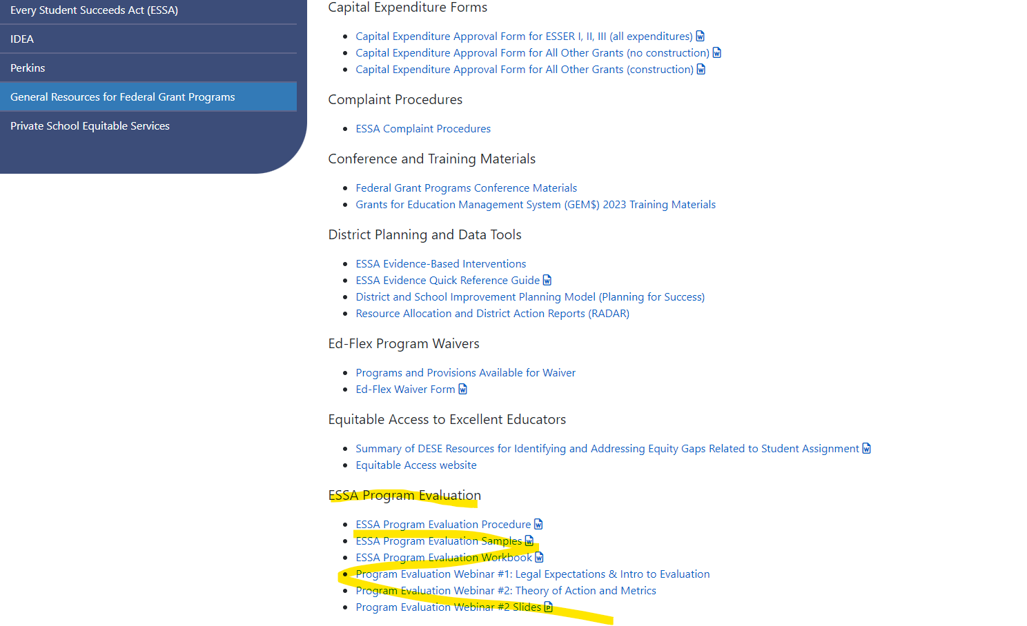
Where to Find Evaluation Resources
1. On DESE Website, go to
Federal Grant Programs
->
General Resources for Federal Grant Programs ->
ESSA Program Evaluation

Slide 7

Workbook Checklist
Step | Question | Done?
1. Identify members of the team | What skill(s) do we need on our team and who has those skills?
2. Conduct Needs Assessment and Design Theory of Action | What are the short- and long-term goals of our program? What key actions will get us to our goals?
3. Define program goal and evaluation questions | What did we design our program to do? What do we want to find out? How would we know? What is measurable and attainable?
4. Create a data collection plan | How and when do we collect the data?
5. Write Program Evaluation Procedure | What are the key components of this submission and how do we write it?
6. Analyze Data | How do we analyze our findings?
7. Write Program Evaluation Summary | What are the key components of this submission and how do we write it?
8. Report, discuss, and apply evaluation findings | How do we report our findings and what do we do because of our findings?
Notes:
Leif

Slide 8
Reminder: Metrics for Data Collection
The data that you need to collect will depend on what you are evaluating. Some common metrics are:
Student achievement/growth: MCAS, DIBELS, Access, ANET, other internal Assessments
Attendance: Attendance rate, tardy rate
Extracurricular engagement: participation rate
Parent Engagement: Parent attendance at parent-teaching meetings, PTA, etc.
See Workbook pages 25-27
Notes:
KW? LJ? There is a good amount of information about this in the workbook. Please watch the recordings for Webinar 1 and 2 where we also cover this.

Slide 9
Align your data with your program objective and your evaluation questions.
Notes:
KW

Slide 10
Example: Family Engagement
Common measure: family attendance at various events – parent/teacher conferences, curriculum night, social events.
But what does that tell you about:
  Whether home-school communication about a child’s academic or other issues is working well?
  Whether parents understand and engage in activities at home to help and encourage schoolwork?
  Whether families understand and support the Title services their child is eligible to receive?
Notes:
KW

Slide 11
Focus data analysis on understanding the story the data is telling.
Notes:
KW

Slide 12
Qualitative Analysis Think Aloud
Focus groups, interviews, open-ended survey responses, etc.
  A first careful read without taking notes or focusing on specifics yet.
  A second read for themes/topics and highlight/underline key words, phrases, or quotes.
  Look for repeated ideas and assign labels (e.g., areas for improvement, successes).
  Organize by grouping similar themes and topics together.
  Look for connections and conclusions. Ask “what are the main messages”?
  Check for bias and inconsistencies.
  Summarize your findings.
See Workbook page 33
Notes:
KW We’ve included resources in the workbook. And I’ll say again, this isn’t the best place to start for a few reasons … bias, getting candid information, etc. I have used colored highlighters. I have also cut up my notes into sections and taped those together. Do a first careful read. Pay attention to main points but don’t take notes and don’t focus too much on specific details yet.
Do a second read for themes and topics that come up repeatedly. Highlight or underline key words, phrases, and quotes.
Look for repeated ideas and patterns and assign those labels (e.g., challenges, successes, areas for improvement).
Organize by grouping similar themes and topics together.
Look for connections and conclusions. Ask yourself “what are the main messages”?
Check for bias and inconsistencies.
Summarize your findings.

Slide 13
Quantitative Analysis Think Aloud: Comparing BOY and MOY
Big Picture Evaluation Questions
  Are students “on or off track” to meet grade level expectations?
  What can we learn about how our program supported students who are on track?
  What can we learn about what our program can do differently to better support students who are off track?
Notes:
Keep but condense KW

Slide 14
Quantitative Analysis Think Aloud
Students and student information:
  Student name
  Relevant student characteristics such as gender, EL, SWD, etc.
Other relevant information:
  Intervention focus (e.g., letter recognition or comprehension, basic math operations, etc.)
  Classroom
  Time of day/instruction missed (e.g., midday, science pullout, etc.)
Scores
  BOY, MOY, EOY
  Benchmarks
Notes:
KW

Slide 15
Quantitative Analysis Think Aloud: Comparing BOY and MOY
Make note of anything interesting and any questions that come to mind.
  Look at the raw data student by student and for relevant student groups
  Look at the differences between BOY and MOY, benchmarks, actual growth, and needed growth.
  Look at descriptive statistics (means, ranges) for relevant student groups
Notes:
Encouraging you to explore. There is no right answer!

Slide 16
BOY and MOY Analysis Think Aloud
 | Child BOY score minus BOY Benchmark | Child MOY Score minus MOY Benchmark
Child 1 | -10 | -2
Child 2 | -26 | -10
Child 3 | -4 | 0
Child 4 | -18 | -8
Child 5 | +3 | +2
3) MY NOTES Look at the differences between BOY scores, MOY scores, and BOY and MOY benchmarks:
  One child exceeded both BOY and MOY benchmarks
  All students closed the gap on the MOY benchmark
  Students who needed more growth needed between 2 and 10 points of growth to meet MOY benchmark
Notes:
Keep but condense 17-25 KW 3) Look at the differences:
How did students do BOY compared to the BOY benchmark?
How did students do MOY compared to the MOY benchmark?
Actual Growth: How much did students grow from BOY to MOY?
Growth Needed to meet MOY: How much did students need to grow to meet the MOY benchmark?
Difference between actual growth and growth needed to meet MOY benchmark: How far off were students from meeting the MOY benchmark?

Slide 17
Title I Required Evaluation Submissions
1) Document 1: Program Evaluation Procedure
This is where you explain the processes that your district uses to evaluation its program.
2) Document 2: Program Evaluation Summary
This is where you analyze your district’s data and discuss implications for future program cycles.
Notes:
LJ

Slide 18
Program Evaluation Procedure: Key Components
In this document, you will:
Describe your district’s Theory of Action for this grant and the main program goals that are aligned to the TOA.
Describe the key stakeholders involved in this evaluation and the role that each stakeholder has played in the evaluation cycle.
Provide a rough annual timeline of your evaluation cycle, including goal setting, data collection, analysis, and report dissemination.
Describe which data are collected and how your team analyzed the table.
Describe how final evaluation documents are shared with the community.
Notes:
LJ

Slide 19
Evaluation Procedure: TOA & Stakeholders
Theory of Action & Program Goals | Roles of Key Stakeholders
What is your district’s theory of action for the program? At a high altitude, how do you hope that your grant will produce change that improves outcomes for students? What are your program’s long and short-term goals? How do you are these goals aligned to the program’s theory of action? | Who is leading the evaluation work? Who has been consulted, what is the role of each stakeholder? How have key strategic decisions been made?

Slide 20
Evaluation Procedure: Timeline & Data Collection
Evaluation Timeline | Data Collection
What the is rough timeline of your evaluation cycle? (In other words: what time of year do you set your goals? When do you collect data? When do you write these reports? When do you disseminate them?) *One option could be to represent this as a visual timeline.* | Which pieces of data do you collect? Why did you decide to collect these? How do you collect the data?

Slide 21
Data Analysis and Dissemination
Data Analysis | Dissemination
What steps did your team take to analyze the data? Describe here. Some Possible Examples Compared BOY, MOY and EOY benchmark assessments Tabulated teacher survey results Identified themes from open ended questions | How were these final evaluation documents shared with the community? Which key community stakeholders were provided with the documents? Some Possible Examples Posted publicly on website Shared at school board meeting Emailed to Title I teachers Discussed next steps with superintendent

Slide 22
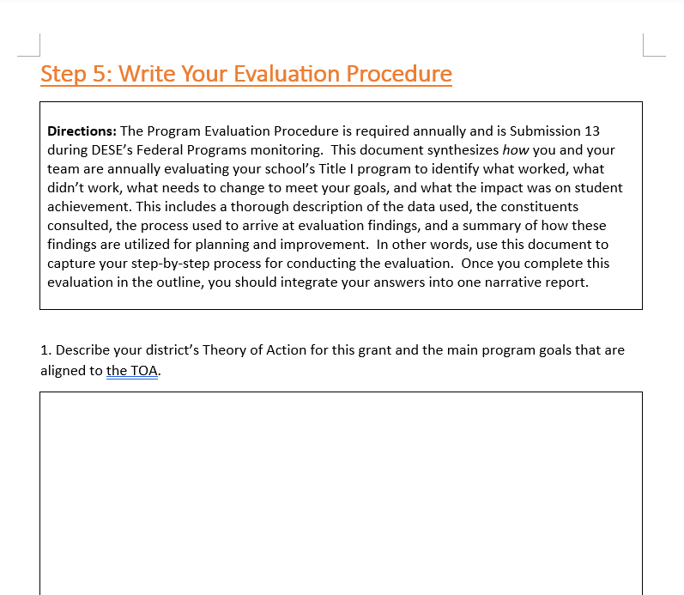
Program Evaluation Workbook Updates
Program Evaluation Workbook – DESE tool designed to support your evaluation process.
V2 released via email and on website after this webinar
Updates: added several sections, including graphic organizer for completing program evaluation procedure/summary

Slide 23
Common Program Evaluation Procedure Qs
How long should the Program Evaluation Procedure be?
There is no prescribed length, but this document is generally a couple of pages in length. We would prefer that you prioritize quality over quantity and focus on being precise with the information that you share.
Should this document be written in narrative form?
Yes, this is generally written as a narrative with different sections. One possibility could be to use the workbook and then copy the sections into a cohesive narrative.
*When in doubt, just thoroughly describe how you evaluate your program so that someone who is unfamiliar with your program could understand your process.*

Slide 24
Program Evaluation: FAQ
Which member of our team should own the “data collection” piece of this work?
Our district is large, with many schools under the central office’s administrative umbrella. How does this affect program evaluation work?
Our district is not in a monitoring year. How does this affect the annual evaluation requirement?
What is the recommended timeline for finishing the written evaluation documents?
Our district is picking this work up in the middle of the year, and we don’t have much foundation to build on. Where should we start?

Slide 25
Collaboration and Thank You
This is a collaborative process and we rely on your feedback. If you have suggestions on how to improve our guidance or would like support, email leif.jacobsen@mass.gov!
That concludes today’s webinar – have a great day!

