Slide 1
Program Evaluation Webinar #4
March 26th, 2025

Slide 2
Introductions
Leif Jacobsen
DESE, Federal Programs Team
Kendra Winner
DESE, Research and Evaluation Coordinator

Slide 3
Your Feedback and Upcoming DESE Support
Upcoming Webinars
As a result, we are planning five webinars in the upcoming year: August: Overview of Program and Evaluation Goals November: Theory of Action & Data Collection January: Writing Your “Program Evaluation Procedure” Document Today: Writing Your “Program Evaluation Summary” Document June 10th (Federal Grants Conference – in-person): Connecting All the Pieces & External Communication Plan; District Panel
Notes:
LJ & KW: when you sign your federal grant assurance, it has all sorts of conditions and one is that they will follow all the expectations of the grant. We will circle back to these. While subject to change, here’s what we’re thinking for November, December, February and May to support your evaluation work.

Slide 4
Objectives
By the end of today’s convening, participants will...
Learn how to effectively write the Program Evaluation Summary document
Review how to translate data analysis into report writing
Notes:
LJ

Slide 5
Why is this important?
Federal law mandates that as a condition of accepting Title grant funding, a district must annually evaluate its Title grant programs.
You should be regularly using data to:
Ensure you’re addressing the needs you identified
Identify what’s going well
Identify what needs to improve
Use findings for planning and improvement.
Document progress against your goals

Slide 6
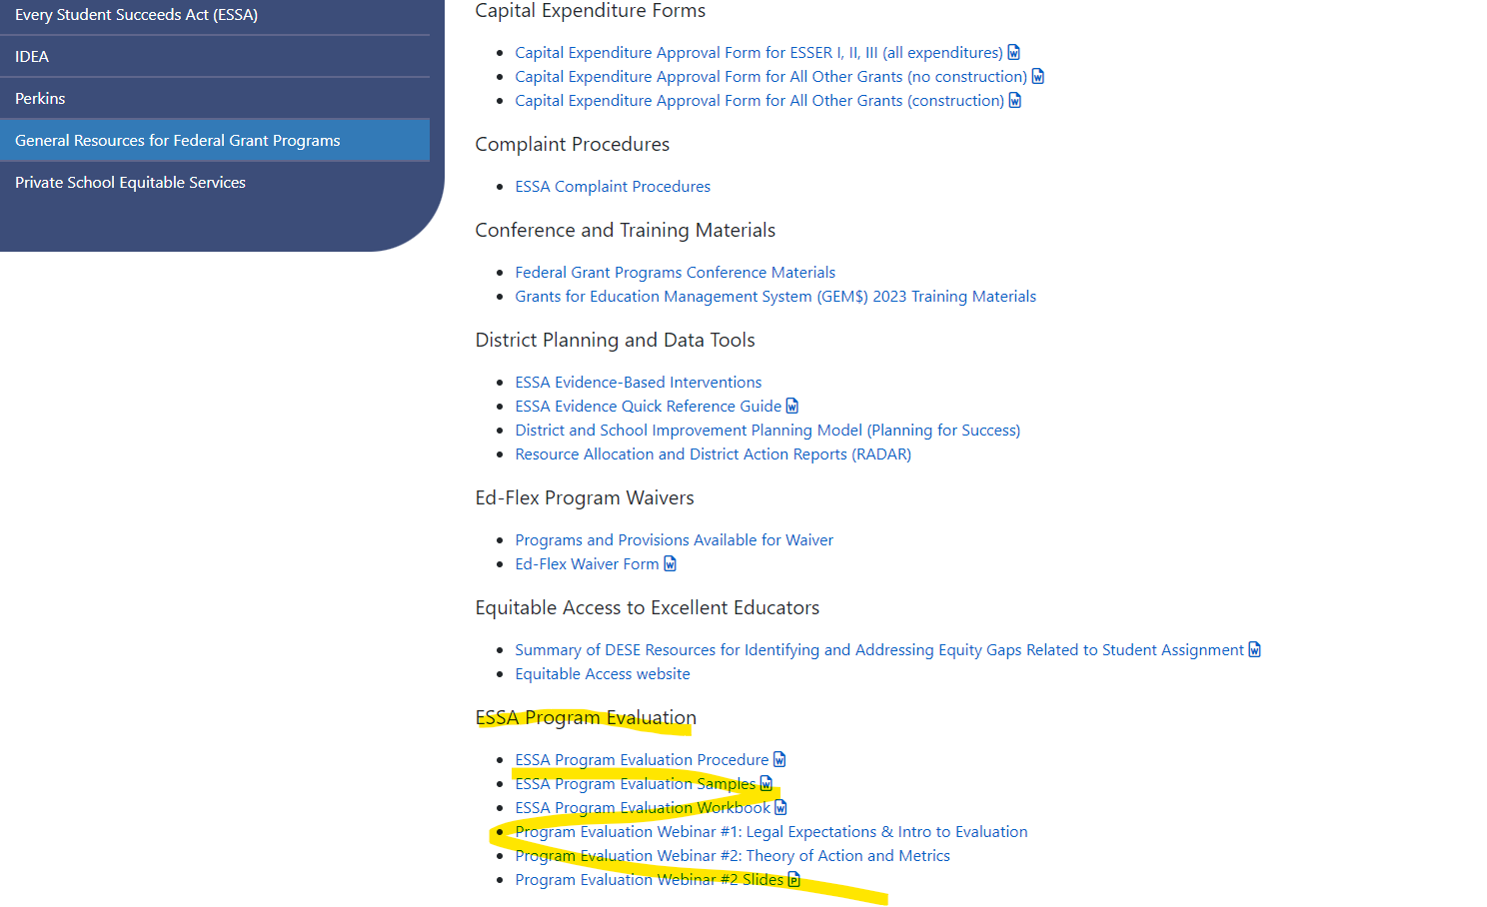
Where to Find Evaluation Resources
1. On DESE Website, go to
Federal Grant Programs
->
General Resources for Federal Grant Programs ->
ESSA Program Evaluation

Slide 7
Workbook Checklist
Step | Question | Done?
1. Identify members of the team | What skill(s) do we need on our team and who has those skills?
2. Conduct Needs Assessment and Design Theory of Action | What are the short- and long-term goals of our program? What key actions will get us to our goals?
3. Define program goal and evaluation questions | What did we design our program to do? What do we want to find out? How would we know? What is measurable and attainable?
4. Create a data collection plan | How and when do we collect the data?
5. Write Program Evaluation Procedure | What are the key components of this submission and how do we write it?
6. Analyze Data | How do we analyze our findings?
7. Write Program Evaluation Summary | What are the key components of this submission and how do we write it?
8. Report, discuss, and apply evaluation findings | How do we report our findings and what do we do because of our findings?
Notes:
Leif

Slide 8
Evaluation Timeline
Summer 1 | Fall | Winter | Spring | Summer 2
Create Theory of Action for program Establish goals of program Establish evaluation metrics | Meet with key stakeholders Set data collection plan | Collect data Draft program evaluation procedure | Collect data Draft program evaluation summary | Make final edits to documents & disseminate to key community stakeholders

Slide 9
Title I Required Evaluation Submissions
1) Document 1: Program Evaluation Procedure
This is where you explain the processes that your district uses to evaluation its program.
2) Document 2: Program Evaluation Summary
This is where you analyze your district’s data and discuss implications for future program cycles.
Notes:
LJ

Slide 10
Program Evaluation Summary: Key Components
Capture both the results and the implications of your evaluation.
Discussion of the strengths and weaknesses of your program based on your data.
Explanation of any consequent program changes made based on your analysis.

Slide 11
Program Evaluation Summary: Part I
Data Overview | Program Goals
Provide an overview of the data that you collected. Explain the key insights that you gathered from the data. | Based on the data, determine whether you have achieved your program goals or not. Analysis, not description…explain WHY based on the data.

Slide 12
Program Evaluation Summary: Part II
Analysis
Has your program contributed to positive student achievement growth? Why or why not? Use the data to support your response. What were the program’s biggest strengths and weaknesses, based on the data? Based on these strengths and weaknesses, what do you intend to change (or keep) going forward? Explain.

Slide 13
Program Evaluation Summary: Focus Area
Key Growth Area: Districts describing their programs but not analyzing them.
Features of Description | Features of Analysis
Often provides key details or facts (good!). Too often relies on surface-level observation, focusing on what the program does rather than whether it is working and why or why not. | Focuses on using data to determine to what extent the program is effective. Breaks down and interprets the data. More conceptual, using reasoning and logic.

Slide 14
Program Evaluation Summary: Focus Area
Key Growth Area: Districts describing their programs but not analyzing them.
Description | Analysis
“Our Title I targeted assistance program serves students in the lowest 20% of math achievement. These students are provided with additional support through a math intervention class. The program has been successful over time as we have rolled out these services.” | “Based on math MCAS data, our 7th and 8th grade Title I students’ math scores grew at a 33% faster rate than the entire 7th and 8th grade cohort. This indicates that the middle-school Title I TA program is meeting its goal of accelerating math achievement in key skill areas, and indicates that we should continue this core component of our program next year.”

Slide 15
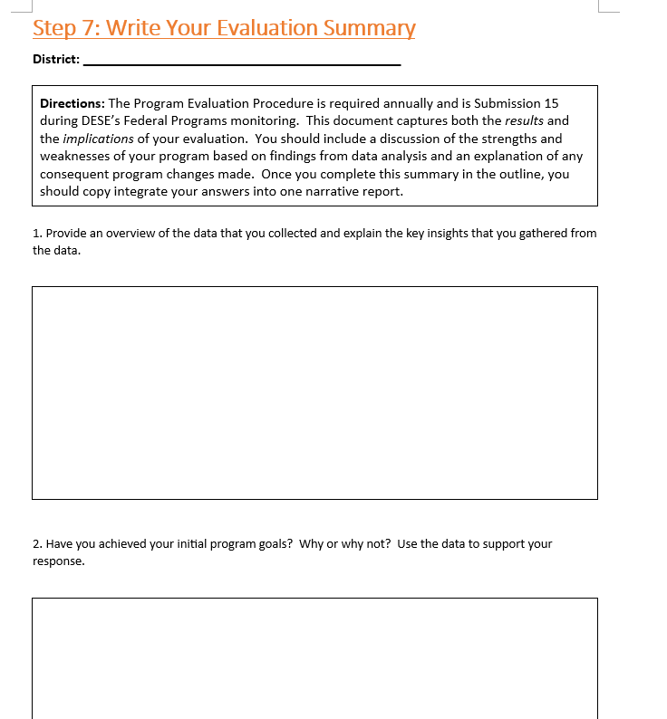
How to Use the Workbook

Slide 16
Analysis Example: Building on a Great Foundation
I’m going to talk through:
The good elements in an example
Improvements I would make
My approach to an analysis

Slide 17
1. Example
Outlines details of the intervention
Specifies the evaluation questions
Identifies metrics including one that captures high growth needed
Displays the data

Slide 18
1. Example: Details of the intervention
Title 1 Funds provided a 1.0 FTE certified teacher to provide Reading and Math support.
Student selection based on Spring MCAS, end of year (EOY) STAR reading assessments, student success in Tier 1, etc.
Students received 10 weeks of standards-aligned instruction based on identified areas of weakness.
Classes met daily throughout the quarter for 50 minutes.
Each grade level was assigned to a class in a different quarter of the school year.

Slide 19
1. Example: Evaluation Questions and Metrics
Measured by STAR Reading Assessments
What percentage of students at the beginning of the year (BOY) were not on grade level?
What percentage of students in the spring (MOY) were below grade-level?
What percentage of students increased one achievement level?
What percentage of students attained a Student Growth Percentile (SGP) of at least 50?

Slide 20
1. Example: Data Display
Grade | All Literacy | 5 | 6 | 7 | 8
# of students | 112 | 17 | 28 | 27 | 40
# below grade-level | 82 | 12 | 23 | 20 | 27
% below grade-level | 73% | 71% | 82% | 74% | 68%
# moved up 1 achievement level | 30 | 1 | 6 | 9 | 14
% moved up 1 achievement level | 27% | 6% | 21% | 33% | 35%
# SGP 50+ | 57 | 3 | 14 | 14 | 26
% SGP 50+ | 51% | 18% | 50% | 52% | 65%

Slide 21
1. Example: Data Display
Grade | All Literacy | 5 | 6 | 7 | 8
# of students | 112 | 17 | 28 | 27 | 40
# below grade-level | 82 | 12 | 23 | 20 | 27
% below grade-level | 73% | 71% | 82% | 74% | 68%
# moved up 1 achievement level | 30 | 1 | 6 | 9 | 14
% moved up 1 achievement level | 27% | 6% | 21% | 33% | 35%
# SGP 50+ | 57 | 3 | 14 | 14 | 26
% SGP 50+ | 51% | 18% | 50% | 52% | 65%

Slide 22
Summing up Example
Details of the Intervention
Title 1 Funds provided a 1.0 FTE certified teacher to provide Reading and Math support.
Student selection based on Spring MCAS, end of year (EOY) STAR reading assessments, student success in Tier 1, etc.
Students received 10 weeks of standards-aligned instruction based on identified areas of weakness.
Classes met daily throughout the quarter for 50 minutes.
Each grade level was assigned to a class in a different
quarter of the school year.
Evaluation Questions and Metric
What percentage of students at the beginning of the year (BOY) were not on grade level?
What percentage of students in the spring (MOY) were below grade-level?
What percentage of students increased one achievement level?
What percentage of students attained a Student Growth Percentile (SGP) of at least 50?
Data Display
Grade | All Literacy | 5 | 6 | 7 | 8
# of students | 112 | 17 | 28 | 27 | 40
# below grade-level | 82 | 12 | 23 | 20 | 27
% below grade-level | 73% | 71% | 82% | 74% | 68%
# moved up 1 achievement level | 30 | 1 | 6 | 9 | 14
% moved up 1 achievement level | 27% | 6% | 21% | 33% | 35%
# SGP 50+ | 57 | 3 | 14 | 14 | 26
% SGP 50+ | 51% | 18% | 50% | 52% | 65%

Slide 23
2. Improvements: Refine Data Display
Big Takeaway: Set up the data in a way that helps YOU do your analysis

Slide 24
2. Improvements: Refine Data Display
Add the quarters each student was assigned
Reorganize columns by quarter
Reverse “below” to “at or above” to emphasize improvement
Add differences between MOY and BOY on or above grade level, both raw and percentage

Slide 25
Data Display
Grade | All Literacy | 5 Q1 | 8 Q2 | 7 Q3 | 6 Q4
# of students | 112 | 17 | 40 | 27 | 28
# MOY - BOY > grade-level | 9 | 1 | 6 | 0 | 2
% MOY – BOY > grade-level | 8% | 6% | 15% | 0 | 7%
# moved up 1 achievement level | 30 | 1 | 14 | 9 | 6
% moved up 1 achievement level | 27% | 6% | 35% | 33% | 21%
# SGP 50+ | 57 | 3 | 26 | 14 | 14
% SGP 50+ | 51% | 18% | 65% | 52% | 50%

Slide 26
2. Improvements: Analysis
Example Analysis:
Probable changes to the program based on the evaluation. Based on the results, the design of the program will remain the same. Students showed improvements in both Reading and Math. Title I Staff, as well as classroom Teachers report that students benefited from the programs.

Slide 27
2. Improvements: Analysis
Has your program contributed to positive student achievement growth? Why or why not? Use the data to support your response.
What were the program’s biggest strengths and weaknesses, based on the data?
Based on these strengths and weaknesses (based on the data), what do you intend to change (or keep) going forward? Explain.

Slide 28
3. Think Aloud Analysis

Slide 29
MOY Achievement Data
Grade | All Literacy | 5 Q1 | 8 Q2 | 7 Q3 | 6 Q4
# of students | 112 | 17 | 40 | 27 | 28
# MOY - BOY > grade-level | 9 | 1 | 6 | 0 | 2
% MOY – BOY > grade-level | 8% | 6% | 15% | 0 | 7%
# moved up 1 achievement level | 30 | 1 | 14 | 9 | 6
% moved up 1 achievement level | 27% | 6% | 35% | 33% | 21%
# SGP 50+ | 57 | 3 | 26 | 14 | 14
% SGP 50+ | 51% | 18% | 65% | 52% | 50%

Slide 30
MOY Achievement Data continued
Grade | All Literacy | 5 Q1 | 8 Q2 | 7 Q3 | 6 Q4
# of students | 112 | 17 | 40 | 27 | 28
# MOY - BOY > grade-level | 9 | 1 | 6 | 0 | 2
% MOY – BOY > grade-level | 8% | 6% | 15% | 0 | 7%
# moved up 1 achievement level | 30 | 1 | 14 | 9 | 6
% moved up 1 achievement level | 27% | 6% | 35% | 33% | 21%
# SGP 50+ | 57 | 3 | 26 | 14 | 14
% SGP 50+ | 51% | 18% | 65% | 52% | 50%

Slide 31
Analysis: Break Down Data by Grade
Data for 5th graders MOY [Q1 17 students]
1 more student achieved grade level or above MOY compared to BOY
1 student moved up one achievement level MOY compared to BOY
3 students (18%) made growth of 50% or more
Data for 8th graders MOY [Q2 40 students]
6 more students achieved grade level or above MOY compared to BOY
14 students moved up one achievement level MOY compared to BOY
26 students (65%) made growth of 50% or more

Slide 32
3. Think Aloud: 5th Grade Data Analysis
Analysis
Data
Has your program contributed to positive student achievement growth? Why or why not? Use the data to support your response.
The program does not appear to be contributing to 5th grade achievement by MOY: few 5th graders have made the kind of progress we were hoping for. One of 17 students moved up one achievement level and 3 of 17 made growth of 50% or more from BOY to MOY. 5th graders receiving intervention Q1 make less progress than students receiving only Tier 1 instruction and have not yet received the intervention.
1 more student achieved grade level or above MOY compared to BOY
1 student moved up one achievement level MOY compared to BOY
3 students (18%) made growth of 50% or more

Slide 33
3. Think Aloud: 5th Grade Data Analysis
Has your program contributed to positive student achievement growth? Why or why not? Use the data to support your response.
The program does not appear to be contributing to 5th grade achievement by MOY: few 5th graders have made the kind of progress we were hoping for. One of 17 students moved up one achievement level and 3 of 17 made growth of 50% or more from BOY to MOY. 5th graders receiving intervention Q1 make less progress than students receiving only Tier 1 instruction and have not yet received the intervention.

Slide 34
3. Think Aloud: 5th Grade Data Analysis
What were the program’s biggest strengths and weaknesses, based on the data?
The biggest strength of the intervention is that the low number of 5th graders making progress shows us that we are selecting students who require additional intervention to attain grade level standards. The biggest weakness of the intervention is that it is not supporting 5th grade student growth as much as it needs to.

Slide 35
3. Think Aloud: 5th Grade Data Analysis
Based on these strengths and weaknesses (based on the data), what do you intend to change (or keep) going forward? Explain.
We will look at the sub scores of individual students in phonemic awareness, phonics, decoding, fluence, and comprehension to identify which specific skills are challenging and realign the intervention to address those skills for 5th graders. We will pay particular attention to those skill areas where the most students are furthest from grade-level to emphasize those skills in the intervention.

Slide 36
3. Think Aloud: 5th Grade Data Analysis
Original Analysis
Probable changes to the program based on the evaluation. Based on the results, the design of the program will remain the same. Students showed improvements in both Reading and Math. Title I Staff, as well as classroom Teachers report that students benefited from the programs.

Slide 37
3. Think Aloud: 8th Grade Data Analysis
Data
Analysis
6 more students achieved grade level or above MOY compared to BOY
14 students moved up one achievement level MOY compared to BOY
26 students (65%) made growth of 50% or more
Has your program contributed to positive student achievement growth? Why or why not? Use the data to support your response.
The program contributes to 8th grade student achievement by MOY, but not as much as we would like.
Despite an impressive 26 of the 40 8th graders making growth of 50% or more by MOY, only 14 students moved up one achievement level. 8th graders are growing and showing more improvement than 6th and 7th graders who have not yet received the intervention and we think that means we are increasing the rate at which the 8th graders receiving the intervention are progressing towards grade level.

Slide 38
3. Think Aloud: 8th Grade Data Analysis
Has your program contributed to positive student achievement growth? Why or why not? Use the data to support your response.
The program contributes to 8th grade student achievement by MOY, but not as much as we would like.
Despite an impressive 26 of the 40 8th graders making growth of 50% or more by MOY, only 14 students moved up one achievement level. 8th graders are growing and showing more improvement than 6th and 7th graders who have not yet received the intervention and we think that means we are increasing the rate at which the 8th graders receiving the intervention are progressing towards grade level.

Slide 39
3. Think Aloud: 8th Grade Data Analysis
What were the program’s biggest strengths and weaknesses, based on the data?
The biggest strength of the intervention is that it is supporting more than half of the 8th graders to make growth of 50% or more by MOY. The biggest weakness is that this growth is not translating into students moving up achievement levels.

Slide 40
3. Think Aloud: 8th Grade Data Analysis
Based on these strengths and weaknesses (based on the data), what do you intend to change (or keep) going forward? Explain.
Similar to our plan for the 5th graders, we will look at the sub scores of individual 8th graders in phonemic awareness, phonics, decoding, fluence, and comprehension to see if specific skills are challenging and realign the intervention to address those skills for 8th graders. We will also look at the 26 students who grew more than 50% and see which skill areas they grew in and look at which of those students moved up an achievement level or a grade level and which did not so we can identify other skill areas to emphasize.

Slide 41
Collaboration and Thank You
If you would like to participate in a support consult to improve your evaluation practice, email leif.jacobsen@mass.gov!
That concludes today’s webinar – have a great day!

