Slide 1
Grants for Education Management System (GEM$)
Competitive Funding Applications
June 26, 2023

Slide 2
Presenters
Kristen McKinnon, Assistant Director, Student and Family Support
Jenn Ahern, Supervisor, Grants Management

Slide 3
Agenda
Grant Funding Opportunity Postings
GEM$ Competitive Grant Workflow
Due Date & Submission Instructions
Intent to Apply / Competitive Q&A
How to get started on a Competitive Grant
Announcing Awards
Questions

Slide 4
1. Grant Funding Opportunity Postings

Slide 5
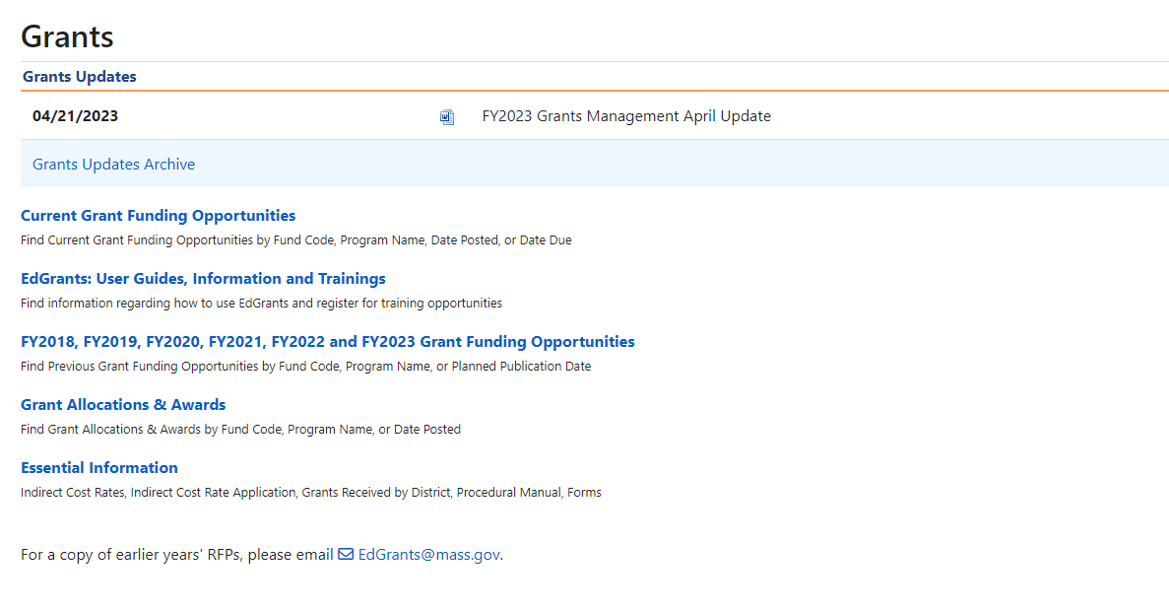
Grant Funding Opportunity Postings https://www.doe.mass.edu/grants/default.html

Slide 6
Grant Funding Opportunities

Slide 7
Grant Funding Opportunities – Request for Proposals (RFPs)
RFP is the governing document for the grant funds
Describes the purpose and priorities of the grant
Outlines the project duration of the grant including any subsequent continuation years
Due Date* (LEA Superintendent / Chief Executive Approved)
Intent to Apply (some)
Competitive applications will be available in GEM$ for all eligible entities

Slide 8
2. GEM$ Competitive Grant Workflow

Slide 9
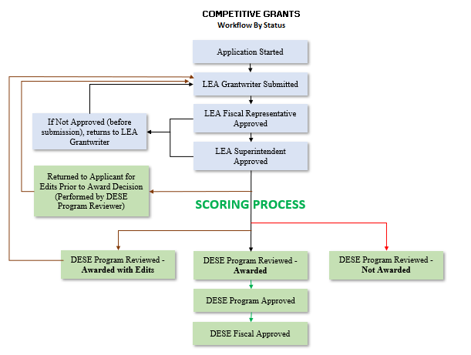
Grant Workflows
Competitive Grants

Slide 10
"Application Started"
In order to move a grant to "Application Started" status the user must have access as the grantwriter for that grant.
User access roles are assigned by the User Access Administrator (UAA) for the LEA.
UAAs are staff within the LEA that create district level users, assign appropriate roles and maintain the user access for the LEA.
Moving the grant to "Application Started" allows the user to begin filling out the application.

Slide 11
3. Due Date & Submission Instructions

Slide 12
Due Date & Submission Instructions
Comp grants in GEM$: the submission date and time is attached to the Superintendent/Chief Executive Approved step in the workflow.
Why?: Part I signature Page / Coversheet is no longer required because this step serves as the organization sign-off for the grant submission
Applications cannot be considered after the due date and time listed in the RFP / GEM$ Funding Application Screen
GEM$ will prevent application submission after the due date and time has passed
Each RFP posting will have clear submission instructions on how the application must be submitted

Slide 13
Grant Workflows
Competitive Grants

Slide 14
4. Intent to Apply / Competitive Q & A

Slide 15
Intent to Apply
Some competitive grants will require or encourage an intent to apply by a certain date
If an intent to apply is not received by the required date this may result in an inability to consider the grant submission
The purpose of the intent to apply is to identify how large the grant pool of applicants will be which facilitates identifying funding and staff resources for the DESE scoring and selection process
Determines which applicants might need temporary access to GEM$ in order to submit their grant (non-existing or new vendors)

Slide 16
Competitive Grant Q & A
DESE cannot answer regarding elements of a competitive grant to individual applicants that call or email
Competitive grants will typically have a Q & A document posted in order to give all applicants answers to any questions that come in to ensure open and fair competition

Slide 17
5. How to get started on a Competitive grant

Slide 18
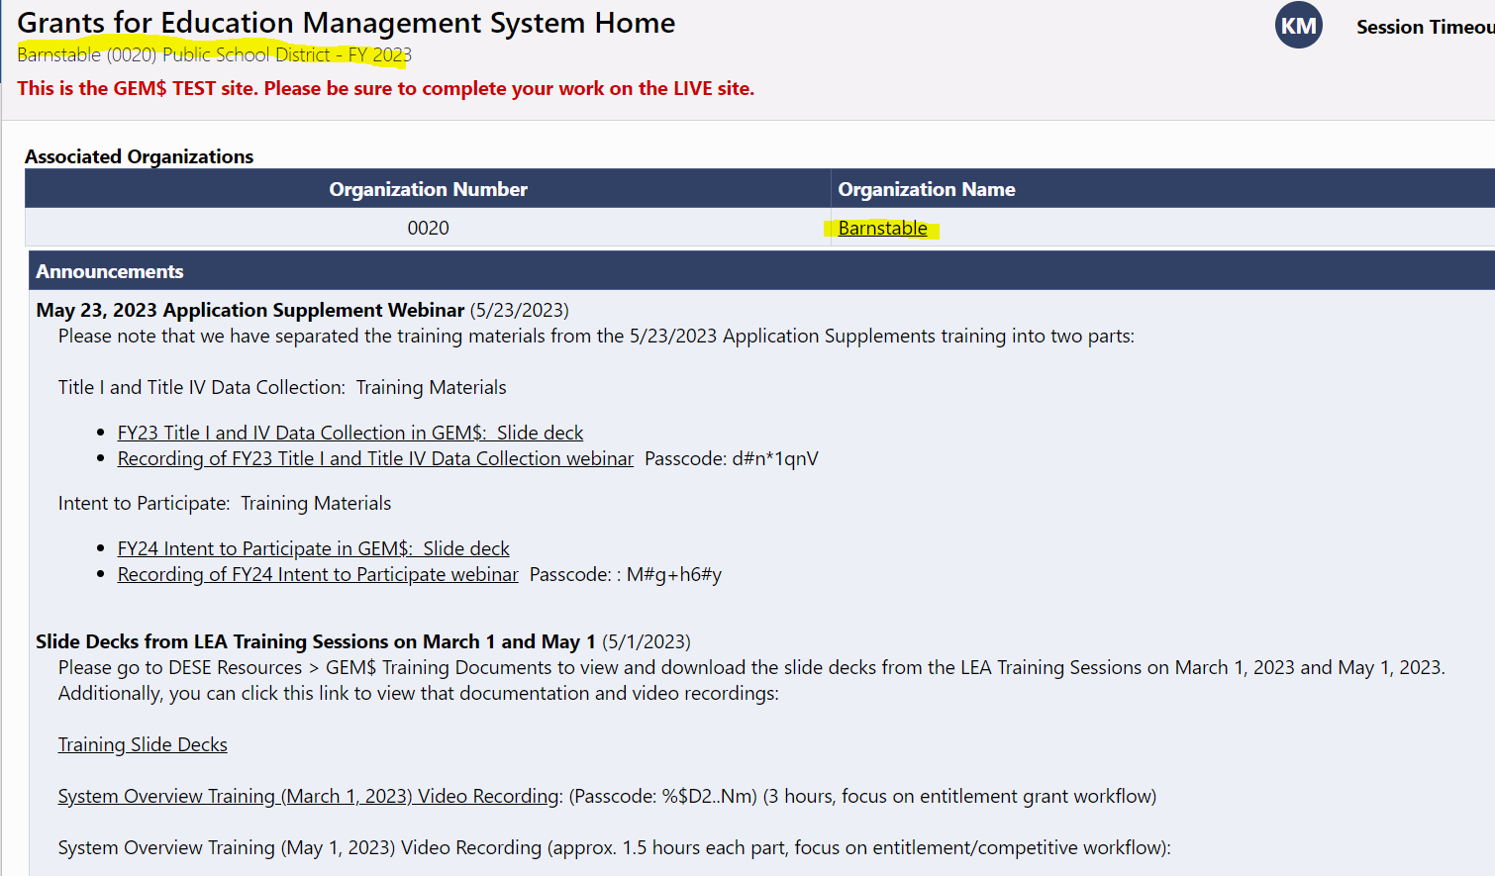
Log in to GEM$

Slide 19
Funding – left hand navigation menu
Go to Funding on the left-hand navigation menu
Select Funding Applications
Select the proper Fiscal Year (July 1, 2023 begins FY2024; grants for Summer (July/August) 2023 and School Year 23/24 are considered FY2024 grants)
Funding Applications screen will display all Competitive grants available for that fiscal year once the filter is set

Slide 20
Funding Applications

Slide 21
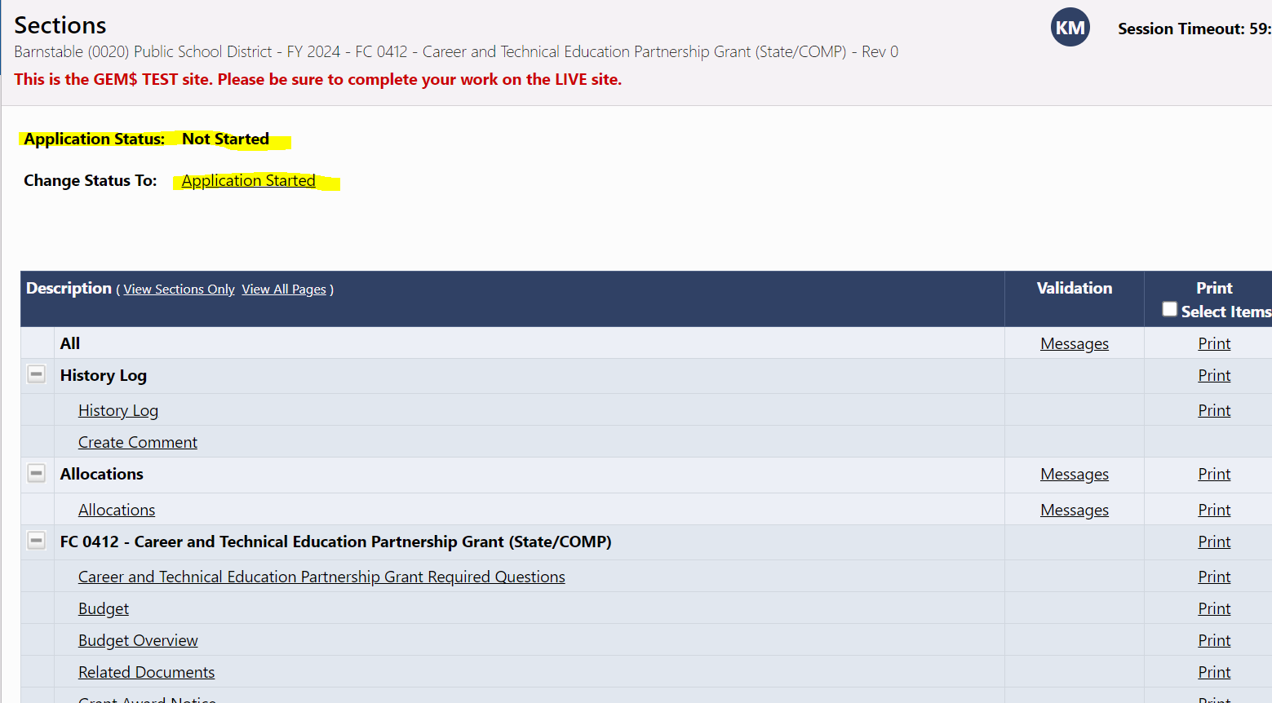
Funding Applicaitons
Click the link for the grant being applied for
Once in the grant application, it must be moved to "Application Started" in order to begin to fill out the information in each section

Slide 22
Sections
Think of "Sections" as the table of contents for any grant
Each grant application will have a history log and comments section at the top to utilize if needed by DESE
Allocations will appear blank for competitive grants, unless / until awarded.

Slide 23
Sections
The main parts of the grant are found under the fund code (FC) and program name within the application; this includes:
programmatic questions
budget / budget overview
any other related documents required
placeholder for the Grant Award Notice (GAN) should the grant be selected and awarded

Slide 24
6. Announcing Awards

Slide 25
Announcing Awards
Once selections are made, DESE program staff overseeing the competitive grant must present a board package to the Commissioner for review and approval of selected awardees
DESE program staff must also obtain approval from the Governor's office prior to announcing awards
All board packages are posted on the DESE grants management website which is the official public announcement of selected awardees
In some cases, the announcement is more public and comes via a DESE or Governor's office press release
Board packages are shared with the board at the next scheduled board meeting after the awards are posted
Once the board package is posted on the website, program staff managing the grant will also reach out to selected awardees notifying them of their award, the start date and any other pertinent information

Slide 26
Announcing Awards

Slide 27
In Summary
DESE will not see the Competitive grant as submitted until the LEA Superintendent / Chief Executive Approved status is completed (serves as signature for grant submission)
Always refer to the RFP posting on the DESE website for guidance on program expectations and submission instructions
Be aware of the due date and plan accordingly

Slide 28
7. Questions

Slide 29
Contact Information
Kristen McKinnon, kristen.a.mckinnon@mass.gov
Jenn Ahern, Jennifer.M.Ahern@mass.gov
Grants website: https://www.doe.mass.edu/grants/ - each RFP has a contact listed
Grants Management main line: 781-338-6595 / EdGrants@mass.gov

