Slide 1
Consortia Fiscal Agents and Members: How to Apply for Entitlement Grants in GEM$
GEM$ Conference - Worcester
June 26, 2023

Slide 2
Presenter
Kathy Cross, Federal Programs Coordinator, Resource Allocation Strategy and Planning

Slide 3
Consortium Terminology
No More Schedule A!
Fiscal Agent = Lead District
  Indicates on Intent to Participate that it is a Lead District for a consortium
  Submits funding application with budget for the consortium
  Ensures each member completes all applicable nonbudget sections
  Administers funds for the consortium
  Ensures services are provided for members
  Monitors compliance with all grant requirements for the consortium
Member Districts = Nonlead districts
  Indicates on Intent to Participate that it is joining a consortium
  Identifies the Fiscal Agent for the consortium on the Intent to Participate
  Completes the nonbudget sections of the funding application for the grant program(s)
  Provides Fiscal Agent with either access to or a pdf copy of its funding application

Slide 4
Why the Intent to Participate?
The Intent to Participate allows DESE to:
Assign member districts’ allocations to the Fiscal Agent for budgeting on its funding application
Limit the application sections visible to members – for example, no budgets, no School Ranking section for Title I
Avoid collecting a Schedule A document separately

Slide 5
All grant recipients, even members of consortia, will need to complete funding applications.
Funding applications for member districts are abbreviated – no budget sections and limited program sections.
To fill out their abbreviated funding applications, member districts’ User Access Administrator must assign all roles in the workflow:
    LEA Grantwriter for Funding Applications
    Fiscal Representative
    Superintendent/Chief Executive

Slide 6
Funding application pages that all districts will need to complete, including members of consortia, if applicable:
IDEA Consolidated (FC 240 & FC 262) | ESSA Consolidated (Titles I-IV) (FC 305, FC 140, FC 180 & FC 309)
Maintenance of Effort (MOE) | Title I, Part A Non-profit Private School Participation
CEIS/CCEIS and Making Money Matter (M³) | Title II, Part A Non-profit Private School Participation
Equitable Services | Title III, Part A Non-profit Private School Participation
Equitable Services Carryover | Title IV, Part A Non-profit Private School Participation
IDEA Assurances | GEPA Questions
Conditions of Assistance (upload)
GEPA Questions

Slide 7
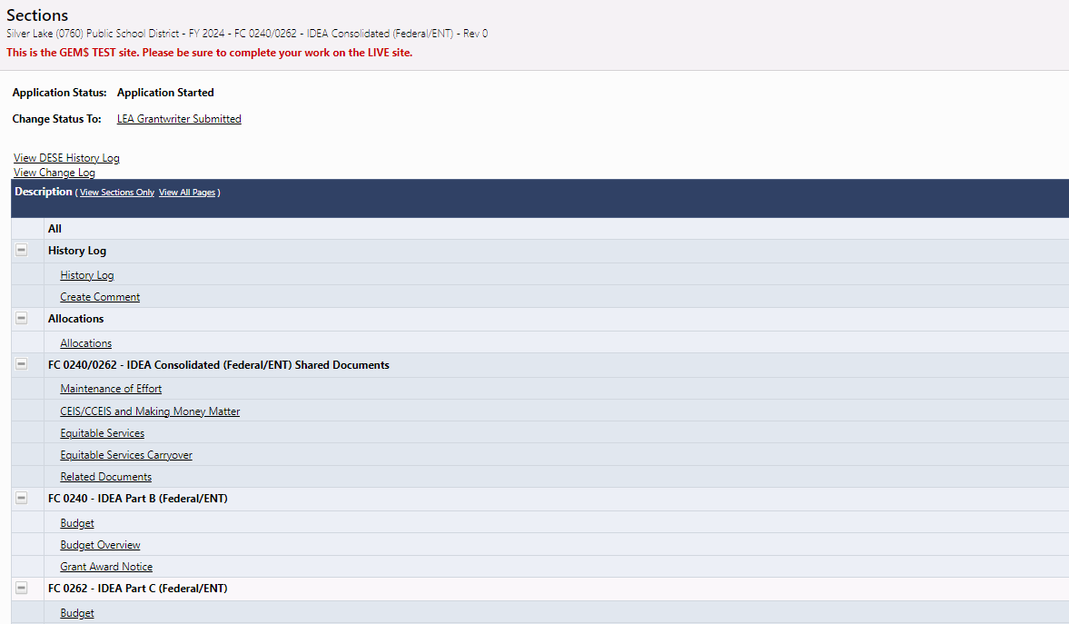
The Allocations page of the application will show funds being assigned from member districts to the Fiscal Agent.
Go to Allocations
Page

Slide 8
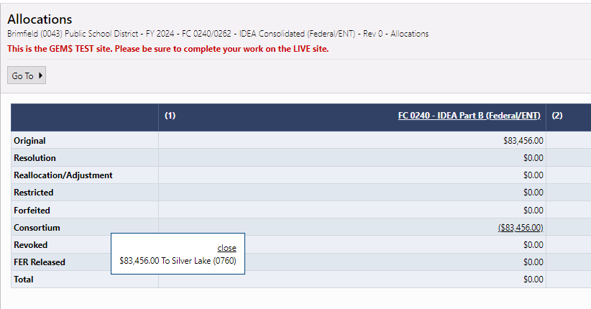
Members see that there allocation has been assigned
Hover over consortium allocation
Assignment to Fiscal Agent appears

Slide 9
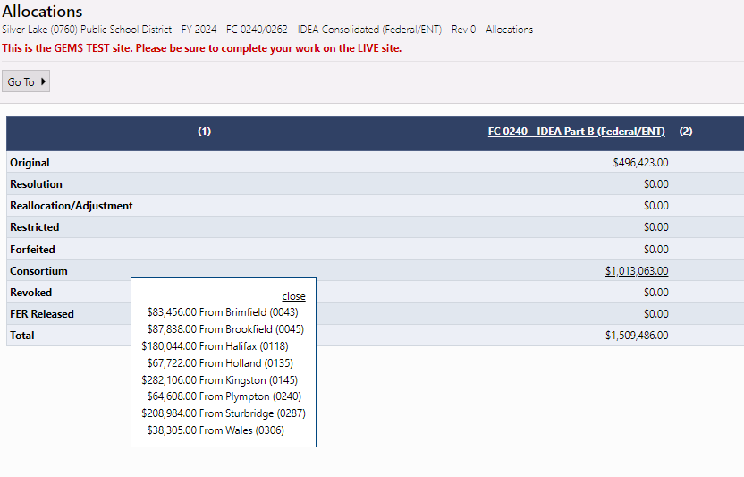
Fiscal Agents see members’ allocations
Hover over consortium allocation
Members
Allocations appear

Slide 10
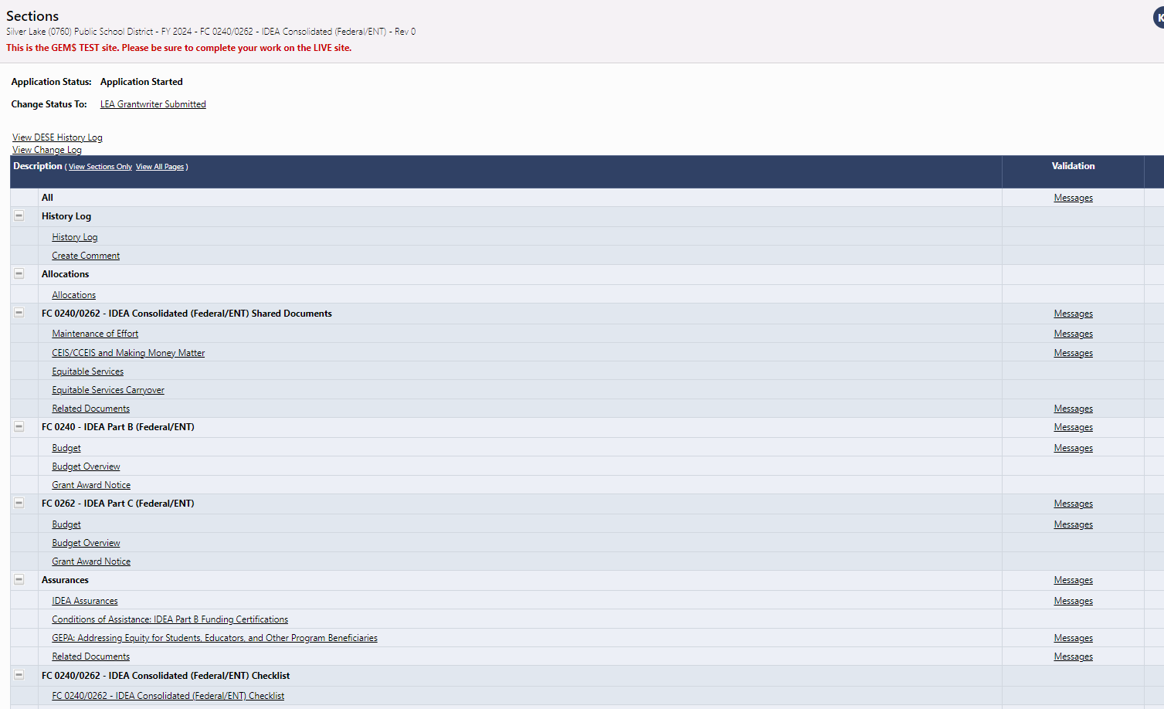
IDEA: The Fiscal Agent will see the entire funding application, including the budget, on the Sections page.
These sections will not appear on Member Districts Applications

Slide 11
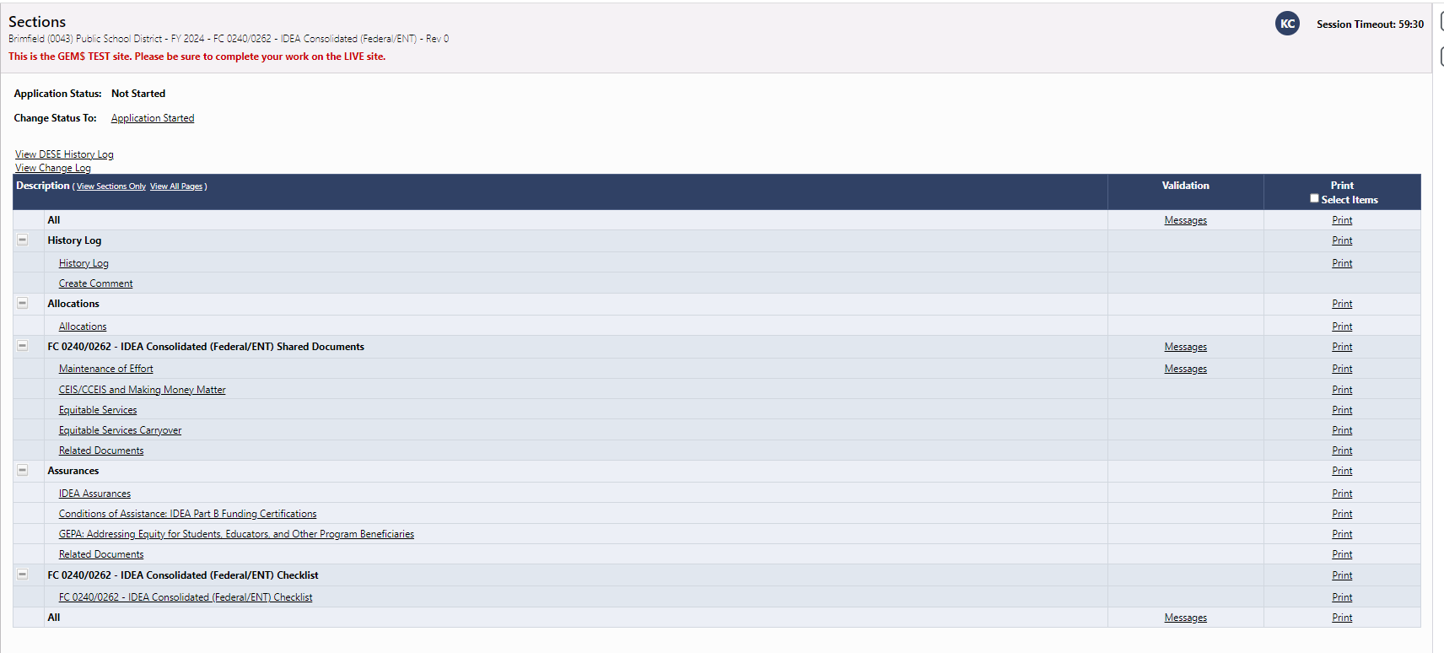
IDEA: Member districts will only see those parts of the funding application that they may need to complete and never the Budget sections.
This district assigns funds to a fiscal agent for both Fund Code 240 and 262, so no budgets for 240 or 262. The sections that remain are required (if applicable) for individual grant recipients.

Slide 12
Member districts will be responsible for outreach and calculation of Equitable Services for eligible schools and students from their districts.
Member sections of funding applications will include equitable services pages, that may include:
  Questions about outreach to those eligible to be served
  Uploads for Affirmations of Consultation with private-school officials/parents
  Calculations for equitable services based on the member district allocations – including all ESSA Titles

Slide 13
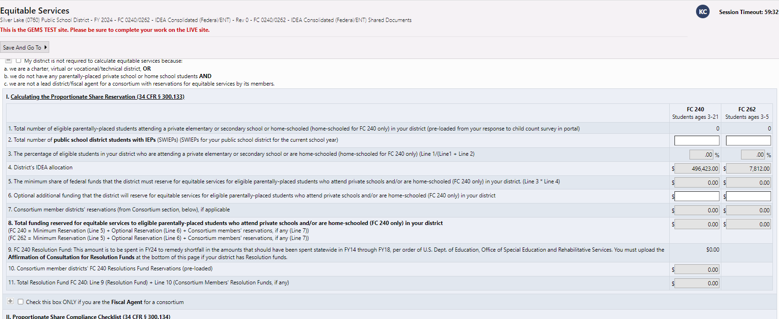
Lead districts will transfer member districts’ equitable service information onto the lead district application

Slide 14
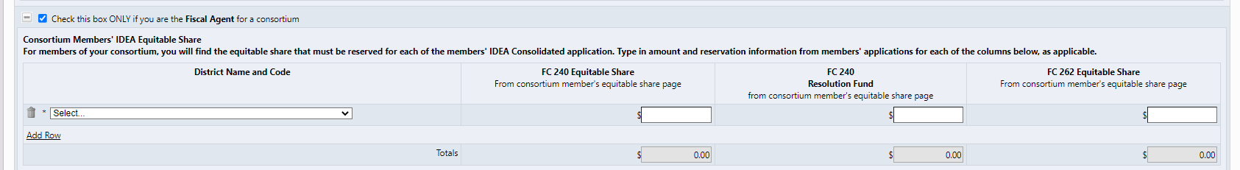
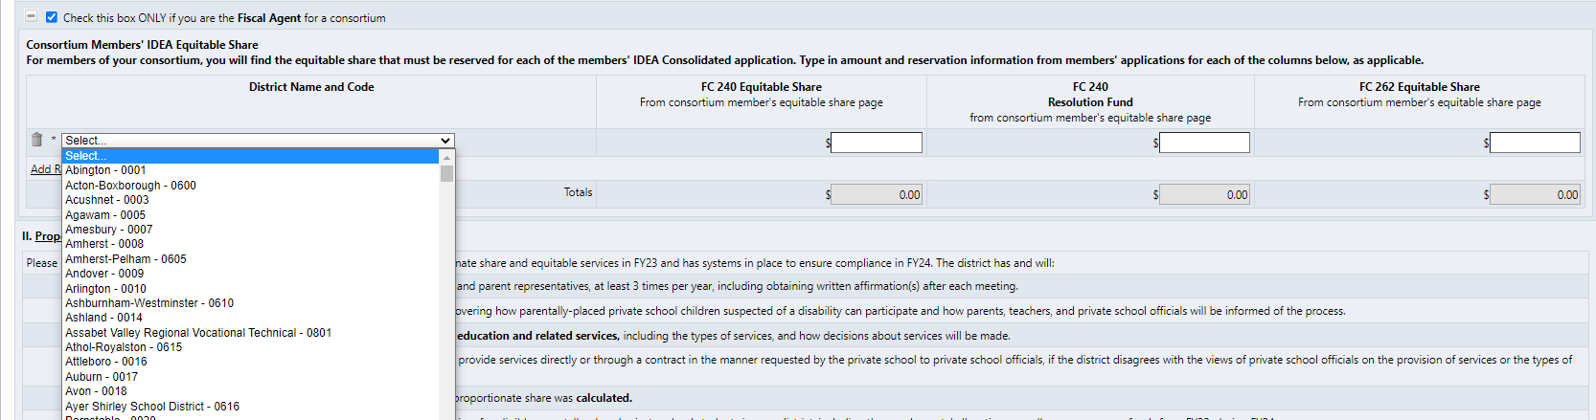
Lead districts will need access to information on their members’ funding applications for equitable services

Slide 15
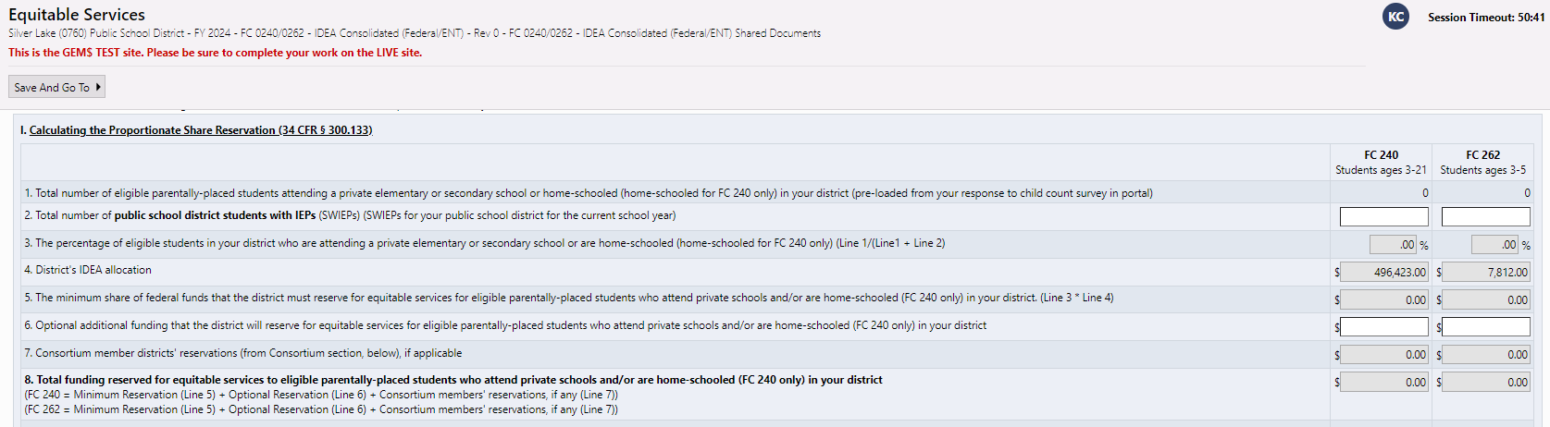
IDEA: Member districts’ equitable services reservations will be added to the total Equitable Services reservation that the Fiscal Agent will budget

Slide 16
ESSA Title Grants: Consortium members and Fiscal Agents need to work together more closely to get the required information for equitable services
Consortium members will have a designated page to complete the equitable services for participating private school students in their districts only for any/all of the Title grants (I, II, III, and/or IV)
This page will be active in your ESSA Consolidated funding application only if you are a member of a consortium (Fiscal Agents will complete the main application with budget)
The equitable service pages for consortium members’ and a line in the main workbook for fiscal agents are still being tested and refined in GEM$. A revised slide deck with screen shots will be posted once the pages are finalized.

Slide 17
Title I requires coordination between fiscal agent and any consortium member with participating nonprofit private schools
To facilitate ranking and serving the schools of the entire consortium (members and fiscal agent), all schools will be listed on the fiscal agent’s School Ranking page.
Consortium members will not have a School Ranking page.
Title I requires the number of district low-income students being served with Title I funds in order to calculate the proportionate share of funds for private schools.
Proportionate Share =
Conundrum: How does each consortium member and the fiscal agent know which number to use for its Title I served low-income district students in the denominator when all appear together on the School Ranking page?
Priv. School Would-be TI Low Inc.
Priv. School Would-be TI Low-Inc. + District TI School Low Inc.

Slide 18
Three steps to getting the numbers right for Title I equitable services
Step 1: Rank and Serve Title I Schools. To correctly calculate equitable services for consortium members and the fiscal agent, the consortium first must determine which schools for the consortium will receive Title I funding using the fiscal agent’s funding application.
Step 3: Each consortium member and fiscal agent uses its own numbers. If any members of the consortium have private schools participating in Title I services, the member or fiscal agent needs to total the low-income enrollment for the Title I served schools on the School Ranking page for each of those districts. The consortium members will insert their number on the their special equitable services page only.
Step 2: Add up low-income, Title I-served students from each district’s schools. The fiscal agent should total the low-income enrollment for the Title I served schools on the School Ranking page for its district only. That total goes on the equitable services page for the main application that it submits (where indicated).

Slide 19
Member districts have two options for conveying information to their Fiscal Agents (and vice versa for Title I)
Option | Pros | Cons
1) Provide your Fiscal Agent with the “LEA Data View” role for your district | Fiscal Agent can view and copy all necessary information from the members’ funding application into its “main” application for the consortium without the member having to do anything after completing its application | Fiscal agent will have access to view any at any stage of completion/approval/drawdown in the consortium member’s grant portfolio, including competitive grants. To limit this access, the consortium member can provide view access for a short period of time (create role and then delete role).
2) Provide your Fiscal Agent with a PDF of your completed pages of the funding application. | Limit outside access to your district’s grant portfolio, while providing the Fiscal Agent with the information from the members’ funding application it needs to complete its “main” application. Pages can be downloaded and “emailed” to the Fiscal Agent in GEM$ | Member districts must take the extra steps of printing and emailing its grant information to the Fiscal Agent. The Fiscal Agent needs to wait for the member districts to provide the information.

Slide 20
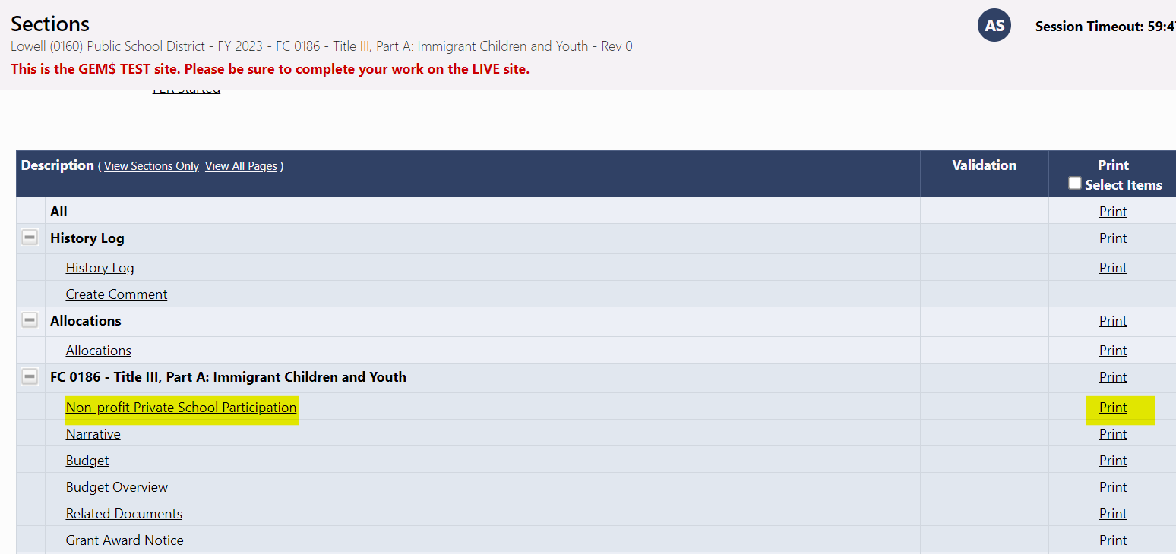
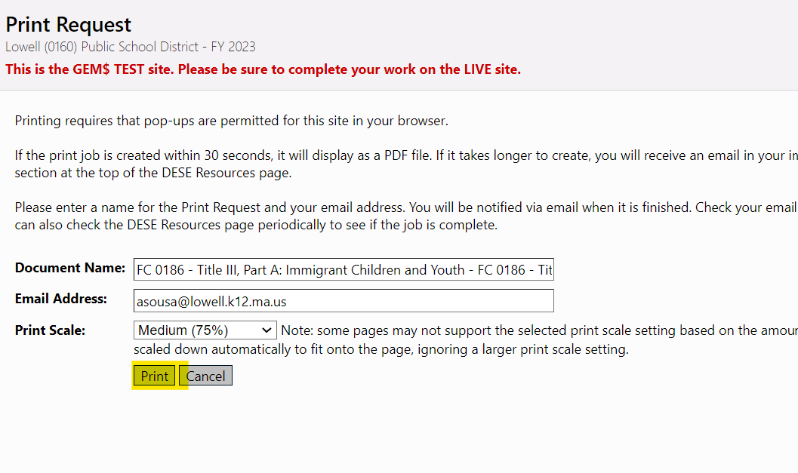
To create a pdf of its member pages, the member district selects “Print” from the Sections page of the funding application

Slide 21
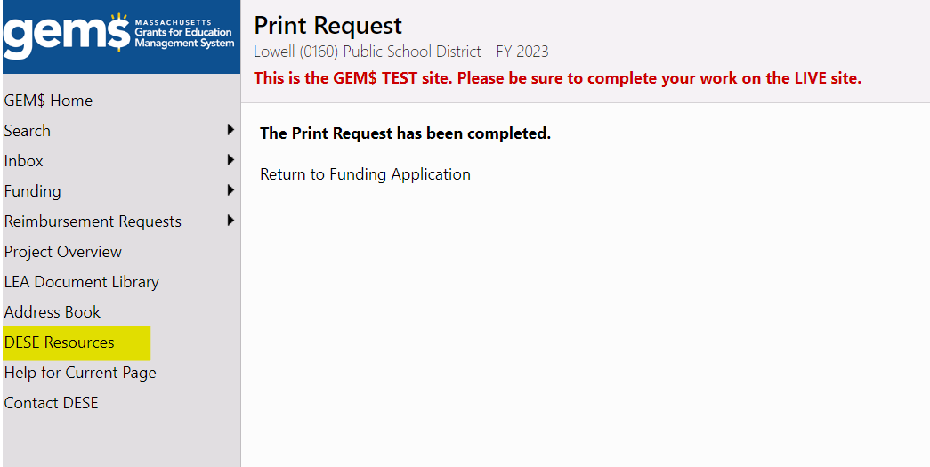
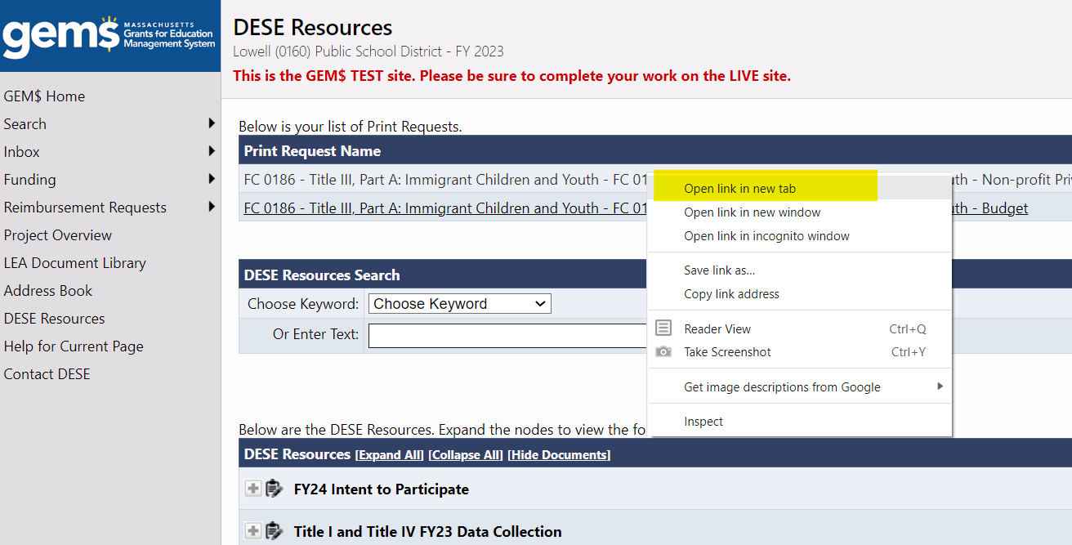
If your pdf does not show up in the lower left-hand corner of the screen immediately, select “DESE Resources” to retrieve it
Right click on the link and select “Open link in new tab.”

Slide 22
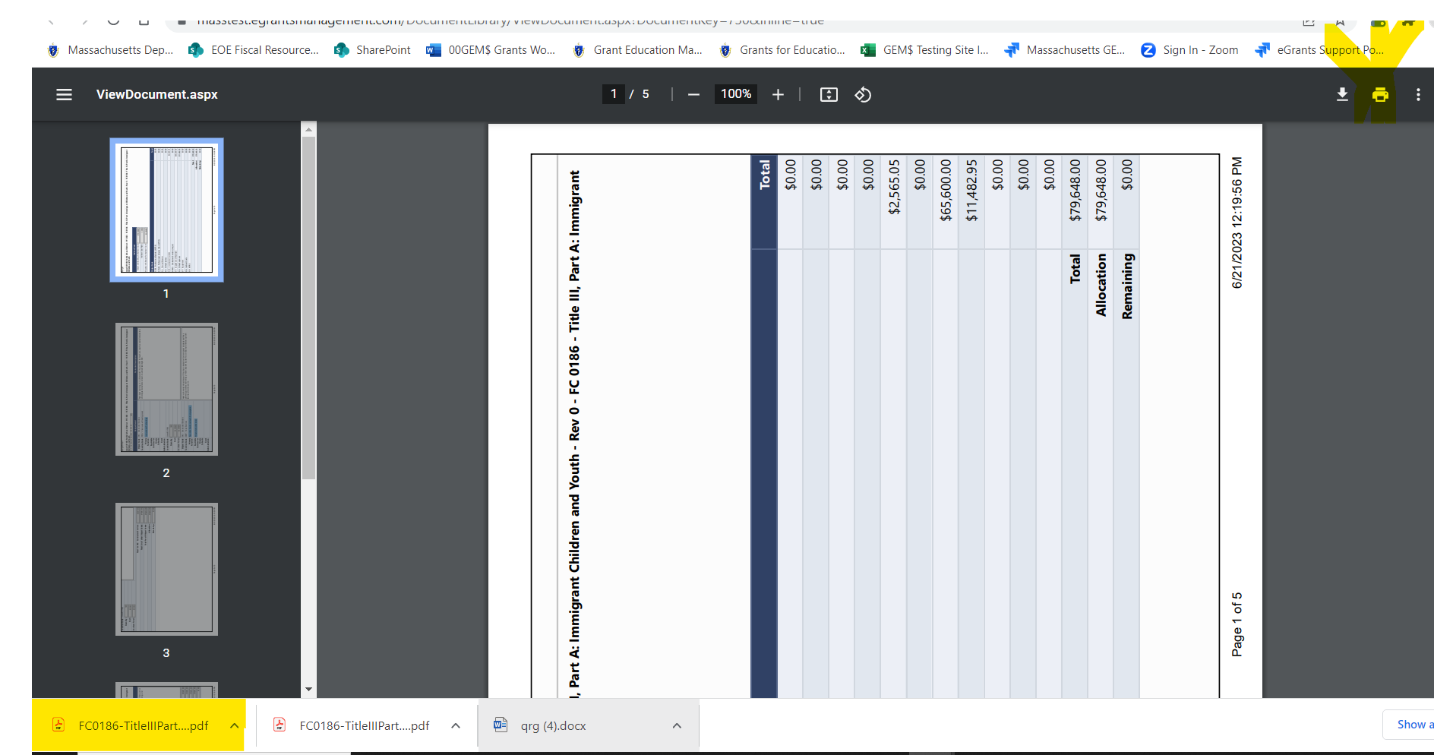
Download the pdf and save to your computer. A copy will appear in the lower left-hand corner of your screen.

Slide 23
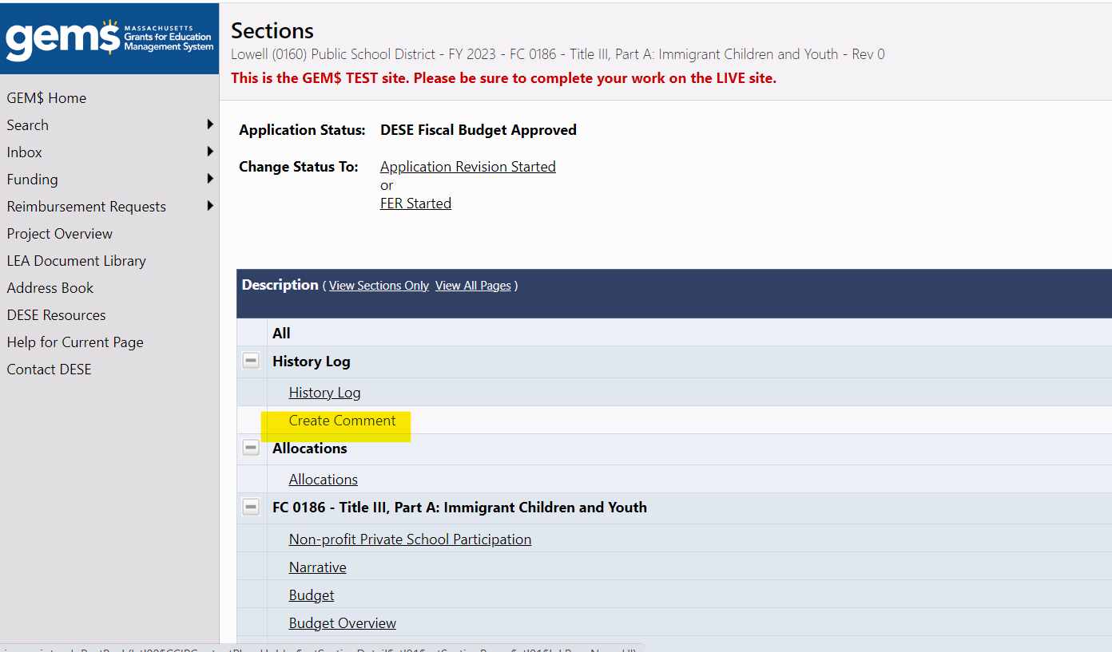
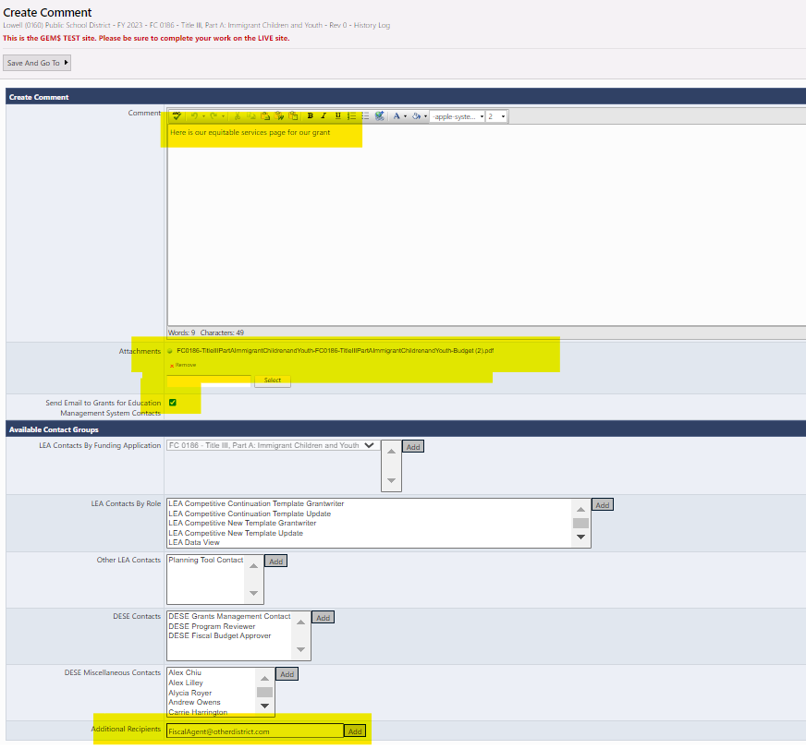
From the funding application Sections page, select “Create Comment”
Write your message, drag and drop the pdfs from the lower-left (or search and add from the saved location), check the box to see email options, type in your Fiscal Agent’s email address at the bottom and click “Add” then “Save and Go to” Sections page. The email will go to your Fiscal Agent and you will have record with your funding application.

Slide 24
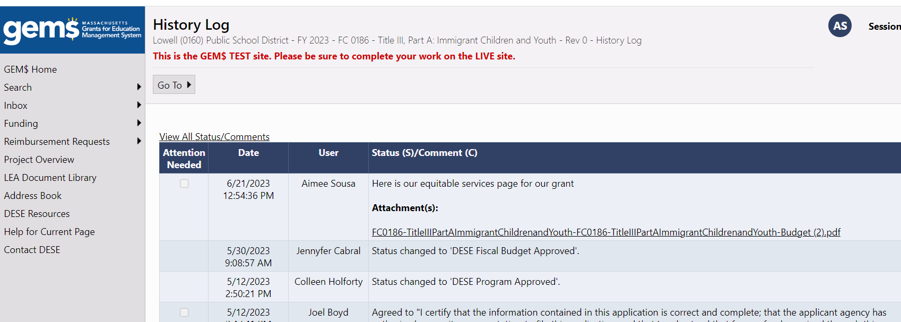
If you send the document to your Fiscal Agent through GEM$, you will be able to find it at any time through the History Log on the Sections page of your Funding Application.

Slide 25
Lead Districts need to pay special attention to special statuses for IDEA grants
In addition to Equitable Services, Lead Districts will need to look for and carry forward member districts’ reservations for:
  Voluntary CEIS (Comprehensive Early Intervening Services)
  Mandatory CCEIS (Comprehensive Coordinated Early Intervening Services)
  ^{M3 (Making Money Matter)}
There is a space in each of these three sections of the CEIS/CCEIS and Making Money Matter page of the IDEA Consolidated Application for Fiscal Agents to fill in their members’ reservations.

Slide 26
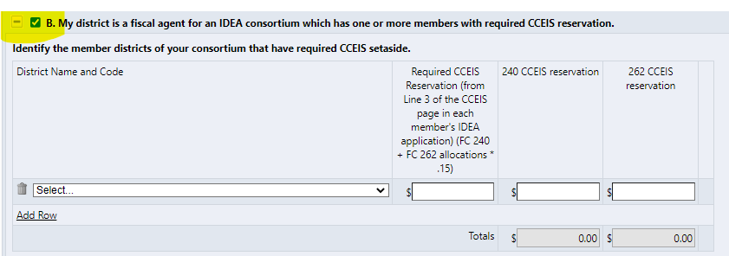
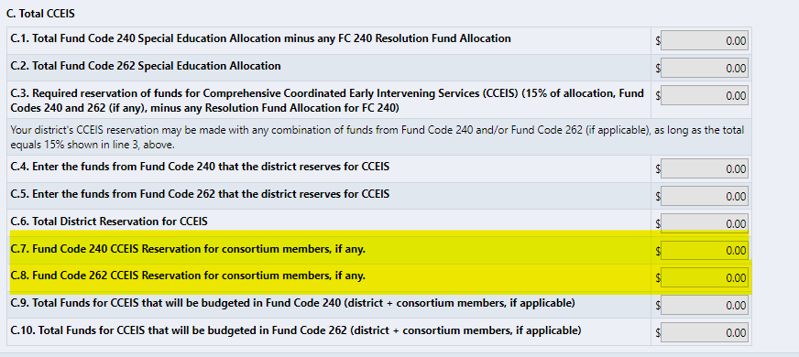
Mandatory CCEIS, for example
Mandatory CCEIS (Comprehensive Coordinated Early Intervening Services) – Districts that disproportionally identify certain students groups for special education in significant numbers are required to set aside 15% of their combined FC 240 and FC 262 (if any) allocations for early intervention services. See DESE Guidance for CCEIS.
The Fiscal Agent will check box B on its funding application (CCEIS section) and fill in any required CCEIS reservations from members’ funding applications (regardless of whether the Fiscal Agent is designated for CCEIS)
Any member districts’ funds for CCEIS will automatically carry forward to section C of CCEIS and be added to any amount that the Fiscal Agent must reserve from its allocation.

Slide 27
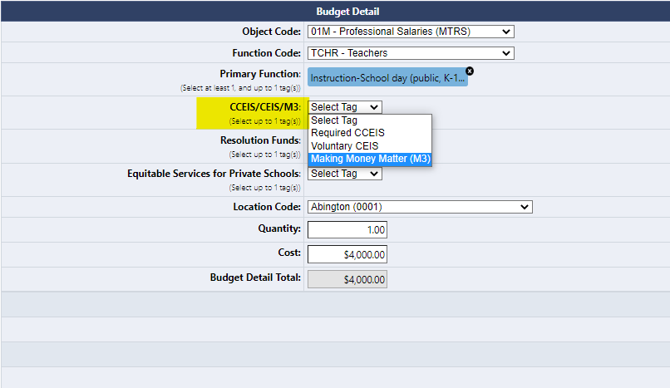
The Fiscal Agent will budget activities for CCEIS, CEIS, and M3 for all districts in the consortium on the Budget pages using budget tags for each reservation
Fiscal Agent will see Validation Error (“messages”) if the Fiscal Agent fails to budget all CCEIS/CEIS/M3 funds reserved on your CEIS/CCEIS and Making Money Matter page (total for Fiscal Agent and consortium members).
The validation is based on the budget tags – so be sure to select the appropriate one. Clicking on the “Messages” will tell you which reservations were not met.
Select appropriate budget tag from the dropdown

Slide 28
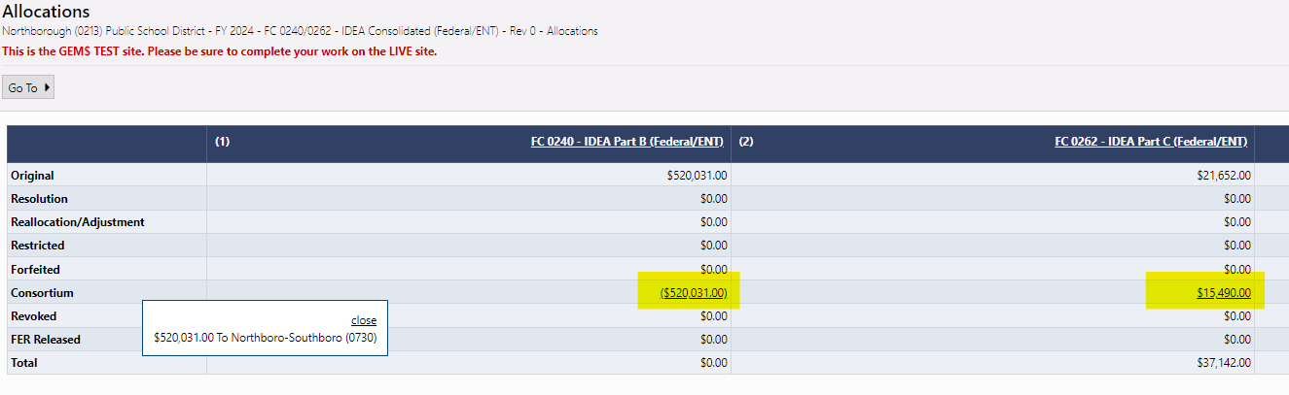
If there are different Fiscal Agents for the two IDEA grants, pay careful attention if members are required to reserve funds for CCEIS or voluntarily reserves funds for CEIS
In the rare instance when there are different Fiscal Agents for the two IDEA grants or a district joins a consortium for one grant but not the other, be careful to budget any CCEIS and CEIS reservations as indicated on the grant.
For example, Northborough 1) assigns its FC 240 funds to Northborough-Southborough but 2) is the Fiscal Agent for FC 262 for Southborough:
1
2

Slide 29
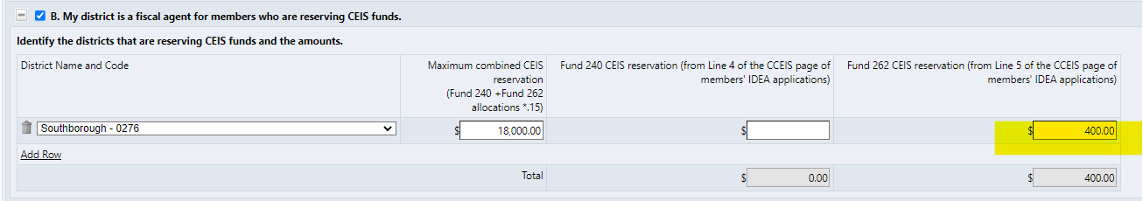
CCEIS – Different Fiscal Agents or One Fiscal Agent and One District-Administered Fund Code
Because CCEIS and CEIS can be split in any proportion between FC 240 and FC 262, the Fiscal Agent must be sure to copy only the reservation from the fund code it is administering
Example:
Northborough is lead district only for FC 262. If member Southborough reserved FC 240 funds of $1,200 and FC 262 funds of $400 for voluntary CEIS, Northborough would carry forward only FC 262 funds to its Northborough’s funding application:
Southborough’s $1,200 in FC 240 CEIS
funds will be budgeted, by
Northborough-Southborough, the
Fiscal agent for its FC 240 funds.
KEY: Fiscal Agent only carries forward reservations for the fund codes that it budgets

Slide 30

Questions

Slide 31

Contact info/Thank you
Contact Information:
Kathy Cross, Kathleen.Cross@mass.gov

